Slide 1

Use IoT, the cloud, and some Angular to make your next event awesome!!!
Harold Pulcher (MVP)
@haroldpulcher
pulcher@pulcher.biz
https://www.youtube.com/user/hpulcher
https://github.com/pulcher/EventBetter

Slide 2
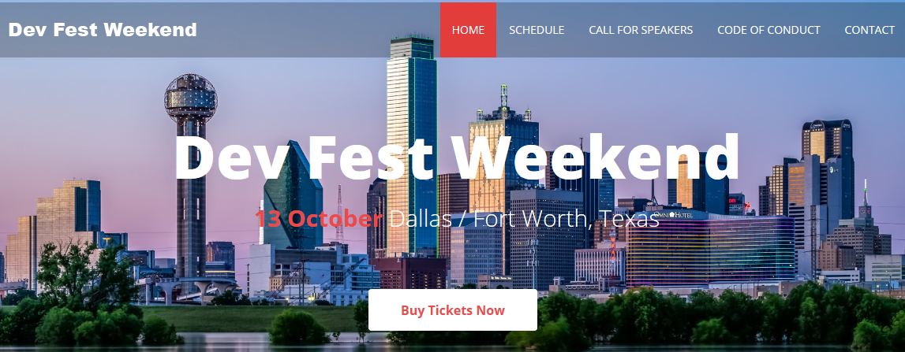
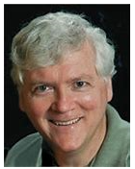
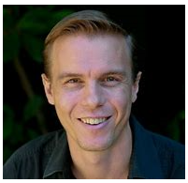
http://www.devfestweekend.com/
UGDiscount

Slide 3
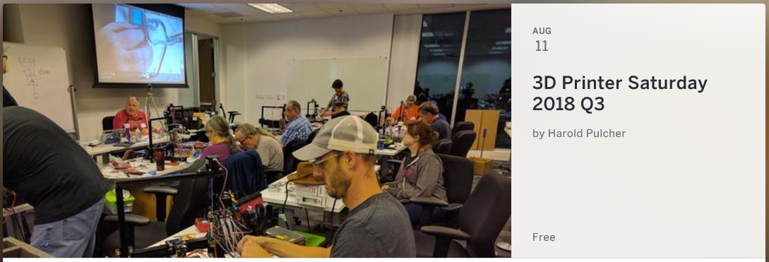
Follow me on twitter for the next date!!!

Slide 4
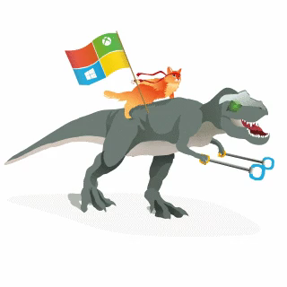
Become a Windows Insider
https://insider.windows.com/

Slide 5
That’s it …

Slide 6
Overlords can be sneaky…
Intelligent Kiosks
Security Monitoring
Mood monitoring
Attention Monitoring
And the list goes on….

Slide 7
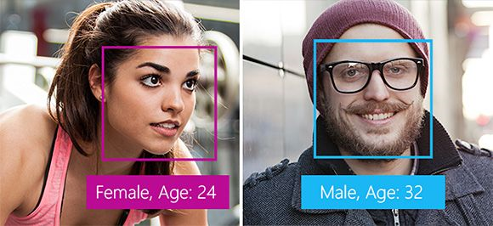
What kind of things can the Overlords do?
Detection

Slide 8
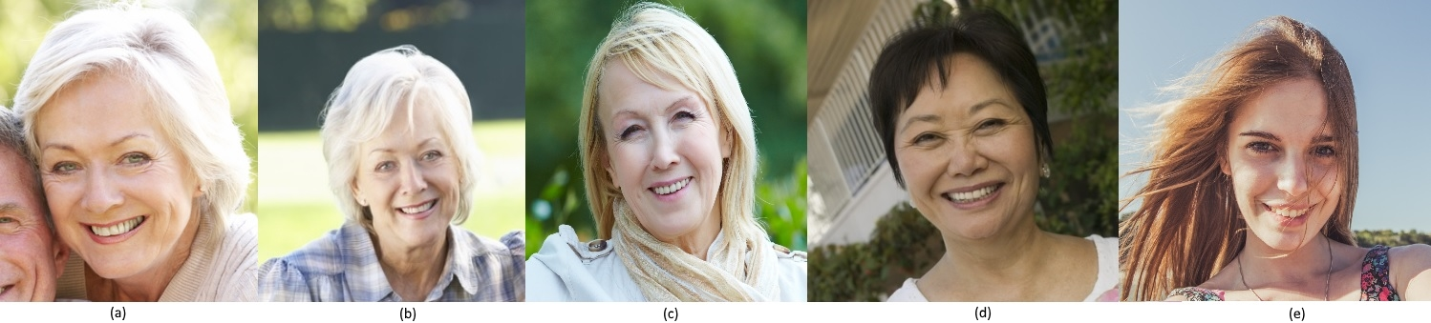

What can of things can the Overlords do?
Verification

Slide 9
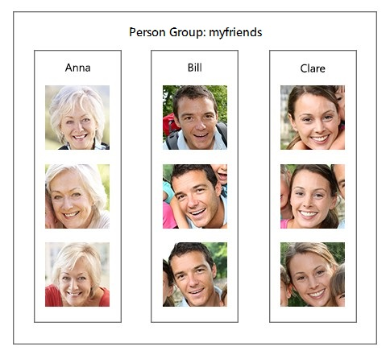
What can of things can the Overlords do?
Recognition

Slide 10
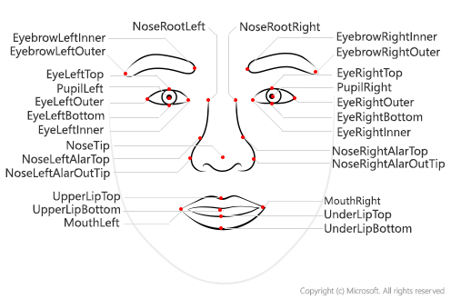
What really are they tracking?

Slide 11
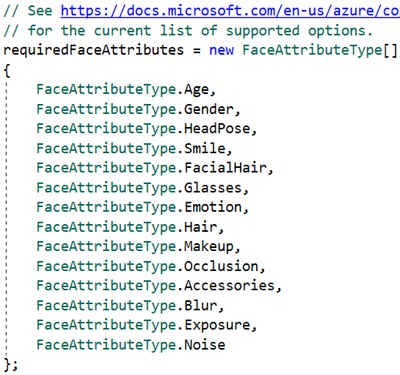
What types of info can they detect

Slide 12
How many overlord coin does this cost?
Checkout: https://azure.microsoft.com/en-us/pricing/details/cognitive-services/face-api/

Slide 13
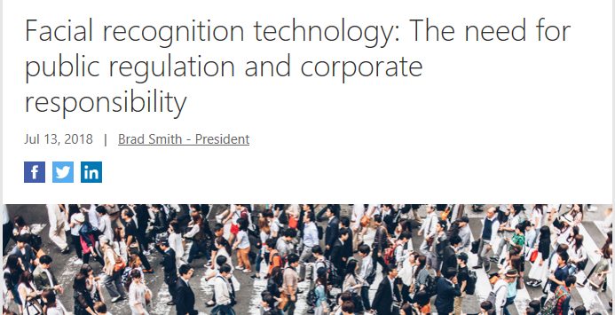
When Overlords go bad…

Slide 14
You sold me, so how to get started!
Get an Azure Account: https://azure.microsoft.com
Create a subscription for the Face Api
Play around in the online playground.
Get to coding….

Slide 15
Demos!!!!!!!

Slide 16
So where is the robot…

Slide 17
Links…
Video: https://www.youtube.com/watch?v=bbrZ2pvubL0
Intelligent Kiosk: https://github.com/Microsoft/Cognitive-Samples-IntelligentKiosk
Cognitive Face API: https://github.com/Microsoft/Cognitive-Face-Windows
Web Playground: http://bit.ly/web-face-api
Glossary: http://bit.ly/face-api-glossary
Azure: https://azure.microsoft.com

