Slide 1
Smile! You are on Robot Overlord TV!
Harold Pulcher (MVP)
@haroldpulcher
pulcher@pulcher.biz
https://www.youtube.com/user/hpulcher
https://github.com/pulcher/Robot-Overlord-TV

Slide 2
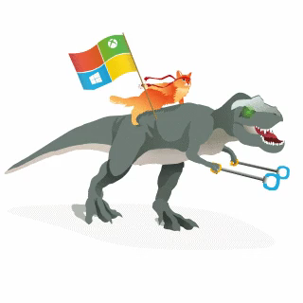
Become a Windows Insider
https://insider.windows.com/

Slide 3

Why I code…

Slide 4
Can the Overlord recognize me?
The Face API provides 2 main functions: Detection and Recognition

Slide 5
What really are they tracking?
Picture of the face with the marking.

Slide 6
What types of info can I get

Slide 7
How big of budget do I need?
Go over costs to recognize
The storage space
And 10,000 people in a group, 1000000 photos.

Slide 8
You sold me, so how to get started!
Azure
Then follow through the steps on the detect and recognize….

Slide 9
Demos!!!!!!!

Slide 11
So where is the robot…

Slide 12
Links…
Video: https://www.youtube.com/watch?v=bbrZ2pvubL0
Intelligent Kiosk: https://github.com/Microsoft/Cognitive-Samples-IntelligentKiosk
Cognitive Face API: https://github.com/Microsoft/Cognitive-Face-Windows
Web Playground: http://bit.ly/web-face-api

