Slide 1

Smile! You are on Robot Overlord TV!
Harold Pulcher (MVP)
@haroldpulcher
pulcher@pulcher.biz
https://www.youtube.com/user/hpulcher
https://github.com/pulcher/Robot-Overlord-TV

Slide 2
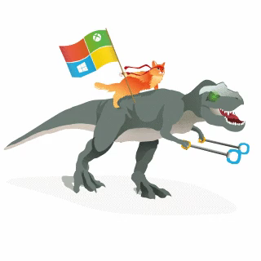
Become a Windows Insider
https://insider.windows.com/

Slide 3

Why I code…

Slide 4
Overlords can be sneaky…
Intelligent Kiosks
Security Monitoring
Mood monitoring
Attention Monitoring
And the list goes on….

Slide 5
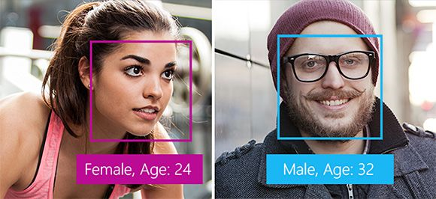
What can of things can the Overlords do?
Detection

Slide 6
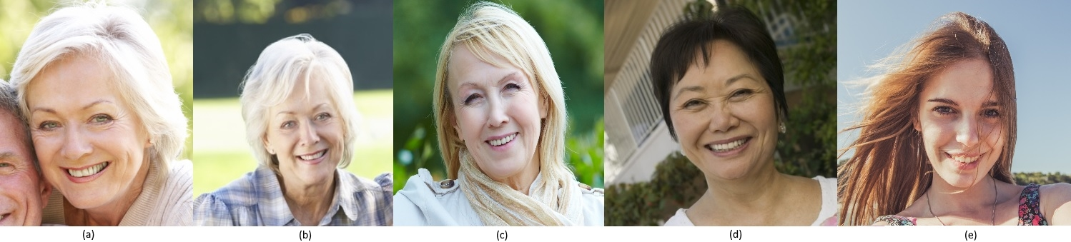

What can of things can the Overlords do?
Verification

Slide 7
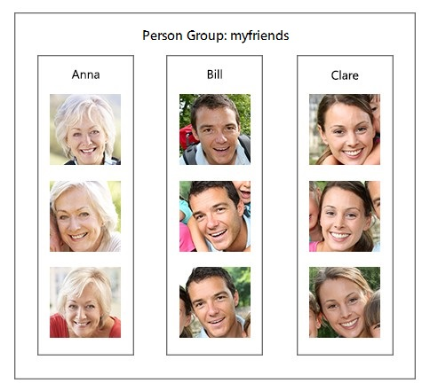
What can of things can the Overlords do?
Recognition

Slide 8
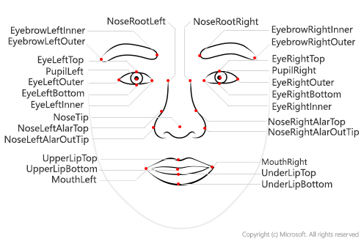
What really are they tracking?

Slide 9
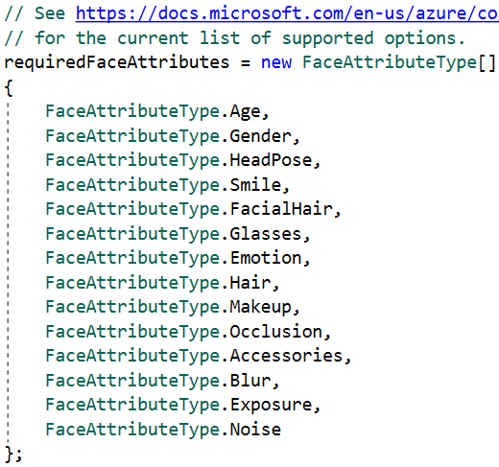
What types of info can they detect

Slide 10
How many overlord coin does this cost?

Slide 11
You sold me, so how to get started!
Azure
Then follow through the steps on the detect and recognize….

Slide 12
Demos!!!!!!!

Slide 14
So where is the robot…

Slide 15
Links…
Video: https://www.youtube.com/watch?v=bbrZ2pvubL0
Intelligent Kiosk: https://github.com/Microsoft/Cognitive-Samples-IntelligentKiosk
Cognitive Face API: https://github.com/Microsoft/Cognitive-Face-Windows
Web Playground: http://bit.ly/web-face-api
Glossary: http://bit.ly/face-api-glossary

