Slide 1
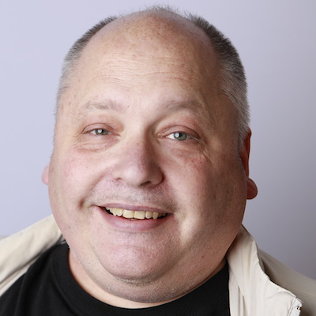
Smile! You are on Robot Overlord TV!
Harold Pulcher (MVP)
@haroldpulcher
pulcher@pulcher.biz
https://www.youtube.com/user/hpulcher
https://github.com/pulcher/Robot-Overlord-TV

Slide 2



Please help us!
Thank our Sponsors:

Slide 3
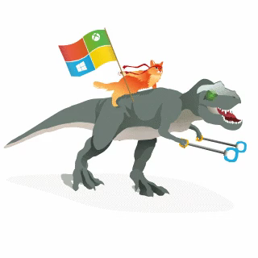
Become a Windows Insider
https://insider.windows.com/

Slide 4

Why I code…

Slide 5
Overlords can be sneaky…
Intelligent Kiosks
Security Monitoring
Mood monitoring
Attention Monitoring
And the list goes on….

Slide 6
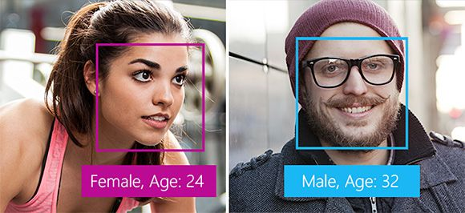
What kind of things can the Overlords do?
Detection

Slide 7
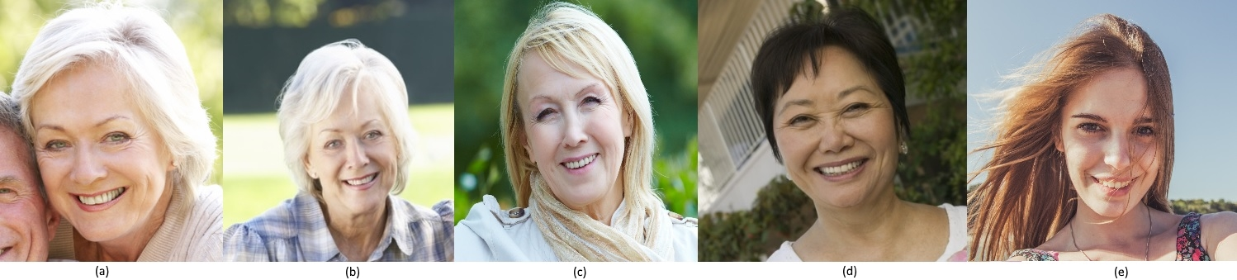

What can of things can the Overlords do?
Verification

Slide 8
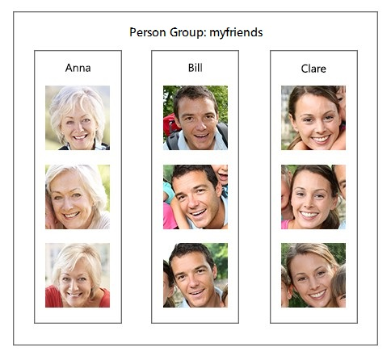
What can of things can the Overlords do?
Recognition

Slide 9
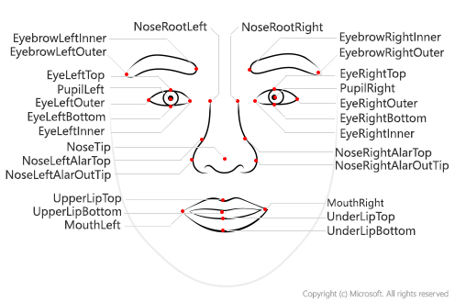
What really are they tracking?

Slide 10
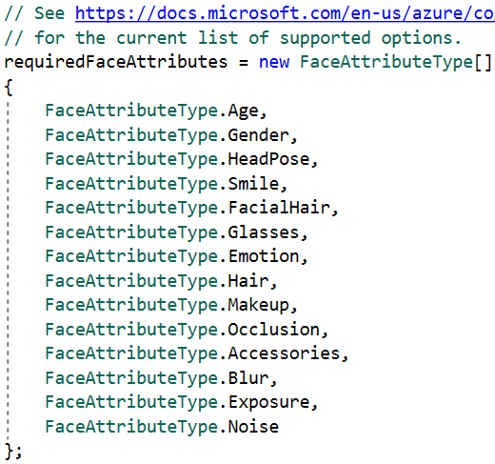
What types of info can they detect

Slide 11
How many overlord coin does this cost?
Checkout: https://azure.microsoft.com/en-us/pricing/details/cognitive-services/face-api/

Slide 12
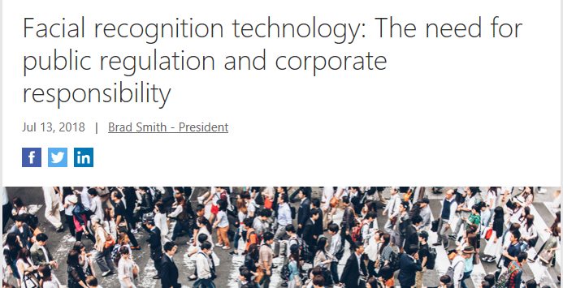
When Overlords go bad…

Slide 13
You sold me, so how to get started!
Get an Azure Account: https://azure.microsoft.com
Create a subscription for the Face Api
Play around in the online playground.
Get to coding….

Slide 14
Demos!!!!!!!

Slide 15
So where is the robot…

Slide 16
Links…
Video: https://www.youtube.com/watch?v=bbrZ2pvubL0
Intelligent Kiosk: https://github.com/Microsoft/Cognitive-Samples-IntelligentKiosk
Cognitive Face API: https://github.com/Microsoft/Cognitive-Face-Windows
Web Playground: http://bit.ly/web-face-api
Glossary: http://bit.ly/face-api-glossary
Azure: https://azure.microsoft.com

Slide 17
Complete An Evaluation Form & Win Your input is important!
You can access Evaluation Forms at:
http://TulsaTechFest.com
Fill them out!
You can win additional prizes!
Like a $50 Best Buy Gift Card!!
Winner drawn – Midnight, Sun Jul 22nd!

