Slide 1
You can write code once, and run it “almost” anywhere!
Harold Pulcher
pulcher@pulcher.biz
https://github.com/pulcher/UwpPresenter

Slide 2


Become a Windows Insider!
https://insider.windows.com/

Slide 3
My intentions are to…
Devolve this presentation into a discussion of possibilities.
Get you interested enough in UWP for you to try it yourself.
For you to think this stuff is as cool as I think it is.

Slide 4
What’s a UWP App?
It is NOT an OS
It is a complete .AppX package
It has a Common API surface across ALL platforms
It can access device specific stuff using Extension SDKs
All the base Controls and Input are adaptive
There is only ONE store

Slide 5
What language do I have to learn?
C# or VB with XAML
C++ with DirectX
Javascript with HTML

Slide 6
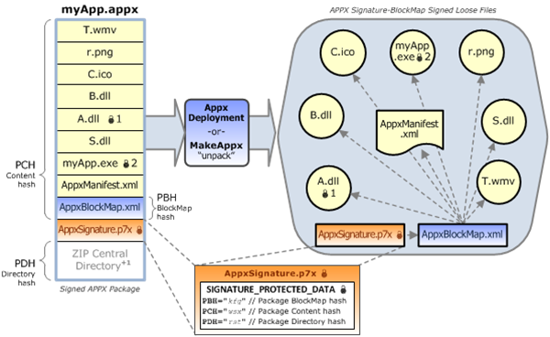
AppX?

Slide 7
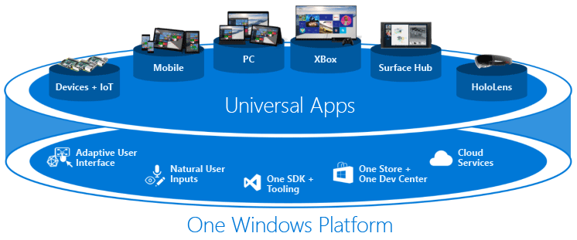
So what’s this
“All Platforms” noise?

Slide 8
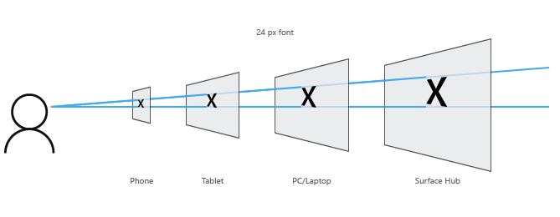
Adaptive Input and Controls?

Slide 9
What do you need to build this greatness?
Windows 10
Visual Studio 2015 including the device emulators
Put your device(s) in “Developer Mode”
Register as a Developer($20)
(and become an insider)

Slide 10
Adaptive UI
Reposition
Resize
Reflow
Reveal
Replace
Re-architect

Slide 11
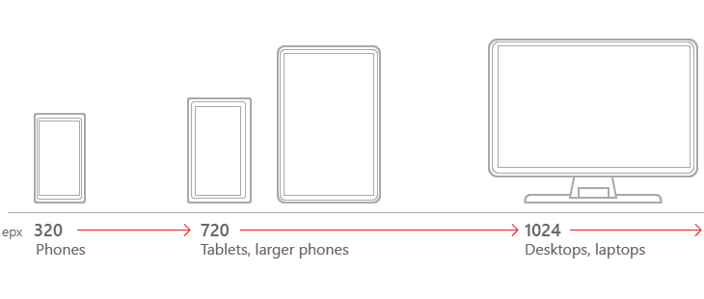
Common Breakpoints
For AdaptiveTriggers

Slide 12
Hello, World!
(Show me some code monkey boy!)

Slide 13
Adaptive Code
Platform Extension SDKs
Extensions don’t invalidate binaries on other devices
No complier conditionals
Can set the min and max UWP versions.

Slide 14
Adaptive, World!
(Show me some more code monkey boy!)

Slide 15
Accessing the filesystem
Application install directory
Application data directories
Downloads folder*
Specified locations in the Manifest
Through the file picker*

Slide 16
Links
UWP Starting point: https://msdn.microsoft.com/en-us/windows/uwp/get-started/whats-a-uwp
Adaptive Input and Controls: https://msdn.microsoft.com/windows/uwp/layout/design-and-ui-intro
Developer Tools: https://go.microsoft.com/fwlink/p/?LinkID=534189
Developer Mode: https://msdn.microsoft.com/en-us/windows/uwp/get-started/enable-your-device-for-development

Slide 17
Links again
Hello, World: https://msdn.microsoft.com/en-us/windows/uwp/get-started/create-a-hello-world-app-xaml-universal
Samples: https://github.com/Microsoft/Windows-universal-samples
Adaptive Code: https://channel9.msdn.com/Events/Windows/Developers-Guide-to-Windows-10-RTM/Adaptive-Code
File Access: https://msdn.microsoft.com/windows/uwp/files/file-access-permissions
KnownFolders: https://msdn.microsoft.com/en-us/library/windows/apps/windows.storage.knownfolders.aspx

