Slide 1

Harold Pulcher (MVP) @haroldpulcher pulcher@pulcher.biz
https://www.youtube.com/user/hpulcher
https://github.com/pulcher/blazor-playground/tree/master/talks/intro_to_blazor

Slide 2




https://...
JS

Slide 3
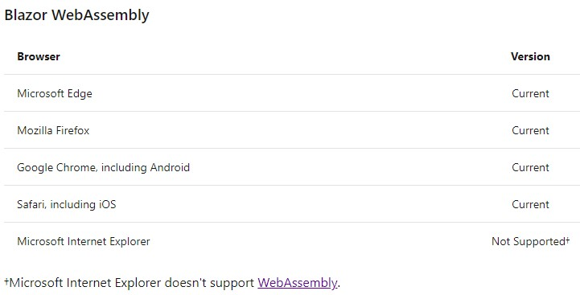

Slide 4



https://...
DOM
Client-side
(Blazor WebAssembly)

Slide 5


https://...
https://...
SignalR
DOM
DOM
Client-side
(Blazor WebAssembly)
Server-side
(Blazor Server)

Slide 6
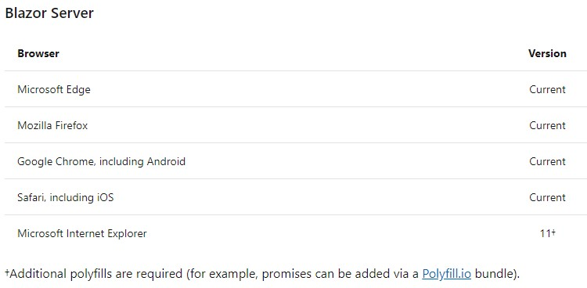

Slide 7
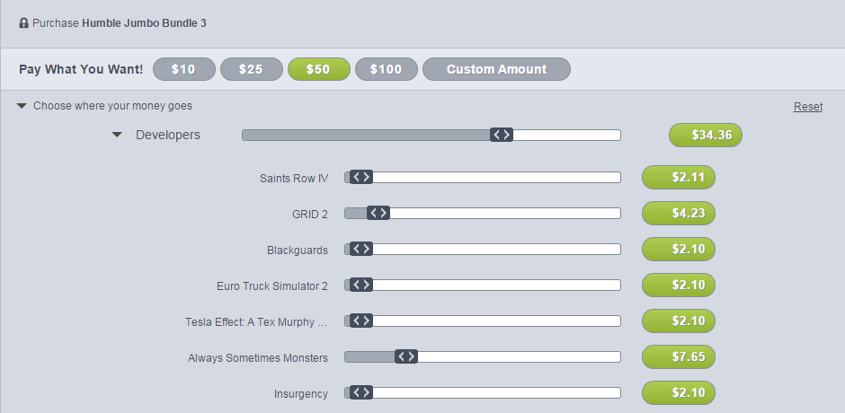
INTERACTIVE WEB UI FOR .NET
A BIGGER APP ON WEBASSEMBLY

Slide 8
WITH
FUTURE
FEATURES
INTERACTIVE WEB UI FOR .NET
A BIGGER APP ON WEBASSEMBLY

Slide 9
Links and stuff
Steve Sanderson Video (used the start of this) presentation: https://www.youtube.com/watch?v=Khn7sDUSEJM
https://webassembly.org/

Slide 12
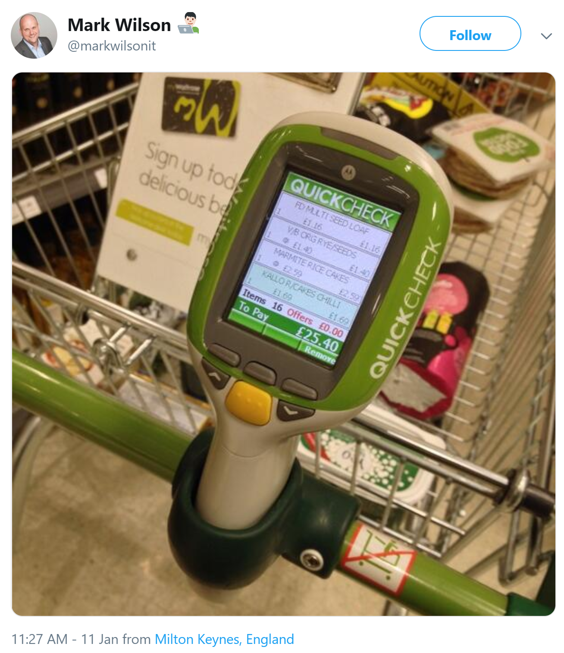

Slide 13

1
2
3
PIN
* * * *
CART
Item 1
£3.95
Item 2
£12.00
Total: £15.95
0000 0000 0000 0000

Slide 14
WITH
FUTURE
FEATURES
A BIGGER APP ON WEBASSEMBLY
BLAZOR EVERYWHERE
gRPC
Testing
PWA

Slide 15
WITH
FUTURE
FEATURES
A BIGGER APP ON WEBASSEMBLY
BLAZOR EVERYWHERE
gRPC
Testing
PWA

Slide 16
https://...
https://...
SignalR
DOM
DOM
Client-side
(Blazor WebAssembly)
Server-side
(Blazor Server)

Slide 17
Client-side
(Blazor WebAssembly)
Server-side
(Blazor Server)
Preview now
Release target: May 2020
Shipped
Released in .NET Core 3.0
Great for:
- Offline support / PWA
- Zero latency UI
- Static-files hosting
Great for:
- Thin client
- Full runtime
- All code on server

Slide 18
Client-side
(Blazor WebAssembly)
Server-side
(Blazor Server)
Preview now
Release target: May 2020
Shipped
Released in .NET Core 3.0
Blazor Hybrid
(Desktop app with web rendering)
Blazor + Native UI
(Mobile/desktop with native OS UI)
Uncommitted. Samples:
aka.ms/blazor-electron aka.ms/webwindow
Uncommitted. Samples: aka.ms/mobile-blazor-bindings

Slide 19

LEARN MORE & GET STARTED
blazor.net
Steven Sanderson
@StevenSanderson

Slide 20
LEARN MORE & GET STARTED
blazor.net
CODE & SLIDES
aka.ms/sanderson-london-2020
== https://github.com/SteveSandersonMS/presentation-2020-01-NDCLondon
Steven Sanderson
@StevenSanderson

