Slide 1

Harold Pulcher (MVP) @haroldpulcher pulcher@pulcher.biz
https://www.youtube.com/user/hpulcher
https://github.com/pulcher/blazor-playground/tree/master/talks/intro_to_blazor

Slide 2




https://...
JS

Slide 3
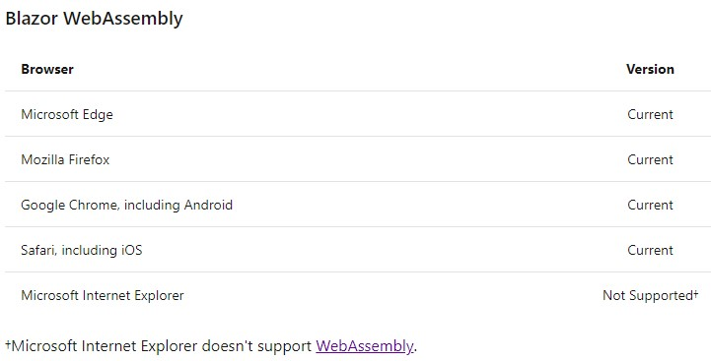

Slide 4



https://...
DOM
Client-side
(Blazor WebAssembly)

Slide 5


https://...
https://...
SignalR
DOM
DOM
Client-side
(Blazor WebAssembly)
Server-side
(Blazor Server)

Slide 6
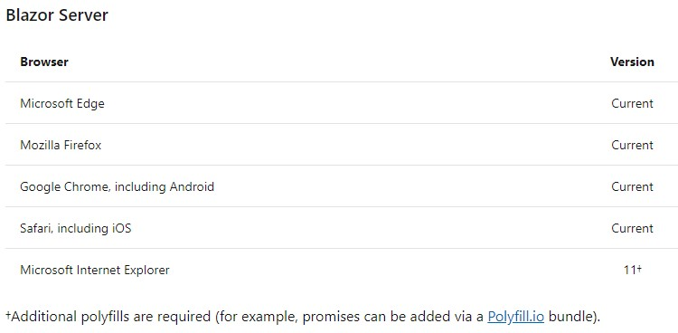

Slide 7
INTERACTIVE WEB UI FOR .NET
A BIGGER APP ON WEBASSEMBLY

Slide 8
WITH
FUTURE
FEATURES
INTERACTIVE WEB UI FOR .NET
A BIGGER APP ON WEBASSEMBLY

Slide 9
Get Started
Install .NET Core 3.1 SDK
Install the Blazor templates
dotnet new -i Microsoft.AspNetCore.Blazor.Templates::3.2.0-preview1.20073.1
For Webassembly:
For Server:
dotnet new blazorwasm -o blazor-wasm1
cd blazor-wasm1
dotnet run
dotnet new blazorserver -o blazor-server1
cd blazor-server1
dotnet run

Slide 10
Let’s see this in action!

Slide 11
Blazor Workshop
https://github.com/dotnet-presentations/blazor-workshop
Just Do It!!!!

Slide 12
Client-side
(Blazor WebAssembly)
Server-side
(Blazor Server)
Preview now
Release target: May 2020
Shipped
Released in .NET Core 3.0
Blazor Hybrid
(Desktop app with web rendering)
Blazor + Native UI
(Mobile/desktop with native OS UI)
Uncommitted. Samples:
aka.ms/blazor-electron aka.ms/webwindow
Uncommitted. Samples: aka.ms/mobile-blazor-bindings

Slide 13
My Asks:
Head over to http://blazor.net and give it a go
Do the workshop!
Send me some feedback: pulcher@pulcher.biz

Slide 14
Links and stuff
Steve Sanderson Video (used the start of this) presentation: https://www.youtube.com/watch?v=Khn7sDUSEJM
Webassembly base information: https://webassembly.org/
Blazor Getting Started: https://docs.microsoft.com/en-us/aspnet/core/blazor/get-started?view=aspnetcore-3.1&tabs=visual-studio
Blazor Templates: https://www.nuget.org/packages/Microsoft.AspNetCore.Blazor.Templates/
Blazor Routing: https://docs.microsoft.com/en-us/aspnet/core/blazor/routing?view=aspnetcore-3.1
Blazor Workshop: https://github.com/dotnet-presentations/blazor-workshop
WebWindow: https://github.com/SteveSandersonMS/WebWindow
.Net Conf: Focus on Blazor: https://channel9.msdn.com/Events/dotnetConf/Focus-on-Blazor
More awesome Steve and Dan dive into Blazor: https://www.youtube.com/watch?v=QnBYmTpugz0

Slide 16
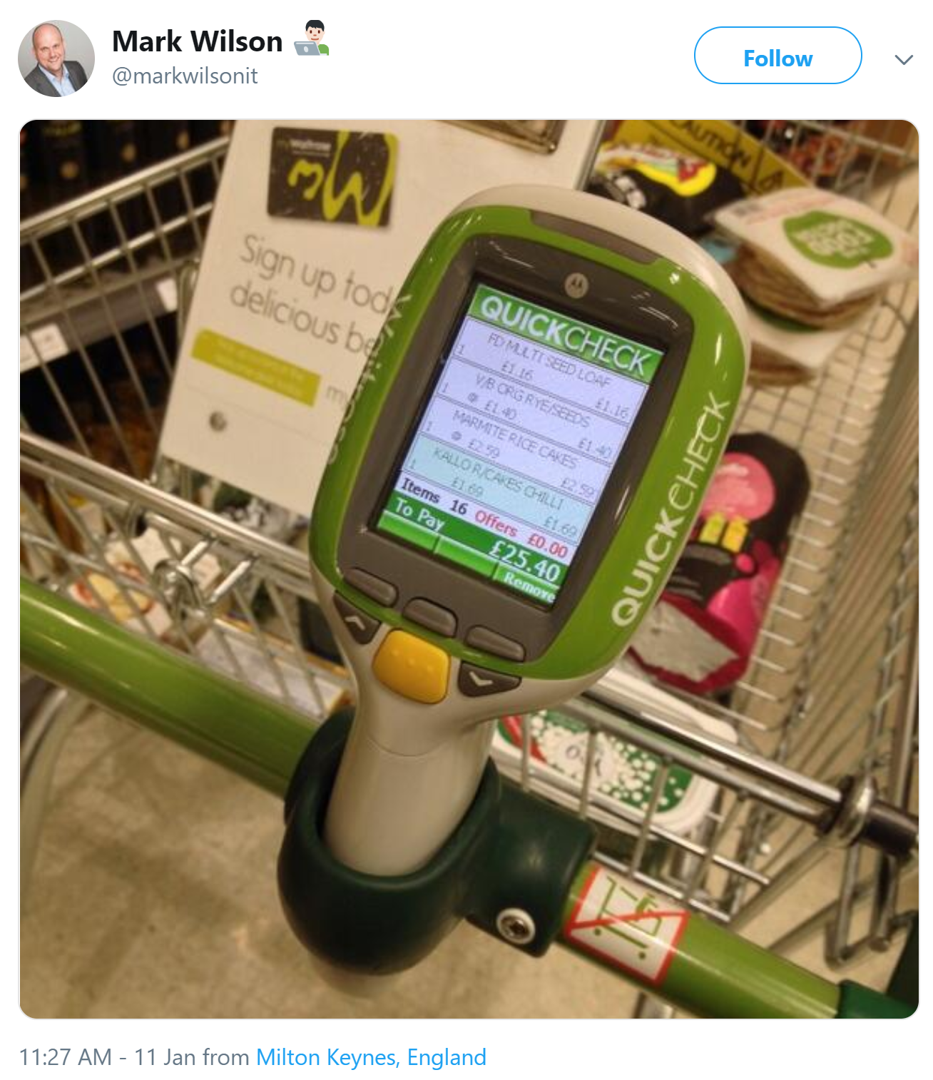

Slide 17

1
2
3
PIN
* * * *
CART
Item 1
£3.95
Item 2
£12.00
Total: £15.95
0000 0000 0000 0000

Slide 18
WITH
FUTURE
FEATURES
A BIGGER APP ON WEBASSEMBLY
BLAZOR EVERYWHERE
gRPC
Testing
PWA

Slide 19
WITH
FUTURE
FEATURES
A BIGGER APP ON WEBASSEMBLY
BLAZOR EVERYWHERE
gRPC
Testing
PWA

Slide 20
https://...
https://...
SignalR
DOM
DOM
Client-side
(Blazor WebAssembly)
Server-side
(Blazor Server)

Slide 21
Client-side
(Blazor WebAssembly)
Server-side
(Blazor Server)
Preview now
Release target: May 2020
Shipped
Released in .NET Core 3.0
Great for:
- Offline support / PWA
- Zero latency UI
- Static-files hosting
Great for:
- Thin client
- Full runtime
- All code on server

Slide 22

LEARN MORE & GET STARTED
blazor.net
Steven Sanderson
@StevenSanderson

Slide 23
LEARN MORE & GET STARTED
blazor.net
CODE & SLIDES
aka.ms/sanderson-london-2020
== https://github.com/SteveSandersonMS/presentation-2020-01-NDCLondon
Steven Sanderson
@StevenSanderson

