Slide 1

Harold Pulcher (MVP) @haroldpulcher pulcher@pulcher.biz
https://youtube.com/user/hpulcher https://twitch.tv/haroldpulcher
https://github.com/pulcher/blazor-playground/tree/master/talks/houston

Slide 2
Agenda:
What is Blazor?
Getting Started
New Features in Blazor WebAssembly
What’s Next
Fun Stuff!

Slide 3




https://...
JS

Slide 4
INTERACTIVE WEB UI FOR .NET
A BIGGER APP ON WEBASSEMBLY

Slide 5
Why you should be interested in this?
C# Language
Tooling / IDE
Consistent ecosystem
Stability

Slide 6



https://...
DOM
Client-side
(Blazor WebAssembly)

Slide 7
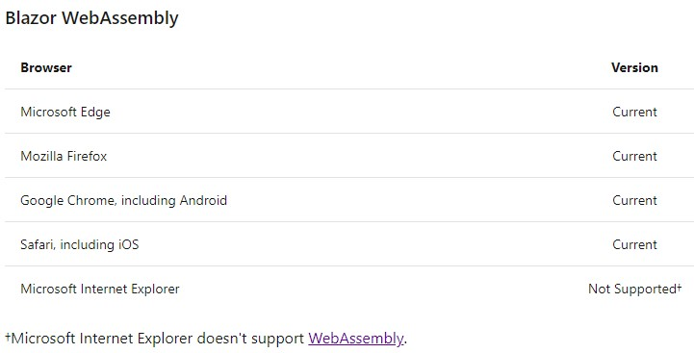

Slide 8


https://...
https://...
SignalR
DOM
DOM
Client-side
(Blazor WebAssembly)
Server-side
(Blazor Server)

Slide 9
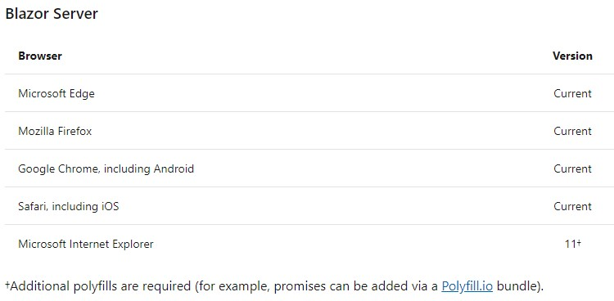

Slide 10
Client-side
(Blazor WebAssembly)
Server-side
(Blazor Server)
Shipped
Released in .NET Core 3.1
Shipped
Released in .NET Core 3.0
Great for:
- Offline support / PWA
- Zero latency UI
- Static-files hosting
Great for:
- Thin client
- Full runtime
- All code on server

Slide 11
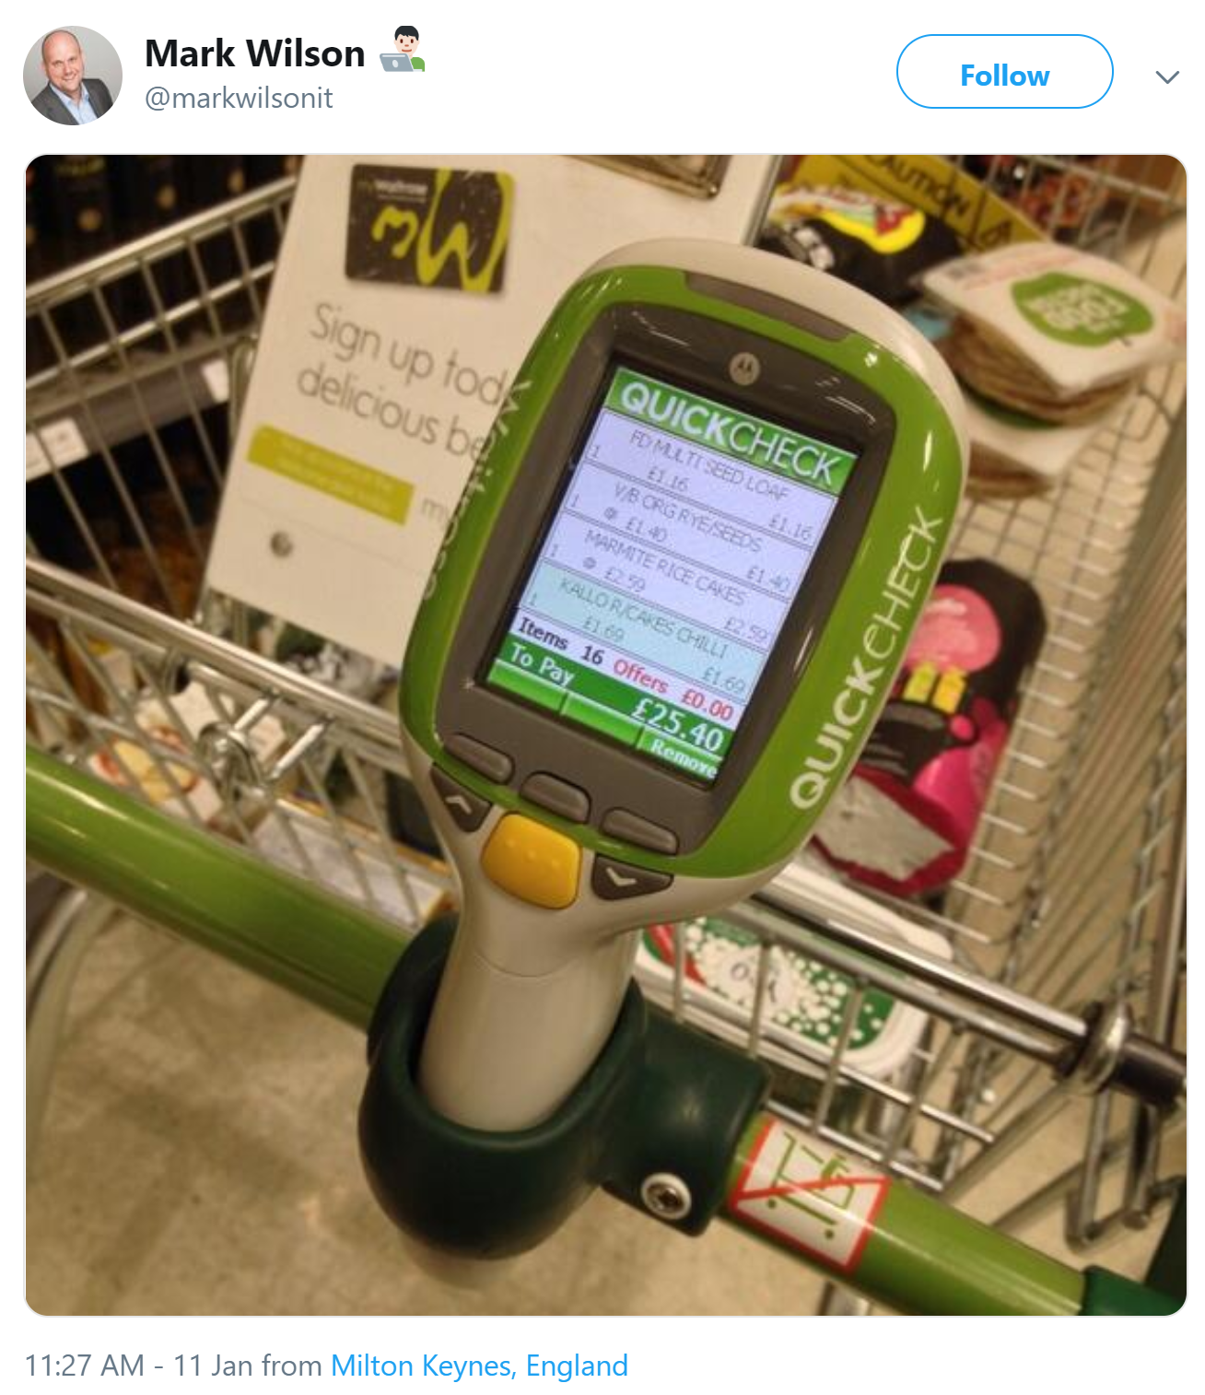

Slide 12
Get Started
Pick your tool of choice: Visual Studio 2019, Visual Studio Code, or Visual Studio for Mac
Install .NET Core 3.1 SDK: dot.net/get-core3
For Webassembly:
For Server:
dotnet new blazorwasm -o blazor-wasm1
cd blazor-wasm1
dotnet run
dotnet new blazorserver -o blazor-server1
cd blazor-server1
dotnet run

Slide 13
Let’s see this in action!

Slide 14
Authorization

Slide 15
Code sharing

Slide 16
JavaScript interop

Slide 17
Debugging

Slide 18
Internationalization

Slide 19
Progressive Web Apps

Slide 20
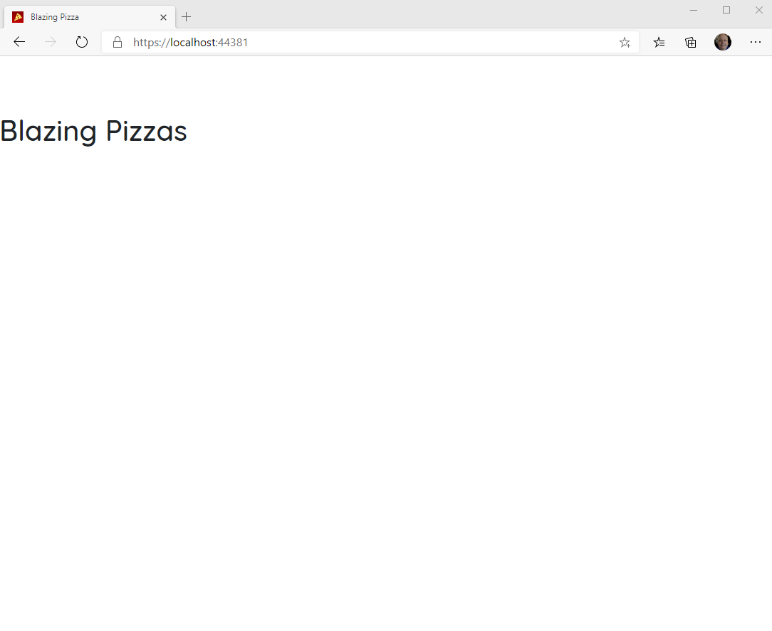
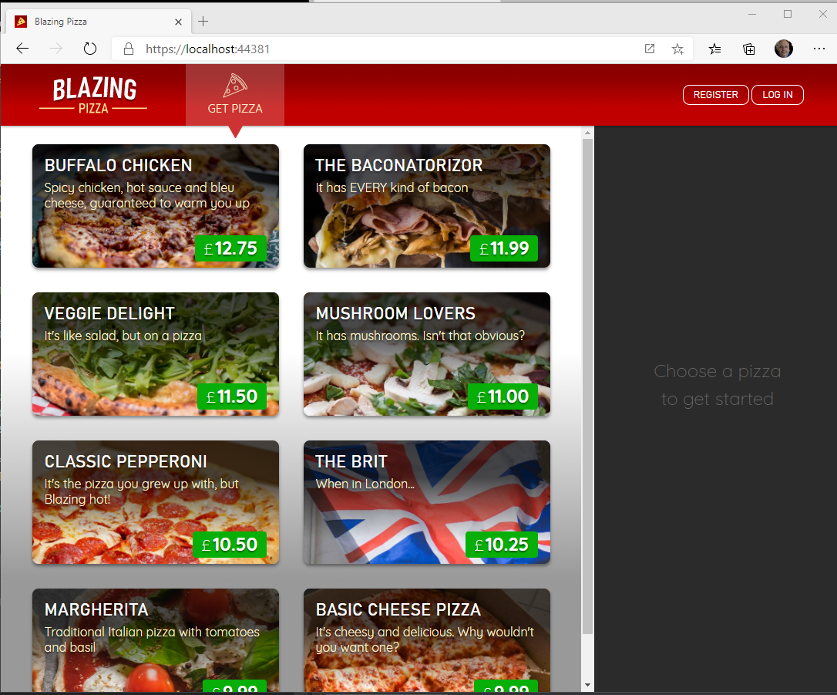

Blazor Workshop
Just Do It!!!!
https://github.com/dotnet-presentations/blazor-workshop

Slide 21
Client-side
(Blazor WebAssembly)
Server-side
(Blazor Server)
Shipped
Released in .NET Core 3.1
Shipped
Released in .NET Core 3.0
Blazor Hybrid
(Desktop app with web rendering)
Blazor + Native UI
(Mobile/desktop with native OS UI)
Uncommitted. Samples:
aka.ms/blazor-electron aka.ms/webwindow
Uncommitted. Samples: aka.ms/mobile-blazor-bindings

Slide 22
What’s next?
Blazor in .NET 5 (Build + Runtime)
Component API Enhancements:
Type constraints, Required Parameters…..
SVG
CSS Isolation
WebAssembly Specific
Multithreaded Runtime
Lazy-Loading

Slide 23
My Asks:
Head over to http://blazor.net and give it a go
Checkout https://aka.ms/blazor-carchecker
Do the workshop!
Send me some feedback: pulcher@pulcher.biz
Follow me on Twitch: @haroldpulcher

Slide 24
Links and stuff
Steve Sanderson Video (used the start of this) presentation: https://www.youtube.com/watch?v=Khn7sDUSEJM
Webassembly base information: https://webassembly.org/
Blazor Getting Started: https://docs.microsoft.com/en-us/aspnet/core/blazor/get-started?view=aspnetcore-3.1&tabs=visual-studio
Blazor Templates: https://www.nuget.org/packages/Microsoft.AspNetCore.Blazor.Templates/
Blazor Routing: https://docs.microsoft.com/en-us/aspnet/core/blazor/routing?view=aspnetcore-3.1
Blazor Workshop: https://github.com/dotnet-presentations/blazor-workshop
WebWindow: https://github.com/SteveSandersonMS/WebWindow
.Net Conf: Focus on Blazor: https://channel9.msdn.com/Events/dotnetConf/Focus-on-Blazor
Basteroids: https://aesalazar.github.io/AsteroidsWasm/
Blazor Pacman: https://pacmanblazor.azurewebsites.net/

Slide 26
WITH
FUTURE
FEATURES
INTERACTIVE WEB UI FOR .NET
A BIGGER APP ON WEBASSEMBLY

Slide 27
WITH
FUTURE
FEATURES
A BIGGER APP ON WEBASSEMBLY
BLAZOR EVERYWHERE
gRPC
Testing
PWA

Slide 28
WITH
FUTURE
FEATURES
A BIGGER APP ON WEBASSEMBLY
BLAZOR EVERYWHERE
gRPC
Testing
PWA

Slide 29

LEARN MORE & GET STARTED
blazor.net
Steven Sanderson
@StevenSanderson

Slide 30
LEARN MORE & GET STARTED
blazor.net
CODE & SLIDES
aka.ms/sanderson-london-2020
== https://github.com/SteveSandersonMS/presentation-2020-01-NDCLondon
Steven Sanderson
@StevenSanderson

Slide 31

1
2
3
PIN
* * * *
CART
Item 1
£3.95
Item 2
£12.00
Total: £15.95
0000 0000 0000 0000

