Slide 1
Harold Pulcher
Senior Consultant and Microsoft MVP

Slide 2
Upcoming Virtual Training Courses
Professional Scrum with Kanban (PSK) Certification Course January 26-27
where participants learn how to leverage Scrum to maximize the value of products and services The Professional Scrum Product Owner (PSPO) is a 2-day certification training (offered online and in person) .
Professional Scrum Master (PSM) Certification Course February 09-10
Professional Scrum Master (PSM) is a 2-day certification course (offered online and in person) that explains the principles and empirical process theory behind the Scrum framework, and the important role that the Scrum Master has in it.
Professional Agile Leadership - Essentials (PAL-E) Certification Course February 16-17
The Professional Agile Leadership Essentials (PAL-E) course provides a foundation for the role that leaders play in creating the conditions for a successful Agile transformation. This course was developed by Scrum.org in collaboration with the Professional Scrum Trainer community. After the class, students are eligible for the PAL I assessment certification. If you pass the assessment, you will gain the industry recognized PAL I certification. This certification will NEVER expire, and it makes you part of an elite community of PAL I badge holders.
For more information or to sign-up, visit:
www.improving.com/training

Slide 3
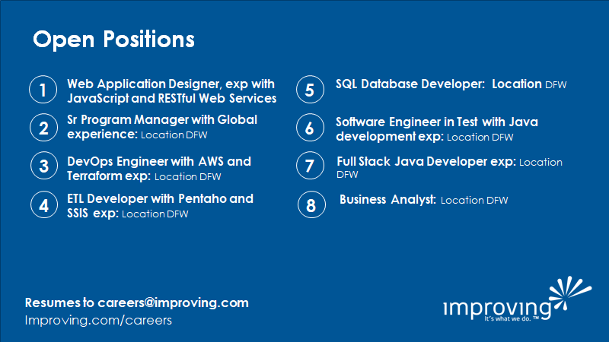

Slide 4
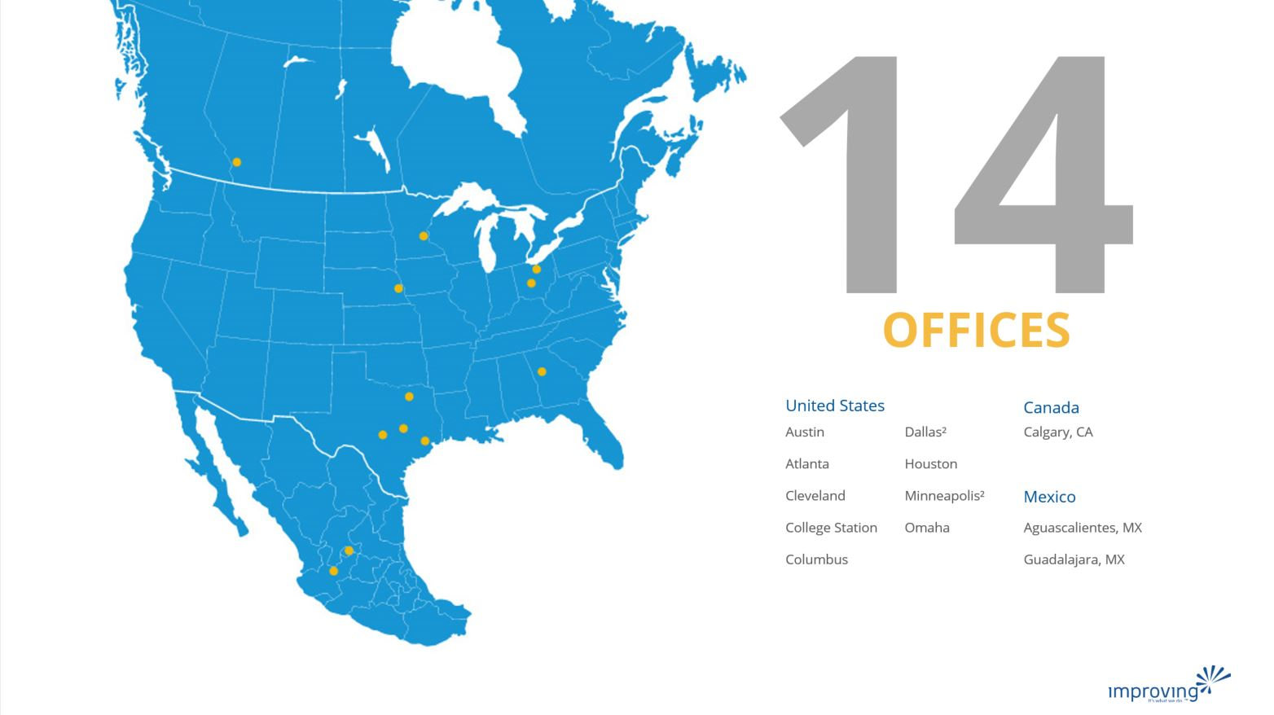
Share details about an upcoming event, conference, user group, booth raffel ect here.

Slide 5

Training class advertisement here​
For details around upcoming training courses available, please check with your local business development managers/office leadership
Fridays at 12pm CST
See past talks on our YouTube Page
https://bit.ly/2Rd0WC5

Slide 6

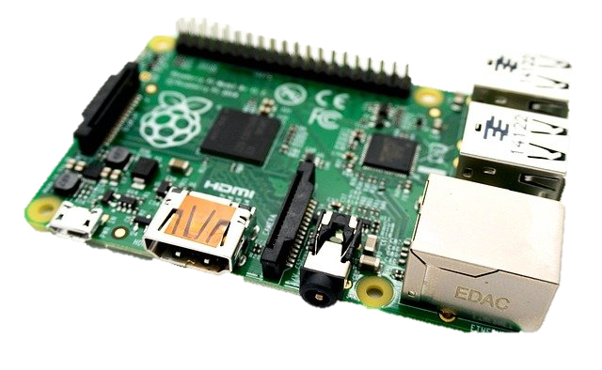
.NET 5 with a slice of Pi
Harold Pulcher (MVP) @haroldpulcher harold.pulcher@improving.com
https://youtube.com/user/hpulcher https://twitch.tv/haroldpulcher
http://bit.ly/improvingBlazorIntro
Notes:
Put on title….
Linux logo?
RPI?
LED?
Pushbutton?
My headshot
Update github link
Add Discord link

Slide 7
Agenda:
Overview
Requirements
Set It Up
Hello World!
Let’s make it better
Debuggin’ the World!
Creepy Head
My ask and questions

Slide 8
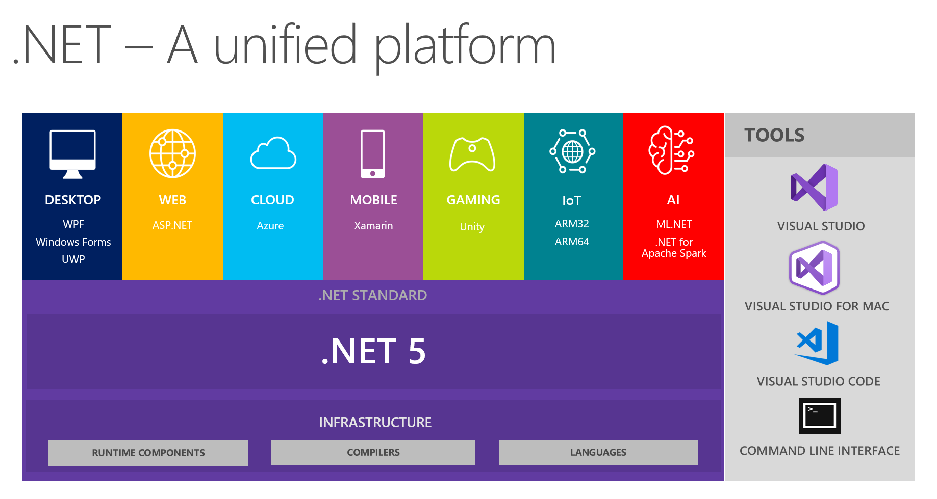
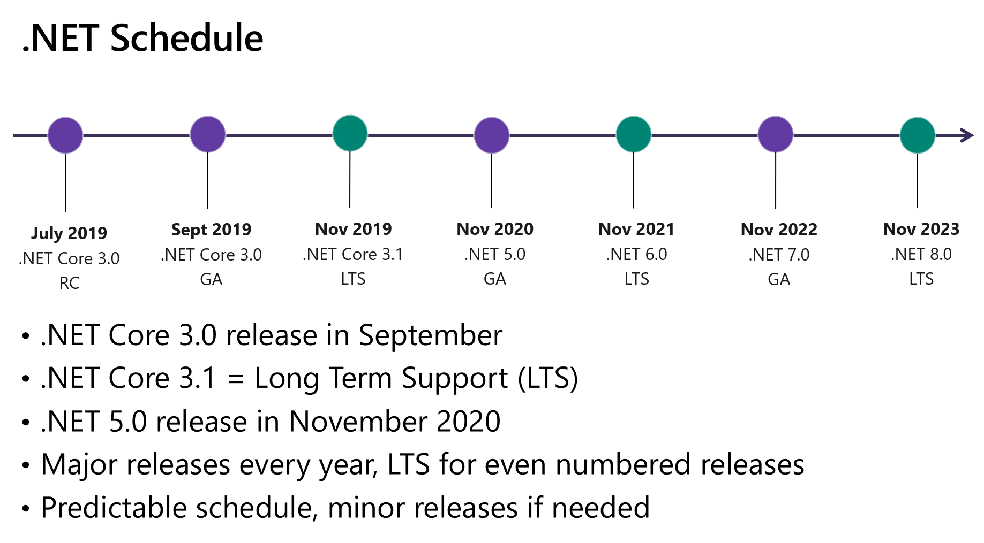
Overview
Notes:
Timeline
Supported platforms
Where to get it
Show page and talk about he various bundles
Get some .NET 5 logo and a Microsoft logo….

Slide 9
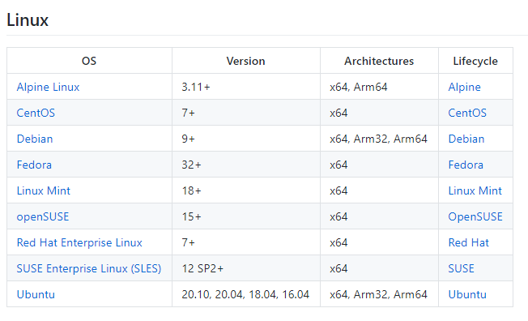
So what distro can I use?
https://docs.microsoft.com/en-us/dotnet/core/install/linux
Notes:
Timeline
Supported platforms
Where to get it
Show page and talk about he various bundles
Get some .NET 5 logo and a Microsoft logo….

Slide 10
Requirements….
Have to have:
Nice to have:
Supported OS
Ubuntu 20.04 in this presentation
.NET 5 SDK for your OS
Microsoft’s prod package installed
Raspberry Pi 4
Pi 3’s will work. Sorry Pi 2’s there is a current bug
Your favorite Linux editor
I like vi. Anyone still use emac’s?
A network connection
Guessing I shouldn’t have to say this.
Access to ‘root’ on the Linux OS
Visual Studio Code
Visual Studio Community
There are a few extensions
Remote Development Extension Pack
Access to an SSH client
OpenSSH is now on Windows 10
WSL2
Windows Terminal
.NET 5 SDK for your remote OS
Windows 10
Notes:
VS Code, VS community
Ssh Client (openssh now included on windows 10)
Installed Linux – VM, WSL2, Raspberry Pi, etc….
My current setup

Slide 11
Setup
Notes:
Prepare the Windows side
Windows Terminal Server
OpenSSH built in
ssh-keygen
Prepare the Linux side
Learn a little Linux
- vim, nano, pico, etc…
- sudo
- ls, etc…
Ensure that ssh is enabled
- /etc/ssh/sshd_config
- - allow root login
copy pub from windows and append to .ssh/authorized_keys
decide user level or global
-- /usr/share/dotnet vs ~/dotnet
download the bundle and expand to the correct place
Add to PATH and env vars: .bashrc
Install the devian ms package
Attempt to login from windows to linux without needing the password…..
Make another identity file for root@. Copy that .pub into the ~root/.ssh/authorized_keys
Make sure you can login without a password being asked for.
Yeah, I know….. This makes me nervous too……

Slide 12
Dev Env Setup
Notes:
Add the Remote Extension bundle
Check the ssh connection
Add the omnisharp c# extension
Launch.json
Execute
Attach
Task.json
Publish.bat
Scp blows
Demo ssh connection
Demo ssh terminal

Slide 13
A little bit of hello world!
Notes:
Dotnet new console –n hello_world
Build it. Run it. local
Demo run it remote, no code change
Go through the pushblick code
Fire it up on the pi
Attach to it.
Set a break point.

Slide 14
Talkng Head…
https://github.com/pulcher/TalkingHead
Notes:
Quick review of the project
Show the code and repo
Show how to start: dotnet new worker –n creepy-head
Push the button.

Slide 15
My asks and questions:
Notes:
Try out VS Code
Fire up a linux instance, or better yet get a Pi. I can help you pick if you like
Submit a PR/Issue to my repo.
Questions?

Slide 16
My Asks:
Head over to http://blazor.net and give it a go
Checkout https://aka.ms/blazor-carchecker
Do the workshop!
Send me some feedback: harold.pulcher@improving.com
Follow me on Twitch and Twitter: @haroldpulcher

Slide 17
Links and stuff
Steve Sanderson Video (used the start of this) presentation: https://www.youtube.com/watch?v=Khn7sDUSEJM
Webassembly base information: https://webassembly.org/
Blazor Getting Started: https://docs.microsoft.com/en-us/aspnet/core/blazor/get-started?view=aspnetcore-3.1&tabs=visual-studio
Blazor Templates: https://www.nuget.org/packages/Microsoft.AspNetCore.Blazor.Templates/
Blazor Routing: https://docs.microsoft.com/en-us/aspnet/core/blazor/routing?view=aspnetcore-3.1
Blazor Workshop: https://github.com/dotnet-presentations/blazor-workshop
WebWindow: https://github.com/SteveSandersonMS/WebWindow
.Net Conf: Focus on Blazor: https://channel9.msdn.com/Events/dotnetConf/Focus-on-Blazor
Basteroids: https://aesalazar.github.io/AsteroidsWasm/
Blazor Pacman: https://pacmanblazor.azurewebsites.net/
* All images are personal or obtained from the “free” section of pixabay.com

