Slide 1
Harold Pulcher
Senior Consultant and Microsoft MVP

Slide 2
Upcoming Virtual Training Courses
Acceptance & Test-Driven Development Course November 17-19
The Acceptance & Test-Driven Development course is three-day instructor-led course simulates true agile development by mapping user stories to acceptance tests to test-first unit tests through realistic examples and exercises.
Object-Oriented Design with Test-Driven Development December 15-18
The Object-Oriented Design with Test-Driven Development course is four-day instructor-led course introduces the object-oriented design fundamentals, principles and heuristics using Test Driven Development (TDD) that allow us to create robust regression tests and good code.
PSPO November 10-11
The Professional Scrum Product Owner (PSPO) certification course is a 2-day course where participants learn how to leverage Scrum to maximize the value of products and services.
For more information or to sign-up, visit:
www.improving.com/training

Slide 3
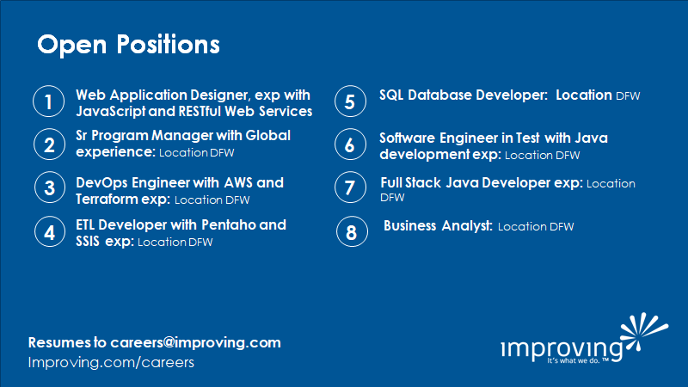

Slide 4
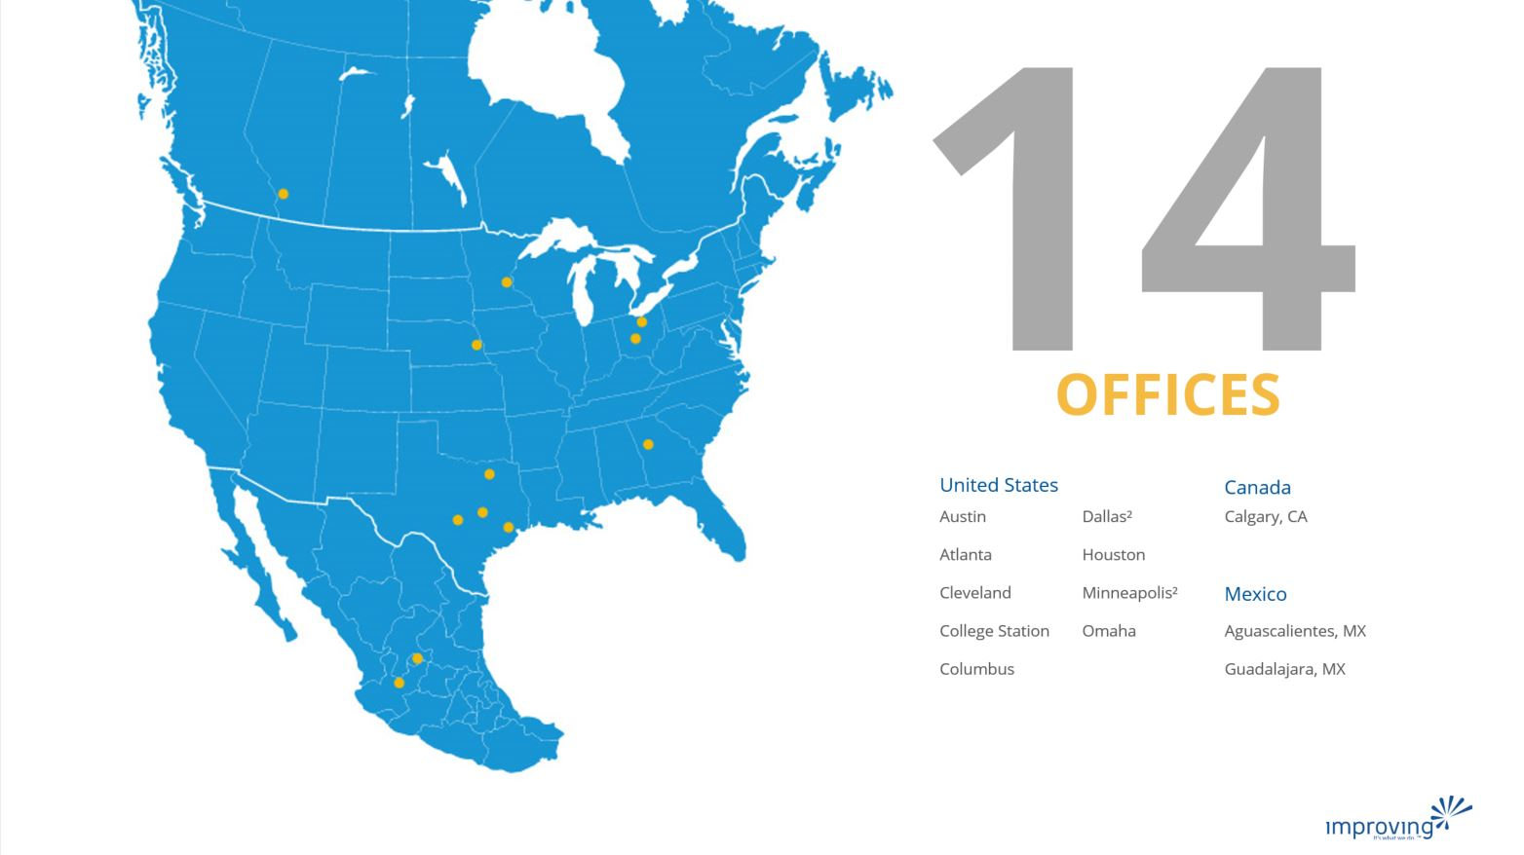
Share details about an upcoming event, conference, user group, booth raffel ect here.

Slide 5

Training class advertisement here​
For details around upcoming training courses available, please check with your local business development managers/office leadership
Fridays at 12pm CST
See past talks on our YouTube Page
https://bit.ly/2Rd0WC5

Slide 6

Harold Pulcher (MVP) @haroldpulcher harold.pulcher@improving.com
https://youtube.com/user/hpulcher https://twitch.tv/haroldpulcher
http://bit.ly/improvingBlazorIntro
Notes:
Put on title….
Linux logo?
RPI?
LED?
Pushbutton?
My headshot
Update github link
Add Discord link

Slide 7
Agenda:
Overview
Requirements
Current Methodologies
Pre-setup
Setup Dev Env
A little bit of Hello World!
Creepy Head
My ask and questions

Slide 8
Overview
Notes:
Timeline
Supported platforms
Where to get it
Show page and talk about he various bundles
Get some .NET 5 logo and a Microsoft logo….

Slide 9
Requirements
Notes:
VS Code, VS community
Ssh Client (openssh now included on windows 10)
Installed Linux – VM, WSL2, Raspberry Pi, etc….
My current setup

Slide 10
Common ways of doing this dev…..
Notes:
VS Code Dev on the rpi and edit on the windows? Headless pi
VS Code Dev on windows and push to the pi.
VS Community --- exercise for the student
Types of exec’s produced:
Self-Contained
Control framework in use
Faster startup
Larger dist size
Framework-Dependent
/usr/share/dotnet
cross-platform dll
Slow to start
dotnet <app.dll>
Small dist size.

Slide 11
Pre-setup
Notes:
Prepare the Windows side
Windows Terminal Server
OpenSSH built in
ssh-keygen
Prepare the Linux side
Learn a little Linux
- vim, nano, pico, etc…
- sudo
- ls, etc…
Ensure that ssh is enabled
- /etc/ssh/sshd_config
- - allow root login
copy pub from windows and append to .ssh/authorized_keys
decide user level or global
-- /usr/share/dotnet vs ~/dotnet
download the bundle and expand to the correct place
Add to PATH and env vars: .bashrc
Install the devian ms package
Attempt to login from windows to linux without needing the password…..
Make another identity file for root@. Copy that .pub into the ~root/.ssh/authorized_keys
Make sure you can login without a password being asked for.
Yeah, I know….. This makes me nervous too……

Slide 12
Dev Env Setup
Notes:
Add the Remote Extension bundle
Check the ssh connection
Add the omnisharp c# extension
Launch.json
Execute
Attach
Task.json
Publish.bat
Scp blows
Demo ssh connection
Demo ssh terminal

Slide 13
A little bit of hello world!
Notes:
Dotnet new console –n hello_world
Build it. Run it. local
Demo run it remote, no code change
Go through the pushblick code
Fire it up on the pi
Attach to it.
Set a break point.

Slide 14
Creepy Head
Notes:
Quick review of the project
Show the code and repo
Show how to start: dotnet new worker –n creepy-head
Push the button.

Slide 15
My asks and questions:
Notes:
Try out VS Code
Fire up a linux instance, or better yet get a Pi. I can help you pick if you like
Submit a PR/Issue to my repo.
Questions?

Slide 16
My Asks:
Head over to http://blazor.net and give it a go
Checkout https://aka.ms/blazor-carchecker
Do the workshop!
Send me some feedback: harold.pulcher@improving.com
Follow me on Twitch and Twitter: @haroldpulcher

Slide 17
Links and stuff
Steve Sanderson Video (used the start of this) presentation: https://www.youtube.com/watch?v=Khn7sDUSEJM
Webassembly base information: https://webassembly.org/
Blazor Getting Started: https://docs.microsoft.com/en-us/aspnet/core/blazor/get-started?view=aspnetcore-3.1&tabs=visual-studio
Blazor Templates: https://www.nuget.org/packages/Microsoft.AspNetCore.Blazor.Templates/
Blazor Routing: https://docs.microsoft.com/en-us/aspnet/core/blazor/routing?view=aspnetcore-3.1
Blazor Workshop: https://github.com/dotnet-presentations/blazor-workshop
WebWindow: https://github.com/SteveSandersonMS/WebWindow
.Net Conf: Focus on Blazor: https://channel9.msdn.com/Events/dotnetConf/Focus-on-Blazor
Basteroids: https://aesalazar.github.io/AsteroidsWasm/
Blazor Pacman: https://pacmanblazor.azurewebsites.net/
* All images are personal or obtained from the “free” section of pixabay.com

