Slide 1

Electronics for programmers
This isn’t magic and it doesn’t take a rocket scientist to understand this stuff.
Harold Pulcher (MVP)
@haroldpulcher
pulcher@pulcher.biz
https://www.youtube.com/user/hpulcher
https://github.com/pulcher/electronics-for-programers
Notes:
Introduce yourself
Microsoft MVP
Hackster-DFW part of hackster.io and ambassador
Mention youtube series
When I get done with this, come find me. I will have this handy to show and play with.
Q: How many programmers does it take to change a light bulb?
A: 0 as it is a hardware problem.
Since our light is out we are sorta now left in the dark. Who like being the dark?
Not me, so lets change that.

Slide 2
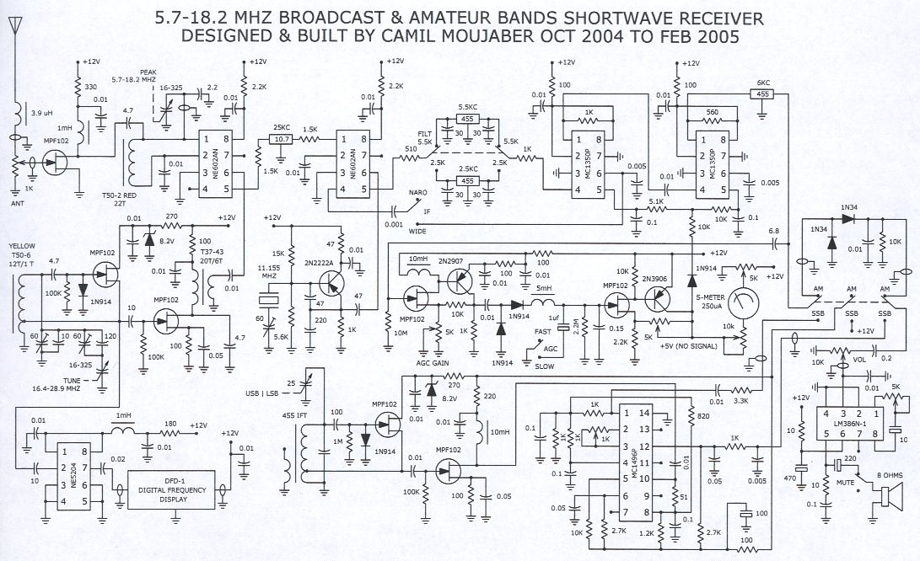
What do all these Hieroglyphics mean?
Notes:
Go through a sample schematic
Maybe 555 timer circuit?
Needs to have cross over lines
Need to have
Resistor
Capacitor
LED
Voltage source
Ground
IC
Image credit: https://www.midcenturyradios.com/schematic.html

Slide 3
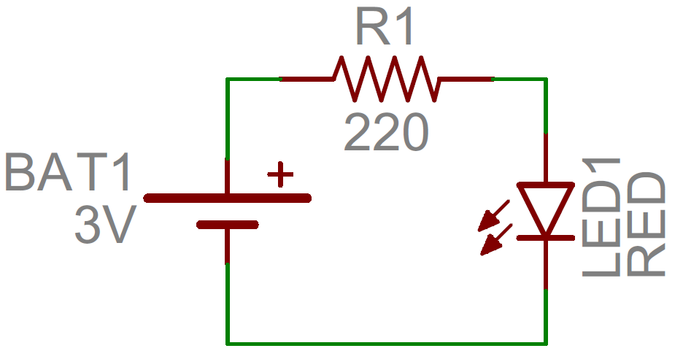
A less complex example
Notes:
Go through a sample schematic
Maybe 555 timer circuit?
Needs to have cross over lines
Need to have
Resistor
Capacitor
LED
Voltage source
Ground
IC
Image credit: https://learn.sparkfun.com/tutorials/how-to-read-a-schematic/all

Slide 4
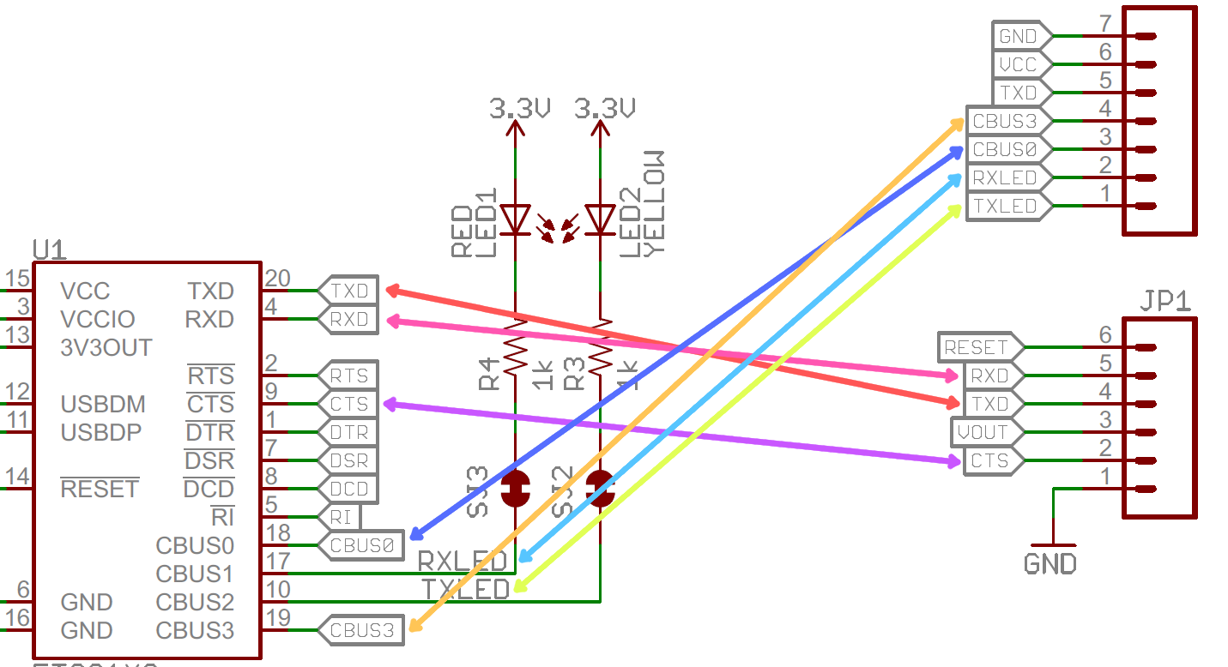
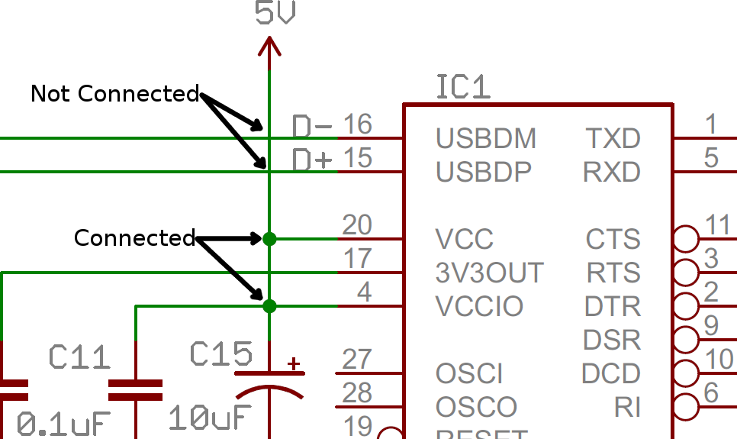
We don’t need Lines….
Notes:
Mention:
VCC = Voltage Common Collector. From the earliest semiconductor days. Could read V+, V-, Vdd(drain drain)
TX/RX = transmit/receive
D = Digital
A = Analog
Go through a sample schematic
Maybe 555 timer circuit?
Needs to have cross over lines
Need to have
Resistor
Capacitor
LED
Voltage source
Ground
IC
Image credit: https://learn.sparkfun.com/tutorials/how-to-read-a-schematic/all

Slide 5
Basic tools
Hard tools
Software
Digital Multimeter
Power Source
Breadboard
Side Cutters
Connecting wire
Wire Strippers
Tinkercad
Fritzing
Bing(google, etc….)
Notes:
DMM
Breadboard\
- Possible demo of the things
Connecting wires
pre-made solid code
Make your own
Power supply
Side cutters
Wire strippers
Touch on soldering
My power supply vs. what you need.
Tinkercad and circuit simulation
Fritzing

Slide 6
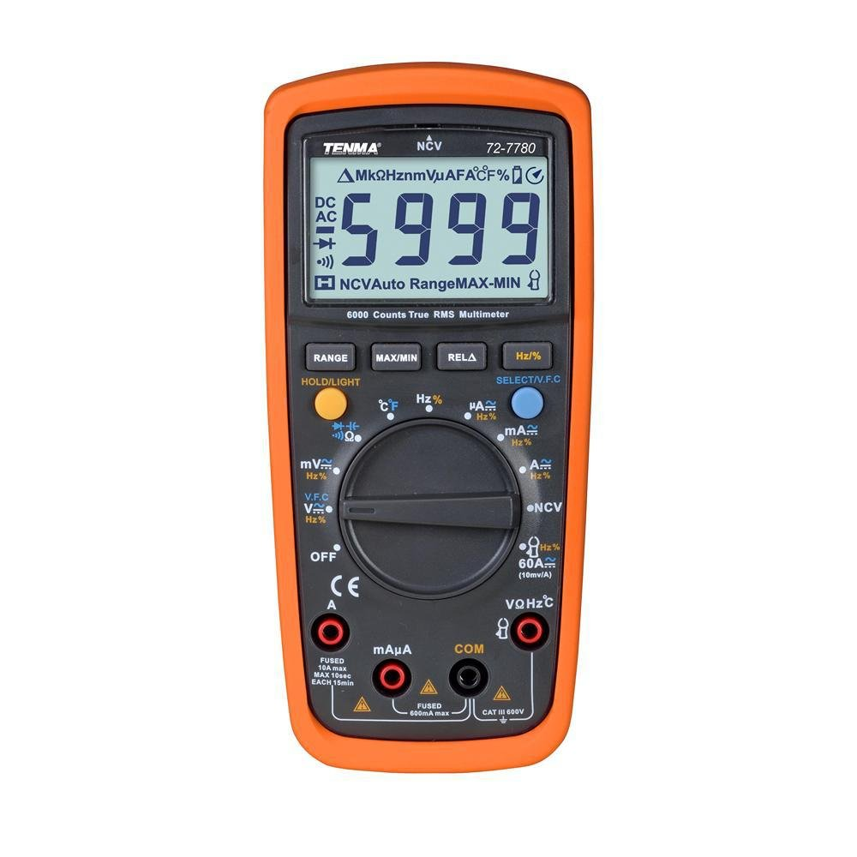
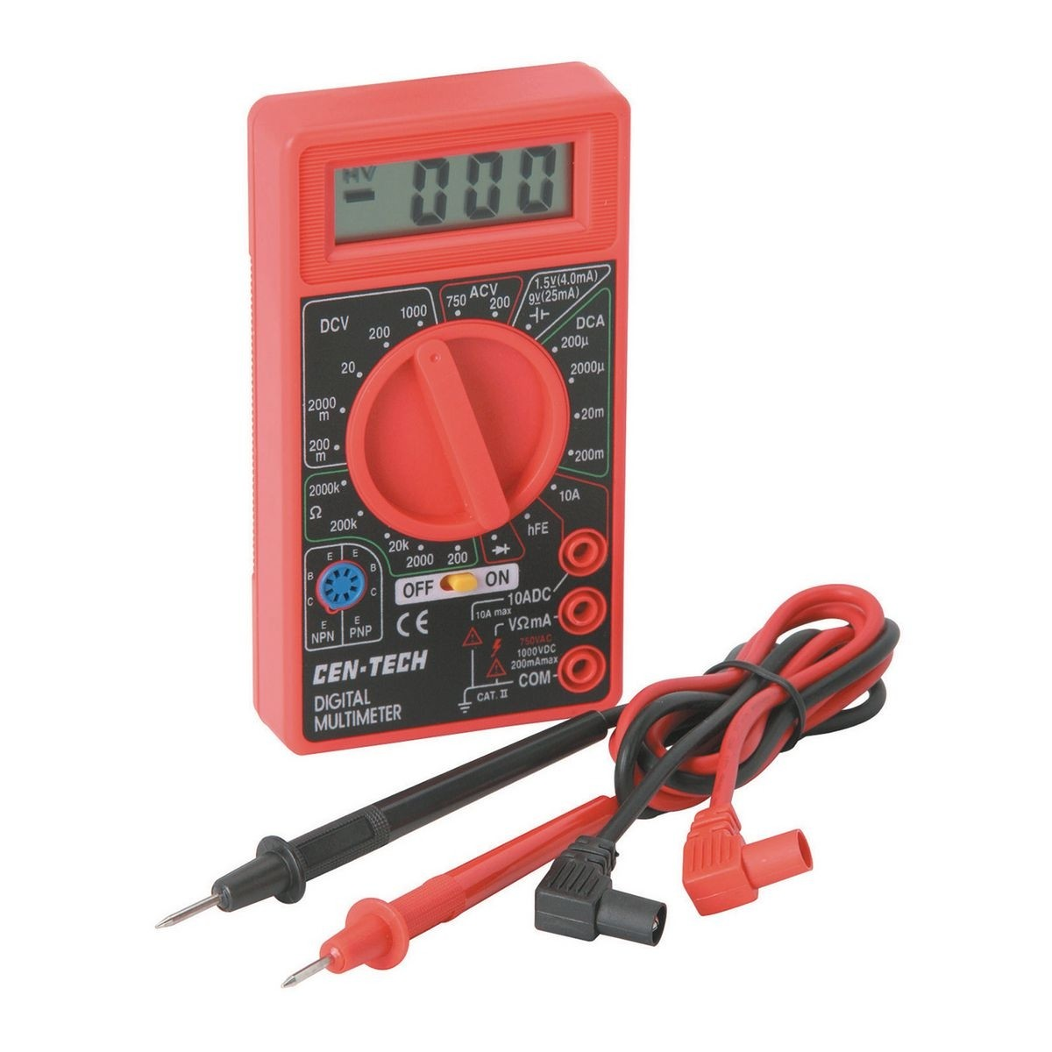
Digital MultiMeter - DMM
6.39
91.75
Notes:
DMM
Amazon: https://www.amazon.com/TENMA-72-7780-TRMS-HANDHELD-COUNT/dp/B011P0A7RO/ref=sr_1_1?crid=3L2ZI74SQZOSJ&keywords=tenma+72-7780&qid=1562536802&s=gateway&sprefix=tenma+72-7%2Caps%2C148&sr=8-1
Harbor freight: https://www.harborfreight.com/7-function-digital-multimeter-63759.html

Slide 7
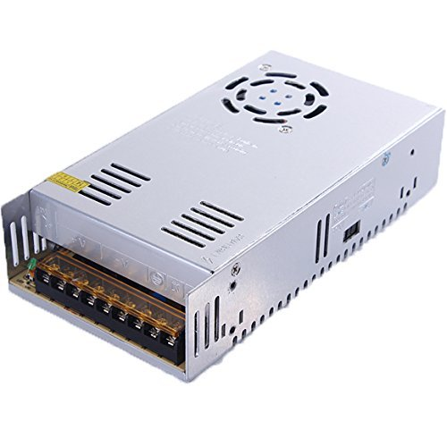
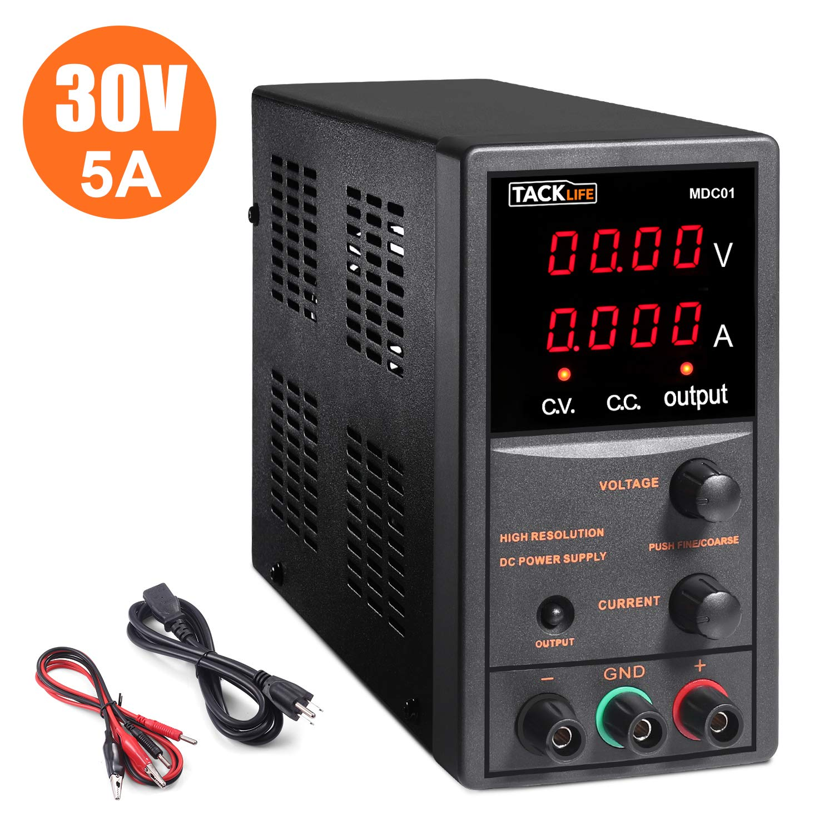
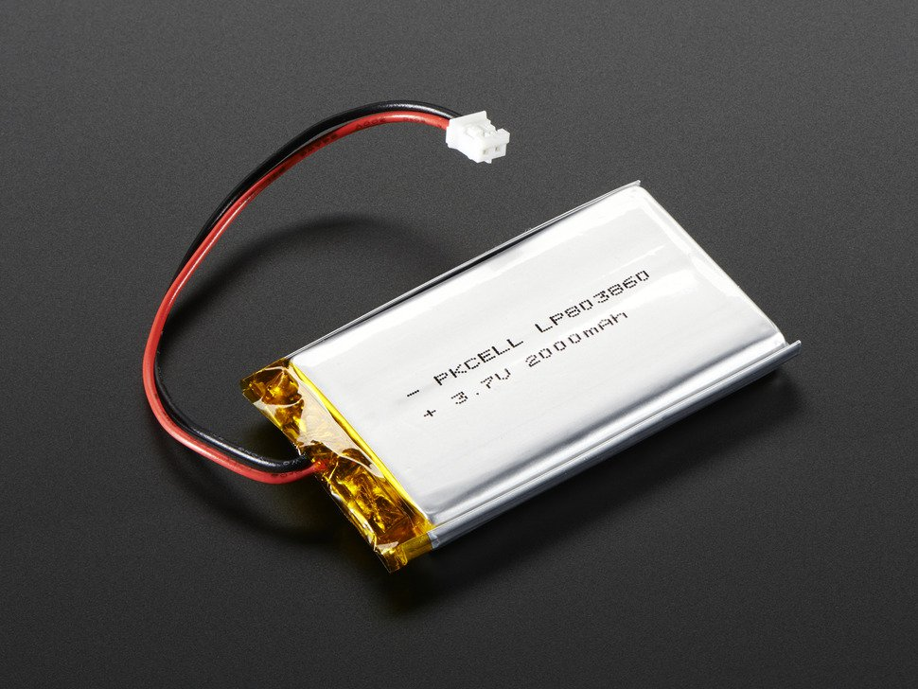
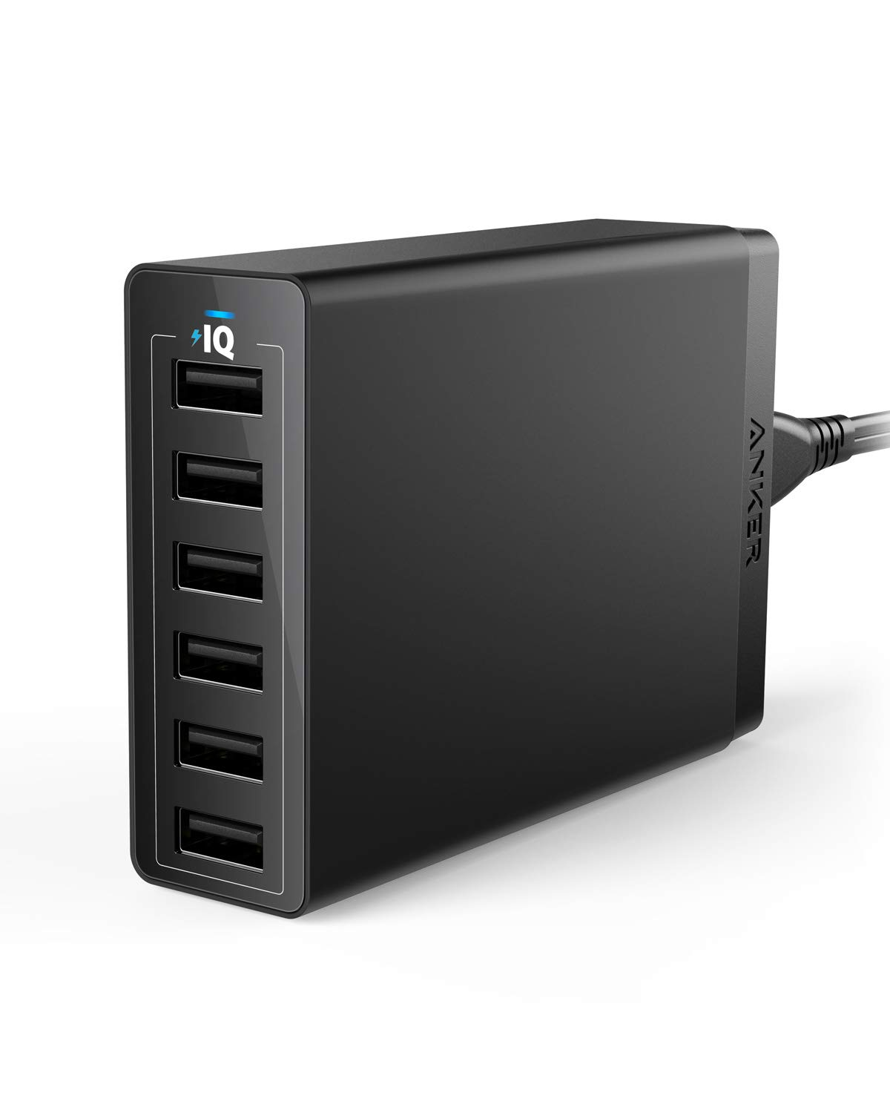
Power Source
Notes:
Power supply
Benchtop: amazon https://www.amazon.com/Switching-Regulated-temperature-protection-Alligator/dp/B07JQXQ8S5/ref=sr_1_3?keywords=benchtop+power+supplies&qid=1562542434&s=gateway&sr=8-3
67.97
LED: amazon: https://www.amazon.com/BMOUO-Universal-Regulated-Switching-Computer/dp/B01EWG6YT8/ref=sr_1_3?keywords=led+power+supplies&qid=1562542641&s=gateway&sr=8-3
17.98
USB Power: https://www.amazon.com/dp/B00P936188/ref=psdc_2407761011_t1_B00VH8ZW02
25.99
Adafruit lipo: https://www.adafruit.com/product/2011
12.50 3.7v 2000mAh

Slide 8
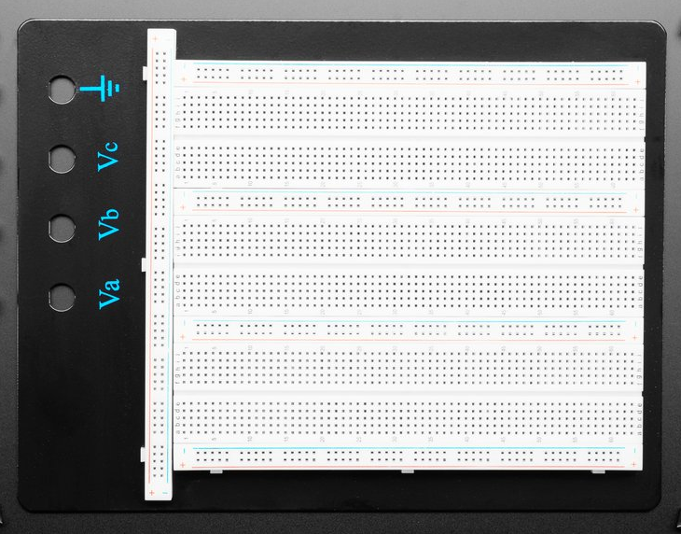
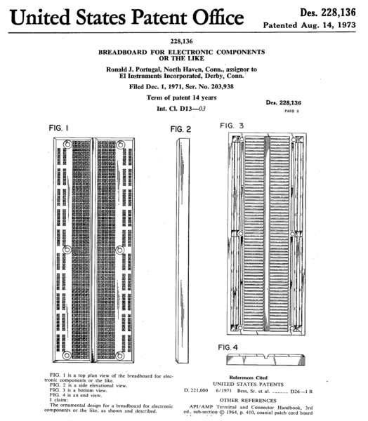
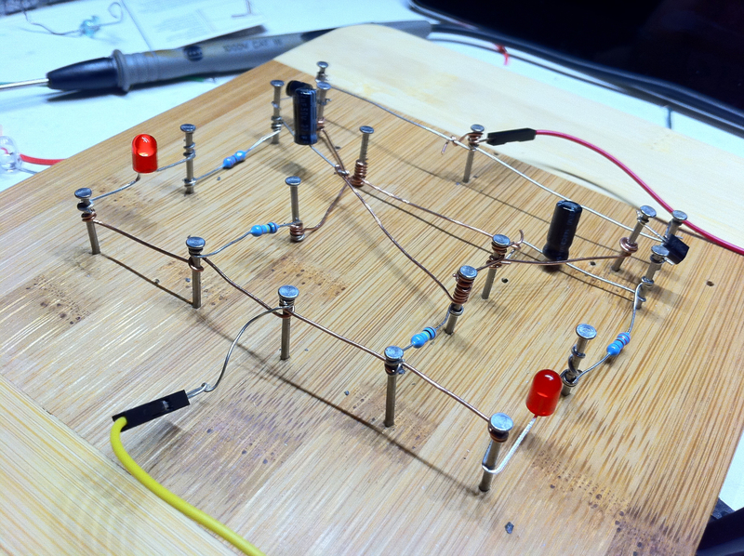
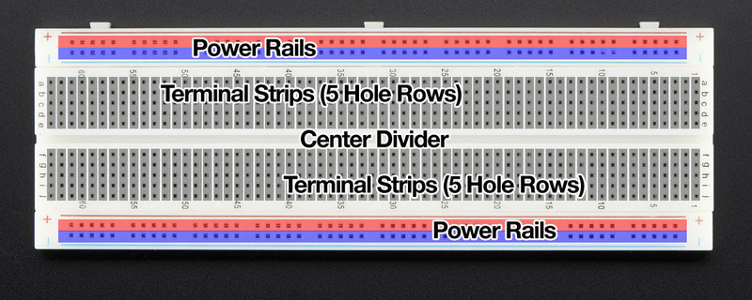
Breadboard
Notes:
Breadboard\
Possible demo of the things
Images and reference: https://learn.adafruit.com/breadboards-for-beginners?view=all

Slide 9
Wire and Things to Cut Wires
Hard tools
Software
Digital Multimeter
Power Source
Breadboard
Side Cutters
Connecting wire
Wire Strippers
Tinkercad
Fritzing
Bing(google, etc….)
Notes:
DMM
Breadboard\
- Possible demo of the things
Connecting wires
pre-made solid code
Make your own
Power supply
Side cutters
Wire strippers
Touch on soldering
My power supply vs. what you need.
Tinkercad and circuit simulation
Fritzing

Slide 10
Basic tools
Hard tools
Software
Digital Multimeter
Power Source
Breadboard
Side Cutters
Connecting wire
Wire Strippers
Tinkercad
Fritzing
Bing(google, etc….)
Notes:
DMM
Breadboard\
- Possible demo of the things
Connecting wires
pre-made solid code
Make your own
Power supply
Side cutters
Wire strippers
Touch on soldering
My power supply vs. what you need.
Tinkercad and circuit simulation
Fritzing

Slide 11
Resistance is Futile
Notes:
OOOOOMMM! Graphic
Link to the resistor page I found
Series vs. Parallel
How to read color code.
There are a number of “phrases”. Most of the easy to remember ones are rude. Bing’em…..
Standard Values
Watt rating…..
Water analogy:
Pressure == Voltage
Flow == Current
Types:
Carbon Film: mention thickness controls the resistance.
Wire wound
Metal Film
Others…
Add Image of the sparkfun resistor page
Demo:
Make your own with a pencil
Show series and parallel connections.
Show Current with math
- Show 12v 3 LED in series need only 10mA calc resistance
Smoke a resistor.

Slide 12
Prepare to Resist!!!
Working Examples
Notes:
Demo:
Make your own resistor
Series
Parallel
Use Multimeter to show Resistance.

Slide 13
Use all the capacity you can
Notes:
Describe the function of a capacitor/inductor and how they are different
Area of metal
Thickness of card controls the capacitance
Show Voltage wave form by hand
Frequence Matters with this
Old days 1kHz… not 10kHz, 1MHz, etc….
- Polarized vs Non-polarized
Electrolytic caps
How they are built
Liquid
It is blown?
Why they have a cross
X is a safety valve
Old Video games
Dry out the electrolytic
Ceramic Cap
How Built
Water analog:
Chamber with a diaphragm
- water flows in and pushes the stuff out the other things.
Series and Parallel.
No real demo as that is hard.
Demo:
Power and LED?
Metal tape and a card stock
Need a capacitance meter
Cut in ½ to show the capacitance reducing.
Blow one up? Maybe not…. ☺

Slide 14
Diodes and one-way streets
Notes:
Purpose:
Allow electricity to only flow in one direction.
Rating by Current and Reverse Voltage
Types:
Silicon typical voltage drop 0.6v
Schotky diodes have much lower voltage drop
Forward voltage
LED emits light, but has very little or no resistance
Don’t have much on the reverse voltage. May conduct and not light up.
Zener Diode
Voltage regulation
Like normal in normal rate.
The reverse will conduct at the rated voltage and site there.
Demo
No resistor and check current
Decent resistor
Large resistor
See if you can burn one up.

Slide 15
What is electricity
Notes:
Or what that “magic smoke is made out of”
Voltage
Current
Conductors
How they relate
AC vs. DC
V = IR in triangle
P = IV in triangle for power

Slide 16
Magic Smoke Time
Let’s see if this voltage thing really works!
Notes:
Demo:
Voltage drop over Series and Parallel
Calculate Power and show watts
Show a ¼ watt resistor getting burnt.
Show Current
- Show POT and reference in Series resistors
- Show how the rc circuit works on an Arduino.

Slide 17
Do we still Need Transistors?
Notes:
NPN(most common, bi-polar), PMP, Photo, FET, MOSFET(high current switching, not as robust as NPN)
You can bing images to find the schematic symbol
Exceed 0.6 above ground triggers most. Ie Gate Voltage
They have current, gain rating, which is a multiplier of the imput.
Hell Yeah!!!
How they are the “switches” that make everything work.
Demo:
Single transistor
Show astable in tinkercad
Show it for real

Slide 18
Switch me on and Relay that to the world
Notes:
What a switch really is and how a relay is just a fancy switch with and inductor
Talk about
Normally Open, Normally Closed
Single vs double
Mechanical vs Solid State vs. and Opto-Isolator

Slide 19
Let get digital Baby!!!
Notes:
Digital vs. Analog
Active high
No 0’s and 1’s
Not a true square wave because well…. Physics!!!
Various form of DIP and the such.
Introduce the Arduino talk more about analog vs digital
Pull up vs. pull down resistor. Reference Active High/Low
Demo:

Slide 20
When the buss comes in, Everyone Rides!!!
Notes:
Talk about I2c, SPI
Talk about level shifting.
Where they are currently used
Show a diagram
Show the hookup, timing, and show some online examples.
Mention the big colorful signs.
Demo:
mkr1000 and the sign showing the hello bits
Show the neopixel
OLED screen and I2C

Slide 21
Back to the Voltage
Notes:
5, 3v3, 1v8
How do you hook all of this together and make it talk?
Firmata

Slide 22
Now that we know all of this……
Lets use it all at once!!!
Notes:
Show the Make better project
Transistor
Led
Arduino(Photon)
DHT11
I2C Display

Slide 23
Links of Doom page
Notes:
Forest Miims III
http://www.forrestmims.org/
https://www.w5yi.org/catalog_details.php?pid=34&sort=21
https://docs.google.com/file/d/0B5jcnBPSPWQyaTU1OW5NbVJQNW8/edit
Electronics for beginners:
Bigclivedotcom
https://www.youtube.com/watch?v=6Maq5IyHSuc
Tinkercad
https://www.tinkercad.com/
Frizing
= http://fritzing.org/home/
Sparkfun
Resistor page here https://learn.sparkfun.com/tutorials/resistors/all
Capacitor
Demo page links
https://github.com/pulcher/electronics-for-programmers
Remind everyone to buy some kits stuff, blow it up, fix it, them expand on what you know.

