Slide 1

Getting Started with GitHub Actions

Slide 2

What exactly is GitHub Actions
Ci/CD Platform
Can be triggered on Events in your Repositories
Hosted and non-hosted Agents/Runners
Notes:
GitHub Actions is a continuous integration and continuous delivery (CI/CD) platform that allows you to automate your build, test, and deployment pipeline.
You can create workflows that build and test every pull request to your repository, or deploy merged pull requests to production.
GitHub Actions goes beyond just DevOps and lets you run workflows when other events happen in your repository. For example, you can run a workflow to automatically add the appropriate labels whenever someone creates a new issue in your repository.
GitHub provides Linux, Windows, and macOS virtual machines to run your workflows, or you can host your own self-hosted runners in your own data center or cloud infrastructure.

Slide 3
Advantages of using GitHub Actions
Best GitHub integration!
It’s Free…. With limits…
All actions in a workflow are isolated.
Access to the GitHub API
Multiplatform: Linux, macOS, Windows, and containers
Concurrent Jobs
Notes:
You can run a workflow on any github event
Issue creation
Push
New release
Etc..
Any Language

Slide 4
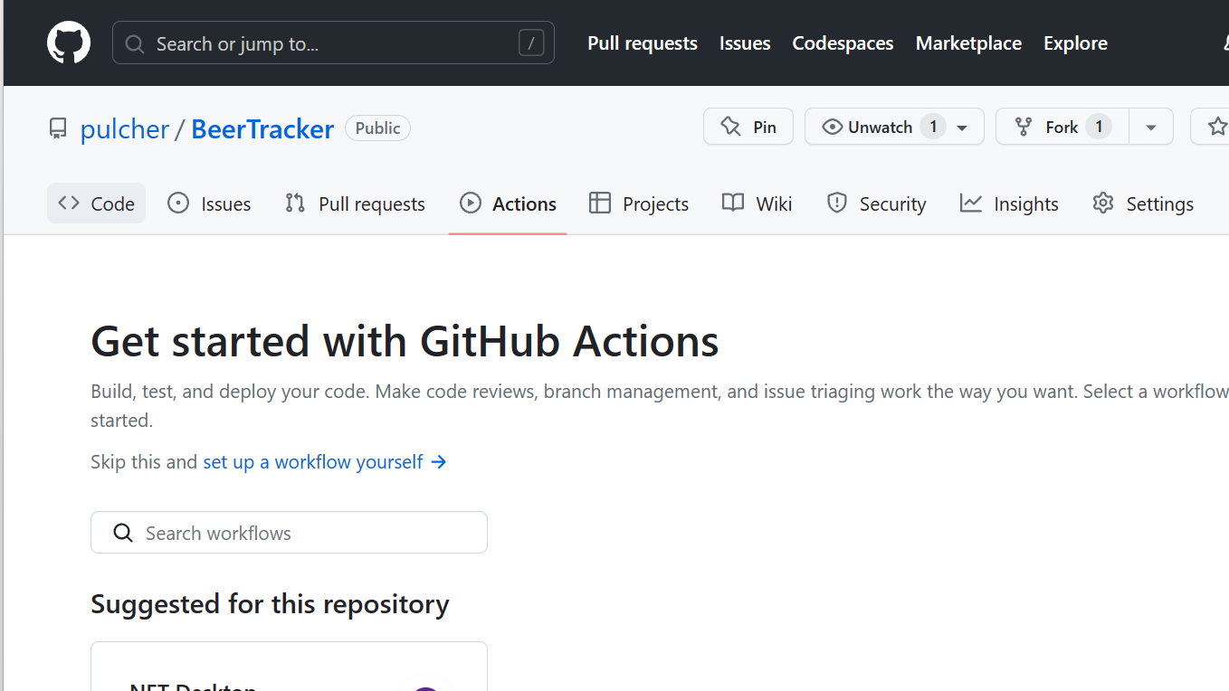
Setting up a GitHub Actions workflow
Notes:
It is already installed!
Click the Actions…
Show this on a repo….

Slide 5
D. Adding workflow events

Slide 6
E. Adding workflow jobs

Slide 7
F. Adding workflow steps

Slide 8
G. Workflow syntax

Slide 9
III. Running GitHub Actions workflows A. Triggering workflows manually

Slide 10
B. Triggering workflows automatically

Slide 11
C. Running workflows locally

Slide 12
D. Viewing workflow results

Slide 13
IV. Customizing GitHub Actions workflows A. Using actions from the GitHub Marketplace

Slide 14
B. Creating custom actions

Slide 15
C. Sharing workflows with other repositories

Slide 16
V. Best practices for using GitHub Actions A. Organizing workflows

Slide 17
B. Securing workflows

Slide 18
C. Testing workflows

Slide 19
D. Reviewing workflow changes
D. Reviewing workflow changes

Slide 20
VI. Conclusion A. Recap of key takeaways
B. Future improvements to GitHub Actions C. Additional resources and references

Slide 21
B. Future improvements to GitHub Actions

Slide 22

Additional resources and references
Documentation: GitHub Actions Documentation - GitHub Docs

