Slide 1
Getting Started with GitHub Actions
Harold Pulcher harold.pulcher@improving.com
@haroldpulcher https://bit.ly/github-actions-getting-started

Slide 2

IMPROVING AWARDS

Slide 3

Assumptions
You have a GitHub account
You have access to at least 1 repository
Notes:
This is what the Management refers to as “Out of scope for this presentation”. ☺

Slide 4
What exactly is GitHub Actions
Ci/CD Platform
Can be triggered on Events in your Repositories
Hosted and non-hosted Agents/Runners
Workflow definitions live with the code
Notes:
GitHub Actions is a continuous integration and continuous delivery (CI/CD) platform that allows you to automate your build, test, and deployment pipeline.
You can create workflows that build and test every pull request to your repository, or deploy merged pull requests to production.
GitHub Actions goes beyond just DevOps and lets you run workflows when other events happen in your repository. For example, you can run a workflow to automatically add the appropriate labels whenever someone creates a new issue in your repository.
GitHub provides Linux, Windows, and macOS virtual machines to run your workflows, or you can host your own self-hosted runners in your own data center or cloud infrastructure.
GitHub CLI all the things!

Slide 5
Advantages of using GitHub Actions
Best GitHub integration!
It’s Free…. With limits…
All actions in a workflow are isolated.
Access to the GitHub API
Multiplatform: Linux, macOS, Windows, and containers
Concurrent Jobs
Notes:
You can run a workflow on any github event
Issue creation
Push
New release
Etc..
Any Language

Slide 6
Components of GitHub Actions
Workflows
Events
Jobs
Actions
Runners
Notes:
Workflows
Yaml
Checked into the repo .github/workflows
Can reference 1 workflow from another
Events
Can originate from inside GitHub: open an issue, create a pull request, pushes a commit,
Jobs
Set of steps
All on the same runner
Can share information
Dependencies with other jobs
All dependent jobs will execute in parallel
Actions
Custom application that will be executed by the job
Lots in the marketplace
Or you can write your own
Runners
Built-in Github runners….. Free, well…… mostly
Linux, Mac, and Windows each have a different cost
- prefer linux 1, Windows 2, Max 10
- Host your own!

Slide 7
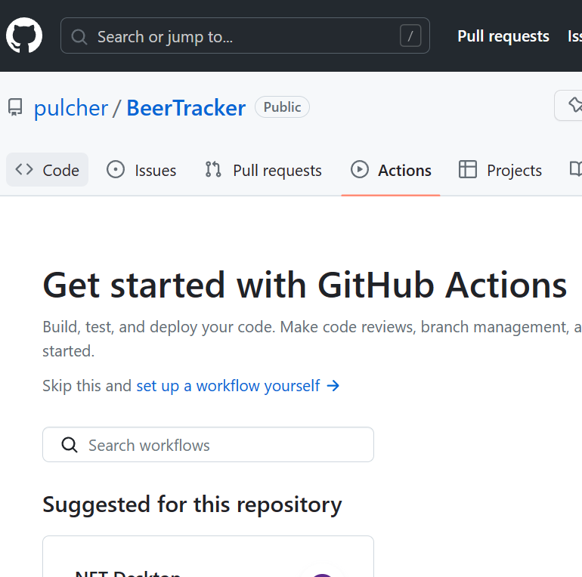
Setting up a GitHub Actions workflow
Notes:
It is already installed!
URL-4: https://github.com/pulcher/BeerTracker
Click the Actions…
Show this on a repo….
Show the marketplace….
Show where it lives…

Slide 8

Triggering a Workflow
Events in your workflows repository
“on:” values that match the triggering event
Events outside of GitHub
GitHub API to the rescue
Scheduled Times
The “on:” is in play
Manually
“workflow_dispatch:” is your friend
Notes:
Show the triggering event syntax:
URL-1: https://docs.github.com/en/actions/using-workflows/workflow-syntax-for-github-actions#on
Events outside of GitHub
URL-2: https://docs.github.com/en/rest/repos/repos?apiVersion=2022-11-28#create-a-repository-dispatch-event
Schedule Times
URL-3: https://docs.github.com/en/actions/using-workflows/workflow-syntax-for-github-actions#onschedule
Manual
Add “workflow_dispatch:” to your .NET yaml on TalkingHead.
URL-8: Actions · https://github.com/pulcher/TalkingHead/actions
Then after adding and clicking go, come back to the slide desk and go a couple of slides.

Slide 9
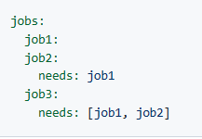
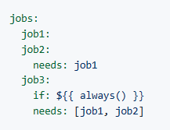
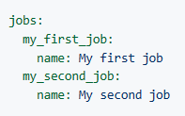
Jobs
A set of steps in a workflow
Can be a shell script or an “Action”
Can be dependent on other jobs
Notes:
Jobs main URL:
URL-5: https://docs.github.com/en/actions/using-jobs/using-jobs-in-a-workflow
Order left -> bottom -> right top -> bottom
- How to set the job_id in your workflow
- Defining the output in the UI for the various job_ids
Jobs 3 depends on the successful outcome of Job1 and 2
Job3 doesn’t care if the outcome is successful, but will execute only after job 1 and 2.

Slide 10

Workflow Commands
Can be used in Shell scripts and action code.
Useful for messages:
Errors
Warning
Notifications
Debugging
Notes:
URL for the commands:
URL-6: https://docs.github.com/en/actions/using-workflows/workflow-commands-for-github-actions

Slide 11

Workflow syntax
YAML
Good example with great explanations:
https://docs.github.com/en/actions/examples/using-scripts-to-test-your-code-on-a-runner
Notes:
Lets go look at that link:
URL-7: https://docs.github.com/en/actions/examples/using-scripts-to-test-your-code-on-a-runner

Slide 12
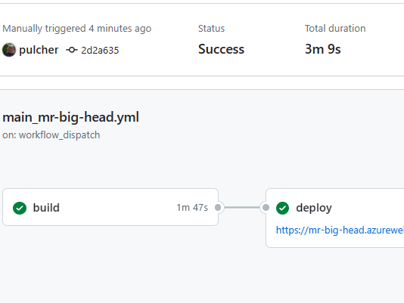
Viewing workflow results
Notes:
Go click on the action that you ran in the “manual” step
Just got back to the tab where you clicked… there should be fun stuff there.
URL-8: https://github.com/pulcher/TalkingHead/actions

Slide 13

Custom actions
Docker container
JavaScript
Composite Actions
Each requires an “action.yaml” file for all the inputs.
Documentation:
https://docs.github.com/en/actions/creating-actions/about-custom-actions
Notes:
Docker:
More consistent and reliable unit of work. All the docker goodness here.
JavaScript
Is faster, but may not be compatible on all platforms.
For Node.js ther eis an action toolkit to help. Checkout: https://github.com/actions/toolkit
Composite Actions
Uses action.yaml includes steps and other workflows.
Show the web page
URL-9: https://docs.github.com/en/actions/creating-actions/about-custom-actions
Actions are open source:
URL-10: https://github.com/actions/checkout/tree/v3

Slide 14
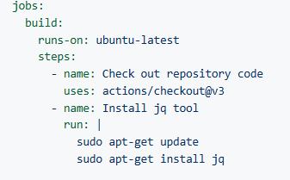

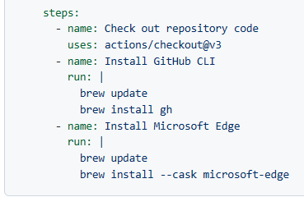

GitHub-Hosted Runners
Linux/Windows
MacOS
Notes:
GitHub-Hosted:
Updated software once a week.
https://docs.github.com/en/actions/using-github-hosted-runners/about-github-hosted-runners

Slide 15

Self-Hosted Runners
Executed in your own environment Cloud and/or Local
Free to use… Duh!
Lots of supported Architectures
Can update themselves
Lots of OS versions for Linux, Windows, and Mac
Need to have network access to
github.com
api.github.com
Notes:
Self-Hosted:
URL-11: https://docs.github.com/en/actions/hosting-your-own-runners/managing-self-hosted-runners/about-self-hosted-runners

Slide 16

Sharing workflows
Publish to the GitHub Marketplace
Your private repository
Your organization

Slide 17

Best practices for using GitHub Actions
Don’t put secrets into your workflows!
Self-Hosted runners need to be highly scrutinized.
Notes:
Azure – Azure Key Vault
AWS – KMS – Key manager service
GitHub secrets
Per repo
Per org

Slide 18

Additional resources and references
Documentation: GitHub Actions Documentation - GitHub Docs

Slide 19

Getting Started with GitHub Actions
Harold Pulcher
harold.pulcher@improving.com
@haroldpulcher
https://bit.ly/github-actions-getting-started

