Slide 1


Stop checking in your secrets
Harold Pulcher
harold.pulcher@improving.com
@haroldpulcher
https://bit.ly/use-user-secrets

Slide 2

Understanding the NEED for Secret Management

Slide 3

Why Secret Management is Important
The following should never make into source code control
Usernames
Passwords
API Keys
Connection Strings
Private URLs
Etc…

Slide 4
Common Approaches to Secret Management
Environment variables.
Configuration files.
Secret management tools.
Notes:
Environment variables are generally stored in plain, unencrypted text. If the machine or process is compromised, environment variables can be accessed by untrusted parties. Additional measures to prevent disclosure of user secrets may be required.

Slide 5

Introducing User-Secrets in .NET
Notes:
The “user-secrets” feature was introduced with .NET Core 2.x and Visual Studio 20171. This feature allows developers to store sensitive information, such as database connection strings and API keys, outside of the project tree in a JSON file, ensuring that these secrets are not included in source control1.

Slide 6

What are User-Secrets?
A tool that enables storing data during development.
Not just for sensitive data.
Stores the data outside of the source tree.
Can be used across multiple projects.
Both IDE and CLI tools available
Notes:
The Secret Manager tool stores sensitive data during application development. In this context, a piece of sensitive data is an app secret. App secrets are stored in a separate location from the project tree. The app secrets are associated with a specific project or shared across several projects. The app secrets aren't checked into source control.

Slide 7
Reasons I have heard as to why people are not using this?
Too hard?
Too complicated?
It just a passing fad from Microsoft!
The current way works just fine.

Slide 8
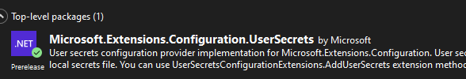
Install a nuget package

Slide 9
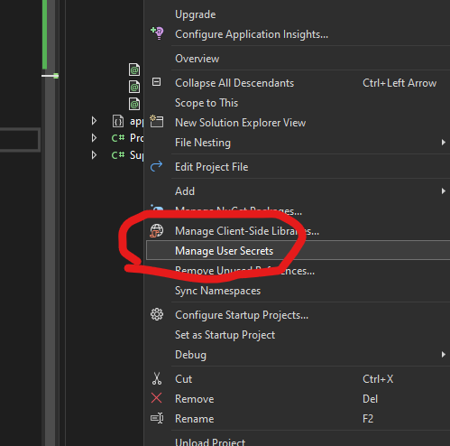
With Visual Studio

Slide 10
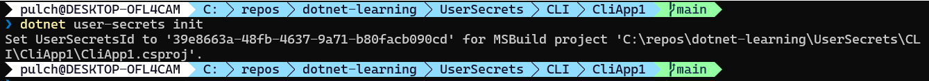
Use the CLI Luke!

Slide 11

I don’t see a change. Did the command work?

Slide 12
Where does User-Secrets store stuff?
Windows:
%APPDATA%\Microsoft\UserSecrets\<user_secrets_id>\secrets.json
Linux/macOS
~/.microsoft/usersecrets/<user_secrets_id>/secrets.json

Slide 13

Show me the code already!
Notes:
Creating a .NET Project
- Step-by-step creation of a new .NET project.
Adding User-Secrets to the Project
- Using the dotnet user-secrets command.
- Storing and retrieving secrets.
Accessing Secrets in Code
- Modifying the Program.cs or Startup.cs to read secrets.
- Example code snippets.

Slide 14
Best Practices for Secret Management
Avoiding common pitfalls.
appsettings.Development.json is not a safe place.
Secrets are secrets even just for development.
I will check this in an delete/change it later.
Understand the Configuration object.
Using User-Secrets in combination with other tools (e.g., Azure Key Vault).
Notes:
News channel on Rabbit AI breach…. Api keys hardcoded: https://youtu.be/vA44foHF4mU?t=523

Slide 15
Advanced Topics
Sharing secrets across multiple projects.
Integrating User-Secrets with CI/CD pipelines.

Slide 16
Remember!
Never check in anything that should not be checked in
Can be used for more than just secrets
Use the tools to help you manage the secrets file.

Slide 17
Resources
Check the Readme at the repo:

Slide 18
Demo: low ceremony web service
Show how the Iconfiguration is already there
Demo: worker
Show adding in User Secrets
Configuration Source
Go over what is looked at in what order
Demo: Show the wrong way todo it.
Git push, delete the branch, then get it back.
Safe storage of app secrets in development in ASP.NET Core | Microsoft Docs
Show the command line for setting the secrets
Azure Key Vault
What it is and how to access
How to flatten the Json structure in Env(__) and others with (☺)
Use Binding to Map a POCO
Get ConnectionString
Asp.net core
Azure Key Vault configuration provider in ASP.NET Core | Microsoft Docs
https://docs.microsoft.com/en-us/dotnet/core/extensions/configuration
CreateDefaultBuilder(args)
Chaining
Binding
Dependency injection in .NET | Microsoft Docs
Use dependency injection in .NET | Microsoft Docs
.NET Generic Host | Microsoft Docs
Tutorial - Use Azure Key Vault with a virtual machine in .NET | Microsoft Docs
Configuration providers in .NET | Microsoft Docs

