Slide 1

CivicDesk
DATA STRUCTURES AND ALGORITHMS PROJECT
Public Grievance Redressal System
Presented by: Pulegari Shashi Kiran Reddy
Chandra Shekhar
Faculty Guide: Dr. Rakesh Salakapuri
Queue | Linked list | Stack | BST | Searching | Sorting
Notes:
Introduce CivicDesk: a C console project built on queues, linked lists, a stack, a BST, searching and sorting. Replace [Team Member 2] (or delete it if you are presenting alone).

Slide 2
Project overview
INTRODUCTION
What is CivicDesk?
MAIN PROJECT
A menu-driven complaint-management program in C99. Every data structure is built by hand with malloc and pointers.
C console application
11 menu options, file save and load, 29 automated tests
What problem does it address?
Complaints pile up with no clear order, no status trail and no quick way to find or rank them.
COMPANION
Primary objective
Browser version
Apply queues, linked lists, a stack, a BST, searching and sorting to one realistic public-service problem.
index.html: JavaScript version of the same logic, for easy demonstration
Notes:
CivicDesk is the main C program. The browser page is a JavaScript companion built only to make the logic easy to demonstrate.

Slide 3




Problem statement
THE NEED
Hard to manage complaints
Urgent cases need priority
Public complaints arrive continuously and need an orderly waiting line.
A water-supply failure should not wait behind a routine request.
Hard to search and track
Records and reports
Officers must find a complaint and see exactly where it stands.
Complaints must be organised, listed and ranked, for example by how long they have been pending.
Notes:
Frame the four difficulties that the rest of the deck answers.

Slide 4





Proposed solution and objectives
THE APPROACH
Complaint registration
Priority-based processing
Status tracking
Name, area, department, priority; a unique ID is generated.
Three queues: Urgent is served before High, then Normal.
A dated trail from Filed to Resolved, with remarks and undo.
Searching
Sorting and reporting
File handling
By ID (BST or binary search); by name or area (linear search).
By pending days, area, ID or priority, with timing.
Save and load all complaints and their history as a text file.
Notes:
Each capability maps to one data structure or algorithm on the following slides.

Slide 5
System architecture
DESIGN
C APPLICATION
BROWSER COMPANION
main.c
Console menu, input handling, printing
index.html
HTML, CSS and JavaScript copy of the same logic
grievance_system.c
GrievanceSystem: owns every structure; save and load
Autosaves in the browser (localStorage)
bst.c
BST by ID
queues.c
3 FIFO queues
undo_stack.c
Undo stack
complaint.c
all[] + status lists
civicdesk_data.txt
Shared text format (CIVICDESK 1)
search_sort.c | sample_data.c | util.c
Searches, five sorts, benchmarks, sample data, helpers
Notes:
Left: the C application. main.c talks only to GrievanceSystem, which owns the BST, the three queues, the undo stack and the array of all complaints. Right: the browser companion is a separate component; the two exchange data only through the shared text file format.

Slide 6
Data structures used
IMPLEMENTATION
Urgent
update 3
top
4821
F
A
I
R
High
update 2
1307
7752
head
tail
Normal
update 1
2194
9036
Filed, Assigned, In Progress, Resolved
one lane per priority
last in, first out
smaller left, larger right
Singly linked list
Priority queues
Stack
Binary search tree
Status trail of each complaint. Append is O(1) through the tail pointer.
Three linked FIFO queues. Urgent, then High, then Normal; arrival order inside each.
Linked stack of status updates. Undo pops the most recent one.
Indexes complaints by ID. In-order traversal gives a sorted list.
Notes:
All four are hand-built with malloc and pointers. The BST example IDs come from the sample data.

Slide 7

Complaint workflow
LIFECYCLE
1
2
3
4
Filed
Assigned
In Progress
Resolved
File a complaint (menu 1)
Process next (menu 2)
Update status (menu 3)
Update status (menu 3)
Priority processing
Status history
Undo
Process next takes the front of the first non-empty queue: Urgent, then High, then Normal. Same priority: earliest filed first.
Every change is appended to the complaint's list with a date and optional remarks. Pending days stop counting at Resolved.
Each update pushes (ID, previous, new) on the stack. Undo removes the latest status. Filed can never be removed.
Notes:
Walk through the four statuses. Processing and filing cannot be undone; only status updates can.

Slide 8
Searching and sorting algorithms
ALGORITHMS
Algorithm | Used for | Best | Average | Worst | Space
Linear search | Name or area, unsorted | O(1) | O(n) | O(n) | O(1)
Binary search | ID, on sorted array | O(1) | O(log n) | O(log n) | O(1)
Bubble sort | Early exit when no swap | O(n) | O(n²) | O(n²) | O(1)
Selection sort | Few swaps, many compares | O(n²) | O(n²) | O(n²) | O(1)
Insertion sort | Fast on nearly sorted data | O(n) | O(n²) | O(n²) | O(1)
Merge sort | Stable; extra buffer | O(n log n) | O(n log n) | O(n log n) | O(n)
Quick sort | Hoare partition, in place | O(n log n) | O(n log n) | O(n²) | O(log n)
Sorts work in place on an array of pointers through one comparator interface, and always sort a copy. The BST also supports ID search (average O(log n), worst case O(n) because it is not self-balancing).
Notes:
Complexities are the standard ones, stated for the implementations in search_sort.c. Bubble sort reaches O(n) only because of the early-exit check. Quick sort uses Hoare partitioning around the middle element and recurses into the smaller side first.

Slide 9
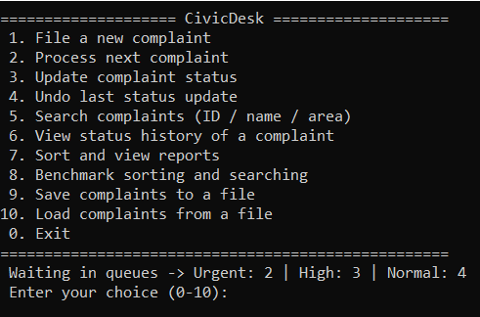
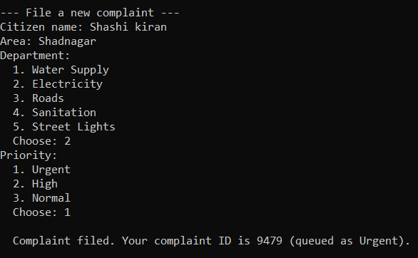
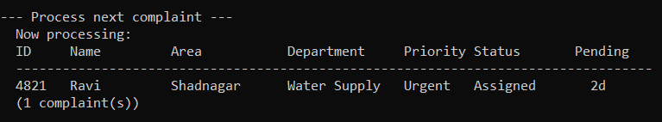
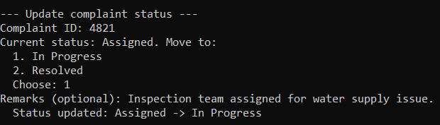
Application screenshots: workflow
DEMONSTRATION
Main menu queue counts always shown
File a complaint ID is generated
Process next Urgent served first
Update status forward steps only
Notes:
Real console output from the C application: the main menu, filing a complaint, processing the next complaint (4821 is Urgent and was filed first) and a status update.

Slide 10
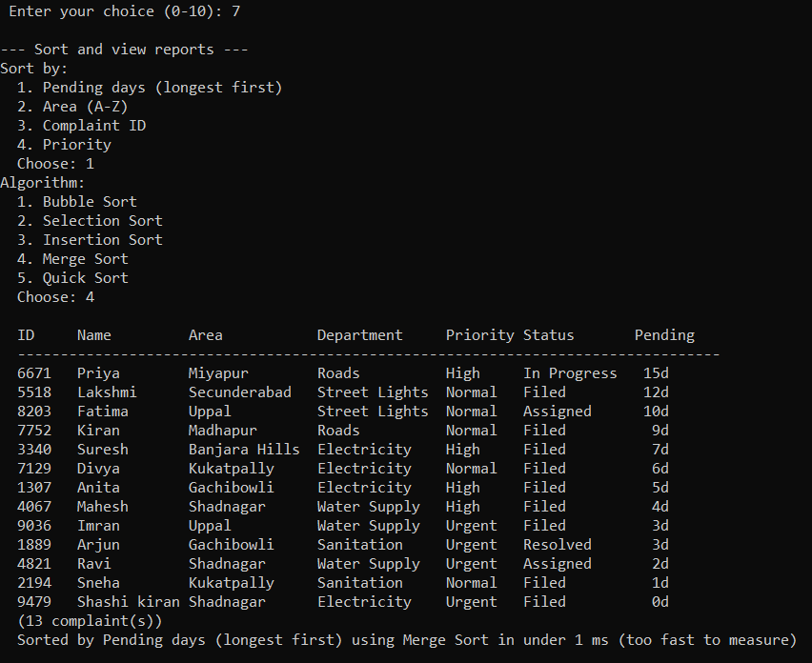
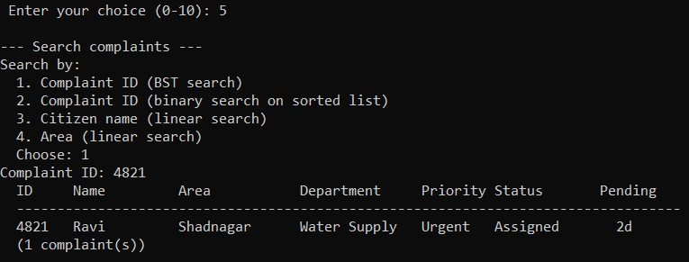
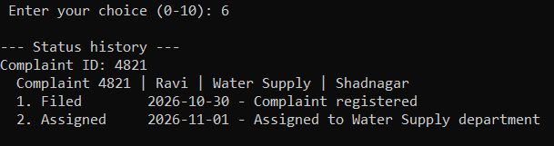
Application screenshots: search and reports
DEMONSTRATION
Search by ID, name or area
Sorted report algorithm and time shown
Status history dated trail
Notes:
Search results, the dated status history of one complaint, and a report sorted with a chosen algorithm, with its running time shown underneath.

Slide 11


Browser companion
WEB DEMO
Same structures in JavaScript
Linked list, queues, stack and BST classes, plus all five sorts.
2
3
4
Under the hood switch
Shows the search and sort pickers, timings and a browser benchmark.
Urgent
High
Normal
Autosave and data file
ID
Name
Area
Status
Saves in the browser; Export and Import use the C program's file format.
Hosted on GitHub Pages
Open it from the link in the repository README.
Schematic of the page layout
Notes:
The page is a JavaScript version of the same logic. The 'Under the hood' switch reveals the algorithm pickers, timings and benchmark. Replace the schematic on the right with a screenshot of the live page if you like.

Slide 12
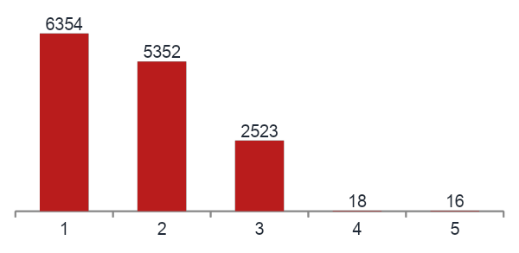
Testing and benchmark results
VERIFICATION
29
Sorting 10,000 complaints (ms)
automated tests
Every sort matches a reference sort on 0, 1, 2, 50 and 400 items
BST and binary search agree on every ID
Urgent, High, Normal order; FIFO inside a level
Undo order; Filed is never removed
Save and load round trip; invalid files rejected without changing data
500 ID lookups in 20,000 complaints: linear 133 ms, binary under 1 ms, BST 1 ms (BST height 35).
Notes:
Benchmark numbers are the measurements recorded in the README, taken from the C application on the author's machine; they vary with hardware and load. Binary search measured below the timer's precision.

Slide 13


Limitations and future work
HONEST SCOPE
Current limitations
Possible next steps
Data is in memory unless saved with option 9
BST is not self-balancing
Only three fixed priority levels
Undo covers status updates only
Fixed-length text fields; console interface
Self-balancing tree (AVL or Red-Black)
Heap-based priority queue
Server and database for shared data
Web or desktop front end
More tests for menu input handling
Notes:
State the limits plainly: this is a classroom demonstration and does not handle real citizen data.

Slide 14
Conclusion
SUMMARY
4
3
5
29
data structures
search methods
sorting algorithms
automated tests
Linked list, queue, stack, BST
Linear, binary, BST
Bubble to quick sort
Structures, algorithms, files
Each data structure is used for the job it suits best.
Repository: github.com/pulegarisashikirran/civicdesk-grievance-system
Live demo: pulegarisashikirran.github.io/civicdesk-grievance-system
Thank you. Questions?
Notes:
Close with the four numbers, then the links. Invite questions.

