Slide 1


Understanding the popularity of different content categories.

Slide 2


Today's agenda
Project recap
Problem
The Analytics team
Process
Insights
Summary

Slide 3

Extraction of sample data sets using SQL
Loading of sample data sets into Accenture sandbox database
Merging of sample dataset tables
Focus on the analysis of sample datasets with visualizations to understand popularity of different content categories.
Creation of an up-to-date big data best practices presentation
Virtual session with Social Buzz team to present previous client success stories relevant to them
Project Recap

Slide 4

Problem
What are the top 5 content categories for 2020 & 2021?

Slide 5



Senior Principal – Marcus Rompton
The Analytics team
Data Scientist – Michelle Grove
Data Analyst – Puleng Tshaba

Slide 6
Process
1
Goal definition
2
Data Extraction & Cleaning
3
Exploratory Data Analysis
4
Data Wranging & Analysis
5
Interpretation and conclusion

Slide 7

Insights
16
1889
January
UNIQUE
CATEGORIES
REACTIONS TO “ANIMAL” CATEGORY
MONTH(S) WITH
MOST POSTS

Slide 8
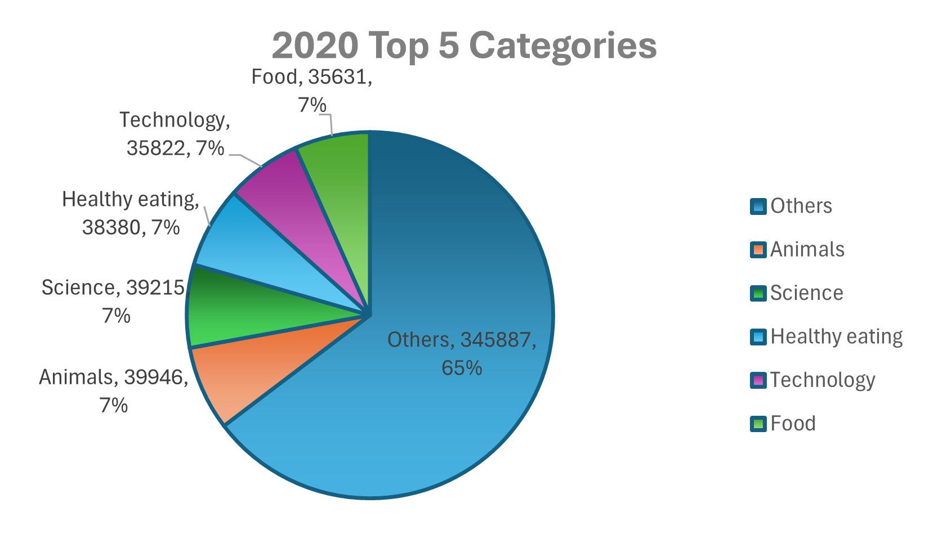
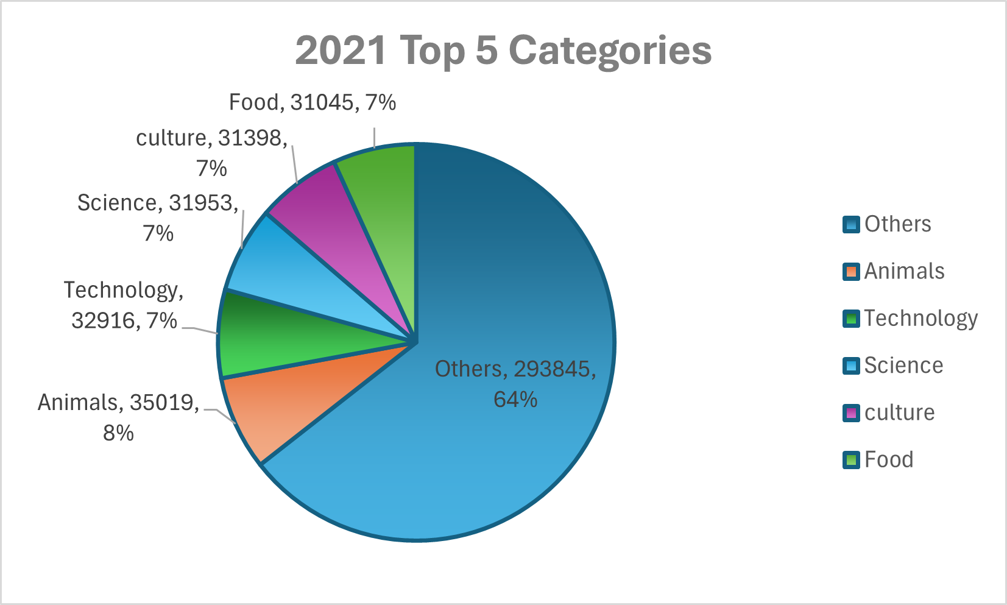
Analysis

Slide 9
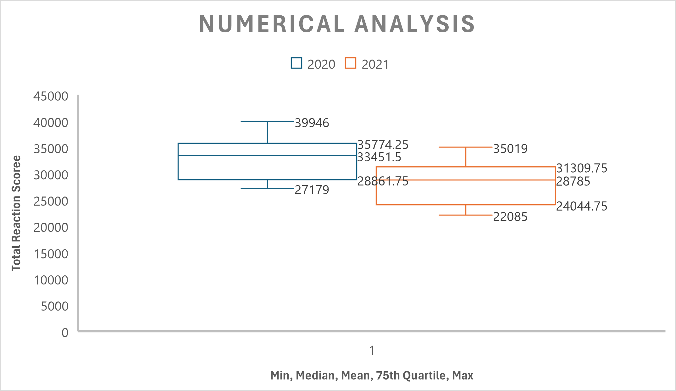

Slide 10
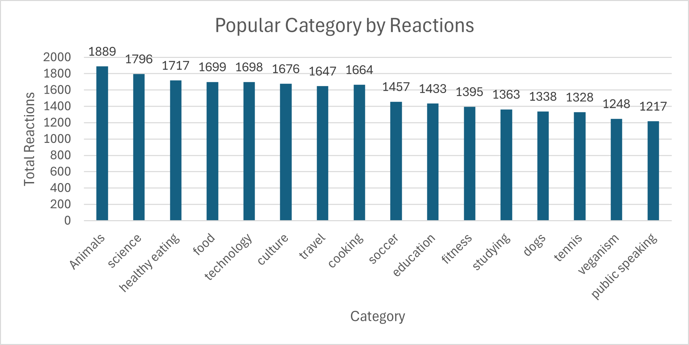

Slide 11

Summary
ANALYSIS
Animals and science are the two most popular categories of content, showing that people enjoy “real-life” and “factual” content the most.
INSIGHTS
Food is a common theme within the top 5 categories with healthy eating ranking the highest. This may give indication to the audience within your user base. You could use this insight to create a campaign and work with healthy eating brands to boost user engagement.
NEXT STEPS
This ad-hoc analysis is insightful, but it’s time to take this analysis into large scale production for real-time understanding of your business. We can show you how to do this.

Slide 12
Thank you!
ANY QUESTIONS?

