Slide 1
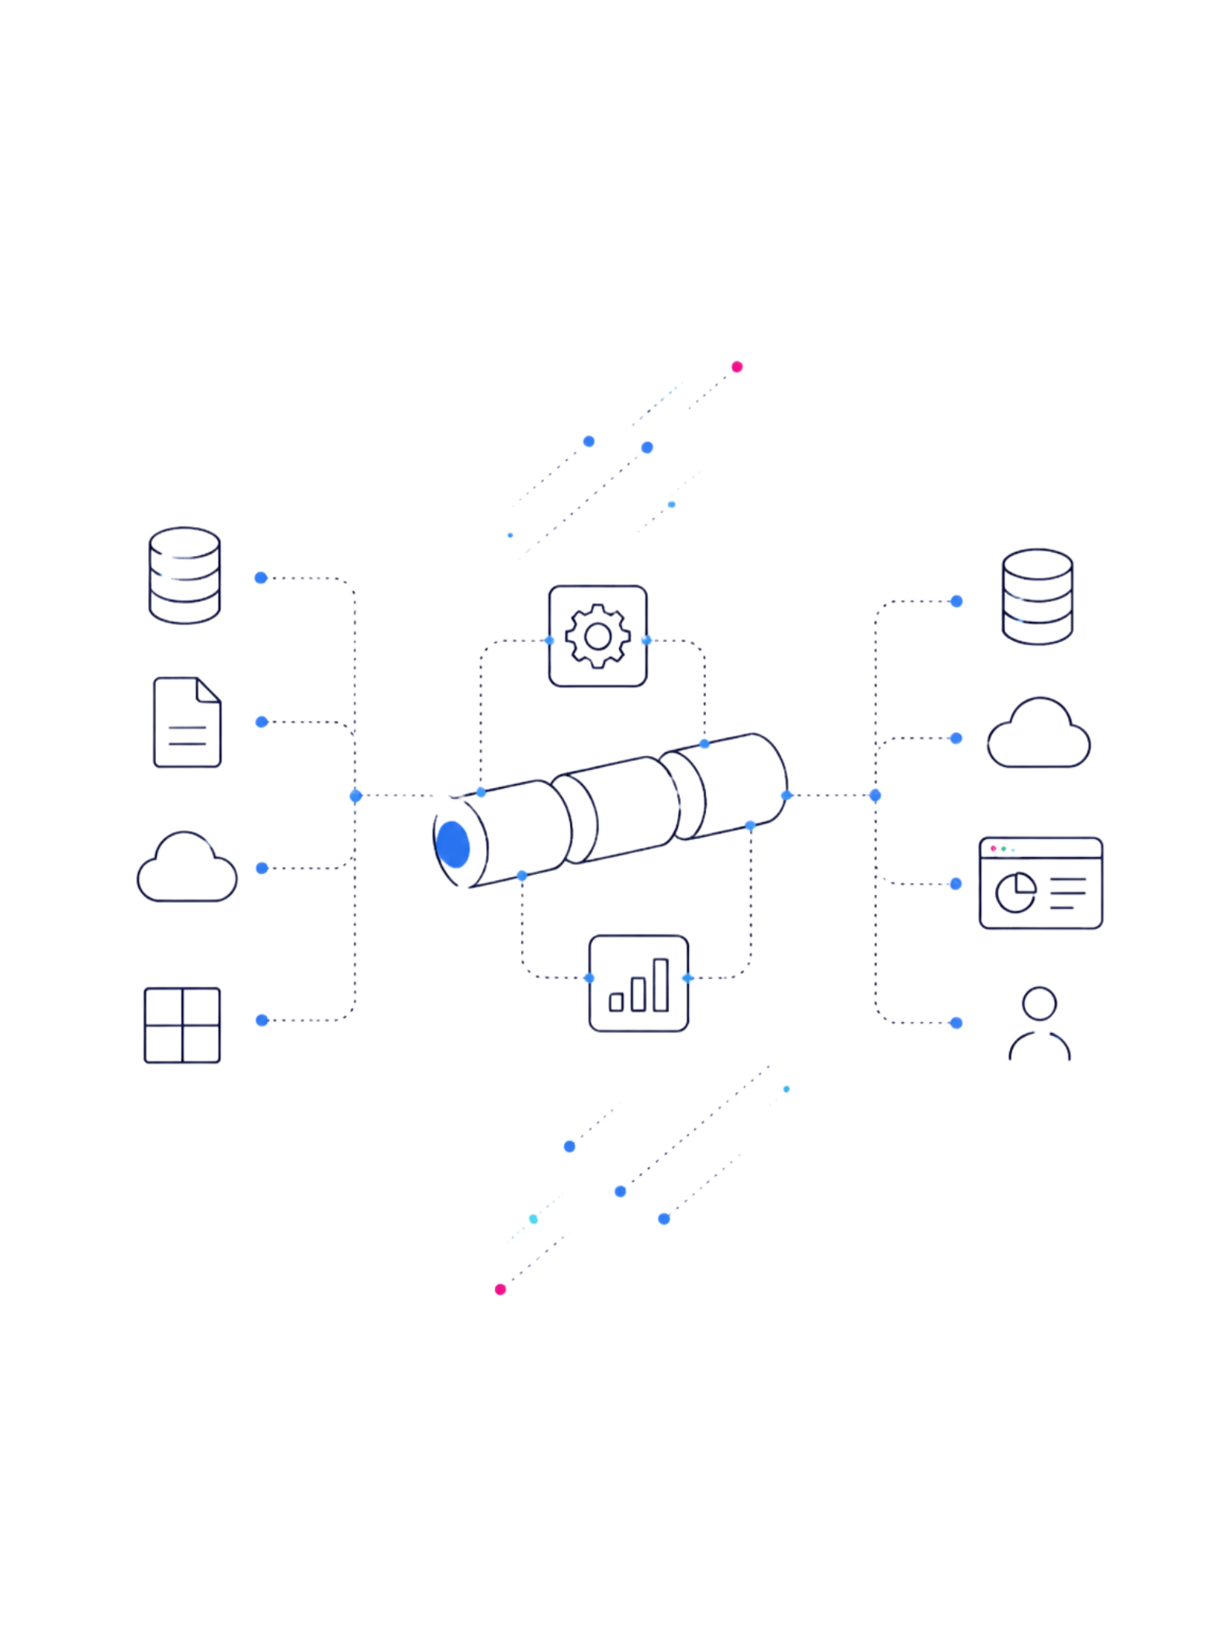
END-TO-END DATA ANALYSIS PROJECT
Brazilian E-Commerce Sales Analysis
A complete Data Analysis pipeline — from raw transactional data to actionable business insights — built with Python, SQL, and Power BI.

Slide 2
Business Problem & Objectives
The Challenge
Key Business Questions
E-commerce data is fragmented across multiple sources — orders, payments, logistics, and reviews — making it difficult to derive unified, actionable insights for stakeholders.
What drives revenue and order volume?
Which sellers and products perform best?
How do delivery delays impact reviews?
Where are customers concentrated geographically?
Can freight costs be optimized?
Decision-Making
Logistics
Data-driven strategy
Optimize delivery
Profitability
Satisfaction
Identify top products
Improve CX

Slide 3
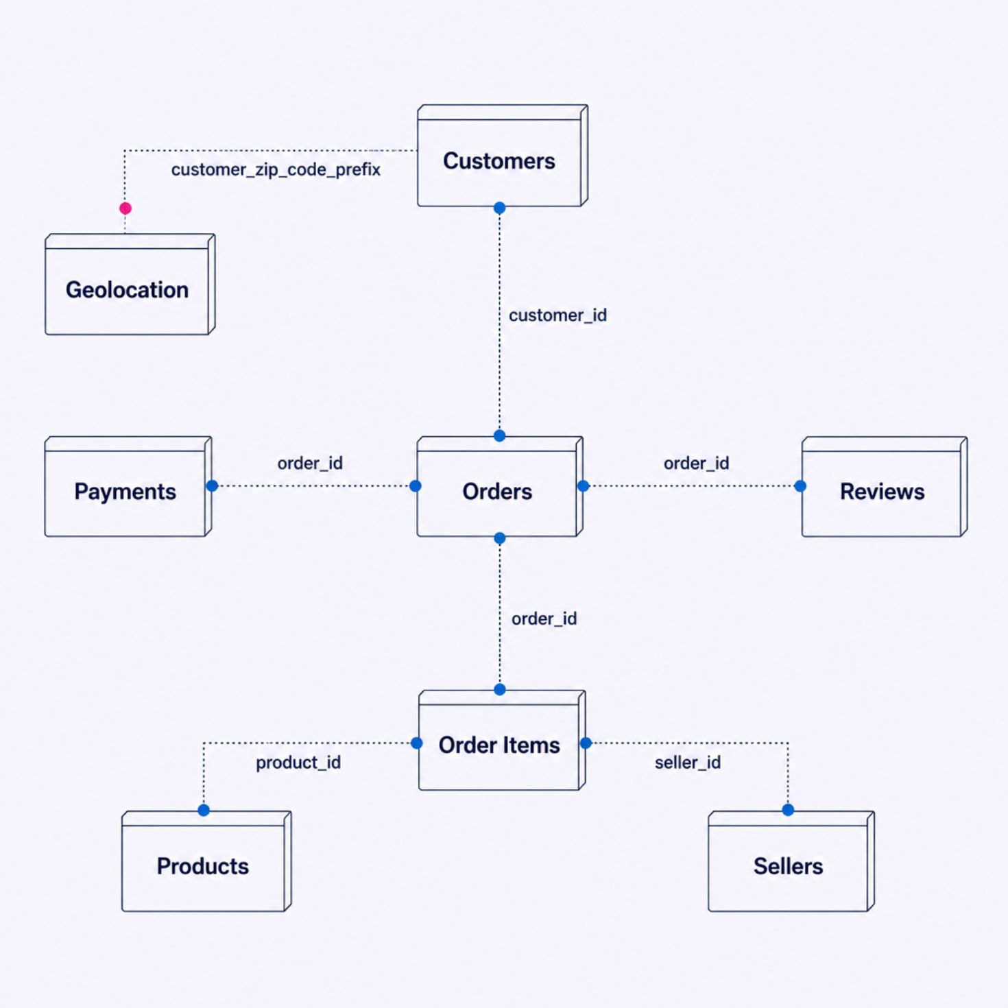
Dataset & Data Model
The Olist dataset comprises 8 relational tables capturing the full e-commerce lifecycle — from customer registration to order delivery and review.
Customers — demographics & location
Orders — timestamps & status
Order Items — products, prices & freight
Products — categories & attributes
Sellers — location & performance
Payments — methods & installments
Reviews — scores & comments
Geolocation — zip codes & coordinates

Slide 4




Python Data Processing
Load CSV
Profile & Clean
Transform & Enrich
Export to PostgreSQL
Python serves as the ETL engine — profiling raw CSV files, resolving data quality issues, and structuring a clean analytical dataset ready for database ingestion.
Pandas & NumPy
Matplotlib & Seaborn
SQLAlchemy
Data manipulation, aggregation, and numerical computation
Exploratory visualizations during preprocessing
ORM-based connection and bulk loading into PostgreSQL

Slide 5
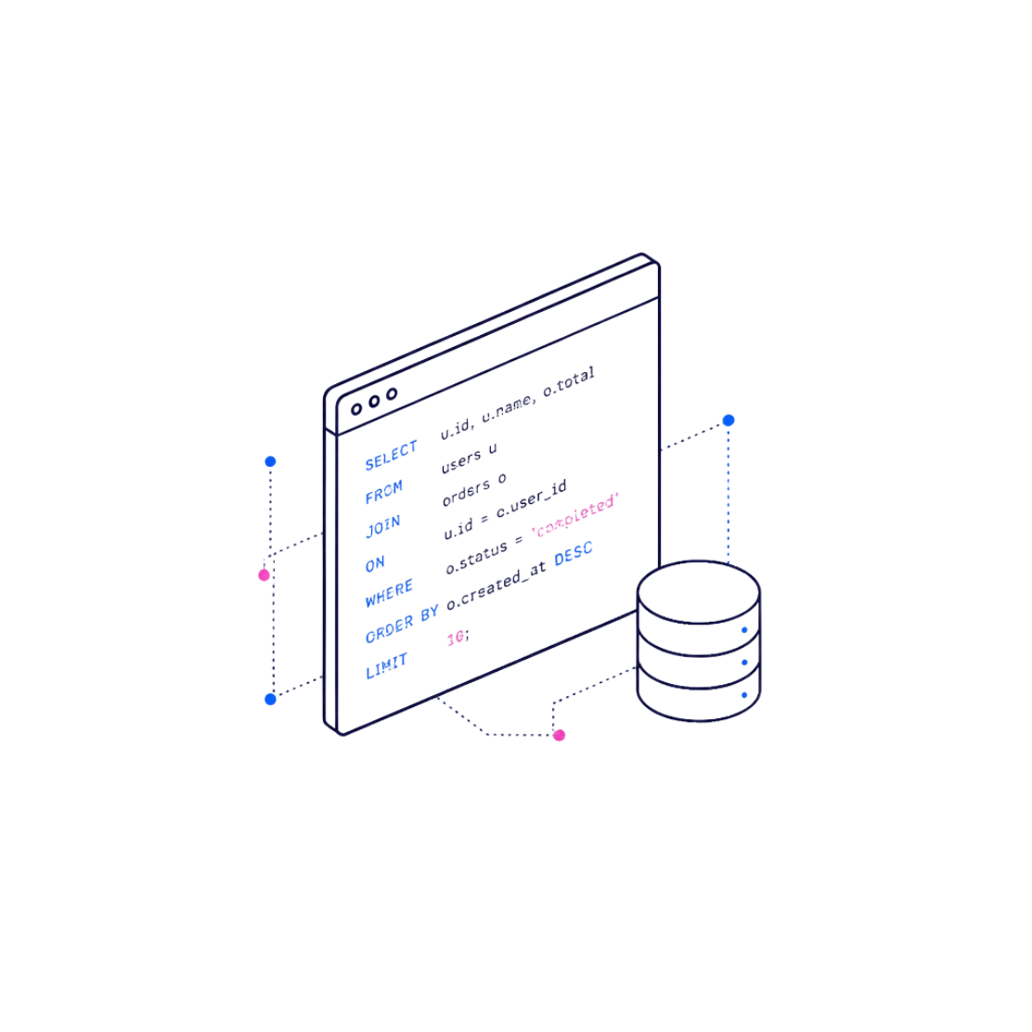



Database & SQL Analytics
PostgreSQL as the Analytical Layer
Cleaned data is loaded into a normalized PostgreSQL schema, enabling complex queries that directly answer business questions.
JOINs
GROUP BY & Aggregates
CASE Statements
Date Functions
Link orders, items, sellers, and customers
Delivery delay classification
Monthly trends & seasonality
Revenue, order counts, AOV

Slide 6
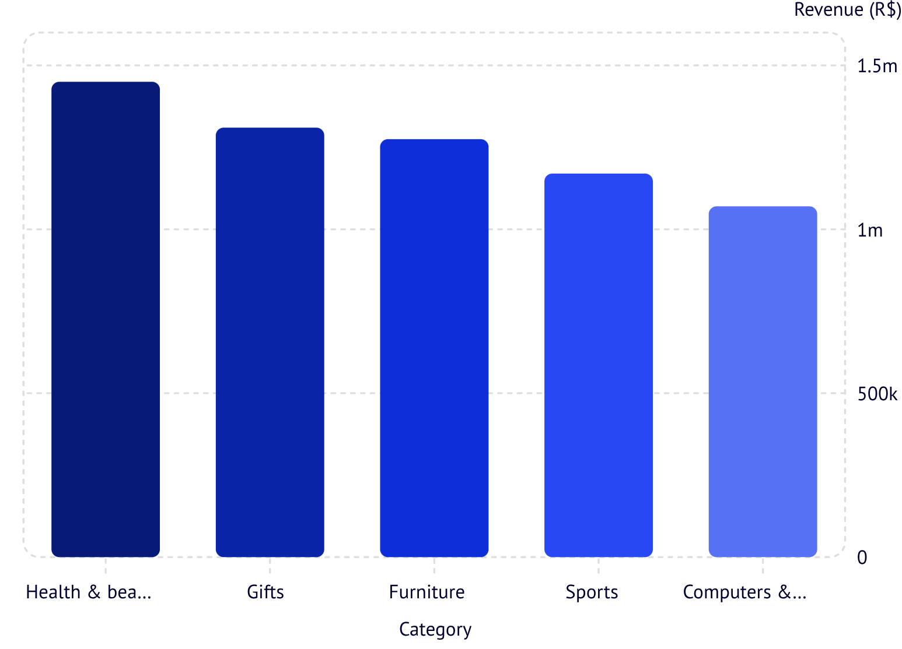
Exploratory Data Analysis
EDA reveals business patterns before dashboard development — surfacing revenue trends, category performance, delivery issues, and regional demand.
Key EDA Findings
Health beauty leads revenue; Gifts leads order volume
SE region accounts for ~60% of all orders
Average delivery delay: 2–3 days beyond estimate
Freight costs represent 12% of order value on average
Review scores correlate strongly with on-time delivery

Slide 7
Power BI Dashboard
An interactive, filter-driven dashboard consolidates all KPIs into a single view for executive and operational stakeholders.
R$16M
112.65K
Total Revenue
Total Orders
Across all orders
In the dataset
R$120
96K
Avg Order Value
Customers
Per transaction
Unique buyers
3K
4.3★
Sellers
Avg Review Score
Active merchants
Out of 5 stars

Slide 8
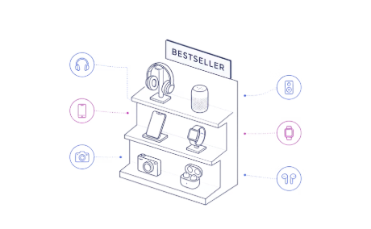

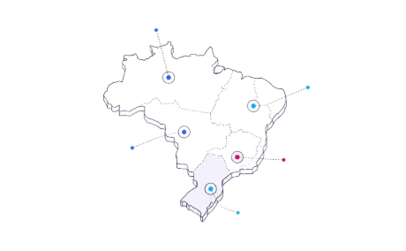
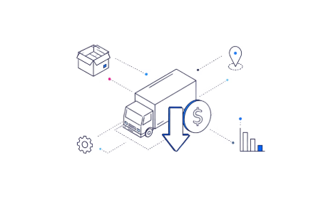
Business Insights & Recommendations
Focus on Electronics & Home
Fix Delivery Delays
Expand in South & Central-West
Optimize Freight Costs
Delayed orders average 0.8 stars lower reviews. Invest in last-mile logistics for SE region.
Negotiate carrier rates for high-volume routes; freight savings could improve margins by 5–8%.
These two categories drive over 50% of revenue — prioritize inventory and seller partnerships here.
These regions show high satisfaction and low competition — ideal for targeted marketing.

Slide 9










Challenges & Skills Gained
Challenges Overcome
Skills Demonstrated
Missing & Inconsistent Data
Complex Table Relationships
Null handling, outlier detection, and standardization across 8 tables
Multi-key JOINs across Orders, Items, Payments, and Reviews
Python
PostgreSQL
SQL Query Optimization
KPI Design
SQL
Power BI
Translating business questions into measurable, dashboard-ready metrics
CTEs and window functions for efficient aggregation on 100K+ rows
EDA
Data Cleaning

Slide 10

Conclusion: From Raw Data to Business Decisions
Raw CSV Data
PostgreSQL Store
Python ETL
This project demonstrates a complete, production-ready BI workflow — integrating data engineering, analytical SQL, and visual storytelling to drive measurable business impact for Brazilian e-commerce.
Data Engineering
Analytics
Python + PostgreSQL pipeline
SQL-driven business questions
Visualization
Business Impact
Interactive Power BI dashboards
Actionable, data-backed decisions

