Slide 1
Introduction to Metadata Power Tools
for the
Curious Beginner
Maureen Callahan, Yale University
Regine Heberlein, Princeton University
Dallas Pillen, University of Michigan
Cleveland, August 20, 2015

Slide 2
Maureen Callahan
Introduction

Slide 3
Preaching the gospel of power tools - why we use these, how they should be approached, how they ultimately result in a better researcher experience
  Why we use these
    So much messy data, so little time
      Getting strategically lazy

Slide 4
Dallas Pillen
Basic Principles of Working with Power Tools

Slide 5
Create a Sandbox Environment
Backups
Make it truly not matter if something goes wrong
It’s okay to break things -- you will learn in the process

Slide 6
Think Algorithmically
Think of archival data as data
Envision success
  What does the data look like now?
  What should it look like when you’re finished?
Break a big problem down into smaller steps
  Write out the steps in natural language

Slide 7
Choosing a Tool
A lot of metadata clean-up can be accomplished with a variety of tools
Often, there is no ‘best’ tool for the job
The best tools are the ones that work for your particular issue and existing skill set
  What is your issue?
  What tools do you already know?
  How can you apply those tools to the issue?
  If necessary, what tools do you need to learn?

Slide 8
Document...
Successes
Failures
Procedures
If you tried Googling something and couldn’t find an answer, that means there is a documentation gap. Fill it!

Slide 9
Regine Heberlein
The Gospel of Metadata

Slide 10
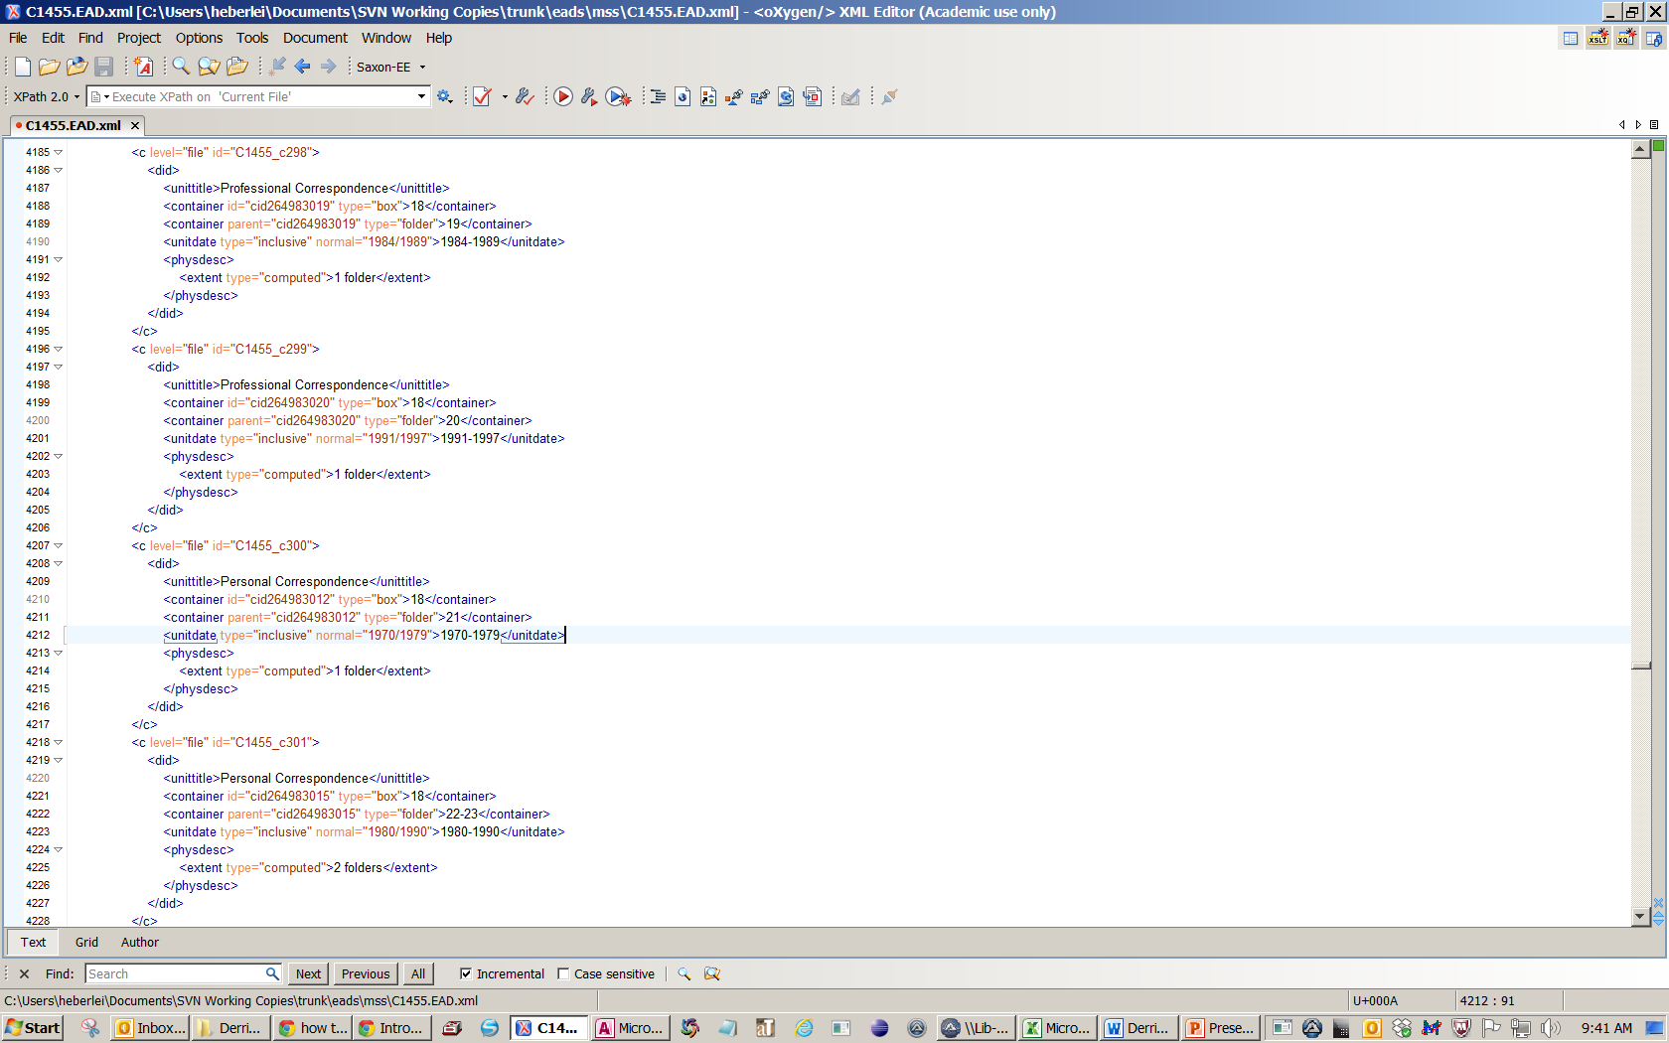
Know Thine Data Like Thyself
uncontrolled value
siblings
string
AT-generated
Notes:
Yo, better—let’s face it, we’re all hypocrites sometimes. You can’t be a hypocrite when it comes to data processing—you’ll be found out.
For XML data: know the schema. Know the local business practices.
In my example, we’re going to mess with the container elements. We’ll move descriptive information about the containers to a dsc[2] and insert pointers from the dsc[1]. Some things to know here:
Element values are strings. They could be extremely stringy, in some cases alphanumeric. Query first, possible cleanup.
Type attribute values are not tightly controlled. Could be upper or lower case. Could be “postcard” or “roll” or “scroll”. Query, possible cleanup/normalization.
Attributes id and parent are AT-generated. Could be there, could not be. We’re going to use both, and they don’t repeat, so need to account for possible presence or absence.
Boxes and folders are siblings, and order is not enforced, so you need to distinguish by type attribute. (It gets messier: they repeat infinitely.)

Slide 11
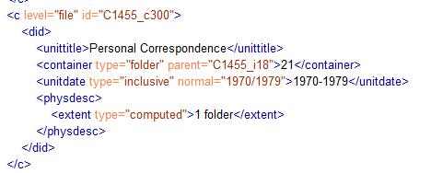
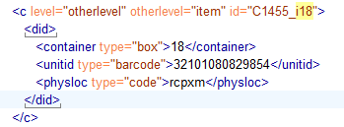
2. Know Your Heart’s Desire
Notes:
What do you want the output to be like? Make sure to follow standards, not just your heart’s desire. Here, pointer for folder inserted to box description in dsc[2].

Slide 12
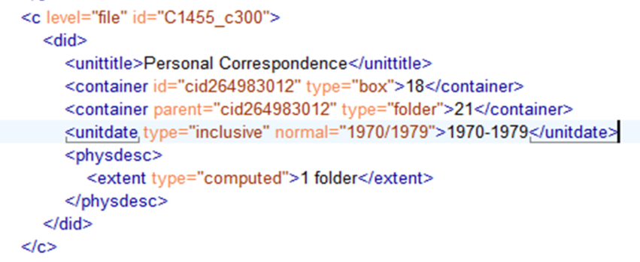
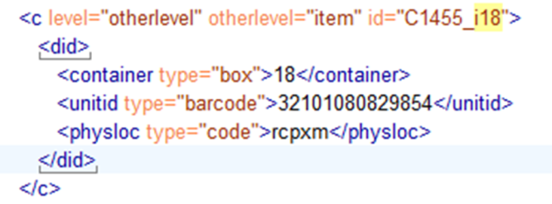

3. Focus on the Logic, Not the Tools
B
A
Hmmm…
https://www.flickr.com/photos/stevenfettig/1390275600
Notes:
How do you get from point A to point B? That’s more than half the battle. The rest is just implementation.

Slide 13


4. Choose the Path of Least Resistance
XSLT?
XQuery?
OpenRefine?
Find/Replace?
Ha!
Just what I need!
Image: http://www.corporate-eye.com/main/a-macys-mystery-continued/
Notes:
…sort of. Think strategically. What can you learn quickly? For what do you have institutional support, in terms of software, a knowledgeable colleague, good documentation? What will work on your machine (permissions, software, memory, processor etc.)

Slide 14

5. Think About the Future
Is learning this tool an investment?
Is writing this tool an investment?
Can the tool be used again?
Does the situation call for a quick, one-off solution or a slower yet permanent tool?
What is the impact on staff skills?
How about other workplace consequences?
Image: http://www.basf-new-business.com/
Notes:
Would it make more sense to do a non-permanent find/replace? Faster, but can’t be re-used?

Slide 15
6. Think Like a Machine
XML Input A
XQuery Update 1
XQuery Update 2
XQuery Update 3
XQuery Update 4
XML Output B
Notes:
We got from A to B. How about getting from A to F?

Slide 16
6. Think Like a Machine
XML Output B = XML Input C
XML Input A
XQuery Update 1
XQuery Update 2
XQuery Update 3
XQuery Update 4
XSLT
XML Output B
XML Output D
Notes:
Break it down. Think about intermittent steps. Think about what output becomes input to what operation. Think about which tasks must run sequentially, which can run concurrently. Think about what your processor wants to do by default (e.g. I found out that batch files, even though they’re read line by line, execute commands concurrently).

Slide 17
6. Think Like a Machine
XML Output B = XML Input B
XML Output D = XML Input E
XML Input A
XQuery Update 1
XQuery Update 2
XQuery Update 3
XQuery Update 4
XSLT
FOP
XML Output B
XML Output D
PDF Output F
Wait… Six operations? Are you kidding me??
Notes:
Ok, butwhat if getting from A to F means running who knows how many transformations...

Slide 18
7. If a Machine Can Do It...
BATCH
Output:
Edited XML
Input:
File Locations
(to each tool)
BATCH
PDF labels
XQuery Update 1
XQuery Update 2
XQuery Update 3
XQuery Update 4
XSLT
FOP
Wait… Declare in 6 places? ARE YOU KIDDING ME??!
Notes:
Get lazy. Rather than running 6 (or however many) operations manually, write a pipeline.

Slide 19
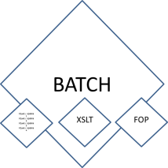
…Let It.
AutoIt
Output:
Edited XML
Input:
File Locations (once only, for 2 input files)
PDF labels
Re-set tools
AAAHH, that’s better.
Notes:
So now I wrote a macro that takes my input EAD and input DB output, changes the files names in all the tools, runs the tools, and then resets the filenames for next time.
Why AutoIt? No idea! It was easy to learn. Most likely, this could have been done in batch. By somebody else, not me!

Slide 20
8. Thou Shalt Steal
don’t reinvent the wheel
learn from others
search the forums
don’t be afraid to ask for help
do credit others’ creative/extensive work
Notes:
forums: e.g. stackoverflow. use judgment for beginners’ questions etc (don’t ask them on saxonica)
don’t be afraid to ask for help (even if Michael Kay or whoever chews your head off)
if someone writes a function for you, credit them in a comment.

Slide 21

9. Dare to Make Mistakes
that is, as long as you know how to undo / revert / roll back!
view mistakes as an opportunity
mistakes can teach you as much about your data as about your tool
share your mistakes so others may benefit
realize that everybody makes them
Image: http://lifehacker.com/5863490/how-to-learn-from-your-mistakes
Notes:
e.g. assumptions about your data
learn from your mistakes: the workarounds, ugly hacks
hop on stackoverflow (or somewhere) to ask and share

Slide 22
Maureen Callahan
THINGS THAT MIGHT KEEP YOU
FROM GETTING STARTED

Slide 23
Demonstrations of setting up your environment and using the proper safety equipment
  If you don’t have admin access…
    Setting up a virtual environment
    Making the argument that, really, you should have admin access

Slide 24
Maureen Callahan
Regine Heberlein
Dallas Pillen
Playing It Safe

Slide 25
Maureen Callahan
Using a Local Instance of a Database

Slide 26
      Local instance of database, e.g. AT or ASpace

Slide 27
Regine Heberlein
Using a Local Versioning System

Slide 28
https://drive.google.com/open?id=0B7vNlf4EPQFeVzFNUFZSbDNDdTA
Notes:
Local working copies
No workflow functionality
However, rollback
History: know who edited what when
Merge conflicting versions (though not nearly as smooth as git)
Know when a file needs to be pushed out
Merge incoming files

Slide 29
Dallas Pillen
Using Distributed Version Control

Slide 30
GitHub
Distributed version control system
Multiple people can work on the same project
  Does not totally remove the opportunity for conflicts, but provides a way to identify and resolve them
Detailed record of what changes were made
Ability to revert back to a previous state

Slide 31
GitHub at the Bentley Historical Library
http://archival-integration.blogspot.com/2015/07/git-flow-for-archival-workflows.html
GitHub is used for version controlling our legacy EAD clean-up project
Four people working on the project in different ways
  Manual clean up
  Automated clean up
GitHub gives us the ability to work on our own fork of the Bentley’s main repository
  Changes are made to individual forks
  Changes are then pushed to the main repository where they can be reviewed and merged
Conflicts still happen -- sometimes two people happen to modify the same file in different ways and submit conflicting pull requests to the Bentley’s main repository
  GitHub helps us identify and resolve these issues

Slide 32
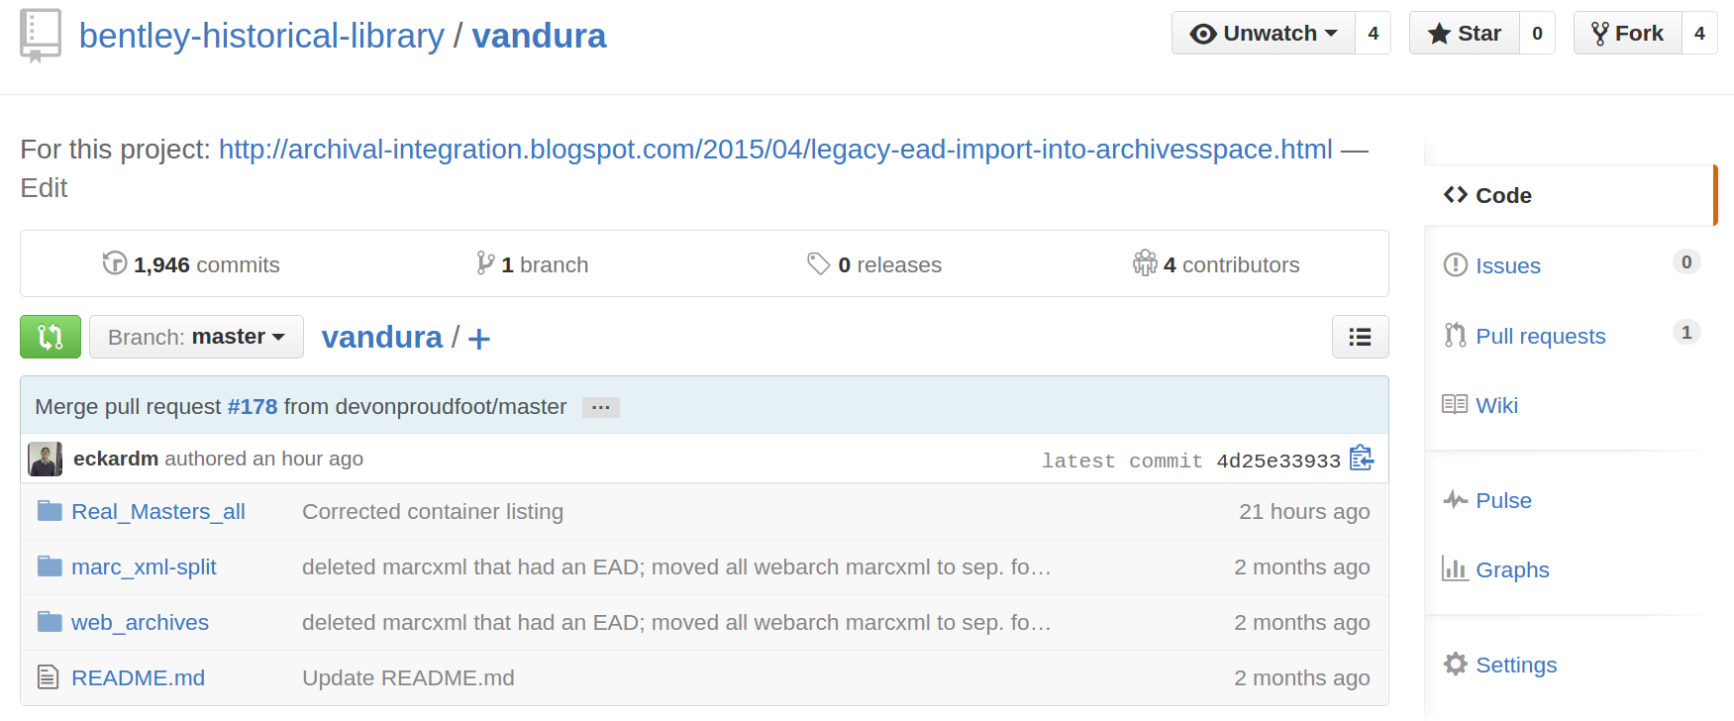

Slide 33
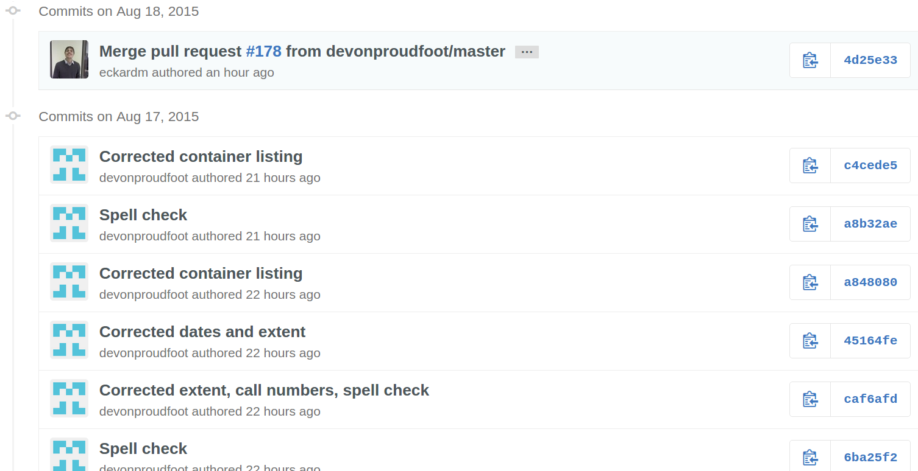
Commits

Slide 34
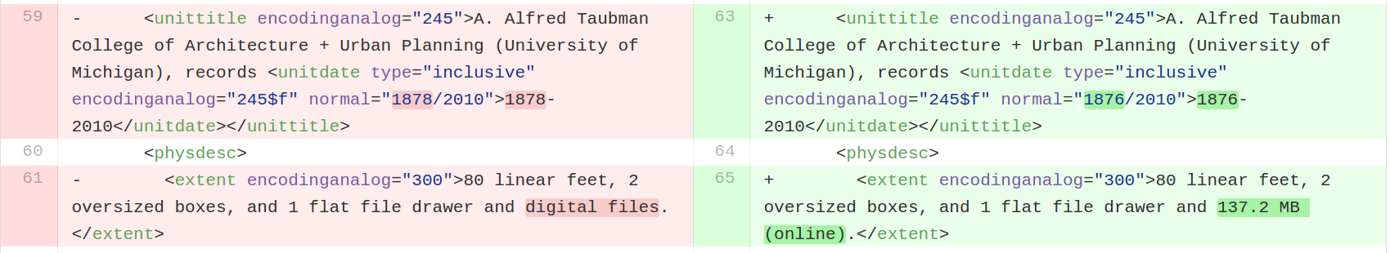
Compare Changes

Slide 35
Maureen Callahan
Regine Heberlein
Dallas Pillen
Demos

Slide 36
Maureen Callahan
Database Querying

Slide 37
Regine Heberlein
XML Transformations

Slide 38
https://drive.google.com/open?id=0B7vNlf4EPQFebEpRUy1xYXBxd28

Slide 39
Dallas Pillen
Python and Open Refine

Slide 40
The Problem
<unitdate> tags without normal attributes
  <unitdate>August 20, 2015</unitdate>
Dates are only human-, not machine-, readable
  Many different forms of dates
    Month DD, YYYY
    MM/DD/YYYY
    YYYY Month DD
    etc., etc.
Normal attributes allow for the inclusion of a machine-readable form of a date
  Standardized form for dates: YYYY-MM-DD
  <unitdate normal=”2015-08-20”>August 20, 2015</unitdate>

Slide 41
The Solution
Identify the scope of the problem
Find a way to normalize a large portion of the dates programmatically
For the remaining non-normalized dates…
  Extract <unitdate> text with Python
  Normalize the dates in OpenRefine
  Insert normal attributes using Python

Slide 42
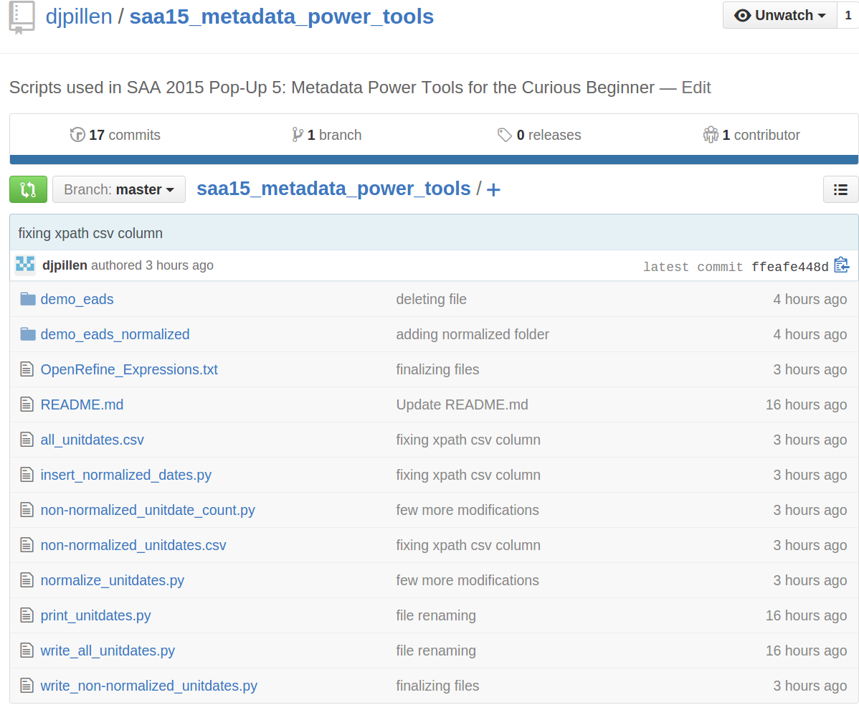
https://github.com/djpillen/saa15_metadata_power_tools

Slide 43
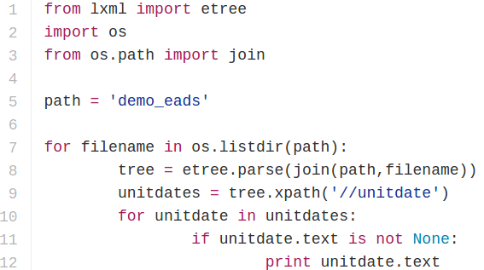
print_unitdates.py - script
Test your xpaths, loops, and other bits of logic

Slide 44
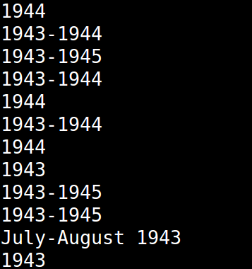
print_unitdates.py - output

Slide 45
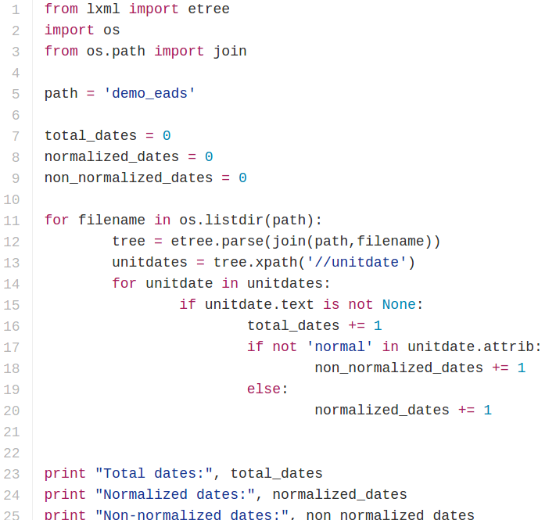
non-normalized_unitdate_count.py - script

Slide 46

non-normalized_unitdate_count.py - output
Get a sense of the scope of the problem

Slide 47
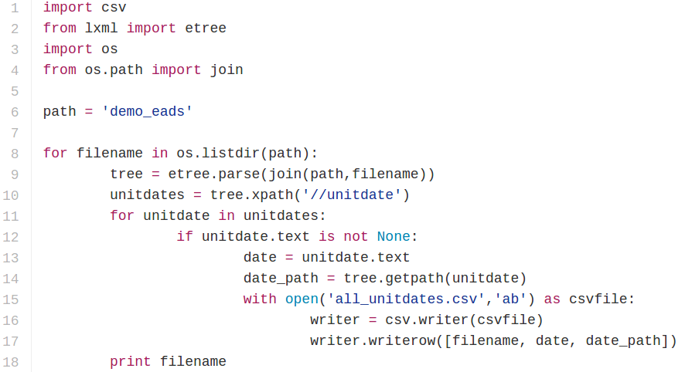
write_all_unitdates.py - script
Output text from EADs to a slightly more readable format

Slide 48
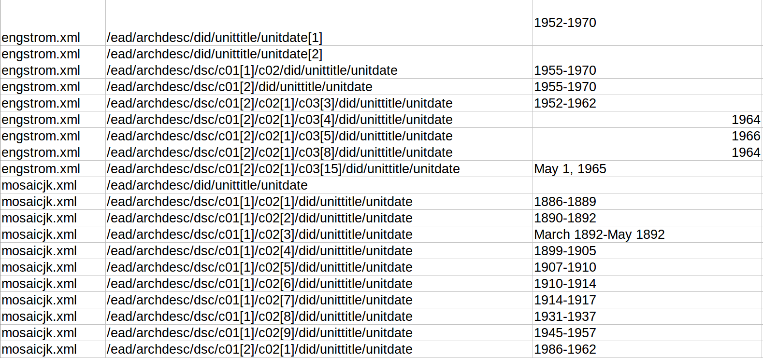
write_all_unitdates.py - output

Slide 49

normalize_unitdates.py
https://github.com/djpillen/saa15_metadata_power_tools/blob/master/normalize_unitdates.py
Adds normal attribute for all <unitdate> elements that contain either a year or a range of years
Normalized about 75% of our unitdates

Slide 50
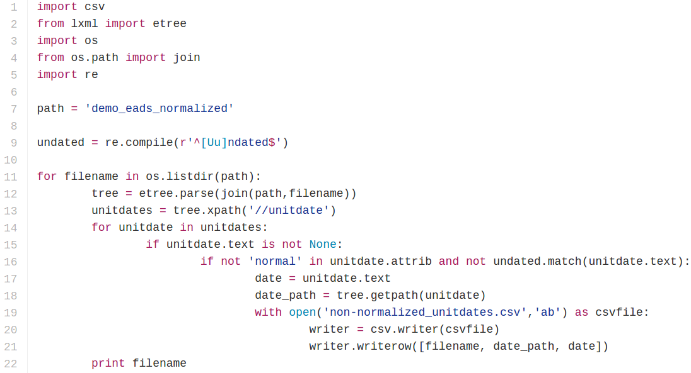
write_non-normalized_unitdates.py - script
Export all non-normalized dates to a csv for manipulation in OpenRefine

Slide 51
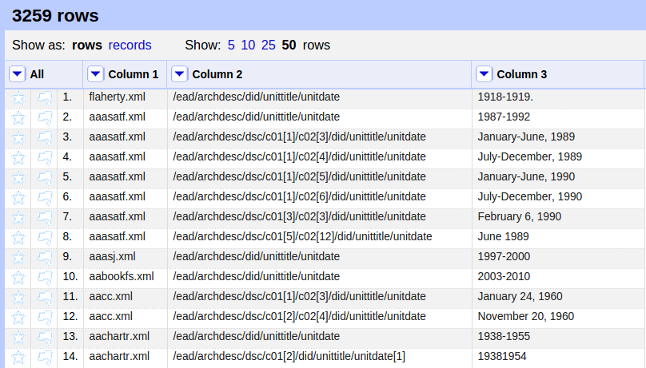
OpenRefine
http://openrefine.org/
Powerful tool for working with messy data -- especially spreadsheets

Slide 52
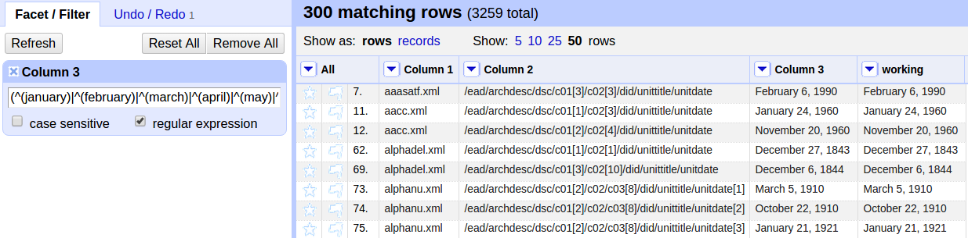
OpenRefine
The GREL (Google Refine Expression Language) text for all of the OpenRefine operations demonstrated in this session can be found here
Step 1: Isolate all dates of the form “Month DD, YYYY”

Slide 53
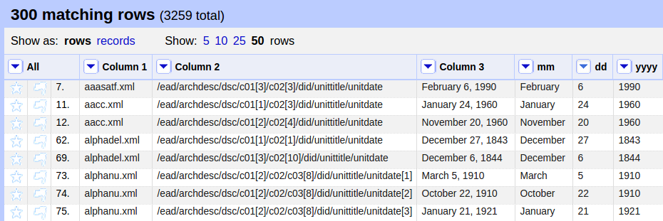
OpenRefine
Step 2: Remove all commas
Step 3: Split into several columns on spaces
Step 4: Rename resulting columns “mm,” “dd,” “yyyy”

Slide 54
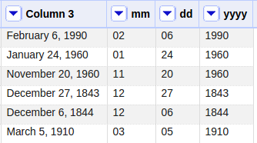
OpenRefine
Step 5: Replace spelled out months with numeric counterparts
Step 6: Add leading 0s to single digit days

Slide 55
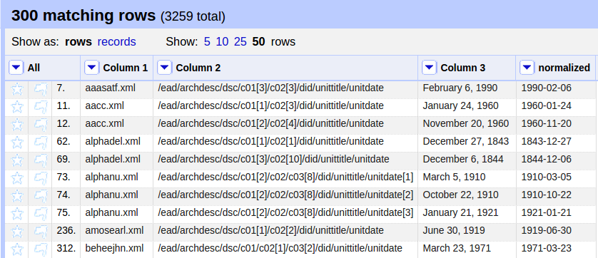
OpenRefine
Step 7: Join columns in the proper order -- YYYY-MM-DD
Step 8: Delete working “mm,” “dd,” and “yyyy” columns
Step 9: Export the normalized dates as a csv

Slide 56
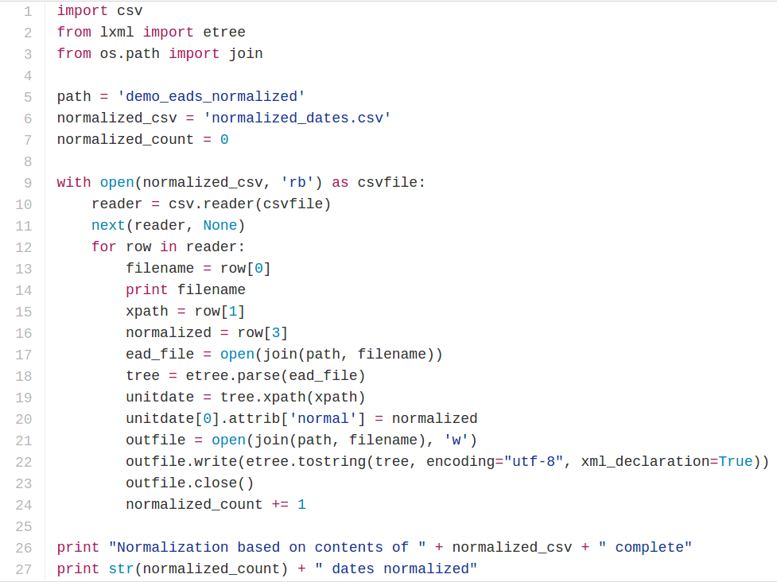
insert_normalized_dates.py - script

Slide 57
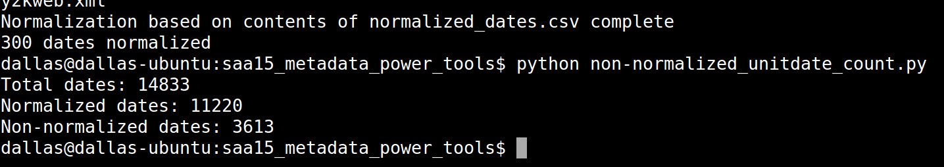
insert_normalized_dates.py - output
Add normal attributes for dates normalized in OpenRefine

Slide 58
Next Steps
Generate a new csv of non-normalized dates
Identify a new subset of dates to normalize in OpenRefine
Continue to chip away at the problem in small, manageable steps

