Slide 1
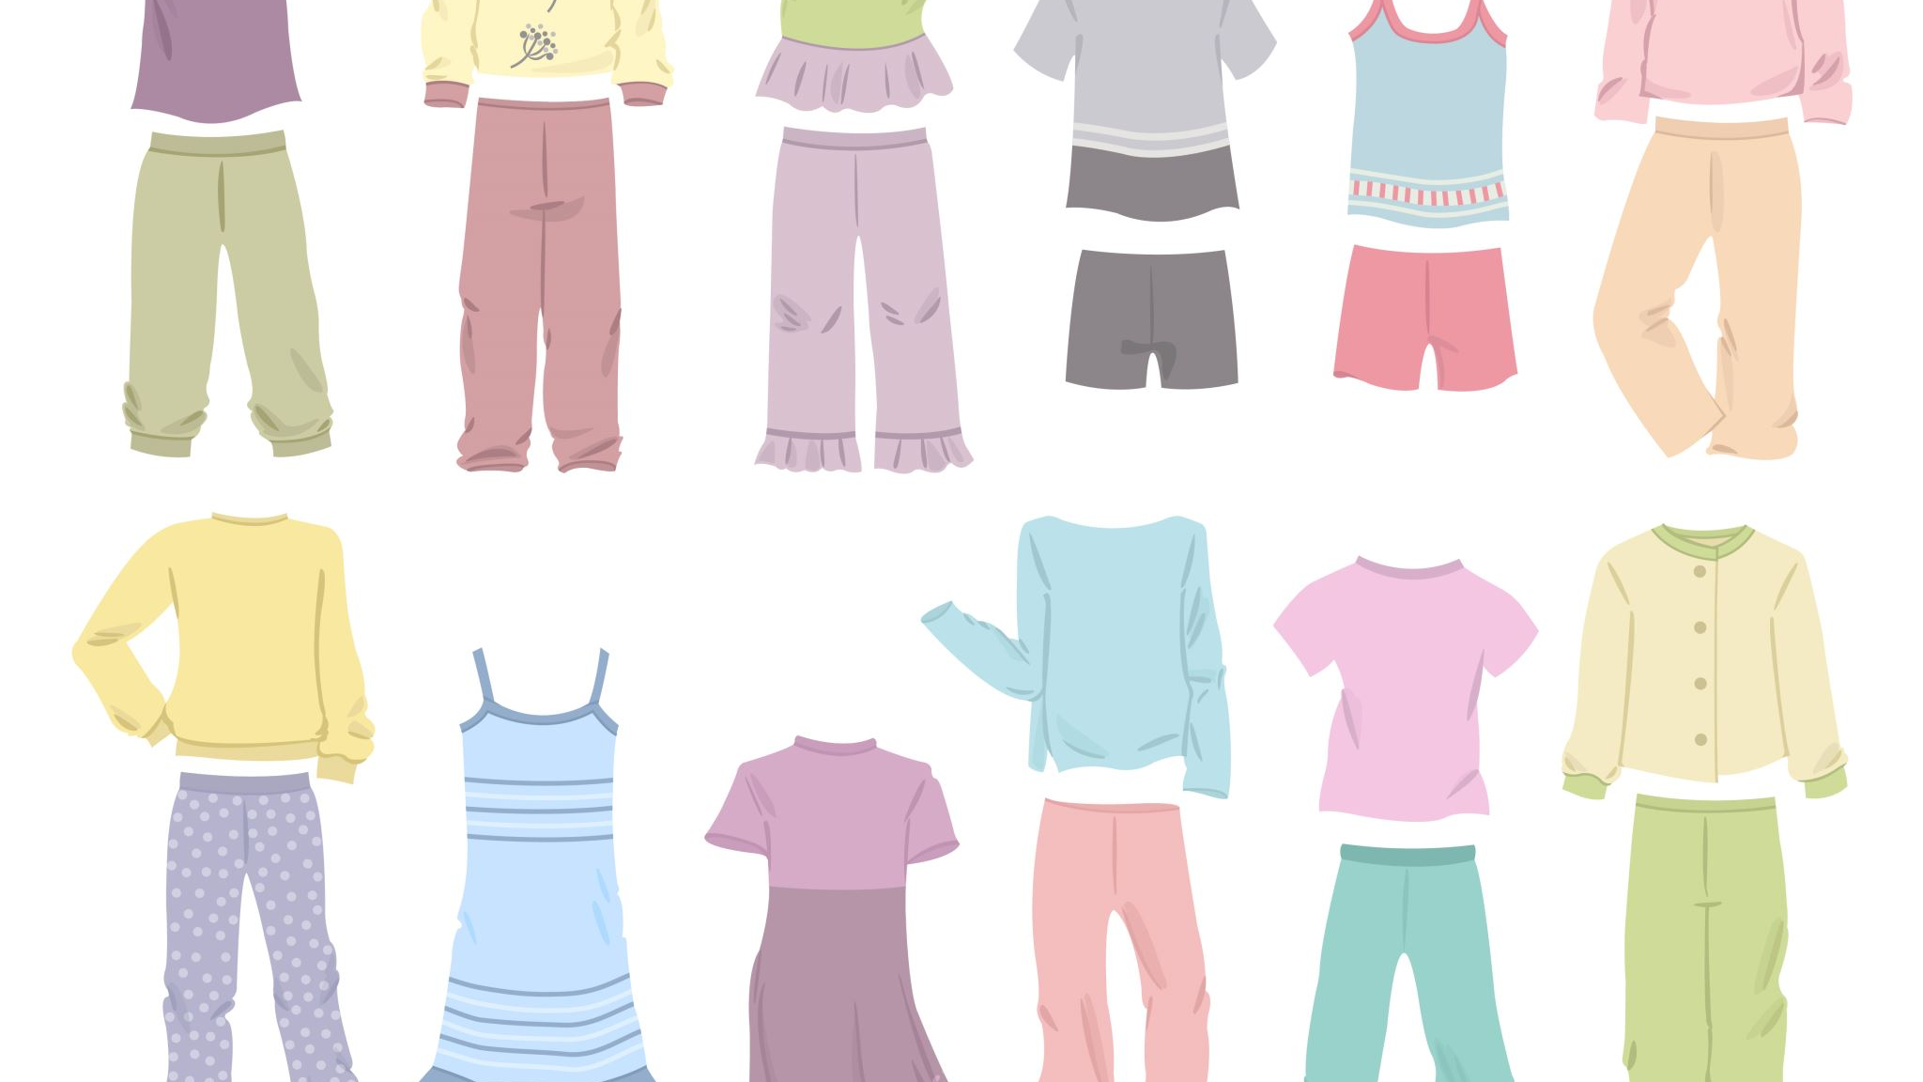
FASHION IMAGES CLASSIFICATION USING DEEP LEARNING AND TRANSFER LEARNING MODEL
Under the Guidance of:
Mrs. E. Pragnavi
Assistant Professor
Prsented by:
P Saiteja (1005-23-742-116)
CSE

Slide 2
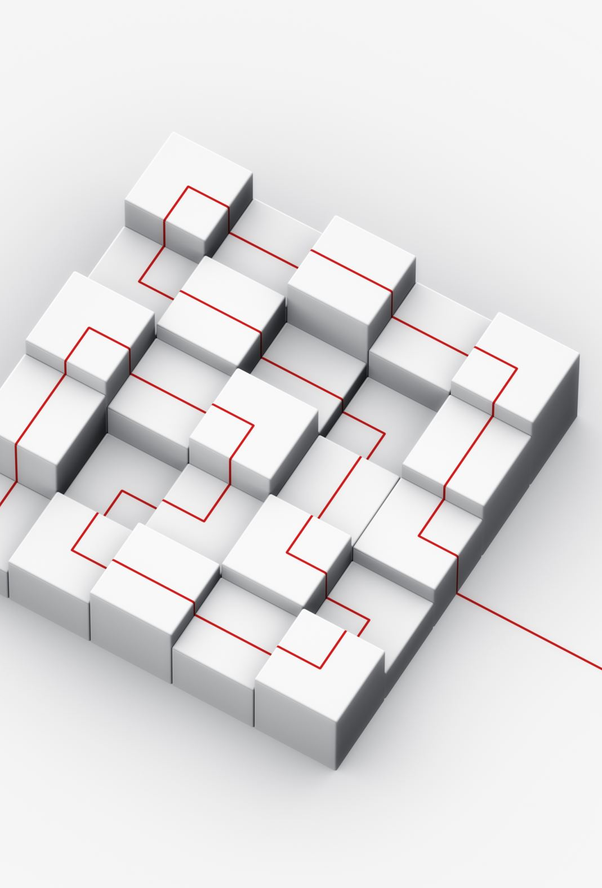
Table of Contents
Abstract
Introduction
System Requirements
Dataset
Existing and Proposed System
System Architecture
Model Training and Evaluation
Confusion Matrix Analysis
Conclusion
References

Slide 3
Abstract
Fashion classification via computer vision presents challenges due to the intricate nature of clothing items. This study investigates the use of Convolutional Neural Networks (CNN) and transfer learning to enhance clothing image classification accuracy using the Fashion MNIST dataset. We employed a CNN model and a transfer learning approach with MobileNetV2, utilizing Google Colaboratory and TensorFlow/Keras for training and evaluation. The CNN model achieved a test accuracy of 90.21% with a loss of 0.3048, demonstrating strong classification performance. Transfer learning with MobileNetV2 improved accuracy to 90.31% with a loss of 0.2887, highlighting the advantage of pre-trained models. These results show that while CNNs are effective, transfer learning can offer incremental improvements, emphasizing its value in refining model performance for fashion image classification and beyond.

Slide 4
Introduction
With the surge in image content online, advanced image analysis tools are essential as visual data increasingly replaces text. Significant progress in image recognition has been driven by deep learning advancements, which are particularly impactful in the fashion industry. Accurate classification of fashion items is crucial for improving online shopping experiences and enabling personalized recommendations. This report evaluates deep learning algorithms on the Fashion MNIST dataset, which includes categories like shirts, pants, suits, and dresses. Using deep convolutional networks (CNN), we analyze their performance and accuracy. The report includes a literature review, methods and materials, results discussion, and conclusions.

Slide 5
System Requirements
=> Hardware:
Processor: Intel Core i5 or higher
RAM: 8 GB or more
Storage: Minimum 10 GB free space
=> Software:
Operating System: Windows 10, macOS 10.14 or later, or Linux
Python: Version 3.6 or higher
Libraries: TensorFlow, Keras, NumPy, Matplotlib
IDE: Google Colab or Jupyter Notebook

Slide 6
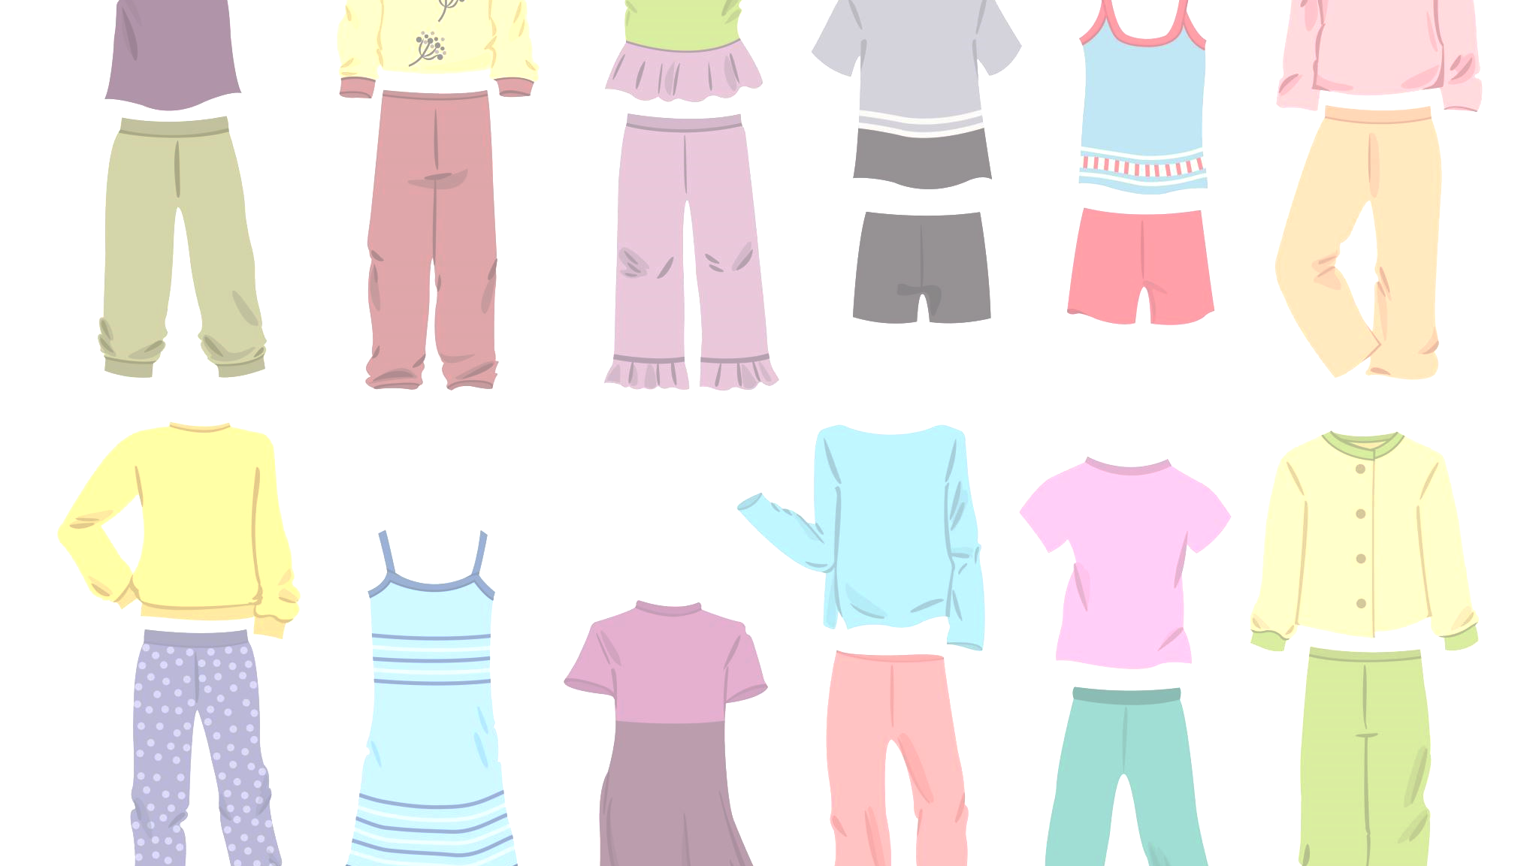
Dataset Analysis
Fashion MNIST is a dataset used to benchmark machine learning models in image classification. It consists of grayscale images of 10 types of fashion items, such as T-shirts, dresses, and sneakers, with each image sized at 28x28 pixels. The dataset is divided into 60,000 training images and 10,000 test images, each labeled with one of 10 categories. Fashion MNIST is designed as a more challenging alternative to the classic MNIST dataset of handwritten digits, offering a more complex problem due to the variability in fashion items. This dataset is widely used to evaluate and compare the performance of machine learning algorithms, particularly in the field of computer vision.

Slide 7
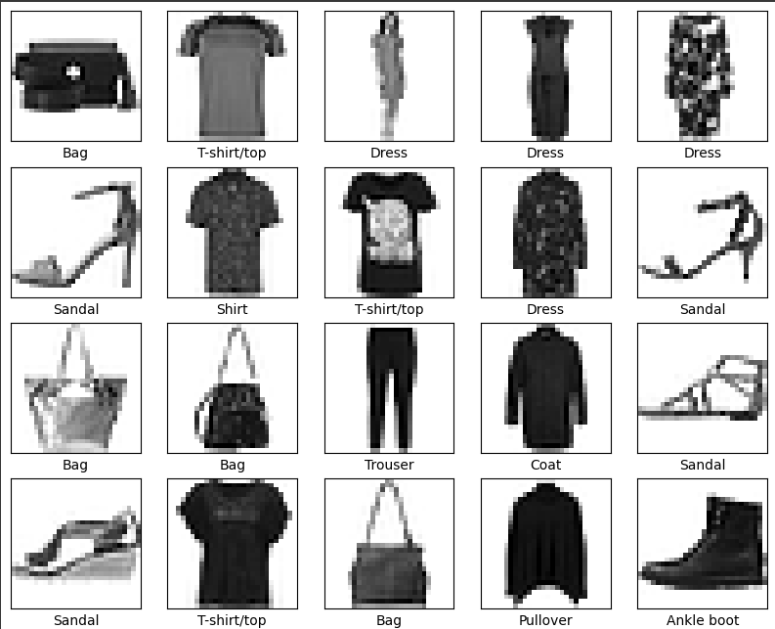
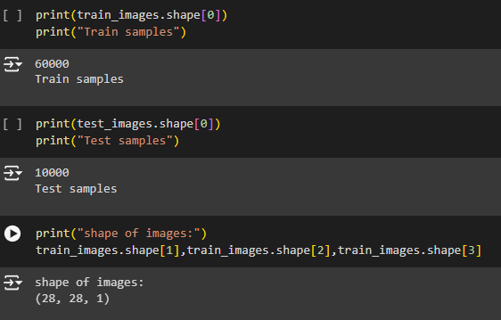
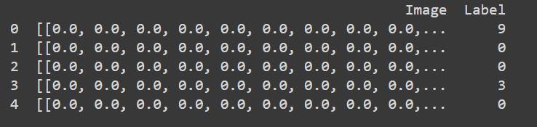
Dataset images

Slide 8
Existing System
The existing fashion image classification systems primarily rely on traditional machine learning algorithms and hand-crafted feature extraction methods. These methods use techniques like Histogram of Oriented Gradients (HOG), Scale-Invariant Feature Transform (SIFT), and color histograms to extract features from images. Classifiers such as Support Vector Machines (SVM), K-Nearest Neighbors (KNN), Decision Trees (DT), and Random Forest (RF) are then used to categorize images. However, these systems often struggle with the high variability and complexity of fashion images, leading to suboptimal performance. Additionally, as the number of categories and dataset size increase, these traditional methods face scalability issues, requiring significant computational resources and time.

Slide 9
Proposed System
In contrast, the proposed system enhances fashion image classification through advanced deep learning techniques and transfer learning. It employs Convolutional Neural Networks (CNN) to automatically learn and extract features from images, effectively capturing complex patterns and textures. By leveraging pre-trained models like MobileNetV2 and fine-tuning them on the Fashion MNIST dataset, the proposed system significantly improves accuracy and training efficiency. It also incorporates a robust preprocessing pipeline to standardize and augment images, ensuring optimal conditions for deep learning. Performance is evaluated using accuracy, loss metrics, and confusion matrices, providing a comprehensive assessment of the model’s effectiveness. This approach offers better scalability and efficiency, handling large datasets and diverse fashion categories with greater computational effectiveness.

Slide 10
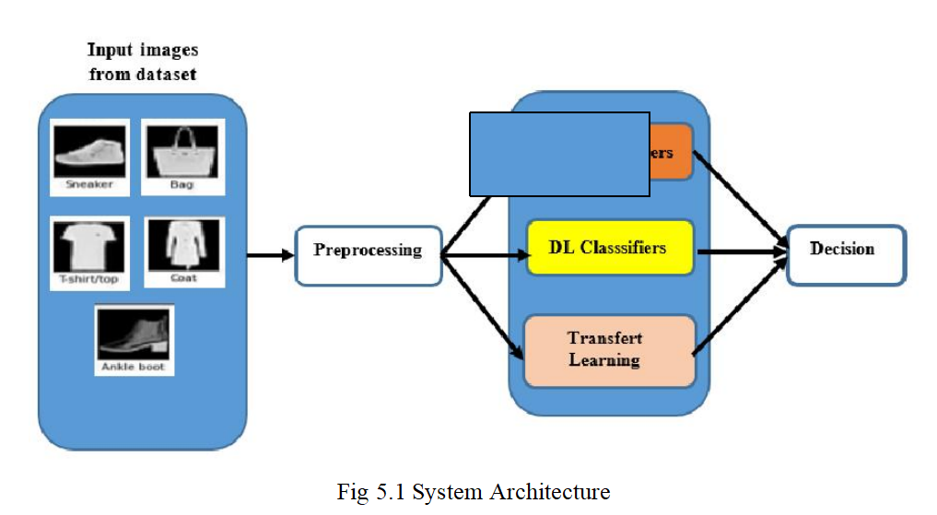
System Architecture

Slide 11
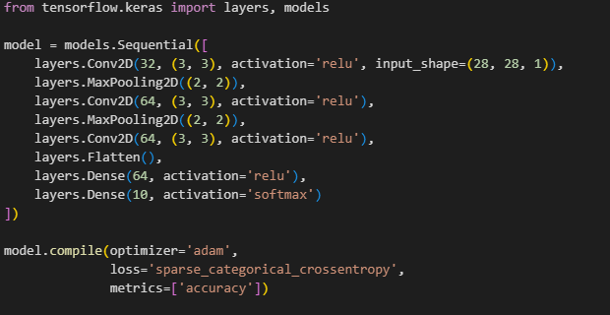
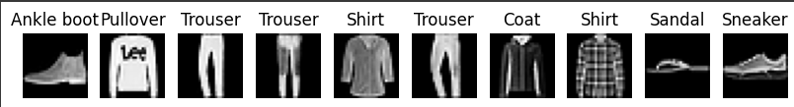
Model Training and Evaluation
CNN Model

Slide 12
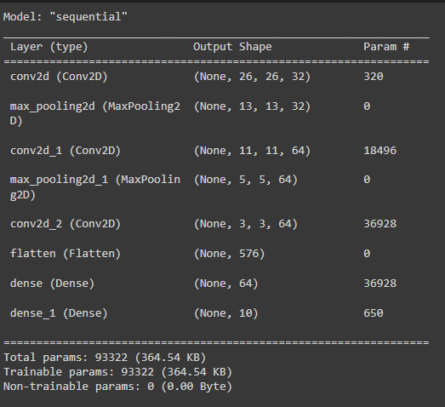
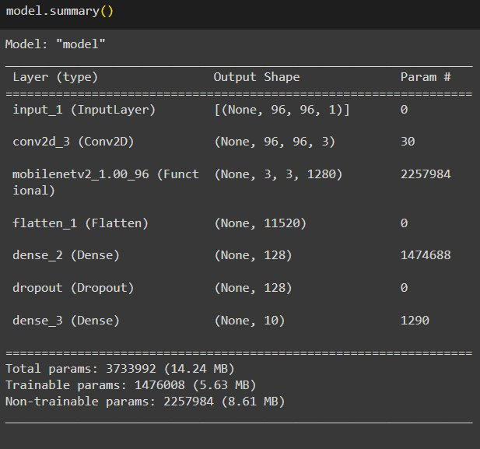
CNN Model Summary
TL with MobileNetV2 model Summary

Slide 13
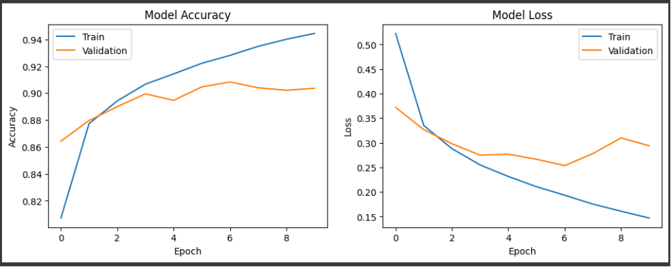
Model Accuracy and Loss

Slide 14
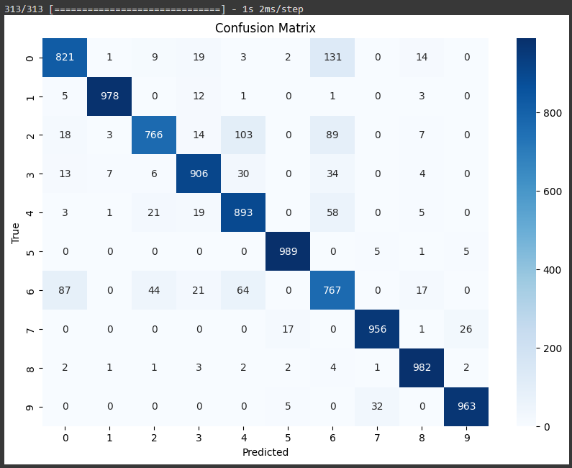
Confusion Matrix of CNN

Slide 15
Conclusion
In conclusion, both the CNN and transfer learning models performed well on the Fashion MNIST dataset, with the transfer learning model achieving a slightly higher accuracy of 90.31% compared to 90.21% for the CNN. While both models demonstrated strong classification capabilities, the transfer learning approach provided a slight edge in performance. Future work could explore optimizing model performance through hyperparameter tuning and model fine-tuning. Additionally, incorporating data augmentation, experimenting with more advanced architectures, and expanding the dataset could enhance robustness and accuracy. Real-world testing and in-depth error analysis will also be valuable for further improving model generalizability and practical applicability.

Slide 16
Referecnces
[1] Hu, W., et al. (2015). Journal of Sensors, Volume 2015.
[2] Xiao, H., et al. (2017). arXiv:1708.07747v2.
[3] Henrique, A. S., et al. (2021). Advances in Science, Technology and Engineering Systems Journal.
[4] Kayed, M., et al. (2020). ITCE 2020.
[5] [Author Unknown]. (2019). IJITEE, Vol. 8, Issue 5.
[6] K V, G., & Sreekumar, K. (2019). IJRTE, Vol. 8, Issue 2.
[7] Seo, Y., & Shin, K.-S. (2018). Expert Systems With Applications.
[8] Bhatnagar, S., et al. (2017). IEEE-ICIIP 2017.
[9] Fashion MNIST dataset. Kaggle Link.
[10] IJRTE, Vol. 7, Issue (5S4), Feb. 2019.
[11] Sharma, [Details Missing]. Procedia Computer Science.
[12] Russakovsky, O., et al. (2015). International Journal of Computer Vision.

Slide 17

Thank YOU
P Saiteja

