Slide 1


Msc Thesis Updates

Slide 2
Current Model
Electric Boiler, NG Boiler, RONDO, Pyrolysis } Heat Technology
Wind, Solar, Grid, Battery } Electrcity Techology
Methanolisation, Electrolysis } PtX , not used in 1st part
Base Scenario:
P_el = 2 MW
P_heat = 5 MW
CO2_tax = 80 EUR/MWh

Slide 3
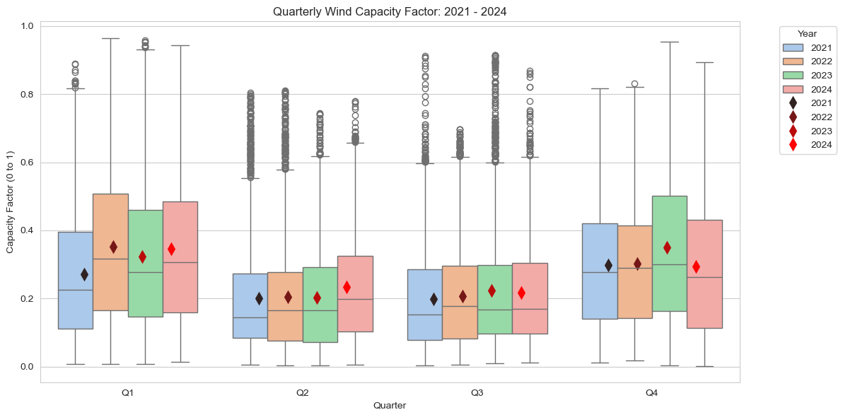
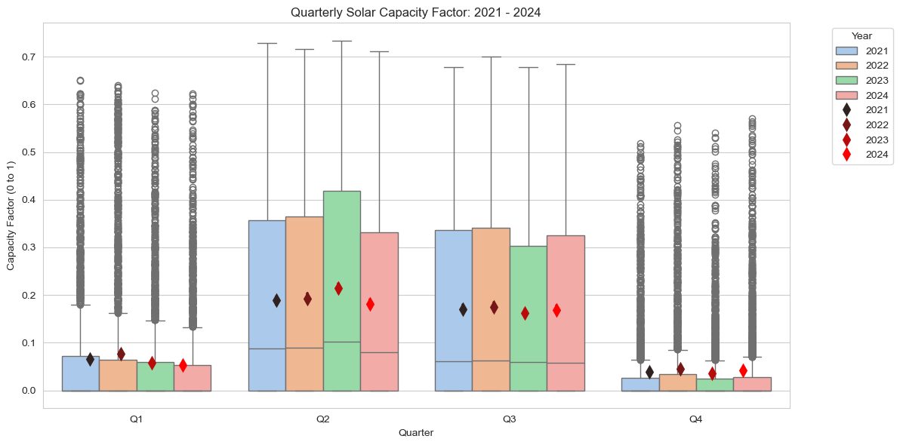
Input Data
Distribution of Wind/Solar CF in each quarter of the year

Slide 4
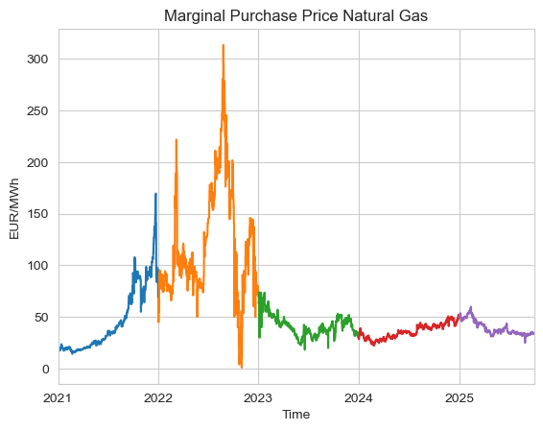
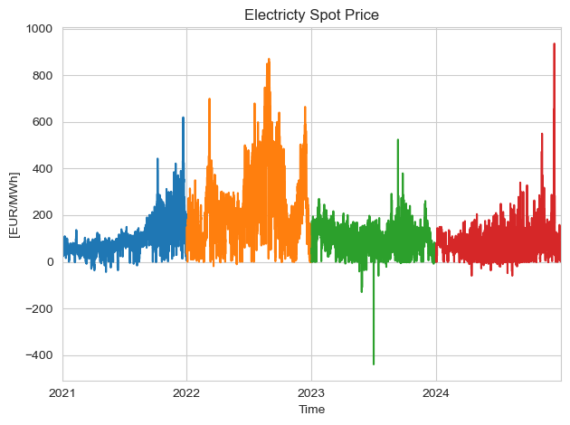
Input Data
-
Notes:
- Grid fees are different

Slide 5
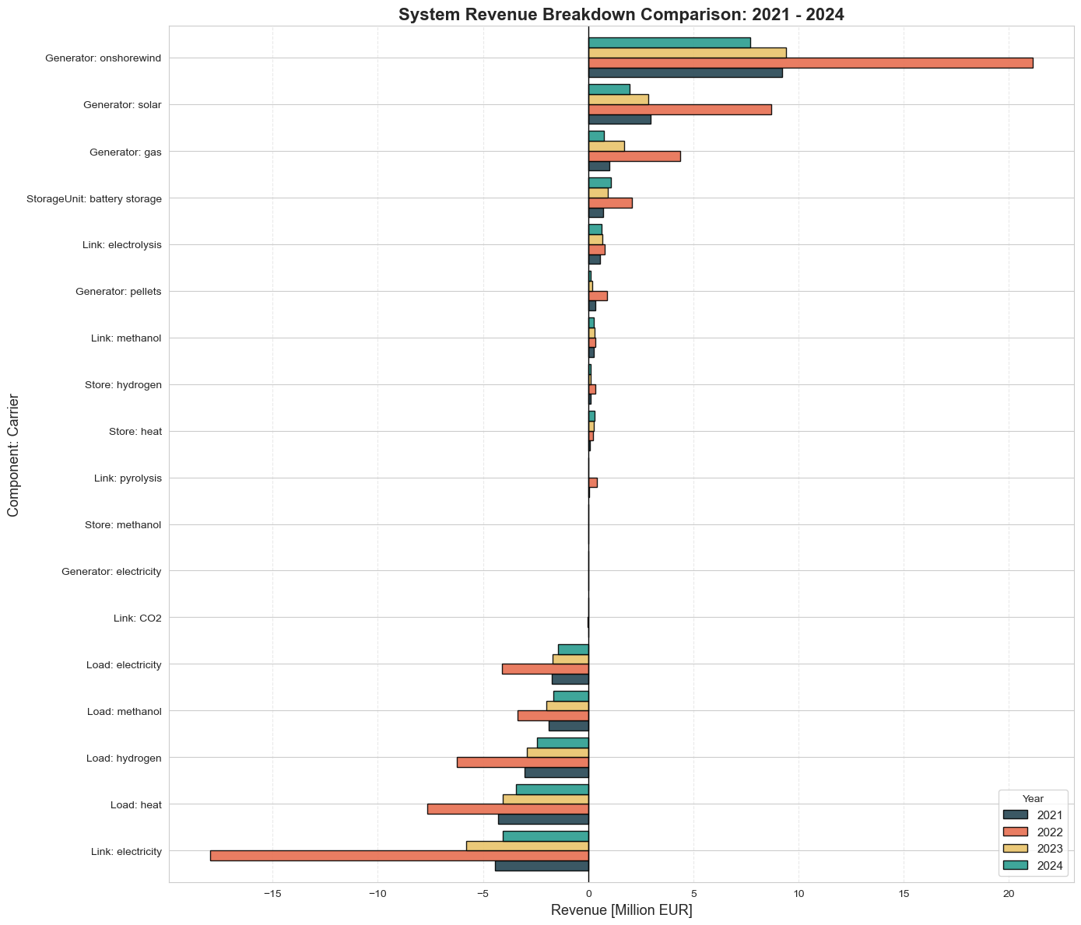
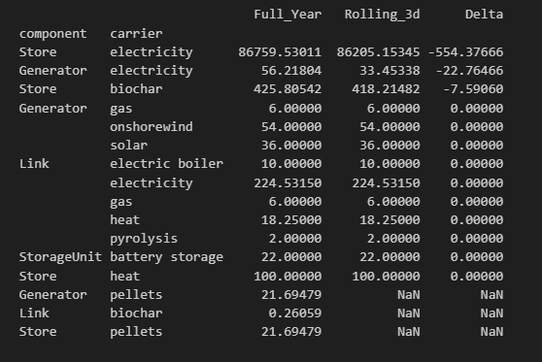

System Revenue
Year | 2021 | 2022 | 2023 | 2024
Objective value | -6.42e6 | -20.2e6 | -7.24e6 | -5.70e6
OPEX | -6.63e6 | -20.5e6 | -7.46e6 | -5.92e6
It looks like the huge difference in the rolling horizon come from the investment costs related to the grid
Operating costs go down with less foresight

Slide 6
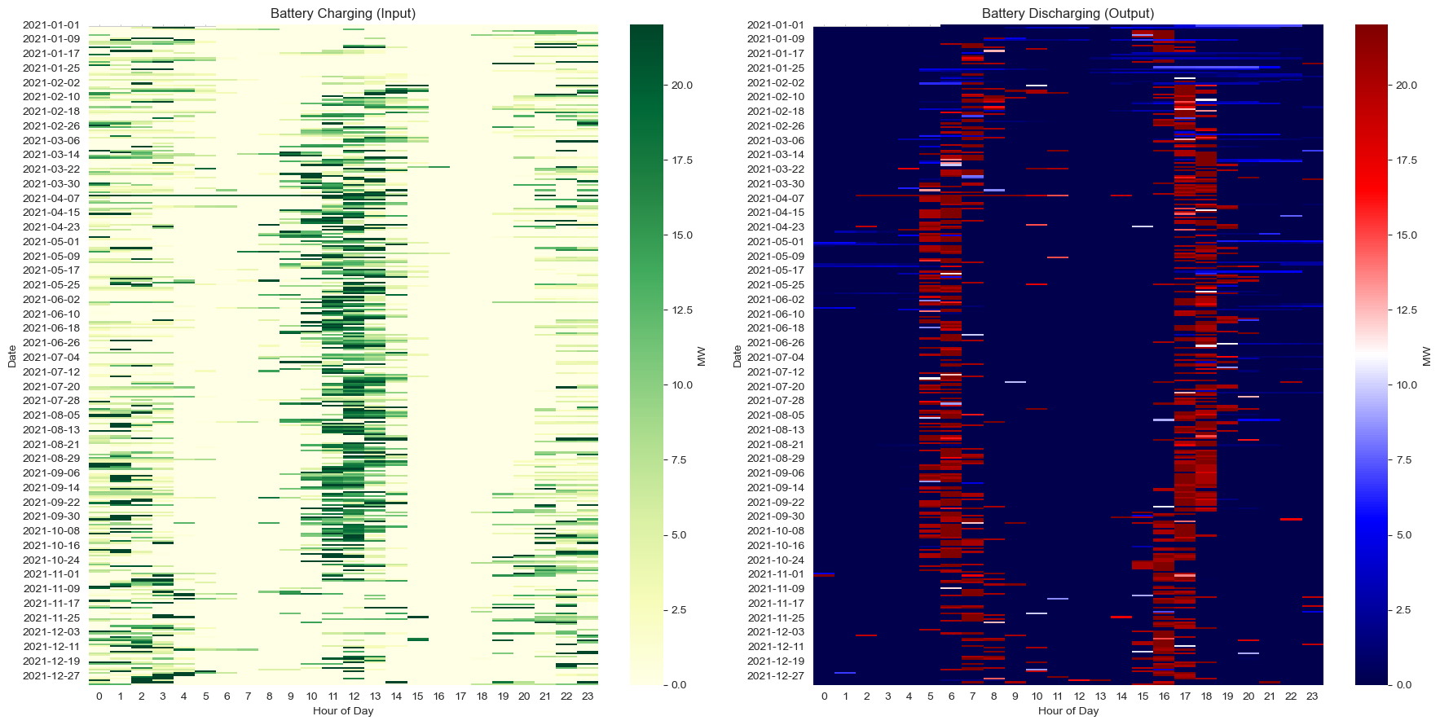
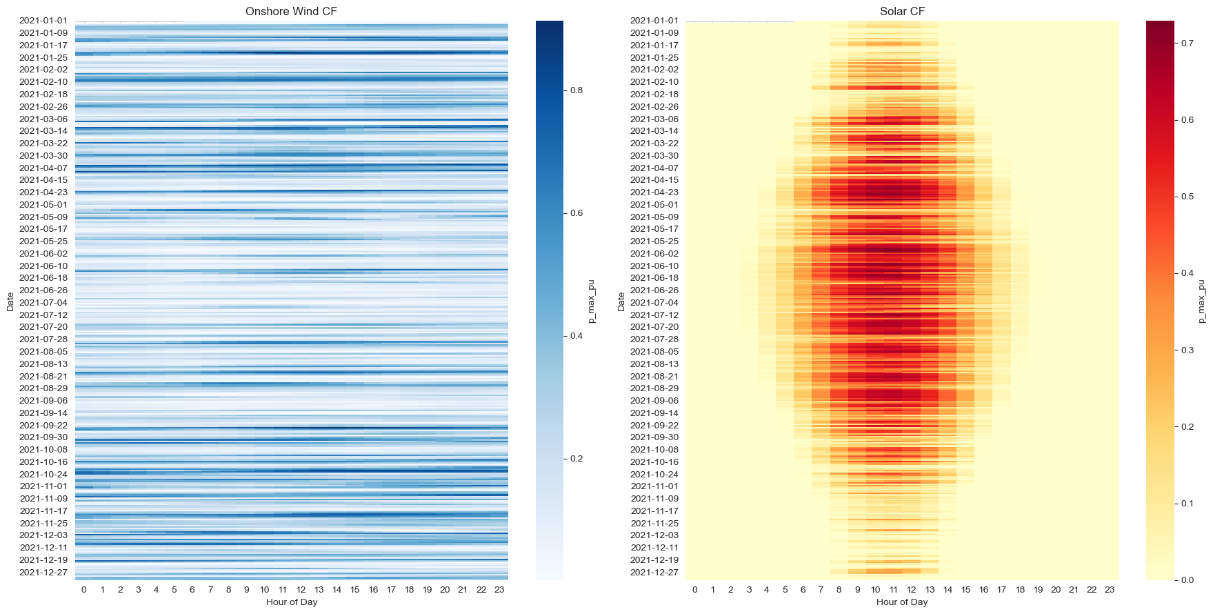
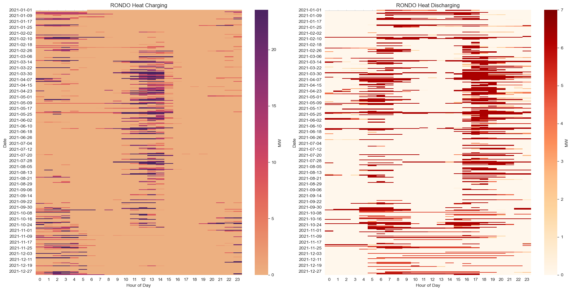

Slide 7
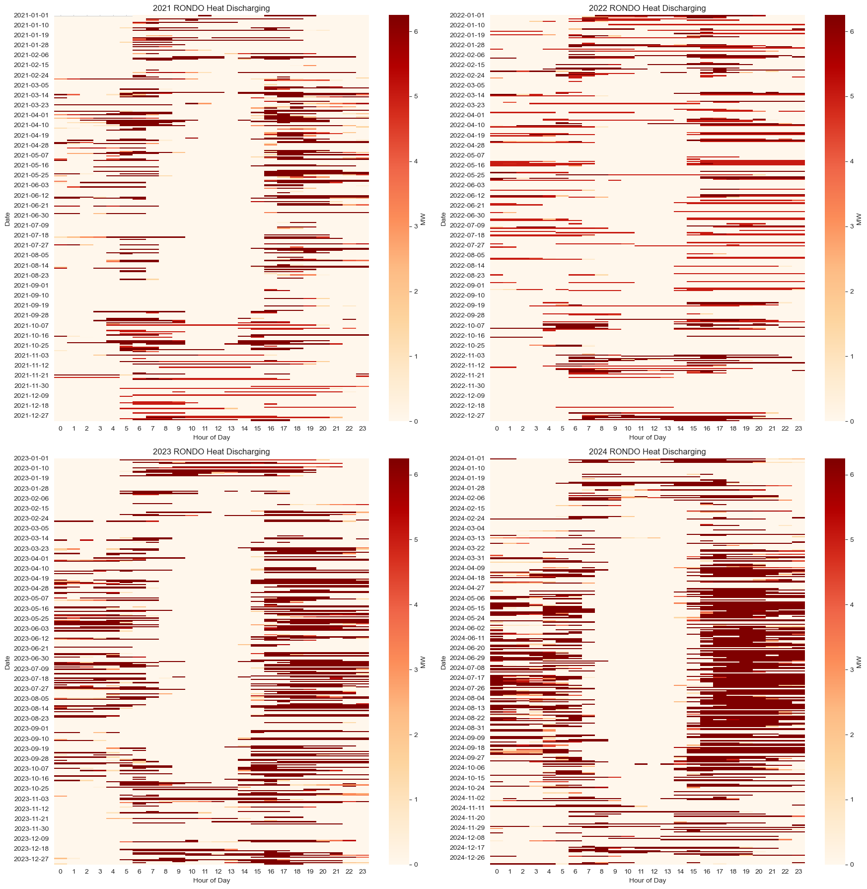
RONDO Discharging Behavior
2024 saw significant usage in RONDO
2021/2022 saw the least usage of RONDO
However, it still contributed to at least around 15 % of the annual heat demand every year.
In fact, ignoring the extreme scenarios of 2021/2022,
It was contributing 20 % plus of the annual heat demand.

Slide 8
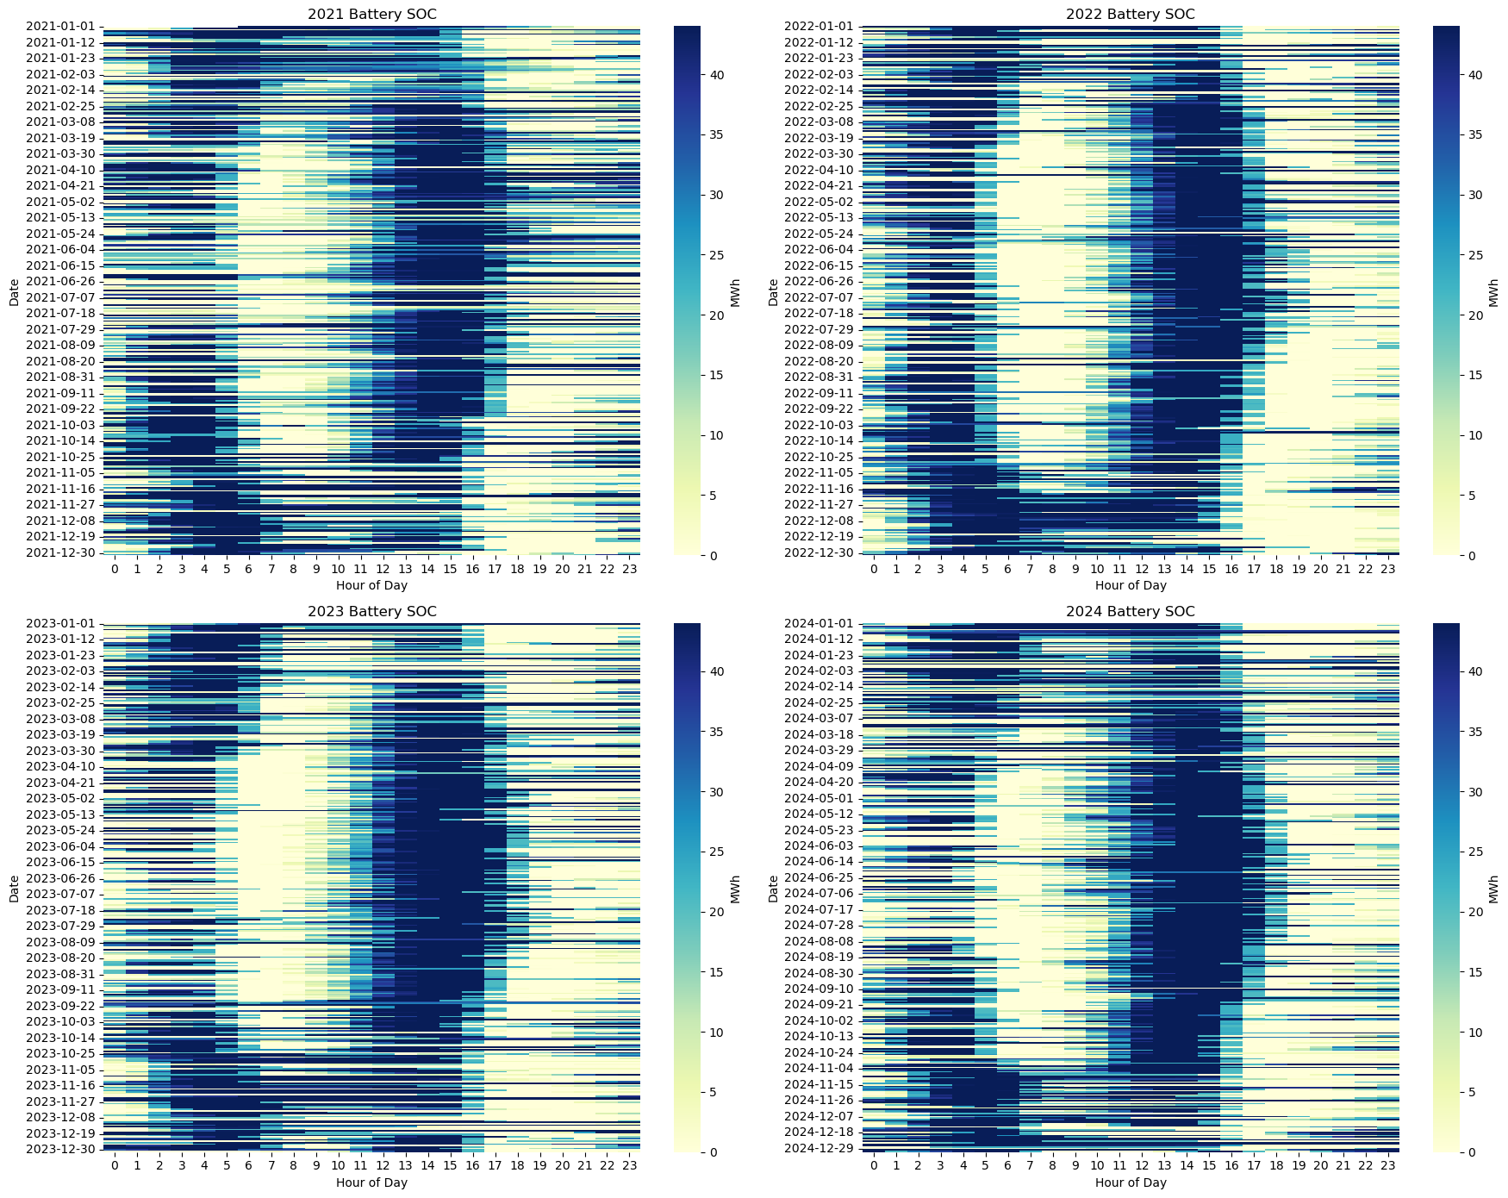
Battery SOC

Slide 9
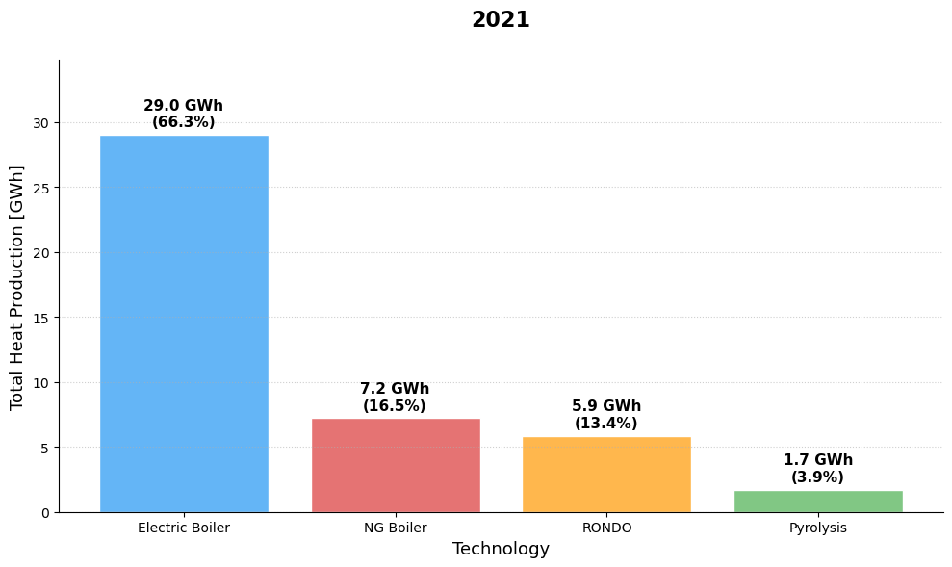
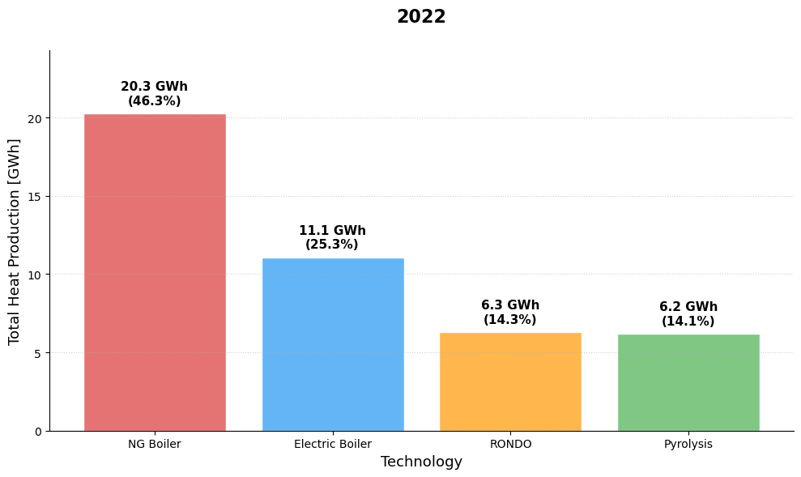
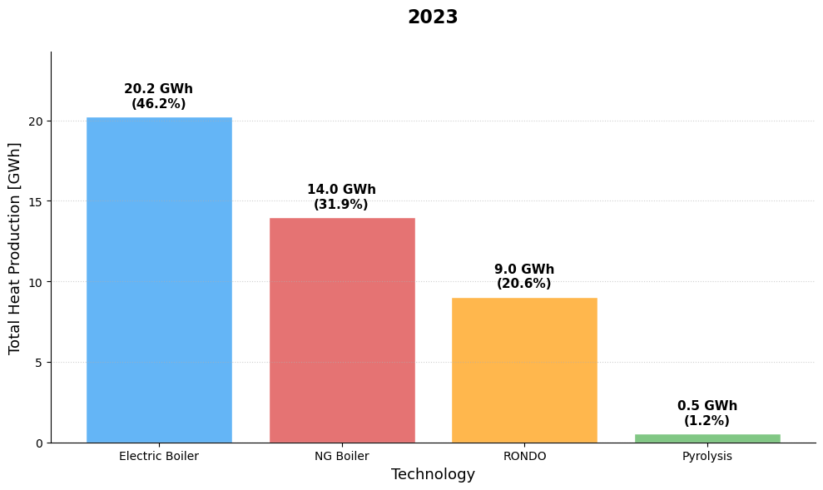
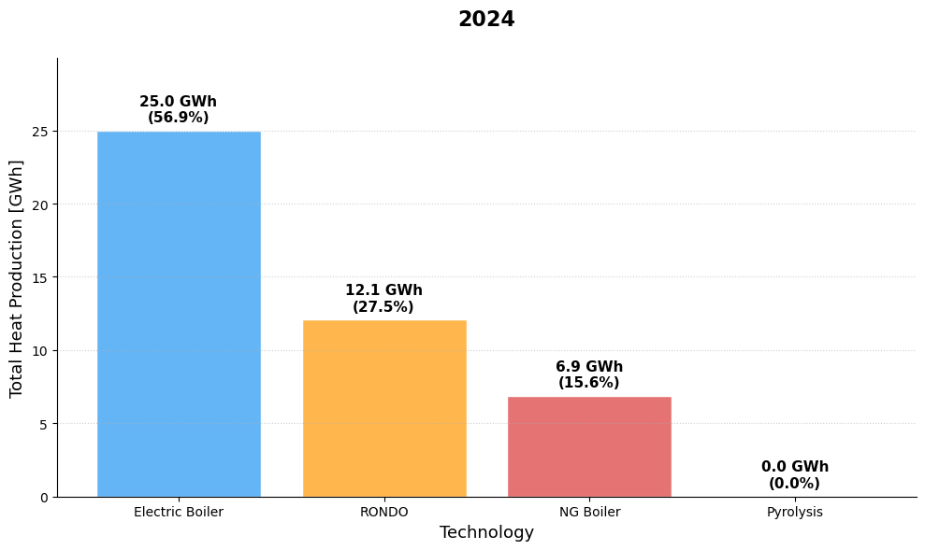
Base Scenario Heat Generation
Notes:
2022 used Pyrolysis most
-

Slide 10
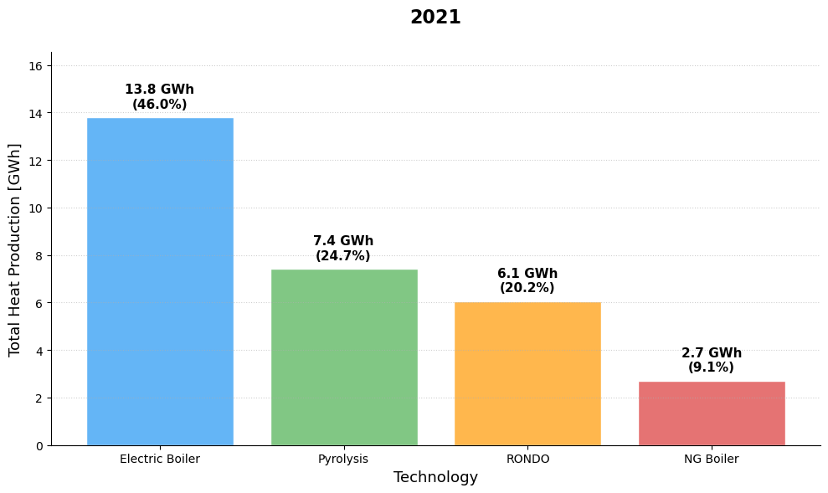
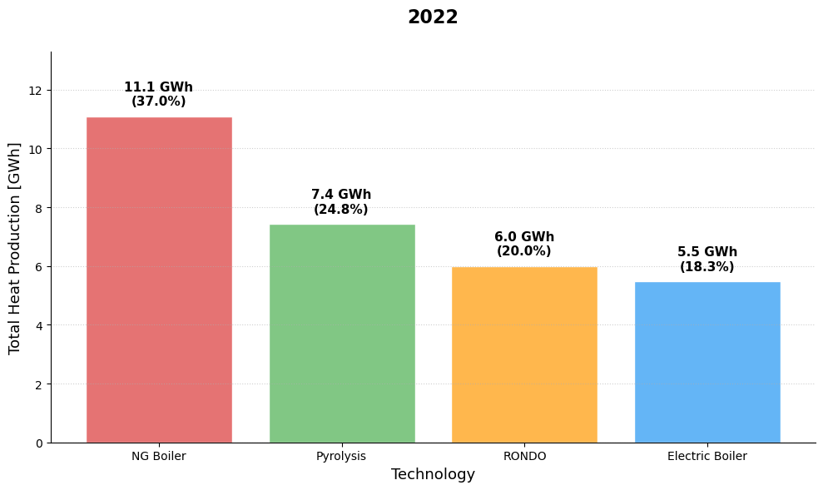
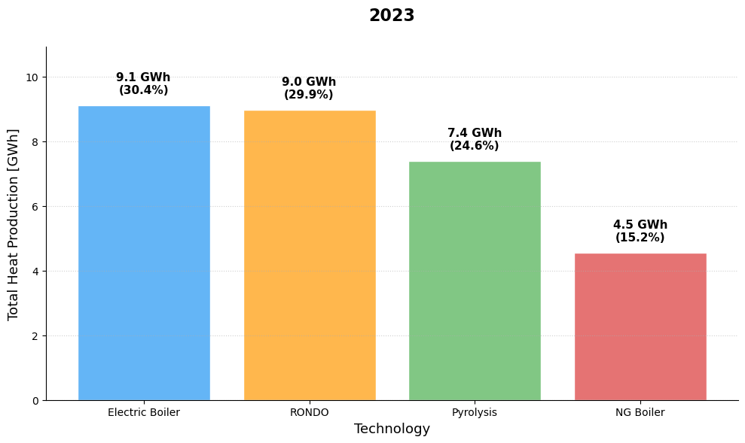
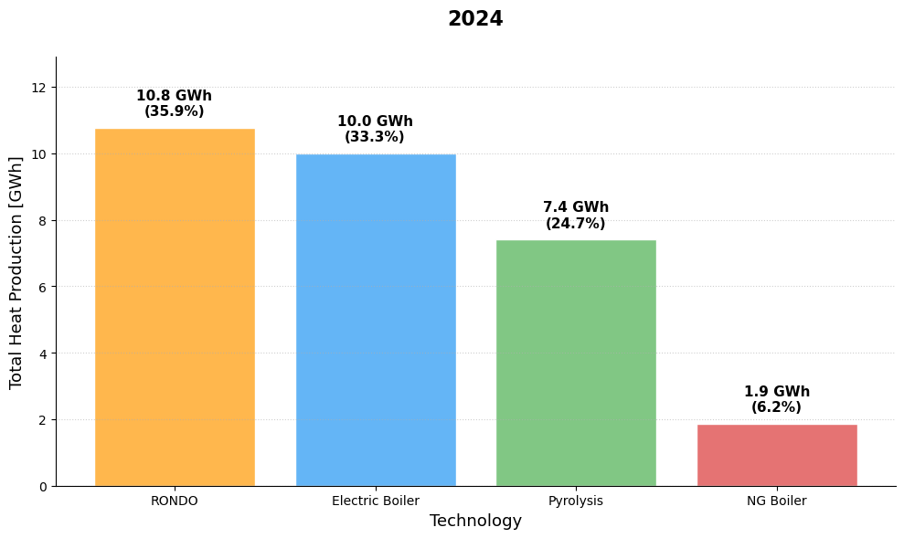

Slide 11
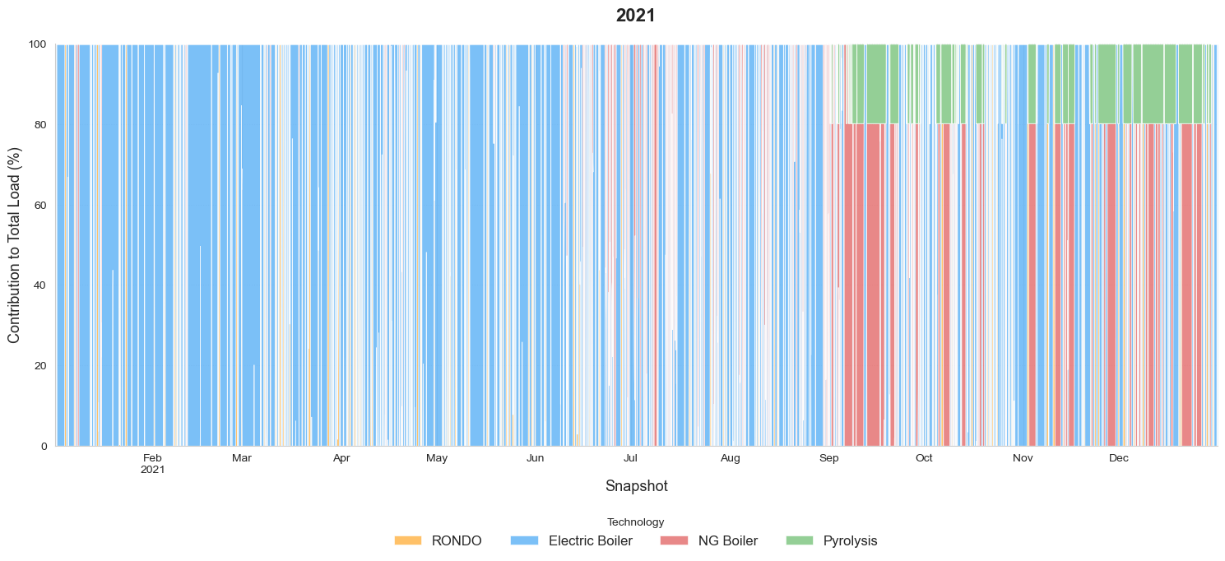
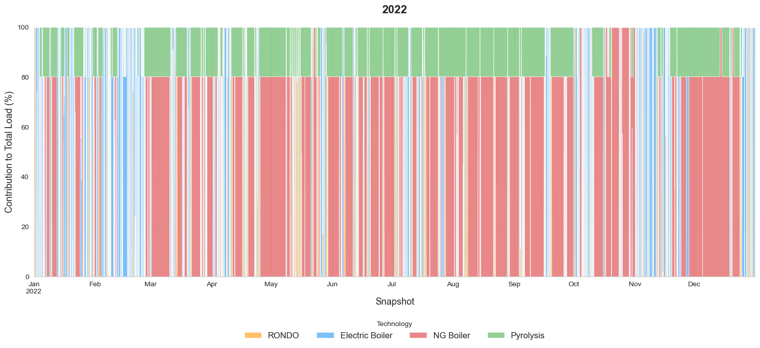
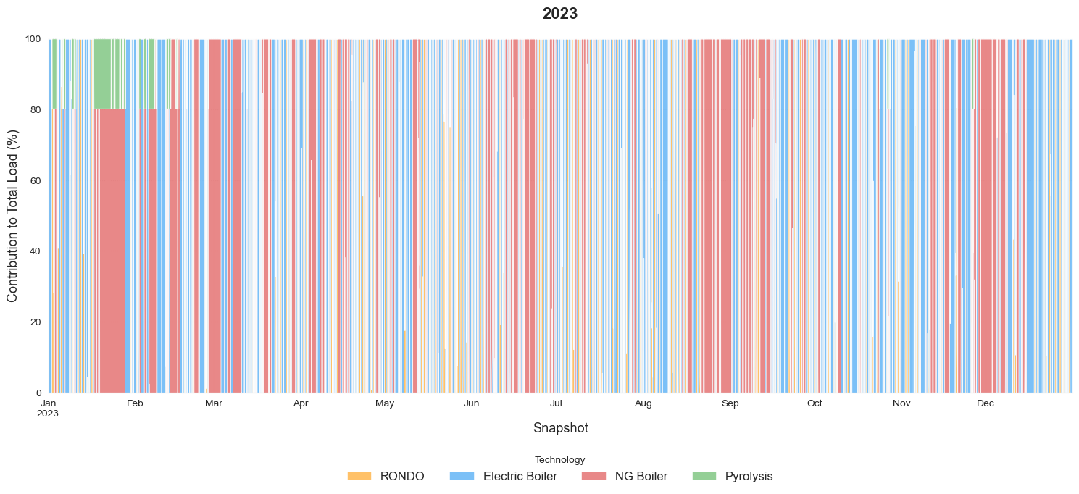
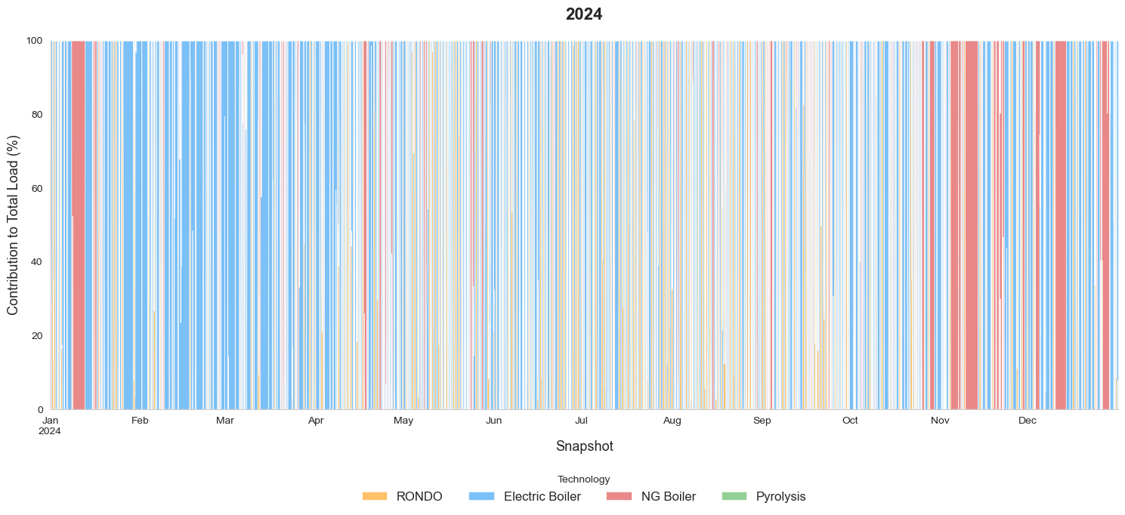

Slide 12


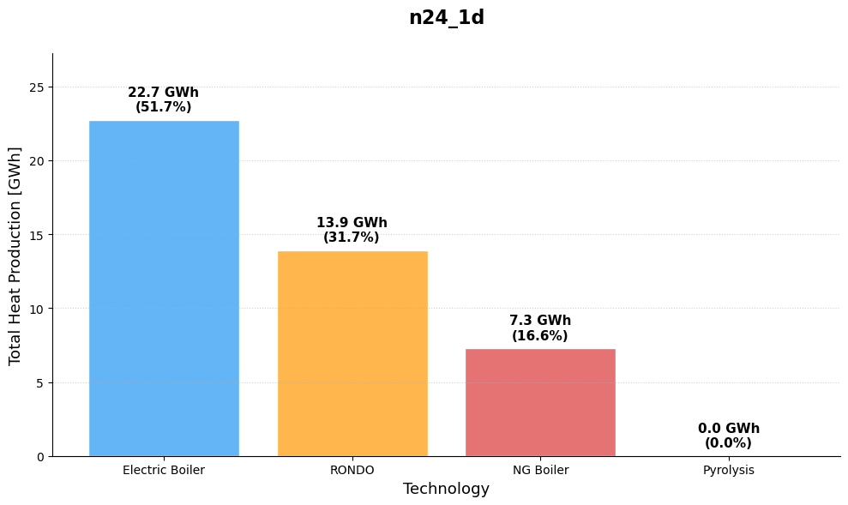

Rolling Horizon

Slide 13

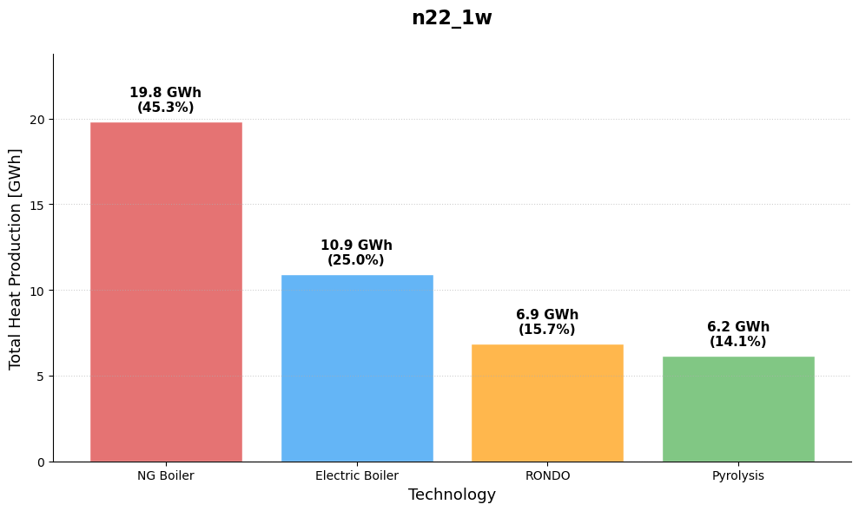
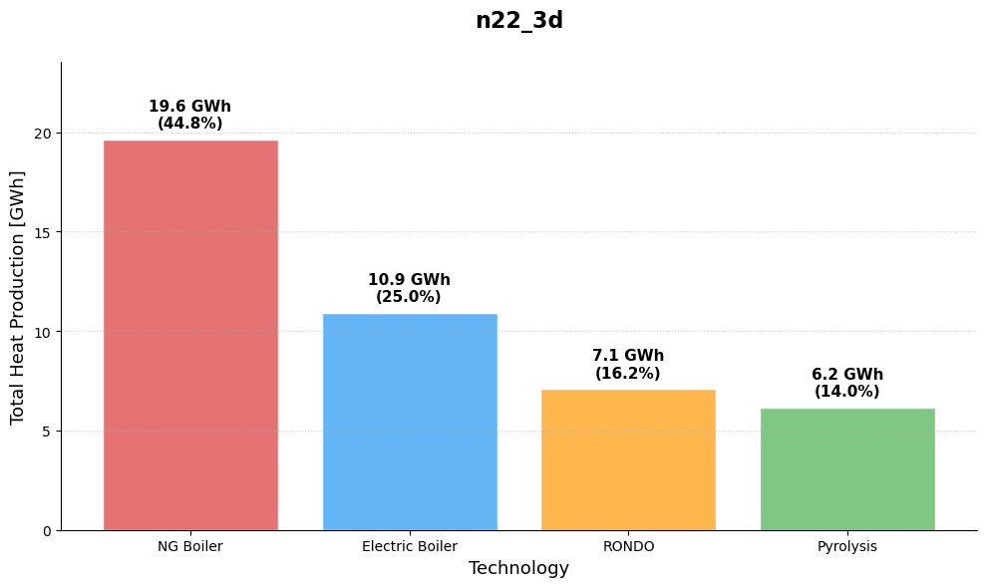
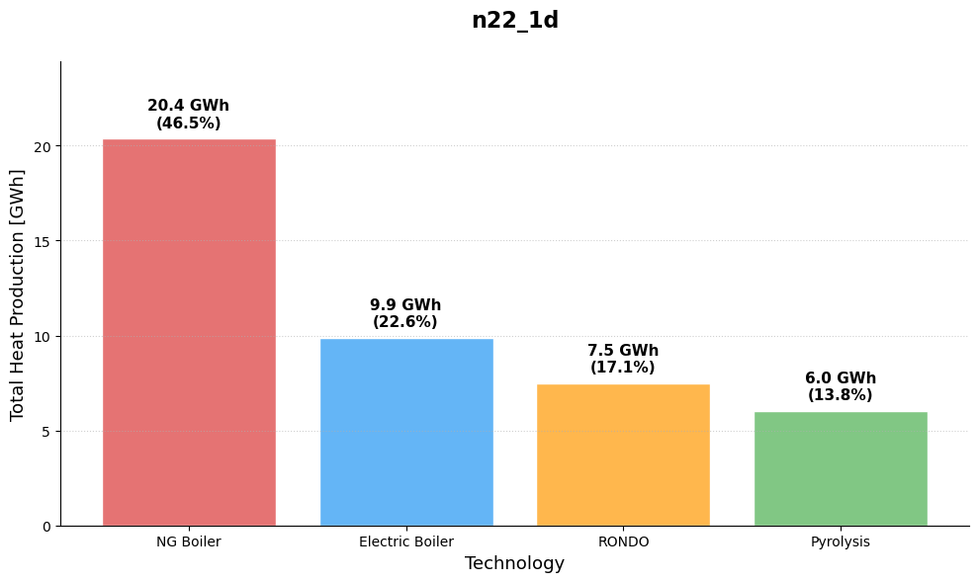
Notes:
Shorter Foresight led to more utilization of RONDO

Slide 14
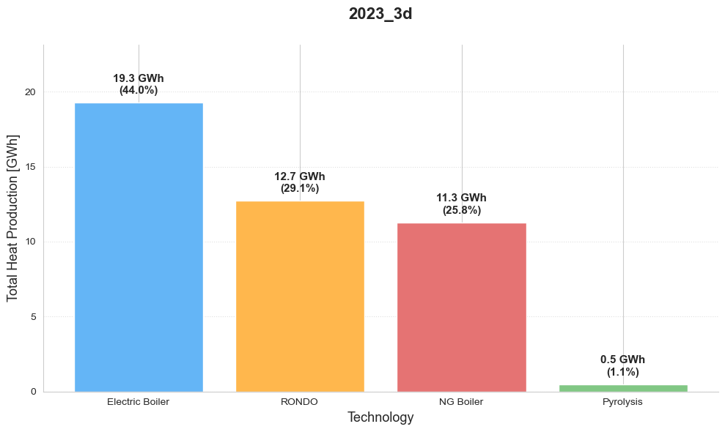
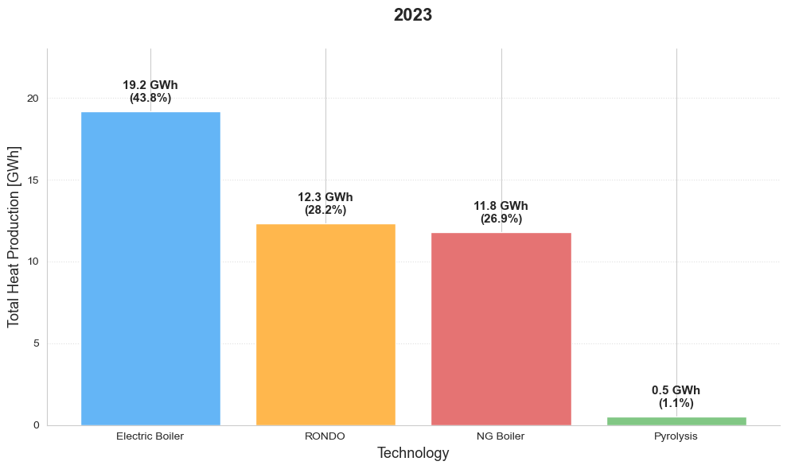
Rolling Horizon Comparison
- Shorter Horizon seems to lead to more usage of RONDO

Slide 15
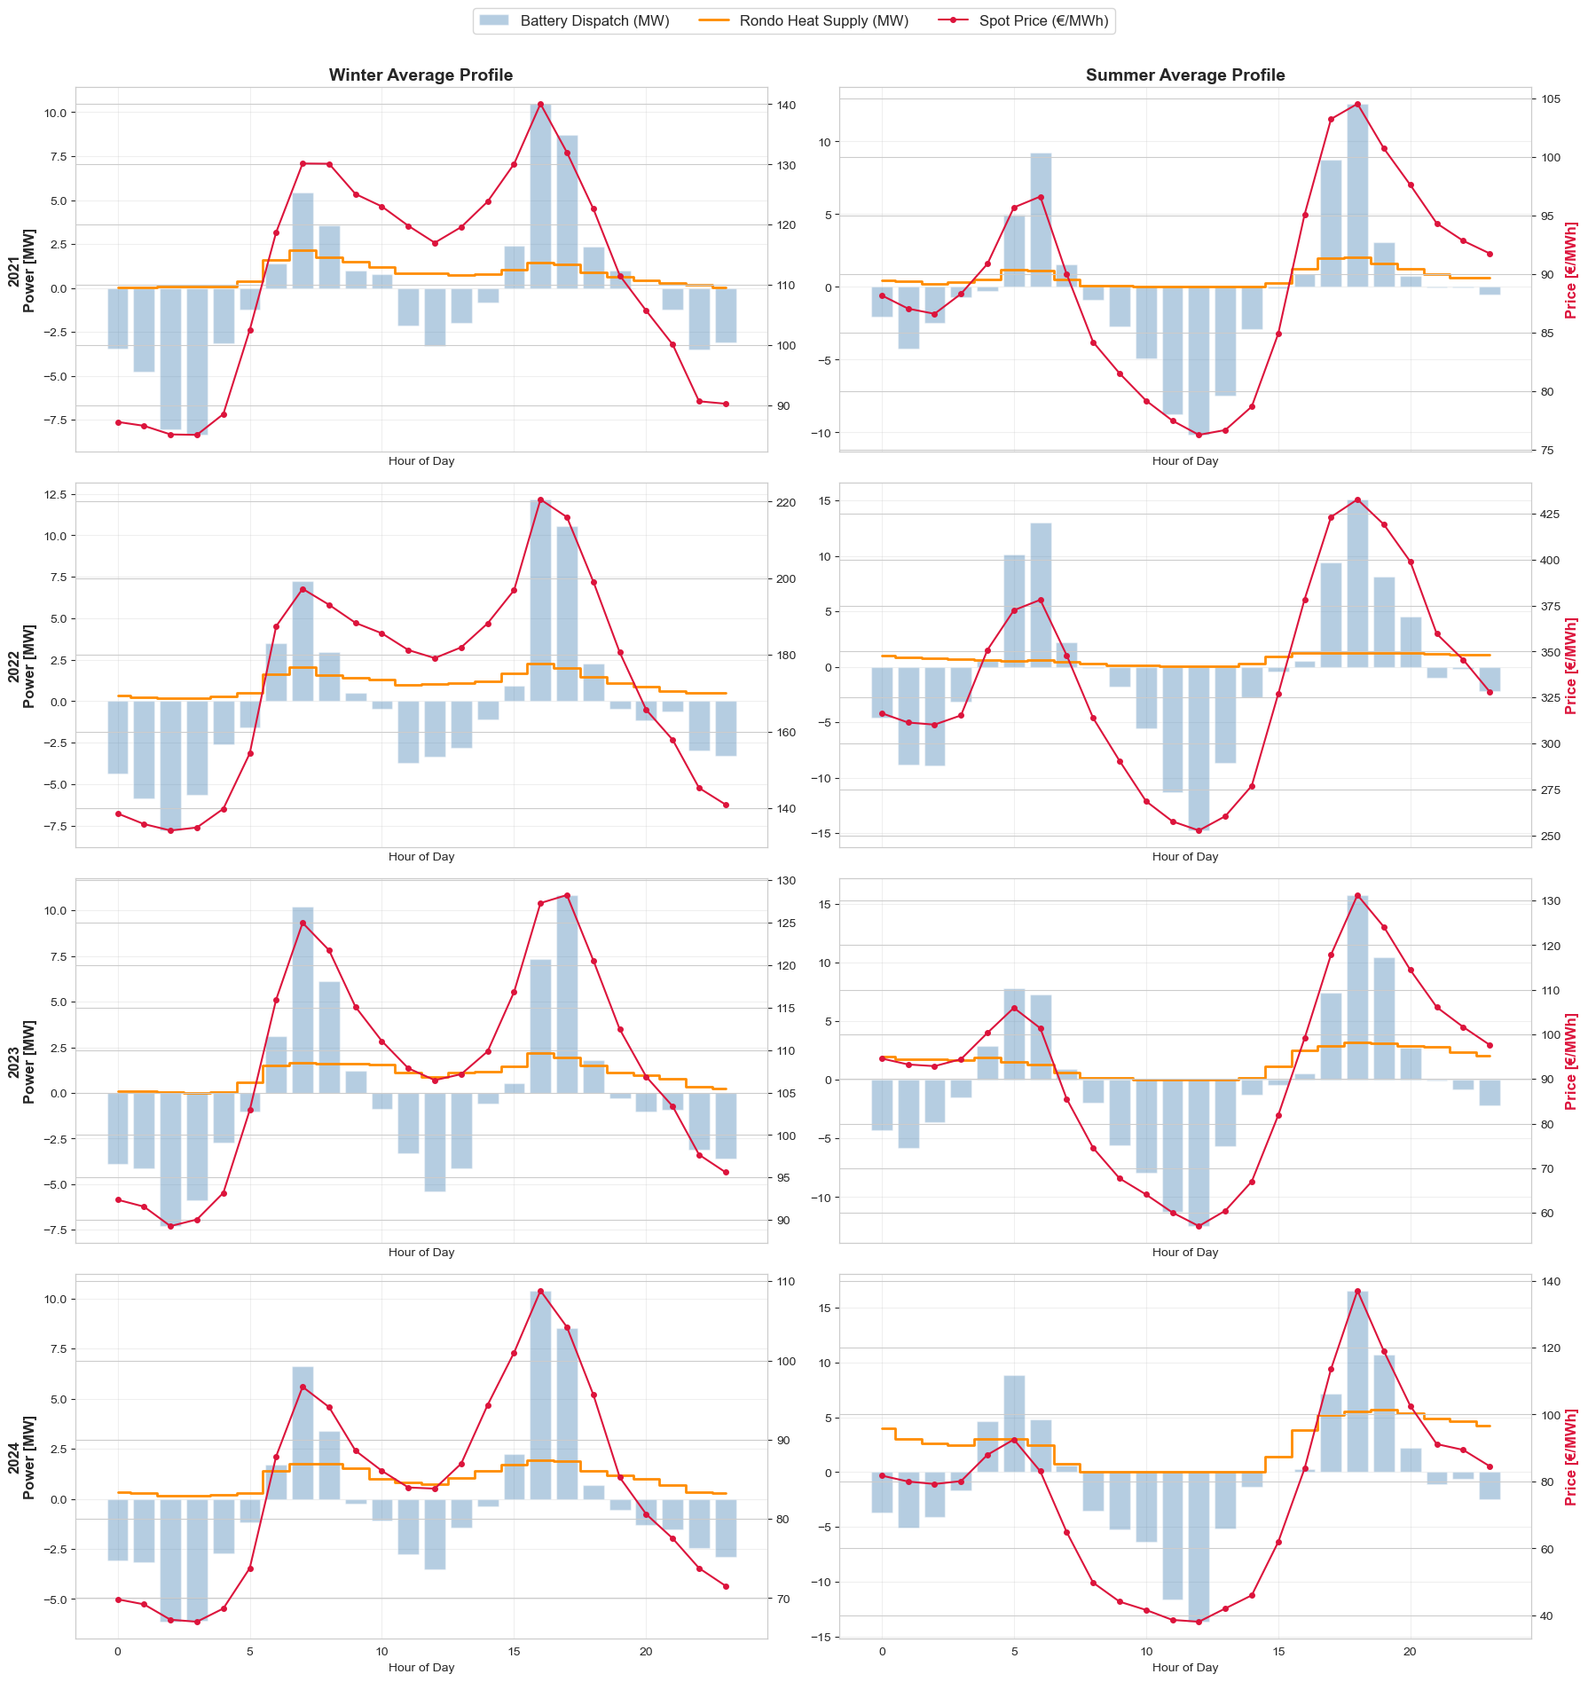
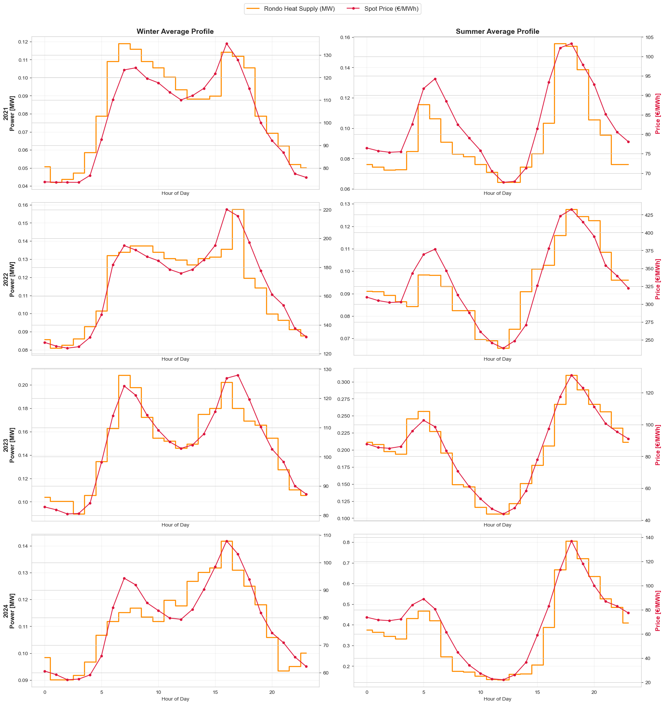
Seasonal Behavior
RONDO discharging closely follows the Spot Price
Same with the Battery Charging/Discharging

Slide 16
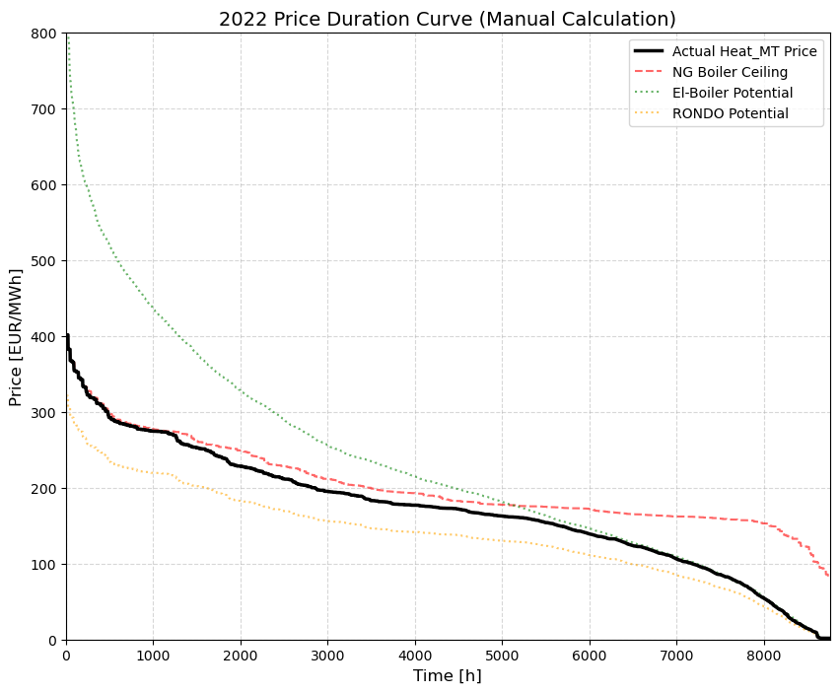
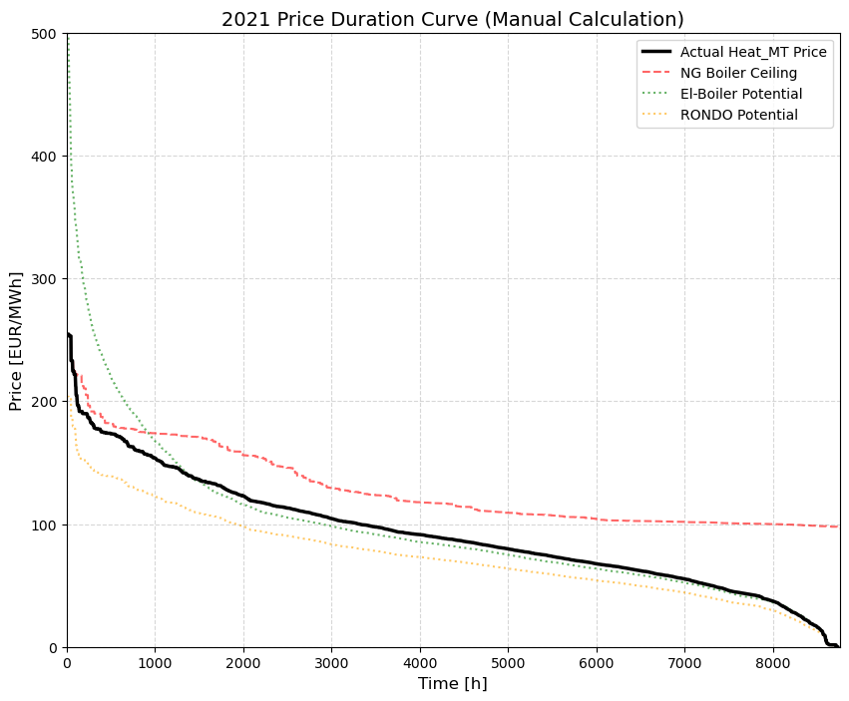
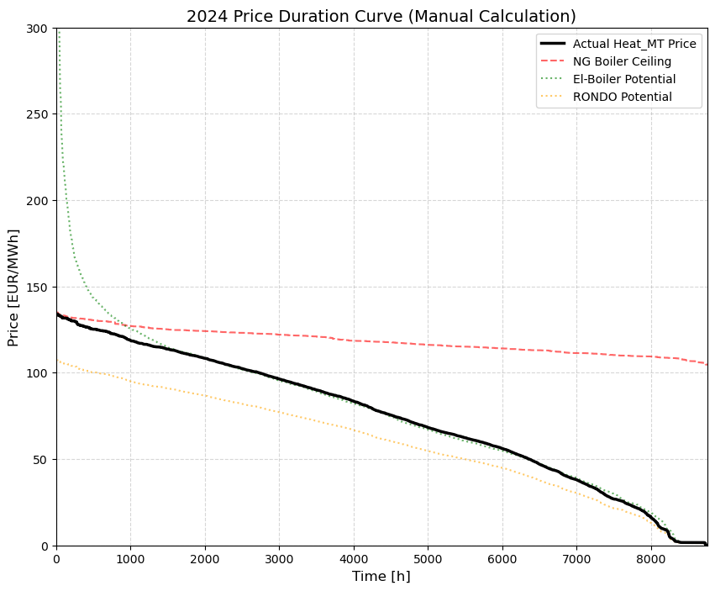
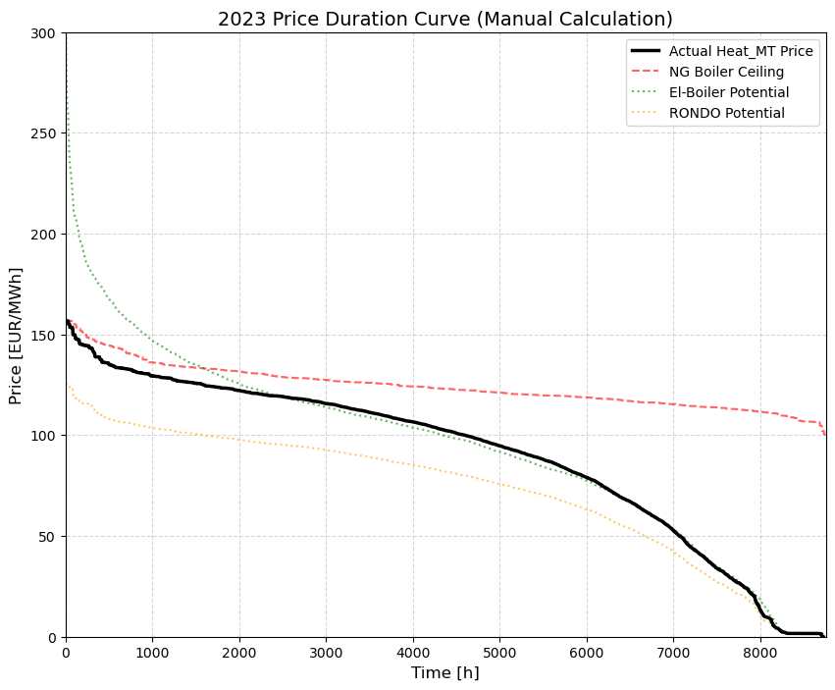
Heat Price
Heat Price is bounded by the electricity and boiler prices
2022 was the only year where NG prices were lower more often than electricity prices.
Heat MC is following the RONDOs MC

Slide 17
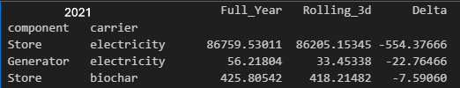
Conclusions
Rolling Horizon did not have much impact on daily operations
However, it underestimates certain links/store capacities (extendable)
This leads to for example lower importing capacity and biochar storage.
These are the only ways the system can make revenue arbitrage/carbon credits

Slide 18
Next Steps
Implementing Biogas Plant
Debugging Annualized Demand
Rolling Horizon with Annualized Demand

Slide 19
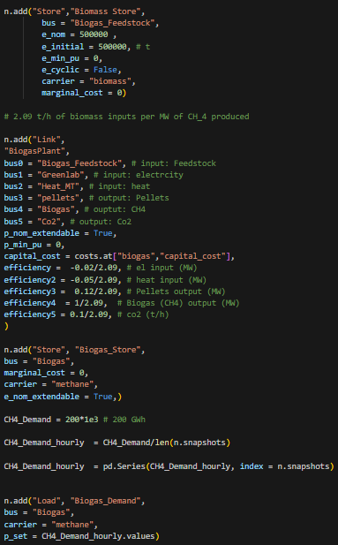
Biomass Plant

Slide 20
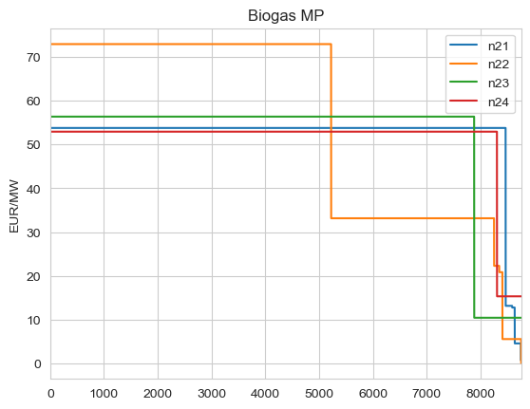
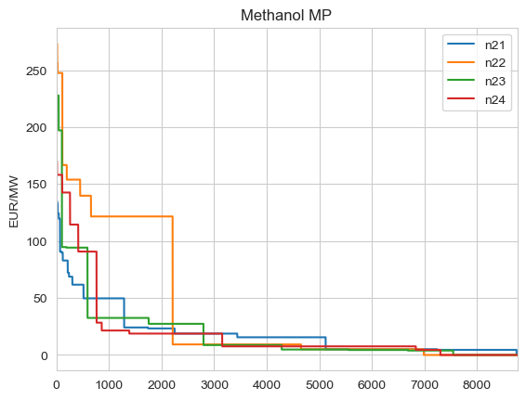
Marginal Price
Not sorted
Marginal Price of Biogas and Methanol
No Methanol Demand and H2 Demand
200 GW Demand for Biogas (CH_4)
Spread Evenly Hourly
Limited the amount of exports to 20 MW
Imports Links is still 84 MW

Slide 21
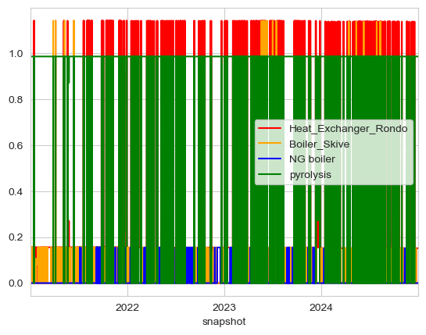
Heat Contribution

Slide 22
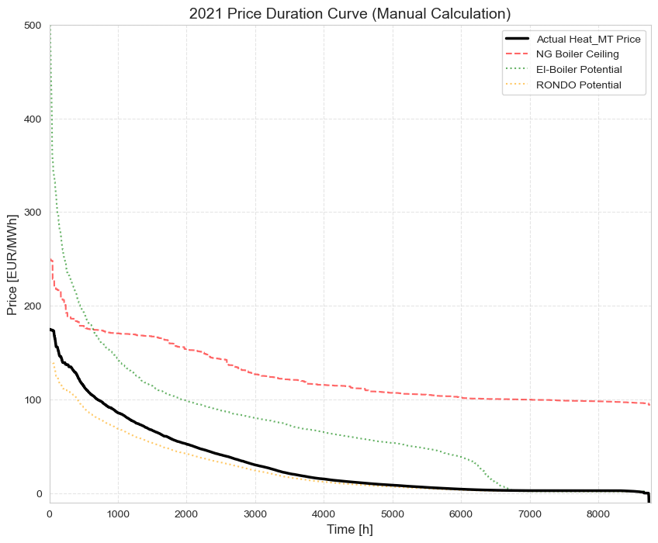
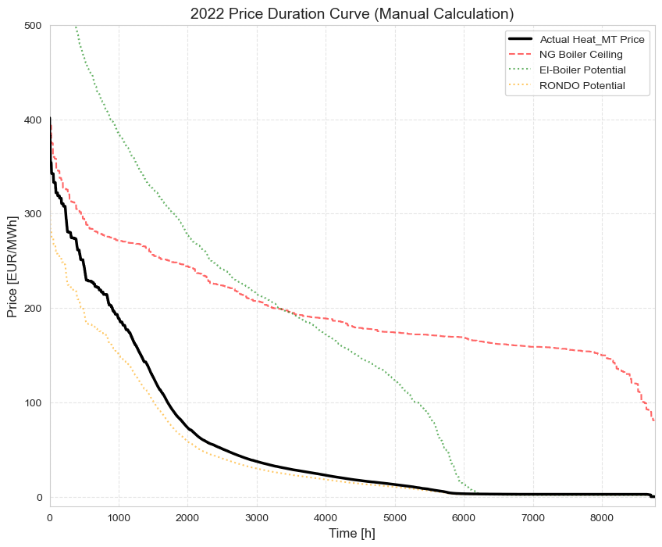
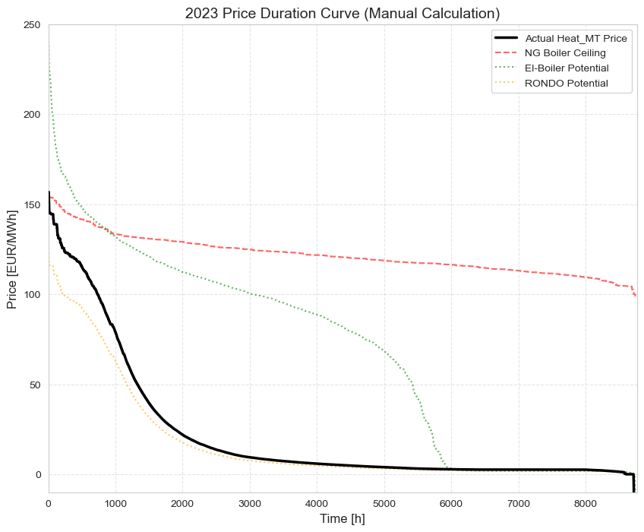
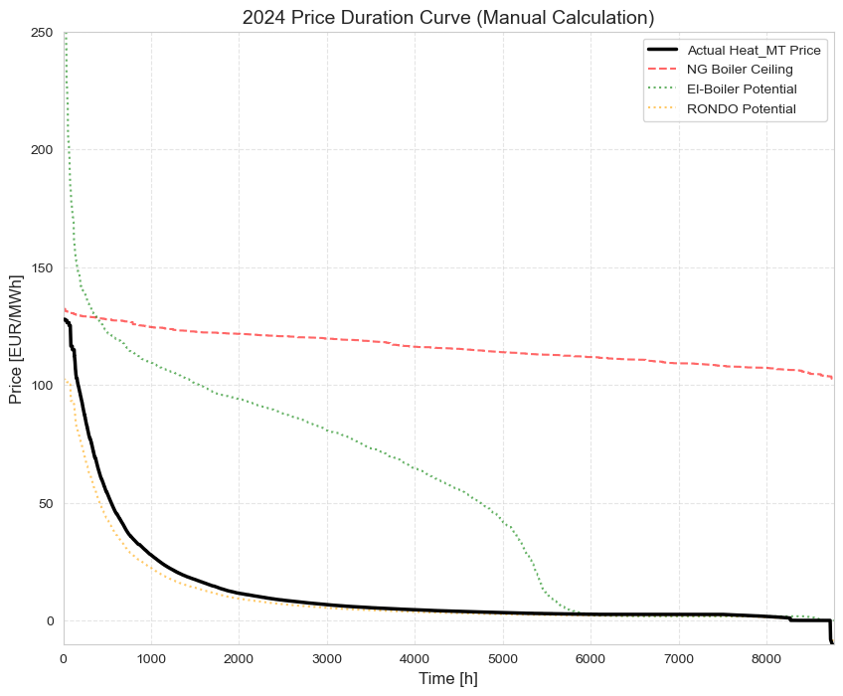

Slide 23
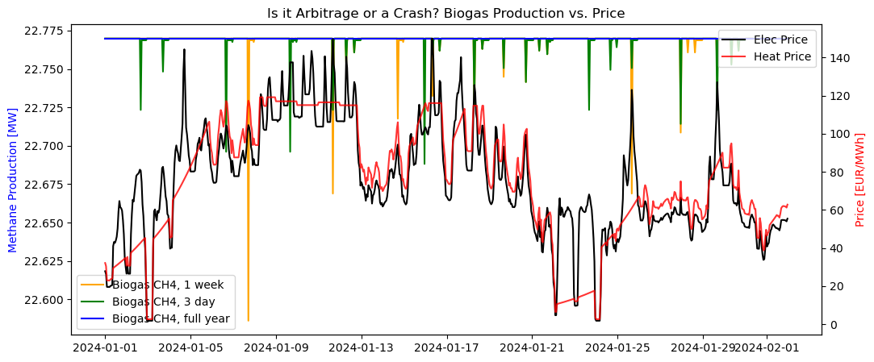

Slide 24
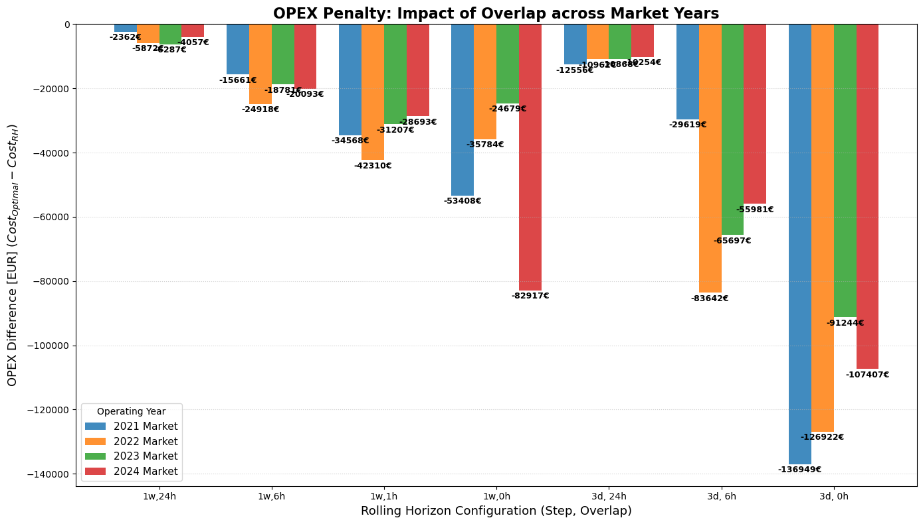

Slide 25
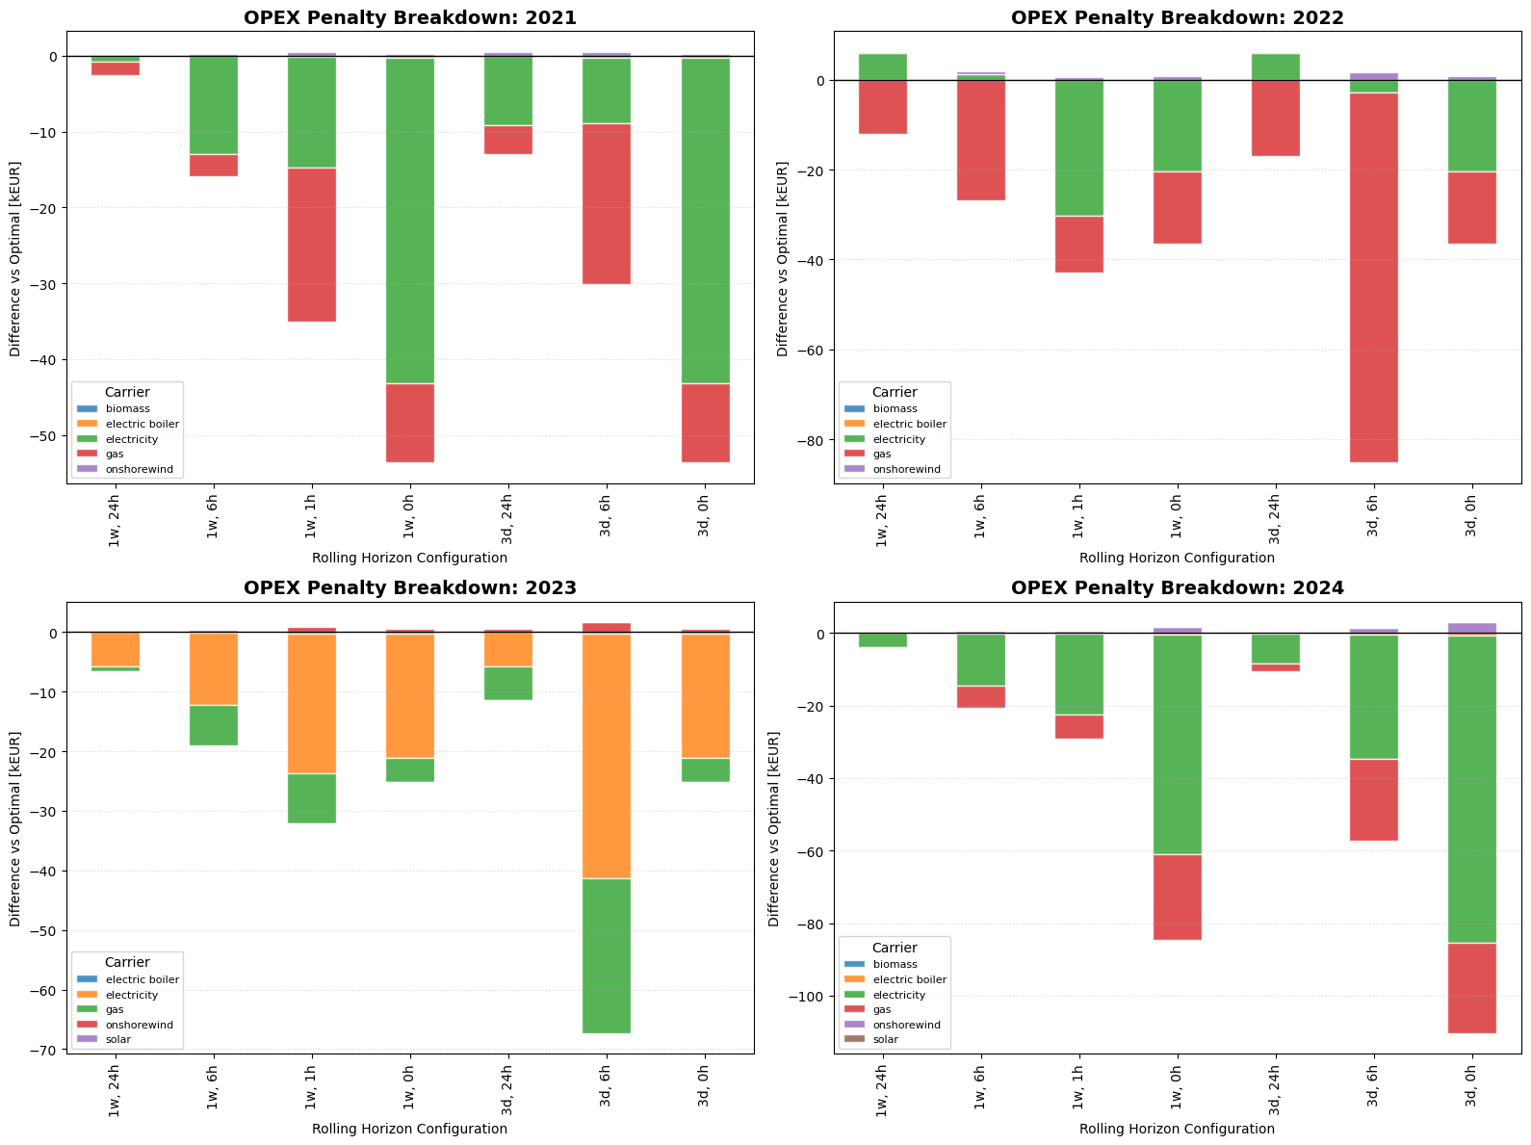

Slide 26
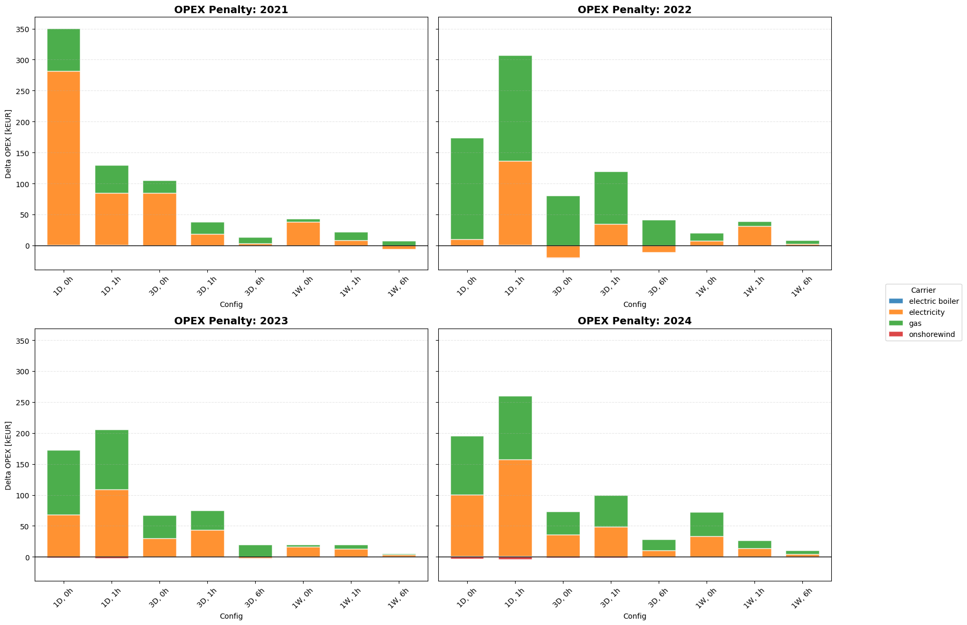

Slide 27
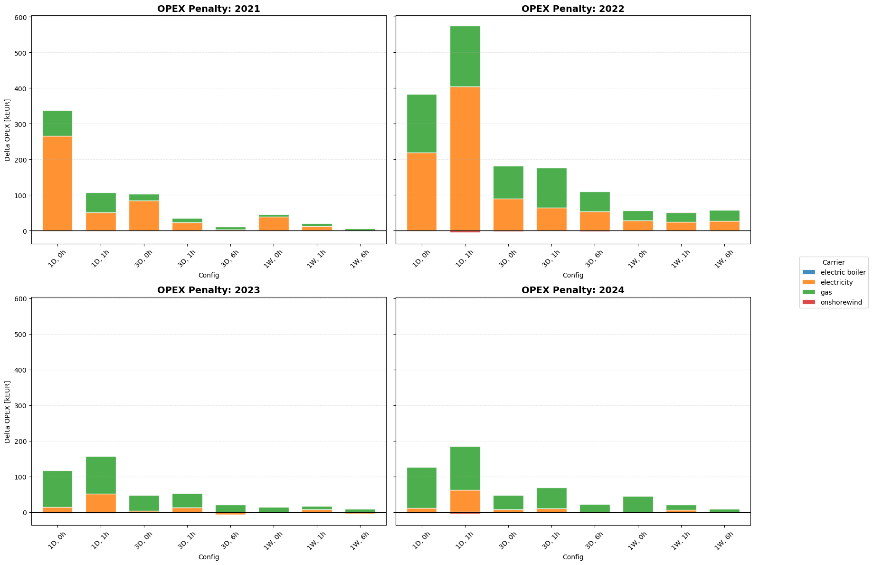

Slide 28
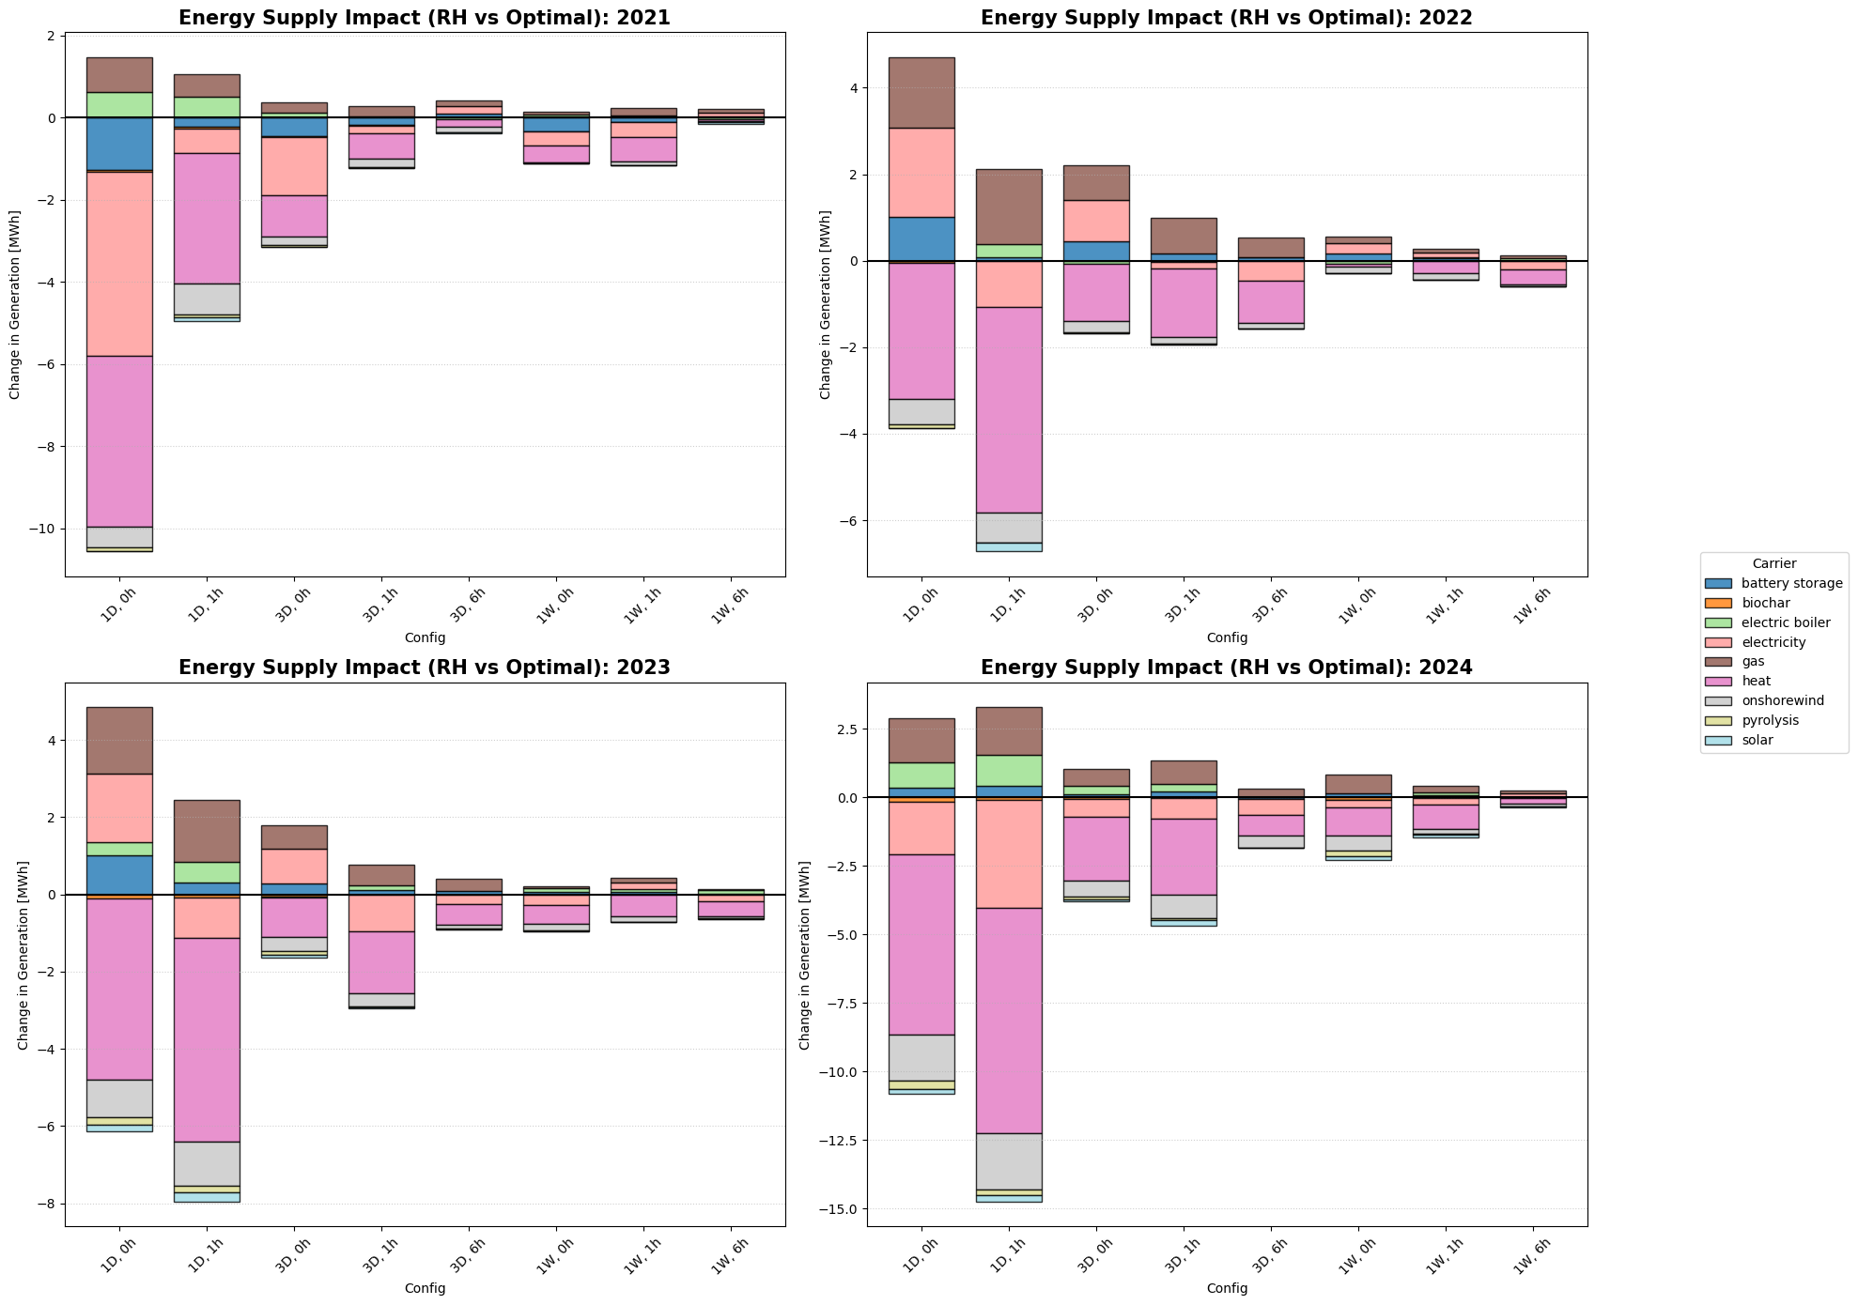

Slide 29


Slide 30


