Slide 1


Msc Thesis Updates

Slide 2
Current Model
Electric Boiler, NG Boiler, RONDO, Pyrolysis } Heat Technology
Wind, Solar, Grid, Battery } Electrcity Techology
Methanolisation, Electrolysis } PtX
Base Scenario:
P_el = 2 MW
P_heat = 5 MW
CO2_tax = 80 EUR/MWh

Slide 3
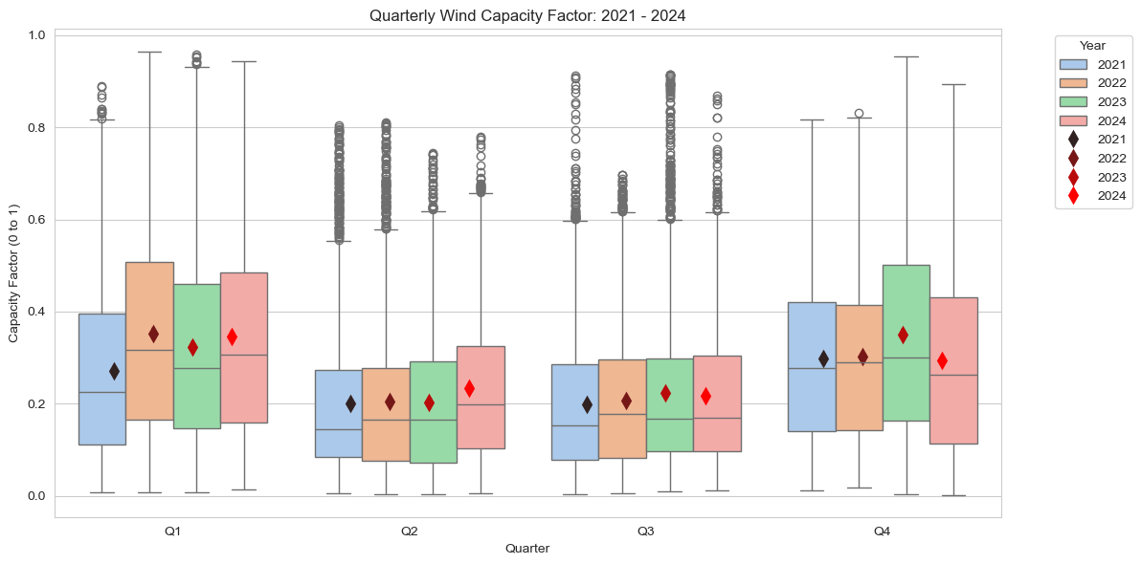
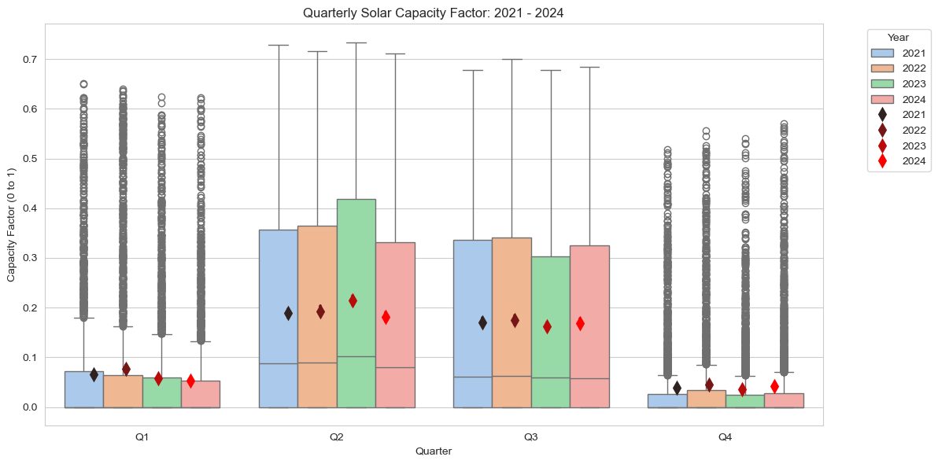
Input Data
Distribution of Wind/Solar CF in each quarter of the year

Slide 4
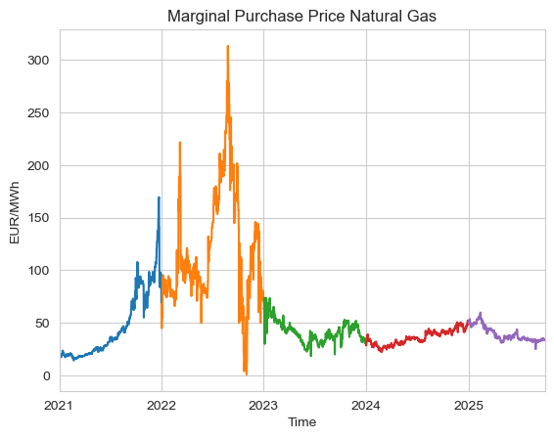
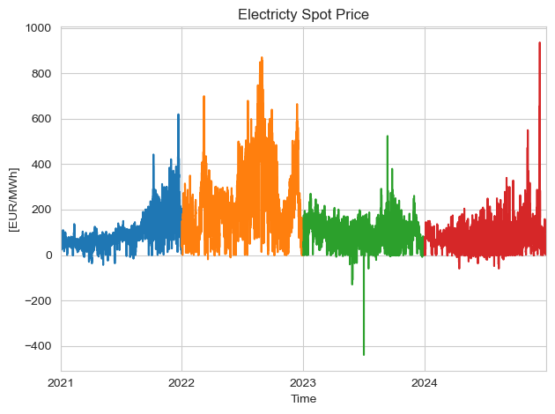
Input Data
-

Slide 5
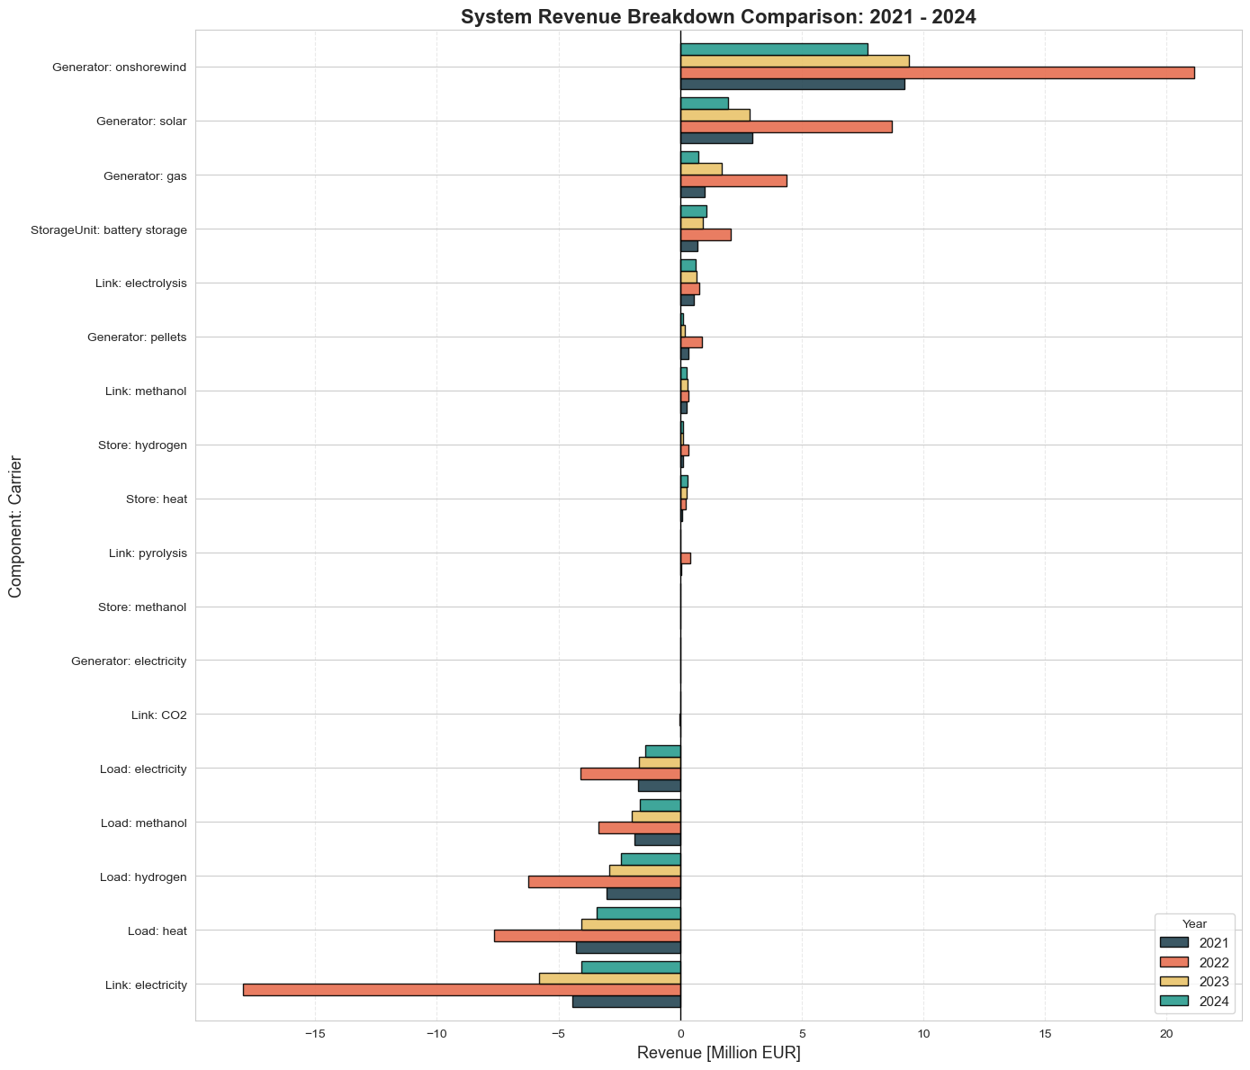
System Revenue

Slide 6
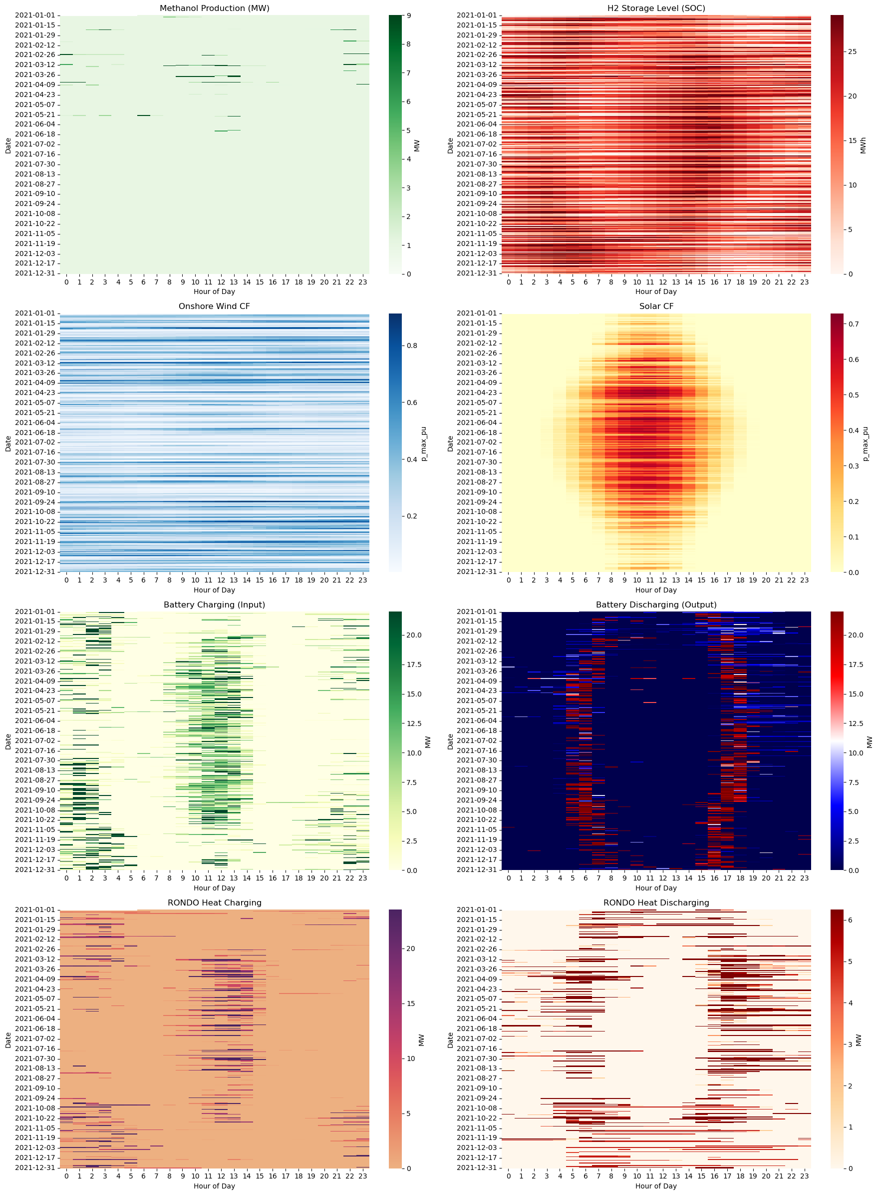

Slide 7
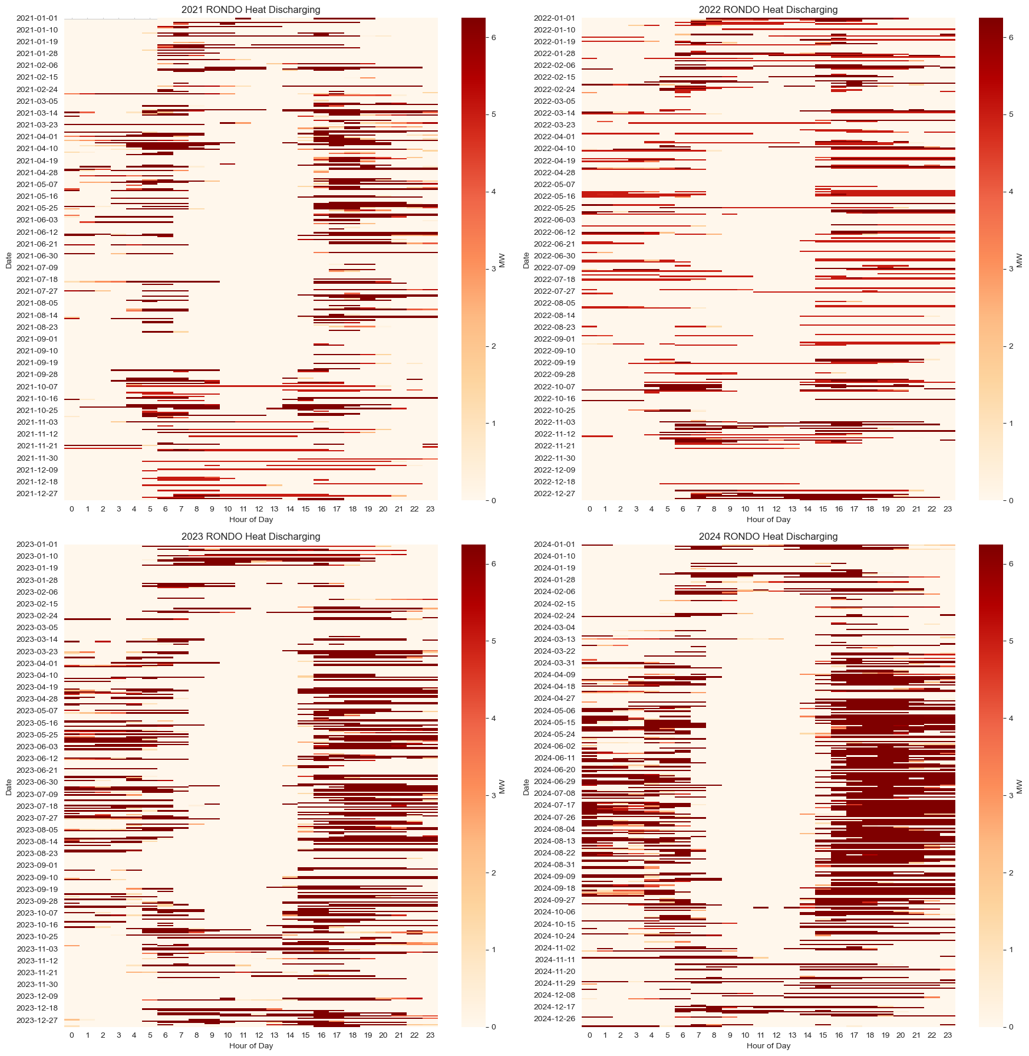
RONDO Discharging Behavior

Slide 8
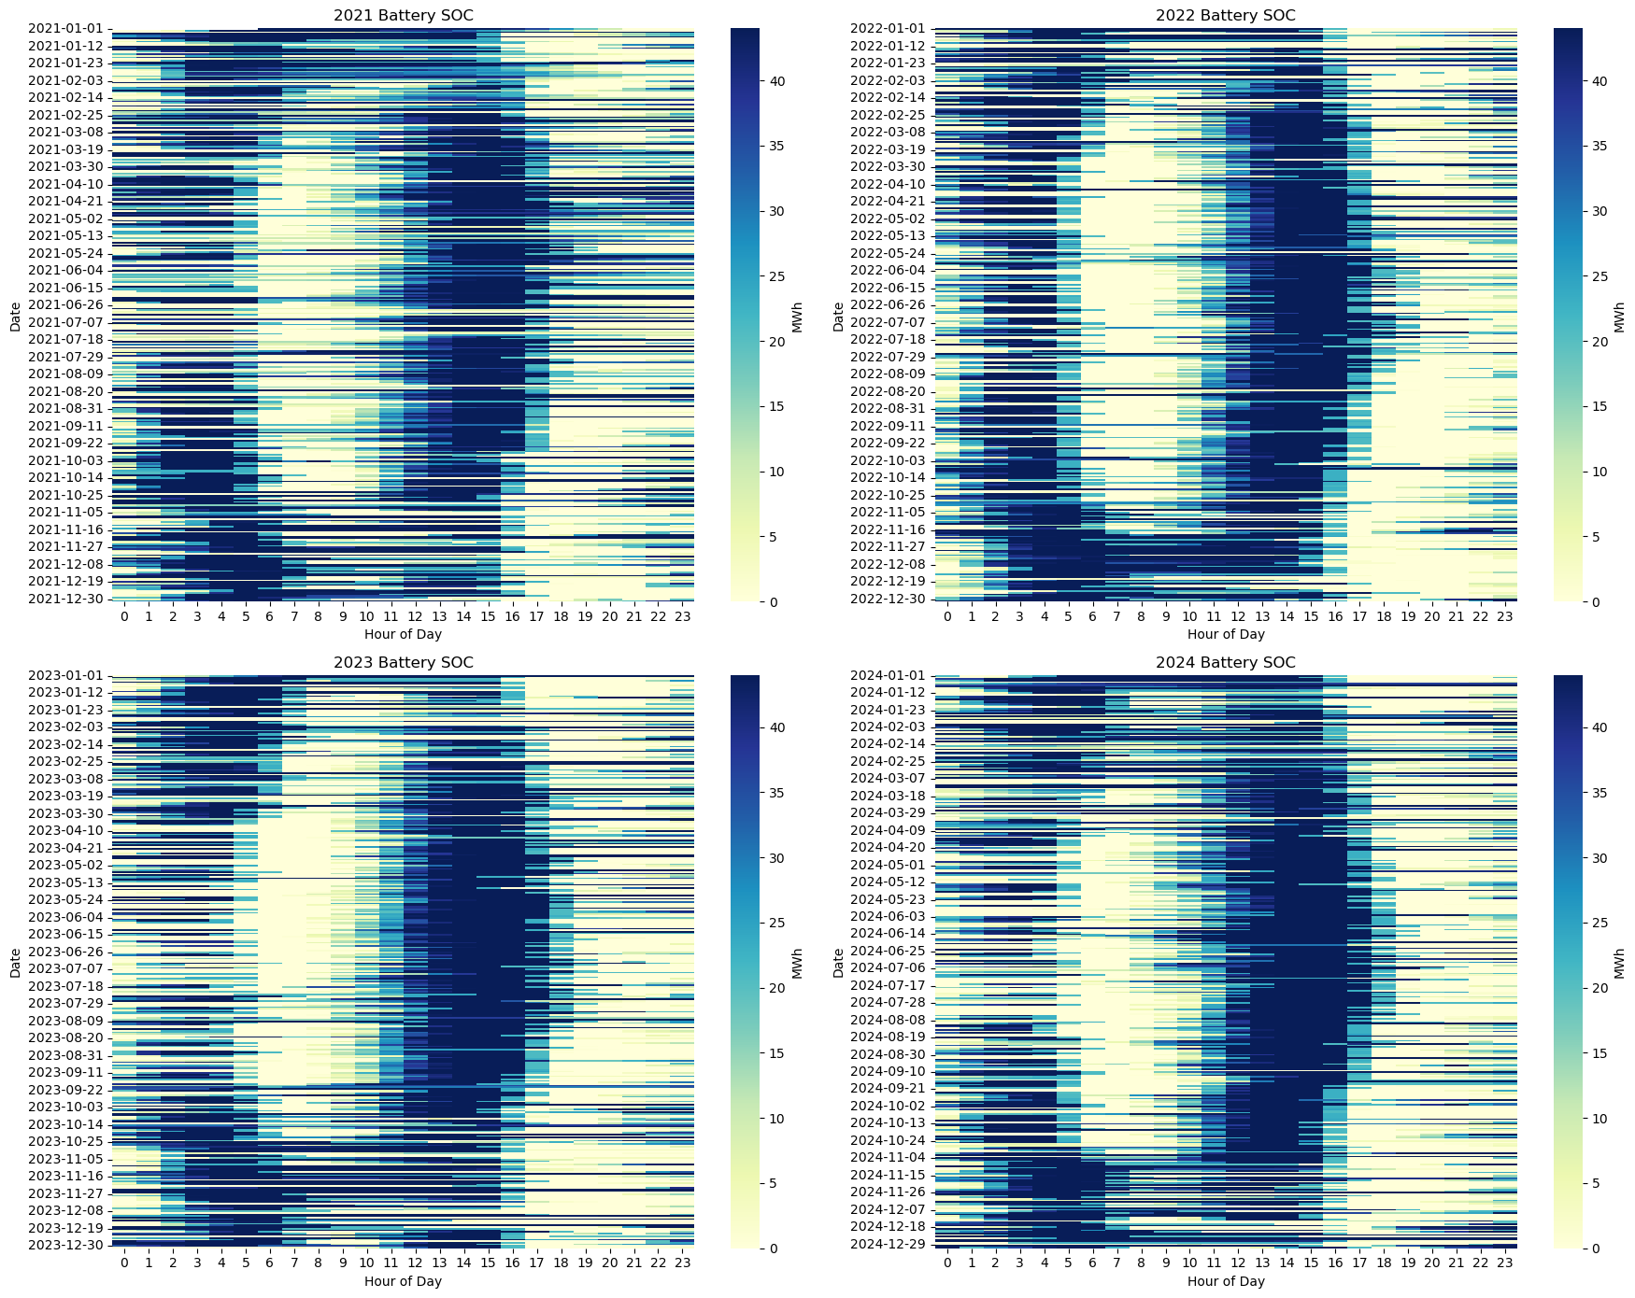
Battery SOC

Slide 9
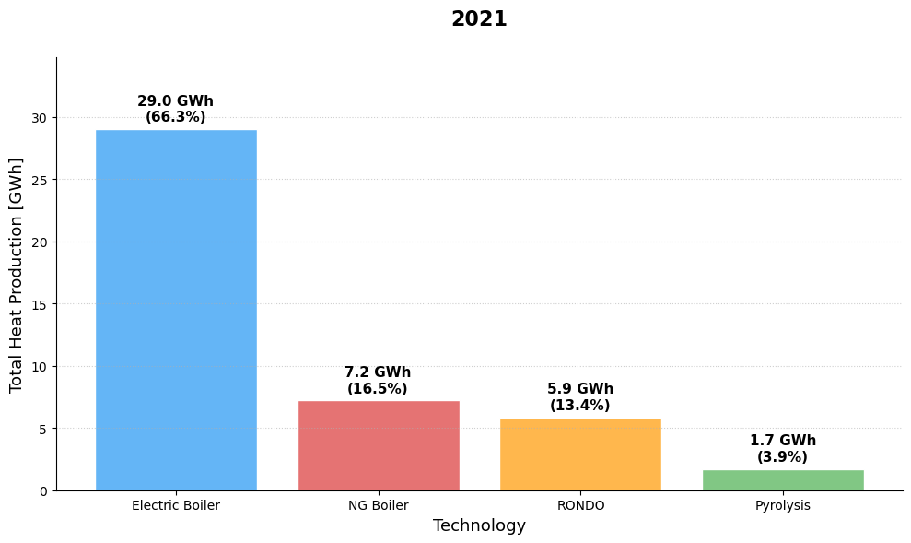
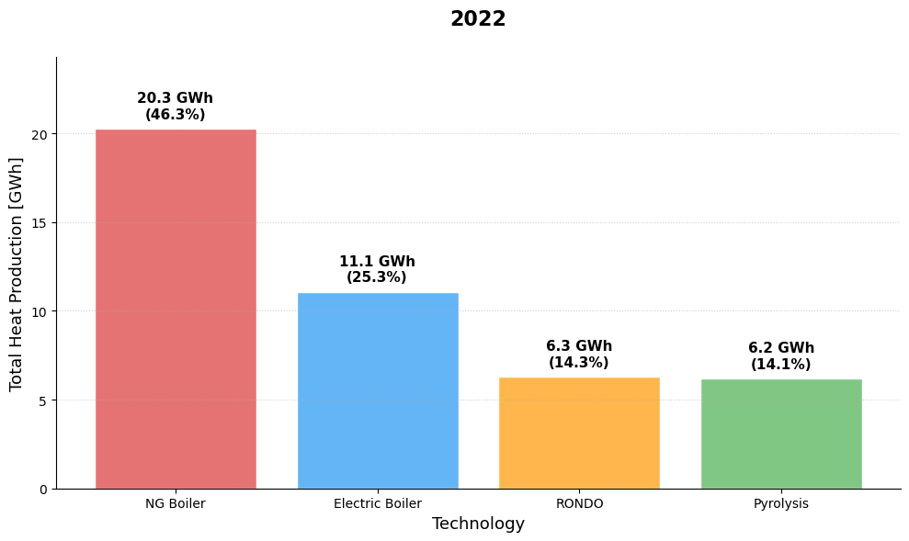
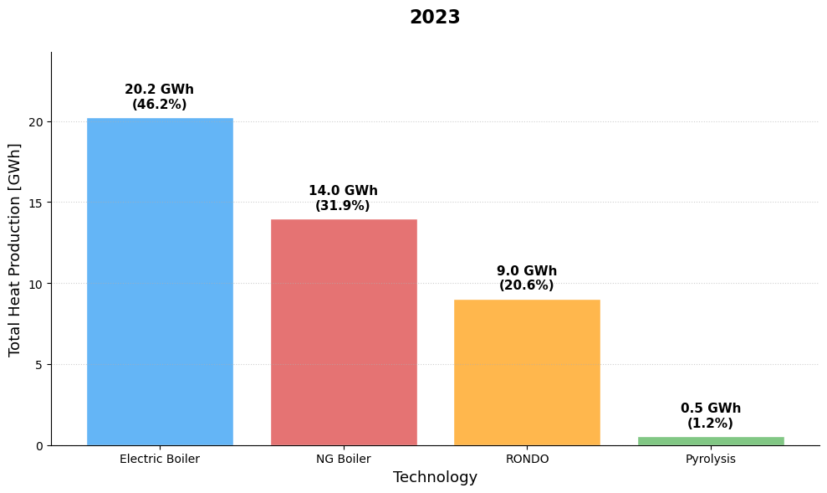
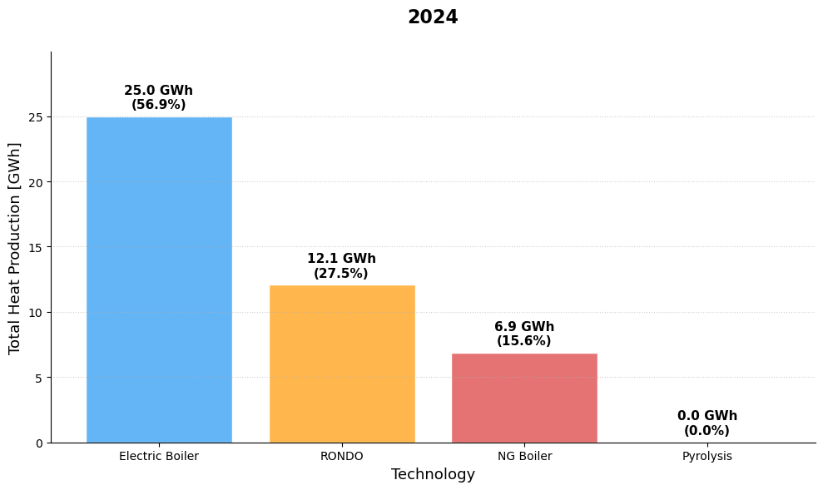
Base Scenario Heat Generation
Notes:
2022 used Pyrolysis most
-

Slide 10
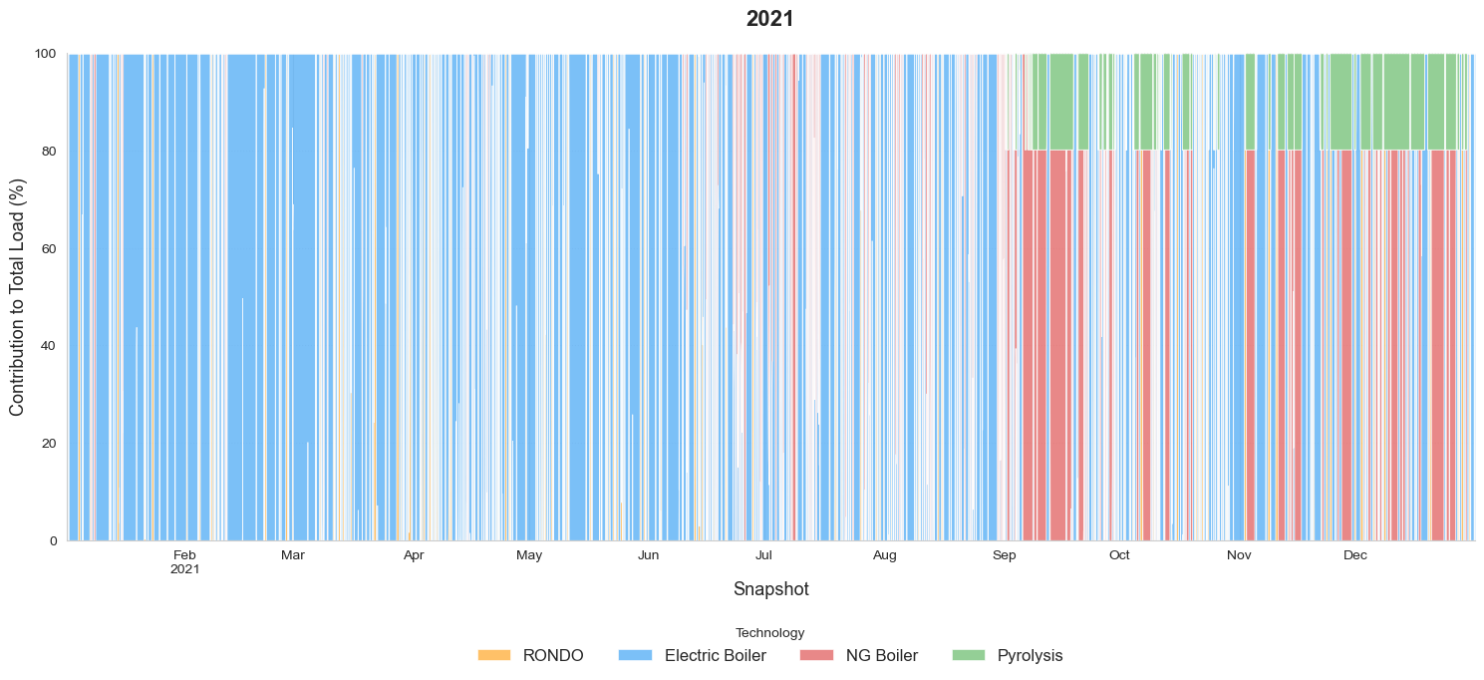
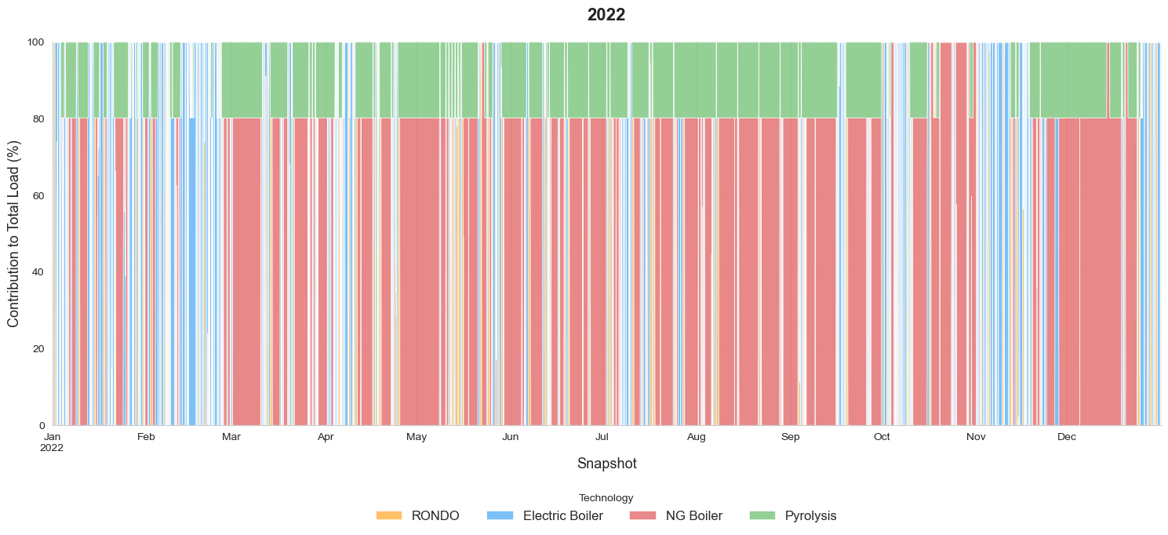
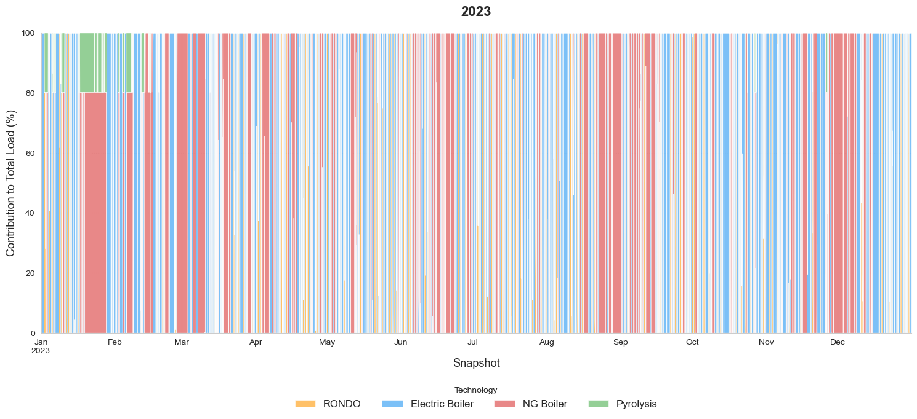
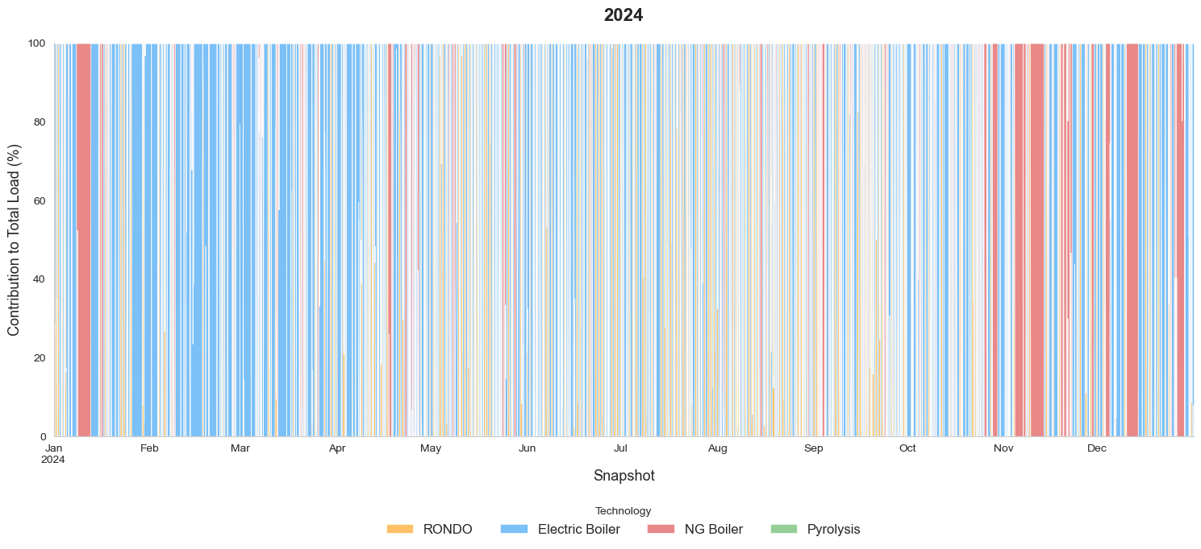

Slide 11


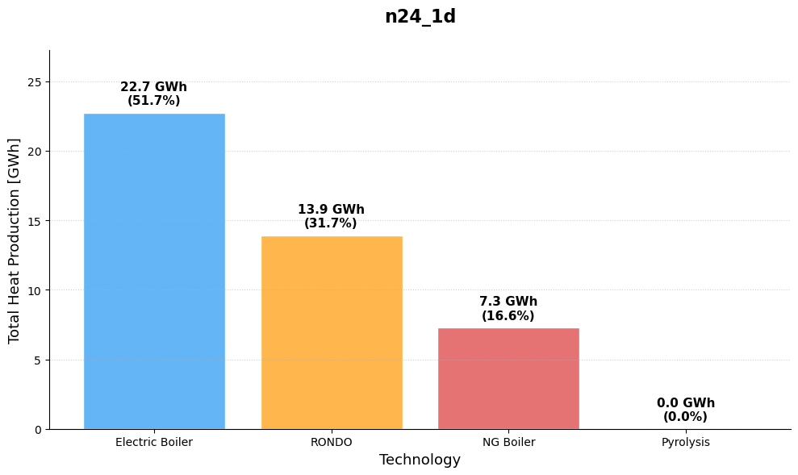

Rolling Horizon

Slide 12

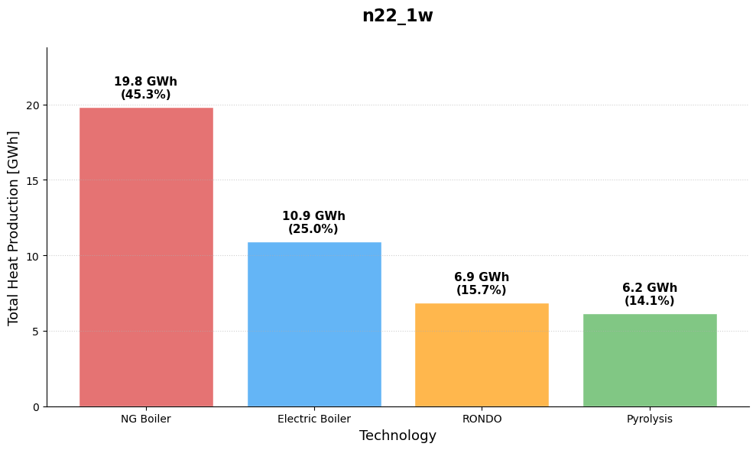
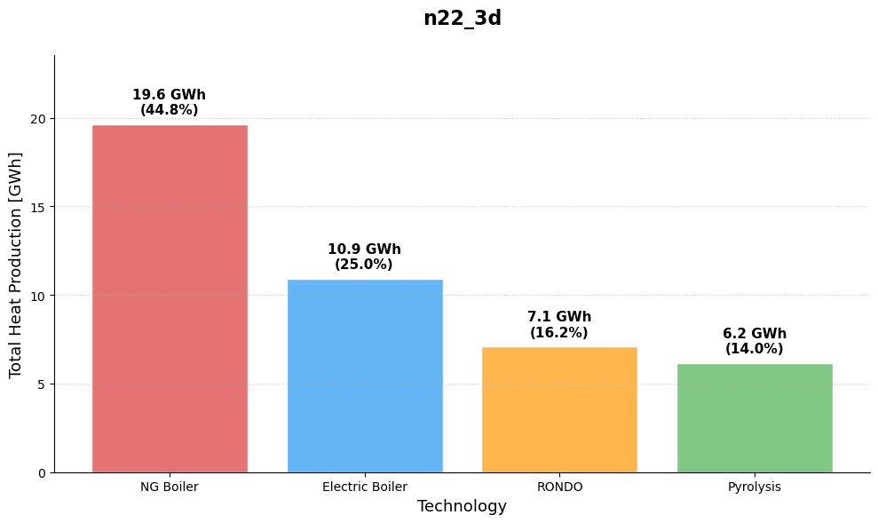
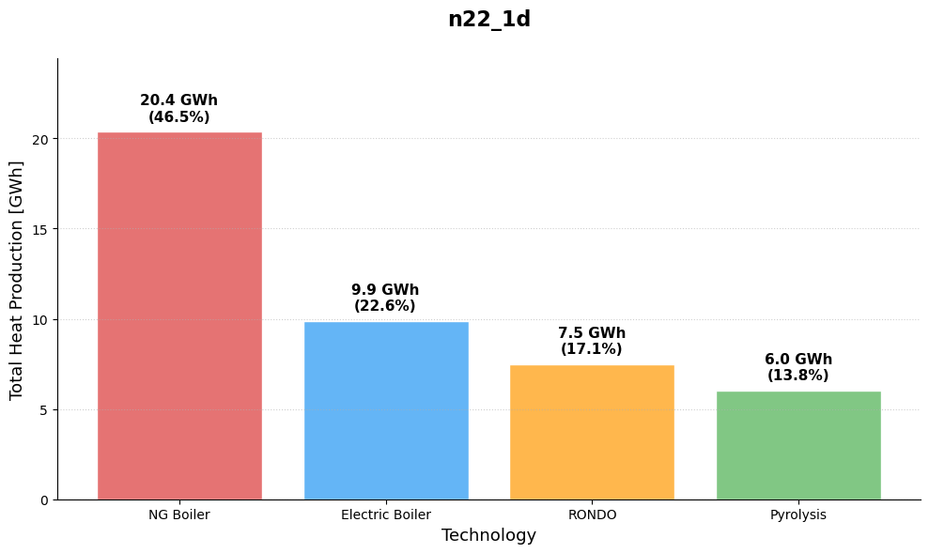
Notes:
Shorter Foresight led to more utilization of RONDO

Slide 13
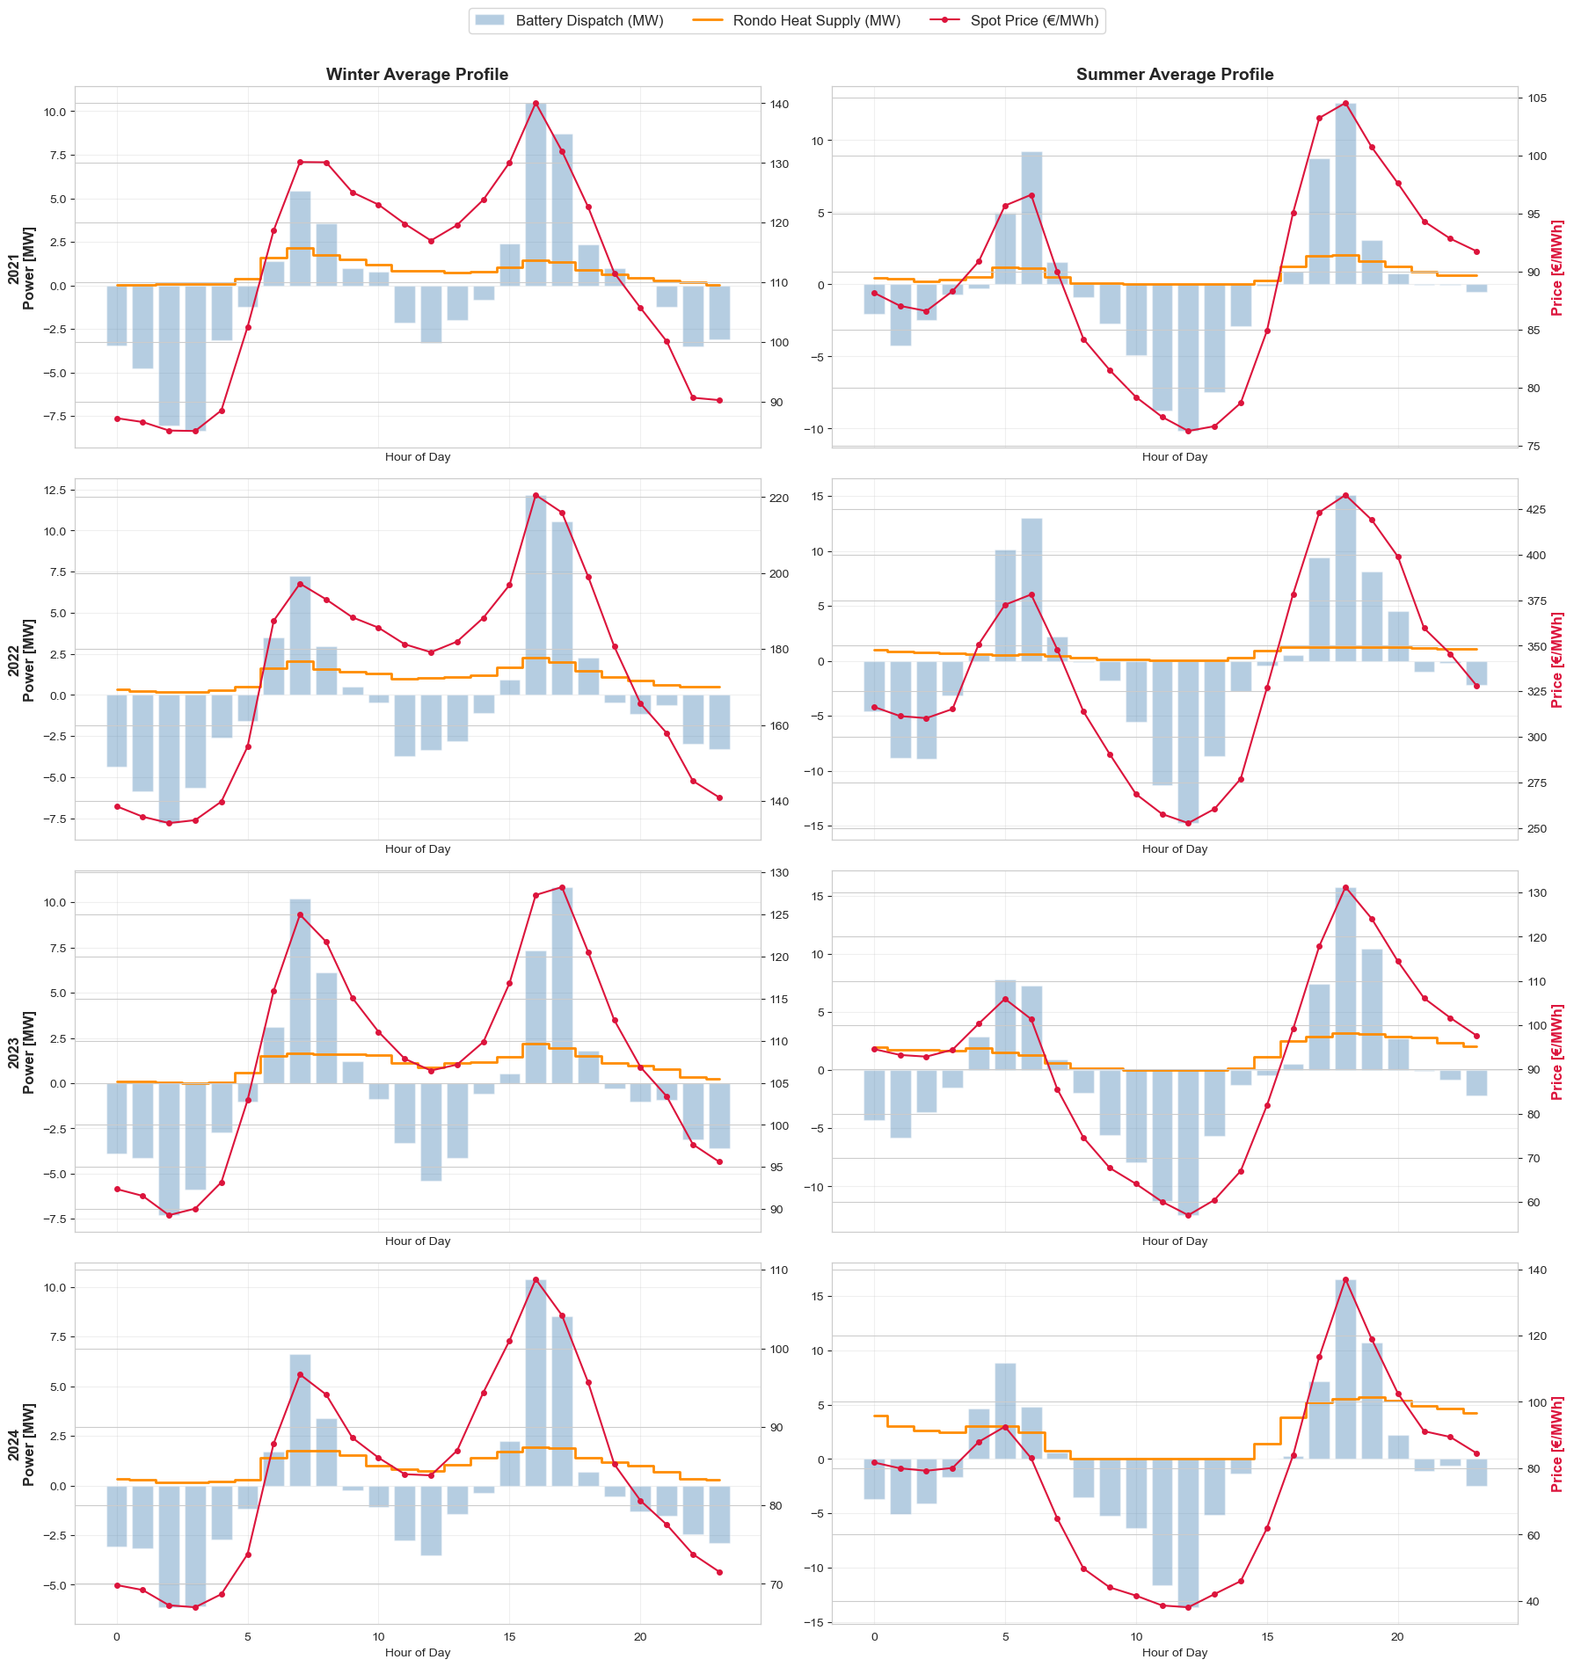
Seasonal Behavior

Slide 14
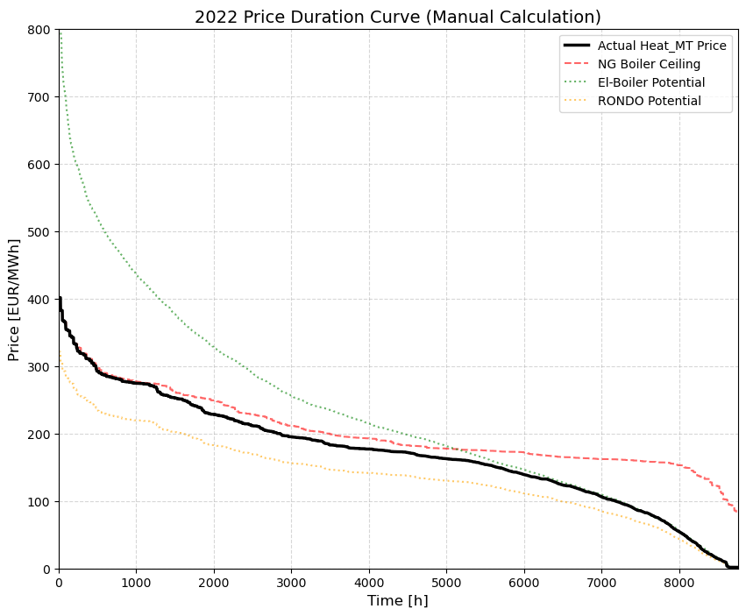
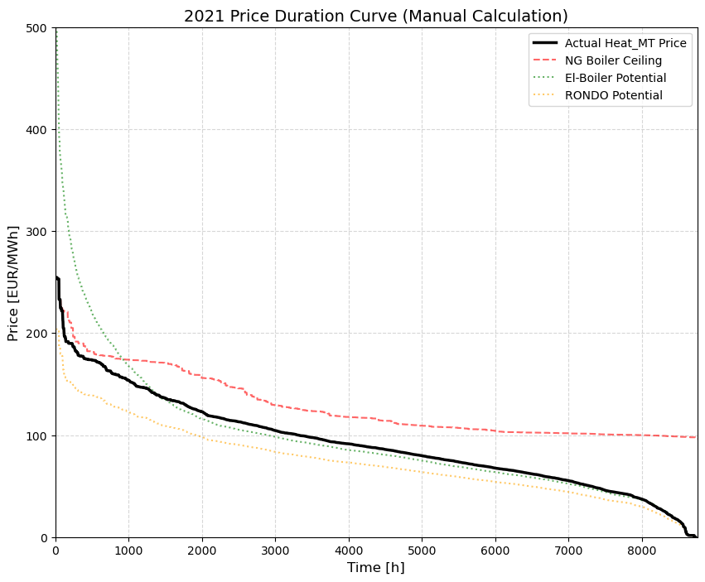
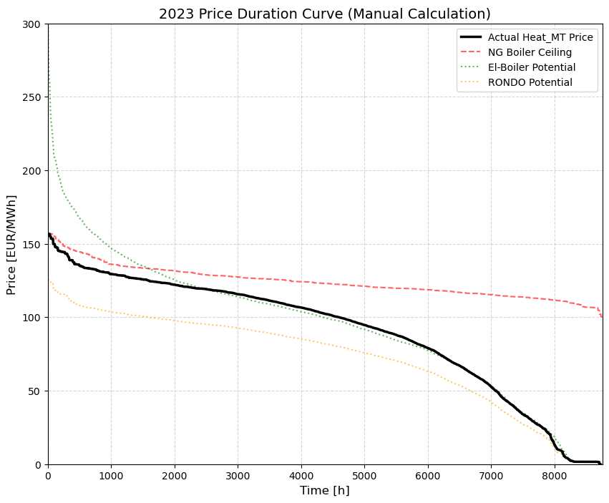
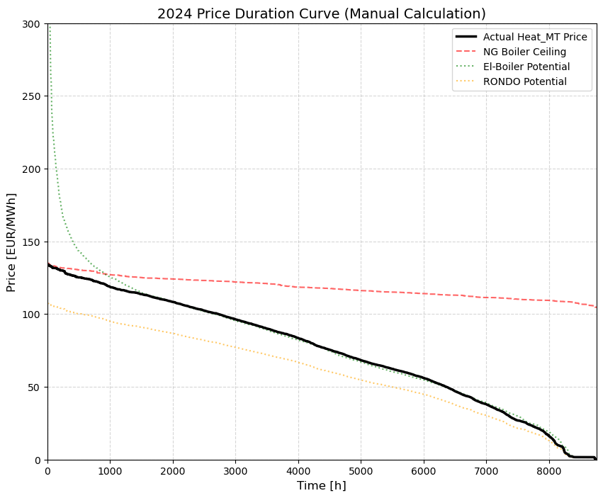
Heat Price

Slide 15
Updates
Managed to simulate Biogas Demand via a store with (500,00 t) Biomass
And Load for Biogas 200 GWh, but only at the last timestep (Alberto´s Method)
Makes Pyrolysis the Baseline/Dominant Heat provider in the system
RONDO was still used more in 2024 in updated model

