Slide 1

HW Accelerated List Decoding
Joshua Mathew

Slide 2
Outline
Background on List Decoding
Accelerator Architecture for FPGA
Noise Generation

Slide 3
BACKGROUND ON LIST DECODING

Slide 4
Convolutional Encoding
What is Convolutional encoding?
A form of forward error correction that convolves stream of bits with some binary polynomial in order to produce an encoded message.
Original Message
Encoded Message
0 | 1 | 0 | 1 | 0 | 0 | 0
G(D)
1 | 1
D
0 | 1 | 0 | 1 | 0 | 0 | 0
1 | 1 | 1 | 1
0 | 1 | 0 | 1 | 0 | 0 | 0
1 | 1 | 1 | 1 | 0 | 1
0 | 1 | 0 | 1 | 0 | 0 | 0
1 | 1 | 1 | 1 | 0 | 1 | 1 | 1

Slide 5

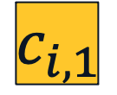





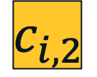

Convolutional Encoding (Cont.)
Trellis Representation
$$b :c_{1}c_{2}$$
$G\left(D\right)=\left[c_{1} c_{2}\right]$
$$c_{i,1}$$
000
000
000
000
$$G\left(D\right)=[ 1+D+D^{3} 1+D+D^{2}+D^{3}]$$
001
1:11
001
001
001
010
010
0:11
010
010
$$b_{i}$$
D
D
D
011
011
011
011
…
100
100
100
0:01
100
101
101
101
101
Hardware representation
(D, D, D) = State
110
110
110
110
$$c_{i,2}$$
111
111
111
111
$$T_{0}$$
$$T_{1}$$
$$T_{2}$$

Slide 6

Trellis Skelly
000
000
000
000
000
001
001
001
001
001
010
010
010
010
010
011
011
011
011
011
100
100
100
100
100
101
101
101
101
101
110
110
110
110
110
111
111
111
111
111
$$T_{0}$$
$$T_{1}$$
$$T_{2}$$
$$T_{3}$$

Slide 7
State Diagram
0:10
110
100
0:01
1:01
0:01
0:11
1:10
0:00
0:00
111
101
010
000
0:10
1:00
1:10
1:01
011
1:11
0:11
001
1:11
1:00

Slide 8
Path object
initial_state
decision_bits
metric
8 bits
43 bits
21 bits

Slide 9




Parallel List Viterbi Decoding (PLVD)
Received Message: 11 11 01 01
Maximum likelihood (ML) path
000
000
000
000
000
Start to end path represents encoding
Lowest distance path is ML decoding
001
1:11
001
001
001
001
010
010
0:11
010
010
010
PLVD Algorithm
011
011
011
011
0:11
011
Iterate through the time points
Maintain list of best paths and metrics
Every node compares incoming lists
The L best paths continue
Edges add distances to metric of L
Repeat for next time point
0:01
100
100
100
100
100
101
101
101
101
101
110
110
110
110
110
111
111
111
111
111
$$T_{0}$$
$$T_{1}$$
$$T_{2}$$
$$T_{3}$$

Slide 10
Additional Conditions
1 | 1 | 1 | 1 | 0 | 1 | 1 | 1
1 | 1 | 1
000
000
001
ENCODE
010
DECODE
100
1 | 1 | 1 | 1 | 0 | 0 | 1 | 1
1 | 0 | 1
Tailbiting Condition (TB)
Used to frame synchronize
End state = Start state
Cyclic Redundancy Check (CRC)
More error checking and correction

Slide 11
ACCELERATOR ARCHITECTURE

Slide 12
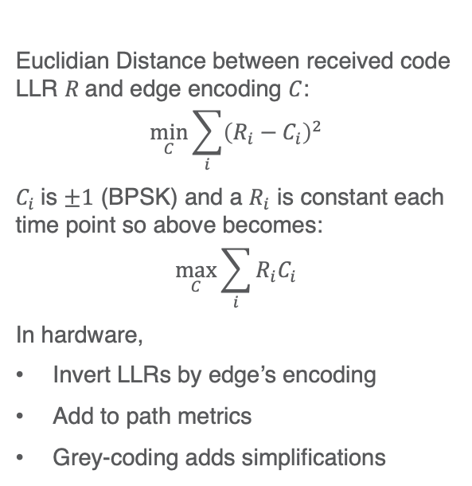
Basic HW Optimizations
Metric Computation
Merge sorting
Euclidian Distance between received code LLR $R$and edge encoding $C$:
$$\min_{C}{\sum_{i}{{\left(R_{i}−C_{i}\right)}^{2}}}$$
$C_{i}$is $±1$ (BPSK) and a $R_{i}$ is constant each time point so above becomes:
$$\max_{C}{\sum_{i}{R_{i}C_{i}}}$$
In hardware,
Invert LLRs by edge’s encoding
Add to path metrics
Grey-coding adds simplifications
Keep Lists sorted throughout PLVD
Makes “filtering” computationally efficient
1, 2
10.0
8.0
5.0
2.0
1.0
1
12.0
5.0
5.0
4.0
1.0
3
2, 3,4
>
4,5
5
1
12.0
10.0
8.0
5.0
5.0

Slide 13
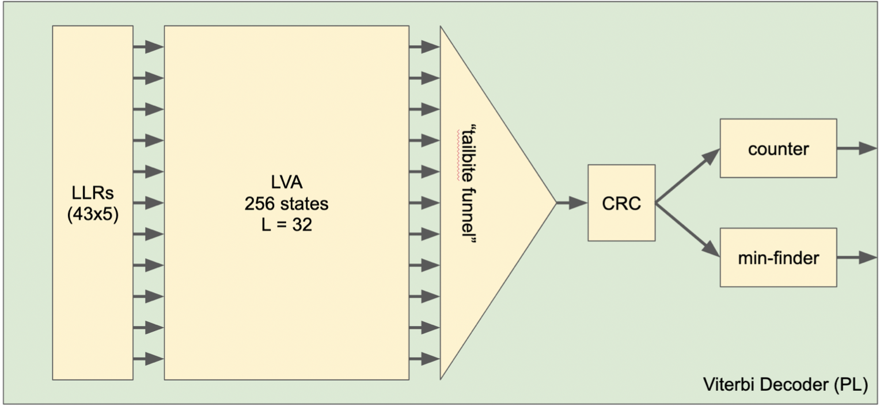
Previous Design

Slide 14
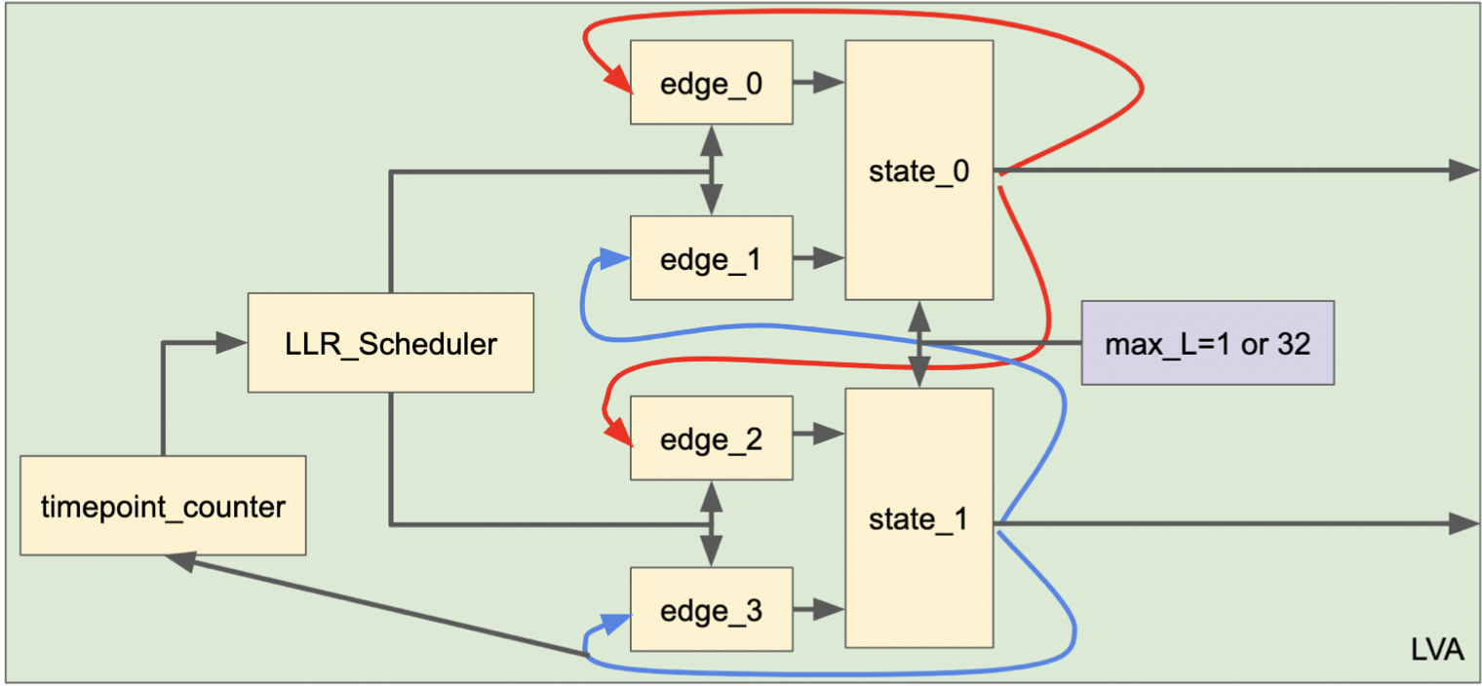
Previous Design (Cont.)
LVA Design
Two FIFOs per state
FIFO memory stores L paths
All states processed in parallel
Fixed inter-module routing
Edge module handles metric
State module handles sort

Slide 15
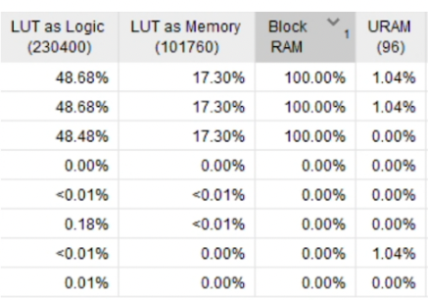
Previous Design Flaws
FIFO Flushing
Over-parallelism
Unused paths stay in FIFO
Cycles wasted on flushing out paths
Worst case scenario is a delay of L
More BRAMs needed than available
LUTs forced to be used as memory
Creates routing and clock timing issues
5.0
2.0
1.0
X
X
X
X
X
10.0
8.0
5.0
2.0
1.0
Pass Merge Sort
Must Flush
Don’t Pass Merge Sort
Next Path Values

Slide 16



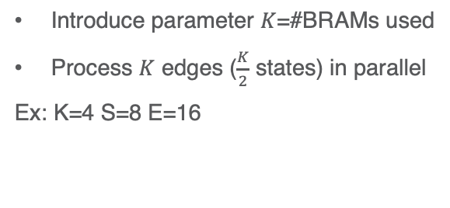



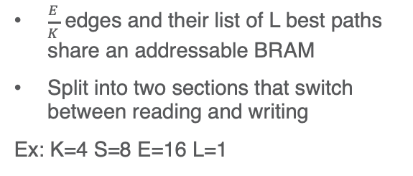








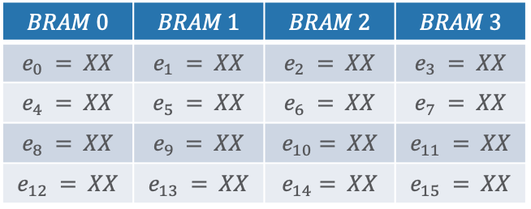


Changes to Design - K BRAMs
Addressable memory
More sequential Processing
$\frac{E}{K}$ edges and their list of L best paths share an addressable BRAM
Split into two sections that switch between reading and writing
Ex: K=4 S=8 E=16 L=1
Introduce parameter $K$=#BRAMs used
Process $K$ edges ($\frac{K}{2}$ states) in parallel
Ex: K=4 S=8 E=16
$$e_{0}, e_{1}$$
000
$$e_{0}, e_{8}$$
$$e_{2}, e_{3}$$
001
$$e_{1}, e_{9}$$
$$BRAM 0$$ | $$BRAM 1$$ | $$BRAM 2$$ | $$BRAM 3$$
$$e_{0} = XX$$ | $$e_{1} = XX$$ | $$e_{2} = XX$$ | $$e_{3} = XX$$
$$e_{4} = XX$$ | $$e_{5} = XX$$ | $$e_{6} = XX$$ | $$e_{7} = XX$$
$$e_{8} = XX$$ | $$e_{9} = XX$$ | $$e_{10}= XX$$ | $$e_{11} = XX$$
$$e_{12} = XX$$ | $$e_{13} = XX$$ | $$e_{14}= XX$$ | $$e_{15} = XX$$
$$e_{4}, e_{5}$$
010
$$e_{2}, e_{10}$$
$$e_{6}, e_{7}$$
011
$$e_{3}, e_{11}$$
$$e_{8}, e_{9}$$
100
$$e_{4}, e_{12}$$
$$e_{10}, e_{11}$$
101
$$e_{5}, e_{13}$$
$$e_{12}, e_{13}$$
110
$$e_{6}, e_{14}$$
$$e_{14}, e_{15}$$
111
$$e_{7}, e_{15}$$

Slide 17

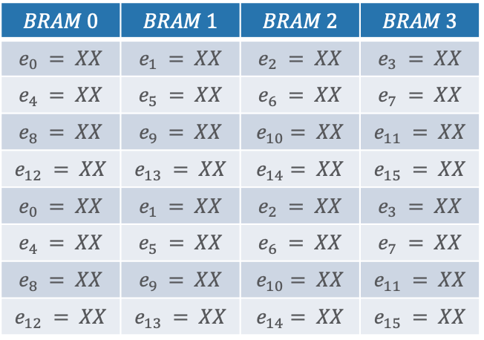

$$BRAM 0$$ | $$BRAM 1$$ | $$BRAM 2$$ | $$BRAM 3$$
$$e_{0} = XX$$ | $$e_{1} = XX$$ | $$e_{2} = XX$$ | $$e_{3} = XX$$
$$e_{4} = XX$$ | $$e_{5} = XX$$ | $$e_{6} = XX$$ | $$e_{7} = XX$$
$$e_{8} = XX$$ | $$e_{9} = XX$$ | $$e_{10}= XX$$ | $$e_{11} = XX$$
$$e_{12} = XX$$ | $$e_{13} = XX$$ | $$e_{14}= XX$$ | $$e_{15} = XX$$
$$e_{0} = XX$$ | $$e_{1} = XX$$ | $$e_{2} = XX$$ | $$e_{3} = XX$$
$$e_{4} = XX$$ | $$e_{5} = XX$$ | $$e_{6} = XX$$ | $$e_{7} = XX$$
$$e_{8} = XX$$ | $$e_{9} = XX$$ | $$e_{10}= XX$$ | $$e_{11} = XX$$
$$e_{12} = XX$$ | $$e_{13} = XX$$ | $$e_{14}= XX$$ | $$e_{15} = XX$$
First $\frac{1}{2}$ of memory
Second $\frac{1}{2}$ of memory

Slide 18
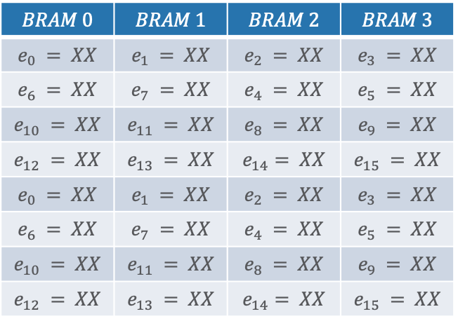
1100
$$BRAM 0$$ | $$BRAM 1$$ | $$BRAM 2$$ | $$BRAM 3$$
$$e_{0} = XX$$ | $$e_{1} = XX$$ | $$e_{2} = XX$$ | $$e_{3} = XX$$
$$e_{6} = XX$$ | $$e_{7} = XX$$ | $$e_{4} = XX$$ | $$e_{5} = XX$$
$$e_{10} = XX$$ | $$e_{11} = XX$$ | $$e_{8} = XX$$ | $$e_{9} = XX$$
$$e_{12} = XX$$ | $$e_{13} = XX$$ | $$e_{14}= XX$$ | $$e_{15} = XX$$
$$e_{0} = XX$$ | $$e_{1} = XX$$ | $$e_{2} = XX$$ | $$e_{3} = XX$$
$$e_{6} = XX$$ | $$e_{7} = XX$$ | $$e_{4} = XX$$ | $$e_{5} = XX$$
$$e_{10} = XX$$ | $$e_{11} = XX$$ | $$e_{8} = XX$$ | $$e_{9} = XX$$
$$e_{12} = XX$$ | $$e_{13} = XX$$ | $$e_{14}= XX$$ | $$e_{15} = XX$$
First $\frac{1}{2}$ of memory
Second $\frac{1}{2}$ of memory

Slide 19







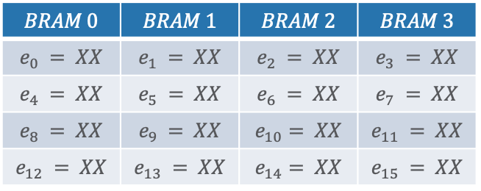
Design Challenge
Inefficient BRAM Labeling
$$e_{0}, e_{1}$$
000
$$e_{0}$$
In examples given earlier, we have 2 reads from BRAM 0 & 1 simultaneously
In hardware this is extremely tricky
001
$$e_{1}$$
$$e_{2}$$
$$e_{3}$$
Challenge:
$$e_{8}, e_{9}$$
Create
An order for parallel state processing
A labeling of edges to BRAMs
Such that each BRAM has exactly 1R/1W per cycle (2 axes of freedom)
$$BRAM 0$$ | $$BRAM 1$$ | $$BRAM 2$$ | $$BRAM 3$$
$$e_{0} = XX$$ | $$e_{1} = XX$$ | $$e_{2} = XX$$ | $$e_{3} = XX$$
$$e_{4} = XX$$ | $$e_{5} = XX$$ | $$e_{6} = XX$$ | $$e_{7} = XX$$
$$e_{8} = XX$$ | $$e_{9} = XX$$ | $$e_{10}= XX$$ | $$e_{11} = XX$$
$$e_{12} = XX$$ | $$e_{13} = XX$$ | $$e_{14}= XX$$ | $$e_{15} = XX$$

Slide 20
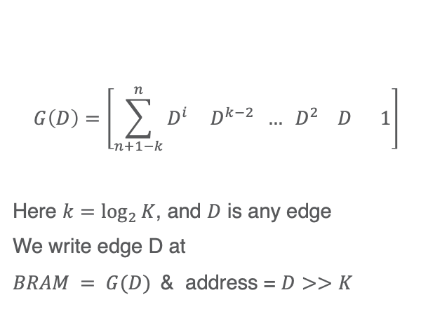
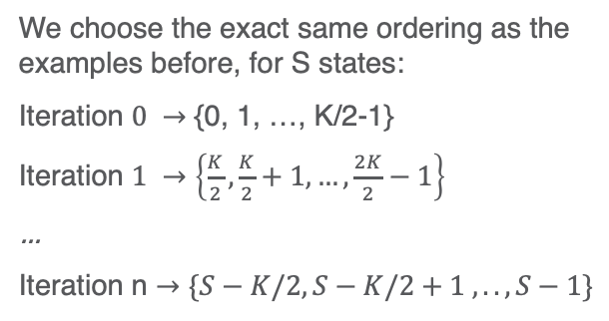
Solution to Labeling Challenge
Key Insights
“BRAM labeling” in principle is just an encoding, thus we can apply linear block code theory
Finding a valid generator polynomial G(D) makes implementation extremely hardware efficient
(1) Naïve ordering
(2) Bram encoder
We choose the exact same ordering as the examples before, for S states:
Iteration $0 →$ {0, 1, …, K/2-1}
Iteration $1 →\left\{\frac{K}{2},\frac{K}{2}+1, …,\frac{2K}{2}−1\right\}$
…
Iteration n $→\{S−K/2, S−K/2+1 ,.., S−1\}$
$$G\left(D\right)=\left[{\sum_{n+1−k}^{n}{D^{i}} D^{k−2} … D}^{2} D 1\right]$$
Here $k=\log_{2}{K}$, and $D$ is any edge
We write edge D at
$BRAM = G(D)$& address = $D>>K$

Slide 21
Final HW Architecture
AXI-LITE
AXI-S
LVA
K/2
Edge
Modules
AXI-LITE
Write Bus
K BRAMS
AXI-LITE
Read Bus
K/2
State
Modules
K/2
K/2
K
K
K/2
K/2

Slide 22
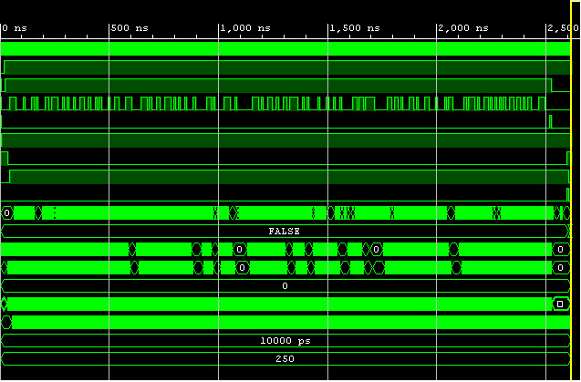
Current and Future Steps
Current Efforts
Verification of design in simulation
Ensures no major timing errors & behavior
Demonstrate lower FPGA resource usage
Future Efforts
Use as computational core for CRC aided TBCC simulations
Simulate novel decoding schemes and compare performance

Slide 23
NOISE GENERATION

Slide 24
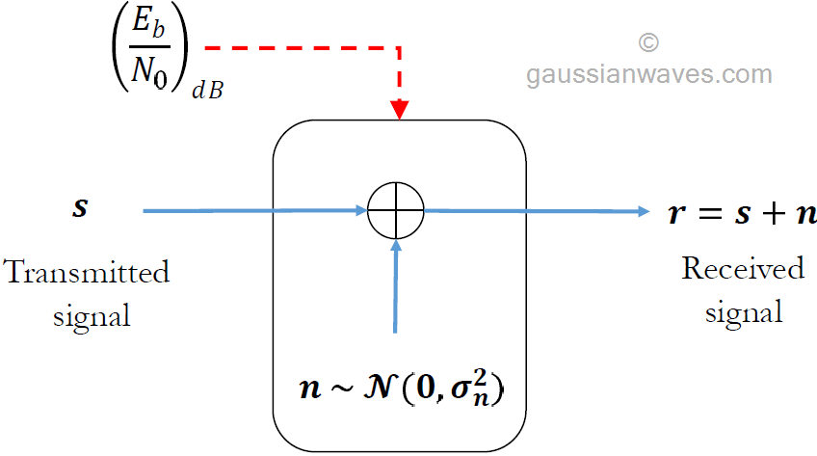
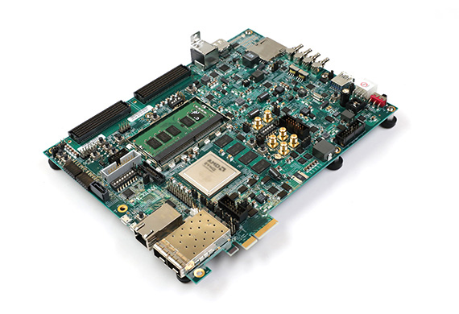
Motivation for AWGN in HW
Big Picture
Encoder
Decoder
Accelerated
If we accelerate this we can fit the entire pipeline onto one FPGA

Slide 25
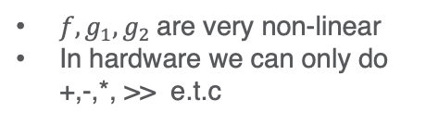
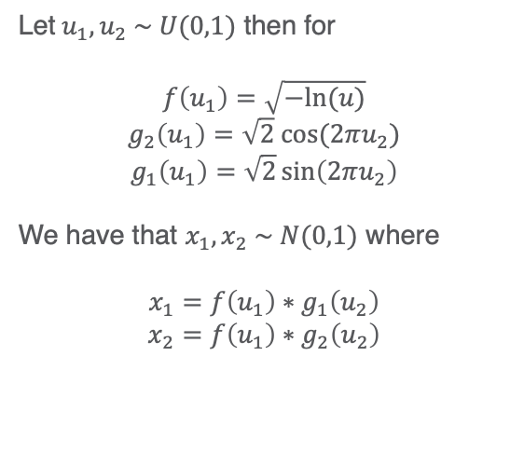
Transforming Uniform RVs into Gaussian
This implementation is based on the findings of Lee, Luk, Villasenor, et al. [2]
Box Muller Transformation
Let$u_{1}, u_{2} \sim U(0,1)$ then for
$$f\left(u_{1}\right)=\sqrt{−ln⁡(u)}$$
$$g_{2}\left(u_{1}\right)=\sqrt{2} cos⁡(2πu_{2})$$
$$g_{1}\left(u_{1}\right)=\sqrt{2}\sin\left(2πu_{2}\right)$$
We have that $x_{1}, x_{2} \sim N(0,1)$ where
$$x_{1}={f\left(u_{1}\right)∗g}_{1}\left(u_{2}\right)$$
$$x_{2}={f\left(u_{1}\right)∗g}_{2}\left(u_{2}\right)$$
ISSUE
$f, g_{1}, g_{2}$are very non-linear
In hardware we can only do +,-,*, >> e.t.c

Slide 26
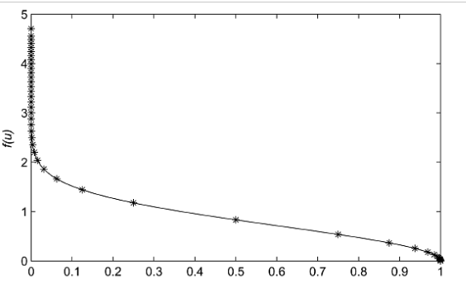
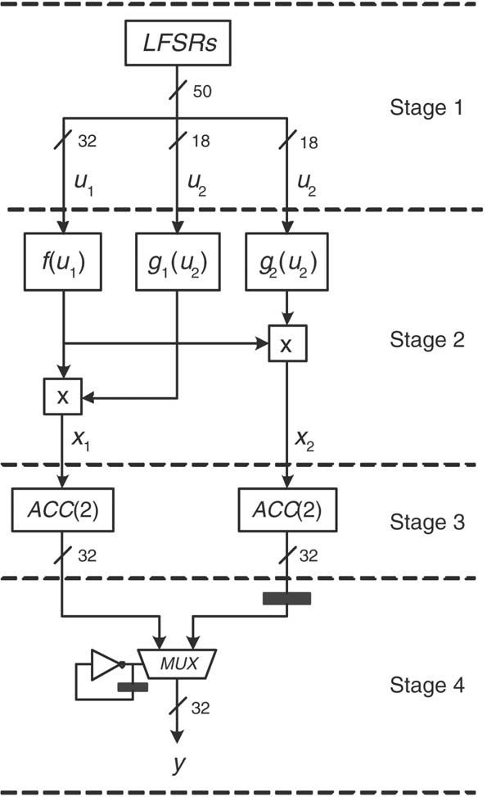
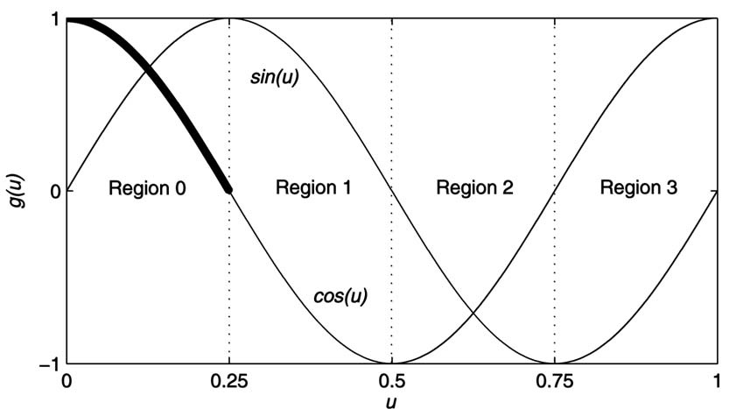
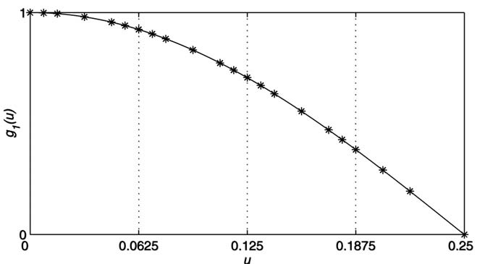
Non-Uniform Segmentation
Each segment is linearized
Coefficients stored in ROM
Linearization used to approximate that segment

Slide 27
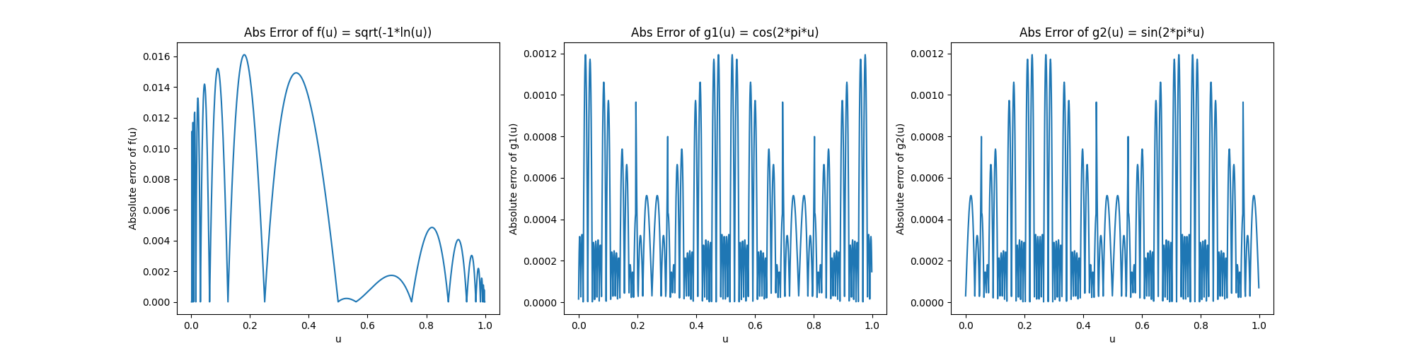
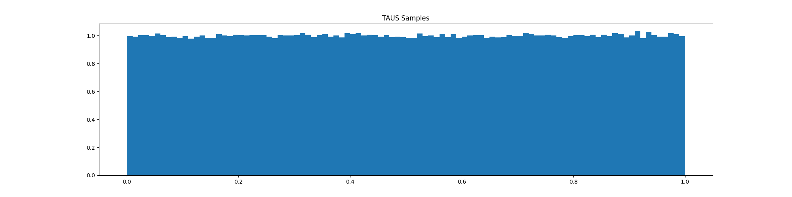
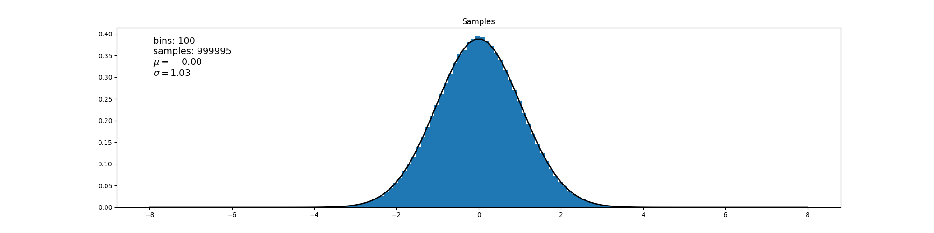
Results

Slide 28
Acknowledgements
Professor Richard D. Wesel
Professor Greg Pottie
Chester Hulse
Aadhidhya Ravikumar
Daniel Chen
Remaining CSL Undergraduates

Slide 30
References
[1] Chester Hulse, “FPGA Implementation of Decoders for CRC-Aided Tail-biting Convolutional Codes”
[2] Lee, Luk, Villasenor, et al., “A Gaussian Noise Generator for Hardware-Based S- imulations”

