Slide 1
Rates of reaction

Slide 2
reactants → products
The rate of a reaction is the speed at which reactants are turned into products.
To investigate reaction rates, we need to measure how the amount of reactants or products changes with time.
For example, we can measure the time taken for a colour change or the volume or mass of gas produced.

Slide 3
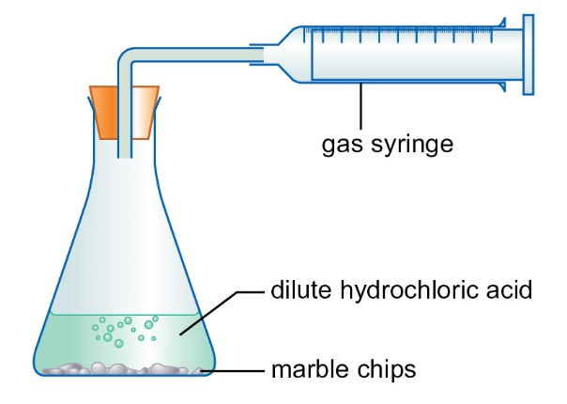
Volume of gas
Calcium carbonate (marble chips) reacts with dilute hydrochloric acid to form carbon dioxide.
The gas can be collected in a gas syringe or…

Slide 4
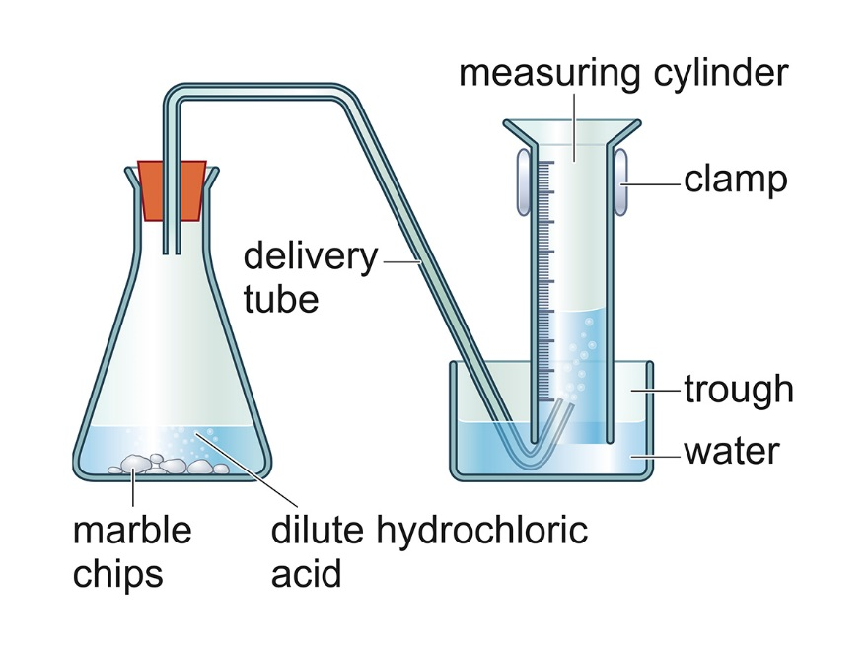
… over water in an upturned measuring cylinder.
When a gas is formed in a reaction we can collect it and measure the volume of gas at regular time intervals, or we can measure the time taken to produce a given volume of gas.

Slide 5
Question
How do you know when the reaction is complete in the previous two methods?
Answer
The reaction is complete when there is no further increase in the volume of gas collected.

Slide 6
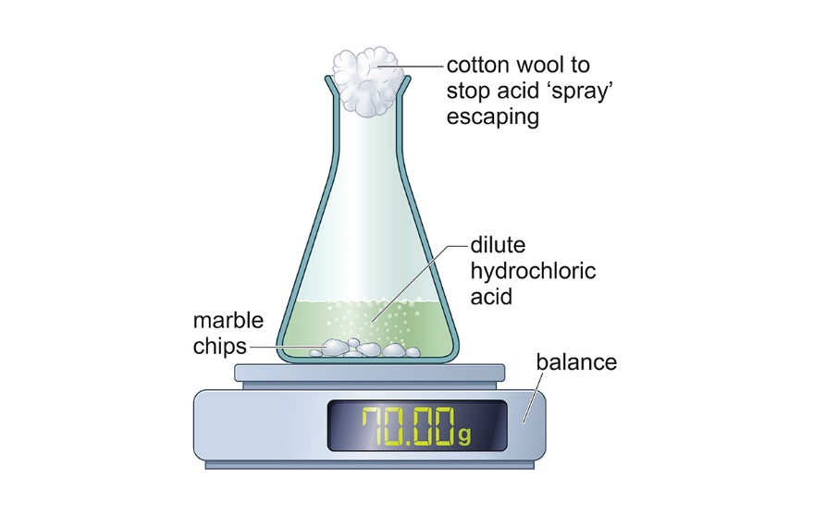
Mass of gas
We could also measure the mass of the flask and reactants, allow the gas to escape and measure the change in mass at regular time intervals.
The mass of gas produced is equal to the loss in mass of the reactants.

Slide 7
Question
Why is it important to stop acid ‘spray’ escaping?
Answer
The mass loss will be too high if any acid escapes, and there is a hazard of acid getting into the eyes or on the skin.

Slide 8
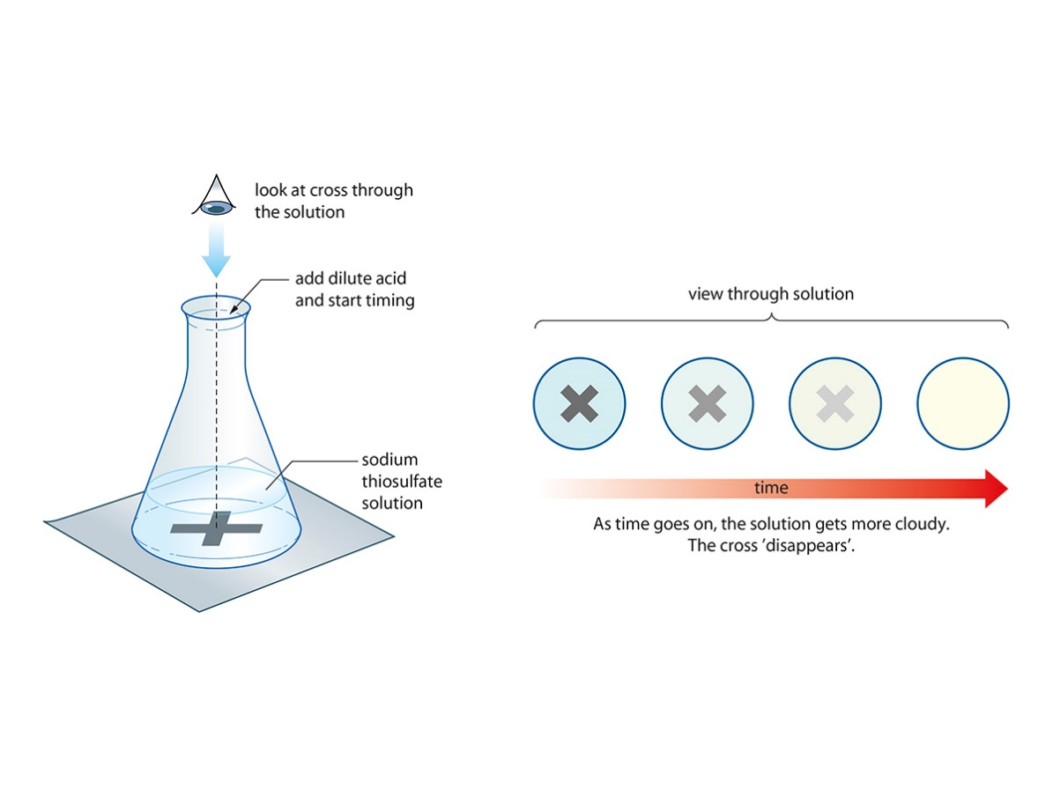
Colour change
Sodium thiosulfate solution reacts with dilute hydrochloric acid to form a yellow precipitate of sulfur. We can measure the time it takes for the precipitate to cover a black cross.

Slide 9
Question
Magnesium reacts with sulfuric acid as shown in the equation
Mg(s) + H₂SO₄(aq) → MgSO₄(aq) + H₂(g)
Suggest a method for investigating the rate of this reaction.
Answer
Collect the hydrogen in a gas syringe or upturned measuring cylinder and measure the volume at regular time intervals.
Measuring the mass loss would not work well here as the mass of hydrogen would be very small.

Slide 10
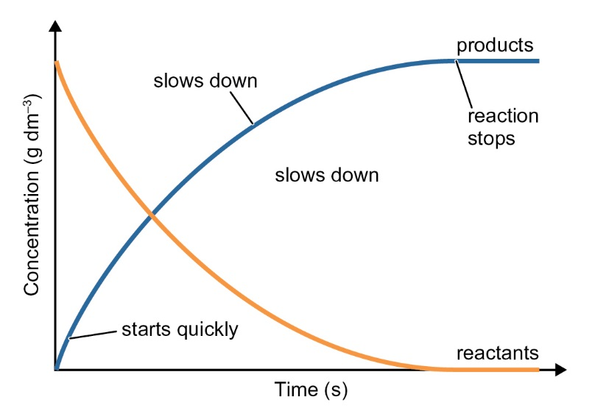
Graphs
The graph shows how the concentrations of the reactants and products change during a reaction.
The gradient (slope) of the graph is the rate of reaction at that point.
The steeper the line, the faster the rate of reaction.

Slide 11
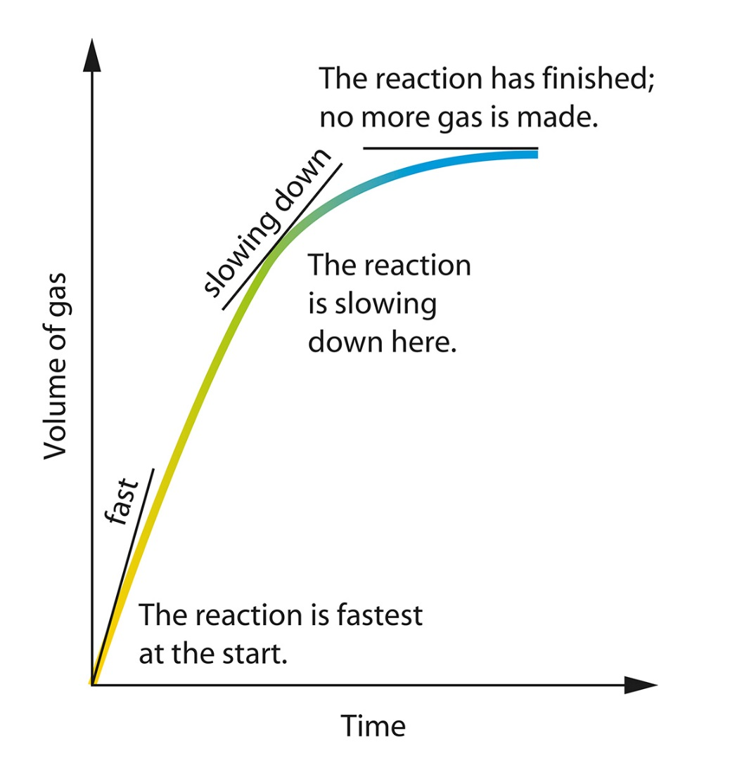
The graph shows how the rate of reaction changes during the reaction.
The straight lines touching the curve at different points are tangents to the curve.
The slope of the tangent shows the rate of reaction at that time.
The steeper the line, the faster the rate.

Slide 12
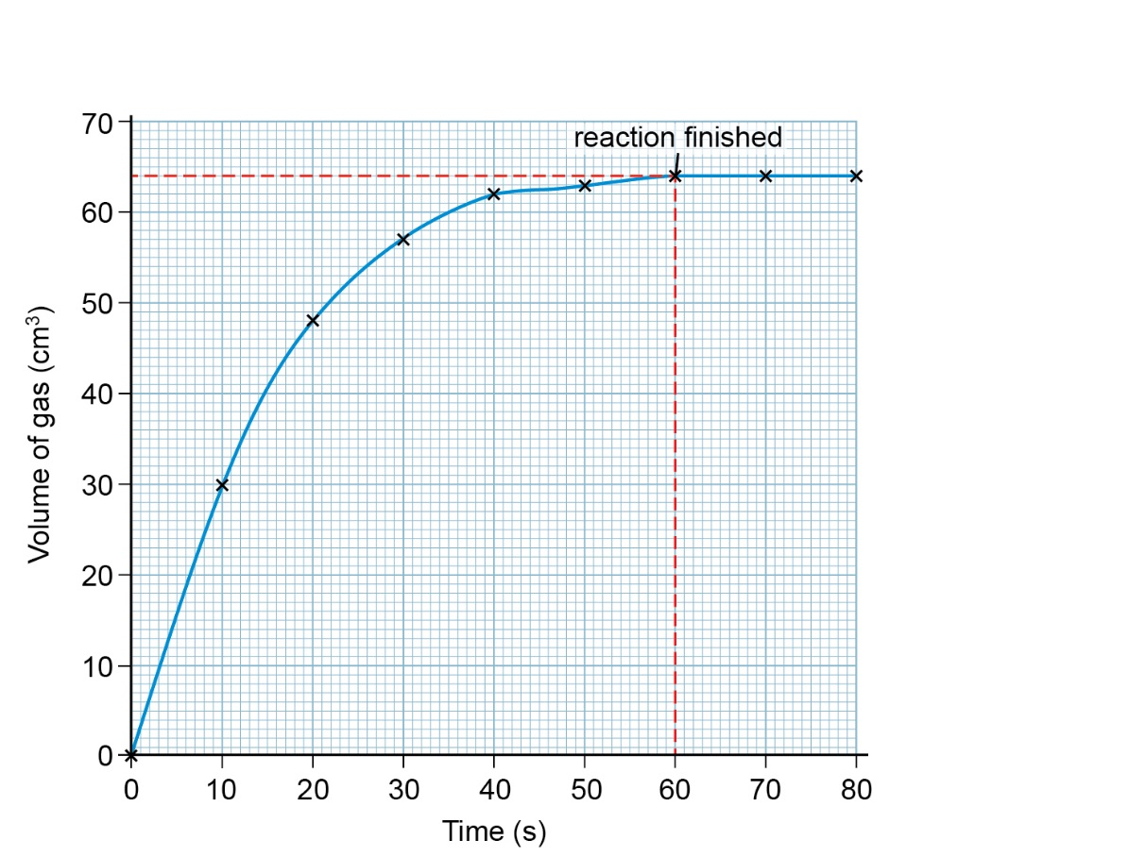
Rate of reaction
The graph shows how the volume of gas changes with time.
The reaction has finished at 60 s when 64 cm³ of gas has collected.
The average rate of reaction = volume of gas
time taken to produce gas
= 64 = 1.07 cm³/s
60

Slide 13
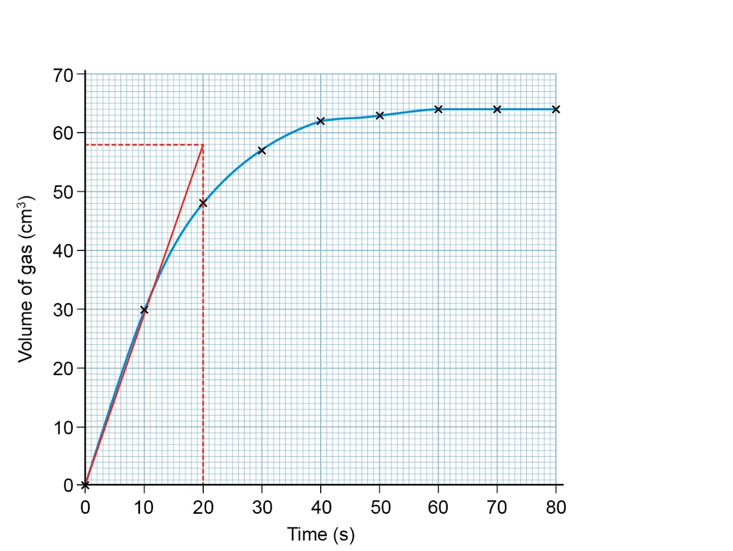
Calculating initial rate
Draw a tangent to the curve at the start and extend it to go through an exact time.
Draw horizontal and vertical lines from the end of the tangent to the axes.
Read off the volume of gas and time where the lines cross the axes:
20 s and 58 cm³ on this graph.

Slide 14
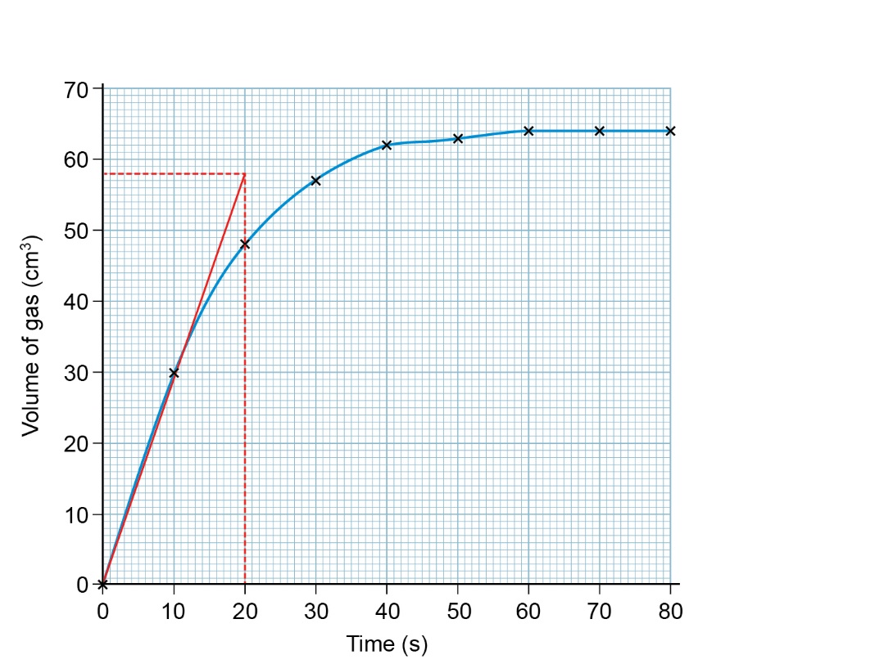
The rate of reaction is equal to the gradient of the tangent.
gradient = change in y
change in x
The initial rate of reaction at (0,0) is:
= (58 − 0)
(20 − 0)
= 2.9 cm³/s

