Slide 1
RESEARCH PRESENTATION
CASB family
Coverage-aware oversampling for binary classification
Pulkit Sharma • Priyanshu Kumar • Niranjan Yadav
Department of Artificial Intelligence
SVNIT, Surat
01
Notes:
Good morning. Our project is about learning from data where one class has far fewer examples than the other. We call the smaller class the minority class. Our method, CASB, adds examples for this class. I will explain how it works, compare it with other methods, and show both its strengths and limitations.
Evidence: latex_paper/manuscript.tex

Slide 2
01 PROBLEM AND OBJECTIVES
High accuracy can hide missed minority cases
95%
0%
Accuracy
Minority recall
100 observations: 95 majority and only 5 minority
Predict majority for every case: 95 correct, but all 5 minority cases missed
Goal: detect minority cases while controlling false positives
Illustrative 95:5 dataset: always predicting the majority misses every minority case.
02
Notes:
Imagine we have 100 examples. Ninety-five belong to one class and only five belong to the other. If a model always predicts the bigger class, it gets 95 answers right. But it misses every example from the smaller class. This is why high accuracy alone can be misleading. We want to find more minority cases without making too many wrong predictions. These numbers are an example, not an experiment result.
Evidence: latex_paper/manuscript.tex

Slide 3
01 PROBLEM AND OBJECTIVES
Research objectives
01
Reduce confusion near minority-majority class boundaries
02
Address intra-class imbalance across dense and sparse minority regions
03
Compare CASB variants and their precision-recall tradeoffs
04
Evaluate performance across datasets and classifiers
Aim: support difficult boundary regions and sparsely represented minority regions.
03
Notes:
We have two main aims. First, we want to reduce confusion where the two classes are close together. Second, we want to support minority regions that have very few examples. This second problem is called intra-class imbalance: even inside the smaller class, some areas have many points and others have few. We also compare our versions across different models and scores. These are our aims; we do not claim to solve these problems completely.
Evidence: latex_paper/manuscript.tex

Slide 4
02 LITERATURE REVIEW
Established resampling methods
Method | Main action | Relevant limitation
ROS | Repeat minority samples | Can repeat unreliable labels
SMOTE | Interpolate between neighbours | May cross majority regions
Borderline-SMOTE | Focus on danger sources | Other sources receive no direct quota
ADASYN | Weight locally difficult sources | Difficulty can also reflect noise
CASB asks: can broad source eligibility coexist with targeted generation?
Local difficulty and reliable labels are different questions.
04
Notes:
ROS copies existing minority examples. SMOTE makes new points between two nearby minority points. Borderline-SMOTE focuses on minority points near mixed-class areas. ADASYN adds more points around cases that look difficult. Each choice has a weakness. For example, a difficult point might be useful, but it might also have a wrong label. Our method studies how to share the new points across different minority regions.
Evidence: references.bib: chawla2002, han2005, he2008

Slide 5
02 LITERATURE REVIEW
Closest ideas in previous work
Prior approach | Connection to CASB
Minority instance types | Safe, borderline, rare and outlier structure
Safe-Level / Geometric SMOTE | Local information guides synthetic generation
LNE | Neighbourhood types control resampling intensity
UGO | Shared framework with different generators
The contribution lies in the implemented combination, not in discovering minority types.
CASB studies a particular combination of source allocation and generation rules.
05
Notes:
Earlier studies already looked at safe, boundary and sparse minority regions. Other methods changed where new points could be placed, or used model uncertainty to guide sampling. CASB builds on these ideas. Our focus is the particular way we combine source groups, generation rules and cleaning. We have not directly compared against every close earlier method, so that is still future work.
Evidence: references.bib: safe2009, geometric2019, napierala2016, skryjomski2017, lne2024, saglam2026

Slide 6
03 DATA AND EVALUATION
Benchmark scope
44
40
4
Binary KEEL tasks
Complete matched tasks
Classifiers
Five supplied folds and two seeds
Abalone categorical feature: training-fitted one-hot encoding
52 failed ADASYN evaluations remain explicit
Examples: Ecoli, Glass, Yeast, Abalone, Pima and Haberman
06
Notes:
We collected 44 binary classification tasks. Binary means there are two classes. We used four classifiers. Four tasks had incomplete ADASYN results, so the main comparison uses the same 40 complete tasks for every method. Each task uses five supplied train-test splits and two random seeds. For Abalone, we changed the Sex category into numeric columns using only the training data. We kept failed runs visible instead of replacing them with guessed scores.
Evidence: latex_paper/manuscript.tex

Slide 7
03 DATA AND EVALUATION
Four classifier families
Classifier | Configuration | What it learns
SVM | RBF kernel, C = 1 | A nonlinear margin
KNN | 7 neighbours, distance weights | Local class structure
Random forest | 100 trees, minimum leaf size 2 | Tree splits and class proportions
Logistic regression | Maximum 3,000 iterations | A linear decision score
Same outer partitions and training-only ratio selection
07
Notes:
We use four different classifiers. SVM learns a boundary between classes. KNN predicts from nearby examples. Random forest combines many decision trees. Logistic regression learns a simpler linear decision rule. Testing different classifiers helps us see whether a result depends on the model. We use the same outer train-test splits for a fair comparison.
Evidence: latex_paper/manuscript.tex

Slide 8
03 DATA AND EVALUATION
Four metrics describe different costs
Metric | Interpretation
G-mean | Balance detection across both classes
F1 | Balance minority precision and recall
Precision | How many predicted minority cases are correct?
Recall | How many true minority cases are detected?
High recall alone is insufficient: check precision and F1 alongside G-mean.
No composite score hides a precision–recall tradeoff.
08
Notes:
Recall asks: of all real minority cases, how many did we find? Precision asks: of the cases we called minority, how many were correct? F1 combines precision and recall into one score. G-mean checks how well we detect both classes. Higher is better for each score here. We show all four because improving recall can sometimes reduce precision.
Evidence: latex_paper/manuscript.tex

Slide 9
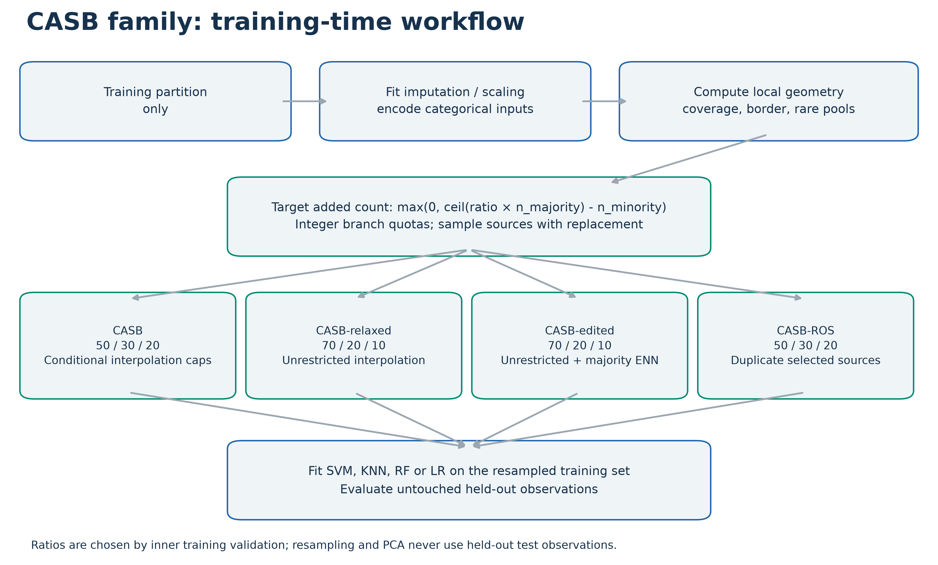
04 PROPOSED METHOD
CASB workflow
Allocation depends on neighbourhood geometry, not classifier uncertainty.
09
Notes:
This picture shows the complete process. Start with training data, prepare the features, and measure the neighbourhood around minority points. Next, form three source groups and decide how many new points each group should produce. Choose a CASB version, make the new training set, and train the classifier. The test data is used only at the end to measure performance.
Evidence: paper_material/02_casb_family_workflow.png

Slide 10
04 PROPOSED METHOD
CASB: choose where to start and how far to move
01
02
03
04
Measure local structure
Build source pools
Allocate additions
Generate new points
Labels and distances
Coverage / border / rare
50% / 30% / 20%
Select source, neighbour and step
Two decisions: which minority point to use, and how far to interpolate.
10
Notes:
CASB means Coverage-Aware Safe-Border SMOTE. It makes two main choices. First: which minority point should we start from? Second: how far should we move toward another minority point? We use three groups to answer the first question. For some groups, the distance to the majority class limits the second choice. The word safe describes our intention. It does not mean every new point is guaranteed to have the right label.
Evidence: latex_paper/manuscript.tex

Slide 11
04 PROPOSED METHOD
Step 1: identify useful minority sources
Pool | Selection rule | Purpose
Coverage (C) | Every minority observation | Keep broad source eligibility
Border (B) | 20% < majority fraction <= 70% | Focus on locally mixed regions
Rare (R) | Minority distance in top quartile | Include sparse minority regions
Pools overlap: one minority observation can belong to coverage, border and rare.
Border and rare also require at least 2 minority neighbours and positive majority distance.
11
Notes:
For each minority point, we look at nearby training points. Coverage contains every minority point. Border contains points with a mixture of nearby majority and minority examples. Rare contains points whose minority neighbours are relatively far away. Border and rare also need enough nearby minority support. The groups can overlap: the same point may be in more than one group. Rare here means locally sparse, not a proven separate rare cluster.
Evidence: latex_paper/manuscript.tex

Slide 12
04 PROPOSED METHOD
Exact conditions for the three source pools
Symbol / rule | Formula or value | Meaning
Coverage C | C = M | Every minority point
Border B | B = {i ∈ M : 0.2 < oᵢ ≤ 0.7, sᵢ ≥ 2, dᵢ > 0} | Mixed neighbourhood with minority support
Rare R | R = {i ∈ M : qᵢ ≥ Q₀.₇₅(q), sᵢ ≥ 2, dᵢ > 0} | Sparse neighbourhood with minority support
M = minority indices; oᵢ = majority fraction; sᵢ = minority support; dᵢ = majority distance; qᵢ = sparsity distance. Q₀.₇₅ = 75th percentile.
12
Notes:
Coverage has no extra filter: every minority point is eligible. Border requires more than twenty percent and at most seventy percent majority neighbours. It also needs at least two minority neighbours and a positive distance to the nearest majority point. Rare uses the seventy-fifth percentile of q as its threshold, with the same support and distance checks. Points exactly at that threshold are included. The groups overlap; they are not three separate classes. Coverage can still include noisy minority points. Symbol guide: M = minority indices; oᵢ = majority fraction; sᵢ = minority support; dᵢ = majority distance; qᵢ = sparsity distance. Q₀.₇₅ = 75th percentile.
Evidence: latex_paper/manuscript.tex: Proposed method

Slide 13
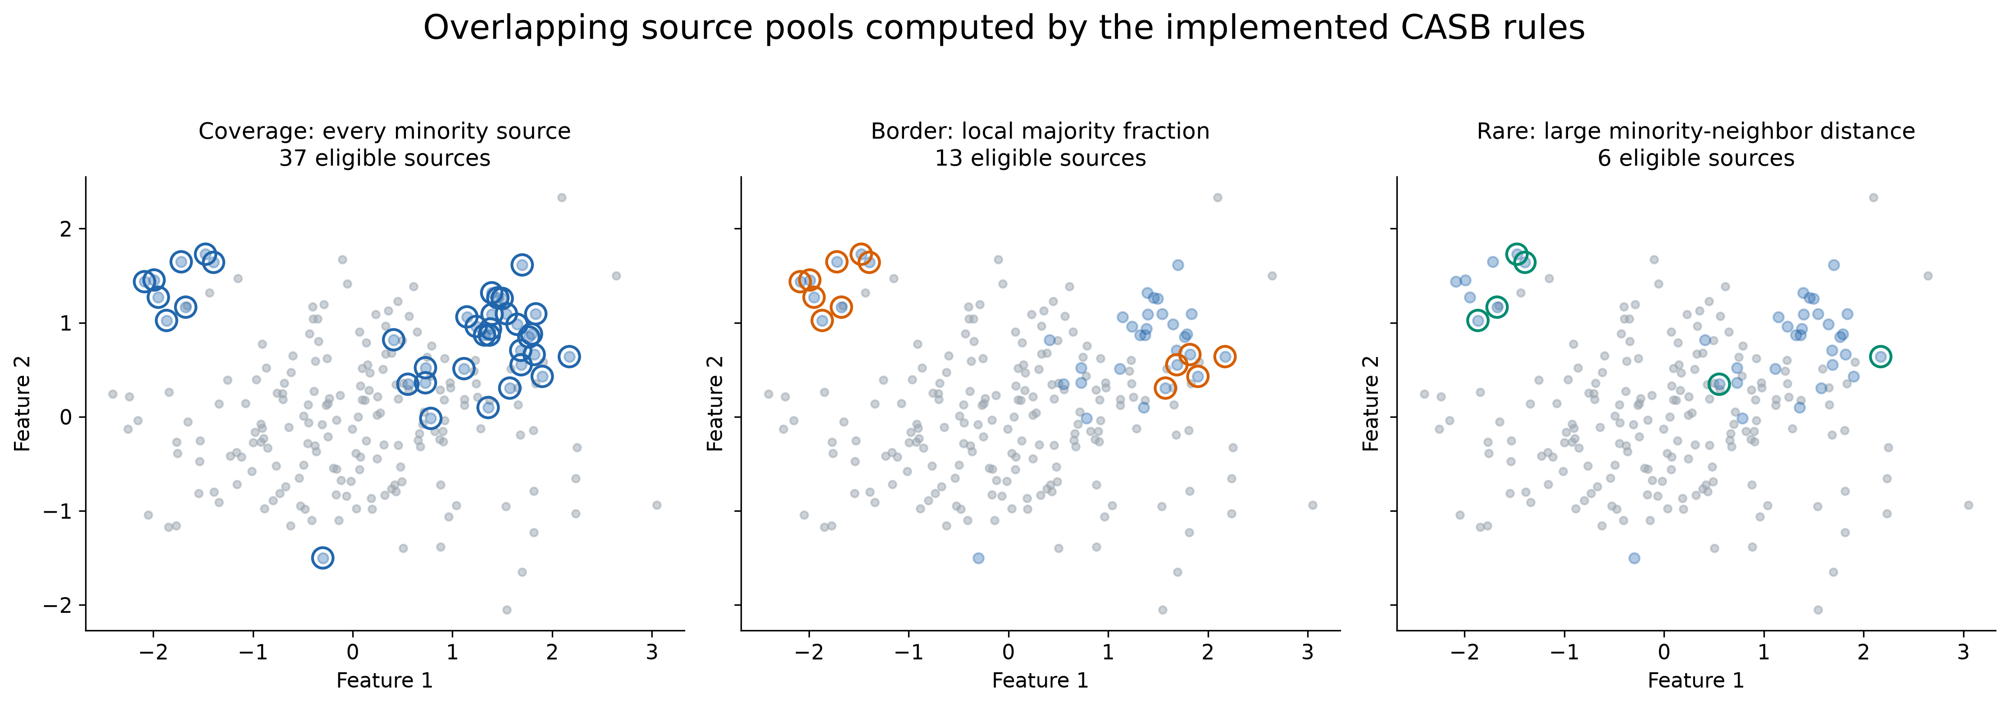
04 PROPOSED METHOD
Three overlapping source pools
Coverage includes every minority observation. Border and rare pools may overlap.
13
Notes:
The rings show which original points can be selected from each group. They are not new points. Coverage includes all minority points. Border focuses on mixed areas. Rare focuses on sparse areas. The same source can belong to several groups. Notice that being eligible does not guarantee a point will actually be selected.
Evidence: paper_material/04_source_pools.png

Slide 14
04 PROPOSED METHOD
Budget, weights and exact integer allocation
Symbol / rule | Formula or value | Meaning
Added samples | G = max(0, ⌈ρ nⱼ⌉ − nₘ) | ρ = target minority / majority ratio
Original / ROS | (wC, wB, wR) = (0.50, 0.30, 0.20) | Coverage / border / rare
Relaxed / edited | (wC, wB, wR) = (0.70, 0.20, 0.10) | More coverage allocation
Initial quota | aᵦ = ⌊wᵦG⌋; remainder = G − Σᵦ aᵦ | Add remaining units by largest fractions
G = additions; ρ = target ratio; nₘ / nⱼ = minority / majority counts; b = branch; wᵦ = weight; aᵦ = quota. ⌈ ⌉ rounds up; ⌊ ⌋ rounds down.
14
Notes:
The target ratio rho tells us how many minority points we want compared with majority points. Multiply rho by the majority count, round up, then subtract the current minority count. Never add a negative number. Multiply this budget by each branch weight and round down first. Give leftover units to the largest fractional remainders. Ties use coverage, border, rare order. Training validation chooses rho from 0.5, 0.75 and 1.0. These branch weights and thresholds are fixed design choices. Symbol guide: G = additions; ρ = target ratio; nₘ / nⱼ = minority / majority counts; b = branch; wᵦ = weight; aᵦ = quota. ⌈ ⌉ rounds up; ⌊ ⌋ rounds down.
Evidence: latex_paper/manuscript.tex: Proposed method

Slide 15
04 PROPOSED METHOD
Step 2: divide the generation budget
28
16
11
Coverage additions
Border additions
Rare additions
Example: 100 majority + 20 minority; target ratio = 0.75
Need 55 additions; original quotas = 50 / 30 / 20
Choose sources uniformly within each pool, with replacement
The quotas divide new samples, not the original minority observations.
15
Notes:
Here is a small example. We have 100 majority points and 20 minority points. We want 75 minority points, so we need 55 new ones. Original CASB gives 28 additions to coverage, 16 to border and 11 to rare. These come from the 50, 30 and 20 percent weights, with rounding. We randomly choose sources within each group, and a source can be chosen again. If border or rare is empty, we choose from coverage but keep the original branch rule.
Evidence: latex_paper/manuscript.tex

Slide 16
04 PROPOSED METHOD
Step 3: limit movement using majority distance
Allocated branch | Maximum movement from source
Coverage; majority fraction <= 20% | Full source-to-neighbour segment
Rare branch | Smaller of segment length and 0.35 x d
Other coverage / border steps | Smaller of segment length and 0.50 x d
Example: neighbour distance = 4, majority distance = 2; ordinary capped movement <= 1.
d = distance to the nearest observed majority point; a cap does not certify the label.
16
Notes:
After choosing a source, we choose a nearby minority point. Usually we choose among up to five neighbours; the rare branch uses up to two. Let d be the distance to the closest majority point. A normal limited step can move at most half of d. A rare step can move at most 0.35 times d. Coverage points with very few majority neighbours can use the full line. For example, if d is two, the normal limited move is at most one unit. This limits movement but does not prove the new label is correct.
Evidence: latex_paper/manuscript.tex

Slide 17
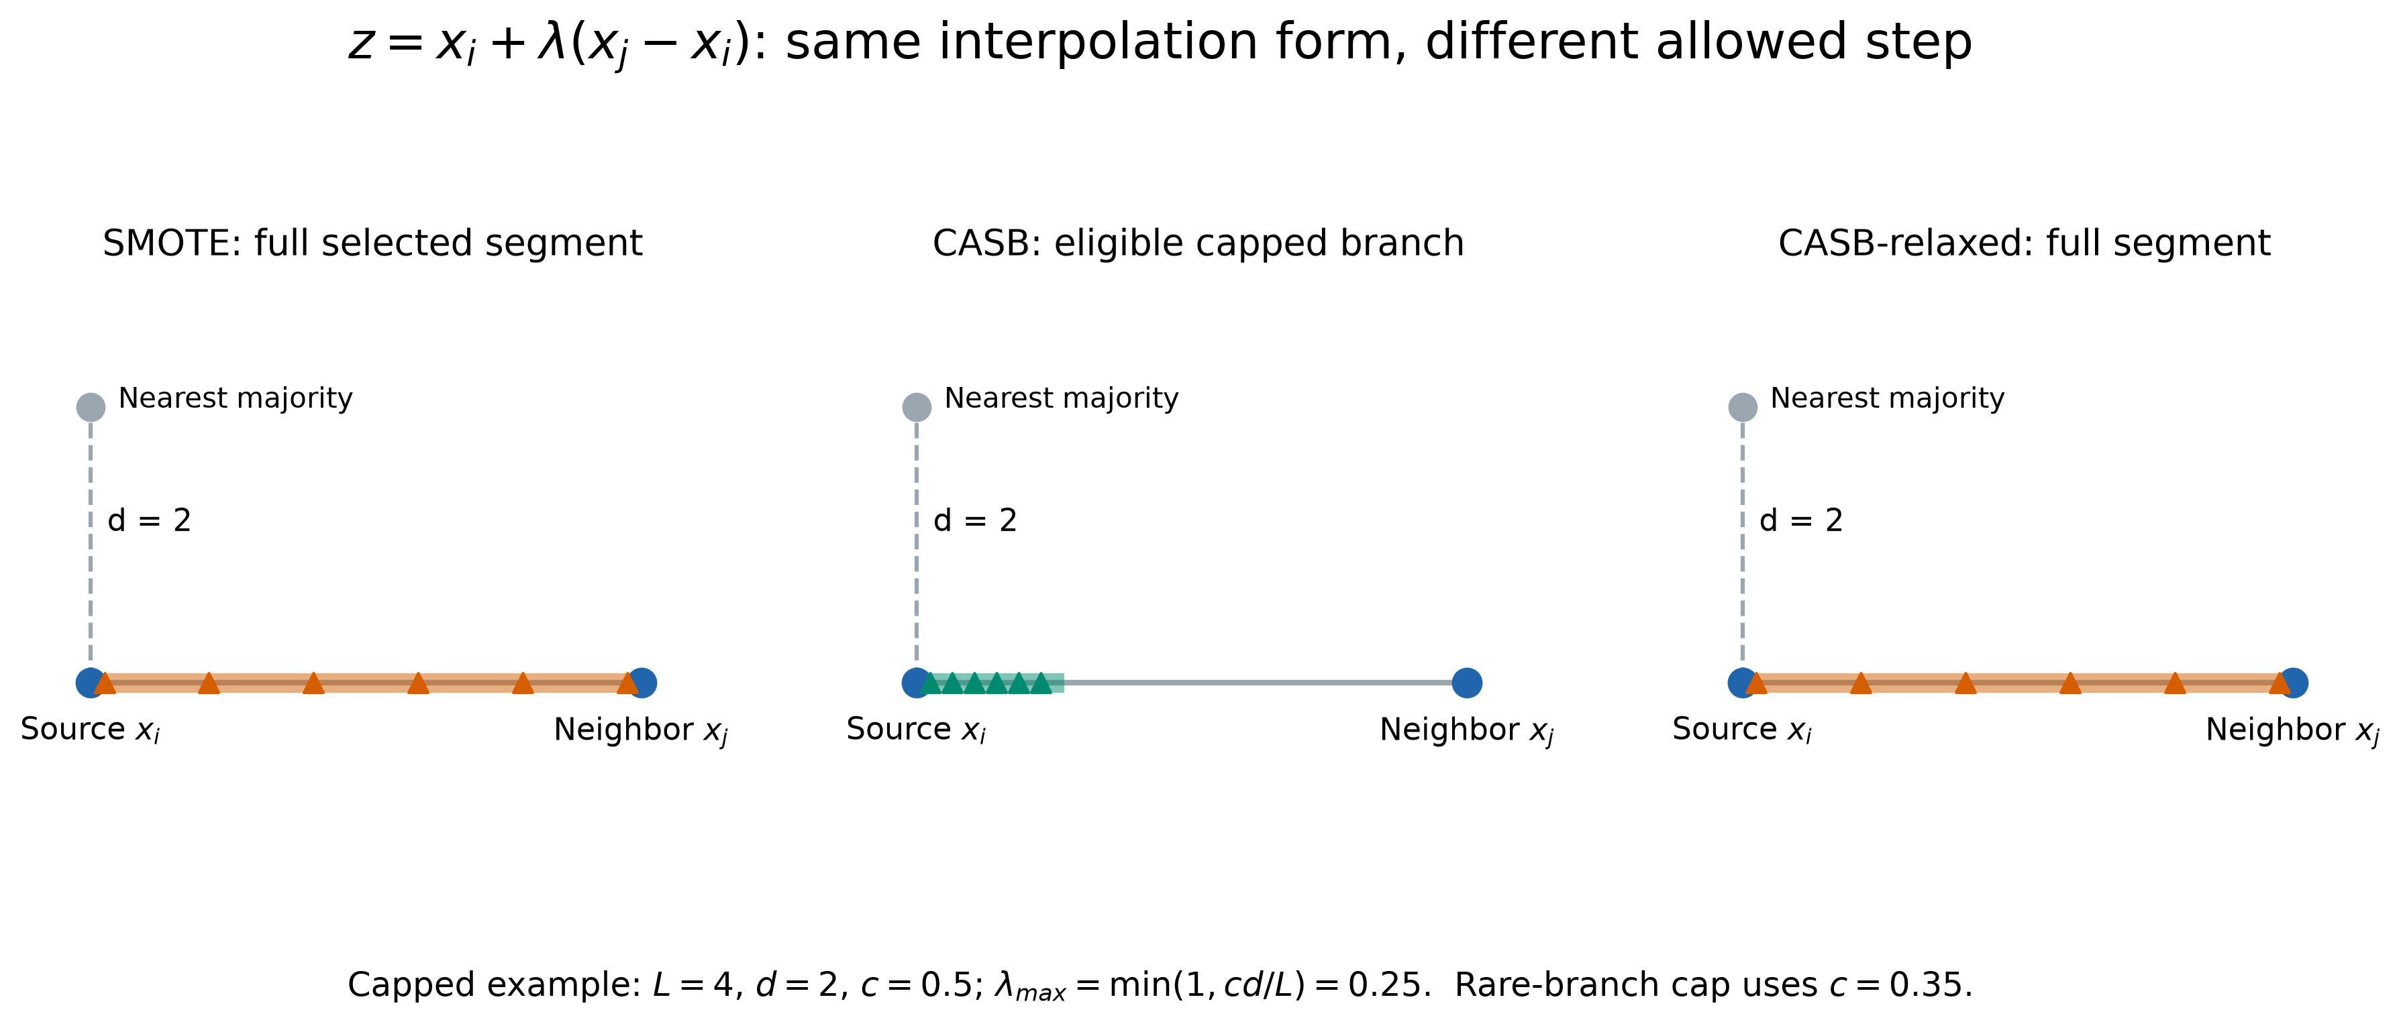
04 PROPOSED METHOD
The interpolation rule
z = new point; xₛ = source; xₜ = neighbour; λ = step fraction. L = neighbour distance; d = nearest-majority distance; c = cap factor.
17
Notes:
The new point lies on a straight line from the source to its chosen neighbour. Lambda tells us how far along that line to move. Zero means stay at the source, and one means reach the neighbour. SMOTE can use the whole line. Original CASB shortens the allowed part for some branches. Relaxed allows the whole line again. CASB-ROS stays at the source and makes a copy.
Evidence: paper_material/03_interpolation_geometry.png

Slide 18
04 PROPOSED METHOD
Generate a point: formula and branch limits
Symbol / rule | Formula or value | Meaning
Neighbour t | t ∈ Kₛ; rare uses first min(2, |Kₛ|) | Choose uniformly
New point | L = ‖xₜ − xₛ‖₂; z = xₛ + λ(xₜ − xₛ) | L = source-to-neighbour distance λ ∼ Uniform(0, λmax)
Zero edge | λmax = 0 if L = 0 | Repeat source coordinates
Coverage exception | λmax = 1 if b = C and oₛ ≤ 0.2 | Full segment allowed
Rare / other | Rare: min(1, 0.35 dₛ/L) Otherwise: min(1, 0.50 dₛ/L) | Apply after the zero-edge case
s = source; t = neighbour; L = source-to-neighbour distance; z = new point; λ = step fraction; λmax = upper limit; dₛ = nearest-majority distance; oₛ = majority fraction; b = branch.
18
Notes:
Choose a source s and a minority neighbour t. L is the distance between them. Lambda is a random fraction of the allowed move, and z is the new point. A zero-length edge copies the source. Coverage with at most twenty percent majority neighbours allows the whole line. A rare step is limited by 0.35 times the nearest-majority distance. Other capped steps use 0.50. Both limits stop at the selected neighbour. For L equal to four and d s equal to two, the ordinary maximum lambda is 0.25 and the rare maximum is 0.175. Symbol guide: s = source; t = neighbour; L = source-to-neighbour distance; z = new point; λ = step fraction; λmax = upper limit; dₛ = nearest-majority distance; oₛ = majority fraction; b = branch.
Evidence: latex_paper/manuscript.tex: Proposed method

Slide 19
04 PROPOSED METHOD
Four CASB variants
Variant | C / B / R quota | Generation | Cleaning
CASB | 50 / 30 / 20 | Conditional cap | None
CASB-relaxed | 70 / 20 / 10 | Full segment | None
CASB-edited | 70 / 20 / 10 | Full segment | Majority-only ENN
CASB-ROS | 50 / 30 / 20 | Exact duplication | None
Quotas allocate generated samples, not disjoint fractions of the original data.
19
Notes:
This table puts the four versions side by side. C, B and R mean coverage, border and rare. The percentages tell us how to divide new additions, not how many original points belong to each group. Original CASB and CASB-ROS use the same weights. Relaxed and edited use different weights. Because relaxed changes both the weights and movement limits, we cannot say which change alone caused a result.
Evidence: latex_paper/manuscript.tex

Slide 20
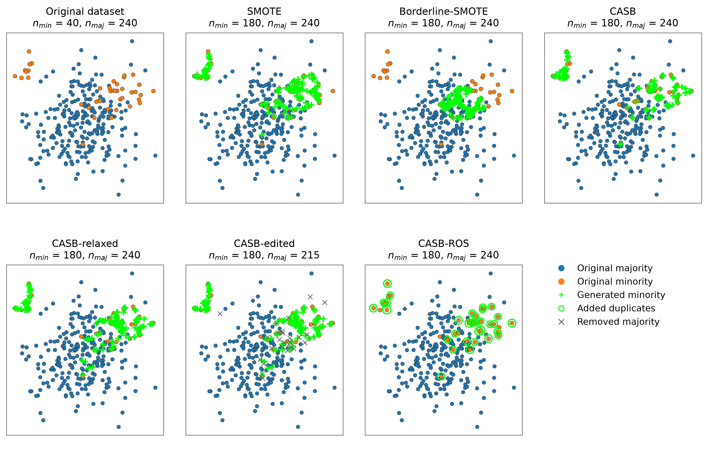
04 PROPOSED METHOD
What resampling changes
Same constructed input, seed and ratio. Grey crosses mark removed majority points.
20
Notes:
First look at the original data, then compare the other panels. SMOTE and the CASB interpolation versions add new locations. CASB-ROS adds copies at existing locations. Edited also removes some majority points. This is a constructed example to explain the process. It is not a real benchmark dataset and does not by itself show which method predicts best.
Evidence: paper_material/14_final_distribution_panels.png

Slide 21
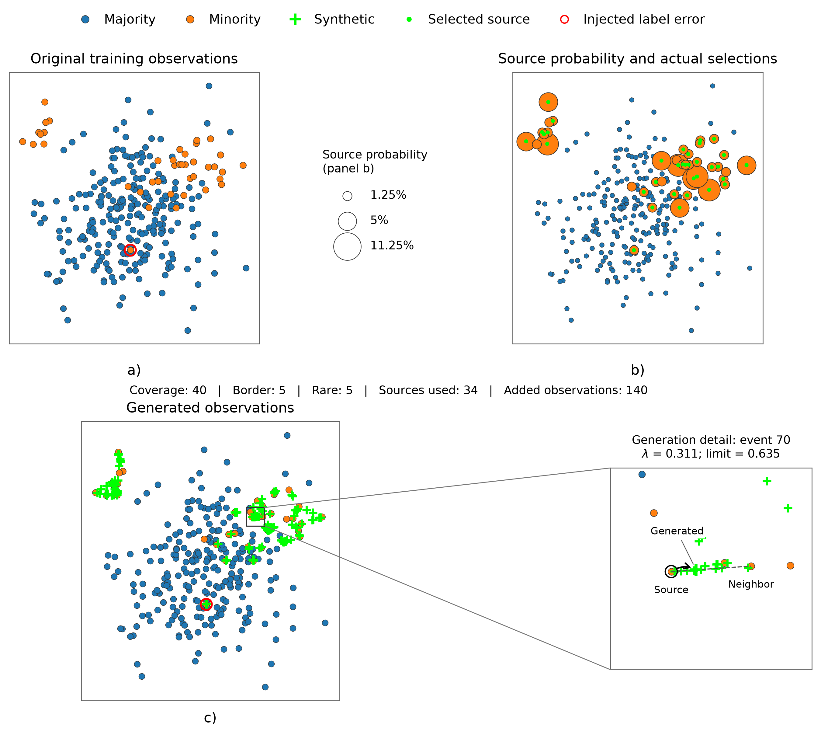
04 PROPOSED METHOD
Generation can be audited
Source, neighbour, branch and interpolation step can be traced for each new point.
21
Notes:
For a new point, we can check which source and neighbour were used, which group selected the source, and how far the point moved. This makes the generation process easier to inspect. The red-marked error was deliberately placed in this example. CASB did not discover that error. The figure shows that we can trace the process; it does not show that we can reliably detect noise.
Evidence: paper_material/13_audited_generation_walkthrough.png

Slide 22
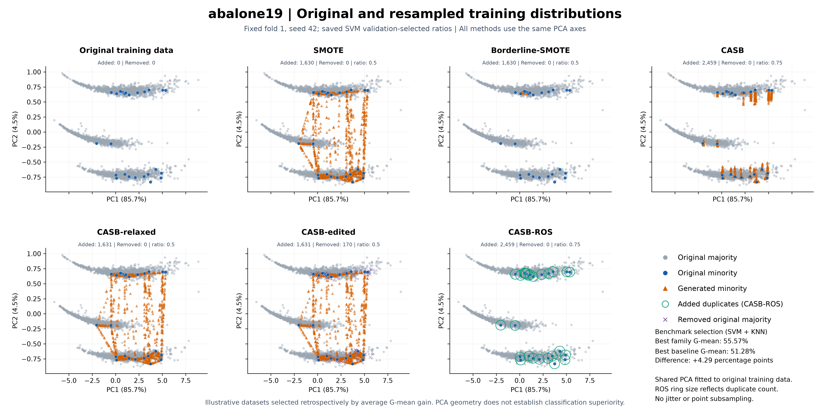
04 PROPOSED METHOD
A real-data view: Abalone19
Original training data and resampled views share the same PCA axes.
22
Notes:
This is the Abalone19 plot from our paper. Grey dots are original majority points and blue dots are original minority points. Orange triangles are new points. Green rings show added copies. Start with the original panel, then compare SMOTE, Borderline-SMOTE and our four versions. PCA lets us show many features in just two directions. The method still generates in the full feature space. Because a category was encoded as numbers, some generated values can fall between category codes. This picture alone cannot prove that a method is better.
Evidence: paper plot/abalone19_PCA_comparison.png

Slide 23
05 RESULTS AND COMPARISON
Average scores across the benchmark
Method | G-mean | F1 | Precision | Recall
ROS | 80.922 | 65.668 | 62.595 | 75.138
SMOTE | 81.354 | 65.704 | 62.261 | 75.618
Borderline-SMOTE | 79.519 | 64.806 | 61.005 | 74.100
ADASYN | 81.518 | 64.400 | 59.440 | 76.742
CASB | 80.329 | 66.056 | 63.676 | 73.976
CASB-relaxed | 81.060 | 65.908 | 62.669 | 75.096
CASB-edited | 82.411 | 65.084 | 59.368 | 78.720
CASB-ROS | 80.172 | 65.959 | 63.657 | 73.950
40 matched datasets × 4 classifiers; equal weights; scores in percent
23
Notes:
This table gives the average score of each method across the same 40 datasets and four classifiers. Here the scores are percentages. Each dataset and classifier receives equal weight. Edited has strong G-mean and recall averages, but that comes with lower precision. Different versions lead on different scores. There is no single version that is best for every goal.
Evidence: statistical result/average_metric_scores.csv: strict_all_methods, SVM/KNN/RF/LR

Slide 24
05 RESULTS AND COMPARISON
Table 6 | G-mean by classifier
Classifier | NORES | ROS | SMOTE | B-SMOTE | ADASYN | CASB | CASB relaxed | CASB edited | CASB ROS
SVM | 0.592 | 0.826 | 0.816 | 0.797 | 0.815 | 0.805 | 0.814 | 0.826 | 0.810
KNN | 0.658 | 0.817 | 0.827 | 0.819 | 0.832 | 0.821 | 0.824 | 0.834 | 0.810
RF | 0.645 | 0.752 | 0.772 | 0.740 | 0.773 | 0.755 | 0.769 | 0.793 | 0.752
LR | 0.597 | 0.841 | 0.839 | 0.825 | 0.841 | 0.832 | 0.836 | 0.843 | 0.835
SVM/KNN | 0.625 | 0.822 | 0.822 | 0.808 | 0.823 | 0.813 | 0.819 | 0.830 | 0.810
Overall | 0.623 | 0.809 | 0.814 | 0.795 | 0.815 | 0.803 | 0.811 | 0.824 | 0.802
40 matched datasets | Scores: 0 to 1 | Highlighted cells: row winners | NORES: no resampling
24
Notes:
This is the G-mean part of Table 6 from our paper. It measures how well both classes are detected. Read one classifier row at a time and compare the methods across that row. Scores here run from zero to one, so 0.8 means 80 percent. The coloured bold cell is the winner based on the full unrounded score. Two displayed values can look equal because we round them. NORES means no resampling. The last rows average classifiers equally. All methods use the same 40 complete datasets. These averages do not by themselves prove a statistically significant difference.
Evidence: latex_paper/manuscript.tex: Table 6, benchmark_comparison

Slide 25
05 RESULTS AND COMPARISON
Table 6 | F1 by classifier
Classifier | NORES | ROS | SMOTE | B-SMOTE | ADASYN | CASB | CASB relaxed | CASB edited | CASB ROS
SVM | 0.547 | 0.670 | 0.666 | 0.656 | 0.647 | 0.673 | 0.671 | 0.661 | 0.674
KNN | 0.604 | 0.644 | 0.646 | 0.647 | 0.632 | 0.654 | 0.646 | 0.634 | 0.644
RF | 0.594 | 0.676 | 0.679 | 0.658 | 0.668 | 0.676 | 0.679 | 0.676 | 0.678
LR | 0.537 | 0.637 | 0.637 | 0.632 | 0.629 | 0.640 | 0.640 | 0.632 | 0.641
SVM/KNN | 0.575 | 0.657 | 0.656 | 0.651 | 0.639 | 0.663 | 0.659 | 0.648 | 0.659
Overall | 0.570 | 0.657 | 0.657 | 0.648 | 0.644 | 0.661 | 0.659 | 0.651 | 0.660
40 matched datasets | Scores: 0 to 1 | Highlighted cells: row winners | NORES: no resampling
25
Notes:
This is the F1 part of Table 6 from our paper. It measures the balance between minority precision and recall. Read one classifier row at a time and compare the methods across that row. Scores here run from zero to one, so 0.8 means 80 percent. The coloured bold cell is the winner based on the full unrounded score. Two displayed values can look equal because we round them. NORES means no resampling. The last rows average classifiers equally. All methods use the same 40 complete datasets. These averages do not by themselves prove a statistically significant difference.
Evidence: latex_paper/manuscript.tex: Table 6, benchmark_comparison

Slide 26
05 RESULTS AND COMPARISON
Table 6 | Precision by classifier
Classifier | NORES | ROS | SMOTE | B-SMOTE | ADASYN | CASB | CASB relaxed | CASB edited | CASB ROS
SVM | 0.666 | 0.633 | 0.634 | 0.615 | 0.600 | 0.652 | 0.643 | 0.612 | 0.653
KNN | 0.700 | 0.586 | 0.590 | 0.582 | 0.559 | 0.599 | 0.591 | 0.561 | 0.592
RF | 0.706 | 0.711 | 0.694 | 0.682 | 0.665 | 0.713 | 0.696 | 0.649 | 0.720
LR | 0.672 | 0.573 | 0.572 | 0.561 | 0.553 | 0.582 | 0.578 | 0.553 | 0.581
SVM/KNN | 0.683 | 0.610 | 0.612 | 0.599 | 0.580 | 0.626 | 0.617 | 0.586 | 0.622
Overall | 0.686 | 0.626 | 0.623 | 0.610 | 0.594 | 0.637 | 0.627 | 0.594 | 0.637
40 matched datasets | Scores: 0 to 1 | Highlighted cells: row winners | NORES: no resampling
26
Notes:
This is the Precision part of Table 6 from our paper. It measures how often a minority prediction is correct. Read one classifier row at a time and compare the methods across that row. Scores here run from zero to one, so 0.8 means 80 percent. The coloured bold cell is the winner based on the full unrounded score. Two displayed values can look equal because we round them. NORES means no resampling. The last rows average classifiers equally. All methods use the same 40 complete datasets. These averages do not by themselves prove a statistically significant difference.
Evidence: latex_paper/manuscript.tex: Table 6, benchmark_comparison

Slide 27
05 RESULTS AND COMPARISON
Table 6 | Recall by classifier
Classifier | NORES | ROS | SMOTE | B-SMOTE | ADASYN | CASB | CASB relaxed | CASB edited | CASB ROS
SVM | 0.497 | 0.769 | 0.757 | 0.741 | 0.764 | 0.744 | 0.752 | 0.785 | 0.750
KNN | 0.562 | 0.762 | 0.778 | 0.774 | 0.800 | 0.762 | 0.770 | 0.806 | 0.749
RF | 0.549 | 0.670 | 0.689 | 0.665 | 0.696 | 0.670 | 0.687 | 0.735 | 0.671
LR | 0.482 | 0.804 | 0.800 | 0.785 | 0.810 | 0.782 | 0.795 | 0.822 | 0.788
SVM/KNN | 0.529 | 0.766 | 0.768 | 0.757 | 0.782 | 0.753 | 0.761 | 0.796 | 0.750
Overall | 0.522 | 0.751 | 0.756 | 0.741 | 0.767 | 0.740 | 0.751 | 0.787 | 0.739
40 matched datasets | Scores: 0 to 1 | Highlighted cells: row winners | NORES: no resampling
27
Notes:
This is the Recall part of Table 6 from our paper. It measures how many real minority cases we find. Read one classifier row at a time and compare the methods across that row. Scores here run from zero to one, so 0.8 means 80 percent. The coloured bold cell is the winner based on the full unrounded score. Two displayed values can look equal because we round them. NORES means no resampling. The last rows average classifiers equally. All methods use the same 40 complete datasets. These averages do not by themselves prove a statistically significant difference.
Evidence: latex_paper/manuscript.tex: Table 6, benchmark_comparison

Slide 28
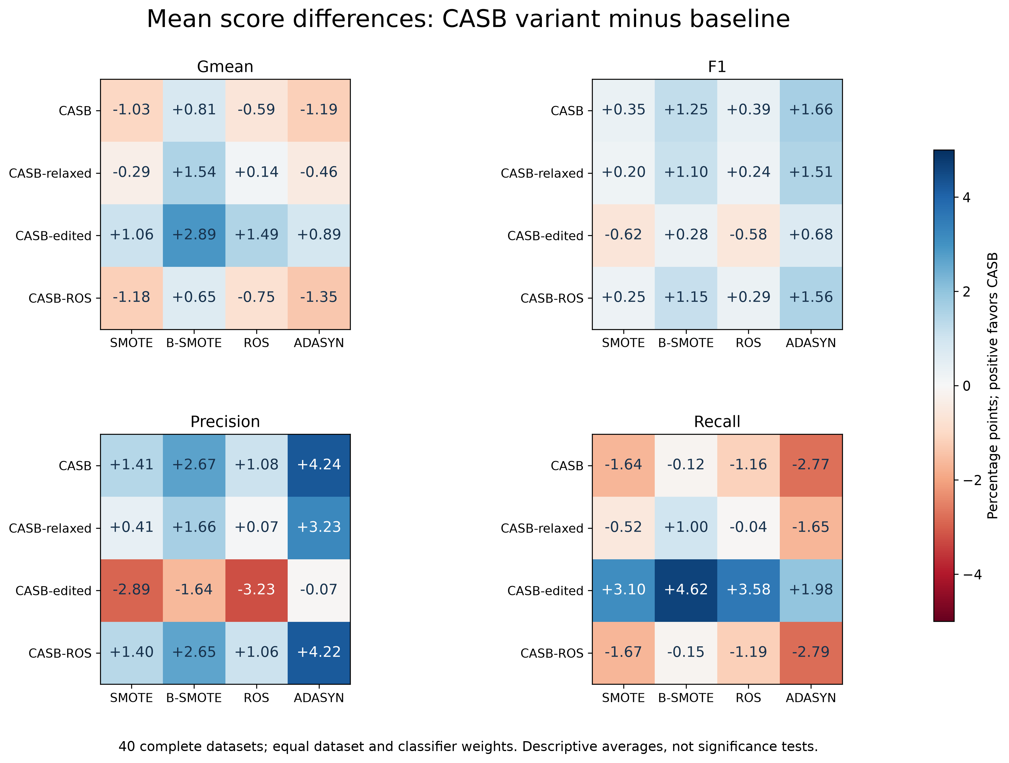
05 RESULTS AND COMPARISON
Performance varies by metric
Positive differences favour the named CASB variant; negative values remain visible.
28
Notes:
Each coloured cell shows the average score of a CASB version minus a baseline score. A positive value means the CASB version scored higher. A negative value means it scored lower. This helps us see the tradeoffs. Do not look only at the positive cells: losses matter too. These are average differences, not statistical test results.
Evidence: paper_material/06_average_score_differences.png

Slide 29
05 RESULTS AND COMPARISON
Best family averages by classifier
Classifier | G-mean gain | F1 gain | Precision gain | Recall gain
SVM | +0.019 | +0.494 | +1.935 | +1.603
KNN | +0.204 | +0.670 | +0.911 | +0.617
RF | +2.031 | −0.052 | +0.881 | +3.930
LR | +0.145 | +0.363 | +0.888 | +1.253
Percentage-point differences vs strongest core baseline; retrospective per-metric selection
29
Notes:
For each classifier and score, we pick the family version with the highest average and compare it with the strongest main baseline. Positive values favour our family. For random forest, F1 is slightly below the best baseline, even though the other three scores are higher. We chose the best version after seeing the results, so this table does not describe a method that chooses its version automatically before testing.
Evidence: latex_paper/tables/envelope.tex

Slide 30
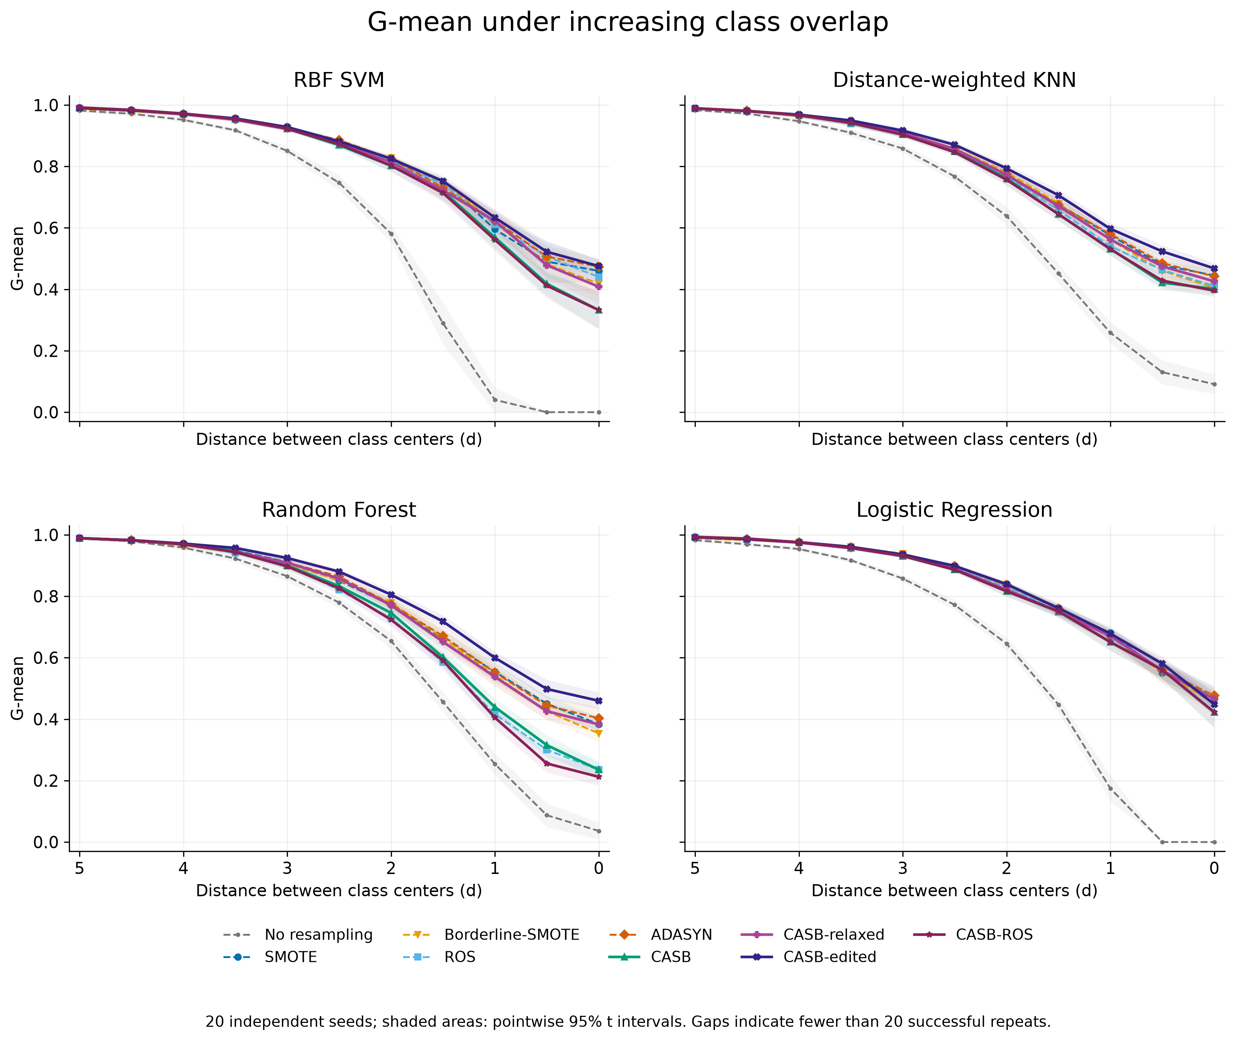
05 RESULTS AND COMPARISON
G-mean under controlled overlap
Smaller class-centre distance means greater overlap. Each curve shows a fixed method.
30
Notes:
This experiment uses generated two-dimensional data so we can control how much the classes overlap. Smaller distance between the class centres means more overlap. Each curve shows one fixed method, and the panels show different classifiers. We use 20 seeds. The bands show uncertainty around the mean. This experiment studies overlap, not wrong training labels, and it is separate from the real-dataset benchmark.
Evidence: paper_material/17_overlap_gmean.png

Slide 31
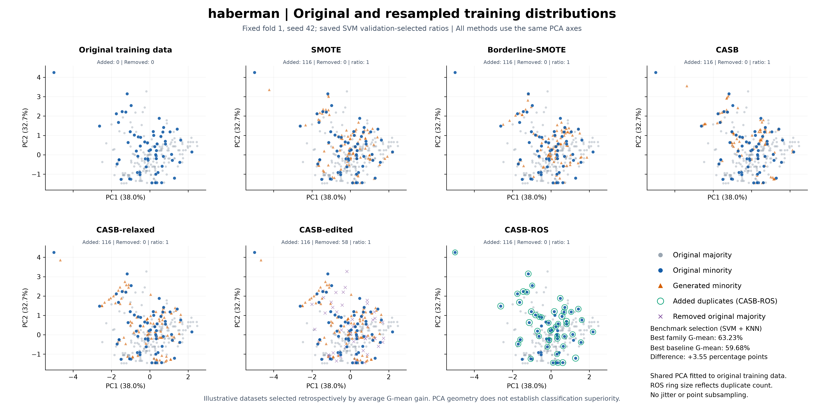
05 RESULTS AND COMPARISON
A real-data view: Haberman
PCA is fitted on the original training data; generation occurs in the full feature space.
31
Notes:
Here we show the real Haberman dataset. Every panel uses the same PCA view, fitted on original training data. The resampling settings were chosen using training validation. We selected this example after seeing the results, so it is an illustration rather than independent evidence. Similar-looking clouds are expected because several methods use straight-line interpolation. The picture cannot prove that the labels of new points are correct.
Evidence: paper plot/haberman_PCA_comparison.png

Slide 32
06 DATASET WIN COUNTS
Family wins against all four core baselines
Classifier | G-mean | F1 | Precision | Recall | Joint*
SVM | 15 | 19 | 20 | 17 | 10
KNN | 20 | 19 | 21 | 17 | 12
RF | 28 | 26 | 21 | 26 | 20
LR | 15 | 17 | 19 | 16 | 9
Out of 40 datasets. *Same variant wins both G-mean and F1. Per-metric family selection is retrospective.
32
Notes:
For each dataset and score, we ask whether at least one CASB version beats all four main baselines. We count that as one family win. For random forest, the family wins on G-mean in 28 of the 40 datasets. The best version may differ from one dataset or score to another. Joint means the same version wins on both G-mean and F1. These are descriptive win counts, not counts of statistically proven wins.
Evidence: latex_paper/tables/family.tex: Core four

Slide 33
06 DATASET WIN COUNTS
What a family win means
01
02
03
04
One dataset + metric
Best CASB variant
Strongest baseline
Strictly higher?
40 matched tasks
May vary by task
SMOTE / B-SMOTE / ROS / ADASYN
Count one family win
A fixed method and a test-selected family envelope answer different questions.
33
Notes:
Take one dataset and one score. Find the best CASB version, then find the strongest baseline. If the CASB score is strictly higher, count one family win. This checks what the family achieved after we saw the test results. It does not tell us how to choose the right version on new data. For that, we would need to select the version using training data only.
Evidence: latex_paper/manuscript.tex

Slide 34
07 CONCLUSION AND FUTURE WORK
Limitations and next experiments
Current limitation | Next experiment
Synthetic labels are not guaranteed correct | Validate generated samples with stronger local checks
Coverage can repeat minority noise; editing retains it | Test minority-noise detection and robust source selection
Straight lines may cross curved or disconnected regions | Study geometry-aware generation
Related datasets; classifier- and metric-dependent gains | Validate on independent sources with a frozen protocol
Priority: matched ablations, stronger comparison methods and independent validation.
Future work should test the explanation, not only seek a higher score.
34
Notes:
There are four main limitations. First, a new point may still have the wrong label. Second, coverage can select noisy minority points, and edited does not remove them. Third, a straight line may be a poor path when a minority region is curved or split into separate areas. Fourth, some datasets are related, and the gains depend on the classifier and score. Next we should test stronger checks, better source selection, different generation paths, and new independent datasets.
Evidence: latex_paper/manuscript.tex

Slide 35
07 CONCLUSION AND FUTURE WORK
Conclusion
01
CASB makes source allocation explicit and auditable
02
Editing often improves recall while reducing precision
03
RF: family G-mean wins on 28 of 40 matched tasks
04
Independent-family validation remains essential
Contribution: a reproducible framework with measured, classifier-dependent tradeoffs.
35
Notes:
CASB gives us a clear way to decide where new minority samples come from. The different versions show useful tradeoffs, especially between recall and precision. Random forest has 28 family G-mean wins out of 40 matched tasks. But we do not claim that CASB wins everywhere. Testing on new independent dataset sources is still important.
Evidence: latex_paper/manuscript.tex

Slide 36
REFERENCES
References 1/2
Chawla et al. (2002)
Han, Wang & Mao (2005)
SMOTE: Synthetic Minority Over-sampling Technique
Borderline-SMOTE: A New Over-Sampling Method in Imbalanced Data Sets Learning
JAIR 16, 321–357
LNCS 3644, 878–887
He et al. (2008)
Bunkhumpornpat et al. (2009)
ADASYN: Adaptive synthetic sampling approach for imbalanced learning
Safe-Level-SMOTE: Safe-Level-Synthetic Minority Over-Sampling TEchnique for Handling the Class Imbalanced Problem
IJCNN, 1322–1328
PAKDD, 475–482
Douzas & Bacao (2019)
Napierala & Stefanowski (2016)
Geometric SMOTE a geometrically enhanced drop-in replacement for SMOTE
Types of minority class examples and their influence on learning classifiers from imbalanced data
Information Sciences 501, 118–135
JIIS 46, 563–597
References from the research paper bibliography.
36
Notes:
These are the sources used in our paper for the methods, related work, data and software. There is no need to read the full list aloud. The source details are here for anyone who wants to look up a study.
Evidence: latex_paper/references.bib

Slide 37
REFERENCES
References 2/2
Skryjomski & Krawczyk (2017)
Koziarski & Woźniak (2024)
Influence of minority class instance types on SMOTE imbalanced data oversampling
Local neighborhood encodings for imbalanced data classification
PMLR 74, 7–21
Machine Learning 113, 7421–7449
Sağlam & Cengiz (2026)
Alcalá-Fdez et al. (2009)
Uncertainty guided oversampling: A classifier-specific approach for effective handling of class imbalance in machine learning
KEEL: A software tool to assess evolutionary algorithms for data mining problems
Knowledge-Based Systems 342, 115886
Soft Computing 13, 307–318
Lemaître, Nogueira & Aridas (2017)
Pedregosa et al. (2011)
Imbalanced-learn: A Python Toolbox to Tackle the Curse of Imbalanced Datasets in Machine Learning
Scikit-learn: Machine Learning in Python
JMLR 18(17), 1–5
JMLR 12, 2825–2830
References from the research paper bibliography.
37
Notes:
These are the sources used in our paper for the methods, related work, data and software. There is no need to read the full list aloud. The source details are here for anyone who wants to look up a study.
Evidence: latex_paper/references.bib

Slide 38
QUESTIONS
Thank you
Questions and discussion
Pulkit Sharma • Priyanshu Kumar • Niranjan Yadav
Department of Artificial Intelligence, SVNIT Surat
38
Notes:
Thank you. I am happy to take questions about how we select sources, how the four versions differ, and how we measure the results. If asked whether CASB always beats SMOTE, the answer is no. Its benefit depends on the dataset, classifier and score. Our contribution is the implemented method and the measured tradeoffs.
Evidence: latex_paper/manuscript.tex

