Slide 1

Lab Sovereign Data Exchange – Solid Model
Final Milestone
Date: 6th July 2022
Team Solid

Slide 2
Overview
◼ Project goals
◼ Why Solid
◼ Features of the prototype
◼ Frontend and server interaction
◼ Flow diagrams
◼ Demo
◼ Possible Future work

Slide 3
Project Goals
Creating collaborative note sharing application using Solid as a decentralized data store
Developing interface for users to create, edit and share notes
Allow users to communicate within the interface by managing permissions to the notes created in their pods
1. Friend sharing: a user can be allowed to view another user’s info when given the appropriate permissions
2. Public sharing: A user can decide to make the data available for public usage

Slide 4
Why Solid
Decentralization
The ultimate goal of Solid is to allow users to have full control of their own data, including access control and storage location.
The user data is stored in their personal Pod spaces and they have full control over who has access to it
Sovereignty
Solid facilitates this using Access Control Lists (ACLs)
Resource’s ACL determines access to that Resource
An ACL entry specifies the following Access Modes (Read, Append, Write, Control)
ACL can be applied to entire containers which is inherited by the objects in it or even to individual objects

Slide 5
Features of the prototype
Personal data management
Add note
Edit note
Delete note
Sharing
Create a public note
Share a note with a different user (friend sharing)
Control
Revoke public access to a note
Revoke a friend’s access to a note
Collaboration
Edit a shared writable note

Slide 6
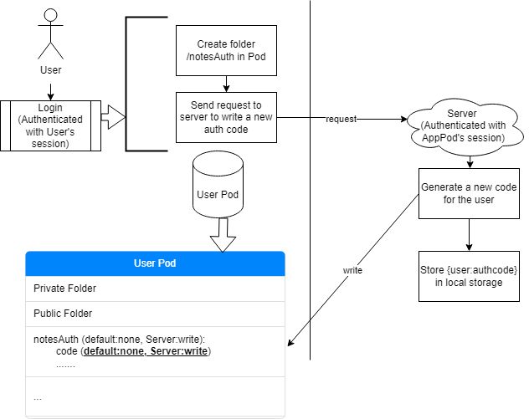
Frontend and server interaction (Authentication)

Slide 7
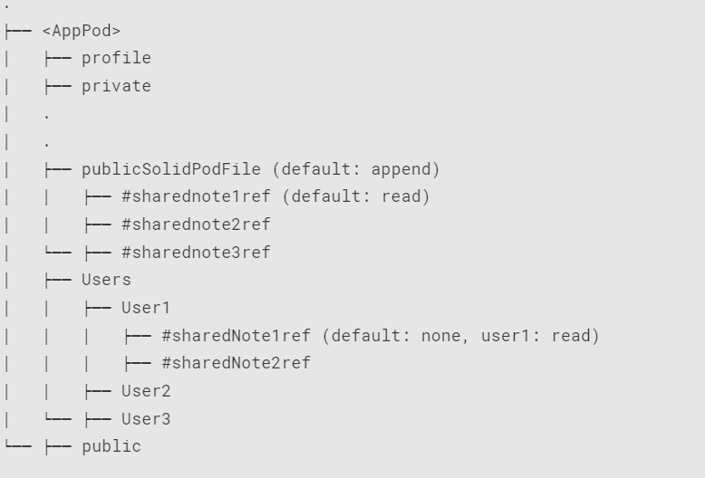
Overview of AppPod directory structure

Slide 8
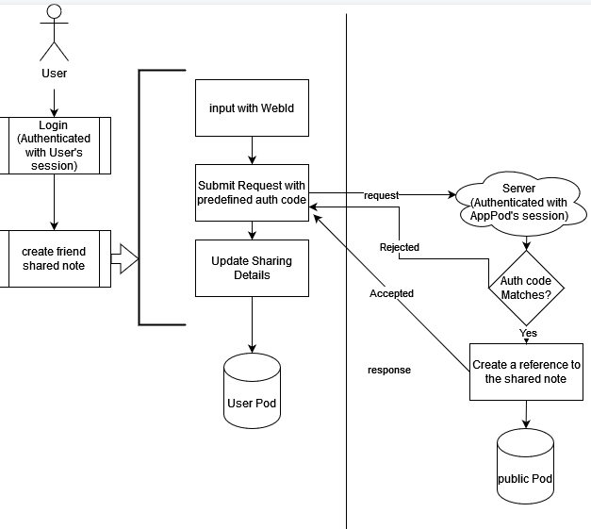
Flow diagrams
user sharing)
User chooses to share a Note with a specific WebId.
User Asks App to create a reference accessible to the predetermined WebId.
User grants read access for the selected Note to this WebId.

Slide 9
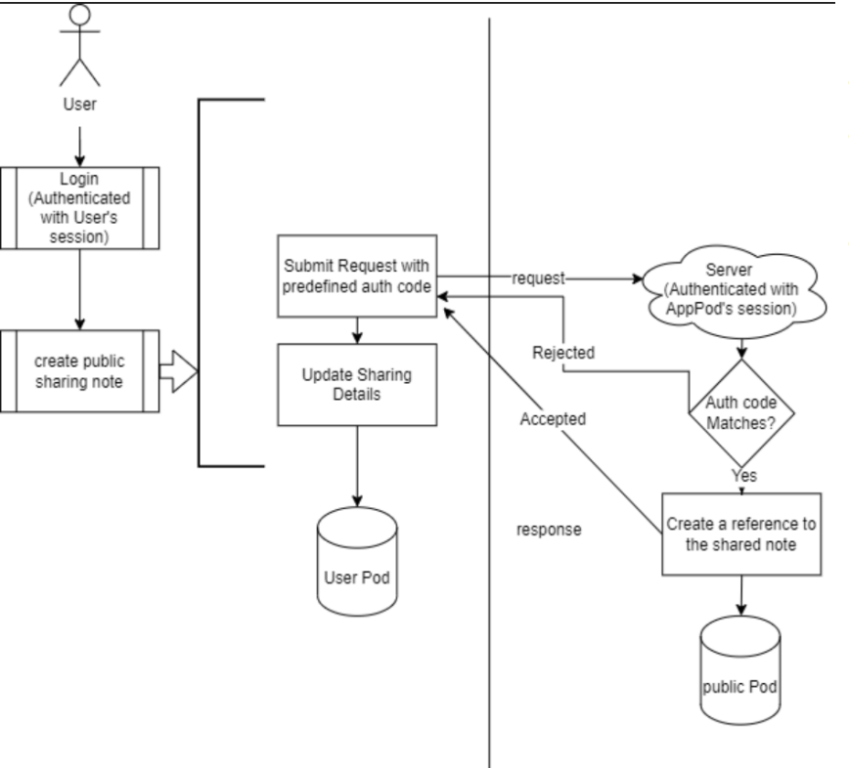
Flow diagrams
(public sharing)
User chooses to share a Note with everyone
User Asks App to create a public reference for the selected Note.
User publicizes the Note (read only).

Slide 10
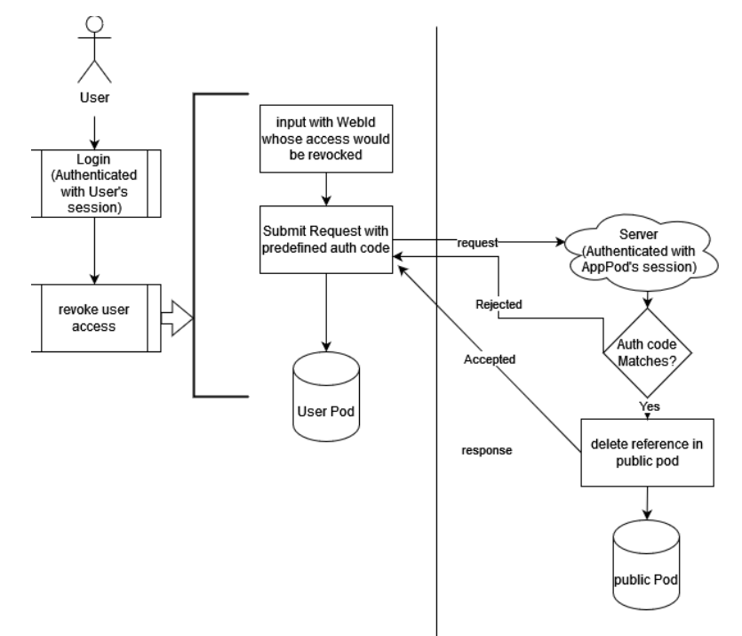
Flow diagrams
(revoke user
access)
User select a Note.
User chooses a WebId to withhold the Note from him/her.
User Asks App to delete the reference accessible for this WebId.
User withdraws read grant from this WebId for the selected Note.

Slide 11
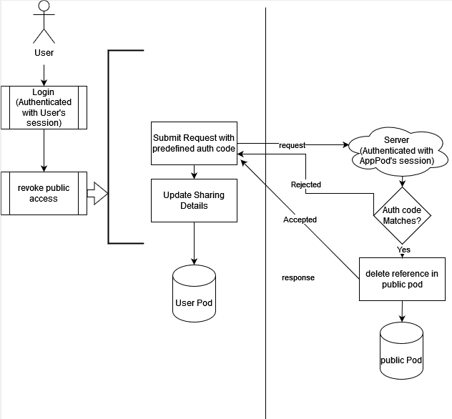
Flow diagrams
(revoke public
access)
User chooses a Note to withhold from public.
User Asks App to delete the public reference of selected Note.
User remove public access from the selected Note.

Slide 12
Demo

Slide 13
Possible Future Extensions of the Prototype
Association for notes with specific tags (e.g Mathematics, Physics, Biology)
Functionality for users to give edit suggestions to public readable notes
Creating a knowledge graph through linkages: Linking notes to each other through parent/child relationships

Slide 14
Thank you!

