Slide 1

Lab Sovereign Data Exchange – Solid Model
Jour-Fixe Meeting
Date: 11th May 2022
Team Solid

Slide 2
Overview of last week
◼ Brief intro of discussions about data exchange, Policies for public and user sharing
◼ Tasks completed
◼ Todo for next week

Slide 3
Policies for exchange
To facilitate sovereignty in a data exchange scenario, we require granular access to the datasets and thing objects stored in a pod
SOLID facilitates this using ACL
A Resource’s Access Control Lists (ACLs) determine the access to that Resource
An ACL entry can specify the following Access Modes (Read, Append, Write, Control)
ACL can be applied to entire containers which is inherited by the objects in it, or even to individual objects

Slide 4
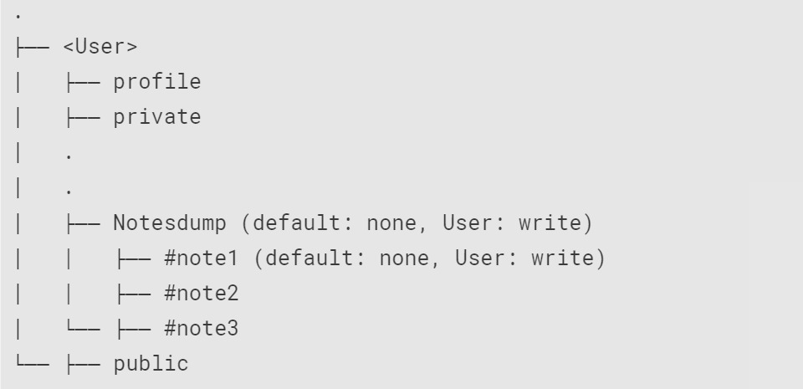
Overview of how notes are stored

Slide 5
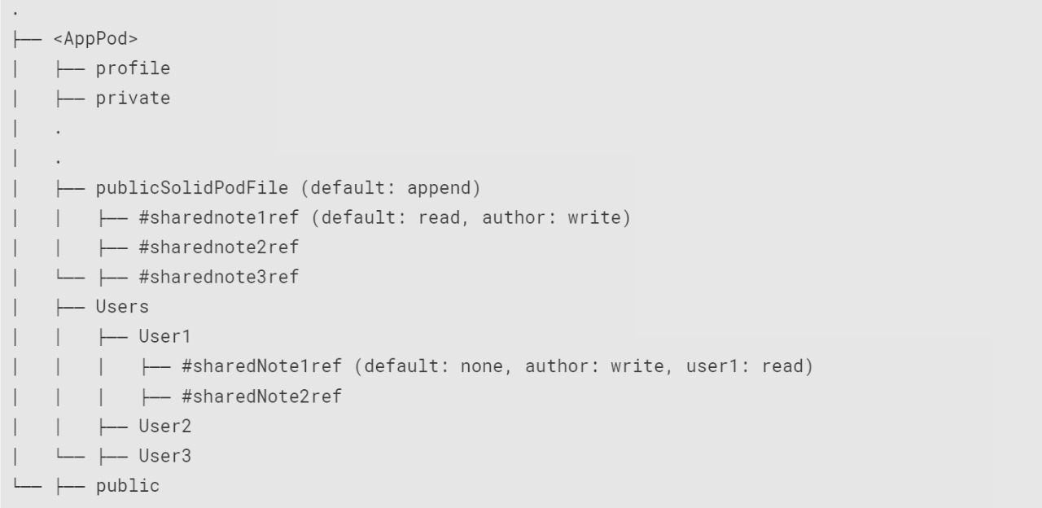
Overview of how notes are stored

Slide 6
Policies for exchange
Public sharing
User creates a Note ‘Note1’ in Notesdump folder, (default: none, User: write)
A ‘thing’ object is added in ‘AppPod/publicSolidPodFile’ it contains : Author name, URL of “Note1” (default: none, User: write) User/Notesdump/Note1
for “Note1” the default access is changed to “read”

Slide 7
Policies for exchange
Public revoke access
'AppPod/publicSolidPodFile', has default public 'append' access
User decides to revoke public access from a note (‘Note1’)
Delete link of the note from AppPod 'AppPod/publicSolidPodFile/Note1'
Remove public access from ‘User/Notesdump/Note1’

Slide 8
Policies for exchange
User sharing
User1 creates a Note (“Note1”) in Notesdump folder, (default: none, User: write)
User1 decides to share note with User2
A ‘thing’ is added in ‘AppPod/Users/User2’ named “Note1ref” it contains: Author name, URL of “Note1” (default: none, User2: read, User1: write)
For “Note1” the access for User2 is changed to “read”

Slide 9
Tasks accomplished
Managing note access using ACL, to specific users using WebId.
Fixed issues in reading notes
Added test to check note access
Policy framework
UI for adding friends
Repository cleanup (readme)

Slide 10
Current Issues
Making the public shared file again private
We remove public 'write' access from 'leslie/publicSolidPodFile', give it only public 'append' access
Assign 'write' access to the Author of the public notes so that only the Authors can delete the links they create in 'leslie/publicSolidPodFile'.
we having problem with the saveFileInContainer

Slide 11
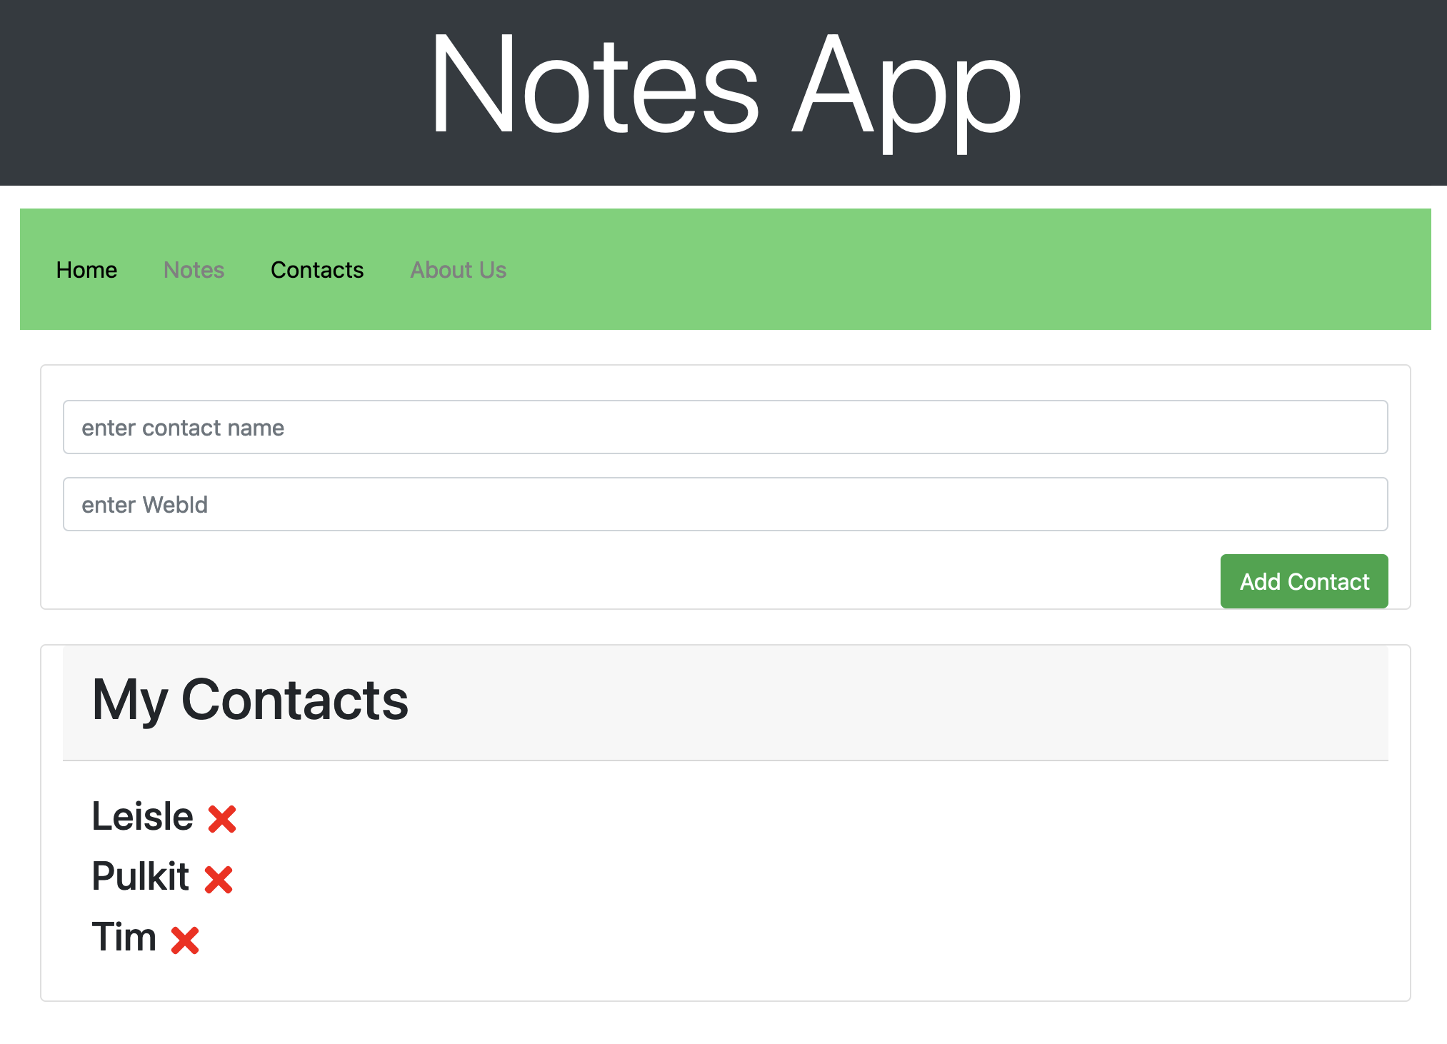
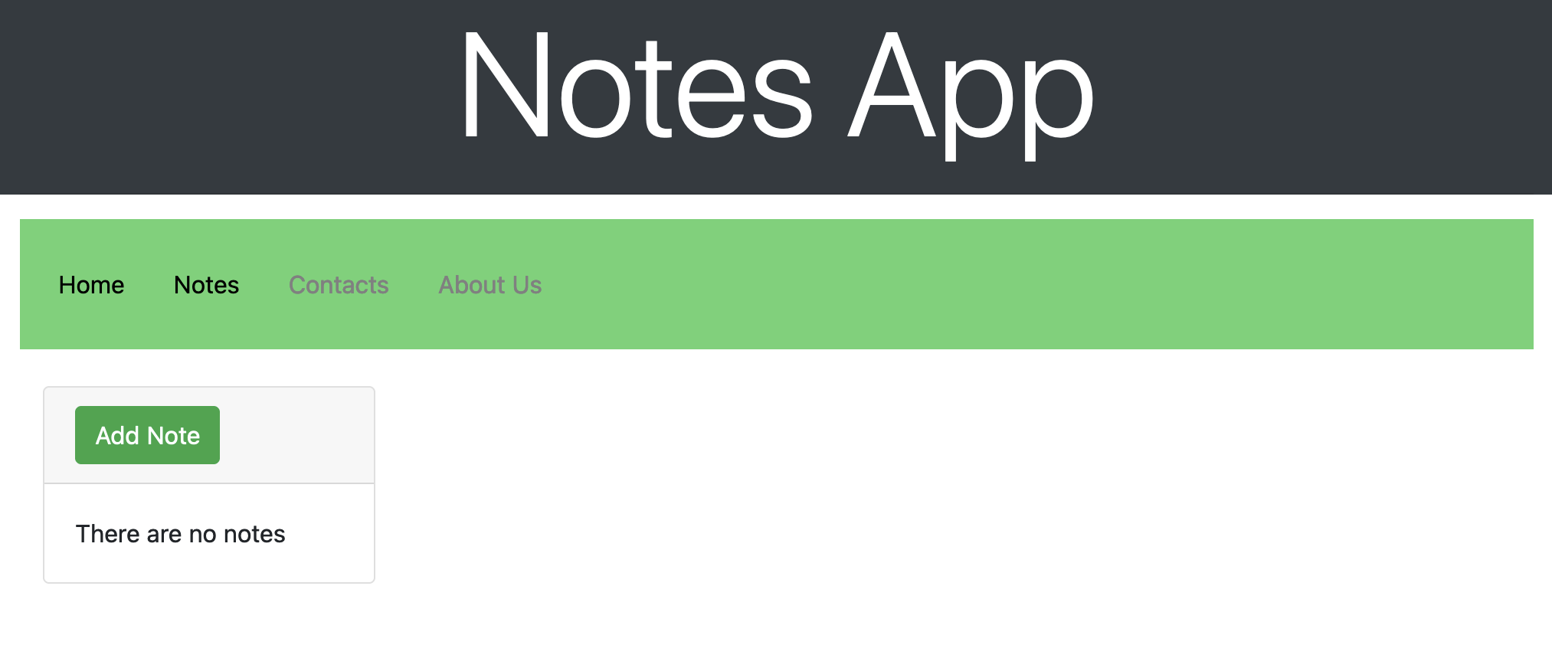
Implementation
4. UI Implementation
Get more familiar with React
Code revamping
Decouple code to components for further usability and readability.
Adding more features
Adding Navigation bar using Routers
Separate content to different pages
Adding frontend code for Adding and Removing contacts

Slide 12
Todo for next week
Implementing the policies for the public deletion of note
Implementing the policies for User-User sharing

Slide 13
Thank you!

