Slide 1

Lab Sovereign Data Exchange – Solid Model
Jour-Fixe Meeting
Date: 18th May 2022
Team Solid

Slide 2
Overview of last week
◼ Issue in session management, changes to policy
◼ Flow diagrams
◼ Discussion for note linking
◼ Todo

Slide 3
Issue in Session management
Managing user session in the backend is not ideal, it requires note data to be sent to the server
Server only to be used for bookkeeping of references, should not be aware of what note data the user is creating
Only manage AppPod session on backend
Move api calls which requires user session to the frontend => note data is never sent to backend => secure
Only keep those endpoints in the backend which interact with AppPod

Slide 4
Changes in user-user sharing
Browser (User1’s session)
User1 creates a Note (“Note1”) in Notesdump folder, (default: none, User: write)
User1 decides to share note with User2
For “User1/Notesdump/Note1” the access for User2 is changed to “read”
AppPod should be given permissions ‘only’ to read ACL for “User1/Notesdump/Note1”
Server (AppPod’s session)
Data received: {Note URL, user1 WebID, user2 WebID}
To disallow fake calls to the endpoint -> check if “Note1” has access “read” for User2
A ‘thing’ is added in ‘AppPod/Users/User2’ named “Note1ref” it contains: Author name, URL of “Note1”
Access is set to (default: none, User2: read, User1: write)

Slide 5
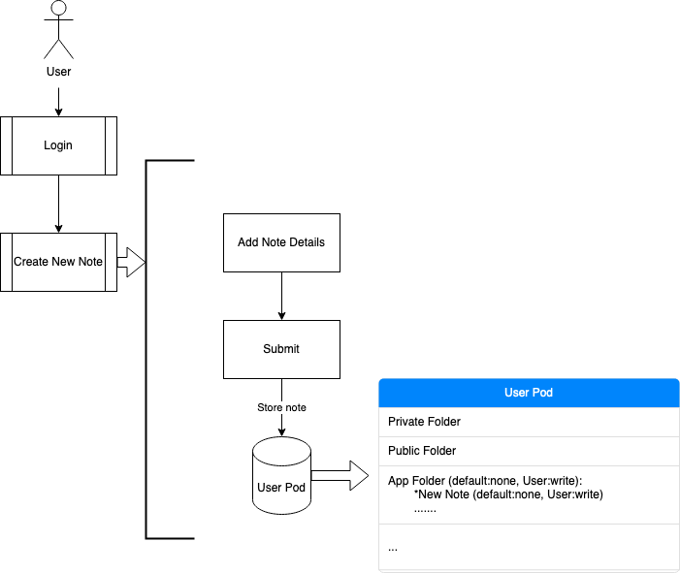
Create New Note

Slide 6
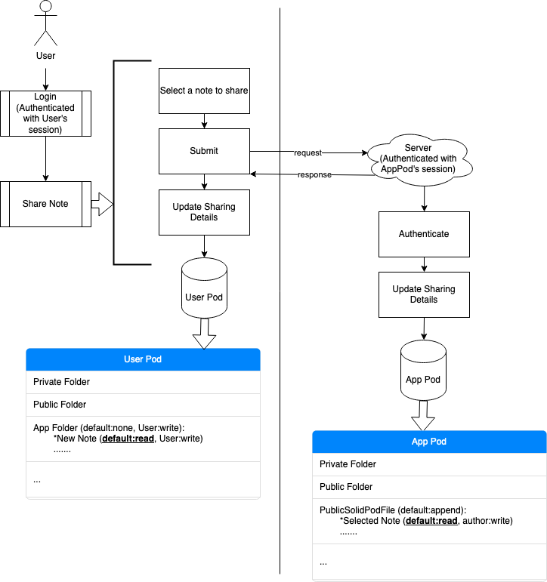
Set Note as public
, read

Slide 7
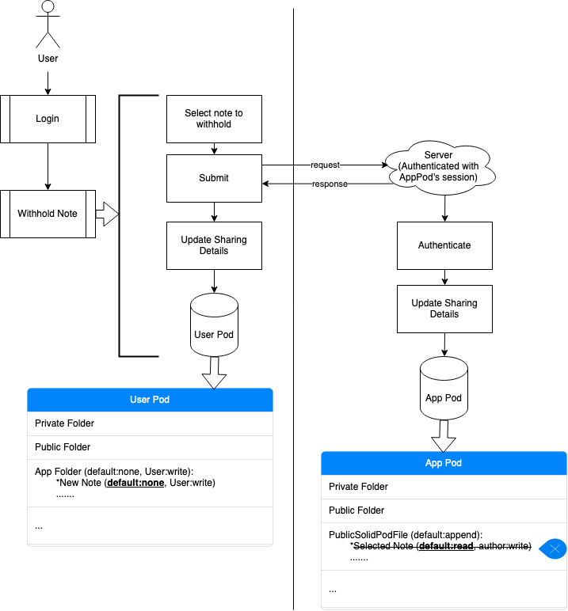
Set Note as private
, read

Slide 8
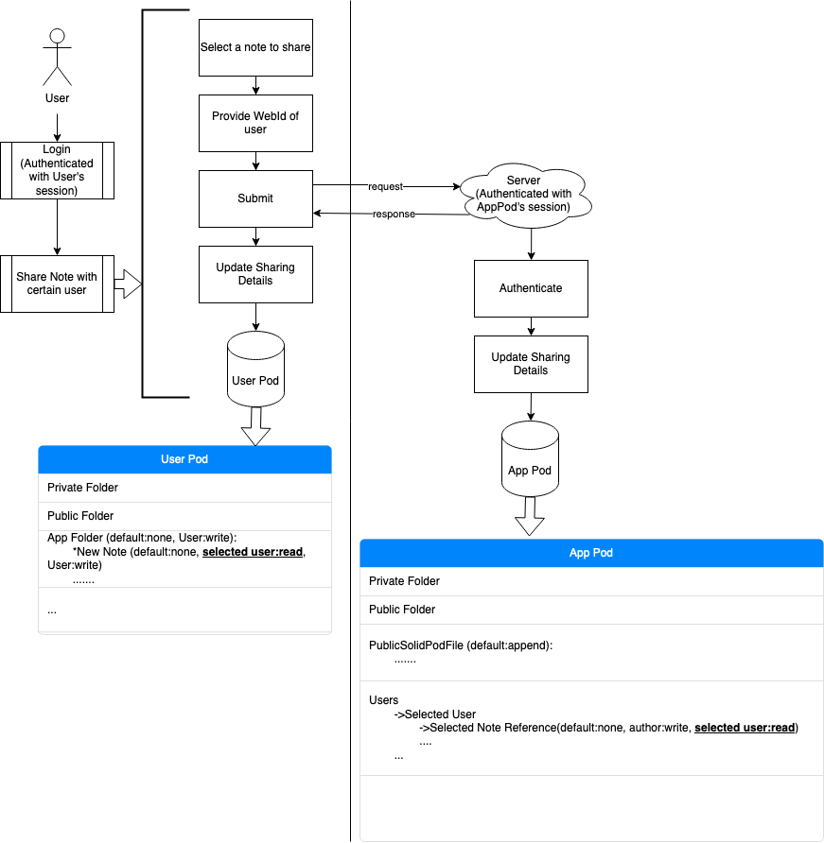
Share Note with a user

Slide 9
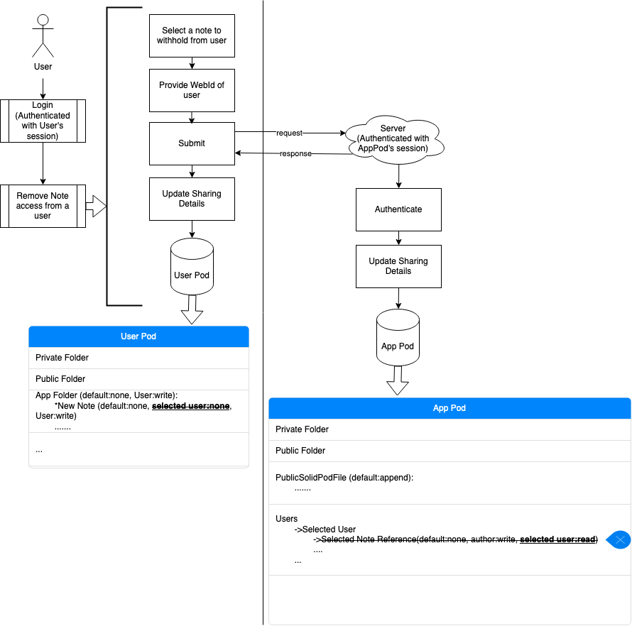
Remove access from User

Slide 10
Discussion: Linking Notes
Created notes, are stored within the https://pod.inrupt.com/User/Notesdump/ folder
Notes have no order and no relations to each other
Linking notes to each other would ensure a broader interconnection between the notes
First implementations as a to-do: Parent- and child-notes
This is in line with our implemented privacy policies as only accessible notes can be referred to and thus linked

Slide 11
Discussion: Implementation Linking Notes
Solid works with RDF Vocabulary (e.g. “https://schema.org/name”) and especially URLs
There are 2 options how to implement this:
1. Create a new Thing Data structure, containing the related URLs
2. Only while adding the linkage, an “https://schema.org/TextDigitalDocument” is added to the data structure, using the “sameAs” method which can store a related URL
If privacy of a linked parent-/childnote is switched from public to private then all relations to that note that previously had access will be deleted

Slide 12
Todo for next week
Complete migration of some api calls to react
Implementing the policies for User-User sharing

Slide 13
Thank you!

