Slide 1

Lab Sovereign Data Exchange – Solid Model
First Jour-Fix Meeting
Date:13th April 2022
Team Solid Introduction

Slide 2
Summary
Group Introduction
Introduction Solid Data Exchange Model
Group Organisation

Slide 3
1. Group Introduction

Slide 4

1. Group Introduction
Timothy Clemens Borrell
Age: 24
Based: Aachen/Münster
Studies: M.Sc. Data Science (2nd Semester)
Hobbies: Golf, Piano, Reading
Expertise: Python, Java, VBA, Latex, MATLAB

Slide 5
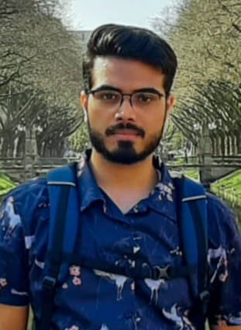
1. Group Introduction
Pulkit Arora
Age: 22
Based: India
Studies: M.Sc. Media Informatics
Hobbies: Hiking, Reading
Expertise: Python, Flask

Slide 6
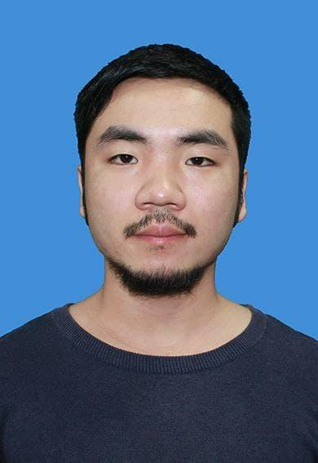
1. Group Introduction
Leslie (Haihua Yang)
Age: 24
Based: China
Studies: M.Sc. Media Informatics
Hobbies: Badminton, Reading
Expertise: Java, javascript, python

Slide 7
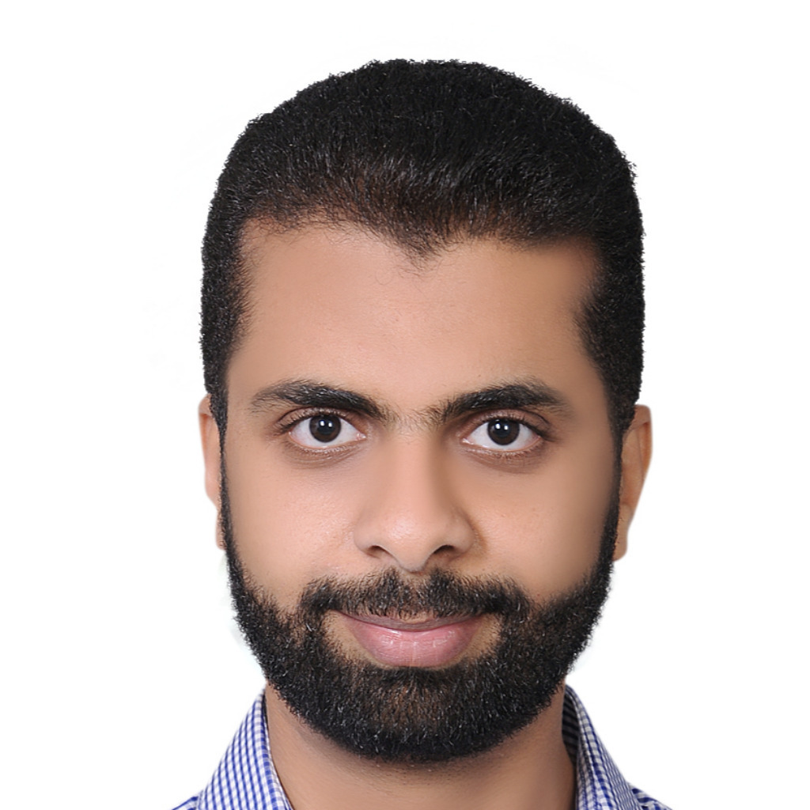
1. Group Introduction
Omar Mahmoud
Age: 33
Based: Egypt
Studies: M.Sc. Data Science
Hobbies: Reading
Expertise: Java, SQL

Slide 8
2. Introduction Solid Data Exchange Model

Slide 9
2. Introduction Solid Data Exchange Model
Brief Overview
Solid is a protocol that lets people store their data securely in decentralized data stores called Pods. Pods are like secure personal web servers for your data.
Any kind of information can be stored in a Solid Pod
You control access to the data in your Pod. You decide what data to share and with whom (be it individuals, organizations, and/or applications). Furthermore, you can revoke access at any time
To store and access data in your Pod, applications use standard, open, and interoperable data formats and protocols

Slide 10
2. Introduction Solid Data Exchange Model
Technical
Programming language: JavaScript, Libraries/Frameworks: ReactJS, NodeJS
„Solid“-specific libraries:
Solid-Node-Client: Facilitates solid access to Pods, local file systems, and other backends via NodeJS
Solid-File-Client: Solid-File-Client is a JavaScript library containing high-level methods to create, read, and manage files and folders

Slide 11
2. Introduction Solid Data Exchange Model
Get Started
Create Solid Pod & WebID
Locally
Using provider (solidcommunity.net)
Developing first application

Slide 12
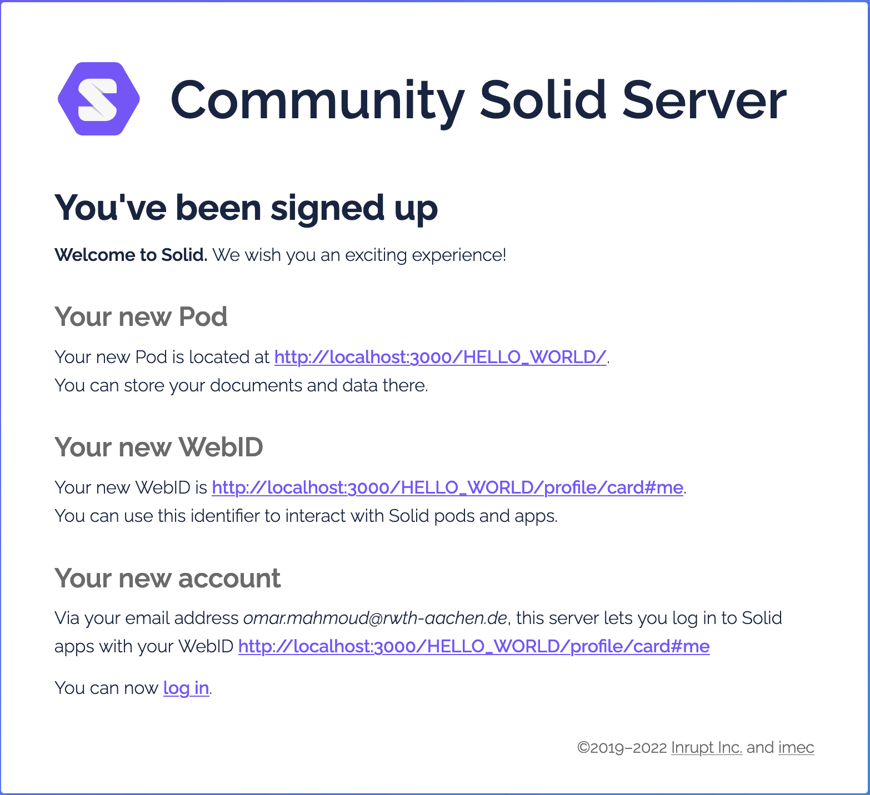
2. Introduction Solid Data Exchange Model
Get Started
Create Solid Pod & WebID
Locally

Slide 13
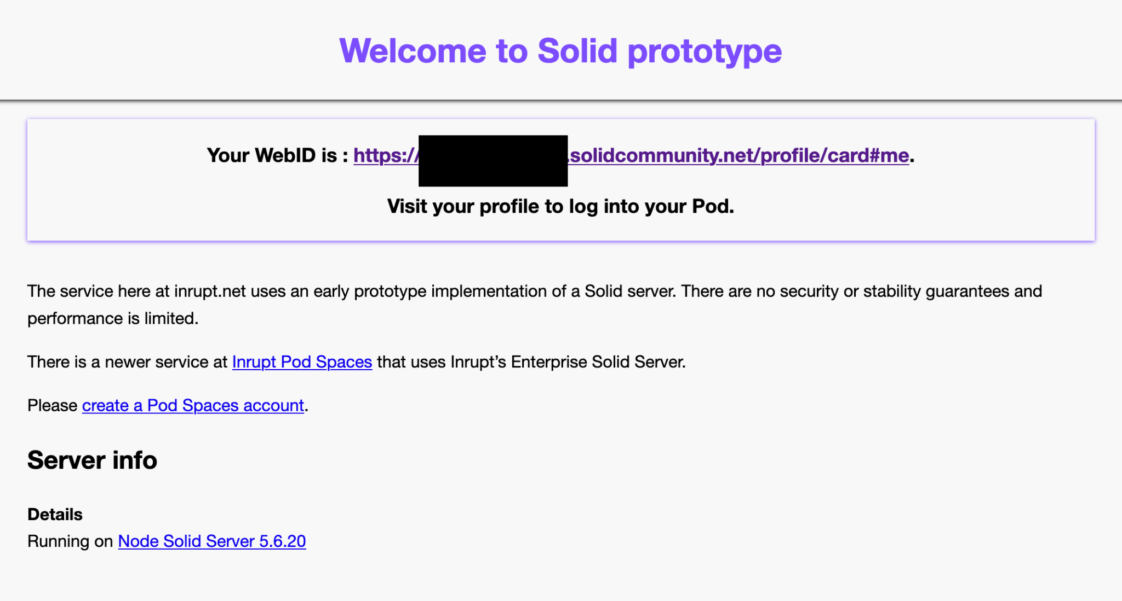
2. Introduction Solid Data Exchange Model
Get Started
Create Solid Pod & WebID
Locally
Using provider (solidcommunity.net)

Slide 14
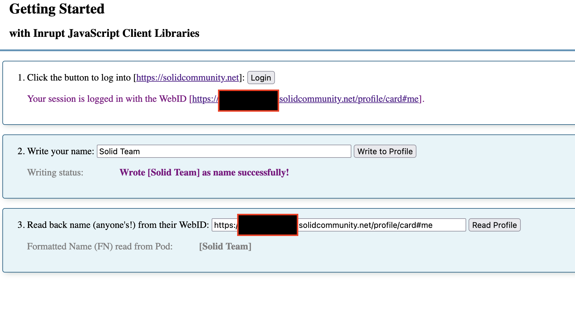
2. Introduction Solid Data Exchange Model
Get Started
Developing first application

Slide 15
3. Group Organisation

Slide 16
3. Group Organisation
Overview
General Team coordination
File Management System: Git (GitLab)
Weekly Meetings held via Zoom and/or Discord
Distributed Responsibilities:
Git (all 4 members)
Documentation of code (members who code will be in charge of its documentation)
Code reviewer (Leslie to begin with, after time all 4 members)
Presentation (All 4, Masterkeeper Timothy)

Slide 17
3. Group Organisation
Meetings
Weekly Jour-Fix on Tuesdays 18:30 – 19:30 (tbd.) via zoom, more flexible and spontaneous meetings via Discord
Weekly Meeting Schedule:
First 20 min: catching up on all individual projects
Second 20 min: Creating Powerpoint Presentation for weekly meeting on Wednesday
Final 20 min: Formulating issues and discussing solutions in group, assigning to-dos for the next week for each individual member

