Slide 1

Lab Sovereign Data Exchange – Solid Model
Second Jour-Fix Meeting
Date: 20th April 2022
Team Solid

Slide 2
Summary
Initial Technical Set-up of Solid Model
Solid-specific JavaScript Libraries

Slide 3
1. Initial Set-up of Solid Model

Slide 4
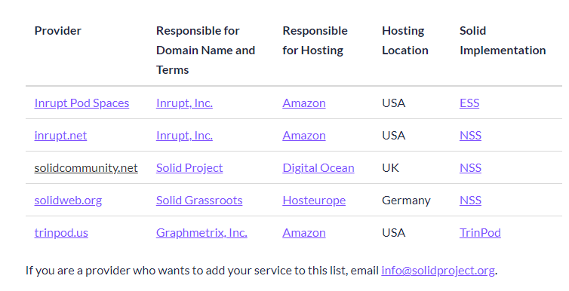
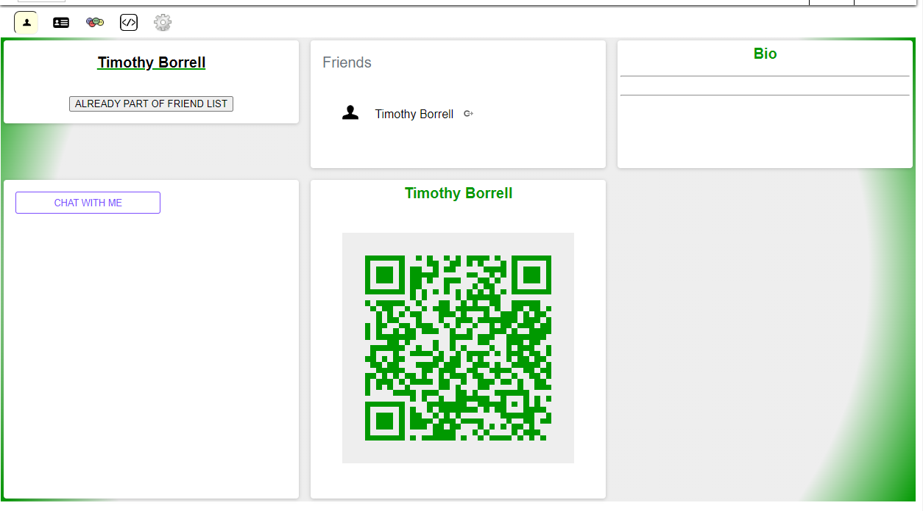
1. Initial Set-up of Solid Model
Prerequisites
Install Node.js which includes the library npm and Parcel
Create Pod and WebID, this either on an own server or through a provider
While using a provider one needs to register to it‘s server and create a Pod as well as a WebID

Slide 5
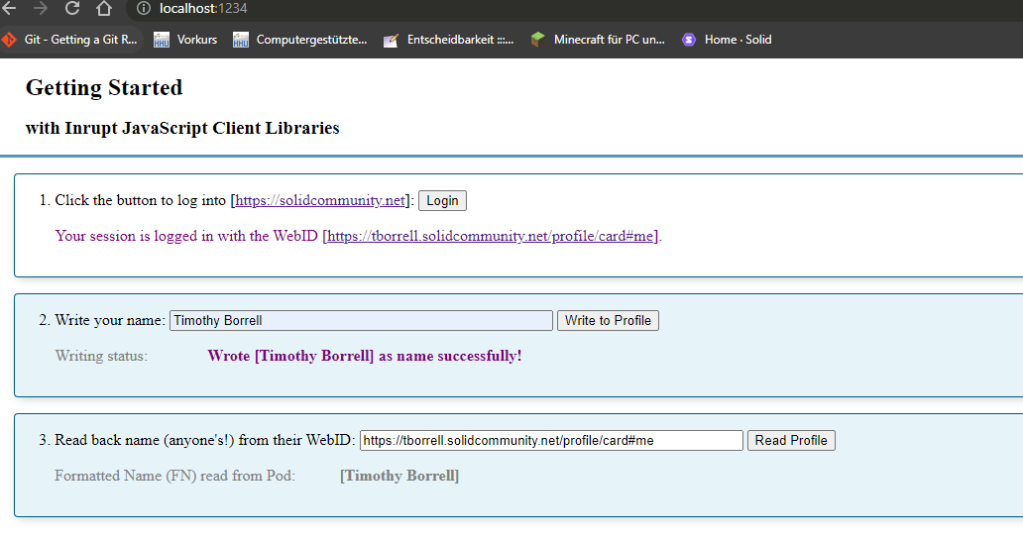
1. Initial Set-up of Solid Model
Build the Application
Initialize the application in directory
Install Client Libraries in Terminal
Create Application (creation of ~.css-, ~.html, and ~.js-files)
Run Application, open „localhost:1234“ in the browser
Able to log in to your pod and fill your server with personal data
Possible to read public profile of anyone else with a Solid Pod through WebID

Slide 6
2. Solid-specific JavaScript Libraries

Slide 7
2. Solid-specific JavaScript Libraries
Solid Authentication
solid-client-authn
It is a suite of libraries to manage the authentication required to access protected resources on Solid servers. The libraries share a common API and include different modules for different deployment environments:
solid-client-authn-browser - can be used to authenticate a solid session in the browser.
solid-client-authn-node - can be used to build server-side and console-based apps, authentication does not need a browser.
Solid-Node-Client - Solid access to Pods, local file systems, and other backends via nodejs. Includes authentication workflow.

Slide 8
2. Solid-specific JavaScript Libraries
Solid Authentication
Example of session authentication via solid-node-client (insecure)
import { SolidNodeClient } from 'solid-node-client';
const client = new SolidNodeClient();
await client.login({
idp : "YOUR_IDENTITY_PROVIDER", // e.g. https://solidcommunity.net
username : "YOUR_USERNAME",
password : "YOUR_PASSWORD",
});

Slide 9
2. Solid-specific JavaScript Libraries
Solid Authentication
Example of session authentication via solid-node-client (recommended)
import { SolidNodeClient } from 'solid-node-client';
const client = new SolidNodeClient();
let session = await client.login(); // awaits for user to enter password in a secure window
// avoids transmitting credentials as plain text
if( session.isLoggedIn ) {
console.log (`logged in as <${session.WebID}>`);
}

Slide 10
2. Solid-specific JavaScript Libraries
Solid OS
Solid UI User Interface widgets and utilities for Solid
Mashlib Solid-compatible data mashup library and Databrowser
Solid Panes A set of core solid-compatible apps based on solid-ui

Slide 11
2. Solid-specific JavaScript Libraries
Solid UI
create a button
const solidLogo = 'https://solidproject.org/assets/img/solid-emblem.svg'
const myButton = UI.widgets.button(document, solidLogo, 'test', () => window.alert('clicked!'))
UI.widgets.clearElement(document.body)
document.body.appendChild(myButton)

Slide 12
2. Solid-specific JavaScript Libraries
Mashlib
pane-registry: An index to hold all loaded solid panes, whether statically or dynamically loaded
solid-panes:existed module in solid such as folder, tracker, chat.

Slide 13
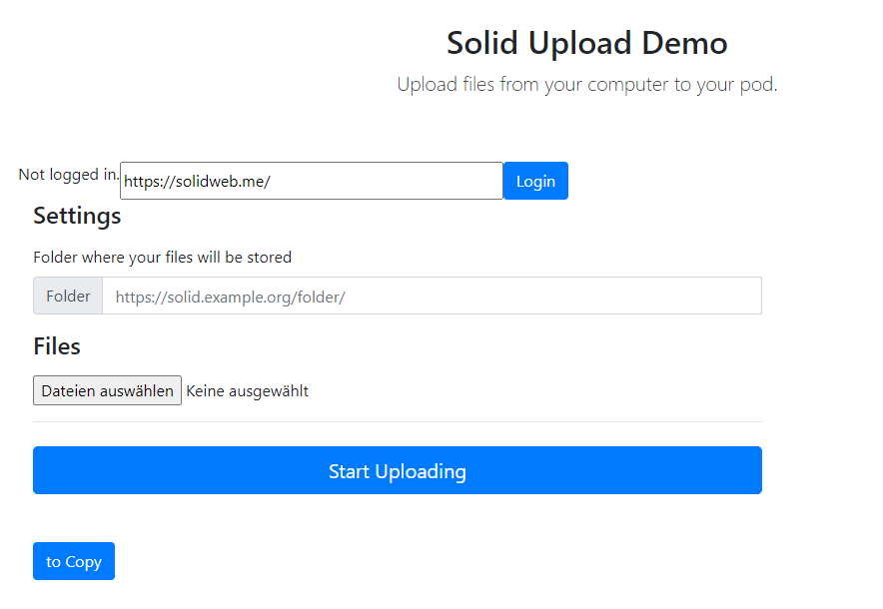
2. Solid-specific JavaScript Libraries
Resource Management Libraries
Solid File Client
Create, read, copy, upload, manage files and folders
Used in browser scripts in Node.js scripts
Library supports binary and text files, is able to read and write data from Solid Pods, local file systems
Can work with web resources, resources stored in browser‘s local storage or local file system.

Slide 14
2. Solid-specific JavaScript Libraries
Resource Management Libraries
Inrupt Solid Client JS
Able to read/write structured Data
Able to read/write Files
Allows developers to access data and manage permissions on the data that is stored in Solid Pods
Can be run locally or in an authenticated browser, allowing apps to authenticate against a Solid server, only necessary if one wishes to access private resources in a Pod

Slide 15
2. Solid-specific JavaScript Libraries
Vocabulary
Keep data independent from applications.
(consistency) The same data has the same meaning across different applications

Slide 16
2. Solid-specific JavaScript Libraries
Vocabulary
Keep data independent from applications.
(consistency) The same data has the same meaning across different applications

Slide 17


2. Solid-specific JavaScript Libraries
Vocabulary
Obelisks
An obelisk is owned by a person
An obelisk is built by a sculptor
An obelisk has a height

Slide 18
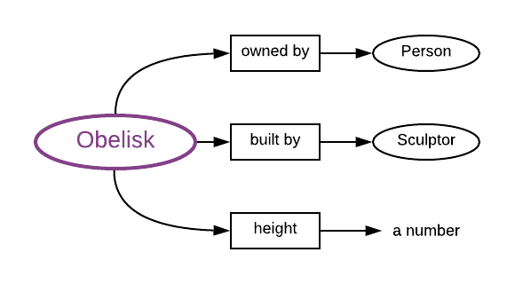
2. Solid-specific JavaScript Libraries
Vocabulary
Obelisks
An obelisk is owned by a person
An obelisk is built by a sculptor
An obelisk has a height
Terms
Things (Classes): obelisk, person, and sculptor
Properties:Owned by, built by, and height

Slide 19
2. Solid-specific JavaScript Libraries
Vocabulary
RDF (Resource Description Framework)
Build vocabularies to be used across web
Everything is identified by IRI (URI + internationalised characters set)Resource Description Framework

Slide 20
2. Solid-specific JavaScript Libraries
Vocabulary
How does it work?
Convert our terms to IRIs
An http://w3id.org/obelisk/Obelisk is http://w3id.org/obelisk/ownedBy a http://w3id.org/obelisk/Person.
An http://w3id.org/obelisk/Obelisk is http://w3id.org/obelisk/builtBy a http://w3id.org/obelisk/Sculptor.
An http://w3id.org/obelisk/Obelisk has a http://w3id.org/obelisk/height, which is a numerical value.

Slide 21
2. Solid-specific JavaScript Libraries
Vocabulary
How does it work?
Convert our terms to IRIs
For simplicity we use prefix obelisk to denote ttp://w3id.org/obelisk/Obelisk
An obelisk is obelisk:ownedBy a obelisk:Person.
An obelisk is obelisk:builtBy a obelisk:Sculptor.
An obelisk has a obelisk:height, which is a numerical value.

Slide 22
2. Solid-specific JavaScript Libraries
Vocabulary
Some famous vocabularies
rdf, rdfs
Example
belisk:Obelisk is a class.
belisk:ownedBy is a property.
@prefix obelisk: <http://w3id.org/obelisk/> .
@prefix rdf: <http://www.w3.org/1999/02/22-rdf-syntax-ns#> .
@prefix rdfs: <http://www.w3.org/2000/01/rdf-schema#> .
obelisk:Obelisk rdf:type rdfs:Class .
obelisk:ownedBy rdf:type rdf:Property .
XML snippet

Slide 23
2. Solid-specific JavaScript Libraries
Vocabulary
Use rdfs:label & rdfs:comment for readability
@prefix obelisk: <http://w3id.org/obelisk/> .
@prefix rdf: <http://www.w3.org/1999/02/22-rdf-syntax-ns#> .
@prefix rdfs: <http://www.w3.org/2000/01/rdf-schema#> .
obelisk:Sculptor rdf:type rdfs:Class ;
rdfs:label "Sculptor" ;
rdfs:comment "An artist who sculpts obelisks." .
XML snippet

