Slide 1

Lab Sovereign Data Exchange – Solid Model
Second Jour-Fix Meeting
Date: 27th April 2022
Team Solid

Slide 2
Summary
Proof of concept (Introduction to our user case, System scope, Requirements overview)
Solution Strategy
Runtime View

Slide 3
1. Proof of concept Introduction

Slide 4
1. Initial Set-up of Solid Model
Introduction to user case :
Collaborative Note Making
System Scope
Main goal is to create a collaborative note sharing application using SOLID as a decentralized data store
Provide a digital keep for users to create, edit and share notes.
Allow users to communicate within the interface by managing permissions to the notes created in their pods
Possibly allow building knowledge graphs by linking Ideas

Slide 5
1. Initial Set-up of Solid Model
Introduction to user case :
Collaborative Note Making
Requirements overview
A decentralized data exchange application should contain the following functionalities:
It provides an interface that allows fetching user data from a decentralized data store. It allows sharing and modifications in one of the following scenarios
1. Within application b/w diff user’s pods: User X can be allowed to view User Y’s info when given the appropriate permissions
2. Public sharing: A user can decide to make the data available for public usage
3. With other data applications: eg, a blog stored in a users pod as a social media posts

Slide 6
1. Initial Set-up of Solid Model
Proof of concept for a simple data exchange scenario using Solid
What the system can do:
1. Allows a user to create a note
2. Allow a user to share his notes with another user (read/edit privileges)
3. Public sharing of notes
4*. Associate notes with tags, eg (private and public) and also with specific tags (Mathematics, physics, screenplay)
5*. Functionality for users to give edit suggestions to public “read-only” notes
6*. Link ideas -> create a knowledge graph (a sentence/phrase in note X can be linked-to note Y)
* Tentative functionalities, not to be included in the POC. Included in a more complex data exchange scenario

Slide 7
1. Initial Set-up of Solid Model
Handling Public Sharing of notes
Problem: How do we list the notes made public, when all the data is decentralized
Proposition 1 (using an application POD with shared data):
Create a Solid pod for the application itself
When a user X makes a note public, it essentially shares the note with the Application’s pod (call that "APPpod")
When someone wants to view the public notes, the app list all the notes shared with the APPpod
AAPpod is a friend for all users
This extends to the functionality 4* of Associating public notes with custom tags

Slide 8
1. Initial Set-up of Solid Model
Handling Public Sharing of notes
Problem: How do we list the notes made public, when all the data is decentralized
Proposition 2 (RDF vocabulary):
Use a text document RDF vocabulary that stores links to other users who can collaborate, this includes maintainers, writers, readers, etc.
Allows a user sees all note shared by their friends to which they can collaborate on
eg, (possibility?) TextDigitalDocument (A Schema.org Type https://schema.org/TextDigitalDocument)
properties like:
- accessMode
- accessibilityAPI
- accountablePerson
- audience
- comment
- conditionsOfAccess

Slide 9
Solution Strategy
Date Strorage: solid
Programming language: javascript
Environment: NodeJS
POD access: solid-file-clien
Authenticate users: solid-auth-client
File name generation: uuid

Slide 10
System Architechture
Level 1:
user
components
handlers
pod

Slide 11
System Architechture level 2: Handler
RequstHandler
PodHandler
pod
cache
Parsers

Slide 12
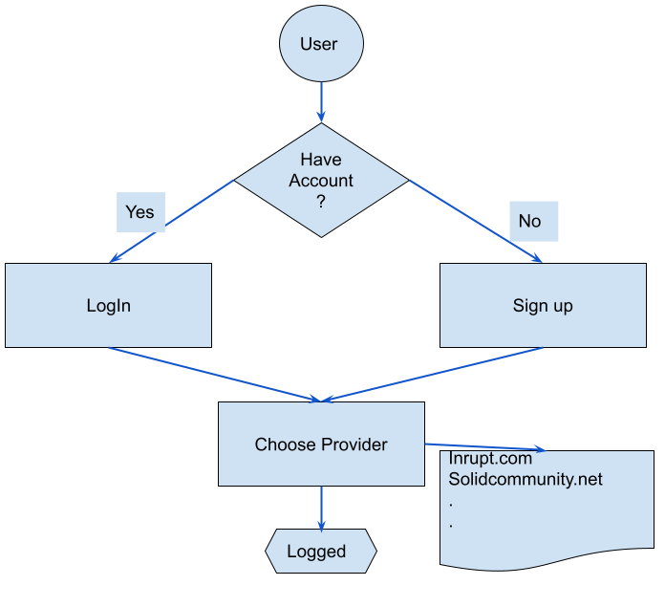
Features Workflow
Log In

Slide 13
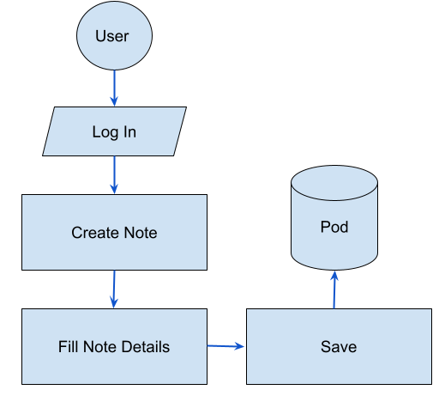
Features Workflow
Create New Note

Slide 14

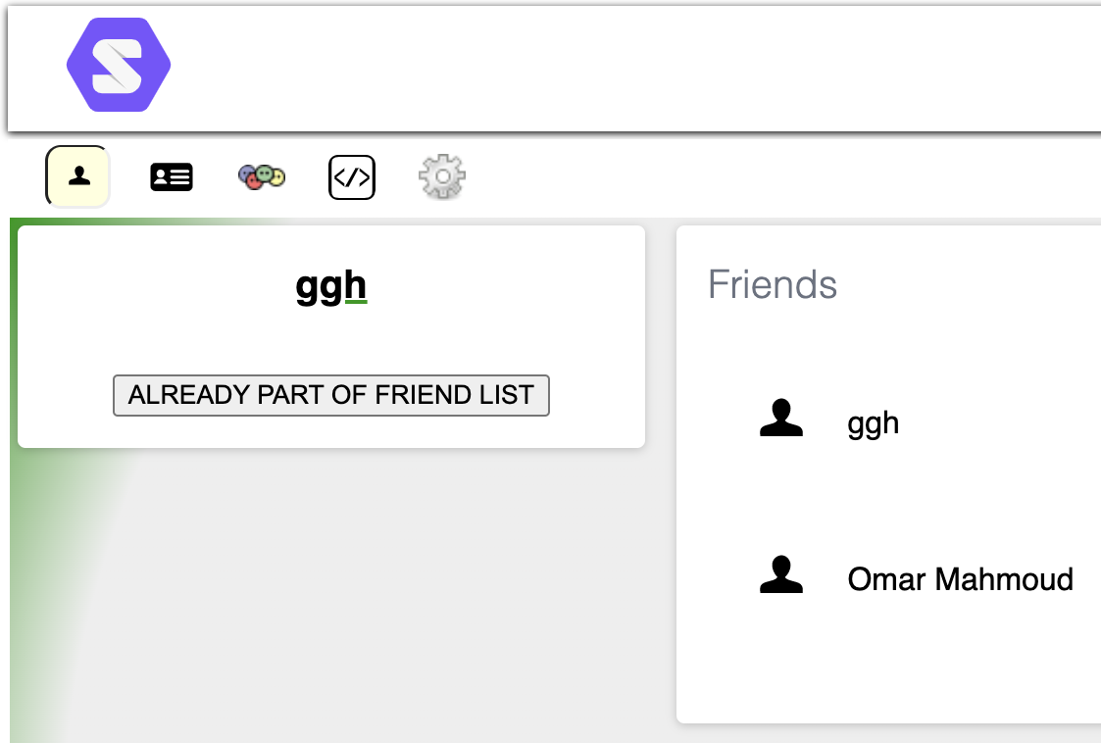
Features Workflow
Add a friend

Slide 15
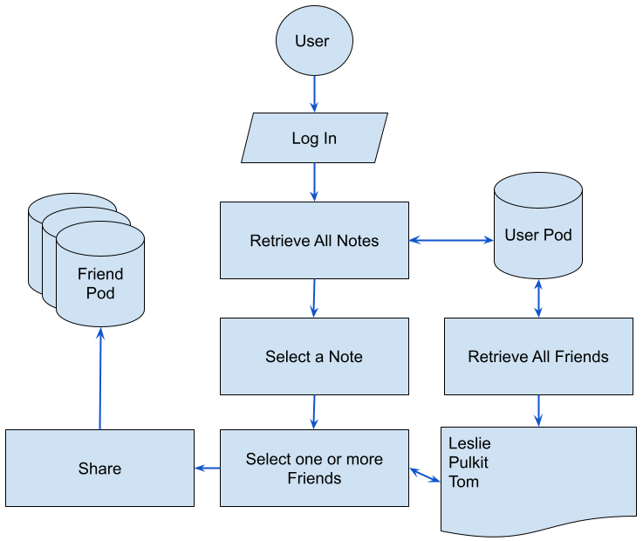
Features Workflow
Share a Note

