Slide 1

Lab Sovereign Data Exchange – Solid Model
Jour-Fixe Meeting
Date: 4th May 2022
Team Solid

Slide 2
Milestone 1
◼ Features of the implemented Proof-of-Concept and current issues
◼ Concept for a complex data exchange scenario
◼ Technical difficulties
◼ Work plan

Slide 3
1. Features of the implemented Proof-of-Concept and current issues

Slide 4
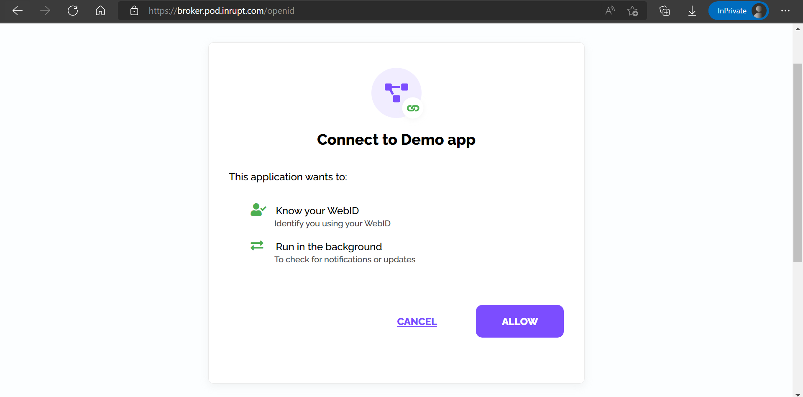
Login (localhost:5000/)

Slide 5
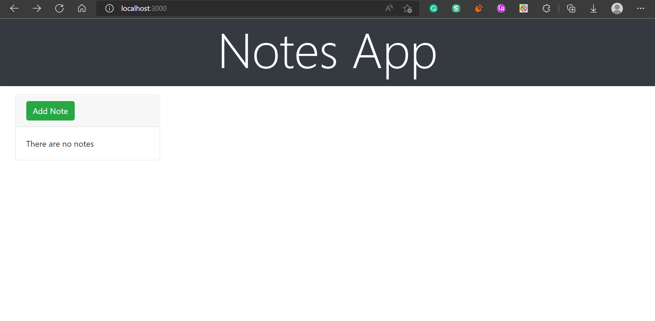
Basic User Interface

Slide 6
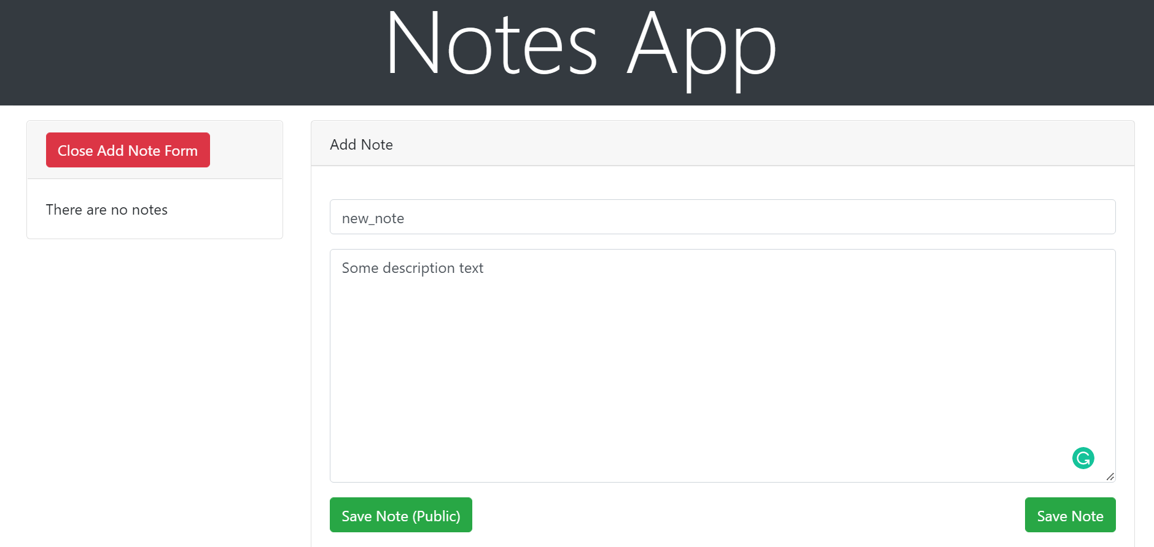
Creating a Note

Slide 7
1. Initial Set-up of Solid Model
Interactions with POD
GET/POST endpoints
localhost:5000/ -> Handles login to inrupt pod and redirect to the user interface
localhost:3000/ -> User interface to create Notes
localhost:5000/reactNote -> Receives Note data from the react server, creates a thing object and writes it to the inrupt pod
localhost:5000/readAllNotes -> Reads all notes from the notes dump folder
localhost:5000/storetoPublicPod -> Stores a node in the user pod (private) and creates a link to it in the Public pod

Slide 8
1. Initial Set-up of Solid Model
Creating a note
Verify user is logged in using “session.info.isLoggedIn”
Built Thing object using buildThing(...)
Vocabulary used for text notes: “https://schema.org/TextDigitalDocument”
Save Thing to pod (currently at “https://pod.inrupt.com/pulkit6559/Notesdump/”) using saveSolidDatasetAt(...)

Slide 9
1. Initial Set-up of Solid Model
Method /readNote
Requirements overview
1. Appropriate permissions to read notes (restricted data cannot be read)
2. URL in which Notes are stored (here: "https://pod.inrupt.com/pulkit6559/Notesdump/")
3. URL in Notestorage, that directs user to input information of the note
4. Libraries from Solid-Client: getSolidDataset, getThing + method that is going to be used

Slide 10
1. Initial Set-up of Solid Model
Method /readNote
How to read notes
1. Import client libraries
2. Fetch SolidDataset, a document that contains the data of the notes
3. Get Data entity “Thing”, fetching either single information or all data entities from the dataset
4. Read attribute of “Thing” through different methods (e.g. getInteger, getStringByLocaleAll etc.)

Slide 11
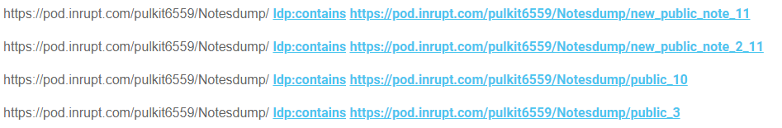
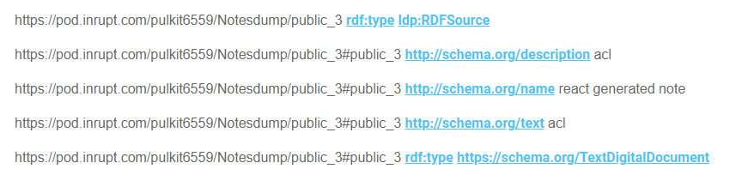
1. Initial Set-up of Solid Model
Method /readNote
List of all accessible Notes
List with all Notes
Note Data (here note “public 3”)

Slide 12
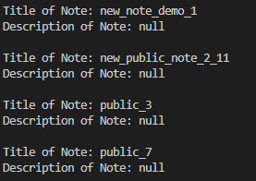
1. Initial Set-up of Solid Model
Method /readNote
List with all Notes
Code output (unfinished)
1. Description access not working yet
2. Only console output
3. Will be formatted into a *.JSON file
4. Further information accessible too

Slide 13
1. Initial Set-up of Solid Model
Method /storetopublicpod
How to share the notes
1. get the address and name of the note from the frontend
2. create a SolidDataset, a document that contains the address of the note(thing.description)
3. use method savesoliddataset() to save the address of the note to the APPpod (currently at -> https://pod.inrupt.com/leslie/publicSolidPodFile/)

Slide 14
1. Initial Set-up of Solid Model
Public sharing (Current Issue]
After the Thing object for note link created in the public pod, the Note content itself is still private to the user who created it
Need to make the access to the note public using setPublicResourceAccess(...)
Problem: Function is still experimental and gives an error when accessed
“{input: 'undefined',code: 'ERR_INVALID_URL'}”

Slide 15
1. Initial Set-up of Solid Model
2. Complex data exchange scenario
What the system can do:
1. Allows a user to create/read notes
2. Allow a user to share his notes with another user (read/edit privileges)
3. Public sharing of notes
4*. Associate notes with tags, eg (private and public) and also with specific tags (Mathematics, physics, screenplay)
5*. Functionality for users to give edit suggestions to public “read-only” notes
6*. Link ideas -> create a knowledge graph (a sentence/phrase in note X can be linked-to note Y)
* Included in a more complex data exchange scenario

Slide 16
Technical difficulties
3. Technical difficulties
Adding a contact
Adding viewer to a note

Slide 17
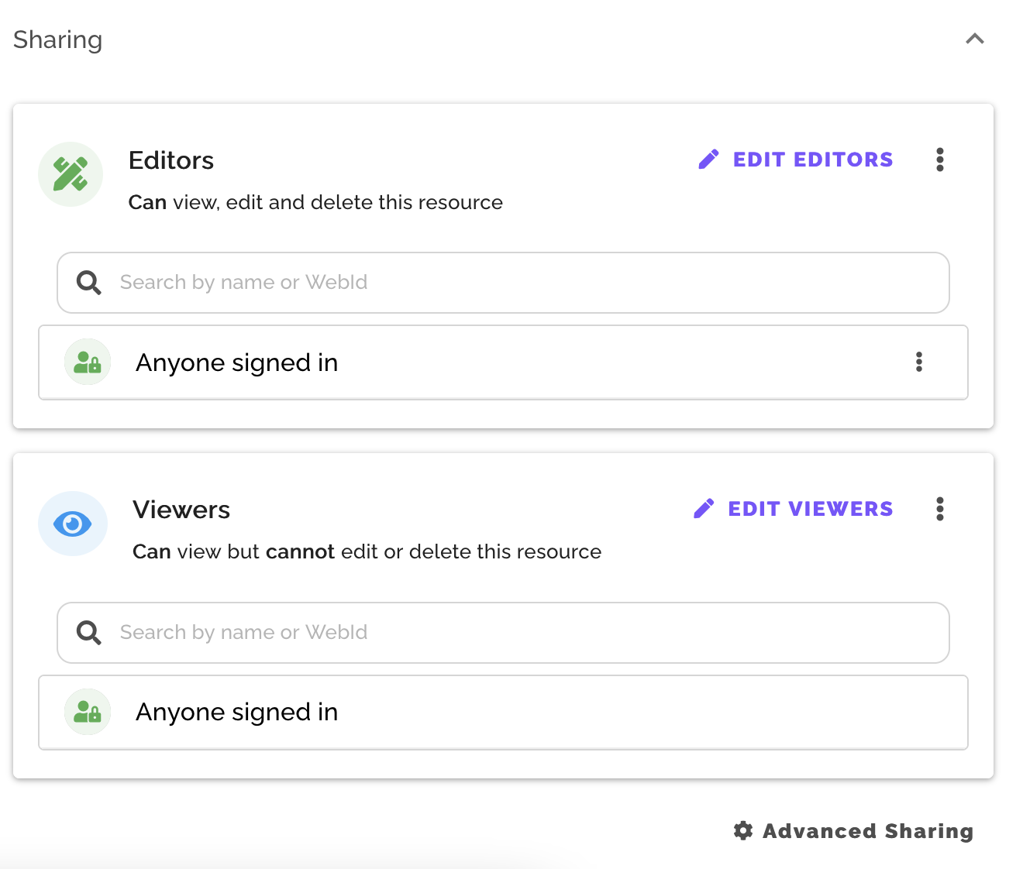
Technical difficulties
Technical difficulties
Adding a Contact
We could not find an API to directly add a contact
We tried to modify people.ttl file, but 401 error was produced each time, although we have access to other files inside the pod, even after modifying people.ttl file to be accessible by anyone error persists

Slide 18
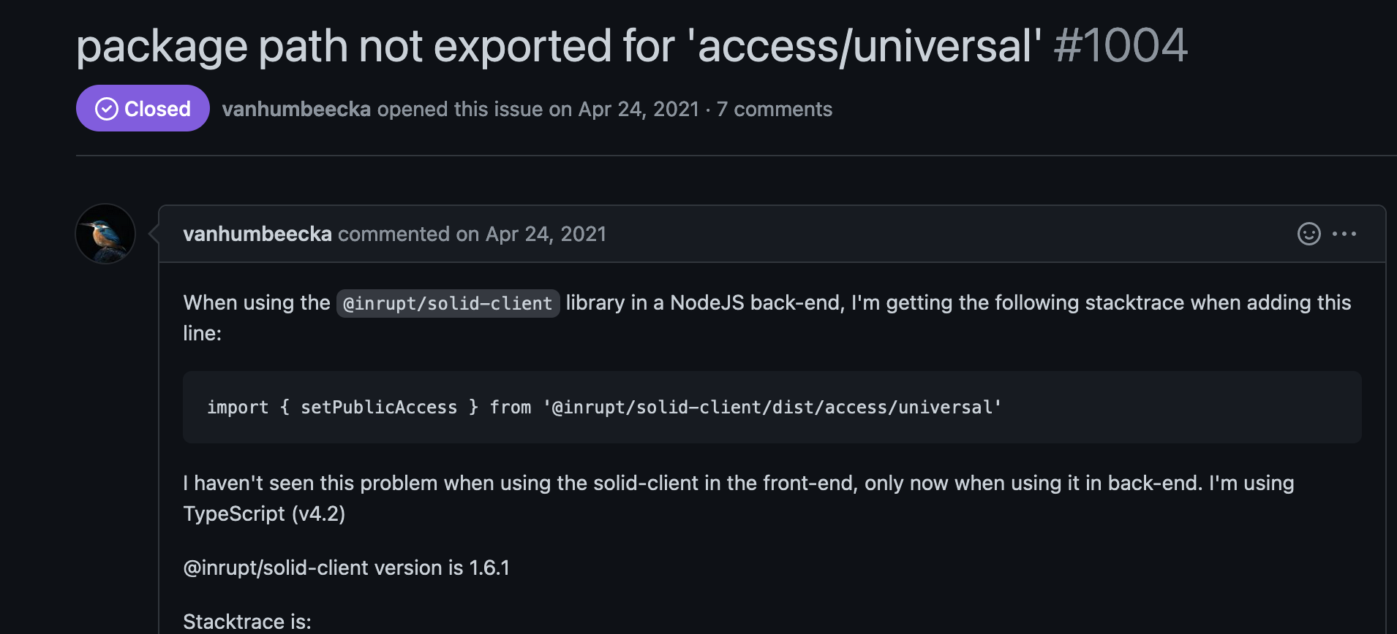
Technical difficulties
Technical difficulties
Adding Viewer to Note
Library has some problems with sub directories inclusion (export), Need further investigation

Slide 19
Technical difficulties
4. Work Plan
Next week
Interface for reading notes
Fix issue with setPublicResourceAccess
Fix modifying agent access issue
Investigating alternative way to add contacts.
week 2
Make shared notes visible in Friends user interface
Allow adding tags for each note
Create UI changes to view notes clubbed by tags
week 3
Allow edit suggestions/comments to read only notes
Relevant UI changes

