Slide 1


CAPSTONE PROJECT
AI-Powered Student Performance Prediction System
Presented By
Student Name: PULKIT AGRAWAL
College Name: St. Joseph’s College
Department: Computer Science
Email ID: agrawalpulkit358@gmail.com
GitHub: Click here

Slide 2
OUTLINE:
Problem Statement
Proposed System/Solution
System Development Approach
Algorithm & Deployment
Result
Conclusion
Future Scope
References

Slide 3

Problem Statement:
Many students struggle to understand how their study habits, attendance, and lifestyle affect their academic performance. There is no simple system available that can analyze student data and predict performance to help them improve.
Students often fail to identify weak areas early, which negatively impacts their final results. An intelligent system is required that can analyze student data and provide performance prediction so students can take corrective actions and improve outcomes.
Source- Google.com

Slide 4
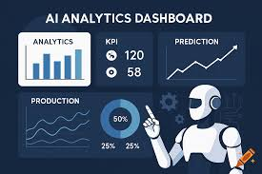
Proposed Solution:
The proposed system uses Machine Learning to analyze student academic data and predict performance. The system studies factors like study hours, attendance, and academic patterns to generate predictions.
This solution helps students to: • Understand their expected performance • Identify weak areas • Improve study strategies • Make better academic decisions
The system is simple, efficient, and can be extended to a cloud-based platform so that students can access it from anywhere.
Source- Google.com

Slide 5
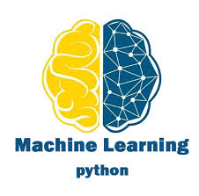
System Approach:
• Python Programming • Google Colab Environment • Machine Learning (Linear Regression) • Pandas Library for data handling • Scikit-learn for model building • Dataset from Kaggle
The model was developed and tested using Google Colab. Machine Learning techniques were applied to analyze student data and generate performance predictions.
Source- Google.com

Slide 6
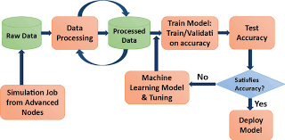
Algorithm & Deployment:
Algorithm Used: Linear Regression
The dataset is first loaded and cleaned for processing. Important features affecting student performance are selected.
The Linear Regression machine learning algorithm is trained using the dataset.
The trained model then predicts student performance based on patterns found in the data.
Deployment Concept: This system can be deployed on Microsoft Azure cloud using Azure Machine Learning services. It can be converted into a web-based system so that students can access performance prediction from anywhere.
Source- Google.com

Slide 7
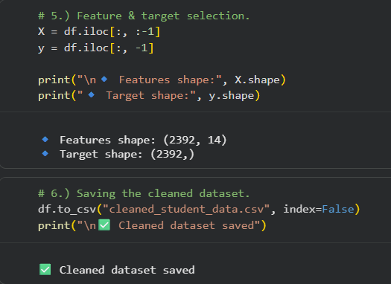
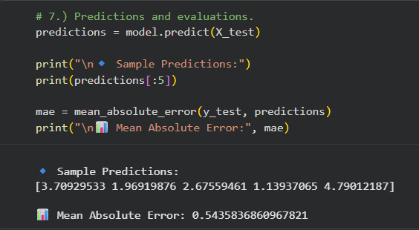
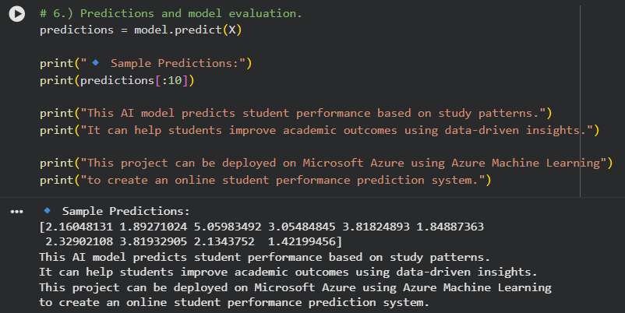
Result:
The machine learning model was successfully trained using the student performance dataset.
The system generated accurate predictions based on student academic data.
The results demonstrate how AI can be used to analyze and improve student performance.
The project shows that machine learning can help students understand their academic progress and take steps for improvement.

Slide 8

Conclusion:
The project successfully demonstrates the use of Machine Learning in predicting student performance. It shows how AI can help students understand their academic progress and improve outcomes.
This system is simple, effective, and useful for students. It can be implemented in educational platforms to provide data-driven insights and performance analysis.
Overall, this project highlights the importance of Artificial Intelligence and cloud technologies in modern education systems.
View the full source code here (GitHub): Click Here
Source- Google.com

Slide 9

Future scope:
This project can be further improved by using larger datasets and advanced Machine Learning models. Real-time data integration can make predictions more accurate and useful.
The system can also be developed into a web or mobile application for students and teachers. Integration with cloud platforms and dashboards can help in better visualization and performance tracking.
In the future, AI-based performance prediction can play a major role in smart education systems.
Source- Google.com

Slide 10
References:
Student Performance Dataset – Kaggle
Python Documentation – https://docs.python.org
Machine Learning Library – Scikit-learn Documentation
Data Visualization – Matplotlib Documentation
Development Platform – Google Colab

Slide 11
Thank You

