Slide 1
AI Mental Health Companion Chatbot.
CAPSTONE PROJECT
Presented By:
Student Name- PULKIT AGRAWAL
College Name- St. Joseph’s College
Department- Computer Science

Slide 2
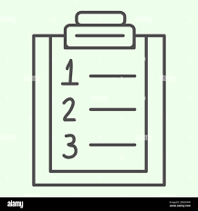
OUTLINE
Overview of Mental Health Challenges
Proposed AI solution using NLP
Technical implementation with Python
Results and Project Impact

Slide 3

Problem Statement
.
Students face high levels of stress, anxiety, and loneliness.
Hesitation to approach professional counselors due to privacy concerns.
Need for an immediate, non-judgmental, and accessible support tool.

Slide 4
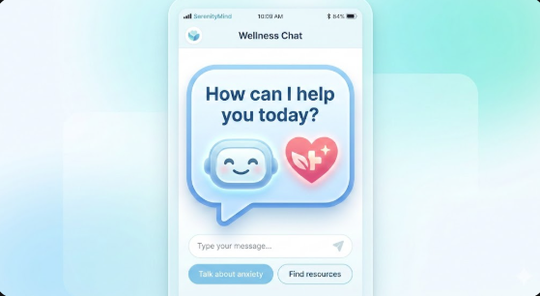
Proposed Solution
A safe, AI-driven chatbot that uses sentiment analysis.
Detects user mood (Positive, Negative, or Neutral) in real-time.
Generates empathetic, motivational responses and relaxation tips.

Slide 5

System Approach
Language: Python (for its simplicity and vast libraries).
Data Handling: Pandas library for managing the mental health dataset.
AI Logic: TextBlob library for processing Natural Language and scoring sentiment.

Slide 6
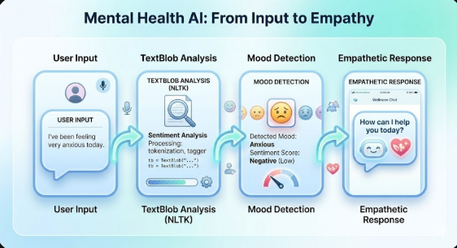
Algorithm & Deployment
Input: User types a sentence describing their feelings.
Process: The script calculates "Polarity" (Sentiment Score).
Decision: * Score < 0: Negative Mood -> Empathetic response.
Score > 0: Positive Mood -> Encouraging response.
Deployment: Successfully tested within a Jupyter Notebook environment.

Slide 7
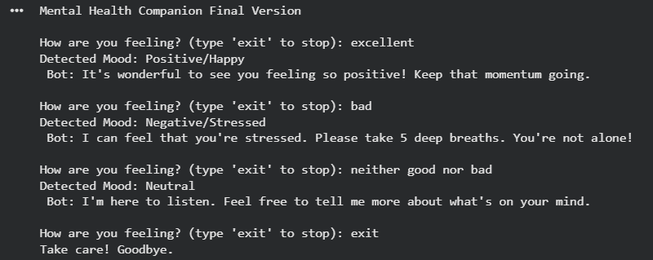
Result
Successfully analyzed statements from the "Combined Data" dataset.
The bot provides instant responses without manual intervention.
Accurately identifies stress-related keywords and offers comfort.

Slide 8

Conclusion
AI can effectively serve as a first-line companion for student well-being.
The project demonstrates that high-impact AI solutions can be built with simple, efficient code.
Future scope includes adding voice support and professional resource links.

Slide 9
Future scope
Multilingual Support: Enhancing the bot to understand and respond in regional languages to help more students.
Professional Integration: Linking the chatbot to professional counseling services or emergency helplines for high-risk cases.
Voice & Video Interface: Moving beyond text to include voice-to-text features for more natural user interaction.
Personalized Resources: Using long-term mood tracking to suggest specific study habits or dietary plans based on the user's emotional trends.

Slide 10
References
1.) Kaggle: Sentiment Analysis for Mental Health Dataset.
2.) TextBlob Library Documentation.

Slide 11
Github link
Github Link : Click here

Slide 12
THANK YOU

