Slide 1
Product Trust Verification System
A Unified Framework for Fake Review Detection and Product Authentication
Student Name: Pulkit Bahuguna
Program & Dept: M.Sc. CS & IT
Roll Number: 25MSCIR038
Project Role: Project Developer
Institution Name: Jain(Deemed-to-be-University)
Project Duration: 6 Weeks
Guide Name: Dr. Raghavendra R
Date of Presentation: 17th July 2026

Slide 2
Agenda
1. Introduction
2. What the Project Covers
3. Project Goals
4. What We Built (System Modules)
5. Tools & Technologies Used
6. What We Learned
7. Challenges Faced & How We Solved Them
8. What We Contributed
9. Summary & Next Steps

Slide 3
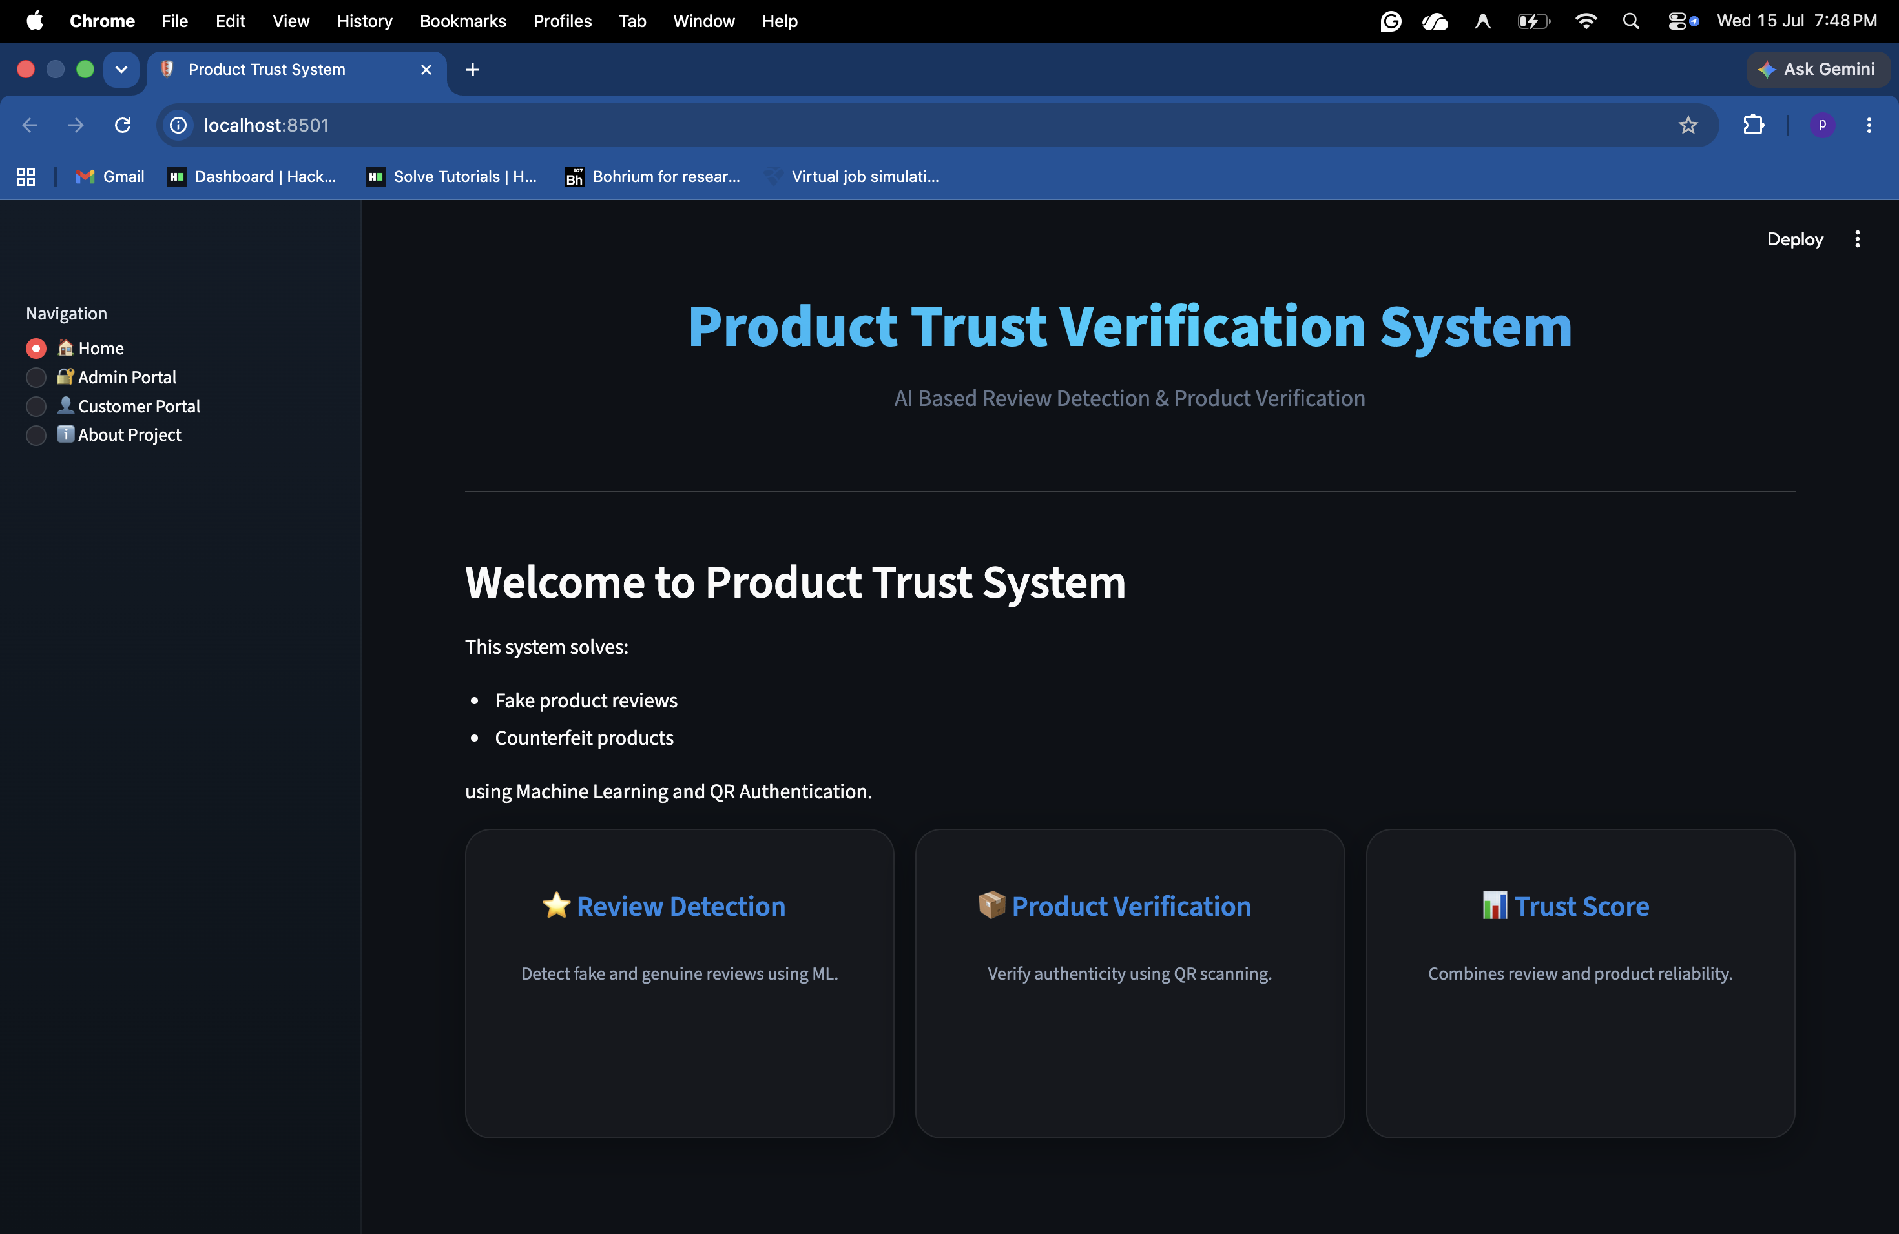
Introduction
Many customers depend on online reviews before buying a product. Unfortunately, not all reviews are genuine, and counterfeit products are also becoming more common. These issues reduce customer trust and make online shopping risky.
This project brings together review analysis and product verification into a single platform. Customers can check reviews before purchasing and verify the authenticity of the product after receiving it.

Slide 4
What the Project Covers
The application is divided into two main sections: Admin Portal and Customer Portal.The Admin Portal is used to register products and generate unique QR codes, while the Customer Portal allows users to analyze reviews and verify product authenticity.
Admin Features
Admin Registration
Secure Login
Register New Products
Generate QR Codes
View Product Details
2. Customer Features
Customer Registration
Customer Login
Fake Review Detection
Product Verification using QR Scan

Slide 5
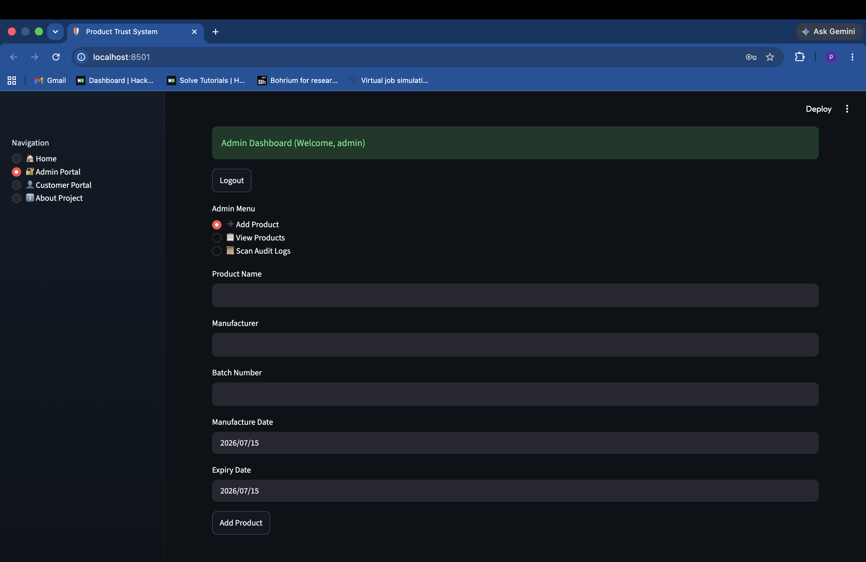
Project Goals
Objective
The main objective of this project is to create a simple and reliable system that helps improve customer trust while shopping online.
Goals
Detect fake reviews using Machine Learning.
Generate a unique QR code for every registered product.
Verify product authenticity through QR scanning.
Store product information securely in an SQLite database.
Provide separate access for Admins and Customers.

Slide 6
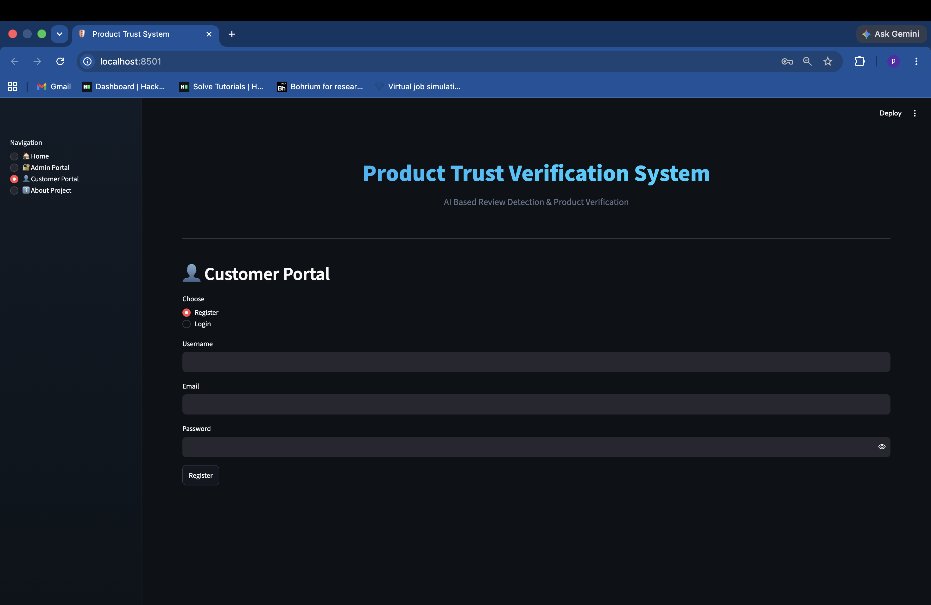
System Modules
The project is developed using different Python modules, where each module is responsible for a specific task.
Modules
1. predict_review.py
Cleans the review text.
Converts text into numerical features using TF-IDF.
Predicts whether a review is Genuine or Fake.
Displays the prediction confidence.
2. Product_Verifier.py
Reads the QR code.
Retrieves product information from the database.
Verifies whether the product is authentic.
3. Admin.py
Handles Admin registration and login.
Registers products.
Generates QR codes.
4. app.py
Provides the Streamlit interface.
Connects all project modules together

Slide 7
Tools & Technologies Used
Technologies
The project was developed using the following technologies:
Python as the programming language.
Scikit-Learn for building the Machine Learning model.
TF-IDF Vectorizer for text feature extraction.
Joblib for saving and loading the trained model.
SQLite for storing product and user information.
OpenCV, QRCode and Pillow for QR code processing.
Streamlit for building the web application.

Slide 8
What We Learned
Learning Outcomes
Working on this project helped in understanding how different technologies can be combined to solve a real-world problem.
Some of the key learnings are:
Cleaning and preprocessing text data.
Using TF-IDF for feature extraction.
Training and using a Machine Learning model.
Generating and verifying QR codes.
Working with SQLite databases.
Building interactive web applications using Streamlit.
Implementing role-based login systems.

Slide 9
Challenges & Solutions
Challenge | Solution
Improving review prediction | Used TF-IDF with Logistic Regression for better classification.
Managing product information | Stored all product details in an SQLite database.
Restricting Admin access | Added an Admin Access Key during registration.
Building an easy-to-use interface | Developed the application using Streamlit.

Slide 10
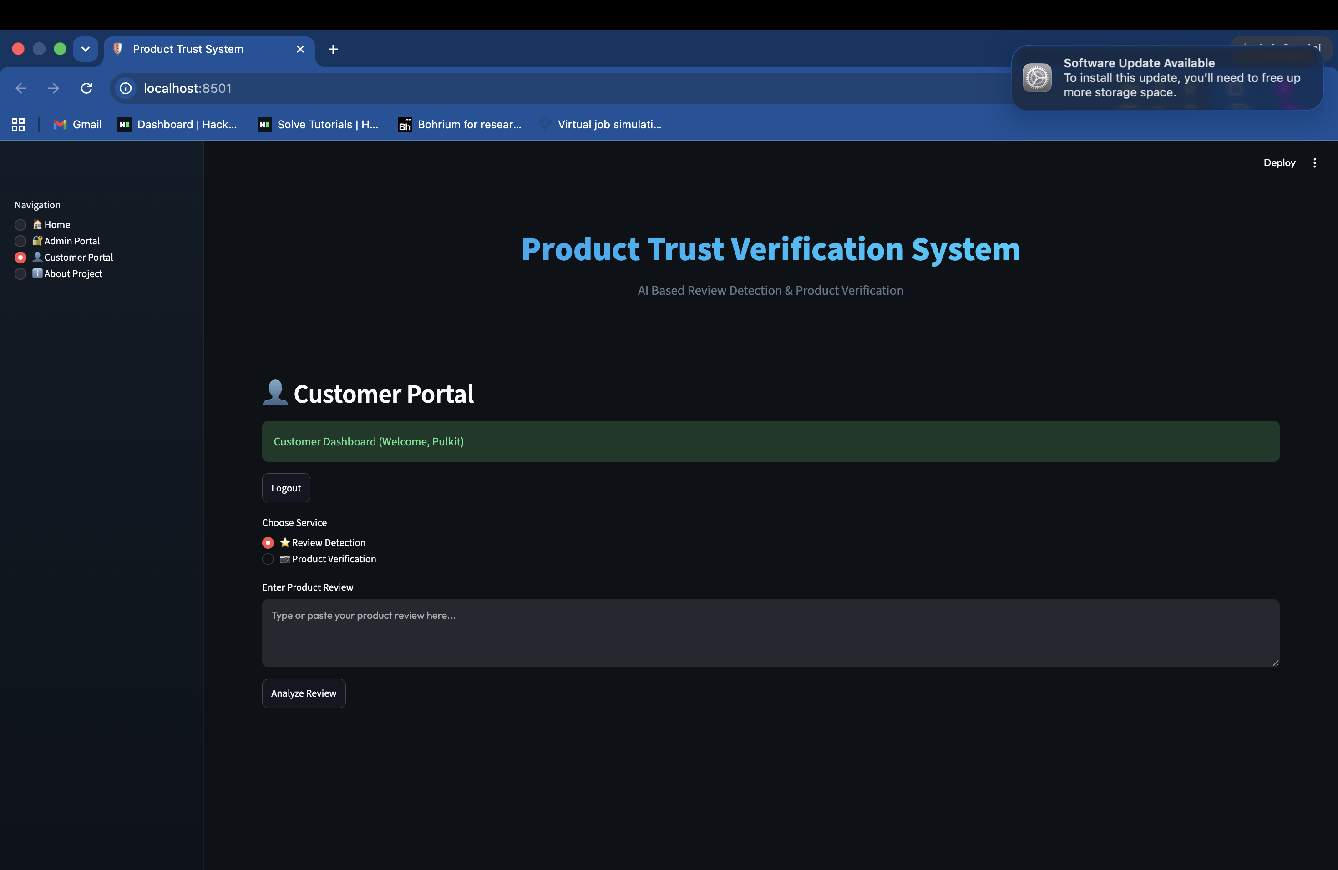
What We Contributed
This project combines review detection and product verification into a single platform, making it easier for both administrators and customers to use.
Contributions
Developed separate portals for Admins and Customers.
Built a Machine Learning model for fake review detection.
Implemented QR-based product verification.
Generated unique QR codes for registered products.
Designed an interactive Streamlit interface.
Connected Machine Learning with database operations.

Slide 11
Summary & Next Steps
Summary
The Product Trust Verification System combines Machine Learning-based review analysis with QR code-based product verification to help customers make more informed purchasing decisions. The current system provides separate portals for administrators and customers, making product registration and authenticity verification simple and user-friendly.
Future Scope
1. Browser Extension (Plugin)
Develop a browser extension that works directly on e-commerce platforms such as Amazon and Flipkart. Customers can check product trust without leaving the shopping website.
2. Cumulative Review Trust Score
Instead of analyzing one review at a time, the plugin can analyze hundreds of customer reviews for a product and generate a single overall Trust Score, giving customers a more reliable understanding of product credibility.
3. Product Verification Before Purchase
The extension can verify whether a product is registered by the manufacturer before placing an order, allowing customers to identify trusted sellers and genuine products in advance.
4. AI-Based Review Summarization
Automatically summarize thousands of customer reviews into key positives, negatives, and common customer opinions, helping users understand feedback quickly.
5. Manufacturer & Seller Integration
Allow manufacturers to register products directly on the platform and enable verified sellers to display authenticity badges for registered products.

