Slide 1


Frontend Engineering- I Project
Team Details :
Rudransh Verma (Group Leader) Pulkit Bajaj
Akshay Pratap
Faculty Coordinator : Dr. Vinay Gautam
Chitkara University Institute of Engineering and Technology, Chitkara University, Punjab
preencoded.png

Slide 2

AAKASH: Advanced Weather Forecasting
Application
AAKASH is a cutting-edge weather forecasting application developed by a talented team of students from Chitkara University. It provides real-time weather data with an intuitive interface, catering to users' diverse meteorological needs.
preencoded.png

Slide 3
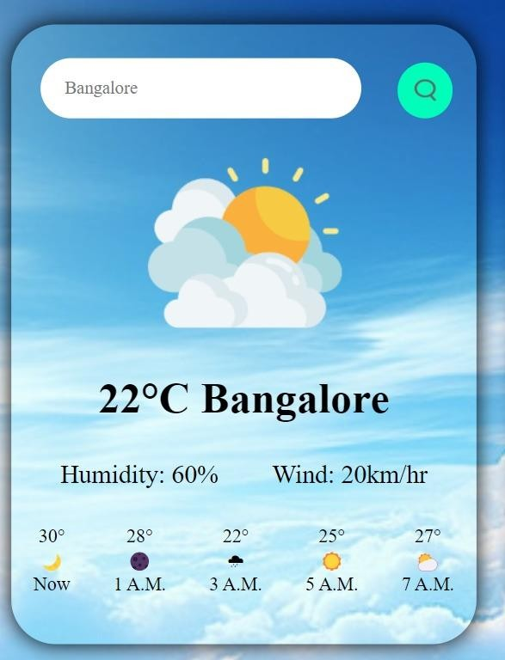
Project Overview
1
Comprehensive Approach
2
Feature-rich Design
The project highlights key features and bonus functionalities for enhanced user experience.
AAKASH covers all aspects from problem statement to technical implementation.
3
Technical Proficiency
Utilizes HTML, CSS, and JavaScript for robust front-end development. development.
preencoded.png

Slide 4
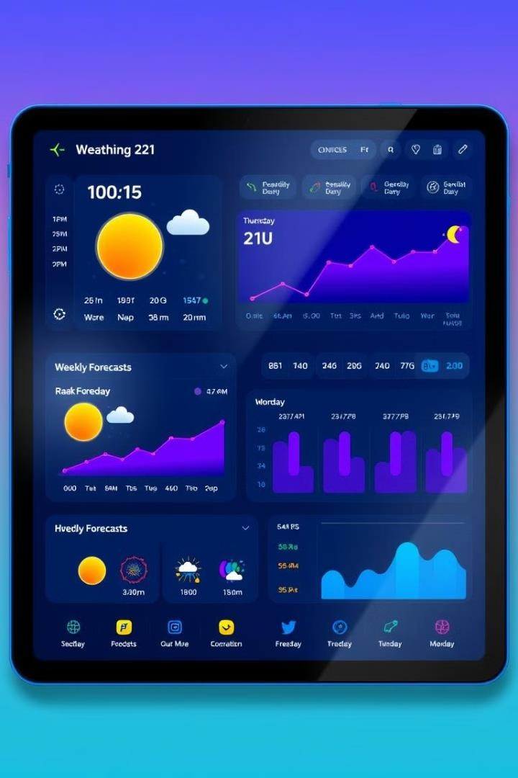
AAKASH: Detailed Overview
Real-time Data
Comprehensive Metrics
AAKASH fetches and displays up- up-to-the-minute weather information for global locations. locations.
Offers detailed insights on temperature, rainfall, wind speed, and more.
User-centric Design
Location Services
Features an intuitive interface for for effortless navigation and information retrieval.
Provides weather data based on on user's current location for immediate relevance.
preencoded.png

Slide 5



Technical Implementation
HTML
CSS
JavaScript
Utilizes semantic markup for improved improved accessibility and SEO performance.
Implements responsive design principles principles for cross-device compatibility. compatibility.
Handles API integration and dynamic content updates for real-time functionality. functionality.
preencoded.png

Slide 6
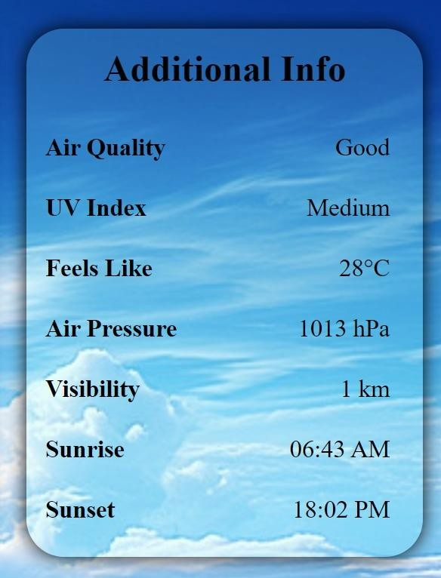
Key Features of AAKASH
1
Real-time Forecasting
AAKASH provides up-to-the-minute weather data using advanced API integration.
2
Location-based Services
The app automatically detects and displays weather information for the user's user's current location.
3
Comprehensive Metrics
AAKASH offers detailed insights on rainfall, humidity, wind speed, UV index, Air index, Air Pressure and AQI.
4
Temporal Forecasts
Users can access both hourly and weekly weather predictions for better planning. planning.
preencoded.png

Slide 7
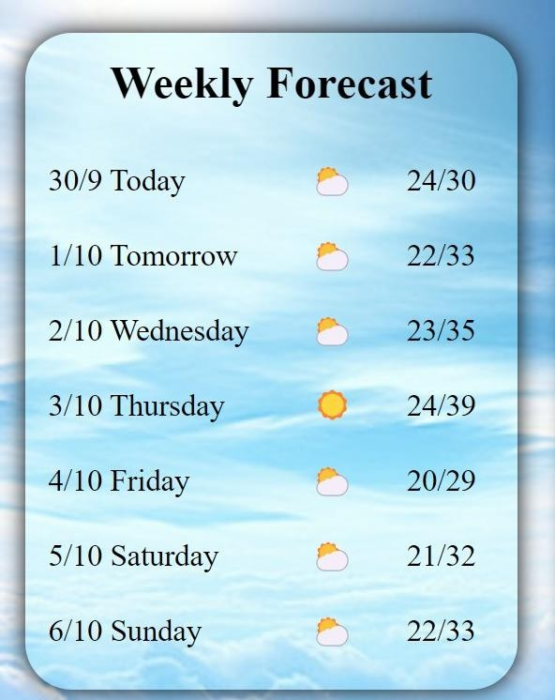




Bonus Features
City Pinning
Location Search
Users can pin up to three cities for
quick access to their weather data.
A search bar allows users to find
weather data for any specific location.
Cross-platform Compatibility
Temperature Conversion
AAKASH offers easy switching between between different temperature units units for user convenience.
The responsive design ensures seamless usage across various devices devices and screen sizes.
preencoded.png

Slide 8

Project Conclusion
Comprehensive Weather Data
User-Centric Design
Real-Time Updates
AAKASH provides detailed current weather information and forecasts for multiple locations.
The app features an intuitive interface with recent location history for enhanced usability.
AAKASH ensures up-to-date information information with location-specific data refresh throughout the day.
preencoded.png

Slide 9

References and Resources
Development Tools | Visual Studio Code for efficient coding and debugging
Design Resources | Freepik website for high-quality images and icons
Learning Materials | CodeWithHarry and GreatStack for for tutorials and best practices
preencoded.png

Slide 10
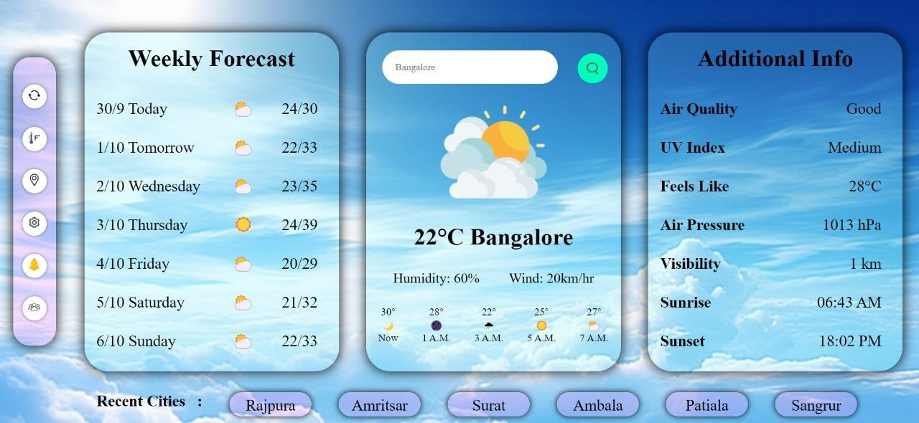
AAKASH in Action
This image showcases the AAKASH weather app in action. It displays a user-friendly interface with current weather conditions, temperature, and additional metrics. The app's design is clean and intuitive, demonstrating its effectiveness in providing weather information at a glance.
preencoded.png

Slide 11

We sincerely thank
you for your valuable time.
preencoded.png

