Slide 1
VOIS AICTE · BATCH 1 · 2026-2027 · MAJOR PROJECT
Seasonal Agriculture
Performance Analysis
Investigating how agricultural performance shifts across Kharif, Rabi and Zaid — using 4,000 farm records from eight Indian states.
Pulkit Chopra
Maharaja Agrasen Institute of Management Studies
AICTE Student ID: STU6a0fa9ea7ddf11779411434
Notes:
Good morning. I'm Pulkit Chopra from Maharaja Agrasen Institute of Management Studies. My major project analyses how agricultural performance changes across India's three cropping seasons, using a dataset of 4,000 farms across eight states.

Slide 2
THE CHALLENGE
Problem Statement
Agricultural activities are influenced by seasonal variations in environmental conditions, farming practices, resource availability and market conditions. As a result, agricultural performance may differ from one season to another.
However, raw agricultural data does not clearly explain how performance changes across seasons, or what patterns can be observed under different seasonal conditions.
The task
Analyse the dataset and investigate seasonal differences in agricultural performance by identifying meaningful patterns, trends, relationships and variations within the available data.
ANALYTICAL QUESTIONS
1
Are the three seasons genuinely different in environmental terms?
2
Does yield vary by season — and is the variation statistically significant?
3
How do cost, revenue and profit shift from season to season?
4
Does disease and pest pressure follow a seasonal pattern?
5
Does the best irrigation method depend on the season?
6
Are the patterns consistent across states, or are some regions insulated?
Notes:
The core problem: raw agricultural data doesn't explain HOW performance changes across seasons. I framed six analytical questions to structure the investigation, rather than running a generic analysis of the whole dataset.

Slide 3
WHAT WAS BUILT
Project Description
An end-to-end data analytics project on a 4,000-farm agricultural dataset spanning eight Indian states, eight crops and three cropping seasons. The analysis moves from raw data through cleaning and statistical testing to evidence-based recommendations, documented entirely in a Jupyter Notebook.
4,000
28
3
Farm records analysed
Variables per farm
Seasons compared
01
Data preparation
Extracted the table into a structured CSV, checked duplicates and impossible values, and imputed 120 missing entries using crop-and-season group medians.
02
Exploratory analysis
Profiled each season's environment, then compared yield, cost, revenue, risk and water use across Kharif, Rabi and Zaid.
03
Statistical testing
Applied one-way ANOVA, Welch t-tests, chi-square and correlation analysis to separate real seasonal effects from noise.
04
Insight & recommendation
Traced each finding to its mechanism and converted it into specific guidance for farmers and planners.
Notes:
The project follows four stages. The key point is that this is a focused investigation of seasonal difference — not a generic descriptive analysis. Every step was chosen to answer the six questions on the previous slide.

Slide 4
AUDIENCE
Who Are The End Users?
1
Farmers &
cultivators
2
Agricultural
cooperatives
3
Government &
policy planners
Decide which crop to sow in which season, and which irrigation method to use — the decisions this analysis most directly informs.
Advise member farmers on seasonal planning and negotiate shared irrigation infrastructure investments.
Target subsidies, credit and crop insurance at the seasons and regions where farms actually lose money.
4
Agri-input
companies
5
Banks &
insurers
6
Researchers &
agronomists
Align fertiliser, seed and crop-protection supply with genuine seasonal demand rather than a flat annual plan.
Price seasonal credit and crop insurance against measured risk instead of uniform assumptions.
Use the seasonal baselines here as a reference point for field trials and further study.
Notes:
Six user groups. The primary audience is farmers and cooperatives, because the strongest finding — that irrigation method should change by season — is a decision they make directly and can act on immediately.

Slide 5
TOOLS & METHODS
Technology Used
Python 3
pandas
Core analysis language
Data cleaning, grouping, pivot tables
ANALYTICAL METHODS
One-way ANOVA
Tests whether season affects yield, profit and risk
Welch's t-test
Pairwise season comparisons with unequal variance
Chi-square test
Independence of irrigation choice and season
Correlation analysis
Identifies which factors actually drive yield
Group-median imputation
Fills gaps without flattening seasonal signal
NumPy
Matplotlib
Numerical operations and array maths
Charting and figure composition
Seaborn
SciPy
Statistical plots and heatmaps
ANOVA, t-tests, chi-square
Jupyter Notebook
pdfplumber
Reproducible analysis document
Table extraction from the source PDF
Environment: the full analysis is documented in a single Jupyter Notebook so every figure and statistic can be reproduced from the raw dataset.
Notes:
Standard Python data-analytics stack. I want to highlight the statistical testing — I didn't just compare averages, I tested whether the differences were significant. That turned out to matter enormously, as the next slides show.

Slide 6
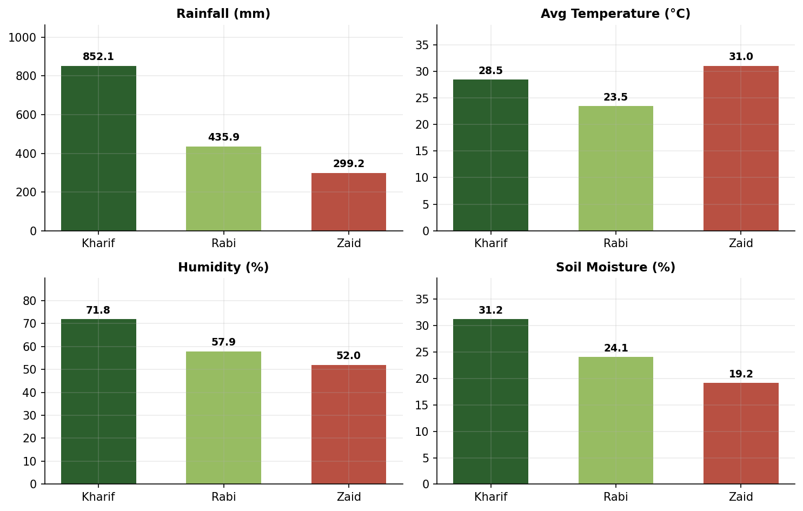
RESULTS · 1 OF 6
The seasons are three distinct regimes
KEY FINDINGS
Kharif receives 852 mm rainfall — 2.8× Zaid's 299 mm.
Zaid is hottest at 31.0 °C with soil moisture down to 19%.
Rabi is the coolest season at 23.5 °C.
Every environmental variable except soil pH differs significantly (p < 0.001).
Season is therefore a meaningful grouping variable, not just a label.
Notes:
First I confirmed the seasons genuinely differ before attributing anything to them. Kharif is the monsoon, Rabi the cool winter, Zaid the hot dry summer. All differences significant at p below 0.001.

Slide 7
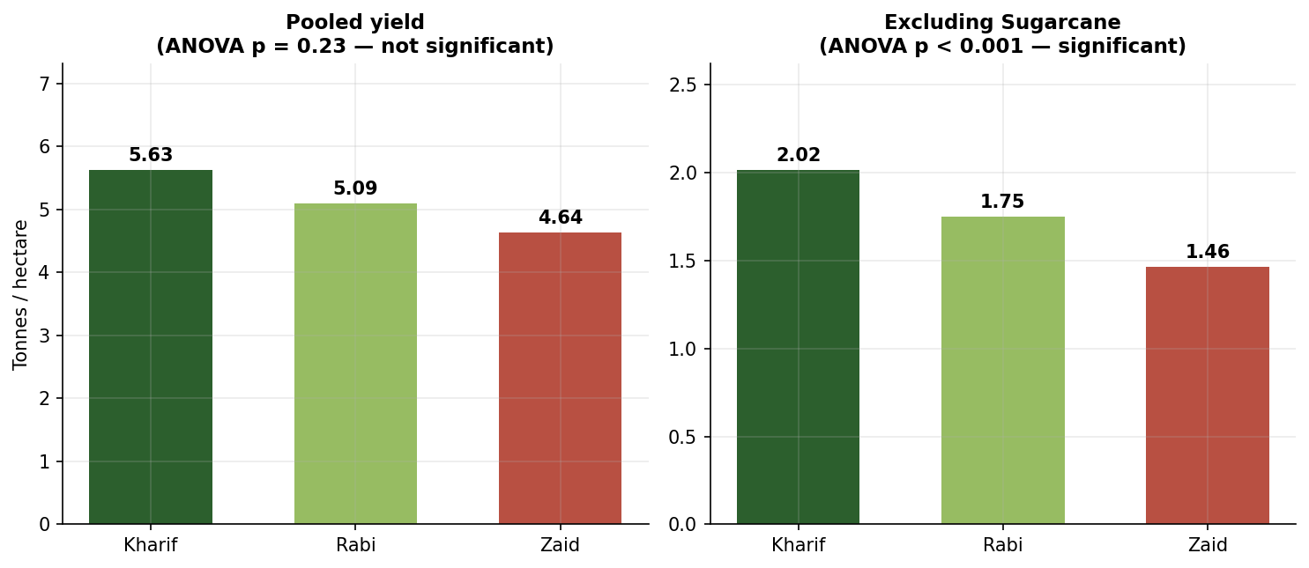
RESULTS · 2 OF 6
The pooled data hides the real pattern
KEY FINDINGS
Pooled yield shows NO seasonal effect (ANOVA p = 0.23).
Cause: sugarcane yields ~20× other crops and is over-represented in Zaid (8.6% vs 7.0%).
Removing that one crop makes the effect highly significant (p < 0.001).
A classic case of Simpson's paradox.
A generic whole-dataset analysis would have reached the opposite conclusion.
Notes:
This is the most important methodological finding. If I had stopped at the pooled average, I would have concluded season doesn't affect yield — which is wrong. One outlier crop, slightly over-represented in Zaid, cancelled out a real decline happening everywhere else.

Slide 8
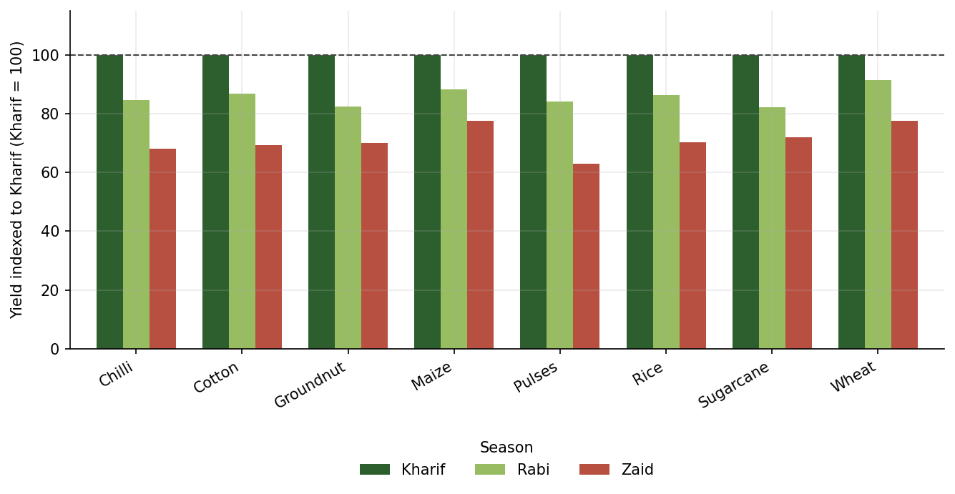
RESULTS · 3 OF 6
Yield falls Kharif → Rabi → Zaid in all 8 crops
KEY FINDINGS
The decline is universal — no crop is an exception.
Statistically significant for every crop individually (all p < 0.001).
Largest fall: pulses at −37.0% from Kharif to Zaid.
Smallest fall: wheat at −22.5%, followed by maize at −22.6%.
Wheat and maize are the most seasonally resilient choices.
Notes:
Once crop is held constant the pattern is unambiguous. Every crop peaks in Kharif and bottoms in Zaid. Each bar group is indexed to its own Kharif yield so all eight crops fit on one comparable scale.

Slide 9
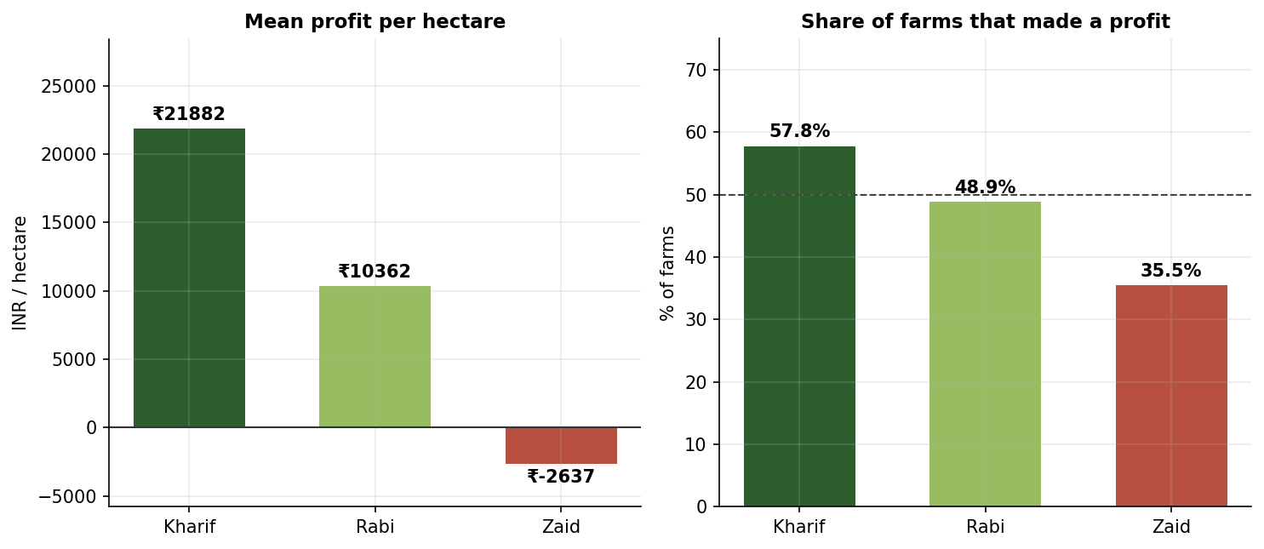
RESULTS · 4 OF 6
Profit collapses faster than yield
KEY FINDINGS
Kharif: ₹21,882 per hectare, 57.8% of farms profitable.
Rabi: ₹10,362 per hectare, 48.9% profitable.
Zaid: −₹2,637 per hectare — the average Zaid farm loses money.
Only 35.5% of Zaid farms break even.
Every pairwise difference is significant (all p < 0.001).
Notes:
Yield falls by around 30 percent, but profit swings from strongly positive to negative. Profit is far more sensitive than yield, because costs don't fall with output.

Slide 10
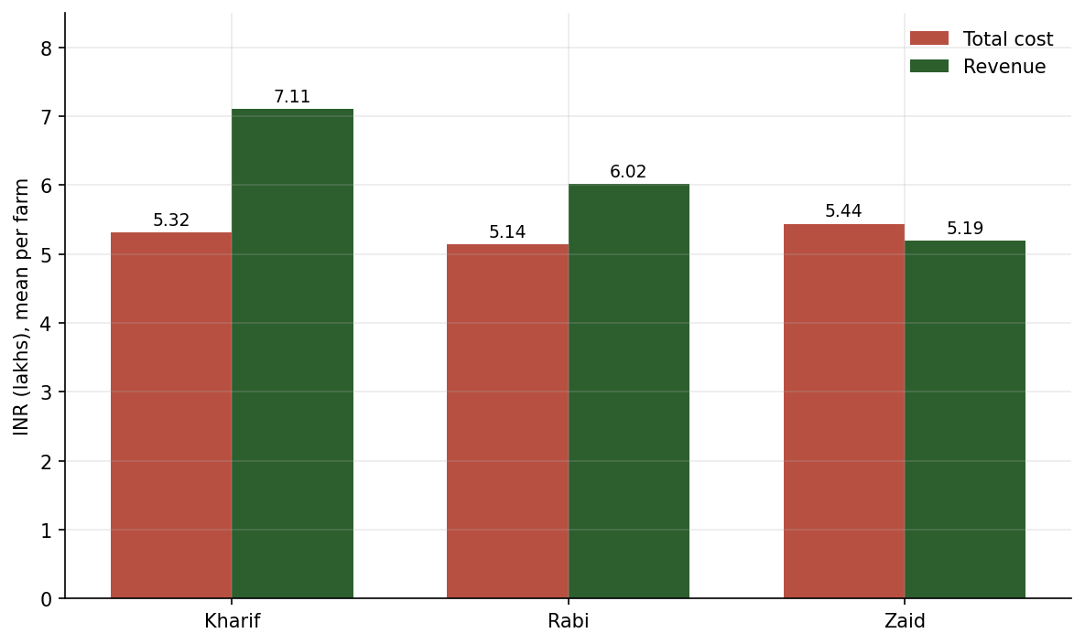
RESULTS · 5 OF 6
It is a volume problem, not a price problem
KEY FINDINGS
Costs are essentially flat — Zaid costs 2.3% MORE than Kharif.
Revenue falls 27% from Kharif to Zaid.
Market prices vary less than 3.5% across seasons for every crop.
So the revenue fall is entirely driven by lower output.
Farmers pay roughly the same to produce substantially less.
Notes:
This slide explains the mechanism. I checked whether the revenue drop came from prices or volumes. Prices barely move — under three and a half percent for every crop. So it's purely volume: the yield decline flowing straight to the bottom line, against a cost base that doesn't shrink.

Slide 11
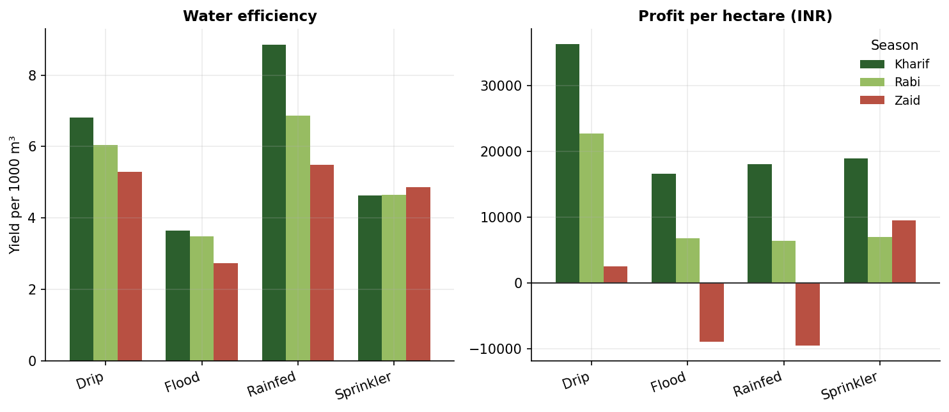
RESULTS · 6 OF 6
Irrigation choice ignores the season — outcomes do not
KEY FINDINGS
Chi-square: method choice is independent of season (p = 0.74).
But in Zaid, Flood loses ₹8,937/ha and Rainfed loses ₹9,498/ha.
Drip (+₹2,540) and Sprinkler (+₹9,515) stay profitable.
Flood uses the most water (8,114 m³) at the worst efficiency (2.73).
≈ ₹19,000/ha separates the best and worst method in Zaid.
Notes:
This is the most actionable finding. Farmers pick their irrigation method the same way regardless of season — the chi-square p-value of 0.74 confirms it. But the consequences are completely season-dependent. In Kharif every method works. In Zaid, Flood and Rainfed swing to heavy losses.

Slide 12
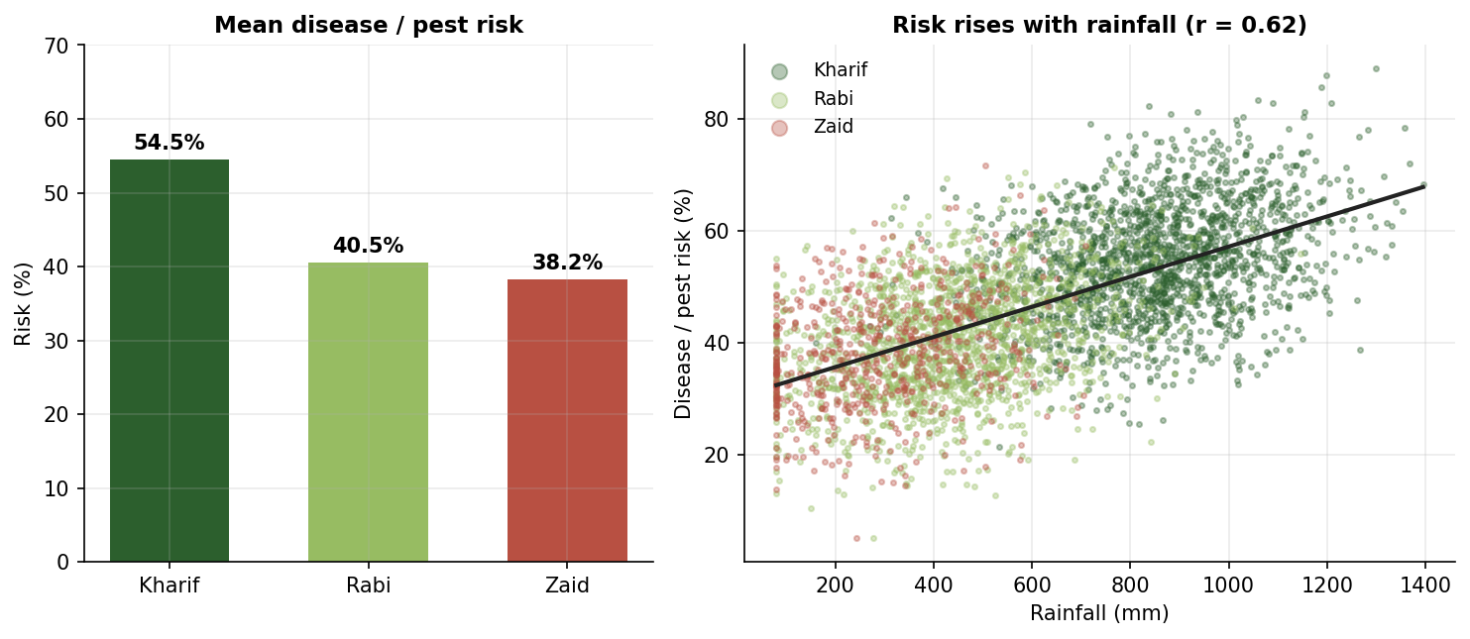
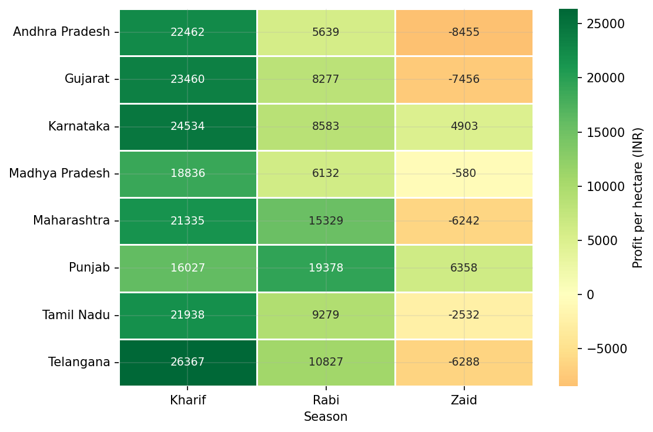
SUPPORTING RESULTS
Risk and Regional Consistency
The Kharif trade-off
Kharif is the most profitable AND the riskiest season — disease risk is 54.5% versus 38.2% in Zaid, tracking rainfall at r = +0.62. Yet pesticide use is flat across all three seasons (5.08 / 5.02 / 5.17 L/ha): protection is not being matched to risk.
A structural, not regional, pattern
The ordering holds in 7 of 8 states. Punjab is the only state profitable in every season — and the only one where Rabi beats Kharif.
Notes:
Two supporting results. On the left, the trade-off: the monsoon moisture that drives Kharif yields also breeds pests. On the right, the pattern holds across seven of eight states, so it's structural. Punjab is the interesting exception — heavily irrigated, wheat-centred Rabi system.

Slide 13
CONCLUSIONS
What the data shows
01
Season is real and measurable
02
Yield declines in every crop
Three environmentally distinct regimes; all variables except soil pH differ at p < 0.001.
Kharif → Zaid falls of 22.5% to 37.0%, each significant at p < 0.001.
03
The pooled view is misleading
04
Profit is the amplified signal
One outlier crop hides the effect entirely — correct grouping was essential.
₹21,882 → ₹10,362 → −₹2,637 per hectare across the three seasons.
05
The cause is volume, not price
06
Method choice is the fixable gap
Prices move under 3.5%; costs are flat. Revenue falls 27% on output alone.
Irrigation is chosen independently of season (p = 0.74) but its outcome is not.
Notes:
Six conclusions. If I had to pick one, it's number three — the pooled view is misleading. That finding changed the entire analysis and is the reason the others could be found at all.

Slide 14
FROM EVIDENCE TO ACTION
Recommendations
FOR FARMERS
FOR PLANNERS & INSTITUTIONS
Switch irrigation method by season, not by habit — the Zaid gap between best and worst method is ≈ ₹19,000 per hectare.
Treat Zaid as a cost-control season: with only 35.5% of farms profitable, trimming input spend beats chasing yield.
Match crop protection to seasonal risk — Kharif carries 43% more disease pressure but the same pesticide intensity.
Prefer wheat and maize for Zaid; they lose the least (−22.5%, −22.6%) against pulses at −37.0%.
Target drip-irrigation subsidies at Zaid cultivation, where method choice decides whether a farm makes money at all.
Route seasonal credit and crop insurance towards Zaid — the season with the highest share of loss-making farms.
Study Punjab's Rabi system as a model: the only state profitable across all three seasons.
Always disaggregate by crop before comparing seasons — pooled agricultural comparisons can invert the true relationship.
Notes:
Recommendations split by audience. The drip-irrigation point is the one I'd emphasise — it's a change farmers can make immediately, and the data attaches a rupee value to it.

Slide 15
WHERE THIS GOES NEXT
Future Scope
1
Predictive modelling
2
Multi-year data
3
Live weather integration
Train a regression or gradient-boosting model to forecast yield and profit from sowing-time conditions, turning a descriptive analysis into a planning tool.
The current dataset is a single period. Several years would separate genuine seasonal effects from one-off weather conditions.
Connect IMD forecast APIs so seasonal guidance updates with the actual monsoon rather than historical averages.
4
Interactive dashboard
5
Irrigation ROI model
6
Satellite & soil sensors
A Power BI or Streamlit dashboard letting a farmer filter to their own state, crop and season instead of reading a static report.
Cost the switch from Flood to Drip against the ₹19,000/ha Zaid gap to compute a real payback period.
Add remote-sensing and IoT soil data for field-level rather than farm-level seasonal recommendations.
Notes:
Six directions. The one I'd pursue first is the predictive model — it converts this from a description of what happened into a tool that tells a farmer what to expect before they sow.

Slide 16
PROJECT REPOSITORY
GitHub Link
Repository
https://github.com/AswiniKumar55/-Seasonal-Agriculture-Performance-Analysis-.git
REPOSITORY CONTENTS
Seasonal_Agriculture_Performance_Analysis.ipynb
Complete analysis notebook — cleaning, statistical testing, all 10 visualisations and written interpretation.
agriculture_dataset.csv
The cleaned 4,000-row, 28-column dataset used throughout the analysis.
README.md
Project overview, method summary and instructions to reproduce the results.
Notes:
The full notebook is on GitHub, so every figure and statistic in this deck can be reproduced from the raw dataset.

Slide 17
COURSE · DATA VISUALIZATION
VOIS Course Completion Certificate
Insert your VOIS Data Visualization
completion certificate image here
Notes:
PULKIT — replace this placeholder box with a screenshot of your VOIS Data Visualization certificate before submitting.

Slide 18
Thank you
Questions are welcome.
Pulkit Chopra
Maharaja Agrasen Institute of Management Studies
AICTE Student ID: STU6a0fa9ea7ddf11779411434
Notes:
Thank you. Happy to take questions on the method or the findings.

