Slide 1
QUIT IT
-RISHABH KAKRYA
AYUSH VAID
PULKIT GUPTA

Slide 2
INTRODUCTION
Smoking in India has been known since at least 2000 BC when cannabis was smoked and is first mentioned in the Atharvaveda, which dates back a few hundred years BC.
According to the World Health Organization (WHO), India is home to 12% of the world’s smokers.
As of 2015, the number of men smoking tobacco in rose to 108 million, an increase of 36%, between 1998 and 2015 .
About 6 million people die of tobacco use globally every year and India accounts for 1/6th of the total deaths.[1]

Slide 3
CONSEQUENCES
With this increasing consumption of smoking and tobacco the diseases associated with these are also on an increase.
An Indian Council of Medical Research (ICMR) report says that use of tobacco accounts for about 30% of all cancers in men and women in India. Cancer of mouth is most common among men followed by lung cancer.
Tobacco related cancer accounts for 42% of the male deaths and 18.3% of female cancer deaths [2].

Slide 4
SOLUTION
Our app keeps record of the people consuming such products.
It stores all their details like their name, age, address, age when they start consuming, per day consumption, salary, type of products they consume etc.
.Then the data is analyzed graphically depending on patient’s starting age, gender, literacy etc.
Also a report with a personalized message is generated for the user.
The message is generated depending on the details provided by the user like salary, profession, per day consumption etc.

Slide 5
FEATURES
App makes use of the latest technologies like android platform, firebase and material design.
App uses firebase real-time-database for database.
Analysis of patient’s data according to parameters like starting age of smoking or chewing, gender etc has been provided.
A report is generated for every patient containing details like name, gender, profession, fraction of salary spent in smoking or chewing and a personalized message. Moreover this report can be printed for the user through our app.
A personalized message is generated for each patient in his/her report. This message contains the impact of his habits of smoking or chewing in his/her near future.

Slide 6
WORK DONE
App begins up with a login screen; user has to either sign in using gmail or facebook or can also register on the app.
As the user login a screen appears containing the list of records of patients.
Report can be generated for the user by selecting the particular user record and can further be printed by clicking on the print report button.
On the main screen; a button is also provided for entering a new patient record. On clicking on new patient, new entry screen pops up containing the fields to be filled for the new user.
App drawer menu on the main screen contains a section for analytics for smoking or chewing patients. Analytics screen then contains various graphs displaying the data analysis.
Report screen contains a toolbar menu for either viewing, updating or deleting the record of the selected patient.
Main screen also contains a toolbar menu for signing out of the login account.

Slide 7
WORK DONE
Patient report can also be directly mailed from the Report interface.
Patient image was included in the Patient entry form.
Patient home was created depicting graphically the smoking and chewing frequency of the user, average cigarettes smoked and tobacco chewed month wise.
A notification activity was created for taking the daily response in terms of frequency, of the user at night.

Slide 8
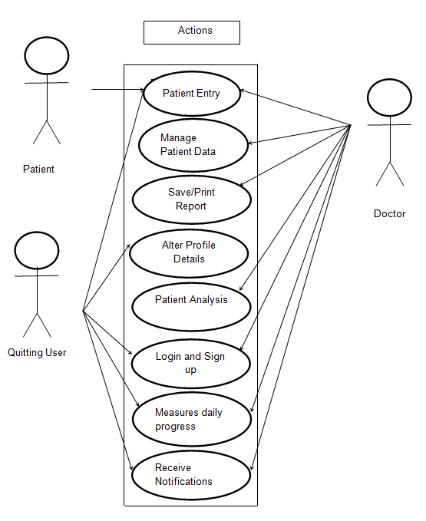
USE CASE DIAGRAM

Slide 9
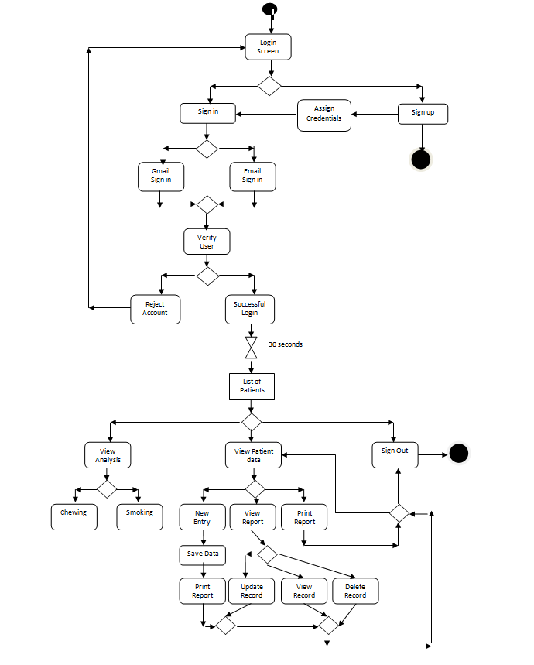
DOCTOR ACTIVITY DIAGRAM

Slide 10
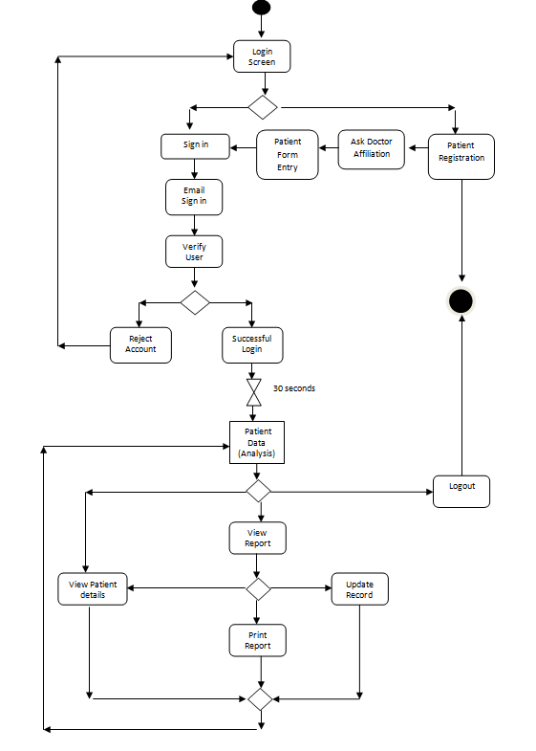
PATIENT ACTIVITY DIAGRAM

Slide 11
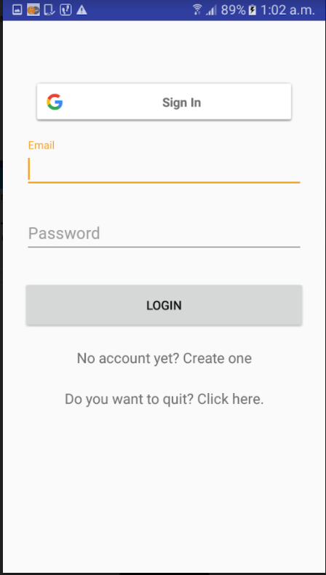
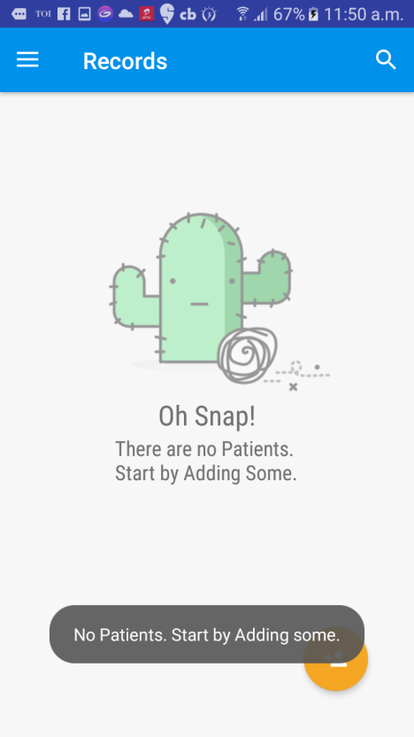
SCREENSHOTS

Slide 12
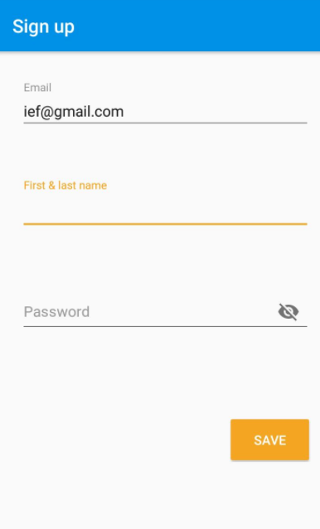
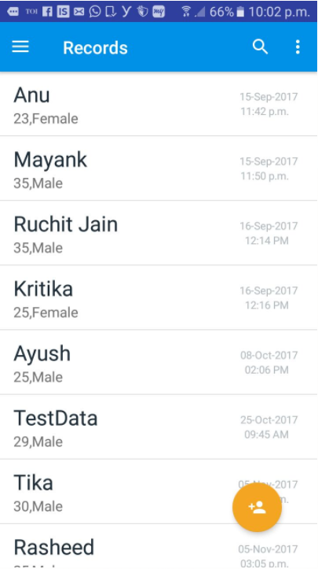
SCREENSHOTS

Slide 13
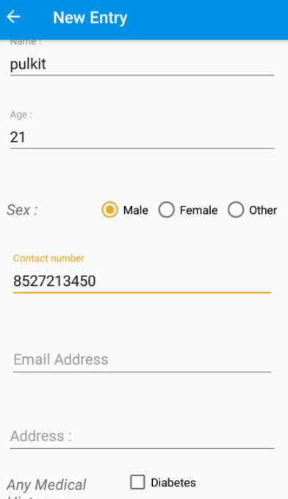
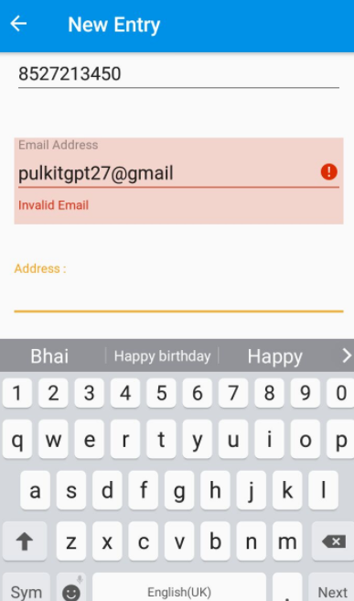
SCREENSHOTS

Slide 14
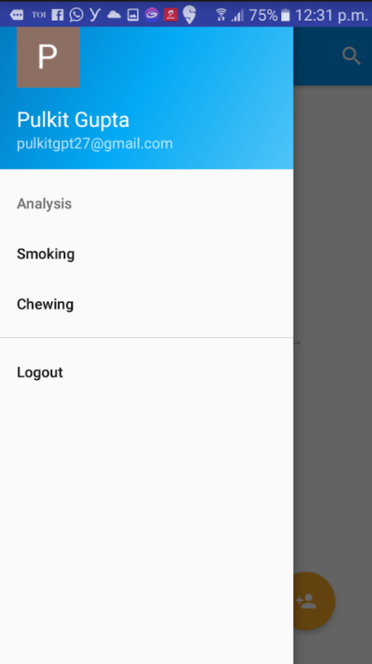
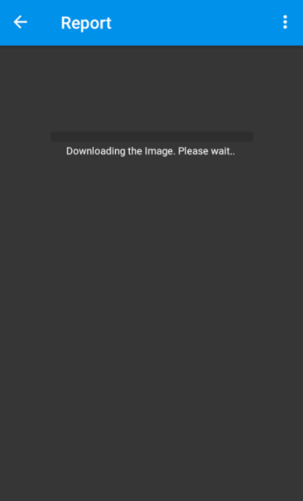
SCREENSHOTS

Slide 15
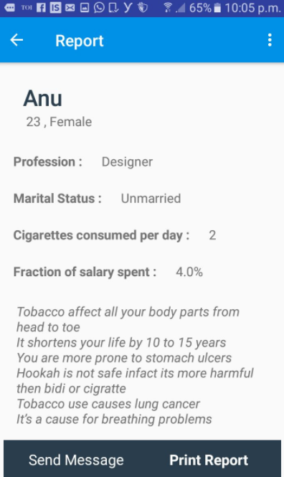
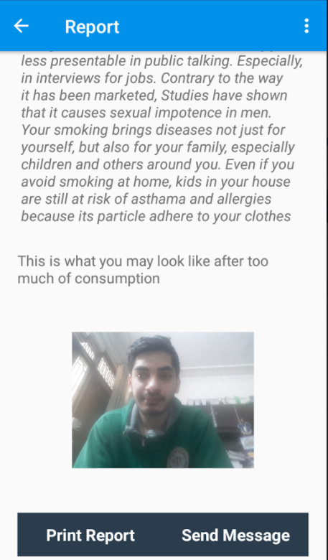
SCREENSHOTS

Slide 16
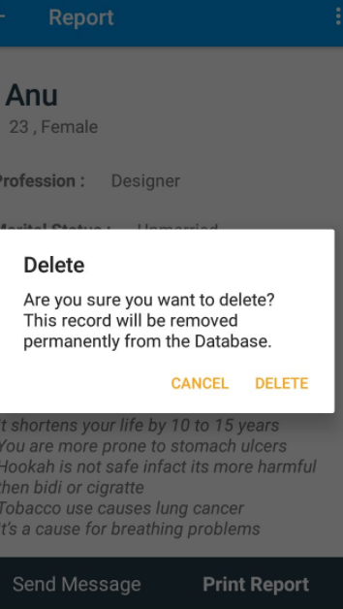
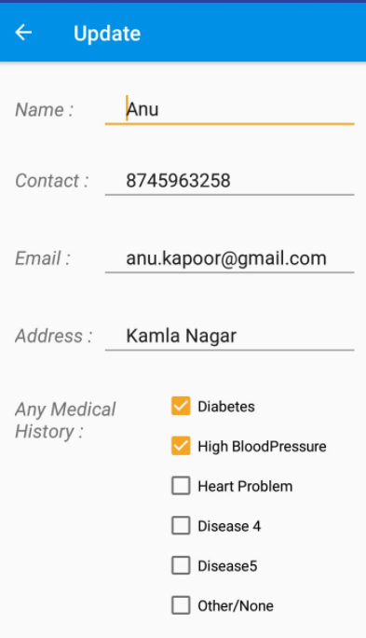
SCREENSHOTS

Slide 17
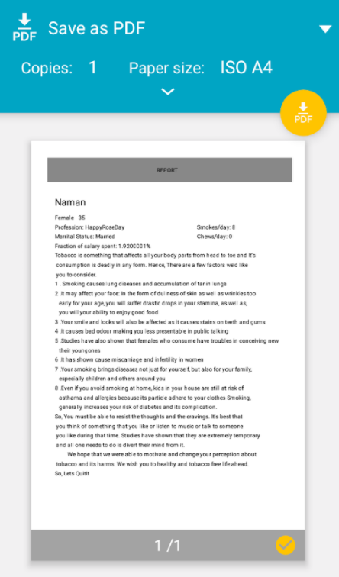
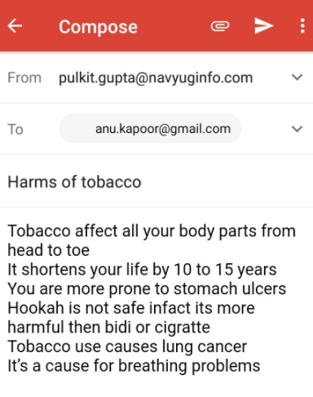
SCREENSHOTS

Slide 18
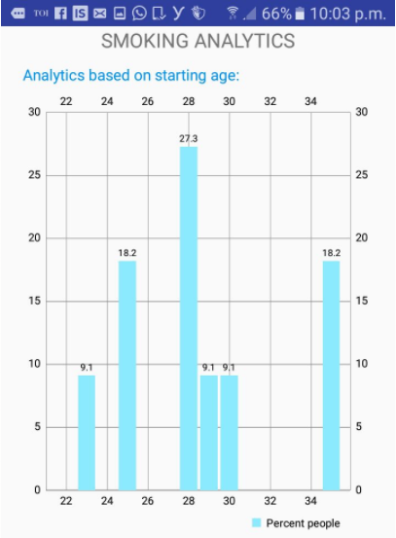
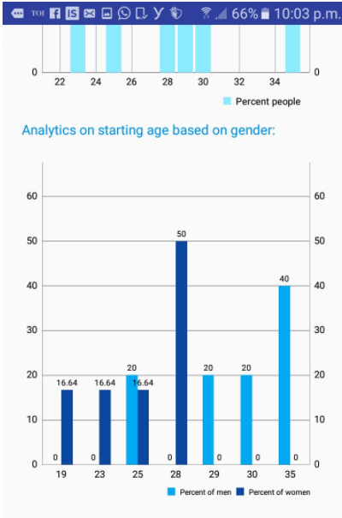
SCREENSHOTS

Slide 19
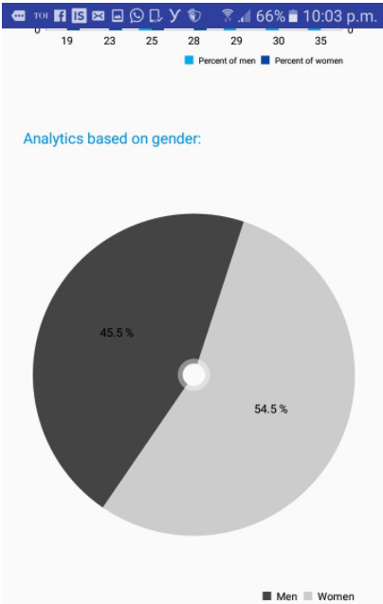
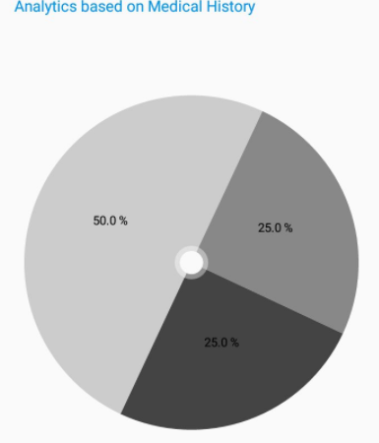
SCREENSHOTS

Slide 20
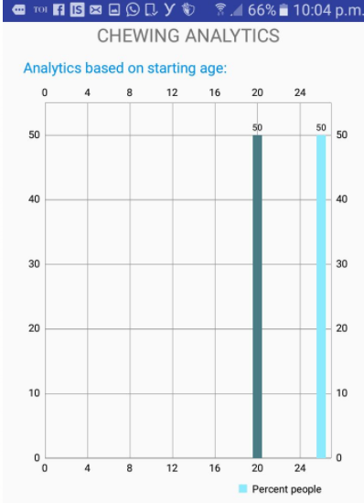
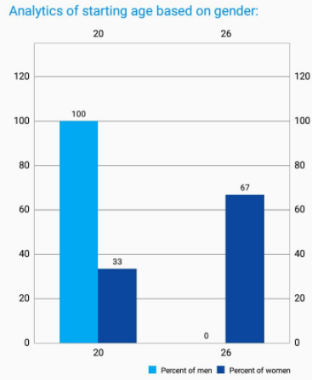
SCREENSHOTS

Slide 21
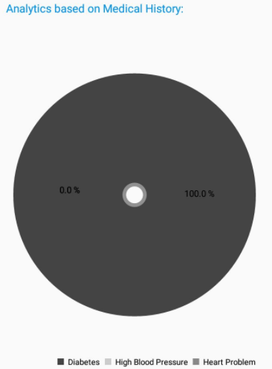
SCREENSHOTS

Slide 22
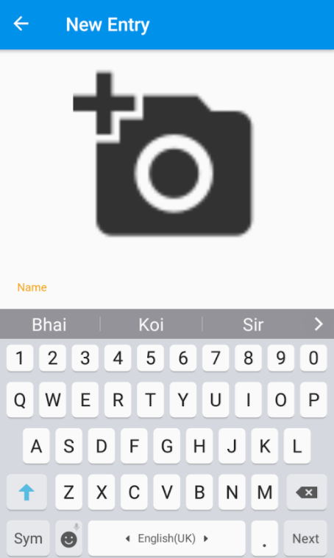
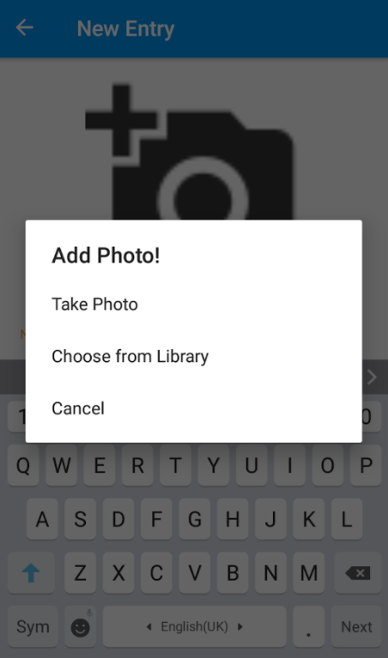
SCREENSHOTS

Slide 23
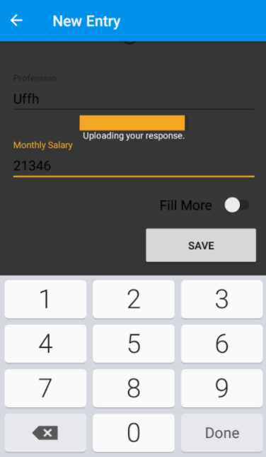
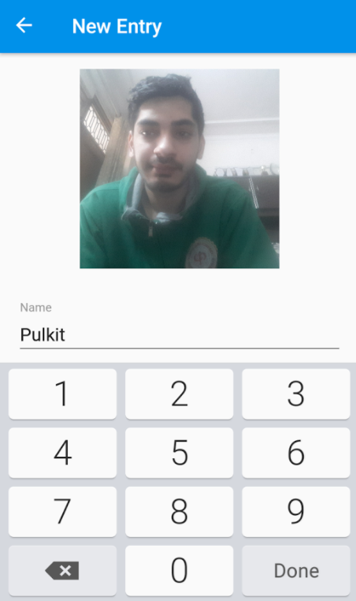
SCREENSHOTS

Slide 24
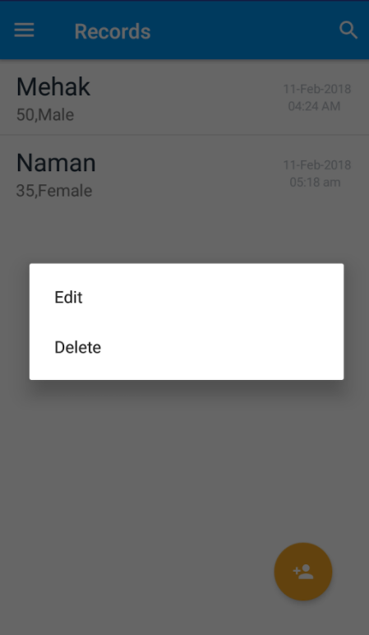
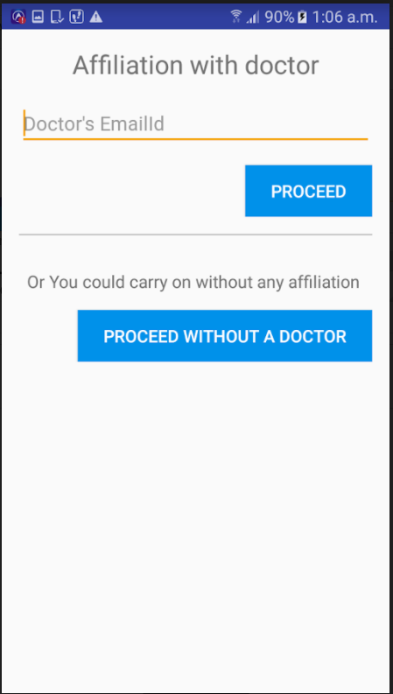
SCREENSHOTS

Slide 25
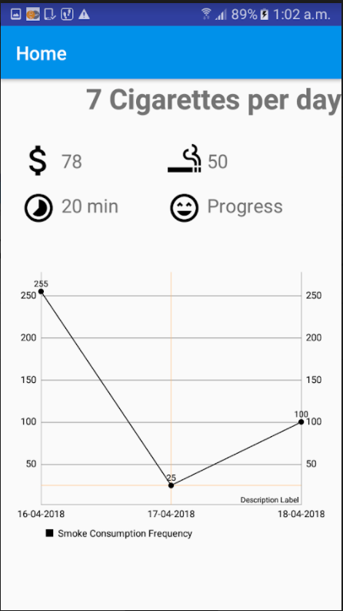
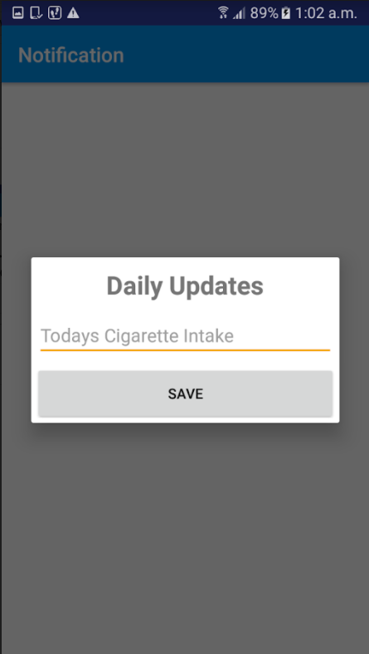
SCREENSHOTS

Slide 26
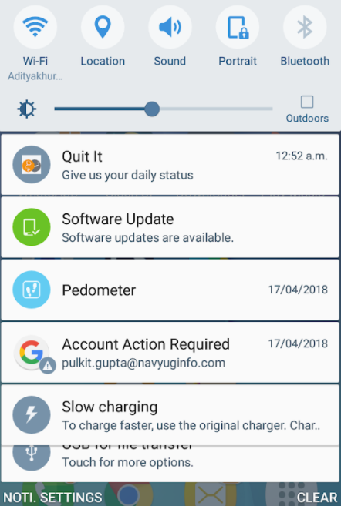
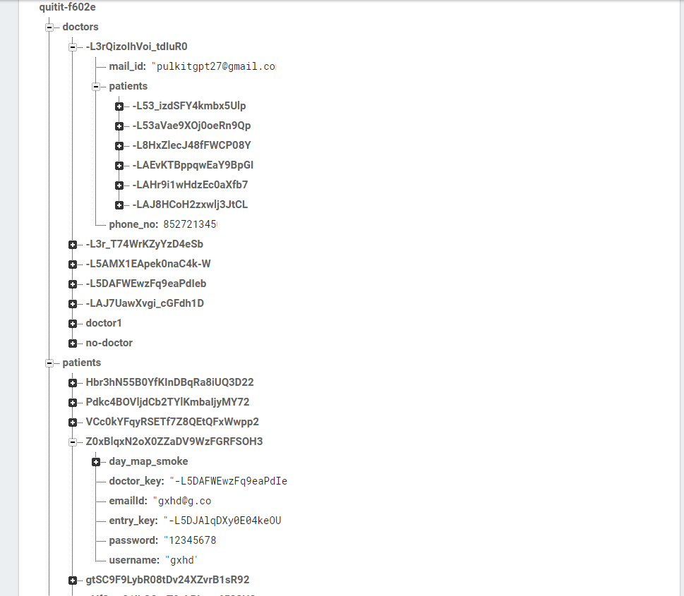
SCREENSHOTS

Slide 27
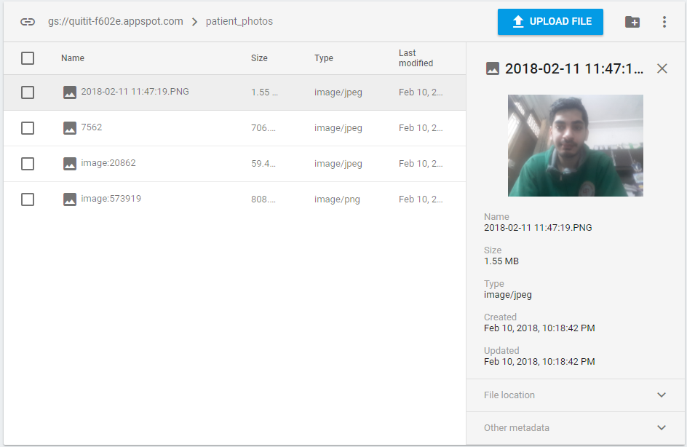
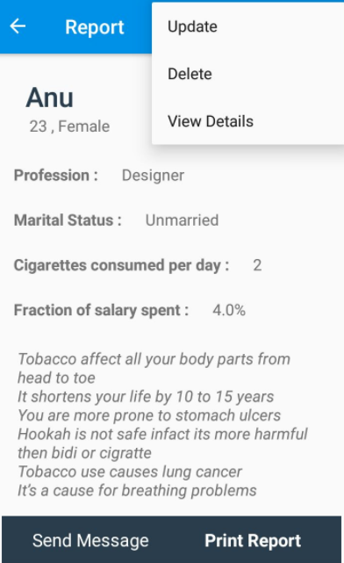
SCREENSHOTS

Slide 28
FUTURE WORK
Quit IT is about to end its second phase. The phase where it can be used to help out user quit their habit of consumption of tobacco. There, the user shall enter his details that may include, but are not restricted to, their consumption details, their personal information and their interests. QuitIT shall include the features to measure user’s daily intake, Reduction or increase in their habit, Timing, mental state as well as physical state as of when they usually consume or when they get a craving for one. All this data will then be used by our app to help the user in their quest for quitting their addiction.

Slide 29
THANK YOU

