Slide 1
Automatic Record Linkage
Pulkit Jain, Texas A&M University

Slide 2
Introduction
Record linkage (RL) is the task of finding records in a data set that refer to the same entity across different data sources (e.g., data files, books, websites, and databases).
Traditionally, it is a manual process which consumes a lot of time and requires specially trained people.
The present work is concentrated on linking same people in multiple databases using machine learning algorithms.
Through machine learning algorithms, we can automate record linkage process and use it at a mass scale and also increase the speed of the process.
My work is about evaluation of various kinds of features, which can help in our prediction, thus enhance overall detection.

Slide 3
Similarity based features:
These features give a numeric output depicting how dis-similar two strings are.
Can be used to compare names.
A value of 0 implies that the two strings (names) are alike.

Slide 4
Edit distance:
Edit Distance is a way of quantifying how dissimilar two strings (e.g., words) are to one another by counting the minimum number of operations required to transform one string into the other.
Example: Levenshtein distance.
Saturday to Sunday requires 4 operations (“atur” to “un_ _”) . Distance = 4.
For a dynamic web based application refer:
https://pulkitjain1004.shinyapps.io/pair_align/

Slide 5
Jaro-winkler edit distance
It is a modification of Edit Distance, which gives more weight to characters in starting of string.
The idea is, a spelling typos is less likely to occur in the beginning.
Therefore, if two strings have similar starting characters, it gives a less distance than regular Edit Distance.

Slide 6
Phonetics: Soundex (early effort)
Use of Phonetics can also be included to compare how alike two names may sound.
Soundex: A hash value is calculated by using the first letter of the name and converting the consonants in the rest of the name to digits by using a simple lookup table.
Examples of Soundex Conversion:
Catherine C365
Katherine K365
Katarina K365
Johnathan J535
Jonathan J535
John J500
Teresa T620
Theresa T620
Smith S530
Smyth S530
Jessica J200
Joshua J200

Slide 7
Phonetics: NYSIIS
NYSIIS: New York State Identification and Intelligence System
Built on Soundex by tweaking the lookup table or starting from scratch with their own rules.
It produces better results than Soundex because it takes special care to handle phonemes that occur in European and Hispanic surnames.
Examples of NYSIIS Conversion:
Catherine CATARAN
Katherine CATARAN
Katarina CATARAN
Johnathan JANATAN
Jonathan JANATAN
John JAN
Teresa TARAS
Theresa TARAS
Smith SNATH
Smyth SNATH
Jessica JASAC
Joshua JAS

Slide 8
Phonetics: double metaphone
Metaphone improves on earlier systems such as Soundex and NYSIIS
It includes special rules for handling spelling inconsistencies and for looking at combinations of consonants in addition to some vowels
Double Metaphone, goes even further by adding rules for handling some spellings and pronunciations from languages other than English.
Examples of Double Metaphone:
Catherine ['K0RN', 'KTRN']
Katherine ['K0RN', 'KTRN']
Katarina ['KTRN', None]
Johnathan ['JN0N', 'ANTN']
Jonathan ['JN0N', 'ANTN']
John ['JN', 'AN’]
Teresa ['TRS', None]
Theresa ['0RS', 'TRS’]
Smith ['SM0', 'XMT']
Smyth ['SM0', 'XMT’]
Jessica ['JSK', 'ASK']
Joshua ['JX', 'AX']

Slide 9
Categorical features:
Several features can be categorized in two classes, (match vs non-match).
Examples may include, gender, race, etc.
Can be tweaked to reflect same birth place or not, same age or not etc.

Slide 10
Rule Based Features:
We can also create features which can correspond to a match if a set of conditions are met.
For example: if two entities have same first name, age, birth place, then classify it as TRUE.
Or if JW distance is less than 0.5, has same age, & birth place, then classify it as TRUE.
Such features can help counter problems faced when females change “last” name due to change in marital status.
New feature can be tailored according to specific needs.

Slide 11
Methodology
The codes is split in following major steps.
1) How to build positive/negative pairs for training and testing data.
2) Generating features for those pairs.
3) Running either svm or random forests to evaluate performance for different features.

Slide 12
First Iteration
First Iteration is a basic attempt to establish the set up.
Used R library e1071 for svm.
Used NC voter databases of district number15, for years April 2013 & March 2017. About 8,000 entities in the data.
Only two features have been used. Namely, Levenshtein distance b/w first name and last name across the two data sets.

Slide 13
First Iteration
Selection of pairs for training and testing:
Link all matching entities in the data sets (approx. 6000). Linked by reg ID.
Calculate Levenshtein distance for all entities.
Select a total of 100 positive examples. 50 among those with highest distance, 50 with zero distance.
Selection of negative examples: The 50 entities with highest distance were crossed with each other to create 50*49 negative cases.

Slide 14
First Iteration
A total of 2,550 cases were created.
Out of that, 600 were used as a test set, and rest for training.
Selection was done randomly.
Radial SVM Classifier was used.
Results:
Confusion Matrix
True Value
0 1
test 0 561 11
1 6 22

Slide 15
Second Iteration
Used NC voter databases of district 15, years April 2013 & March 2017.
About 8,000 entities in the data.
A total of 20 features have been used.
Following numbers for each of first, middle and last name.
Simple edit distance.
Jaro_Winkler distance, distance that gives more weights to similar characters is starting of a name.
Edit distance b/w Double Metaphone: Gives two alternate pronunciation of a name. This yields two different values.
If age difference is inside (3,5) then 1 else 0.
Edit distance between address
If “edit distance” says a perfect match then 1, else 0 for following parameters.
Resident_City
Birth_State
Race
Ethnicity
Party
Gender

Slide 16
Second Iteration
Generation of positive pairs:
Data is filtered only to required parameters.
Pairs were matched on the basis of voter registration number.
A total of 6,000 matches were found.
4,000 of them were having all values. (Note: Most of the NA were present for people who have been removed from registration list, change of state, death etc)
In total we had 4,000 positive pairs.

Slide 17
Second Iteration
Generation of Negative pairs:
Out of 8000 observations, 6000 don’t have missing values.
Those 6000 values were cross matched to generate negative pairs.
4 negative pairs for each observation.
Blocking was done at three levels: First name, address and age.
If voter reg no is not same, block on first name, select two pairs with lowest dissimilarity. Select next two by blocking on address. If 4 matches were not found, fill it by blocking on age.
Dissimilarity score:
Normalized edit distance for first, middle, last name and address.
If age difference is inside (3,5) then 0 else 1.
If “edit distance” matches 0, else 1 for following parameters.
Resident_City
Birth_State
Race
Ethnicity
Party
Gender

Slide 18
Feature table was calculated for both of positive and negative pairs.
Initial run of SVM:
Radial SVM classifier, cost = 10, gamma = 1
Randomly split data in training to test ratio of 80:20
Results:
true
test 0 1
0 4629 28
1 15 792

Slide 19
Cross validation:
10 fold cross validation
Says best performance is with gamma 0.5. Notice confidence intervals are overlapping.
gamma error dispersion (std. dev)
1 0.5 0.005271561 0.001234456
2 1.0 0.006589397 0.001750807
3 1.5 0.007211706 0.001913536
4 2.0 0.007321515 0.001928591
5 2.5 0.007358132 0.001869401

Slide 20
Specific results are present in log in round2 folder.
In general, most of the misses are happening for females, who have their last/middle name changed. Probably due to marital status change.
A few instances are also being observed, when it is extremely likely that the same person has two different voter registration numbers. Therefore, resulting in an error. This is probably due to errors in database.

Slide 21
Random Forests:
A random forest is also performed with 4 random predictors at each split and 200 trees.
Its performance is better than SVM.

Slide 22
Third iteration:
Used the same set of positive and negative pairs.
Indice no: 6488, 20456, 20806, appear to be wrongly coded on the basis of results of round2. These have been updated.
New features are built to account for last name change for females.
Rule: gender.x == gender.y && first_name && age_range && birth_state
gender == f: feature = 0 if normalised edit dist (last name) < 0.5 else 1 (gives slightly better result)
feature: JW of State, (types like TN and TX etc.)
gender ==f: JW of middle name
gender ==f, JW of last name and middle name

Slide 23
Third iteration:
Performance comes down when using all of these features together.
In general, simple rule based features which give 0/1 give slightly better performance.

Slide 24
Third iteration:
Confusion matrix: Features of round2 + last_name_similarity_factor
true
test 0 1
0 4652 16
1 6 780
Confusion matrix: Features of round2 + last_name_similarity_factor + birth_st_jw
true
test 0 1
0 4658 30
1 4 766
Confusion matrix: Features of round2 + rule_based + birth_state_jw + last_name_similarity_factor
true
test 0 1
0 4658 29
1 4 767

Slide 25
Third iteration:
Confusion matrix: Features of round2 + rule_based + last_name_similarity_factor
true
test 0 1
0 4656 18
1 6 778
Confusion matrix: Features of round2 + rule_based
true
test 0 1
0 4655 16
1 7 780

Slide 26
Notes about algorithms

Slide 27
Random Forests:
The mean decrease of accuracy in predictions on the out of bag samples when a given variable is excluded from the model
Total decrease in node impurity that results from splits over that variable, averaged over all trees.
In the case of regression trees, the node impurity is measured by the training RSS, and for classification trees by the deviance.
Nut shell: Higher values on mean decrease accuracy implies more importance
Higher value on mean decrease gini implies mixed results on split at that node
A guess can I remove feature having low value in accuracy as well as high value in gini?
With correlated features, strong features can end up with low scores and the method can be biased towards variables with many categories

Slide 28
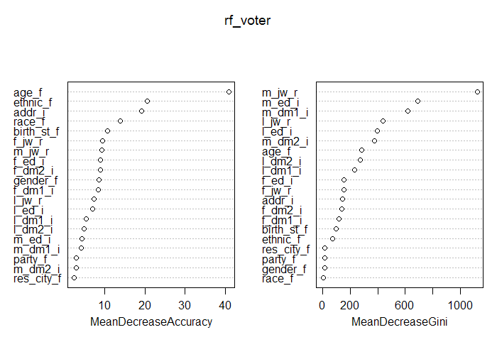

Slide 29
Ref:
http://www.informit.com/articles/article.aspx?p=1848528
https://pal.cct.brookes.ac.uk/free-new-r-packages-for-natural-language-processing/

Slide 30
R libraries:
library(e1071)
library(tree)
library(randomForest)
library(tidyverse)
library(caret)
library(stringr)
library(stringdist)
library(PGRdup)
library(stringi)
library(igraph)
library(data.table)
library(phonics)

