Slide 1
Record Linkage

Slide 2
Phonetics: Soundex (early effort)
A Soundex hash value is calculated by using the first letter of the name and converting the consonants in the rest of the name to digits by using a simple lookup table.
$ python show_soundex.py
Catherine C365
Katherine K365
Katarina K365
Johnathan J535
Jonathan J535
John J500
Teresa T620
Theresa T620
Smith S530
Smyth S530
Jessica J200
Joshua J200

Slide 3
Phonetics: NYSIIS
the New York State Identification and Intelligence System (NYSIIS)
building on Soundex by tweaking the lookup table or starting from scratch with their own rules.
It produces better results than Soundex because it takes special care to handle phonemes that occur in European and Hispanic surnames.
$ python show_nysiis.py
Catherine CATARAN
Katherine CATARAN
Katarina CATARAN
Johnathan JANATAN
Jonathan JANATAN
John JAN
Teresa TARAS
Theresa TARAS
Smith SNATH
Smyth SNATH
Jessica JASAC
Joshua JAS

Slide 4
Phonetics: double metaphone
Metaphone improves on earlier systems such as Soundex and NYSIIS
It includes special rules for handling spelling inconsistencies and for looking at combinations of consonants in addition to some vowels
Double Metaphone, goes even further by adding rules for handling some spellings and pronunciations from languages other than English.
$ python show_dmetaphone.py
Catherine ['K0RN', 'KTRN']
Katherine ['K0RN', 'KTRN']
Katarina ['KTRN', None]
Johnathan ['JN0N', 'ANTN']
Jonathan ['JN0N', 'ANTN']
John ['JN', 'AN']
Teresa ['TRS', None]
Theresa ['0RS', 'TRS']
Smith ['SM0', 'XMT']
Smyth ['SM0', 'XMT']
Jessica ['JSK', 'ASK']
Joshua ['JX', 'AX']

Slide 5
Ref:
http://www.informit.com/articles/article.aspx?p=1848528
https://pal.cct.brookes.ac.uk/free-new-r-packages-for-natural-language-processing/

Slide 6
Random Forests:
The mean decrease of accuracy in predictions on the out of bag samples when a given variable is excluded from the model
Total decrease in node impurity that results from splits over that variable, averaged over all trees.
In the case of regression trees, the node impurity is measured by the training RSS, and for classification trees by the deviance.
Nut shell: Higher values on mean decrease accuracy implies more importance
Higher value on mean decrease gini implies mixed results on split at that node
A guess can I remove feature having low value in accuracy as well as high value in gini?
With correlated features, strong features can end up with low scores and the method can be biased towards variables with many categories

Slide 7
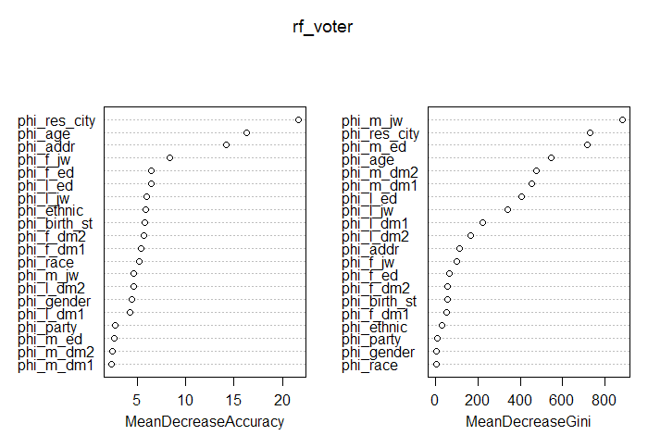

Slide 8
R libraries:
library(e1071)
library(tree)
library(randomForest)
library(tidyverse)
library(caret)
library(stringr)
library(stringdist)
library(PGRdup)
library(stringi)
library(igraph)
library(data.table)
library(phonics)

