Slide 1
Networks
Malone, Thomas. 15.561 Information Technology Essentials, Spring 2005. (MIT OpenCourseWare: Massachusetts Institute of Technology), http://ocw.mit.edu/courses/sloan-school-of-management/15-561-information-technology-essentials-spring-2005 (Accessed 19 Nov, 2014). License: Creative Commons BY-NC-SA

Slide 2
Outline
Point to point connections
Representing information
Analog vs. digital
Representing words and picture
Communications media and bandwidth
Networks
LANs vs WANs
Circuit switched vs. packet switched
Example: The Internet
Network protocols
Enterprise networking
Example: Looking at a web page
Wireless networks
Wireless telephony
Wireless data communication

Slide 3
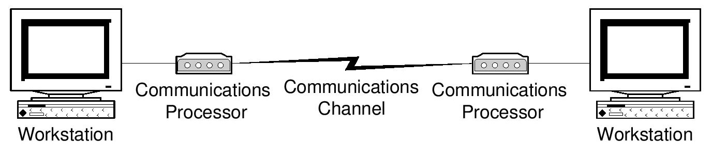
A simple point-to-point connection
Process convert data into signals
Signals are transported through channels
Channels utilize one or more connection media

Slide 4
Data: Analog vs. Digital
Analog data
Can take on any value within a continuous range
Examples:
Human voice
Boston’s temperature
Digital data
Can take on only a finite set of discrete values
Examples:
Data stored in binary computers
The US standard size of clothes

Slide 5
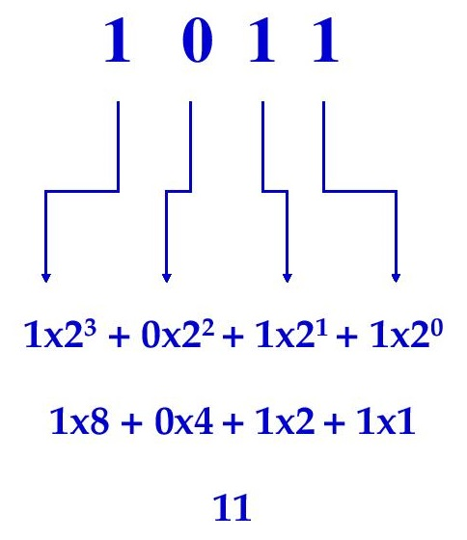
Representing Numbers
Number | 4-bit binary representation
1 | 0001
2 | 0010
3 | 0011
… | …

Slide 6
Representing Characters
Character | ASCII* Representation
A | 1010 0001
B | 1010 0010
C | 1010 0011
… | …
0 | 0101 0000
1 | 0101 0001
… | …

Slide 7
Formatted Documents
In addition to text, must contain information about how it appears on paper
Bold, italic, underlined text
Different sizes of type
Page breaks
“Invisible” formatting characters are embedded in text
Special “begin formatting” character
Format specification character (i.e. “bold type”)
Text string for which formatting applies
Special “end formatting” character
Same character codes have different meaning when interpreted as letters and when as format specifications
65 could mean either ‘A’ or ‘bold’ depending on context

Slide 8
Formatted Documents (cont’d)
Example:
This is nicely formatted line.
Could be stored internally as:
<BG PAR> ‘T’ ‘h’ ‘I’ ‘s’ ‘ ‘ ‘I’ ‘s’ ‘ ‘ ‘a’ <BG UNDERLINE> ‘n’ ‘I’ ‘c’ ‘e’ ‘l’ ‘y’ ‘ ‘ <EN UNDERLINE> <BG COLOR>1 ‘f’ ‘o’ ‘r’ ‘m’ ‘a’ ‘t’ ‘t’ ‘e’ ‘d’ <EN COLOR> ‘l’ ‘I’ ‘n’ ‘e’ ‘.’ <CR>
Where:

Slide 9
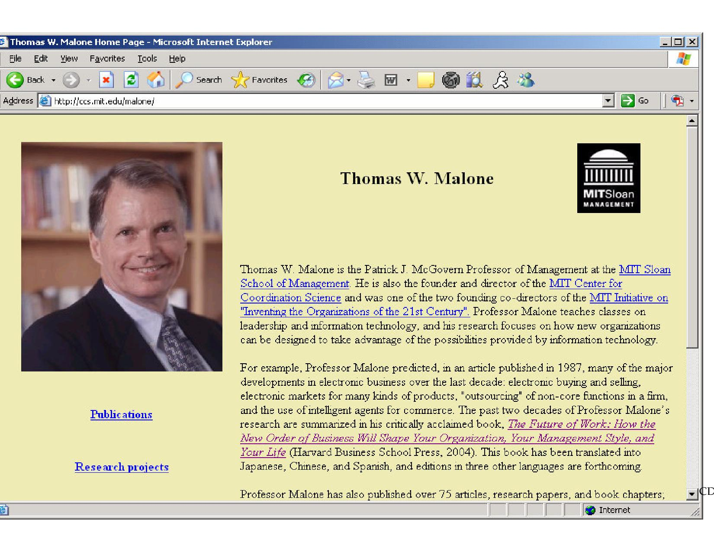

Slide 10
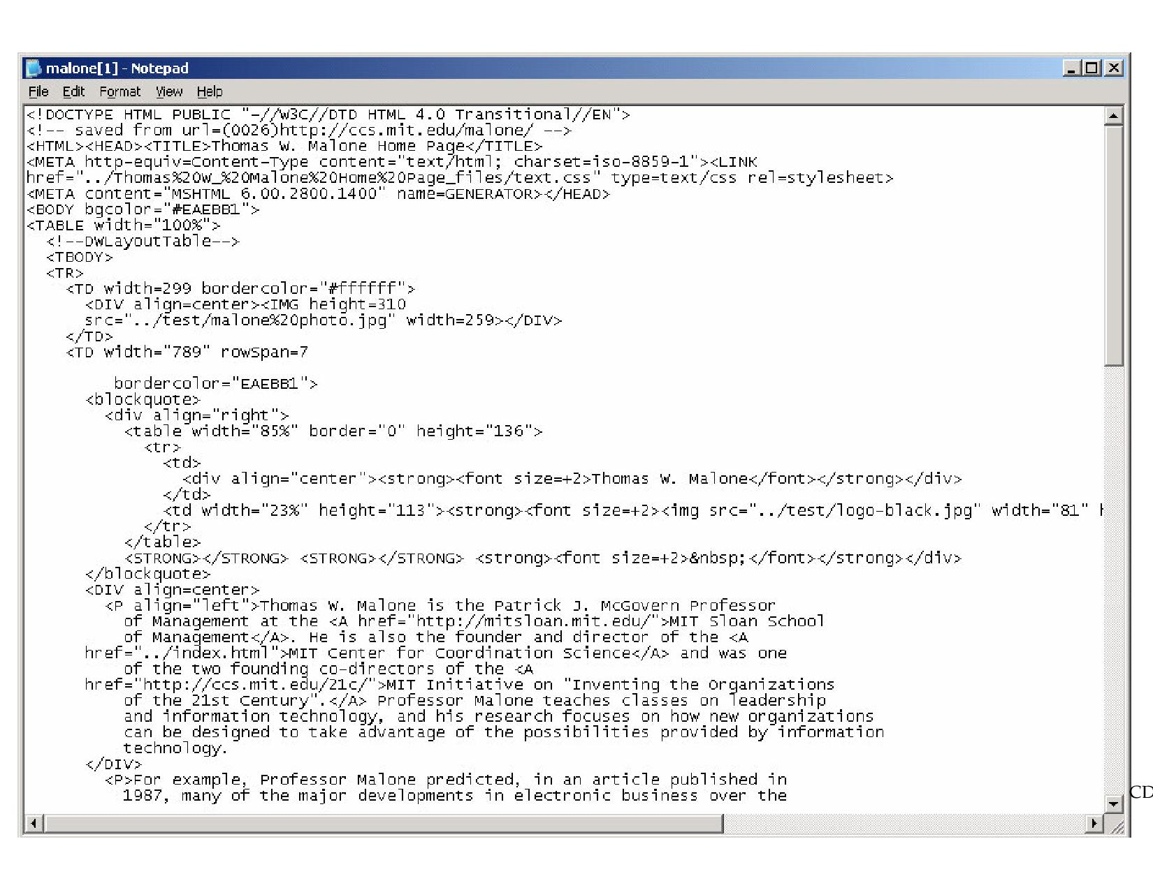

Slide 11
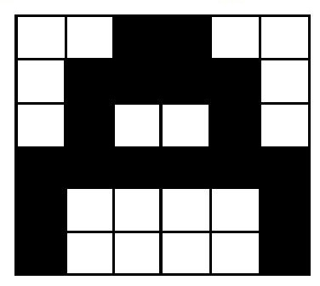
A Simplified Computer
Numbers, letters, and words are not enough: we want pictures
Representing a picture
Draw a very fine grid on it
Grid cells are called pixels or dots
See what is in each grid cell
Bitmap: is cell empty or full?
Grayscale: how dark is the cell?
Color: what color is the cell?
Represent each cell with a pre-specified # of bits (how many?)
Store the bits for the cells in a pre-specified order
e.g. all the cells for the top row, then the next row, etc.

Slide 12
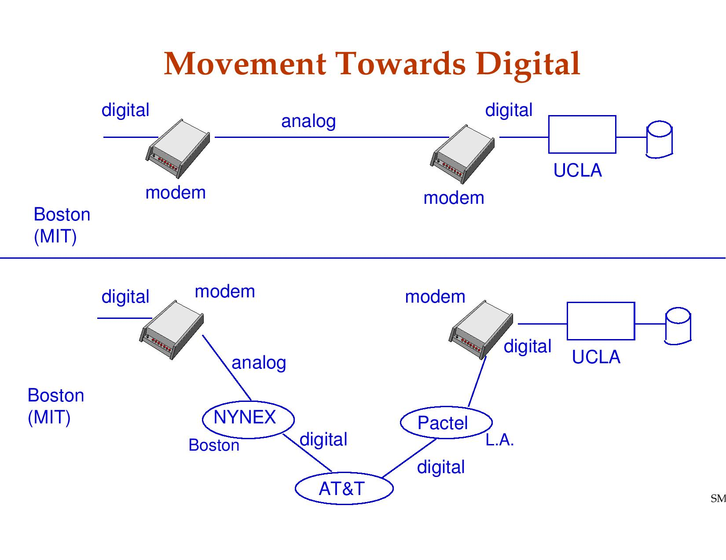

Slide 13
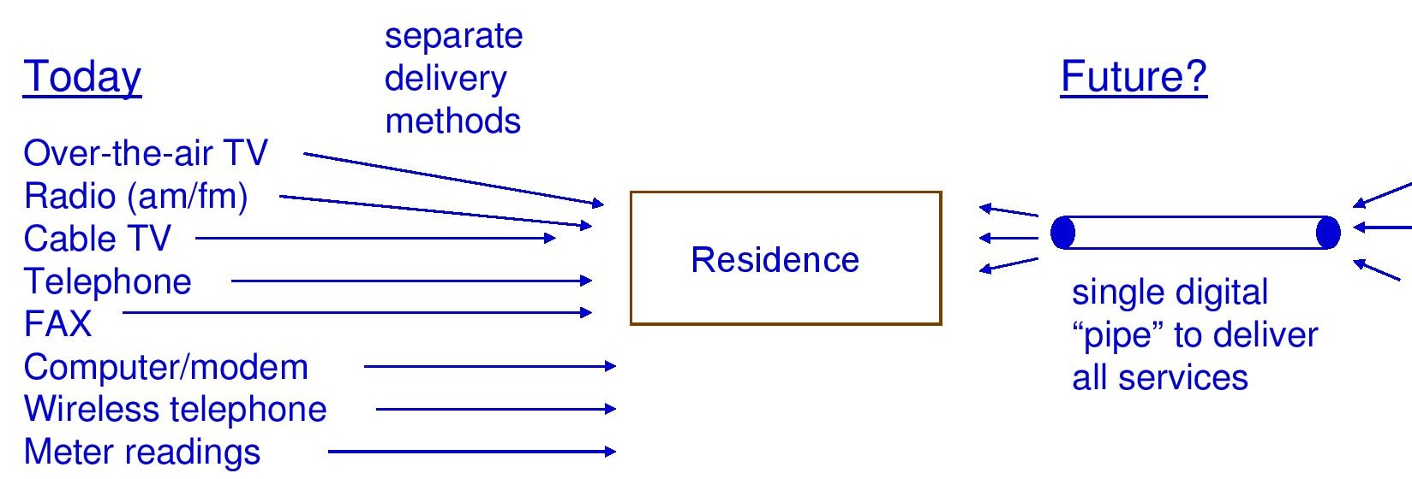
Digital Convergence

Slide 14
Connection media – Examples
Medium Speed Cost
Twisted wire 30 BPS – 10 MBPS Low
Microwave 256 KBPS – 100 MBPS
Coaxial cable 56 KBPS – 200 MBPS
Optical fiber 500 KBPS – 10 GBPS High
BPS = bits per second

Slide 15
What is bandwidth
Technically:
The range of usable frequencies in a communications medium
Practically:
The amount of information that can be carried by a communications medium per unit of time

Slide 16
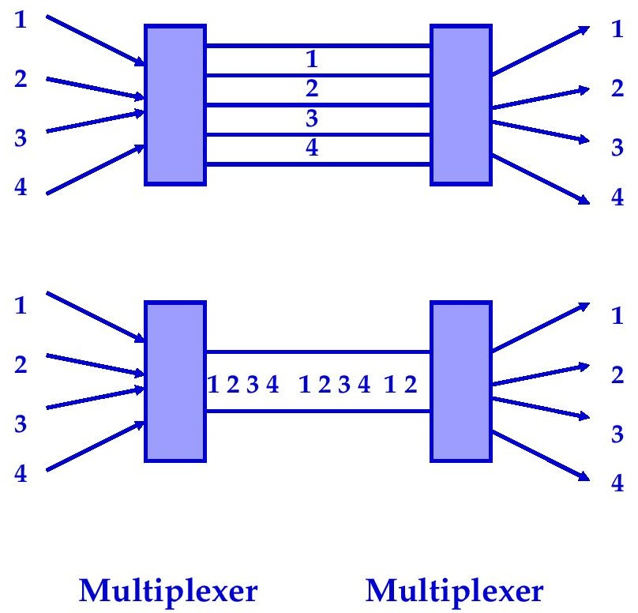
Multiplexing: Squeezing many channels into one
Frequency Division Multiplexing (FDM)
Time Division Multiplexing (TDM)

Slide 17
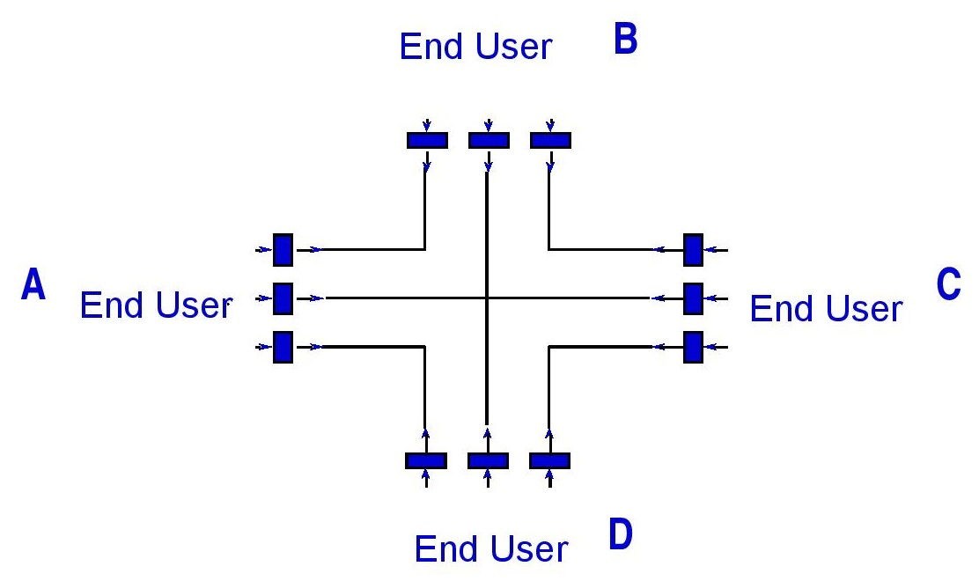
Why build networks?
Full Connectivity doesn’t scale!

Slide 18
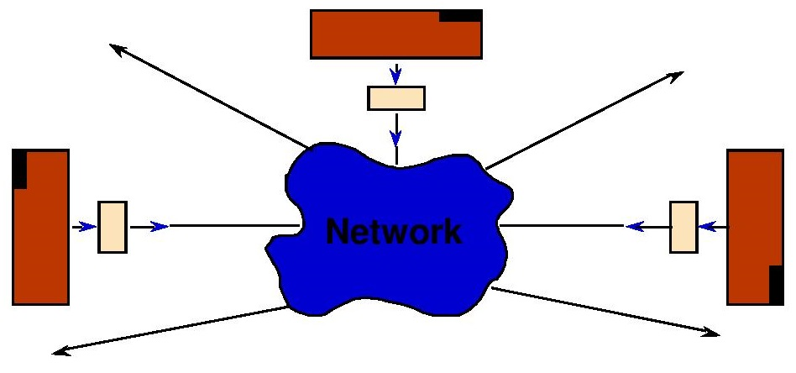
Networks are about sharing
The network allows an entity to switch its attention among a large number of others
Permits sharing of resources attached to the network, including the resources of the network itself

Slide 19
Local and Wide Area Networks
Local Area Networks (LANs)
Short distances
Within organizations
Typical technology: Ethernet or Token Ring
Wide Area Networks (WANs)
Long distances
Across organizations (typically multiple LANs)
Typical technology: Public Switched, Leased Line

Slide 20
Two forms of network connection
Circuit switching
A dedicated end-to-end connection is established for the duration of the connection
Used in telephone network
Packet switching
Messages are divided into small packets
Each packet is separately routed to the destination
Different packets can take different paths and times
Missing or garbled packets are retransmitted, if necessary
Packets are reassembled into messages at the destination

Slide 21
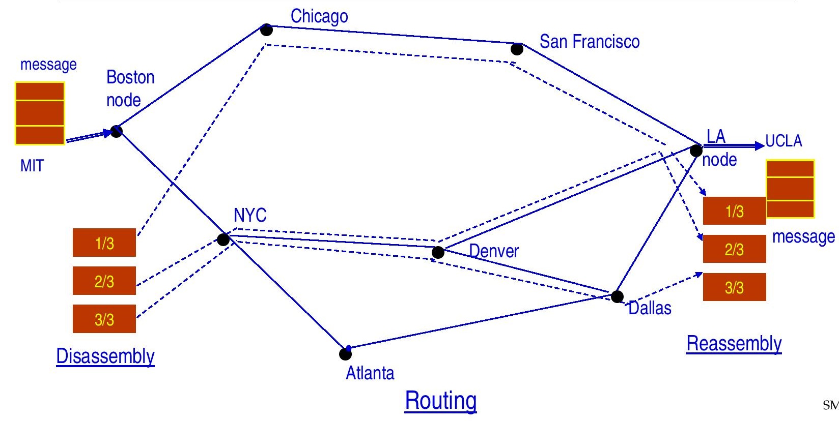
Packet switching

Slide 22
Packet switching
Circuit switching | Packet switching
Minimum delay | Variable delay
Very inefficient use of connection capacity | Much more efficient use of connection capacity
When overloaded, unable to make connection at all | Can almost always connect, but may be long delays
Both ends of connection must use same data rate | Data-rate conversion is easy

Slide 23
The Internet
What is the Internet?
Outgrowth of ARPANET
Based on TCP/IP
A collection of interconnected networks
Provides appearance of widespread connectivity
What is it used for?
E-mail, file transfer, terminal access, client-server traffic, information browsing (aka Web), distributed work, electronic commerce, etc.

Slide 24
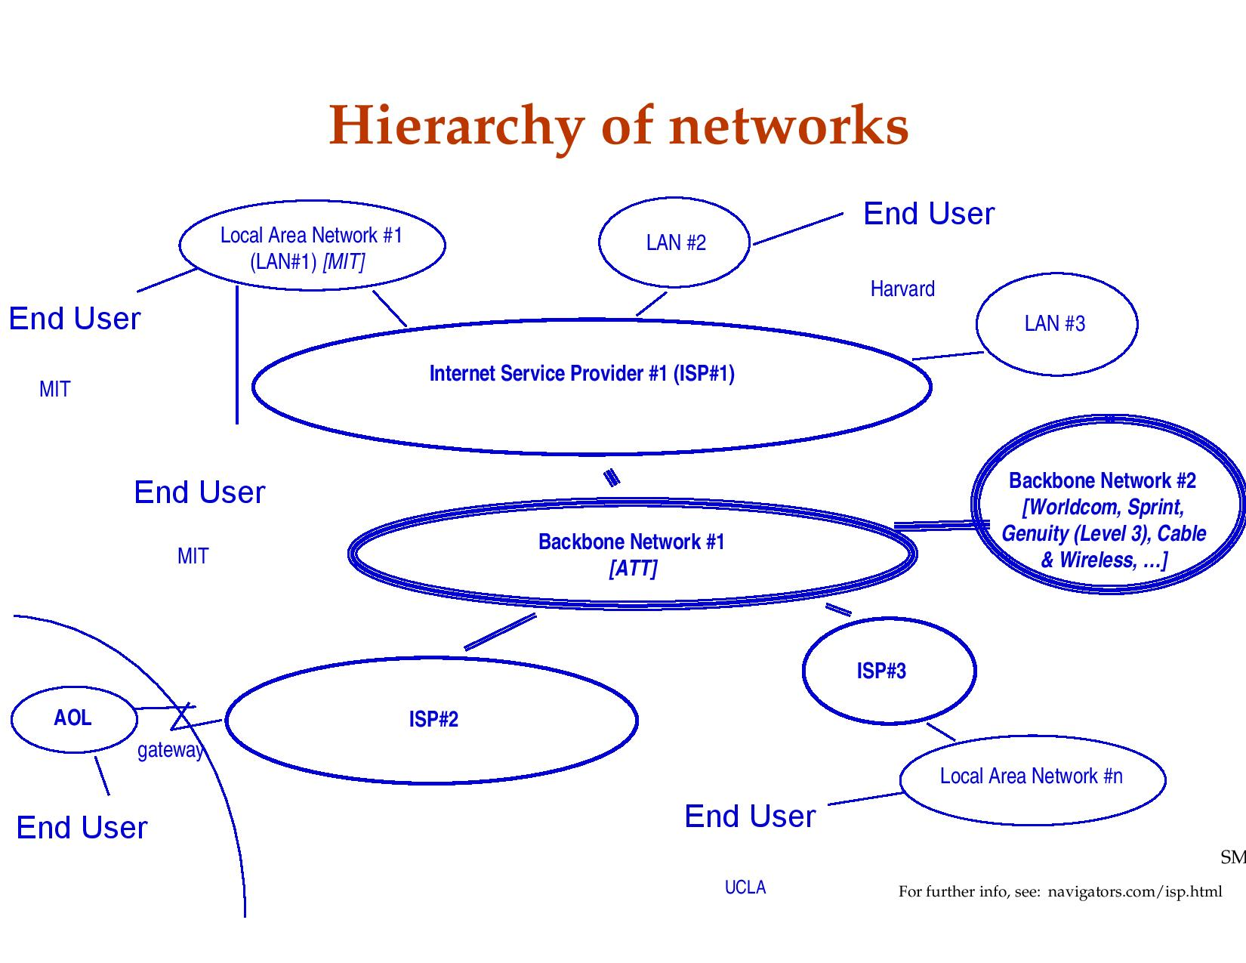

Slide 25
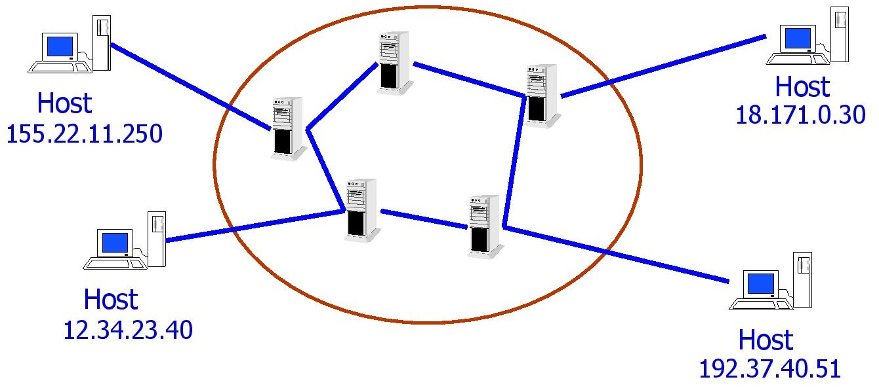
Internet Address (IP address)

Slide 26
Understanding Internet Addresses
18.154.0.27
Uniquely assigned to a specific Internet connection point
32-bit address
Each number between dots is the decimal representation of 8 bits in the address
In this case:
18 specifies MIT (MIT owns all addresses 18.xxx.yyy.zzz)
154 specifies the subnet corresponding to building E56
0.27 is host number within the subnet
Every internet address can optionally have a descriptive host name (e.g. LASAGNA.MIT.EDU)

Slide 27
Who controls the Internet?

Slide 28
What does it mean to be on the Internet?
Run TCP/IP protocol
Have an IP address
Have ability to send IP packets to other machines on the Internet

Slide 29
Network Protocols
Rules of behavior
What, when, and how should A send messages to B and vice versa?
Protocol layers
Each layer uses the layers below it and can be used by the layers above it
Often, multiple alternatives can be substituted at one layer without affecting the other layers

Slide 30
Example: TCP/IP protocol architecture
Application layer Provides communication between applications on separate machines (e.g. email, file transfer, web browsing)
Transport layer Provides end-to-end reliable data transfer across multiple networks (e.g. TCP – Transmission Control Protocol)
Internet layer Routes data from source to destination through one or more networks (IP – Internet Protocol)
Network access layer Manages logical interface between a machine and its local network (e.g. Ethernet, X.25)
Physical Layer Converts bits to signals and back (e.g. wires, radio, etc.)

Slide 31
Different types of connection protocols
X.25 – A packet switching protocol for connecting devices on a WAN
Frame relay – Another packet switching protocol for connecting devices on a WAN (faster but less error checking than X.25. Up to about 45 Mbps)
Asynchronous Transfer Mode (ATM) – A “cell switching” protocol that establishes “virtual circuits” from fixed size packet (faster than X.25, e.g. suitable for real-time video. Up to about 622 Mbps)

Slide 32
Different types of connection “boxes”
Hub – Connects parts of a network, typically different parts of the same LAN (network access level)
Bridge – Connects two LANs using software (network access level)
Switch – Connects different LANs, typically using hardware only (network access level)
Router – Connects two networks that may or may not be similar and routes packets appropriately (Internet level)
Gateway – Connects networks that use different protocols (transport level or above)

Slide 33
Example: The World Wide Web
A collection of interlinked documents stored on computer servers all over the world and accessible to user clients via the Internet
Documents communicated in HTML (Hyper Text Markup Language)
Rules for requesting and providing documents (and other interactions between clients and servers) are defined by HTTP (Hyper Text Transfer Protocol)
Documents may contain easily “clickable” links to other documents.
Documents are identified by “web addresses” called URLs (Uniform Resource Locators)
“Hypertext” means text documents that contain embedded links to other documents.

Slide 34
Looking at a Web page
Connect your PC to the Internet
Dialup an Internet service provider (via modem)
Establish a point-to-point link with the provider’s machine
Using PPP (Point-to-Point Protocol)
Your PC receives a “temporary IP address)
Using DHCP (Dynamic Host Configuration Protocol)
Your PC receives the address of a Domain Name Server (DNS)
Start your browser program (e.g. Internet Explorer)
Type in a URL (Uniform Resource Locator)

Slide 35
Looking at a Web page (cont.)
Brower asks DNS for the IP address of the MIT Server
DNS replies with 18.170.0.167
Browser opens TCP connection to 18.170.0.167
Browser sends the command GET/class/syllabus.htm
The MIT Server sends file syllabus.htm
TCP connection is released
Browser displays the contents of syllabus.htm

Slide 36
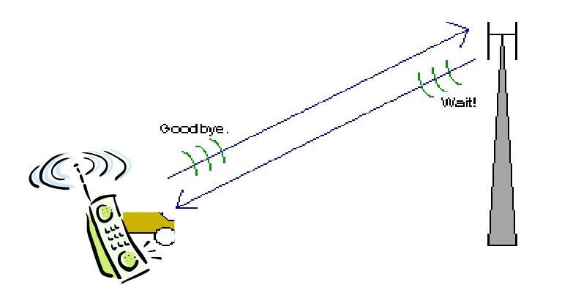
How a cell phone works

Slide 37
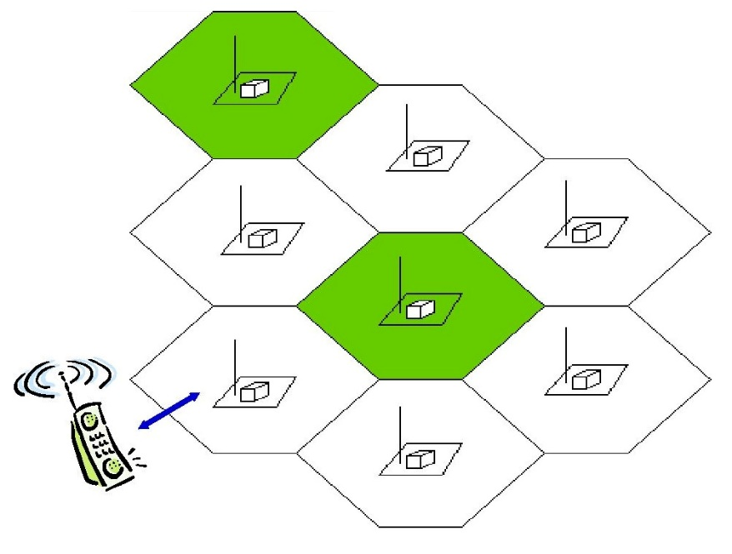
Cellular Phone Networks
Frequency reuse
Handoff

Slide 38
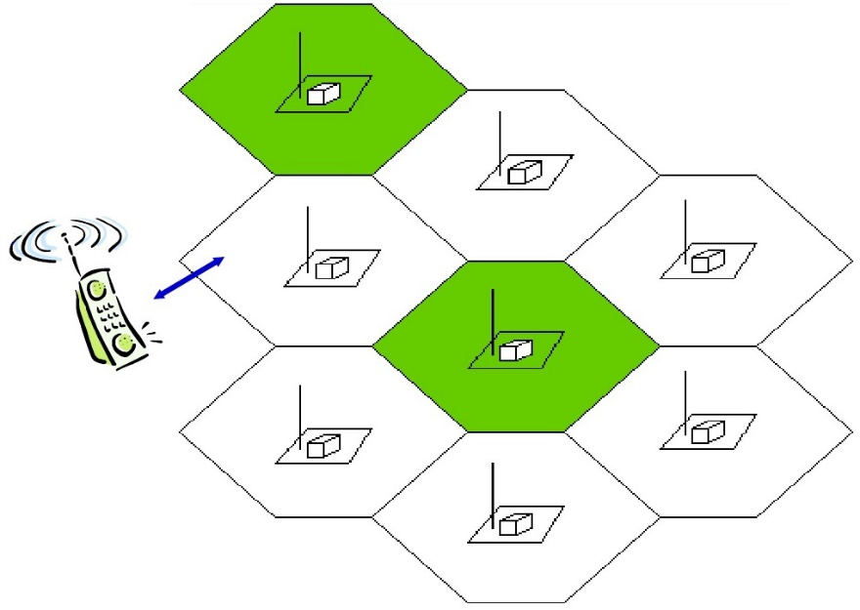
Cellular Phone Networks
Frequency reuse
Handoff

Slide 39
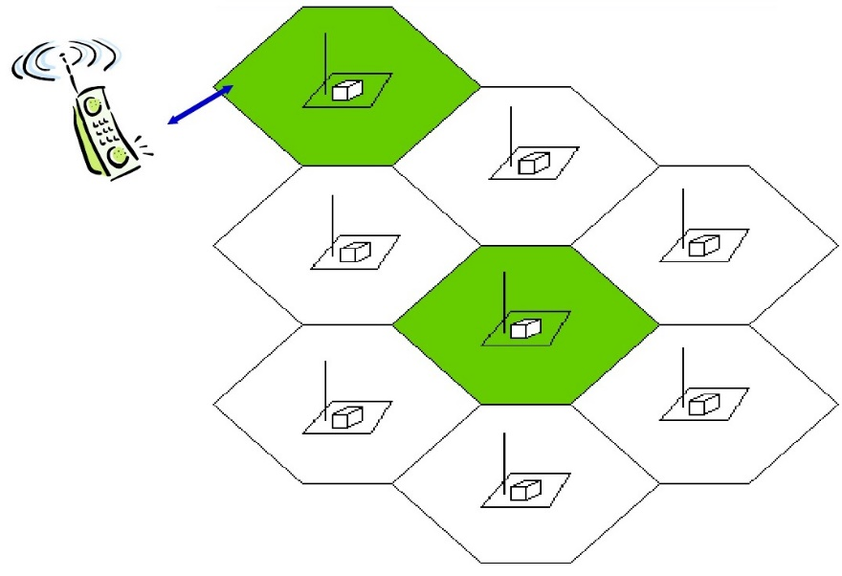
Cellular Phone Networks
Frequency reuse
Handoff

Slide 40
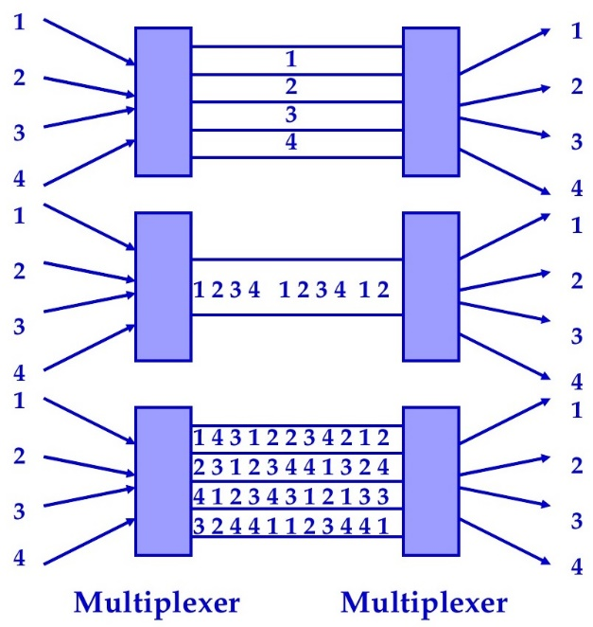
Cellular Phone Networks
Frequency Multiple Division Access (FDMA)
Time Division Multiple Access (TDMA)
Code Division Multiple Access (CDMA)

Slide 41
Generations of cellular technology
First Generation (“1G”, 1980’s and 90’s)
Analog, primarily used for voice, low bandwidth (e.g. 9.6Kbps)
Ex: AMPS (USA)
Second Generation (“2G”, 1990’s and early 2000’s)
Digital, cheaper, somewhat higher bandwidth (e.g. 14.4 Kbps), more data services (e.g. short messages, caller ID)
EX: GSM, TDMA, CDMA, PCS
Third Generation (“3G”, started 2002)
Digital, much higher bandwidth (e.g. 2Mbps), many more services (e.g. video)
Ex: WCDMA, CDMA2000

Slide 42
Different cellular standards
Standard | Appx. Freq. (MHz) | Mode | Multi-plexing method | Voice/ radio Channels | comments
Analog (AMPS) | 800 - 900 | Analog | FDMA | 1 | Common in US, but becoming obsolete
GSM | 900, 1800 - 2100 | Digital | TDMA | 8 | Common in Europe & Asia, growing in US
CDMA (IS-95) | 800 | Digital | CDMA | 20 – 60 | Qualcomm holds key patents
TDMA (IS-54 & IS 136) | 800, 1800 – 2000 | Digital | TDMA | 3 – 6 | Most common “digital” cellular in US
PCS | 1800 – 2100 | Digital | - | - | Generic term for 1800 – 2000 MHz svcs
WCDMA | Many | Digital | CDMA | Many | Migration path from GSM. Up to 2 Mbps.
CDMA2000 | Any | Digital | CDMA | Many | Migration path from CDMA. Common in S Korea. Up to 2 Mbps

Slide 43
Cellular acronyms
AMPS – Advance Mobile Phone System
CDMA – Code Division Multiple Access
FDMA – Frequency Division Multiple Access
GSM – Global System for Mobile Communication
IS – Interim Standard
PCS – Personal Communications Services
TDMA – Time Division Multiple Access
WCDMA – Wideband CDMA

Slide 44
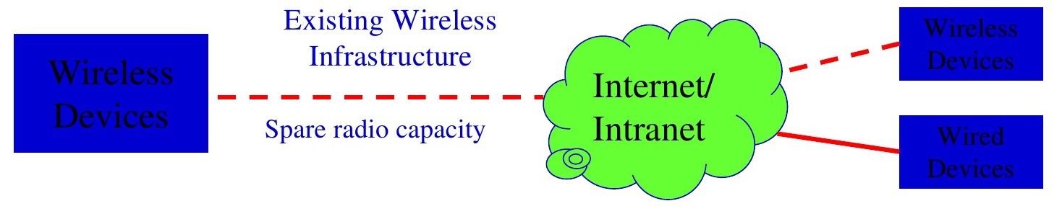
What is Wireless IP?
A wireless connectivity solution employing IP that enables devices to access an Intranet or the Internet
PDAs
Cellphones
Pagers
Laptops
Workstations
Future Devices?

Slide 45
Wi-Fi (Wireless Fidelity)
Protocol for wireless LANs
802.11b format – 11Mbs
802.11g format – 20+ Mbps
Allows you to
Connect to Internet in local “hot spots”
Connect many PC’s to the Internet through one access point

Slide 46
Bluetooth
Wireless device connectivity
Named after Scandinavian king who united several unruly kingdoms
Short range (<10m)
Sample uses
Wireless PDAs always connected to desktop via mobile phone
Wireless headphones connected to notebook
Office / Home device networks that automatically reconfigure by presence
…

Slide 47
How will networks change business?

