Slide 1



Social Genome: Putting Big Data to Work for Population Informatics
Hye-Chung Kum
Associate Professor
Department of Health Policy and Management, School of Public Health
Department of Computer Science and Engineering
Department of Industrial and Systems Engineering
The Center for Remote Health Technologies and Systems (CRHTS)
Texas A&M University
kum@tamu.edu
Population Informatics Research Group
http://research.tamhsc.edu/pinformatics
Notes:
Hi, my name is Hye-chung.

Slide 2
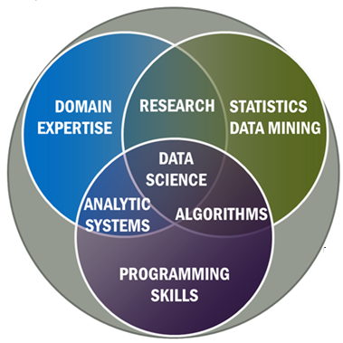

Bioinformatics Apply Data Science to Human Genome Data
Biology
Human
Genome
Data
+

Slide 3
Population informatics Apply Data Science to Social Genome Data
Studies of society (groups of people)
Social sciences
Health sciences (population health)
Social Genome
Data
+

Slide 4
Research Interest
how the abundance of existing digital data, such as government administrative data and electronic health records,
can support accurate evidence-based, timely decisions
for research, policy, management and evaluation
while protecting the confidentiality of individual subjects of the data
focuses on methods to design efficient and effective human computer hybrid processes and systems to clean, integrate, and extract actionable information from raw chaotic data and deliver the information in a timely secure manner to decision makers such as researchers, policy makers, clinicians, and patients.

Slide 5
Methods
Holistic Safe Cyber Infrastructure
Privacy-by-Design
Secure Cloud Computing/Layered Access Models
Statistical Information Disclosure
Data Governance Models
Data Integration (Record Linkage) & Privacy
Remote Health
Clinical Decision Support
Sequential Analysis

Slide 6
Domain Science
Chronic Care Management
Post Traumatic Stress Disorder (PTSD)
Patient-Centered Medical Homes
Liver Cancer
Suicide Prevention
Post Acute Care Services
Care Navigation
Primary Care and Mental Health Integration
Hospital Financing: Uncompensated Care
Medicaid Waiver
Child Welfare
TANF
Food & Nutrition

Slide 7
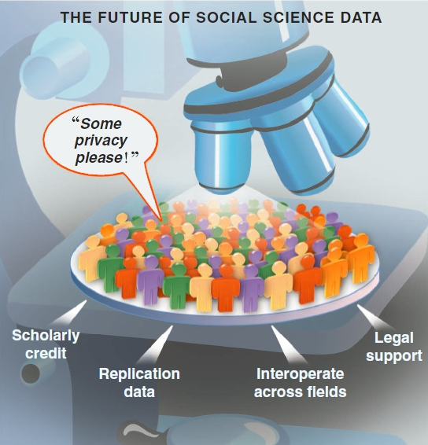
Holistic Safe Cyber Infrastructure Privacy-by-Design
A different perspective on privacy and research using personal data
Personal Data is Delicate/Hazardous/Valuable
Important to have proper systems in place that give protection but allow for continued research in a safe manner
All hazardous material need standards
Safe environments to handle them in : closed computer server system lab
Proper handling procedures : what software are allowed to run on the data
Safe containers to store them : DB system
Source: Gary King. Ensuring the Data-Rich Future of the Social Sciences, Science, vol 331, 2011, pp 719-721.
Notes:
Population informatics is the burgeoning field at the intersection of social sciences, health sciences, computer science, and statistics that applies quantitative methods and computational tools to answer questions about human populations.
Social genome data can tell us about how people live, work, respond to change, and make decisions, and most importantly the collective impact of these individual decisions. Such insights help us understand the root causes of social and public health problems, predict the downstream effects of different policy options, and allocate our collective resources for the greatest impact.
Just as bioinformatics has revolutionized biological research, population informatics could catalyze significant advances in our understanding of trends in society, health, and human behavior.
Never before in history have we had more data to use for population research, however, privacy and confidentiality protection is critical to the success of population informatics research.
--------------------

Slide 8
IT Security Layered System of Access Models
Riskier Data Safer Data
Protection Usability
Restricted Controlled Monitored Open
Open Access: Summary statistics (open data)
Monitored Access: Register your research plan
Controlled Access: Approval by IRB
Risk of privacy violation vs. benefit to society
Restricted Access: Link data accurately
H.-C. Kum and S. Ahalt, “Privacy by Design: Understanding Data Access Models for Secondary Data,” Am. Medical Informatics Assoc. (AMIA) Clinical Research Informatics Summit, 2013
Notes:
It will have different level of access based on the risk of harm… Safe summary data is provided as open data under open access, while more sensitive data is provided as monitored, controlled, or restricted access depending on the potential for harm in using the data.
For such a vision to become a reality, there must be a shift in our understanding of privacy protection and accountability from using sensitive data for research.

Slide 9

Statistical Information Disclosure Privacy is a BUDGET constrained problem
Differential Privacy proves each query leads to some privacy loss while providing some utility in terms of data analysis
Background knowledge attack is difficult to protect against
“local privacy”: my neighbor works at the hospital
The goal is to achieve the maximum utility under a fixed privacy budget
Approaches to Privacy Protection (slide)
Utility Privacy
Notes:
Second, it is important to understand that information privacy is a budget constrained problem as proven mathematically by privacy experts …that privacy and use of the data MUST be balanced.
The goal is to achieve the maximum utility under a fixed privacy budget. You can not assume unlimited privacy in the real world.

Slide 10

Data Governance via Crowdsourcing
Privacy as contextual integrity (legal)
Helen Nissenbaum (NYU Law School)
Washington Law Review, Vol. 79, No. 1, 2004
a conceptual framework for understanding privacy expectations and their implications developed in the literature on law, public policy, and political philosophy
Privacy Protection / Violation
Social norms of expectation (on use, sharing etc)
Due diligence
Quantifying harm : loss of job
Human Subject Protection (IRB)
Collective Consent: Using Crowdsourcing as an Innovative Alternative to Assessing Risk and Benefit of Database Studies for Human Subject Protection

Slide 11
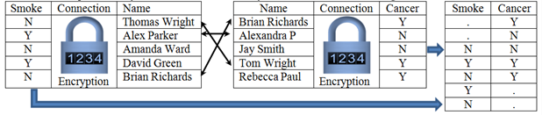
Privacy Preserving Interactive Record Linkage
Decouple data via encryption
Automated honest broker approach via computerized third party model
Chaffe to prevent group disclosure
Kum, H.C., Krishnamurthy A., Machanavajjhala A., Reiter M., and Ahalt S. Privacy Preserving Interactive Record Linkage (PPIRL). J Am Med Inform. Assoc. 2014;21:212–220. doi:10.1136/amiajno-2013-002165

Slide 12
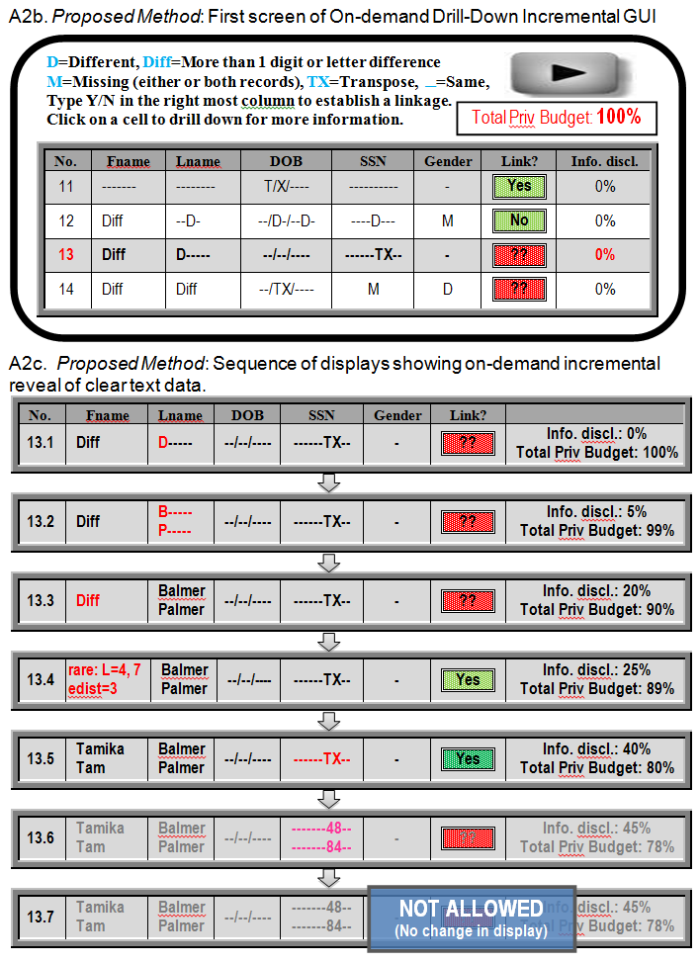
Incremental disclosure
Click on Red
Discloses more information incrementally

Slide 13
Remote Health
Telehealth systems for facilitate management of chronic disease
Decision support information systems
Input: EHR, patient generated IOT data streams
Processing information system:
Secure cloud computing
Hybrid human computer information processing systems
Output:
To patients & care givers: facilitate self management
To providers: Improved monitoring & data collection and on time service delivery
To payers: Effective bundled payment systems
To researcher: Game changing source of data for research

Slide 14
A tool to track & support medical decisions
rapid-learning health system
leverages recent developments in health information technology and a growing health data infrastructure
to access and apply evidence in real time
while simultaneously drawing knowledge from real-world care-delivery processes
to promote innovation and health system change on the basis of rigorous research

Slide 15
Sequential Pattern Mining
Cluster 1 (cluster strength = 40% = 2 sequences)
seq₁
(A)
(B, C, Y)
(D)
seq₄
(A, L)
(D, E)
seq₂
(A)
(X)
(B, C)
(A, E)
(Z)
Weighted Seq
(A:3, L:1):3
(X:1):1
(B:2, C:2, Y:1):2
(A:1, D:2,E:2):3
(Z:1):1
3
Consensus Pat
(A)
(B, C)
(D, E)
Cluster 2 (cluster strength = 40% = 3 sequences)
seq₉
(J)
(K)
(L, M)
seq₅
(I, J)
(B)
(K)
(L)
seq₃
(A, I)
(Z)
(K)
(L, M)
seq₇
(I, J)
(K)
(J, K)
(L)
(M)
seq₈
(I, M)
(K)
(K, M)
(L, M)
seq₆
(I, J)
(L, M)
seq₁₀
(V)
(K, W)
(Z)
Weighted
sequence
(A:1,I:5,
J:4,M:1):6
(B:1,K:2,
V:1,Z:1):5
(J:1,K:6,
M:1,W:1):6
(L:6,M:4):6
(M:1,
Z:1):2
7
Consensus
Pat (w≥3)
(I, J)
(K)
(L, M)
Consensus
Var (w≥2)
(I, J)
(K)
(K)
(L, M)

Slide 16
Actionable
Policy and Practice
Data Savvy
Managers
(Decision Makers)
Data Based Answers to
Real world Problems
Transformational Knowledge
Secure Federated Data Infrastructure
Federated administrative data, Linkable survey microdata
Other (Blog, Private company data, etc.)
Information
Broad new research questions
Data Intensive
Domain Scientists
Frame Real World Questions
to Tractable Questions
Domain Knowledgeable
Computer Scientists
Methods
Datamining & Statistical methods
Social Genome Data Library
Population Informatics: The systematic study of populations via secondary analysis of massive data collections (“big data”) about people.
Kum, H.C., Krishnamurthy A., Machanavajjhala A., and Ahalt S. Social Genome: Putting Big Data to Work for Population Informatics. IEEE Computer Special Outlook Issue. pp 56-63. Jan 2014

Slide 17

Thank You !
Hye-Chung Kum
Population Informatics Research Group
http://research.tamhsc.edu/pinformatics
kum@tamu.edu
Notes:
Hi, my name is Hye-chung.

