Slide 1
Population Informatics, Data Science, & Big Data
Hye-Chung Kum
Population Informatics Research Group
http://research.tamhsc.edu/pinformatics/
http://pinformatics.web.unc.edu/
License:
Data Science in the Health Domain by Hye-Chung Kum is licensed under a
Creative Commons Attribution-NonCommercial-ShareAlike 4.0 International License
Course URL:
http://pinformatics.tamhsc.edu/phpm672

Slide 2
Agenda
Introduction
What is Big Data
What is Data Science
What is Population Informatics
Data Science
Data vs Theory
Doing Analytics Right
Challenges
Examples of population informatics
Management Decision Support
Evaluation
Research

Slide 3
Agenda
Introduction
What is Big Data
What is Data Science
What is Population Informatics
Data Science
Data vs Theory
Doing Analytics Right
Challenges
Examples of population informatics
Management Decision Support
Evaluation
Research

Slide 4
Properties of BIG DATA : 4V
Volume : constantly generating
Velocity : constantly changing
Variety : expressed in many ways
Veracity : lots of errors
EXAMPLE: the INTERNET!
What do you do to find information/knowledge on the Internet?

Slide 5
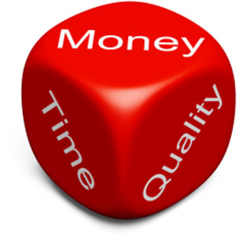
The Big Data Problem – Nutshelled Michael Franklin (UC Berkley)
Something’s
gotta
give:
Time
Quality
Money
Massive Diverse and Growing
Data

Slide 6
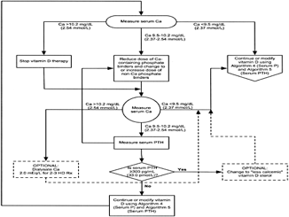
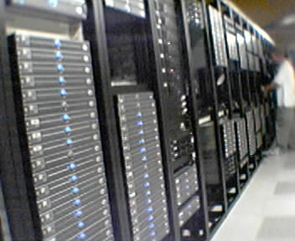

AMPLab: Integrating Three Key Resources
Algorithms
Machine Learning, Statistical Methods
Prediction, Business Intelligence
Machines
Clusters and Clouds
Warehouse Scale Computing
People
Crowdsourcing, Human Computation
Data Scientists, Analysts

Slide 7
Agenda
Introduction
What is Big Data
What is Data Science
What is Population Informatics
Data Science
Data vs Theory
Doing Analytics Right
Challenges
Examples of population informatics
Management Decision Support
Evaluation
Research

Slide 8
What is Data Science?
Other words
Knowledge Discovery & Data mining (KDD)
Business Intelligence / Business Analytics
Collecting and refining information from many sources
Analyzing and presenting the information in useful ways
Iterating between inductive and deductive reasoning to get to the truth
So people can make better business decisions

Slide 9
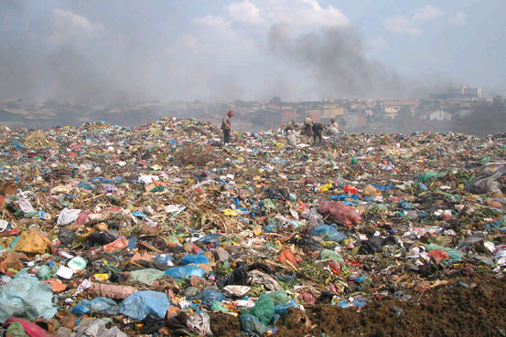


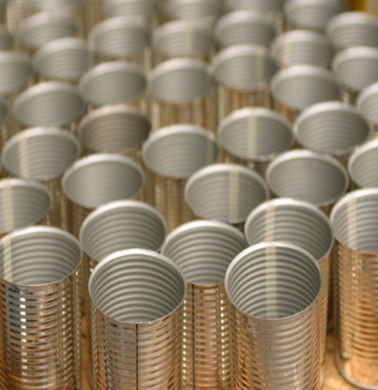

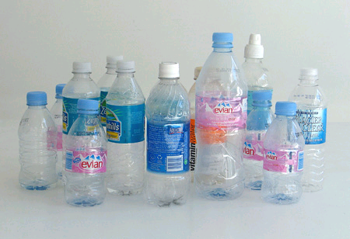
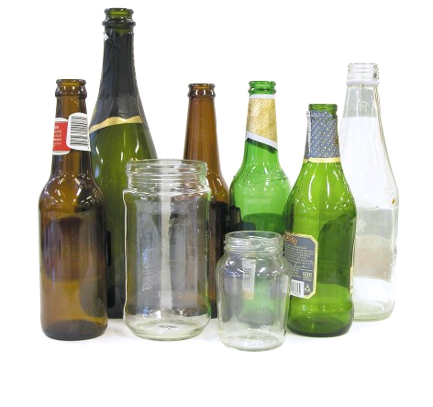
Data Science Knowledge Discovery & Data mining (KDD)
Big Data : operational data
KDD
Clean, Merge, Reprocess
Human consumable, valid, novel, potentially useful,
and ultimately understandable information

Slide 10
KDD Process
Operational
Data
Data cleaning & integration
EDW
Feature Selection (what vars?)
Task Specific Data
Analysis / Datamining
Results
Validation / Evaluation
Information Presentation
Action

Slide 11
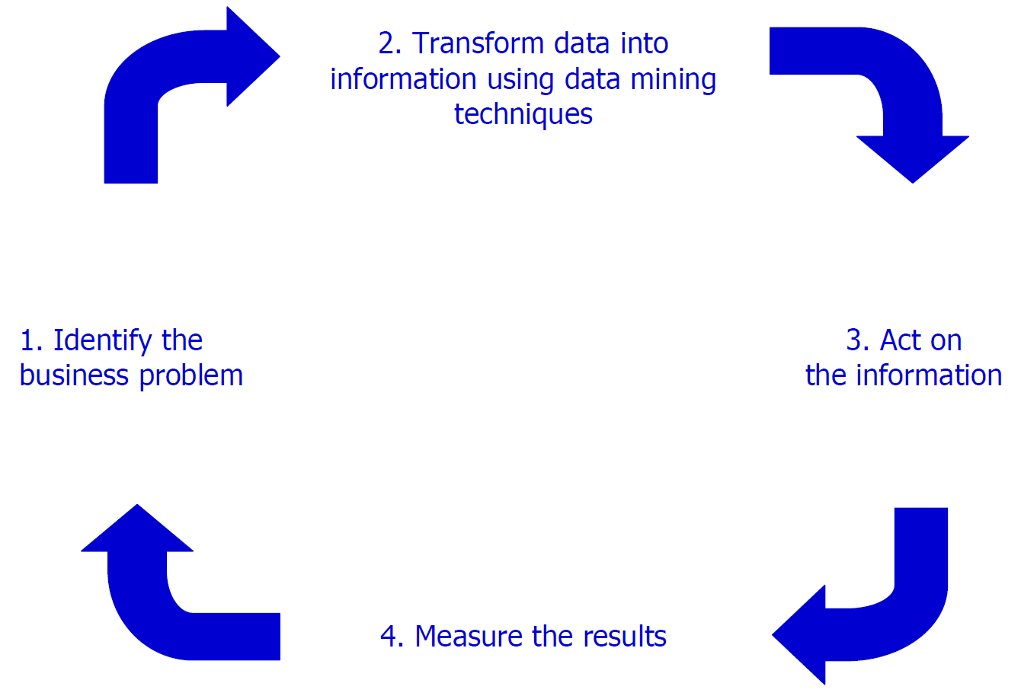
The Virtuous Cycle of Data to Decision & Action

Slide 12
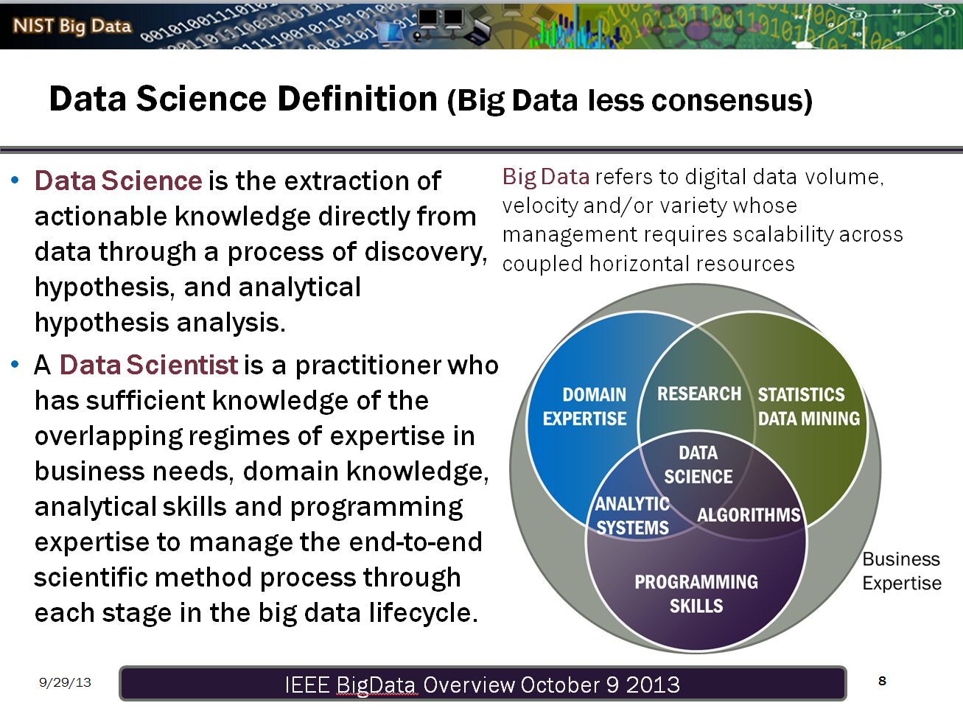

Slide 13
Agenda
Introduction
What is Big Data
What is Data Science
What is Population Informatics
Data Science
Data vs Theory
Doing Analytics Right
Challenges
Examples of population informatics
Management Decision Support
Evaluation
Research

Slide 14
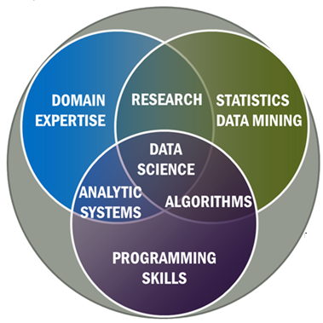

Bioinformatics Apply Data Science to Human Genome Data
Biology
Human
Genome
Data
+

Slide 15
Population informatics Apply Data Science to Social Genome Data
Studies of society (groups of people)
Social sciences
Health sciences (population health)
Social Genome
Data
+

Slide 16
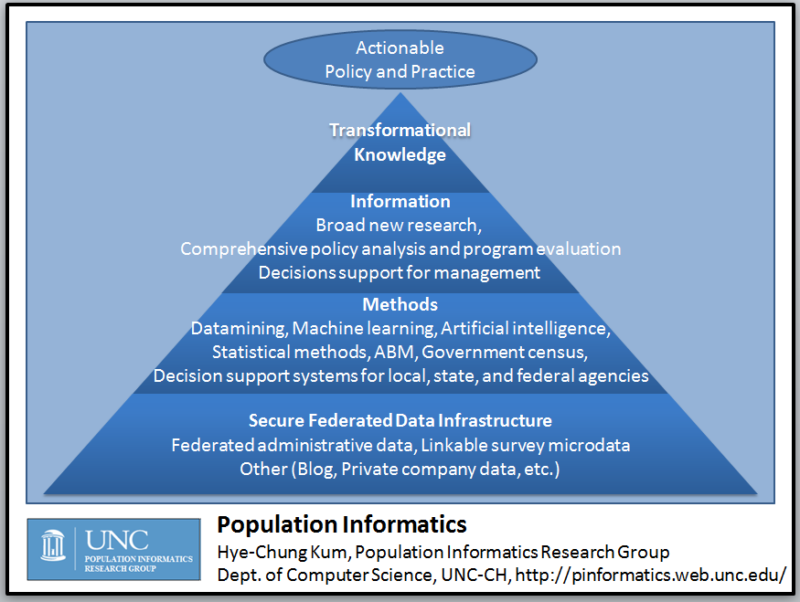
Data Savvy
Managers
(Decision Makers)
Data Intensive
Domain Scientists
Domain Knowledgeable
Computer Scientists
Social Genome Database

Slide 17
The Power of the Social Genome

Our activities from birth until death leave digital traces in large databases

Digital traces capture our social genome, the footprints of our society

The social genome data are massive and chaotic

It holds crucial insights into many of the most challenging problems facing our society (i.e. affordable and accessible quality healthcare, economics, education, employment, and welfare)
Notes:
Social scientists have long drawn on data collections from governments and elsewhere to track demographic trends such as inflation and employment rates. However, now in the digital era, our daily activities from birth until death leave digital crumbs all over cyberspace,
Collectively, these digital traces—across a group, town, county, state, or nation—form a population’s social genome, the collective footprints of our society.
and we have the technology to gather and analyze these crumbs to obtain crucial insights into the most challenging problems in society such as healthcare, economics, and education.

Slide 18
Social Genome
Data-intensive research using distributed, federated, person-level datasets in near real time has the potential to transform social, behavioral, economic, and health sciences—but issues around privacy, confidentiality, access, and data integration have slowed progress in this area. When technology is properly used to manage both privacy concerns and uncertainty, big data will help move the growing field of population informatics forward.

Slide 19
Thomas Davenport Competing on Analytics
Skill set for good data scientists
IT & Programming skills
Statistical skills
Business skills:
Understand pros/cons of decisions & actions
Communication skills
Excel / PowerPoint
Intense curiosity: the most important skill or trait. “a desire to go beyond the surface of a problem, find the question at its heart, and distill them into a very clear set of hypothesis that can be tested”

Slide 20
Data science teams need people with the skills and curiosity to ask the big questions (oreilly)
Technical expertise: the best data scientists typically have deep expertise in some scientific discipline.
Curiosity: a desire to go beneath the surface and discover and distill a problem down into a very clear set of hypotheses that can be tested.
Storytelling: the ability to use data to tell a story and to be able to communicate it effectively.
Cleverness: the ability to look at a problem in different, creative ways.
Health is a very important domain
Team lead: good questions, good interpretation & implications
http://radar.oreilly.com/2011/09/building-data-science-teams.html

Slide 21
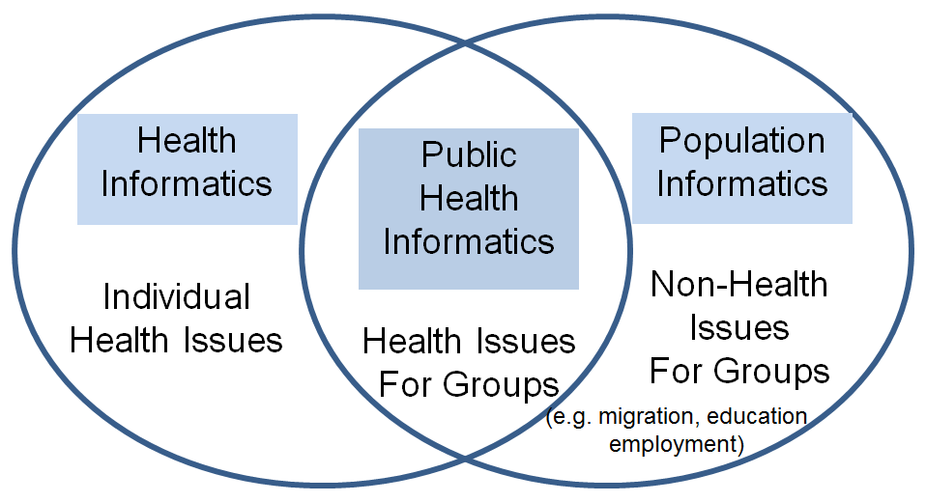
?? Informatics
Notes:
Public health informatics=population informatics

Slide 22
Public Health Informatics
Yasnoff et al. (2000): Public health informatics is defined as the systematic application of information and computer science and technology to public health practice, research, and learning

Slide 23
Public Health Informatics Competencies
Public Health Informatics Competencies Working Group, CDC
Report: Informatics competencies for public health professionals
Class 1: Effective use of information
Class 2: Effective use of information technology
Class 3: Effective management of information technology projects
http://www.nwcphp.org/docs/phi/comps/phic_web.pdf

Slide 24
Public Health Informatics Competencies
Describe at a basic level the fundamentals of a computer network
Describe at a basic level the Internet and World Wide Web
Describe at a basic level technologies employed to ensure computer systems’ security
Public Health Informatics Competencies Working Group
Cunningham et al. 2007. Baseline Assessment of Public Health Informatics Competencies in Two Hudson Valley Health Departments. Public Health Reports. May-Jun 2007. V122

Slide 25
Agenda
Introduction
What is Big Data
What is Data Science
What is Population Informatics
Data Science
Data vs Theory
Doing Analytics Right
Challenges
Examples of population informatics
Management Decision Support
Evaluation
Research

Slide 26
The End of Theory: The Data Deluge Makes the Scientific Method Obsolete
“All models are wrong but some are useful”
The Petabyte Age is different because more is different
Google translate
Google's founding philosophy is that we don't know why this page is better than that one: If the statistics of incoming links say it is, that's good enough. No semantic or causal analysis is required. Correlation is enough.

Slide 27
The End of Theory: The Data Deluge Makes the Scientific Method Obsolete
But faced with massive data, this approach to science — hypothesize, model, test — is becoming obsolete.
Biology: Hutchinson disease
Correlation supersedes causation, and science can advance even without coherent models, unified theories, or really any mechanistic explanation at all.
What can science learn from Google?

Slide 28
Agenda
Introduction
What is Big Data
What is Data Science
What is Population Informatics
Data Science
Data vs Theory
Doing Analytics Right
Challenges
Examples of population informatics
Management Decision Support
Evaluation
Research

Slide 29
There are ways to do analytics right Value in Big Data
63 percent of healthcare executives in the federal government believe that big data will improve population health management.
The Mckinsey report on big data valued integrated data on patient services at $300 billion.
But so few have proper goals and strategies for their data

Slide 30
There are ways to do analytics right It’s not the data, but the people
It's not about the data, but how you're going to manage it.
The focus, according to Hughes, should be on information management, including data governance, stewardship and quality.
If you are just about grabbing data, you will be on a data grab forever.
It may sound impressive to say that your organization has access to terabytes of patient information, but without robust technology and smart people to manipulate it, that data is simply words and numbers without context
A severe shortage of analytics pros makes navigating this landscape all the more difficult
“It's also a mistake to think you can staff up on this easily"
lack of qualified data engineers

Slide 31
There are ways to do analytics right Data Management is Key
Raw data from claims or from an EMR database are not suitable for analysis.
Turning raw data into usable information requires preparation, including normalization and validation.
Only then can an organization gain trustworthy insights from the information and put it to use in maximizing patient care, reducing risk and strengthening a business's bottom line

Slide 32
There are ways to do analytics right EDW: Organized Data Library
Hughes says that organizations have been spending too much time and money on enterprise data warehouses, which he sometimes refers to as "data landfills."
An EDW isn't where data goes to die. An EDW is a staging point for analytics.
An EDW needs to be easy for clinicians to understand and interpret, and also needs to interoperate with and push data back out to other systems
Sometimes this is done in too fragmented a fashion
My thoughts: Art
Appropriate size task, data
Balance organizing data with actual using data

Slide 34
Agenda
Introduction
What is Big Data
What is Data Science
What is Population Informatics
Data Science
Data vs Theory
Doing Analytics Right
Challenges
Examples of population informatics
Management Decision Support
Evaluation
Research

Slide 35
Challenges
Privacy
Data Access
Data Management
Data Integration & Cleaning
Error Management and Propagation

Slide 36
What do we know about information privacy

Slide 37
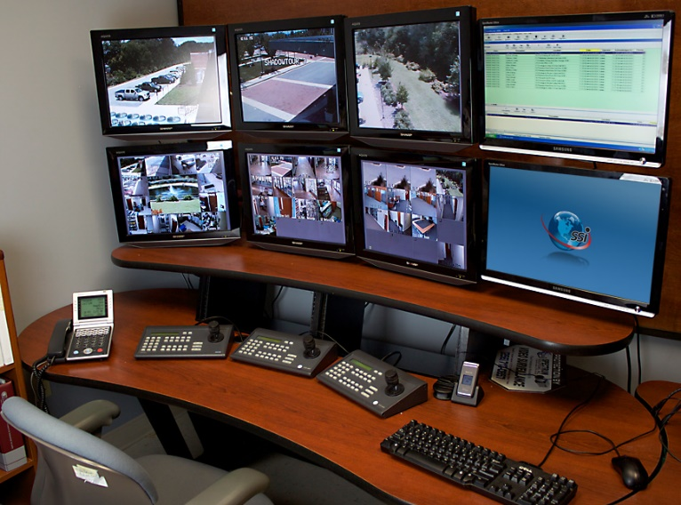

Information Accountability Works
Secrecy : Hiding information
In reality, has limited power to protect privacy
Severe Consequences related to
Accuracy of data and decisions, use of data for
legitimate reasons, transparency & democracy
Information Accountability (Credit Report)
Very clear transparency in the use of the data
Disclosure : Declared in writing, so when something goes wrong the right people are held accountable (data use agreements)
IT WORKS! Primary method used to protect financial data
Internet : crowdsourced auditing (public access IRB)
Logs & audits : what to log, how to keep tamperproof log
D.J. Weitzner et al., Information Accountability, Comm. ACM, vol. 51, no. 6, 2008, pp. 82–87.
Notes:
First, information accountability is effective in privacy protection!
Although secrecy (limiting access) seems the instinctive method for best protection, in practice, secrecy has limited power for real protection. And yet it has severe consequences related to the accuracy of data and decisions, cost of use for legitimate purposes, as well as transparency and democracy. Many of us have experienced the difficulty of correcting a careless data entry error that has a taken weeks to fix.
In contrast, the financial sector has long been able to provide high level of protection on personal financial data, one of the most private information targeted by the most malicious cybercrimes today. Our credit history is our financial social genome which is well protected with a combination of technology and governance via information accountability.
Just as the financial sector has succeeded in providing protection through the use of secure computer software, the building of a safe environment, and increased governance and monitoring of how the data is collected and used, when social genome data libraries can take a similar approach these projects could facilitate the growth of population informatics as a revolutionary research tool to benefit our society

Slide 38

Privacy is a BUDGET constrained problem
Differential Privacy proves each query leads to some privacy loss while providing some utility in terms of data analysis.
The goal is to achieve the maximum utility under a fixed privacy budget
Utility Privacy
Notes:
Second, it is important to understand that information privacy is a budget constrained problem as proven mathematically by privacy experts …that privacy and use of the data MUST be balanced.
The goal is to achieve the maximum utility under a fixed privacy budget. You can not assume unlimited privacy in the real world.

Slide 39
Social Issues: Balance between
Individual privacy
Secrecy does not work very well : accuracy of data
Cost of integrity of data
Bias in research: selective sampling
Incorrect analysis that can lead to wrong decisions
Organization transparency & accountability
Freedom of speech
Marketing is freedom to express why one should prescribe certain drugs
Marketing is freedom to send junk mail & call
Thus, getting more information to better target is acceptable and should be allowed

Slide 40
Privacy as contextual integrity (legal)
Helen Nissenbaum (NYU Law School)
Washington Law Review, Vol. 79, No. 1, 2004
a conceptual framework for understanding privacy expectations and their implications developed in the literature on law, public policy, and political philosophy
Privacy Protection / Violation
Social norms of expectation (on use, sharing etc)
Due diligence
Quantifying harm : loss of job

Slide 41
Privacy Expectation for Doing Research
Consider the RISK of HARM versus BENEFIT to SOCIETY
Taking into account the COST
Individual privacy
Cost of integrity of data : bad data can lead to wrong decisions
Lost opportunity cost of no access to data
Organization transparency & accountability (democracy)
Value gained through obtaining timely, accurate, appropriate information for good decision making
Financial cost of data security measures
Transparent and accountable use of data
Notes:
Finally, personal big data is freely used for many undesirable purposes today. We should distinguish between using big data for research and these other purposes. The use of personal big data for research needs to consider the actual risk of harm, benefit to society, as well as the huge lost opportunity cost of not using big data for research.
We can do this the right way with control and accountability, just as we do in the credit report system
... by making the use of data very transparent.
It is time to reap the benefits of big data by conducting research with it for the greatest social benefit.

Slide 42
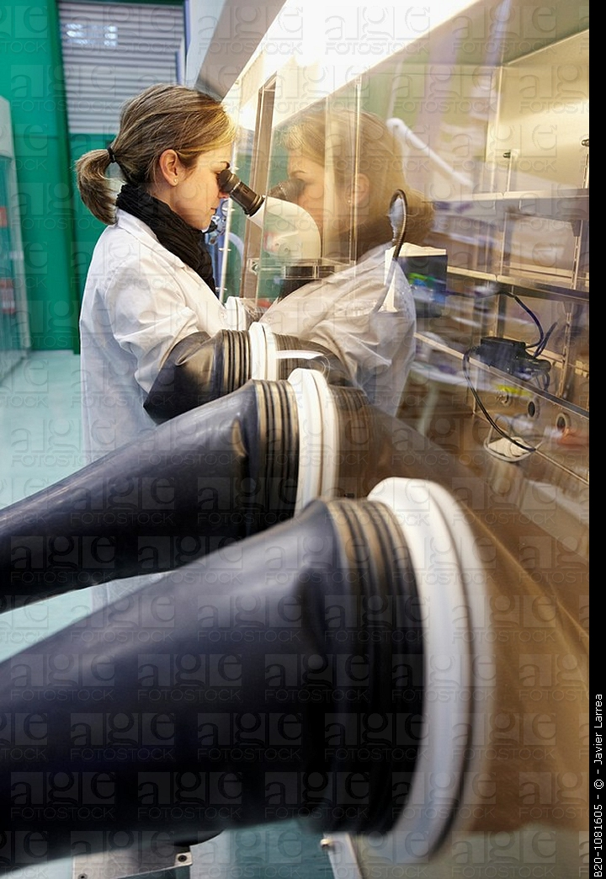
Privacy-by-Design
A different perspective on privacy and research using personal data
Personal Data is Delicate/Hazardous/Valuable
Important to have proper systems in place that give protection but allow for continued research in a safe manner
All hazardous material need standards
Safe environments to handle them in : closed computer server system lab
Proper handling procedures : what software are allowed to run on the data
Safe containers to store them : DB system

Slide 43
WORKFLOW (Data Access)
Safe Platform for
Data to Decision

Slide 44
System of Access Models
Protection Usability
Restricted Controlled Monitored Open
Data Analysis Type I Analysis Type II Publish
Preparation (More sensitive data) (Less sensitive data)
More Protection More Usability
Raw Data Decision
Goal: To design an information system that can enforce the varied continuum from one end to the other such that one can balance privacy and usability as needed to turn data into decisions for a given task

Slide 45
The start …
Write up a research plan on
What data you need
What you want to do with them
Determine access levels for each data
Submit to IRB process

Slide 46
IRB: Risk of privacy violation vs. Benefit to Society
Risk of attribute disclosure
Group disclosure
Linkage attack using auxiliary information
Risk of identity disclosure
Given?
Kinds of data elements used in the study
Name/dob/cancer status/ etc… (are there $$)
What system the data resides in : HW/SW
Risk of outsiders intruding / insider attack / negligence
What can users do with the data on the system
Take data off / look at everything / only do limited queries

Slide 47
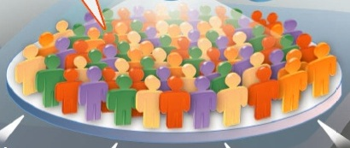
Restricted Access : Prepare the customized data
Decoupled Data (Kum 2012)
Automated Honest Broker SW
Sample selection
Attribute selection
Data integration (access to PII)
Some data cleaning
Full IRB
Example: RDC (TX census RDC)
Notes:
Need access to LOTS of data, often times include PII to prep
High risk to privacy

Slide 48
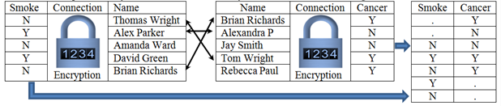
Privacy Preserving Interactive Record Linkage
Decouple data via encryption
Automated honest broker approach via computerized third party model
Chaffe to prevent group disclosure
Kum, H.C., Krishnamurthy A., Machanavajjhala A., Reiter M., and Ahalt S. Privacy Preserving Interactive Record Linkage (PPIRL). J Am Med Inform. Assoc. 2014;21:212–220. doi:10.1136/amiajno-2013-002165

Slide 49
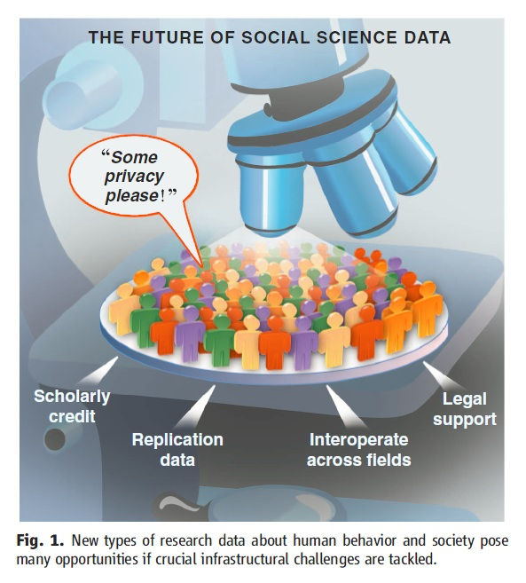
Controlled Access : Model using given tools
With approved deidentified data
Locked down VM: customized appliances
only approved software
Remote access via VPN
Very effective for threats from HBC
Full IRB
U Chicago-NORC , UNC-Tracs (CTSA), UCSD-iDASH, SAIL
Gary King. Ensuring the Data-Rich Future of the Social Sciences, Science, vol 331, 2011, pp 719-721.
Notes:
Delicate species (live, change and move as you observe), requires special handling, container (DBS) and environment (lab)

Slide 50
Monitored Access : Freely Repurpose
Information Accountability model
Exempt IRB: Explicit data use agreement (5 big Q)
Public online (crowdsource)
Any software & auxiliary data
Remote Access via VPN
Less sensitive data (e.g. Aggregate data)
SHRINE, Secure Unix servers
Gary King. Ensuring the Data-Rich Future of the Social Sciences, Science, vol 331, 2011, pp 719-721.
Notes:
Delicate species (live, change and move as you observe), requires special handling, container (DBS) and environment (lab)

Slide 51
Open Access : No restriction on use
Anyone : Publish information for others
No IRB
No monitoring use
Publish data use terms
Disclosure Limitation Methods (filter)
Sanitized data
Public websites, publications
Package with filter (disclosure limitation methods) & take out of lab
Gary King. Ensuring the Data-Rich Future of the Social Sciences, Science, vol 331, 2011, pp 719-721.
Notes:
Delicate species (live, change and move as you observe), requires special handling, container (DBS) and environment (lab)

Slide 52
Privacy Protection Mechanism
Protection Usability
Restricted Controlled Monitored Open
Access | Restricted Access | Controlled Access | Monitored Access | Open Access
Protection Approach | Physical restriction to access | Lock down VM (limit what you can do on the system) | Information accountability | Disclosure Limitation
Monitoring Use | All use on & OFF the computer is monitored | All use on the computer is monitored |  | Trust
IRB | Full IRB approved | Full IRB approved | IRB Exempt (register) | Terms of Use
R1:Crypto-graphic Attack | Very Low Risk | Low Risk. Would have to break into VM | High Risk | NA
R2: Data Leakage | Very Low Risk. Memorize data and take out | Physical data leakage (Take a picture of monitor) | Electronically take data off the system.

Slide 53
Comparison of risk and usability
Protection Usability
Restricted Controlled Monitored Open
 |  | Restricted Access | Controlled Access | Monitored Access | Open Access
Usability | U1.1: Software (SW) | Only preinstalled data integration & tabulation SW. No query capacity | Requested and approved statistical software only | Any software | Any software
 | U1.2: Data | No outside data allowed But PII data | Only preapproved outside data allowed | Any data | Any data
 | U2: Access | No Remote Access | Remote Access | Remote Access | Remote Access
Risk | R1:Crypto-graphic Attack | Very Low Risk | Low Risk. Would have to break into VM. | High Risk | NA
 | R2: Data Leakage | Very Low Risk. Memorize data and take out | Physical data leakage (Take a picture of monitor) | Electronically take data off the system. | NA

Slide 54
Use Published Data for Good Decision Making
Protection Usability
Restricted Controlled Monitored Open
Data Analysis Type I Analysis Type II Publish
Preparation (More sensitive data) (Less sensitive data)
More Protection More Usability
Raw Data Decision
Deployed together the four data access models can provide a comprehensive system for privacy protection, balancing the risk and usability of secondary data in population informatics research

Slide 55
Closing Thoughts
Overarching question: How can we use the abundance of existing digital data, aka big data, (e.g. government administrative data, electronic health records) to support accurate evidence based decisions for policy, management, legislation, evaluation, and research while protecting the confidentiality of individual subjects of the data?
Preferred approaches: Data Science - To build efficient and effective human computer hybrid processes and systems to clean, integrate, and extract actionable information from raw chaotic data and deliver accurate information in a timely secure manner to decision makers (e.g. researchers, policy makers, mangers, clinicians).
Primary data: Social Genome data – person level data, usually identifiable (so we can accurately integrate diverse data) at some point
Primary issues: Privacy (safe data access, code of conduct), data integration, error management,
Velocity, variety, veracity, volume (lots of SMALL datasets)

Slide 56
Agenda
Introduction
What is Big Data
What is Data Science
What is Population Informatics
Data Science
Data vs Theory
Doing Analytics Right
Challenges
Examples of population informatics
Management Decision Support
Evaluation
Research

Slide 57
Examples of population informatics
Management Decision Support
Online Dashboards
Open data
Evaluation
Research
Infographics
http://research.tamhsc.edu/pinformatics/data-science/
video

