Slide 1
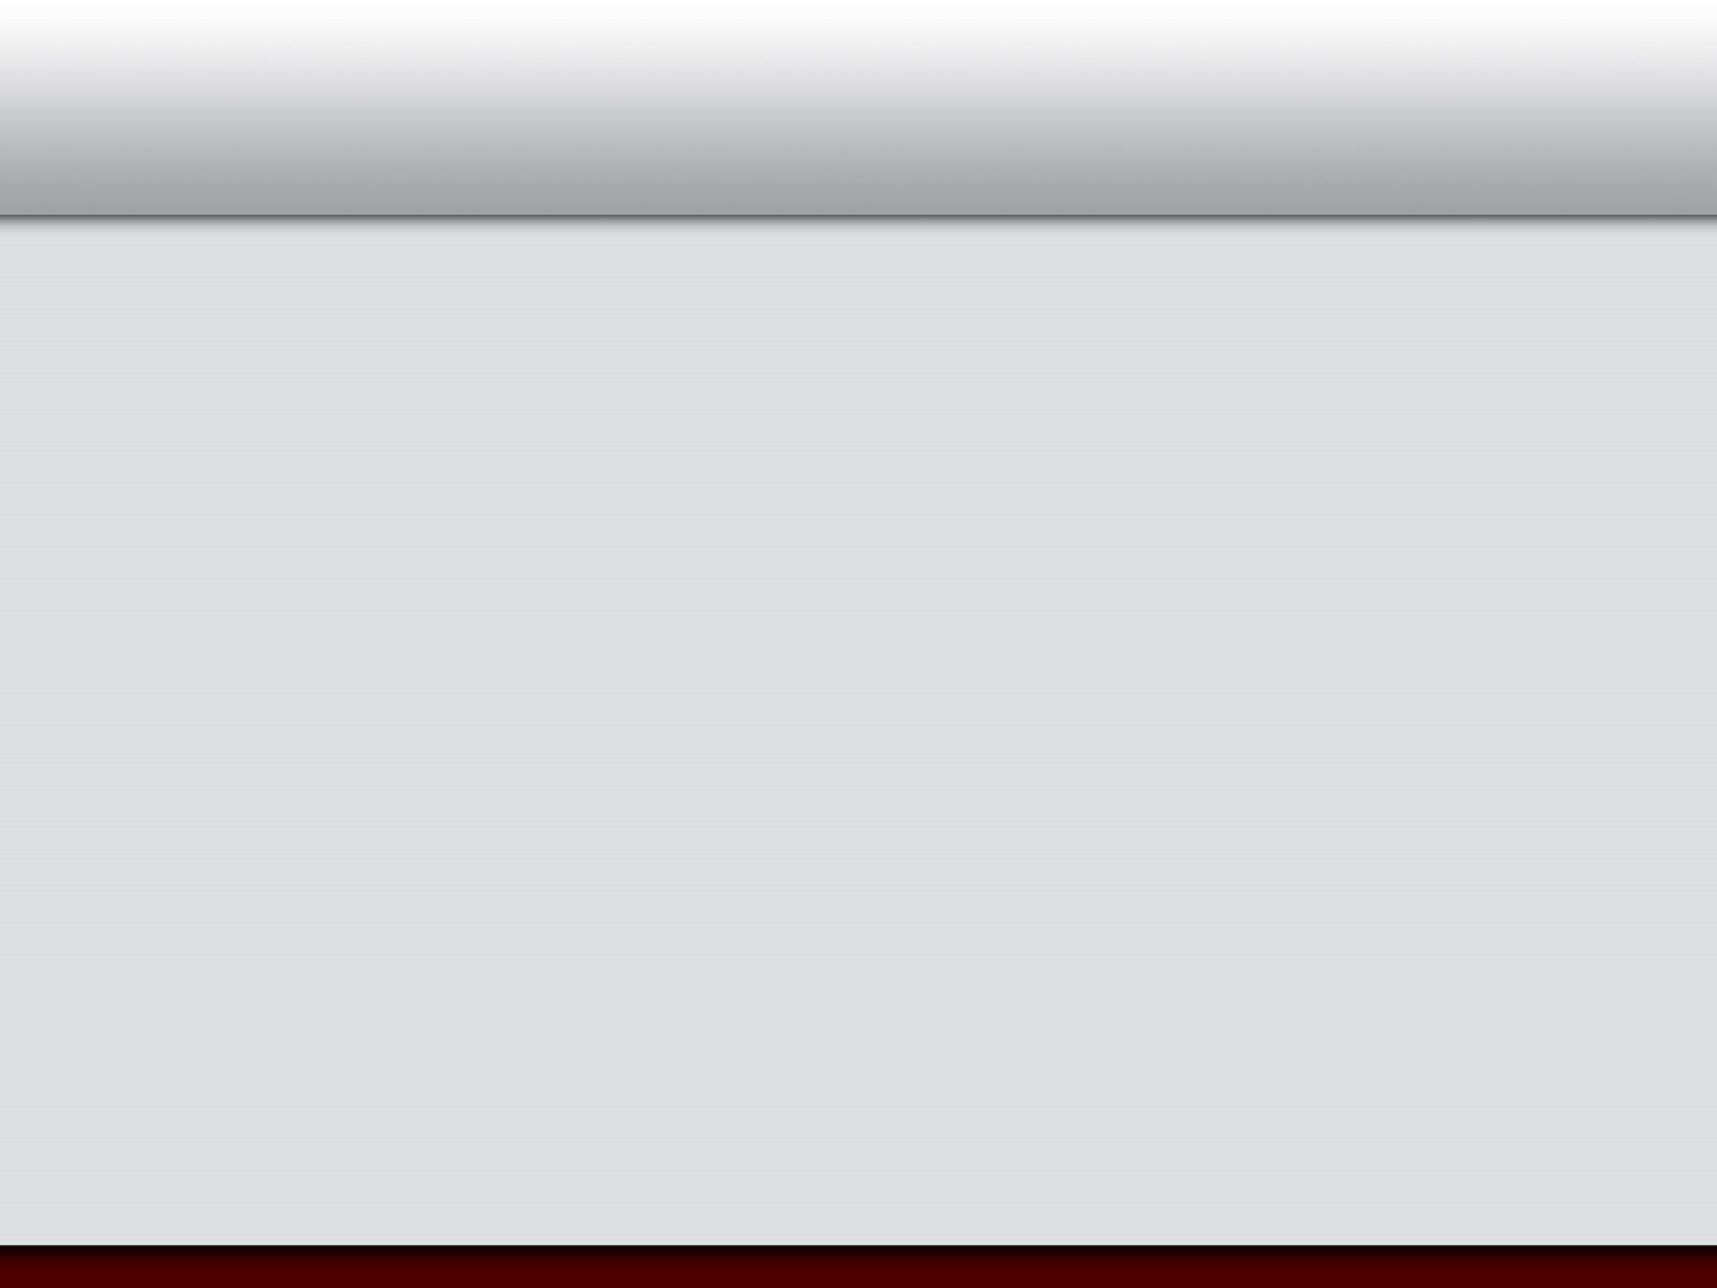


Social Genome: Putting Big Data to Work to Advance Society
Hye-Chung Kum
Texas A&M Health Science Center, Dept. of Health Policy & Management
University of North Carolina at Chapel Hill, Dept. of Computer Science
(kum@tamhsc.edu)
http://research.tamhsc.edu/pinformatics
Notes:
Hi, my name is Hye-chung.

Slide 2
Intro
PhD in computer science (data mining)
Minor: MSW (policy & management)
Primary appointment: HPM (15+ years: CS, SW, HPM)
Population Informatics Research Group
TAMU & UNC
Multidisciplinary: CS, HSR, SW, sociology
NSF Bigdata (cyberinfrastructure) DataBridge: A Sociometric System for Long-Tail Science Data Collections
TX HHSC: 1115 Medicaid Waiver Evaluation
NC DHHS: Management Assistance
NSF, google: Smart Diabetes Management
Privacy Preserving Interactive Record Linkage (PPIRL)-NIH BD2K
Notes:
Health & human services commission

Slide 3
Research Focus
Overarching question: How can we use the abundance of existing digital data, aka big data, (e.g. government administrative data, electronic health records) to support accurate evidence based decisions for policy, management, legislation, evaluation, and research while protecting the confidentiality of individual subjects of the data? This question focuses on the data science of using massive secondary datasets, a step before the traditional statistical methods can be applied to the data to address specific questions to improve public health.
Preferred approaches: Data Science - To build efficient and effective human computer hybrid processes and systems to clean, integrate, and extract actionable information from raw chaotic data and deliver accurate information in a timely secure manner to decision makers (e.g. researchers, policy makers, mangers, clinicians).
Primary data: Person level data, usually identifiable (so we can accurately integrate diverse data) at some point,
Primary issues: Privacy (safe data access), data integration, error propagation, audits, measurements, modeling
Velocity, variety, veracity, volume (lots of SMALL datasets)

Slide 4
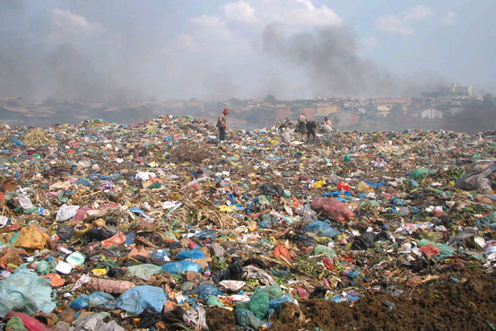




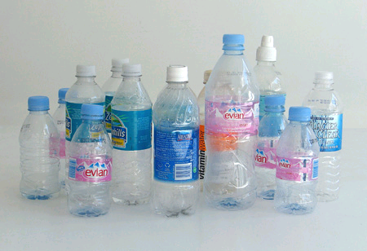
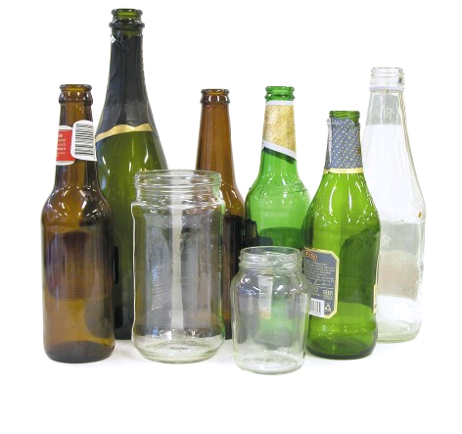
Data Science Knowledge Discovery & Data mining (KDD)
Big Data : impossible to keep organized
KDD
Clean, Merge, Reprocess
Human consumable, valid, novel, potentially useful,
and ultimately understandable information
Notes:
SIGKDD 1998

Slide 5
Actionable
Policy and Practice
Data Savvy
Managers
(Decision Makers)
Data Based Answers to
Real world Problems
Transformational Knowledge
Secure Federated Data Infrastructure
Federated administrative data, Linkable survey microdata
Other (Blog, Private company data, etc.)
Information
Broad new research Questions
Data Intensive
Domain Scientists
Frame Real World Questions
to Tractable Questions
Domain Knowledgeable
Computer Scientists
Methods
Datamining, Machine learning,
Artificial intelligence, Statistical methods, ABM
Social Genome Data Library
Population Informatics: The systematic study of populations via secondary analysis of massive data collections (“big data”) about people.
Kum, H.C., Krishnamurthy A., Machanavajjhala A., and Ahalt S. Social Genome: Putting Big Data to Work for Population Informatics. IEEE Computer Special Outlook Issue. pp 56-63. Jan 2014

Slide 6
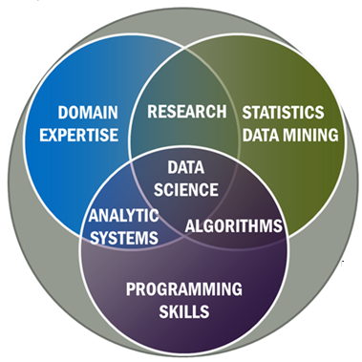
NIST Big Data Working Group

Slide 7
Agenda
What is Population Informatics ?
Social Genome
Privacy Challenges
Data Access
Case Study

Slide 8
Agenda
What is Population Informatics ?
Social Genome
Privacy Challenges
Data Access
Case Study

Slide 9
Social Genome ?
Today, nearly all of our activities from birth until death leave digital traces in large databases.
Together, these digital traces collectively capture the footprints of our society, our social genome
Like the human genome, the social genome data has much buried in the massive almost chaotic data
If properly analyzed and interpreted, this social genome could offer crucial insights into many of the most challenging problems facing our society (i.e. affordable and accessible quality healthcare, economics, education, employment, and welfare)
Notes:
Public health informatics=population informatics

Slide 10
Population Informatics ?
The burgeoning field of population informatics
The systematic study of populations via secondary analysis of massive data collections (termed “big data”) about people.
In particular, health informatics analyzes electronic health records to improve health outcomes for a population.
Challenges have constrained the use of person-level data (micro data) in research.
Privacy
Data Access
Data Integration
Data Management
Error Management and propogation
Notes:
Public health informatics=population informatics

Slide 11
Agenda
What is Population Informatics ?
Social Genome
Data Science
Privacy Challenges
Data Access
Case Study

Slide 12
Social Issues: Balance between
Individual privacy
Secrecy does not work very well : accuracy of data
Cost of integrity of data
Incorrect analysis that lead to can lead to wrong decisions
Organization transparency & accountability
Freedom of speech
Marketing is freedom to express why one should prescribe certain drugs
Marketing is freedom to send junk mail & call
Thus, getting more information to better target is acceptable and should be allowed

Slide 13
Approaches to privacy protection
Secrecy : Hiding information
Instinctive, common sense approach
In reality, has limited power to protect privacy
When someone is out to find out, there are multiple avenues, and the cost of trying to lock down data is too high for the limited protection it can provide
Very high cost related to
Accuracy of data, use of data for legitimate reasons, transparency
Information Transparency & Accountability
Disclosure : Declared in writing, so when something goes wrong the right people are held accountable (data use agreements)
Internet : crowdsourced auditing?
Logs & audits : what to log, how to keep tamperproof log
Financial social genome: credit reports

Slide 14

Differential Privacy Privacy is a BUDGET constrained problem
Differential Privacy proves each query leads to some privacy loss while providing some utility in terms of data analysis.
The goal is to achieve the maximum utility under a fixed privacy budget
Utility Privacy
Notes:
Second, it is important to understand that information privacy is a budget constrained problem as proven mathematically by privacy experts …that privacy and use of the data MUST be balanced.
The goal is to achieve the maximum utility under a fixed privacy budget. You can not assume unlimited privacy in the real world.

Slide 15
Privacy expectations for doing research
Contextual Integrity
Easier than business, surveillance
Confidential relationship between researcher and subjects of the data
In secondary data analysis no contact
IRB approvals based on (Belmont Report)
Benefit to society
Risk of harm
To individuals: privacy violation & inaccurate results
To society : inaccurate analysis resulting in wrong decisions
Notes:
DR. Ohno Machado

Slide 16
Information system requirements
Federal Information Security Management Act of 2002 (FISMA)
Integrity : correctness
Cost of incorrect information leading to incorrect decisions
Confidentiality : sharing information
Sharing what information with who for what purposes
Availability : access

Slide 17
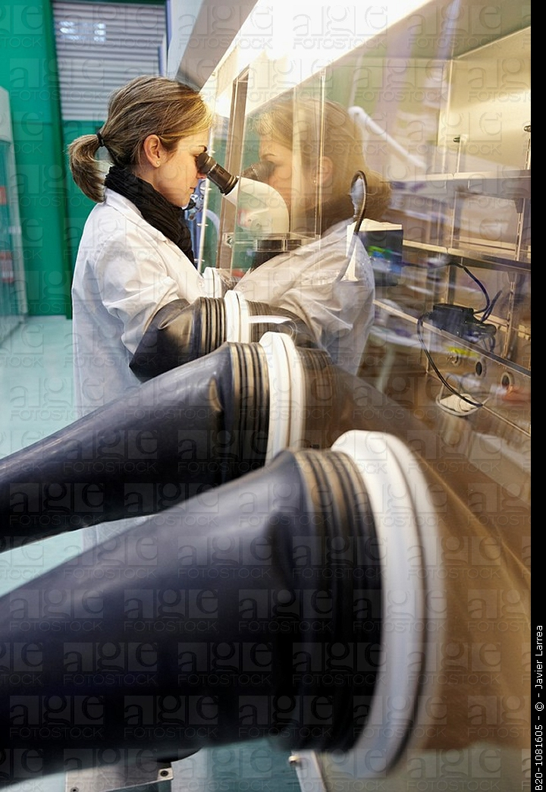
Privacy-by-Design
A different perspective on privacy and research using personal data
Personal Data is Delicate/Hazardous/Valuable
Important to have proper systems in place that give protection but allow for continued research in a safe manner
All hazardous material need standards
Safe environments to handle them in : closed computer server system lab
Proper handling procedures : what software are allowed to run on the data
Safe containers to store them : DB system

Slide 18
Design Principles
First, the Minimum Necessary Standard states that maximum privacy protection is provided when the minimum information needed for the task is accessed at any given time.
Second, the Maximum Usability Principle states that data are most usable when access to the data is least restrictive (i.e. direct remote access is most usable).
Based on common activities in the workflow, design systems that have maximum access to the minimum amount of information required
Combination of technology, governance, and transparency (operation)

Slide 19
Agenda
What is Population Informatics ?
Social Genome
Data Science
Privacy Challenges
Data Access
Case Study

Slide 20
Ethical & Controlled Repository Very clear transparency in the use of the data
Riskier Data Safer Data
Protection Usability
Restricted Controlled Monitored Open
Open Access: Summary statistics (open data)
Monitored Access: Register your research plan
Controlled Access: Approval by IRB
Risk of privacy violation vs. benefit to society
Restricted Access: Link data accurately
Notes:
It will have different level of access based on the risk of harm… Safe summary data is provided as open data under open access, while more sensitive data is provided as monitored, controlled, or restricted access depending on the potential for harm in using the data.
For such a vision to become a reality, there must be a shift in our understanding of privacy protection and accountability from using sensitive data for research.

Slide 21
WORKFLOW
Safe Platform for
Data to Decision

Slide 22
System of Access Models
Protection Usability
Restricted Controlled Monitored Open
Data Analysis Type I Analysis Type II Publish
Preparation (More sensitive data) (Less sensitive data)
More Protection More Usability
Raw Data Decision
Goal: To design an information system that can enforce the varied continuum from one end to the other such that one can balance privacy and usability as needed to turn data into decisions for a given task

Slide 23
The start …
Write up a research plan on
What data you need
What you want to do with them
Determine access levels for each data
Submit to IRB process

Slide 24
IRB: Risk of privacy violation vs. Benefit to Society
Risk of attribute disclosure
Group disclosure
Linkage attack using auxiliary information
Risk of identity disclosure
Given?
Kinds of data elements used in the study
Name/dob/cancer status/ etc… (are there $$)
What system the data resides in : HW/SW
Risk of outsiders intruding / insider attack / negligence
What can users do with the data on the system
Take data off / look at everything / only do limited queries

Slide 25

Restricted Access : Prepare the customized data
Decoupled Data (Kum 2012)
Automated Honest Broker SW
Sample selection
Attribute selection
Data integration (access to PII)
Some data cleaning
Full IRB
Example: RDC (TX census RDC)
Notes:
Need access to LOTS of data, often times include PII to prep
High risk to privacy

Slide 26
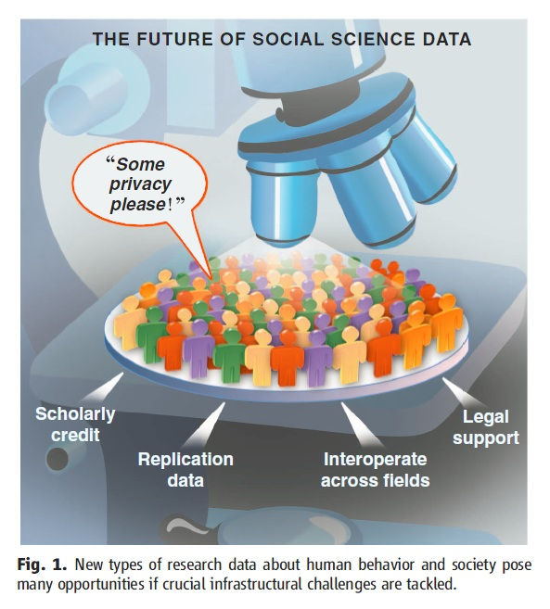
Controlled Access : Model using given tools
With approved deidentified data
Locked down VM: customized appliances
only approved software
Remote access via VPN
Very effective for threats from HBC
Full IRB
U Chicago-NORC , UNC-Tracs (CTSA), UCSD-iDASH, SAIL
Gary King. Ensuring the Data-Rich Future of the Social Sciences, Science, vol 331, 2011, pp 719-721.
Notes:
Delicate species (live, change and move as you observe), requires special handling, container (DBS) and environment (lab)

Slide 27
Monitored Access : Freely Repurpose
Information Accountability model
Exempt IRB: Explicit data use agreement (5 big Q)
Public online (crowdsource)
Any software & auxiliary data
Remote Access via VPN
Less sensitive data (e.g. Aggregate data)
SHRINE, Secure Unix servers
Gary King. Ensuring the Data-Rich Future of the Social Sciences, Science, vol 331, 2011, pp 719-721.
Notes:
Delicate species (live, change and move as you observe), requires special handling, container (DBS) and environment (lab)

Slide 28
Open Access : No restriction on use
Anyone : Publish information for others
No IRB
No monitoring use
Disclosure Limitation Methods (filter)
Sanitized data
Public websites, publications
Publish data use terms
Package with filter (disclosure limitation methods) & take out of lab
Gary King. Ensuring the Data-Rich Future of the Social Sciences, Science, vol 331, 2011, pp 719-721.
Notes:
Delicate species (live, change and move as you observe), requires special handling, container (DBS) and environment (lab)

Slide 29
Privacy Protection Mechanism
Protection Usability
Restricted Controlled Monitored Open
Access | Restricted Access | Controlled Access | Monitored Access | Open Access
Protection Approach | Physical restriction to access | Lock down VM (limit what you can do on the system) | Information accountability | Disclosure Limitation
Monitoring Use | All use on & OFF the computer is monitored | All use on the computer is monitored |  | Trust
IRB | Full IRB approved | Full IRB approved | IRB Exempt (register) | Terms of Use
R1:Crypto-graphic Attack | Very Low Risk | Low Risk. Would have to break into VM | High Risk | NA
R2: Data Leakage | Very Low Risk. Memorize data and take out | Physical data leakage (Take a picture of monitor) | Electronically take data off the system.

Slide 30
Comparison of risk and usability
Protection Usability
Restricted Controlled Monitored Open
 |  | Restricted Access | Controlled Access | Monitored Access | Open Access
Usability | U1.1: Software (SW) | Only preinstalled data integration & tabulation SW. No query capacity | Requested and approved statistical software only | Any software | Any software
 | U1.2: Data | No outside data allowed But PII data | Only preapproved outside data allowed | Any data | Any data
 | U2: Access | No Remote Access | Remote Access | Remote Access | Remote Access
Risk | R1:Crypto-graphic Attack | Very Low Risk | Low Risk. Would have to break into VM. | High Risk | NA
 | R2: Data Leakage | Very Low Risk. Memorize data and take out | Physical data leakage (Take a picture of monitor) | Electronically take data off the system. | NA

Slide 31
Use Published Data for Good Decision Making
Protection Usability
Restricted Controlled Monitored Open
Data Analysis Type I Analysis Type II Publish
Preparation (More sensitive data) (Less sensitive data)
More Protection More Usability
Raw Data Decision
Deployed together the four data access models can provide a comprehensive system for privacy protection, balancing the risk and usability of secondary data in population informatics research

Slide 32
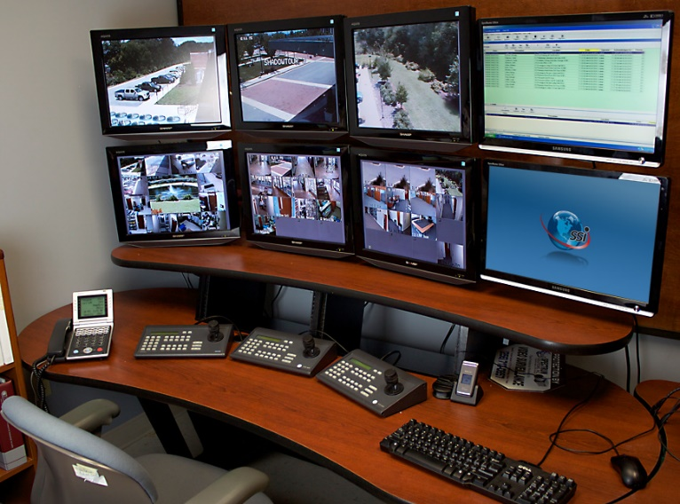

Take Away I Information Accountability Works
Secrecy : Hiding information
In reality, has limited power to protect privacy
Severe Consequences related to
Accuracy of data and decisions, use of data for
legitimate reasons, transparency & democracy
Information Accountability (Credit Report)
Very clear transparency in the use of the data
Disclosure : Declared in writing, so when something goes wrong the right people are held accountable (data use agreements)
IT WORKS! Primary method used to protect financial data
Internet : crowdsourced auditing (public access IRB)
Logs & audits : what to log, how to keep tamperproof log
D.J. Weitzner et al., Information Accountability, Comm. ACM, vol. 51, no. 6, 2008, pp. 82–87.
Notes:
First, information accountability is effective in privacy protection!
Although secrecy (limiting access) seems the instinctive method for best protection, in practice, secrecy has limited power for real protection. And yet it has severe consequences related to the accuracy of data and decisions, cost of use for legitimate purposes, as well as transparency and democracy. Many of us have experienced the difficulty of correcting a careless data entry error that has a taken weeks to fix.
In contrast, the financial sector has long been able to provide high level of protection on personal financial data, one of the most private information targeted by the most malicious cybercrimes today. Our credit history is our financial social genome which is well protected with a combination of technology and governance via information accountability.
Just as the financial sector has succeeded in providing protection through the use of secure computer software, the building of a safe environment, and increased governance and monitoring of how the data is collected and used, when social genome data libraries can take a similar approach these projects could facilitate the growth of population informatics as a revolutionary research tool to benefit our society

Slide 33
Take Away II Privacy is a BUDGET constrained problem
Differential Privacy proves each query leads to some privacy loss while providing some utility in terms of data analysis.
The goal is to achieve the maximum utility under a fixed privacy budget
Utility Privacy
Notes:
Second, it is important to understand that information privacy is a budget constrained problem as proven mathematically by privacy experts …that privacy and use of the data MUST be balanced.
The goal is to achieve the maximum utility under a fixed privacy budget. You can not assume unlimited privacy in the real world.

Slide 34
Take Away III Privacy Expectation for Doing Research
Consider the RISK of HARM versus BENEFIT to SOCIETY
Taking into account the COST
Individual privacy
Cost of integrity of data : bad data can lead to wrong decisions
Lost opportunity cost of no access to data
Organization transparency & accountability (democracy)
Value gained through obtaining timely, accurate, appropriate information for good decision making
Financial cost of data security measures
Transparent and accountable use of data
Notes:
Finally, personal big data is freely used for many undesirable purposes today. We should distinguish between using big data for research and these other purposes. The use of personal big data for research needs to consider the actual risk of harm, benefit to society, as well as the huge lost opportunity cost of not using big data for research.
We can do this the right way with control and accountability, just as we do in the credit report system
... by making the use of data very transparent.
It is time to reap the benefits of big data by conducting research with it for the greatest social benefit.

Slide 35
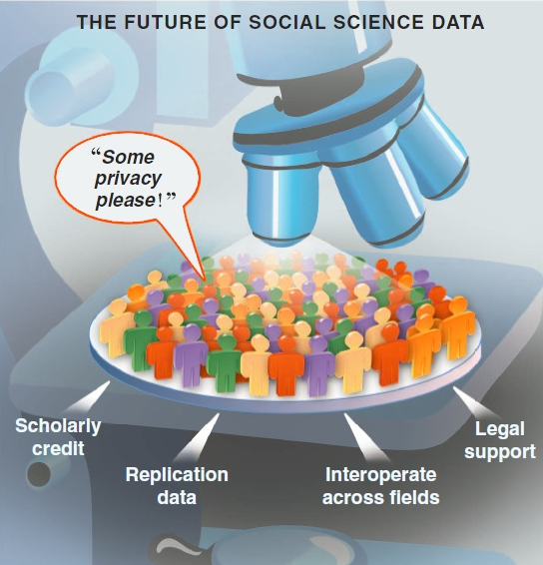
Will you donate your data to find a cure for cancer?
Notes:
Many donate blood for research. Will you donate your data for research?

Slide 36
Agenda
What is Population Informatics ?
Social Genome
Data Science
Privacy
Data Access
Case Study

Slide 37
Case Study Cancer care among the poor
Yung RL, Chen K, Abel GA, et al. Cancer disparities in the context of Medicaid insurance: a comparison of survival for acute myeloid leukemia and Hodgkin's lymphoma by Medicaid enrollment. Oncologist 2011;16(8):1082-91
Linked the New York central cancer registry with Medicaid enrollment and claims files to assess cancer care among the poor

Slide 38
Case Study
Work flow | Data Preparation (Data Integration and Selection) |  | Analysis of Micro (Person Level) Data
System | Conventional System | Proposed System | Conventional System | Proposed System
Model | Indirect Access via Health Dept. | Direct Restricted Access | Monitored Access | Controlled Access
Access | No direct access to data | Direct access to data | Remote direct access for authorized users
Type of Data | Multiple Identifiable Microdata Tables | Multiple Decoupled Microdata Tables | De-identified integrated microdata | De-identified integrated microdata with P(linkage)

Slide 39
Analysis of Risk and Usability
Data Preparation (Data Integration and Selection) | Analysis of Micro (Person Level) Data
Reduce risk significantly from insider attack by decoupling PII from the sensitive data | Reduce risk significantly from insider attack and malware in the proposed model by restricting activities on the VM, and running the VM in isolation from the host OS
increase data usability directly carry out record linkage data (attribute and sample) selection | increase data usability leading to more accurate analysis by propagating the error, probability of linkage, to the analysis phase.

Slide 40
Thank you! Questions?
Population Informatics Research Group
http://pinformatics.web.unc.edu/

Slide 41
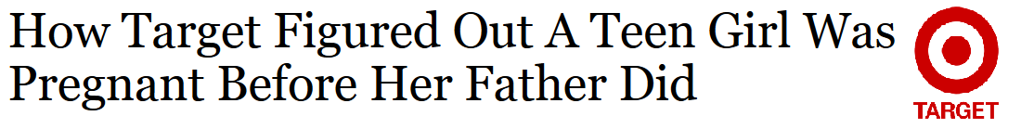
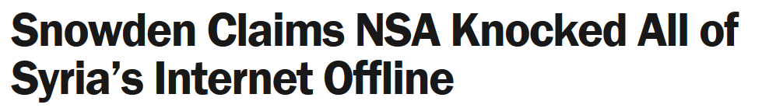
The Cost of the Digital Society
There is no turning back !
Personal information is already being used
Marketing: Target
Intelligence: Edward Snowden
Notes:
there is NO turning back…this is a digital world, and the information is out there… personal information is already being used for undesirable purposes with no transparency or control. We have already paid the cost of the digital society. Target and NSA know about you.

Slide 42

Why not reap the benefits too ?
Allocations of resources for education
What is the long term impact of moving to managed care ?
What effect does teacher pay in middle school have on college grades?
The answers could easily be derived from relevant data sets
Notes:
Isn’t it time we reap the benefits from big data as well?
The ability to answer questions about human populations in near real time using distributed datasets that are large, complex, and diverse has the potential to transform social, behavioral, economic, and health sciences.
The results could lead to more informed and effective policy decisions and allocations of public resources.
We can easily derive the answer to broad questions from relevant datasets such as ‘What is the long term impact of moving to managed care?’ or What effect does teacher pay in middle school have on college grades?
But it has to be done in the right way.

Slide 43
The Problem
Higher privacy standard and accountability
Difficult to access: Privacy/confidentiality
No neutral safe place to put it together
Requires more accurate results compared to recommending books
Error management
Lack Data management tools and expertise
Difficult to integrate: silo/scattered data
Difficult to clean data
Notes:
Research is, and should be held to a higher ethical standard.
It also requires more accurate results than is acceptable when recommending books.
So far, challenges associated with maintaining data privacy and confidentiality, data access, integration, and data management as well as error management have constrained the use of person-level data in these areas of research, leaving rich databases largely untapped.

Slide 44
The Power of the Social Genome

Our activities from birth until death leave digital traces in large databases

Digital traces capture our social genome, the footprints of our society

The social genome data are buried in the massive and chaotic data

It holds crucial insights into many of the most challenging problems facing our society (e.g. healthcare, education, economics)
Notes:
Social scientists have long drawn on data collections from governments and elsewhere to track demographic trends such as inflation and employment rates. However, now in the digital era, our daily activities from birth until death leave digital crumbs all over cyberspace,
Collectively, these digital traces—across a group, town, county, state, or nation—form a population’s social genome, the collective footprints of our society.
and we have the technology to gather and analyze these crumbs to obtain crucial insights into the most challenging problems in society such as healthcare, economics, and education.

Slide 45
The Impact: Population Informatics
Game changing research
Transform health and social sciences
Major impact on public policy and management
Easier and safer access to better data and tools
Improved security of sensitive data already on campus
Improved integration of data
At the price of running a public library
Source: Gary King. Ensuring the Data-Rich Future of the Social Sciences, Science, vol 331, 2011, pp 719-721.
Kum, H.C., Krishnamurthy A., Machanavajjhala A., and Ahalt S. Social Genome: Putting Big Data to Work for Population Informatics. IEEE Computer Special Outlook Issue. Jan 2014
Notes:
Population informatics is the burgeoning field at the intersection of social sciences, health sciences, computer science, and statistics that applies quantitative methods and computational tools to answer questions about human populations.
Social genome data can tell us about how people live, work, respond to change, and make decisions, and most importantly the collective impact of these individual decisions. Such insights help us understand the root causes of social and public health problems, predict the downstream effects of different policy options, and allocate our collective resources for the greatest impact.
Just as bioinformatics has revolutionized biological research, population informatics could catalyze significant advances in our understanding of trends in society, health, and human behavior.
Never before in history have we had more data to use for population research, however, privacy and confidentiality protection is critical to the success of population informatics research.
--------------------

Slide 46
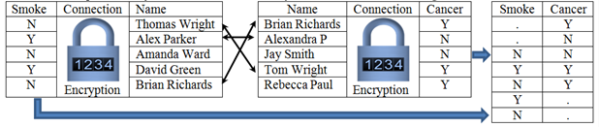
Privacy Preserving Interactive Record Linkage
Decouple data via encryption
Automated honest broker approach via computerized third party model
Chaffe to prevent group disclosure
Kum et al. 2012

Slide 47
AMIA: Population Informatics
Public Health Informatics is the application of informatics in areas of public health, including surveillance, reporting, and health promotion. Public health informatics, and its corollary, population informatics, are concerned with groups rather than individuals. Public health is extremely broad ... etc …
Population Informatics
Public Health Informatics
(Population
Health Informatics)
concerned with groups rather than individuals
Population Research
in Demography
(e.g. migration
patterns)
in Economics
(e.g. employment
patterns)

Slide 48
AMIA: Population Informatics
Public Health Informatics is the application of informatics in areas of public health, including surveillance, reporting, and health promotion. Public health informatics, and its corollary, population informatics, are concerned with groups rather than individuals. Public health is extremely broad ... etc …
Population Informatics
Public Health Informatics
(Population
Health Informatics)
concerned with groups rather than individuals
Population Research
in Demography
(e.g. migration
patterns)
in Economics
(e.g. employment
patterns)

