Slide 1
Phase I Analysis of High Dimensional Data Using Multivariate Control Statistics
ISEN 614: Advanced Quality Control Project
Team no. 2
Teja Gambhir (UIN: 525001619)
Pulkit Jain (UIN: 625005181)

Slide 2
Purpose
The purpose of this project is to conduct a Phase I analysis on a dataset with 209 characteristics and 552 observations with sample size of 1
The end goal is to establish control charts with in-control mean and covariance so that future observations can be monitored in Phase II analysis
To do so, multivariate statistical methods were used to isolate all out-of-control (OOC) data from the in-control (IC) data

Slide 3
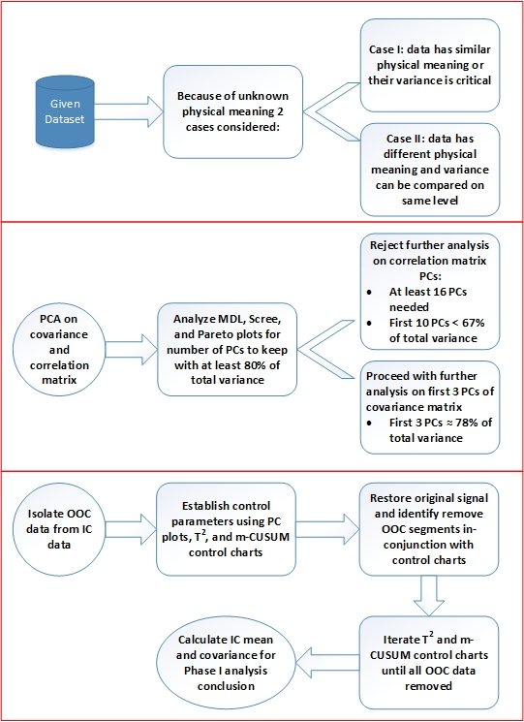
Approach
Because the physical meaning of the dataset was unknown, PCA was performed on the covariance and the correlation matrix
The number of PCs to retain had to account for close to 80% of the total variation for substantial representation of data
Since the total number of observations equal 552, the ARL₀ had to be substantially less in order to observe sufficient OOC points
Multiple iterations of the T² and m-CUSUM control charts were needed in-conjunction in order to ensure both control charts had all in-control data
Figure 1: Pictorial Summary of Approach

Slide 4
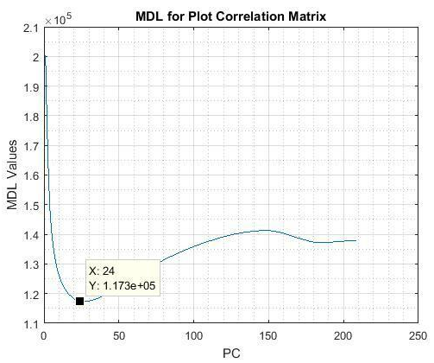
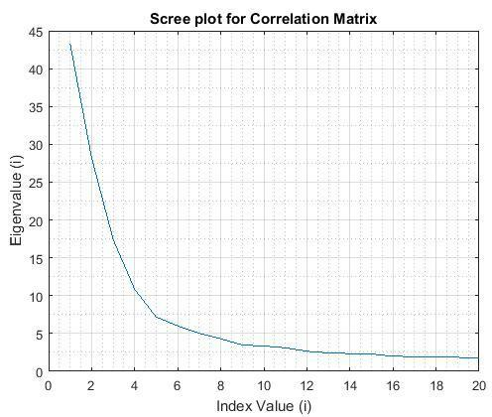
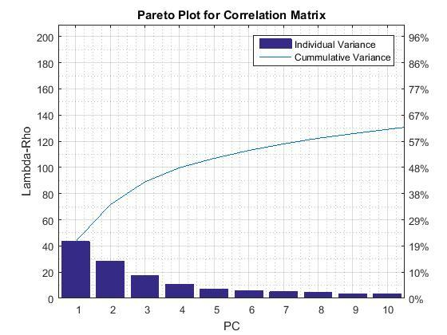
Principle Component Analysis of Correlation Matrix
Figure 2: MDL Plot for PCA on Correlation Matrix
Figure 3: Scree Plot for PCA on Correlation Matrix
Figure 4: Pareto Plot for PCA on Correlation Matrix
MDL plot retains 24 PCs, which is too many
Scree plot begins to level only after 16 PCs, but retaining 16 PCs is still too many
Pareto plot shows 10 PCs contribute less than 67% of the total variance
Because a total variance of around 80% is not reached with a small number of PCs, further analysis with the PCs for the correlation matrix was forgone

Slide 5
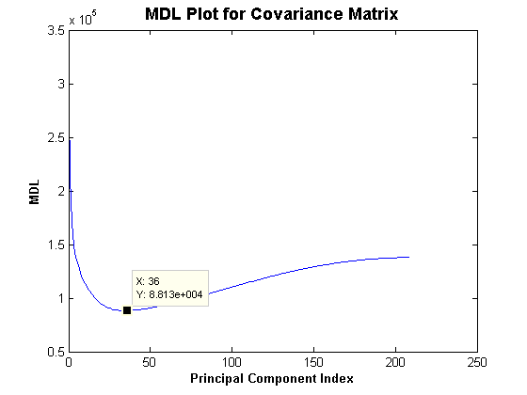
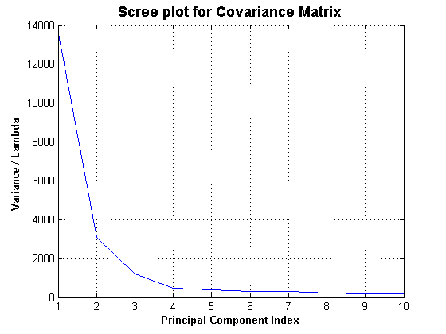
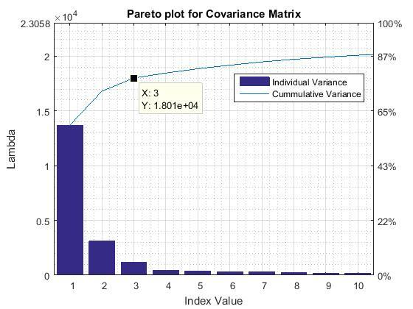
Principle Component Analysis of Covariance Matrix
Figure 5: MDL Plot for PCA on Covariance Matrix
Figure 6: Scree Plot for PCA on Covariance Matrix
Figure 7: Pareto Plot for PCA on Covariance Matrix
MDL plot retains 36 PCs, which is too many
Scree and Pareto plots show 3 PCs have a total variance of 78%, which approximately meets our criteria of a total variance of 80%
The first 3 PCs of the covariance matrix were chosen for further analysis

Slide 6
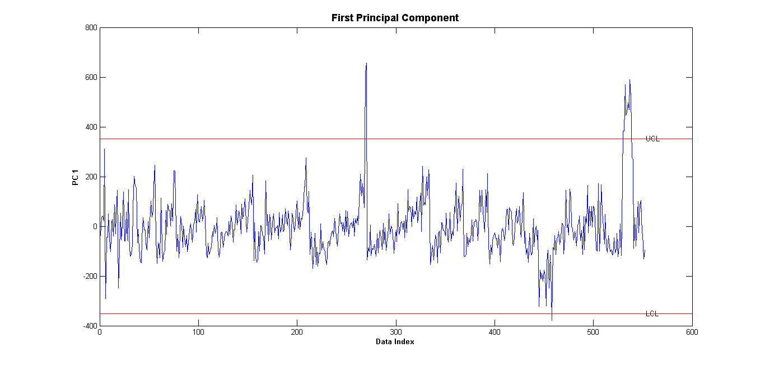
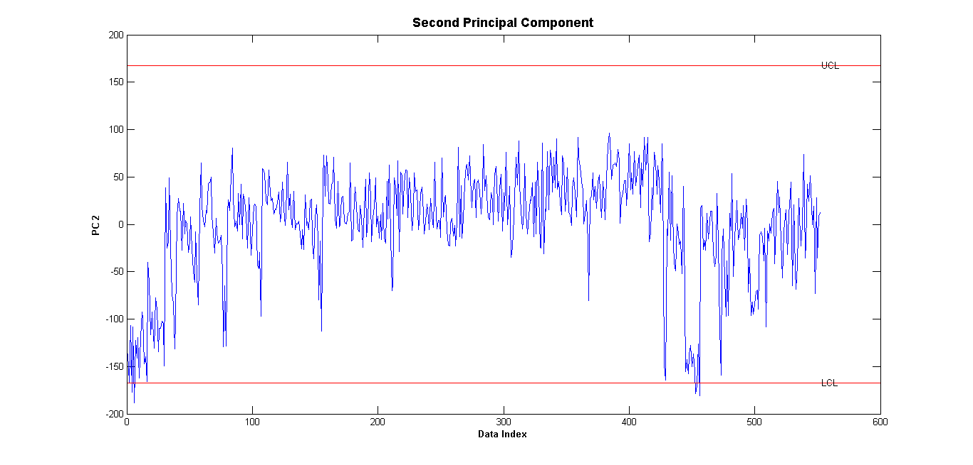
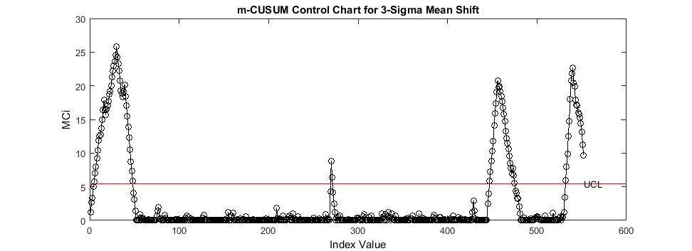
Establishing Control Chart Parameters: m-CUSUM
OOC data was observed on PC1 and PC2, but not on PC3
The first 38 points observed were OOC on PC2 and on the m-CUSUM for the 3-sigma mean shift
All three charts signaled for data points from 500 to 552
Because the m-CUSUM closely identifies the same OOC points as the PCs, a mean shift of 3-sigma was chosen instead of a mean shift of 2-sigma
Chosen parameters: ARL₀ = 200 and UCL = 5.48
Figure 8: PC1 for PCA on Covariance Matrix
Figure 9: PC2 for PCA on Covariance Matrix
Figure 10: m-CUSUM for 3-Sigma Mean Shift

Slide 7
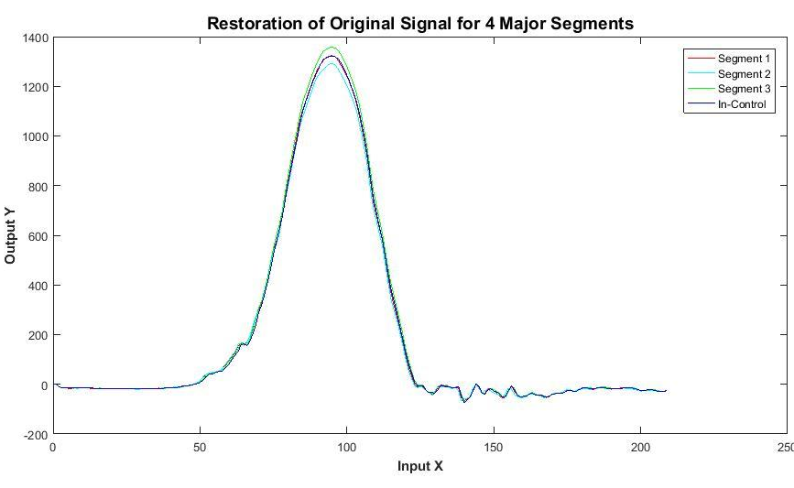
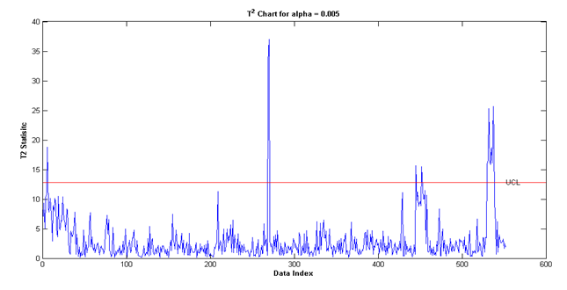
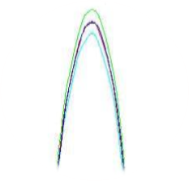
Establishing Control Chart Parameters: T²
Restoration of Original Signal Profiles
The T² chart was able to detect a similar trend because of its sensitivity to large, sustained mean shifts
An alpha of 0.005 was used corresponding with an ARL₀ of 200
Plot shows original profile signal for 3 OOC segments
The 4th segment shows the profile for the IC data points
Segment 3 and segment 2 deviate the most from the IC segment
Figure 11: T2 Control Chart for 3 PCs
Figure 12: Restoration of Original Signal Profiles for 4 Major Segments

Slide 8
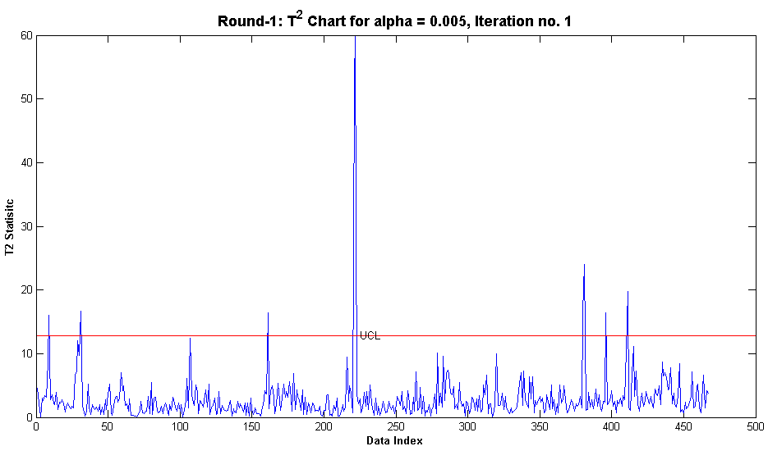
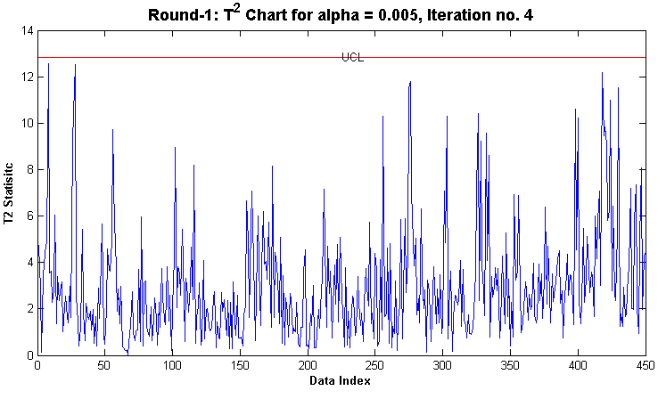
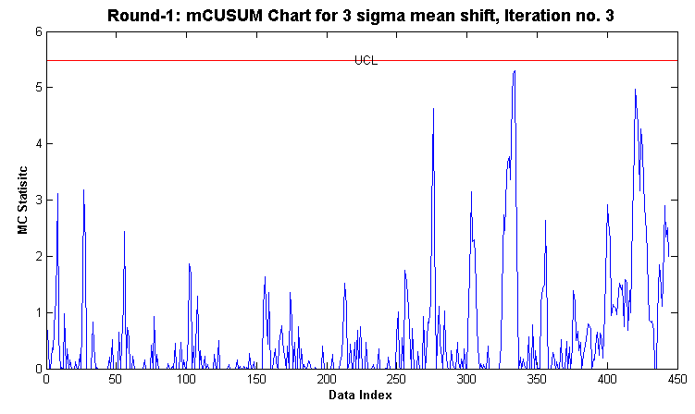
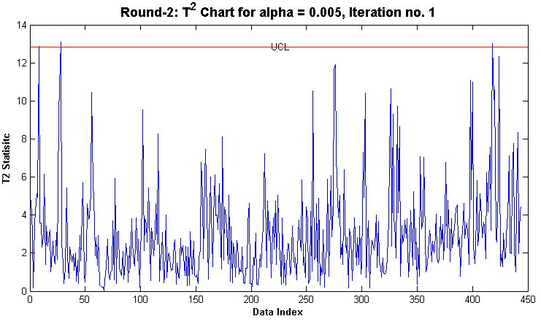
Isolate OOC Data from IC Data: T2 and m-CUSUM Iterations
The 1st round of T² was followed by the 1st round of m-CUSUM to establish IC points on both charts
The 2nd round of T² showed OOC points, so multiple rounds were needed for both charts to remove all OOC data points
T² and m-CUSUM Control Chart Out-of-Control Observations
Round | Control Chart | Iteration | OOC Points | Remaining Observations
One | T² | 1 | 9 | 458
 |  | 2 | 7 | 451
 |  | 3 | 1 | 450
 | mCUSUM | 1 | 5 | 445
 |  | 2 | 1 | 444
Two | T² | 1 | 3 | 441
 |  | 2 | 1 | 440
 | -CUSUM | 1 | 1 | 439
 |  | 2 | 1 | 438
Three | T² | 1 | 0 | 438
Figure 13: T² Round 1 Iteration 1
Figure 14: T² Round 1 Iteration 4
Table 1: OOC Points for Control Chart Iterations
Figure 15: m-CUSUM Round 1 Iteration 3
Figure 16: m-CUSUM Round 1 Iteration 4

Slide 9
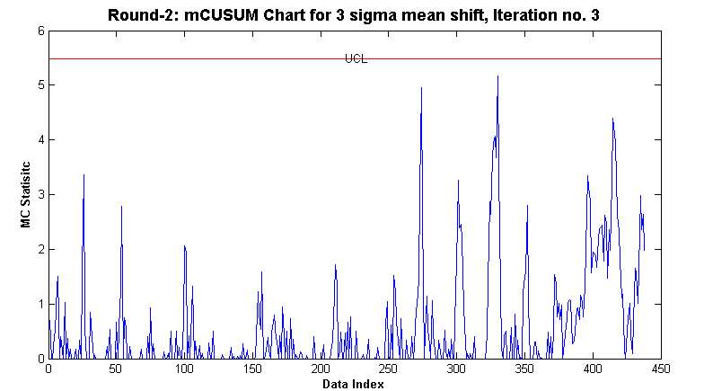
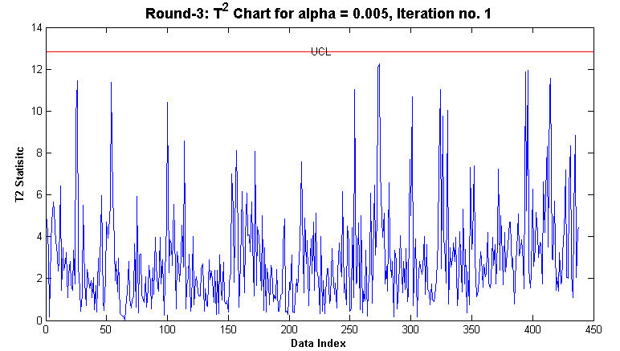

Results
After 3 rounds of iterations, all OOC data points were removed
A total of 438 observation out of the original 552 were found to be in control
In-control mean: $\left[\begin{matrix}\begin{matrix}11.27567 \\ 16.49829 \\ 5.62782\end{matrix}\end{matrix}\right]$
In-control covariance: $\left[\begin{matrix}5724.7 & 519.95 & −456.43 \\ 519.95 & 1180.8 & −354.18 \\ −456.43 & −354.18 & 1084.2\end{matrix}\right]$
Figure 17: m-CUSUM Round 2 Iteration 3
Figure 18: T² Round 3 Iteration 1

Slide 10
Conclusion
Isolating the OOC data from the IC data by doing multiple iterations of the T² and m-CUSUM control charts helped identify 6 more data points during the 2nd round of iterations that were OOC
Despite performing the PCA, the non-diagonal elements of the covariance matrix are non-zero, which implies the values are correlated and thus dependent
This may be attributed to noise, which made it difficult to achieve zero covariance
With the conclusion of Phase I analysis, the control charts established with the IC mean and covariance can be used to monitor future observations
This project forced us to rely on our own judgment and to rationalize all methods used, similar to a possible industry scenario
Having done the project we now have a better understanding of the relative advantages in utilizing one method over another

