Slide 1
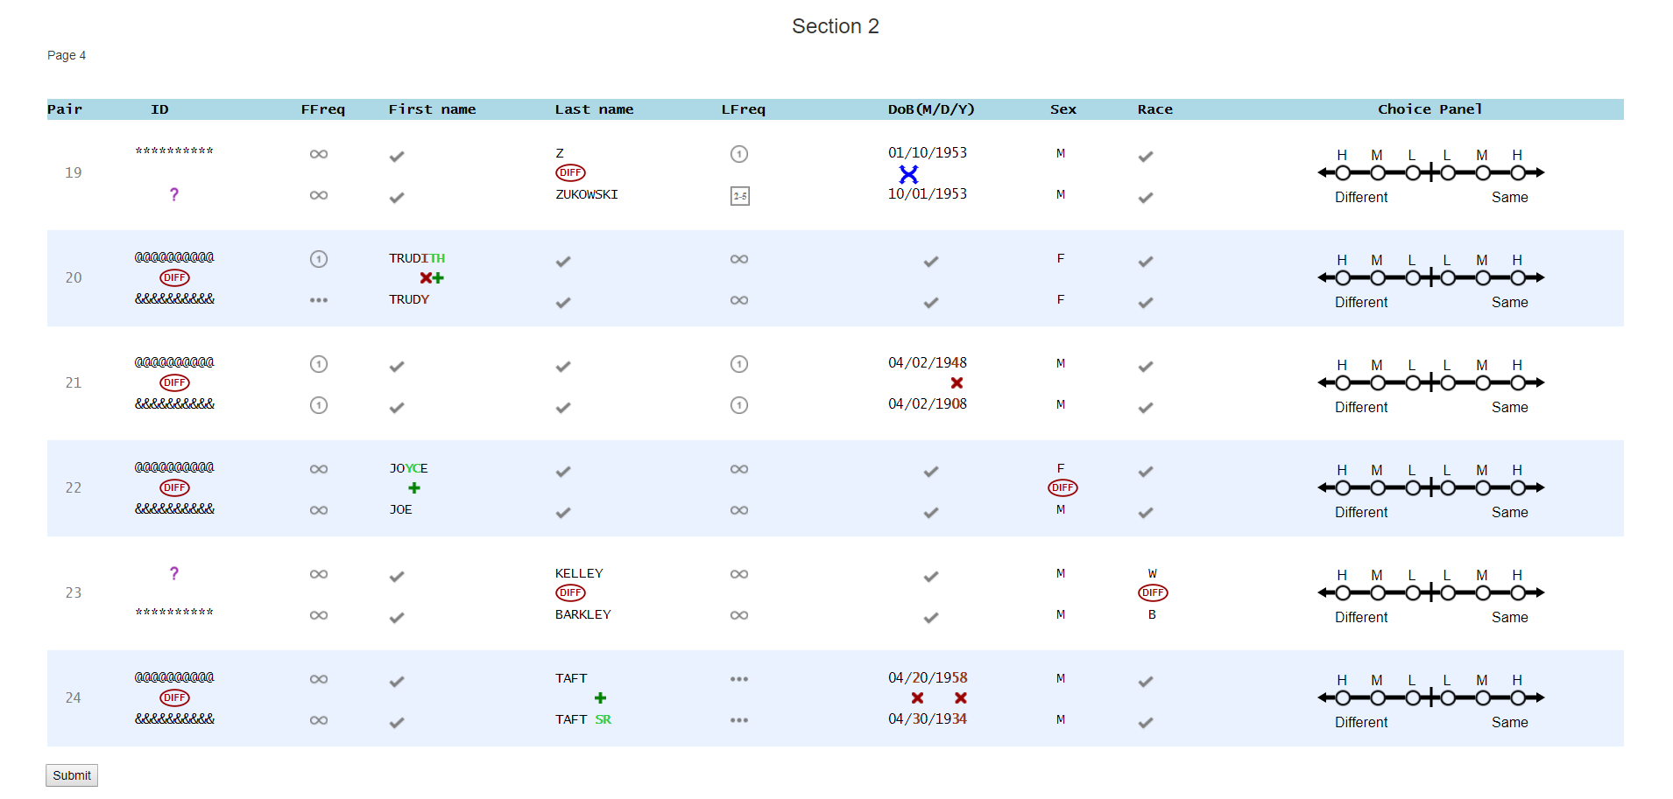

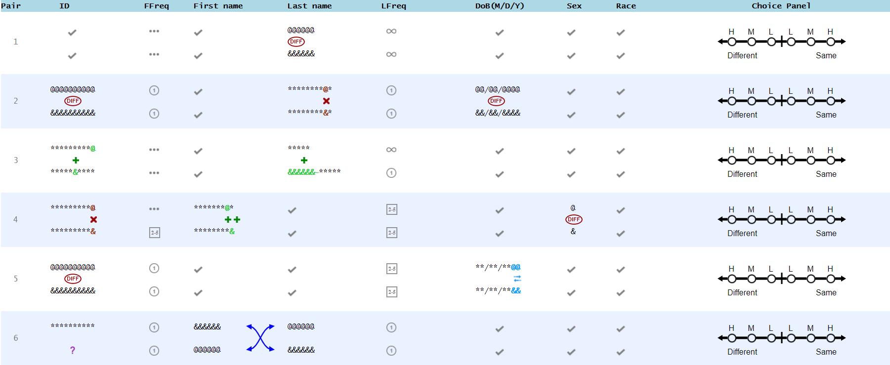
Ending the study
Notes:
“Can you answer the questions below correctly?” in the feedback

