Slide 1

deploSite
Pulkit Jain (PES1PG20CA037)
Guide : Dr Thenmozhi S

Slide 2
Abstract
Website deployment is easy for users who know it all , people like System Admins , Operations Engineers but is difficult for users who nowhere know the technical terms. Websites running on different tech stacks require distinct configuration and managing it all is complicated.
This is where deplosite comes into play . It is a set of configured instructions for distinct tech stacks where a user could choose a configuration, upload its website zip and host on a machine.
It makes website deployment a breeze.

Slide 3
Introduction
Problem Statement
A business that is doing well in the offline space which is in markets , surrowndings with
Restricted reach. The owner wants to increase its reach with a website that he has but
Is not able to find easy options where he can deploy the website . For him/her to be
Successful in Wider Market , the website has to be online but with current providers
this does’nt seem to be happening anytime soon.To understand what the the service
Providers are providing , one has to dig deep on each service’s terms and conditions ,
Dashboard and functionalities that they are bringing for the business.
A Business is concerned more about its operations than to mantaining a website.
This happens to be same with freelancers , portfolio managers and other users.

Slide 4
Introduction
Proposed Solution
Deplosite is a website , it offers all users from different profession to host website
Using its platform .
Deplosite will use s3 service from AWS for static site deployment. EC2 would be
Used for dynamic sites integrating with backends like Javascript , PHP , Python and
Databases like MySQL , mongoDb.
Each deplosite user could come , login to service and host multiple website

Slide 5
Introduction
Purpose
The main aim for project is to let users to have a working zip file containing
project assets and code , zip file Would be uploaded to service and can be seen hosted on AWS.
Scope
1) AWS S3 and EC2 for Deployment . Not open to other platforms
2) Fixed to deploying website , neither creating nor designing them
3) A single interface to carry out tasks
4) Works on provided set of Technologies

Slide 6

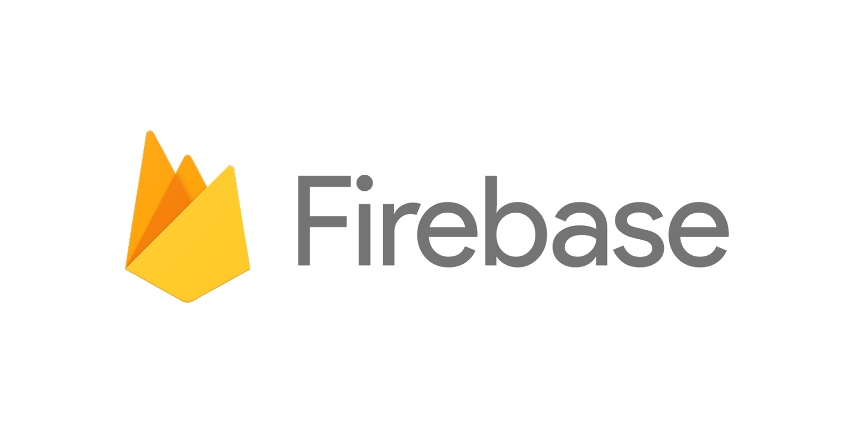






LITERATURE SURvey
Background Domain Study
AWS , Firebase Hosting , Netlify , GoDaddy , Hostinger , Azure , Heroku ,GCP and many other exists that Provides services to deploy websites . They have their infrastructure available and some services use available cloud infrastructure .
There are players like Firebase , Heroku , Netlify that provide free static site hosting , whereas other have Free tiers for a time period and paid subscription models.
This domain is cluttered with existing solutions . some providers provide full blown support for different Use cases like from databases , hosting solution , domain registry , blockchain , notification system ,Machine learning and Networking , whereas others are niche to their hosting domain.
This Photo by Unknown author is licensed under CC BY-SA.
This Photo by Unknown author is licensed under CC BY-SA-NC.
This Photo by Unknown author is licensed under CC BY-NC-ND.
This Photo by Unknown author is licensed under CC BY-SA.
This Photo by Unknown author is licensed under CC BY.

Slide 7
LITERATURE SURvey
Points | Firebase | Netlify | Microsoft Azure | GCP
Brief | Firebase provides serverless deployment models | Deploy modern static websites with CDN, | Both Microsoft Azure and Google Cloud Platform are same providing wide range of computing , storage and networking services
Pricing | Spark – Free with Limits Blaze – Pay as you go | Starter - Free Pro - $45 pm Business - $1500 pm | a free tier with minimal services, many more popular services for 12 months, and $200 credit to try any other paid service | a free tier with some basic services that are always free and a $300 credit to try other services
Features | Hosting , Realtime Db ,Cloud Functions , ML and analytics | Static website deployment | Storage - Azure provides a well-rounded set of storage services and features, but can have a steep learning curve .Compute – GCP has flexible pricing and big kubernetes support .Networking – Both competetive in this domain
Usability | Suited for serverless ,users who want working without backends | Best for Static Hosting only or web apps build on SPA | Storage Services , Ultra Disk SSD with up to 2GB/second, 1.6m IOPS | Kubernetes Containers and SDK for Mobile and Web Platforms

Slide 8

Hardware & Software Requirements
Javascript
Python
Linux OS
HARDWARE:
System : intel i3/i5 2.4 GHz.
Hard Disk : 256 GB.
Ram : 4 GB

Slide 9
SYSTEM ANALYSIS
Functional Requirements
Statistics Monitoring
Automatic Configuration
Management
Wide Options from Static Sites to Dynamic Sites (PHP,Python,JS )

Slide 10
Non Functional Requirements
Usability
Wide Range of Options
Unlike services which stick to a platform , deploSite gives various running environment.
Supportability
Automatic Instantiations of Hosts
Static sites could be given a namespace with routes on same host. Dynamic sites will require a new host.
Reliability
Programmatic Configuration of S/W
Manual and repetitive tasks are time consuming , same are reduced with scripting tools

Slide 11
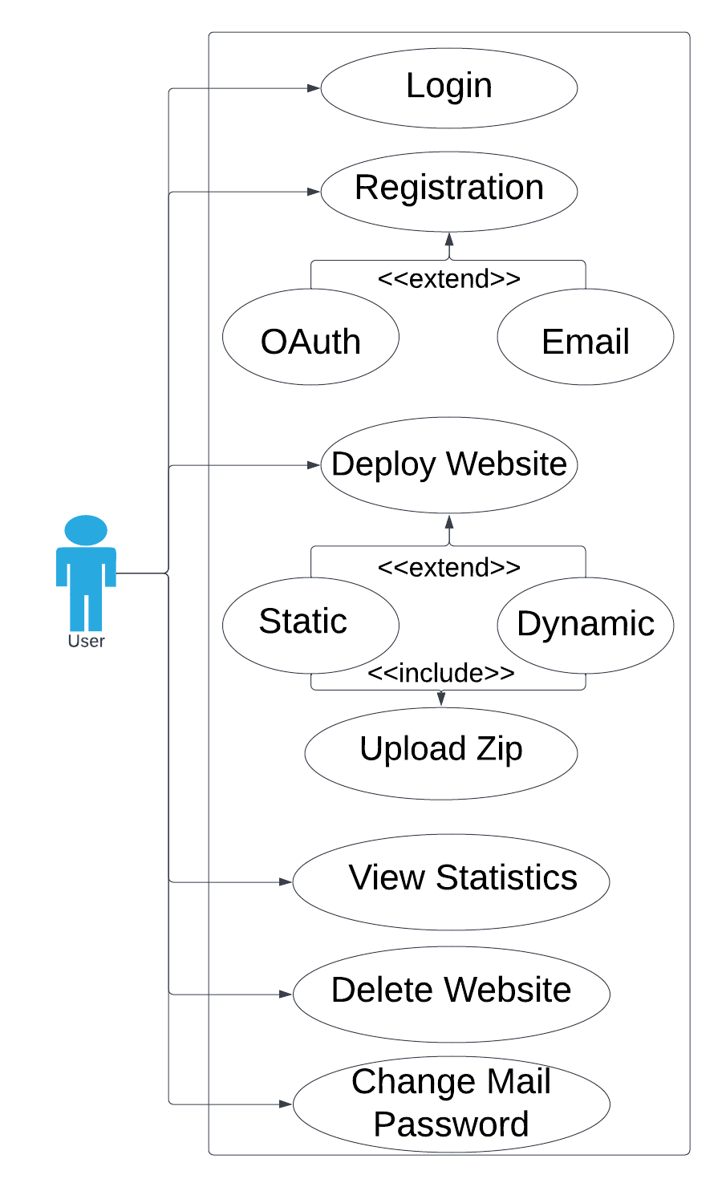
Diagrams
Use Case Diagram

Slide 12
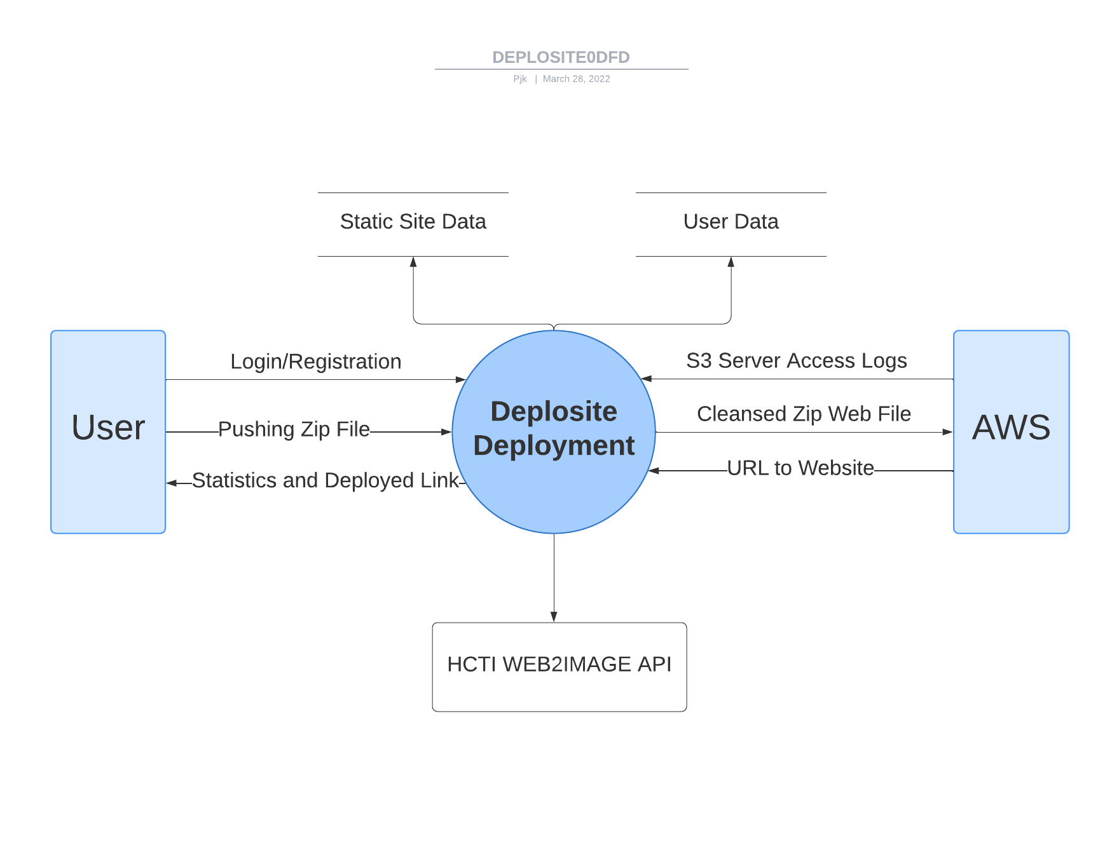
Diagrams
DFD Level 0 Diagram

Slide 13
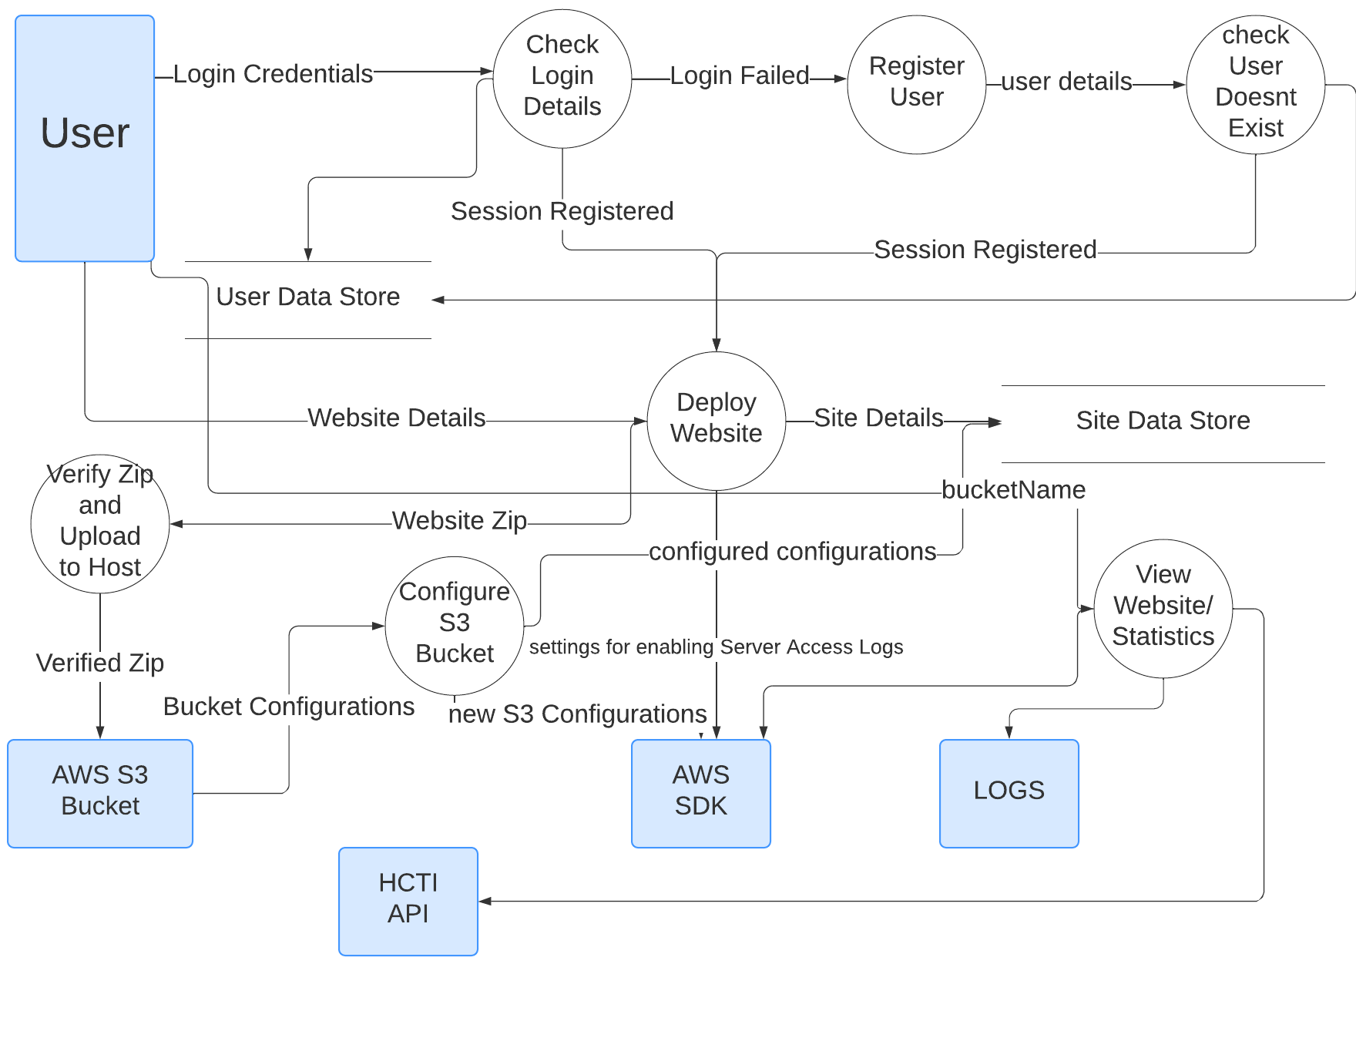
DFD Level 1 Diagram

Slide 14
Document Structure
Diagrams
Document Structure
User Collection :
{
_id : ObjectId,
Username: String,
Email: String,
Password: String
}
Site Collection :
{
_id: ObjectId,
UserRef: Referential Object Id,
Title: String,
Root: String,
Error: String,
Desc: String,
BucketName: String,
Url: String,
Img: String,
Date: Date
}

