Slide 1
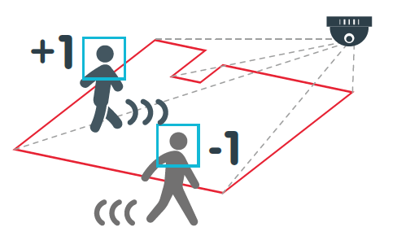
REAL-TIME CROWD DETECTION ANALYTICS IN TRADING OUTLETS
Academic Year 2021 – 22

Slide 2
DEPARTMENT OF COMPUTER SCIENCE
Under the Guidance
OF
Dr SARAVANAN K N
2

Slide 3
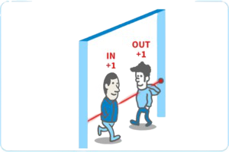
AGENDA
PROBLEM STATEMENT
OBJECTIVES
DATA SET DESCRIPTION
PROJECT WORKFLOW & FLOW CHART
ER DIAGRAM & DATA FLOW DIAGRAM
ALGORITHMS
USER INTERFACE DESIGN
DEMONSTRATION
3

Slide 4
PROBLEM STATEMENT
Trading Outlets like Shopping Malls, Restaurants, etc., are more prone to spread COVID
2. People visiting store want themselves to be safe
3. Outlets want to manage the crowd accordingly
4. People need a mechanism where they get to know
how many people are already present in outlet.
(no such mechanism till now exists)
4

Slide 5
OBJECTIVES
Counting The Number Of People Currently Present In The Outlet
Real-Time Crowd Count Statistic On Website
Gender And Age Estimation
Helping Outlets In Handling Crowd Management
Helping Public to make an Informed Decision
5

Slide 6
DATA SET DESCRIPTION
IN REAL TIME
Live CCTV footage of the entry and exit gates of the outlet
FOR THE SPECIALIZED PROJECT
CCTV videos from YouTube
Downloaded them offline for Project implementation and demonstration purposes
6

Slide 7
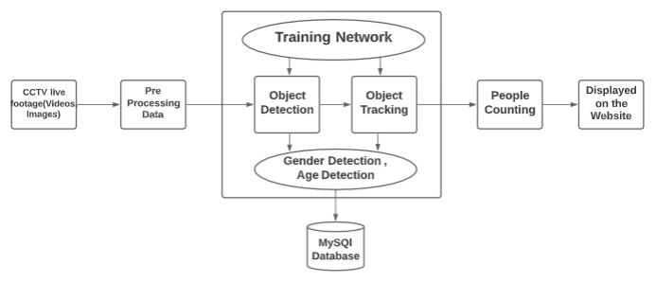
PROJECT WORKFLOW
7

Slide 8
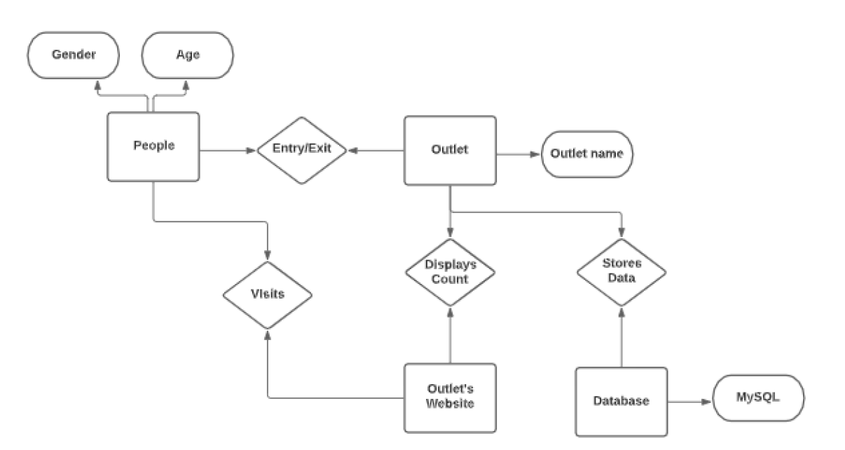
ER DIAGRAM
8

Slide 9
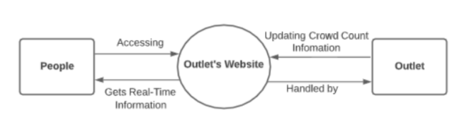
DATA FLOW DIAGRAM (Level 0)
9

Slide 10
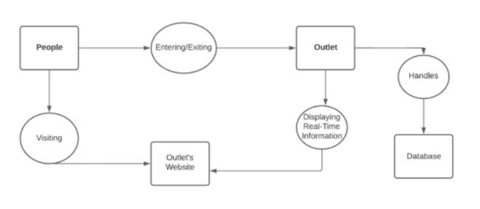
DATA FLOW DIAGRAM (Level 1)
10

Slide 11
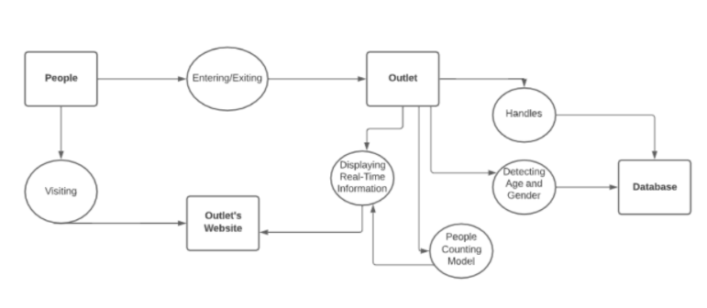
DATA FLOW DIAGRAM (Level 2)
11

Slide 12
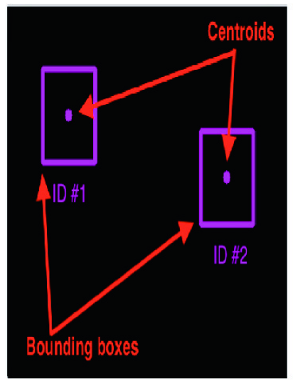
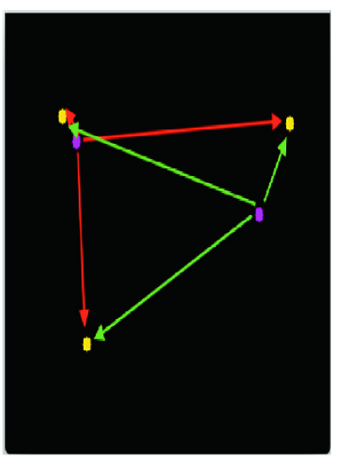
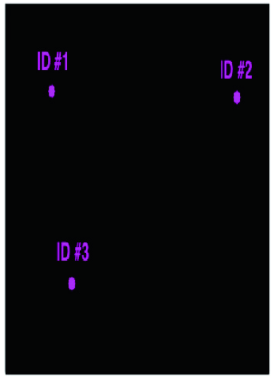
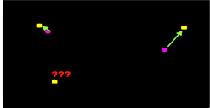
ALGORITHMS
1. Object Tracking - Centroid Object Tracking Algorithm
12

Slide 13
ALGORITHMS
2. People Counter System - People Counting Algorithm
13

Slide 14
LIBRARIES & WEB TECHNOLOGY TOOLS
OpenCV - Standard computer vision/Image processing functions
Dlib - Implementation of correlation filters / correlation tracker implementation
Imutils - OpenCV convenience functions
Numpy - Comprehensive Mathematical Functions
Front-end Technology (HTML , CSS , Bootstrap)
Back-end Technology (Django)
Database (MySQL)
14

Slide 15
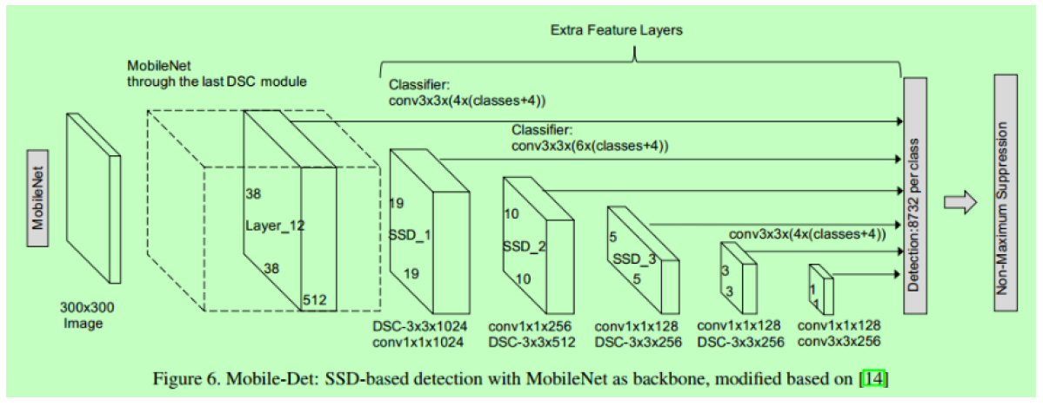
PRE-TRAINED CAFFE DEEP LEARNING MODELS
MobileNet SSD(Single-Shot Detector)
15

Slide 16

USER INTERFACE DESIGN
Fig: Home page design of the website
Fig: Home page design of the website
Fig: Home page design of the website
16

Slide 17
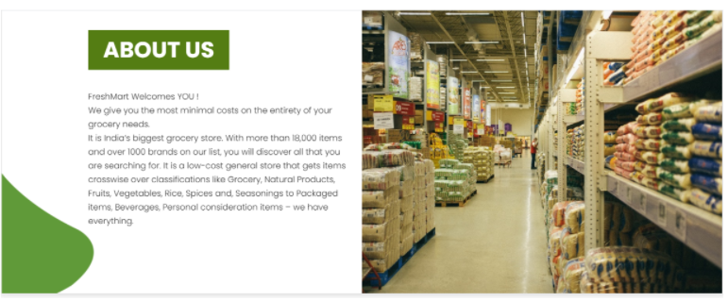
17

Slide 18

18

Slide 19

19

Slide 20

20

Slide 21
DEMONSTRATION
OF
PROJECT
21

Slide 22

22

