Slide 1
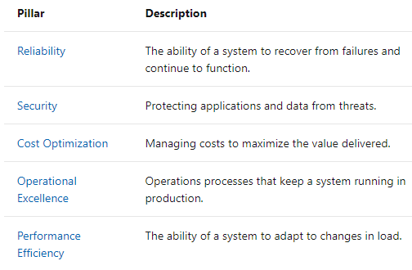
Microsoft Well-Architected Framework

Slide 2
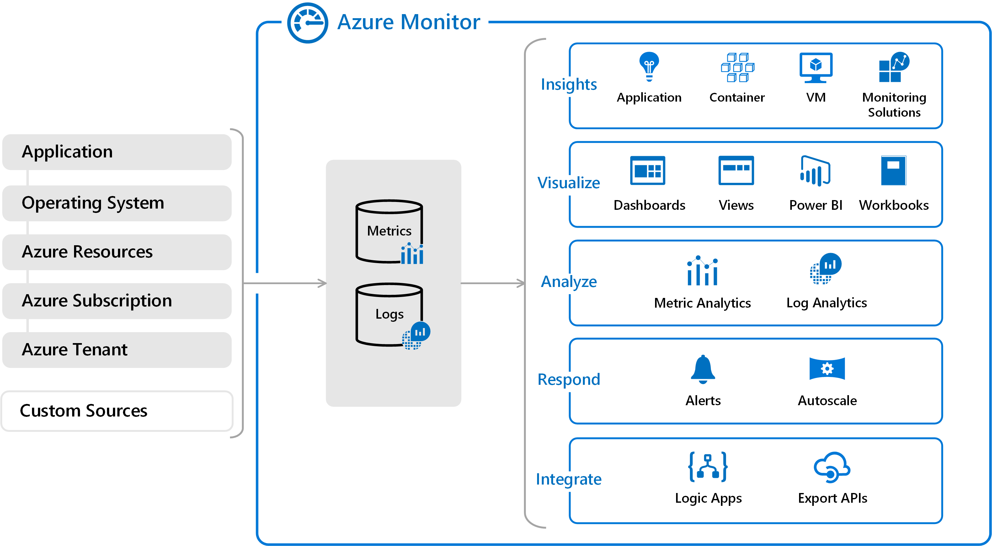
Azure Monitor

Slide 3
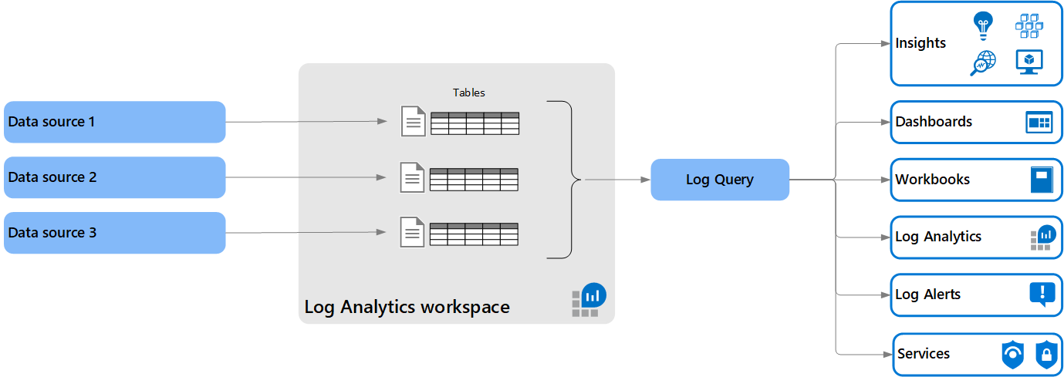
Log Analytics

Slide 4
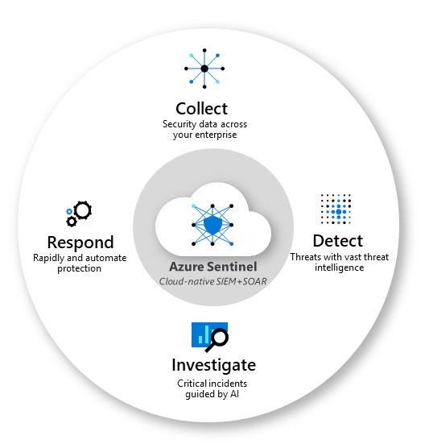
Sentinel

Slide 5
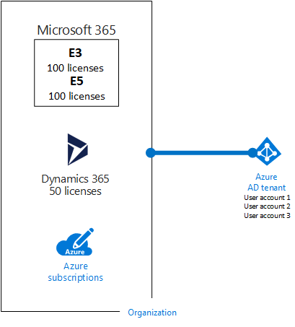
Tenant vs. Subscription

Slide 6
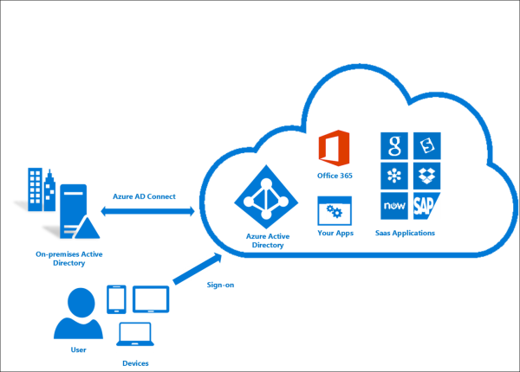
Hybrid Identity

Slide 7
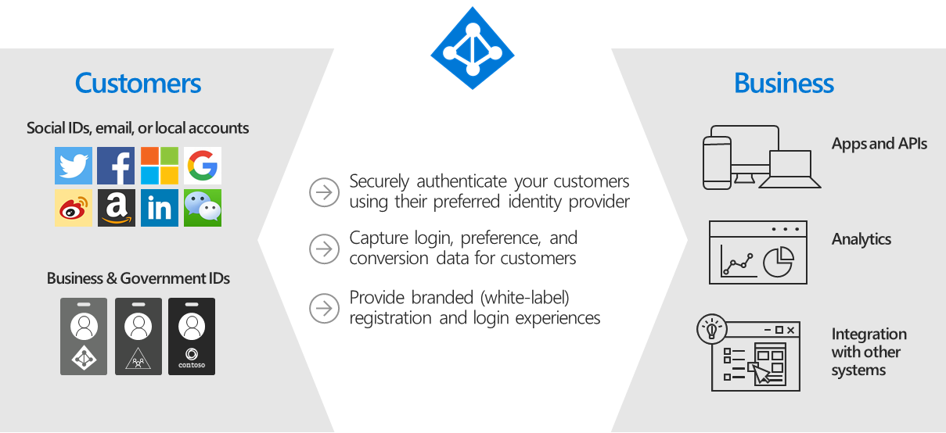
Azure AD B2C

Slide 8
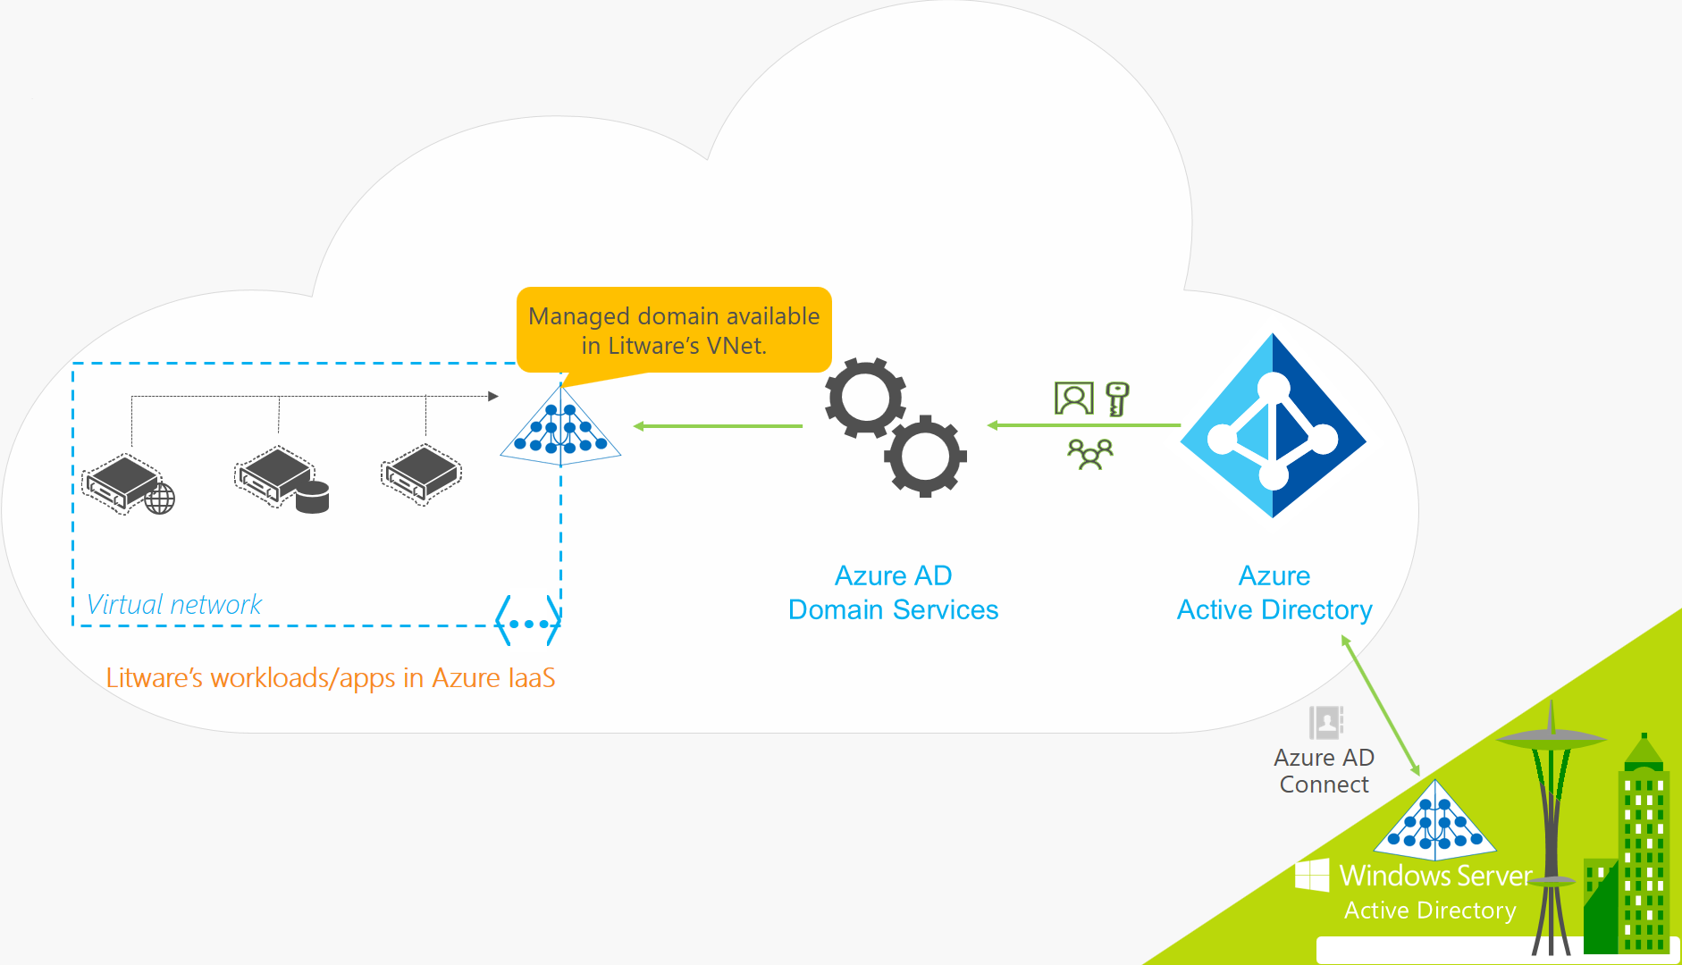
Azure AD Domain Services

Slide 9
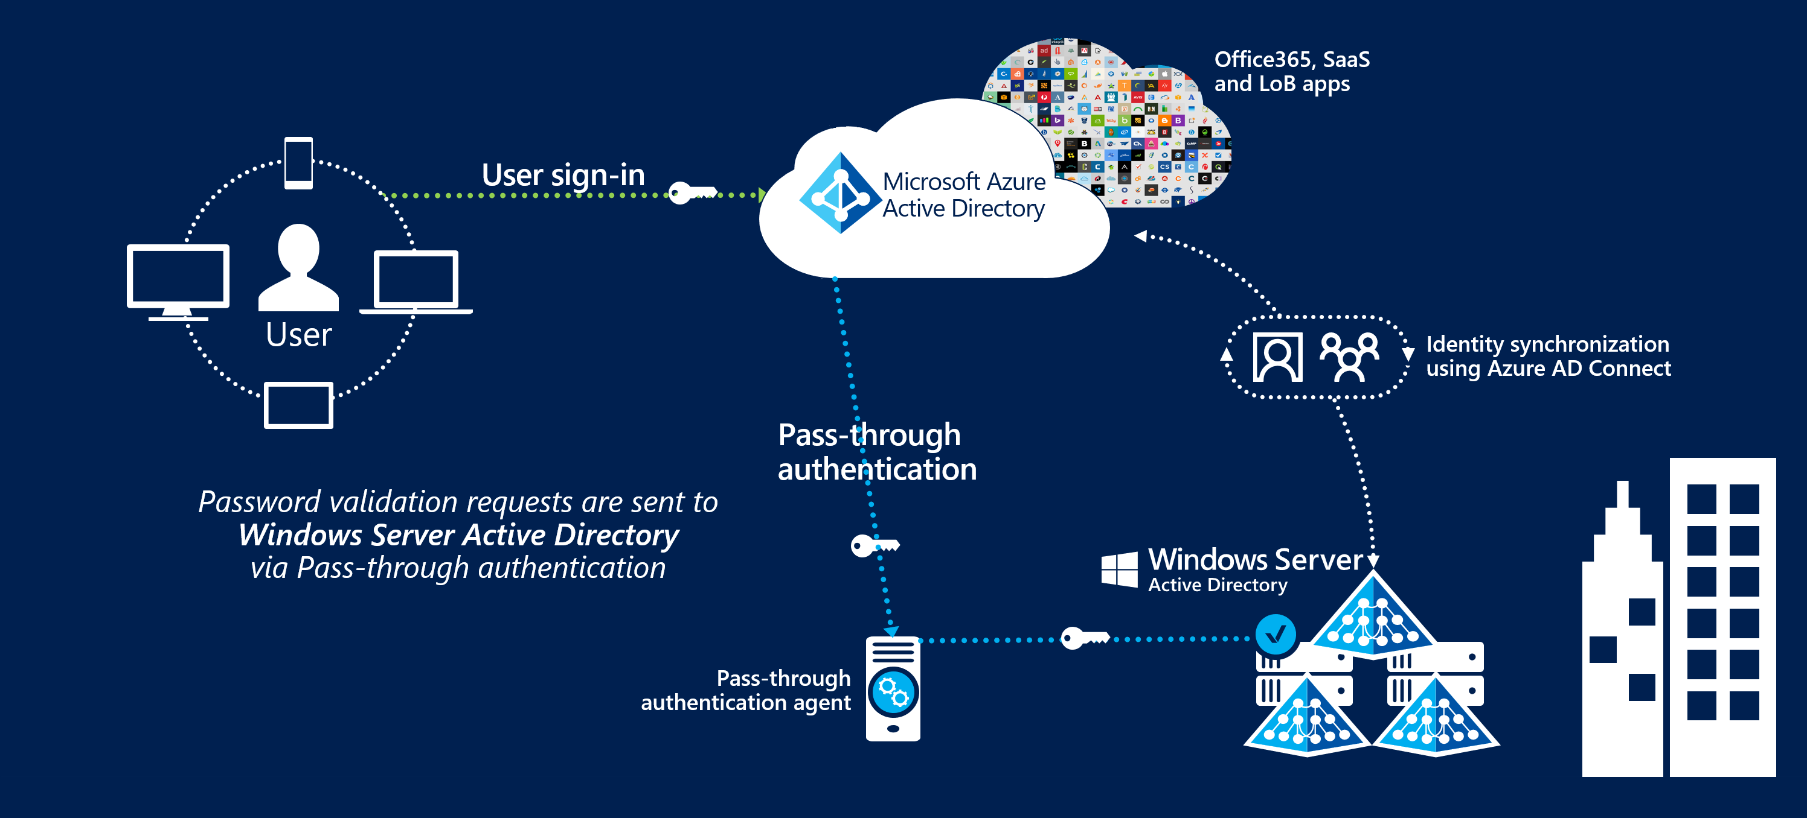
Pass-through Authentication

Slide 10
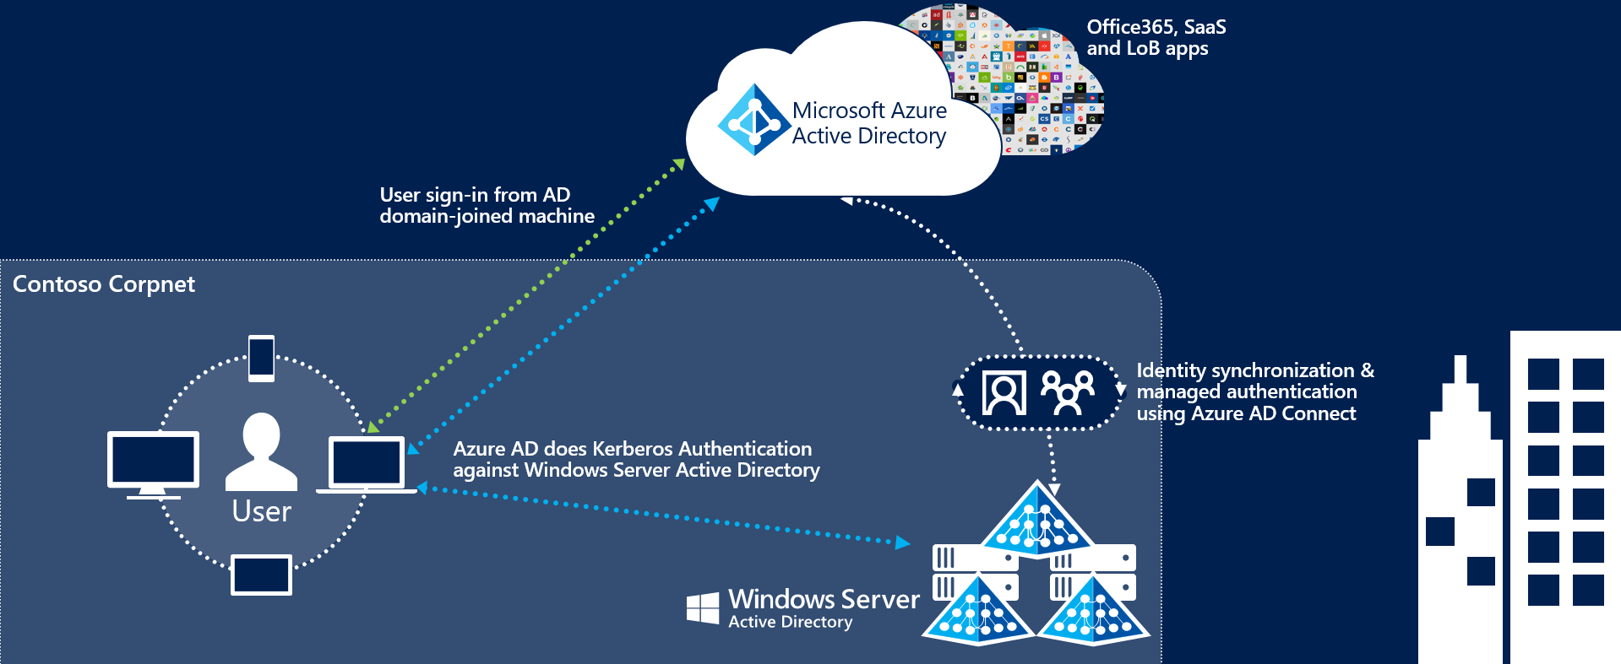
Seamless Single Sign-on

Slide 11
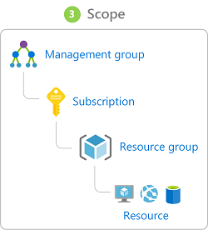
Azure Management Scopes
/ Tenant Root

Slide 12
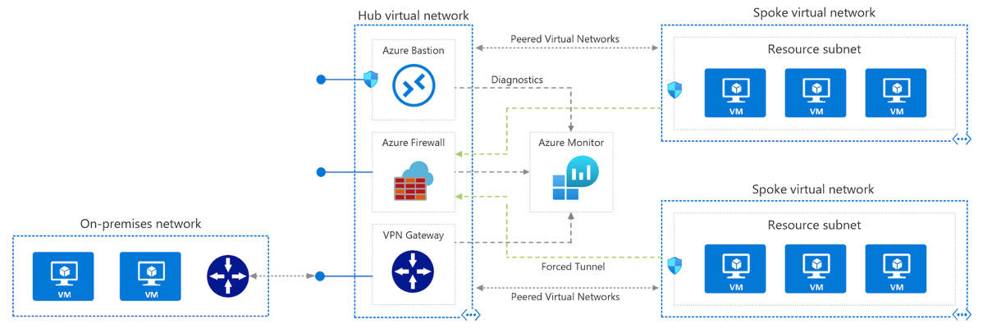
Azure VNet Hub-Spoke

Slide 13
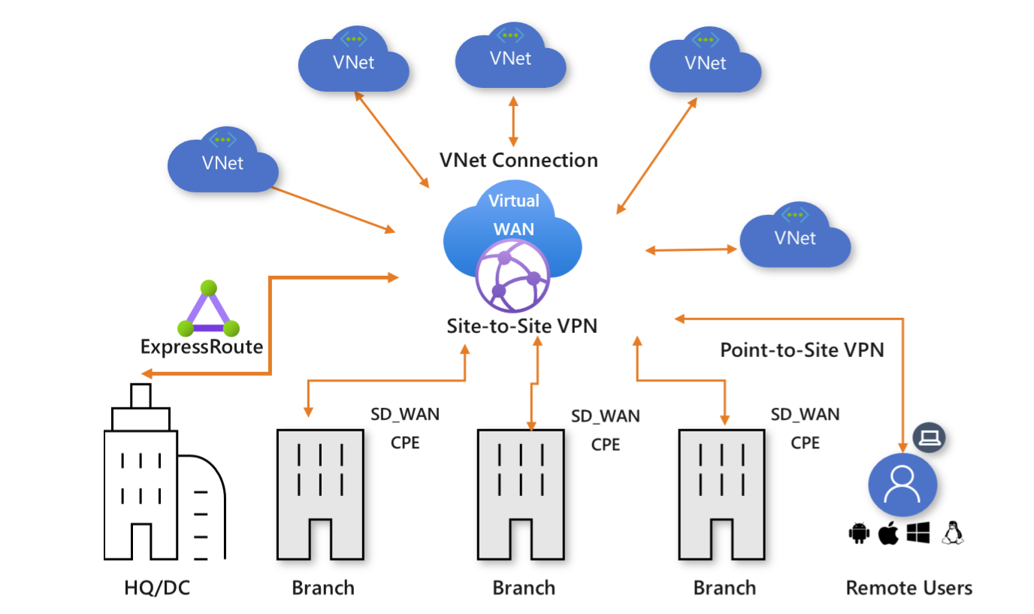
Azure Virtual WAN

Slide 14
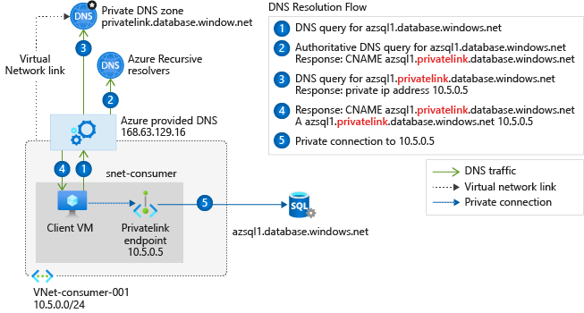
Private Link DNS Configuration

Slide 15
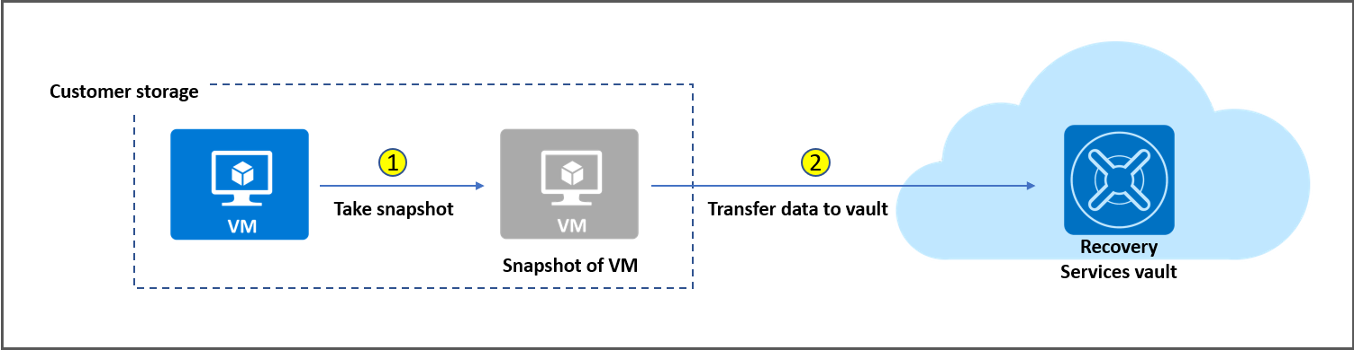
Azure Backup

Slide 16
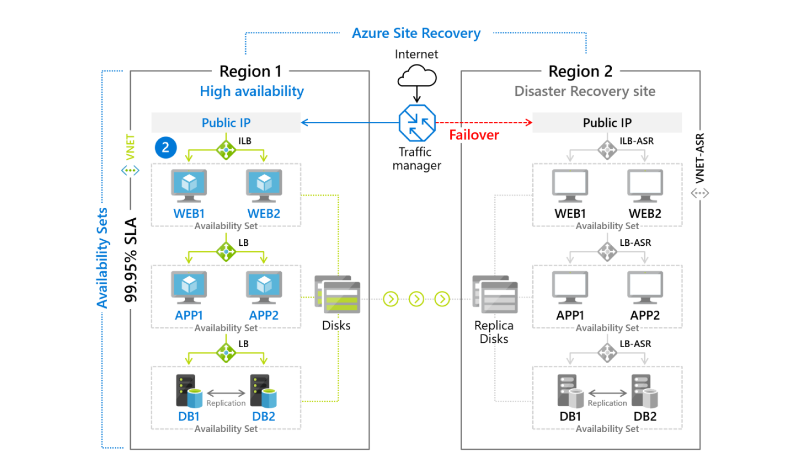
Azure Site Recovery

Slide 17
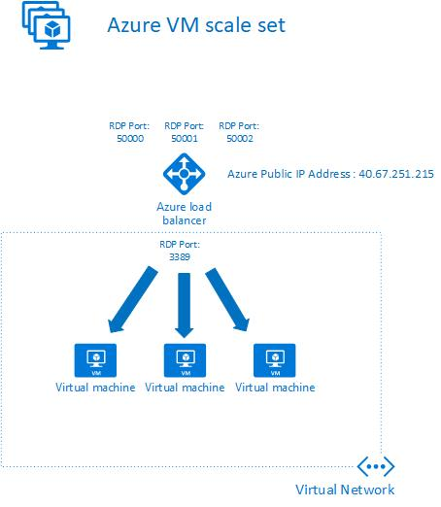
VM Scale Sets

Slide 18
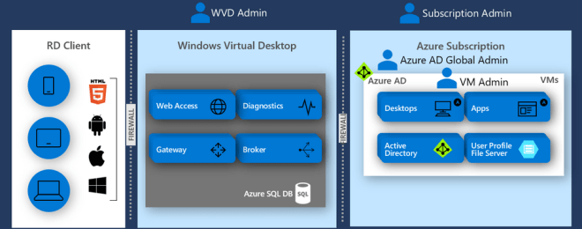
Windows Virtual Desktop (WVD)
timw.info/travis

Slide 19
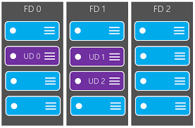
Availability Set

Slide 20
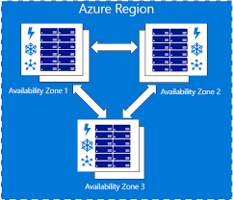
Availability Zone

Slide 21
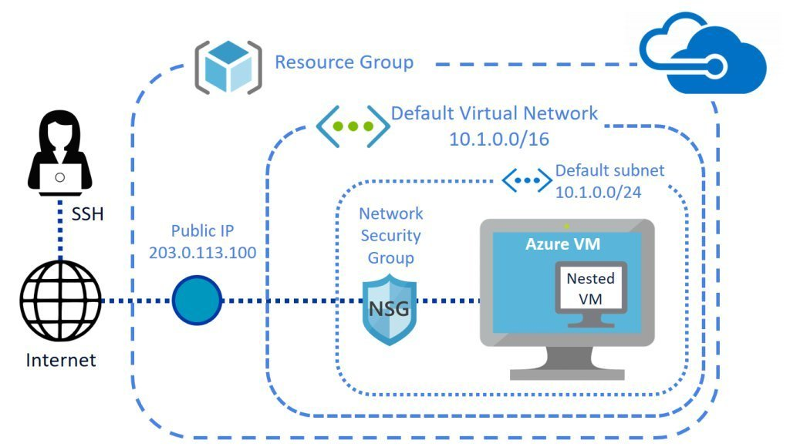
VM Networking

Slide 22
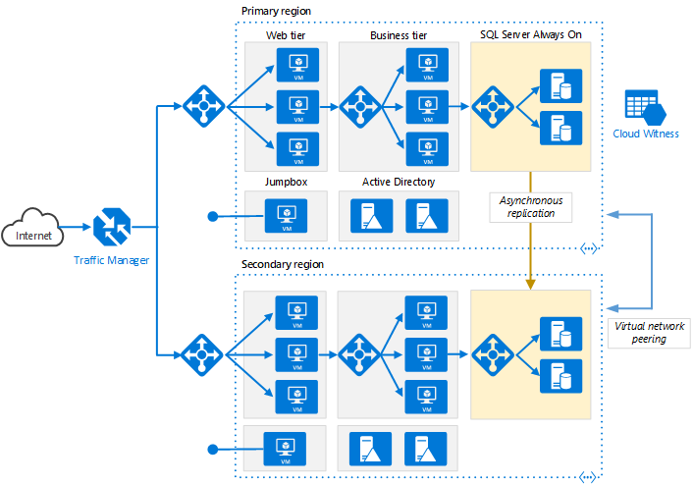
Load Balancing

Slide 23
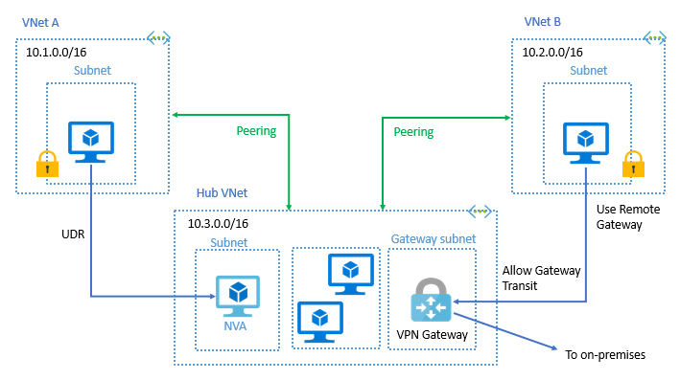
VNet Peering

Slide 24
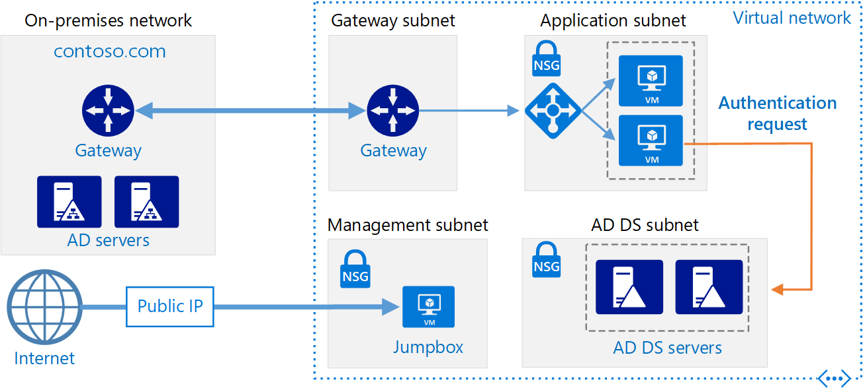
Hybrid Networking

Slide 25
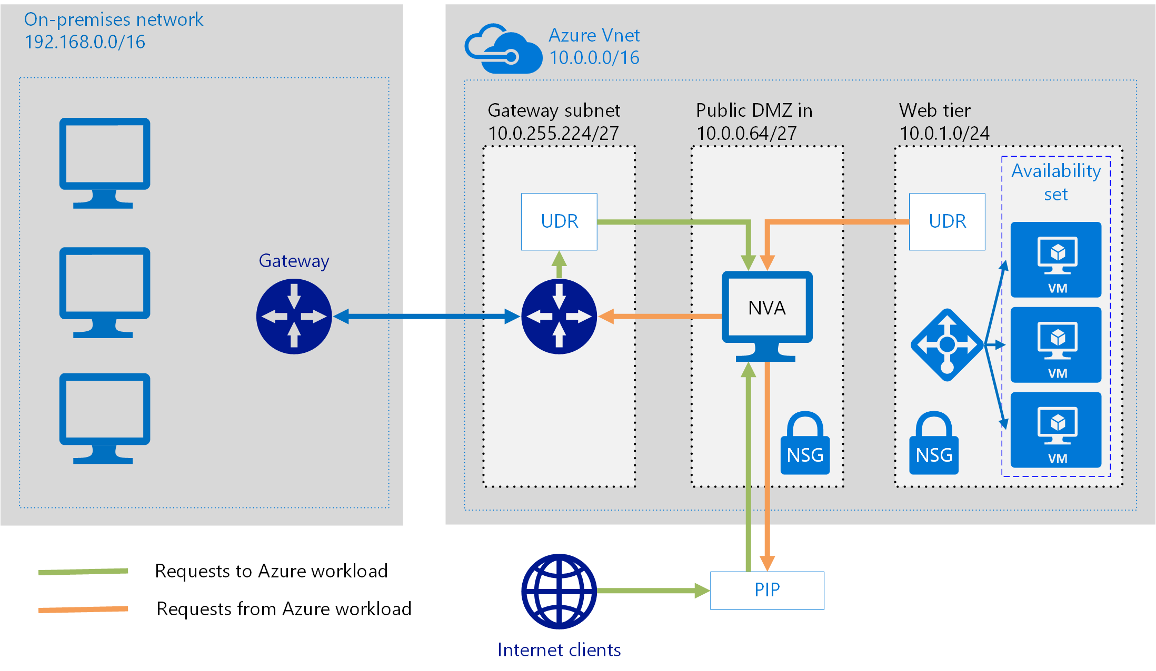
Network Virtual Appliance

Slide 26
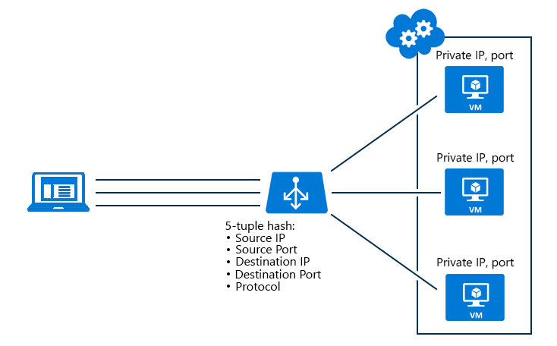
Azure Load Balancer

Slide 27
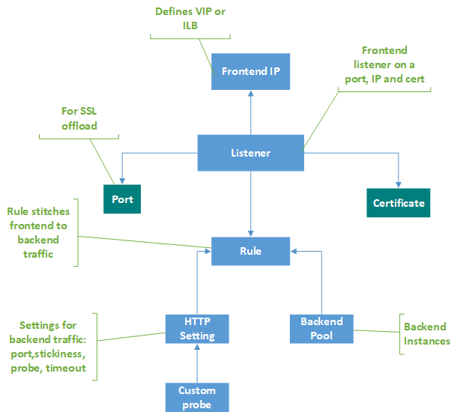
Application Gateway

Slide 28
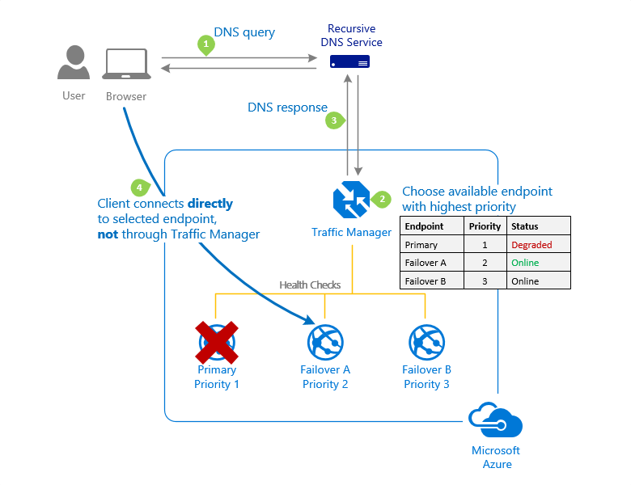
Traffic Manager

Slide 29
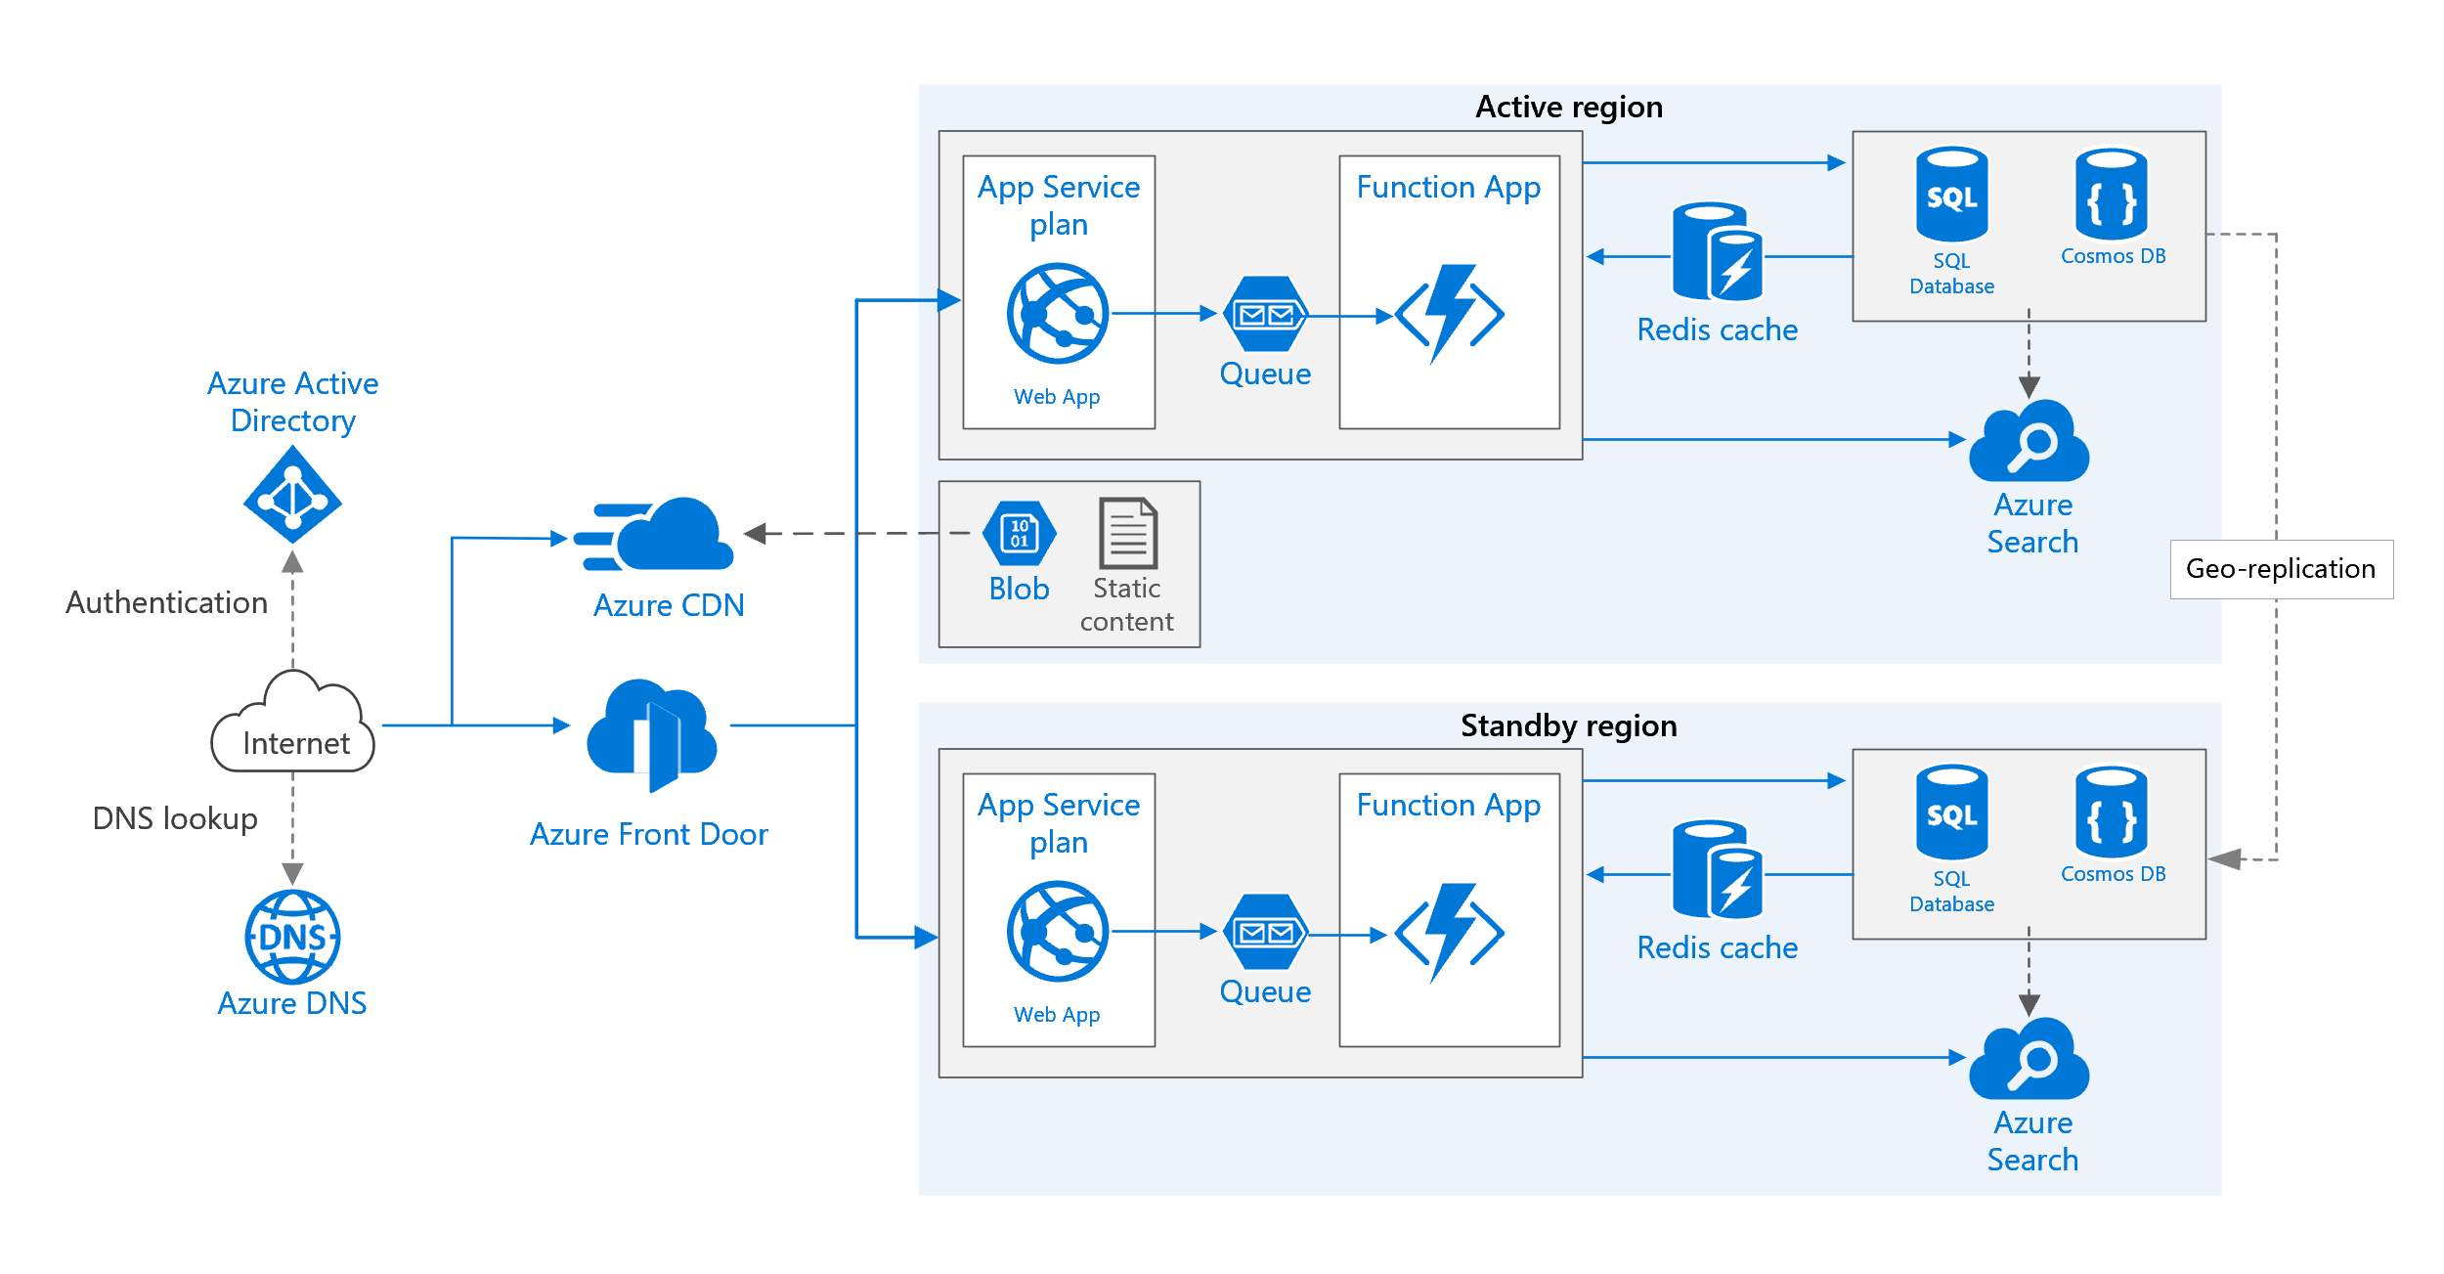
Front Door Service

Slide 30
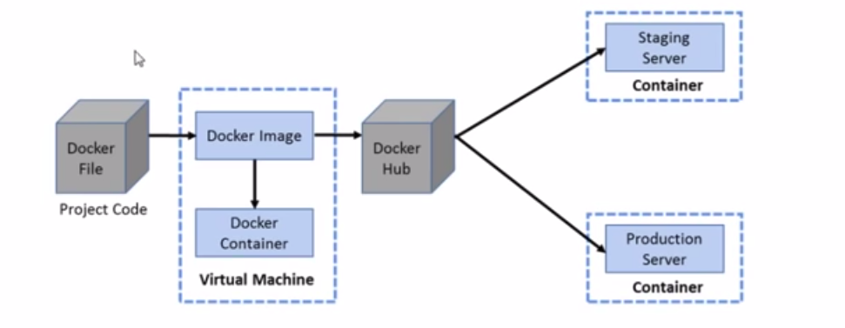

Docker Container Lifecycle
https://timw.info/3635f

Slide 31
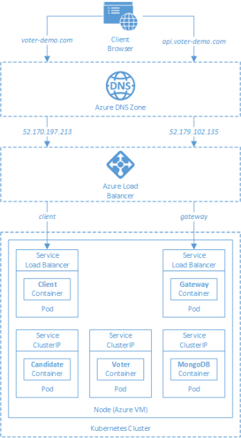
AKS

Slide 32
Azure Backup

Slide 33
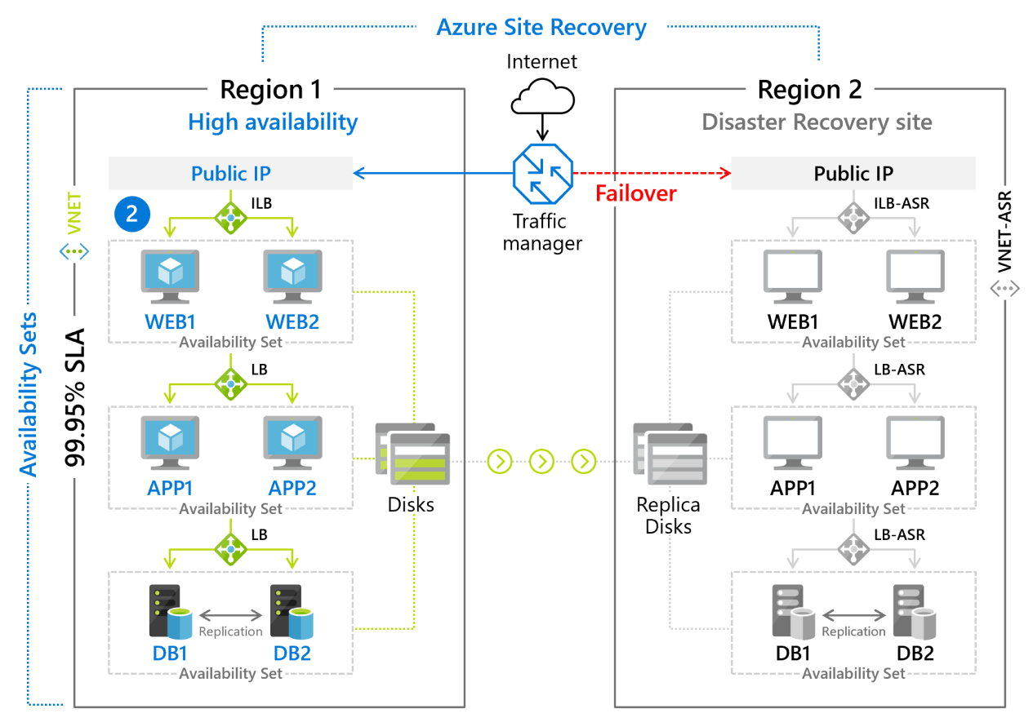
Azure Site Recovery

Slide 34
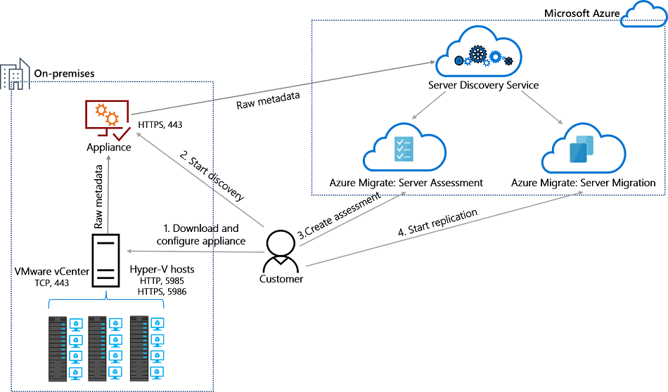
Azure Migrate

Slide 35
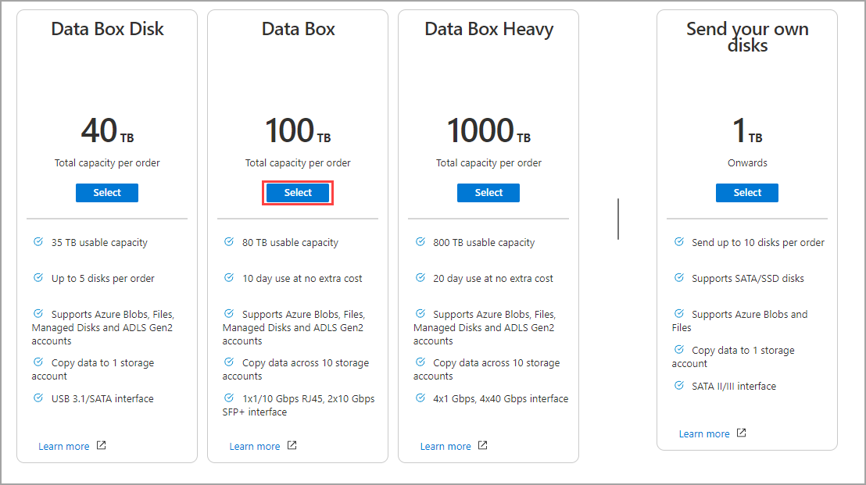
Azure Data Box

Slide 36
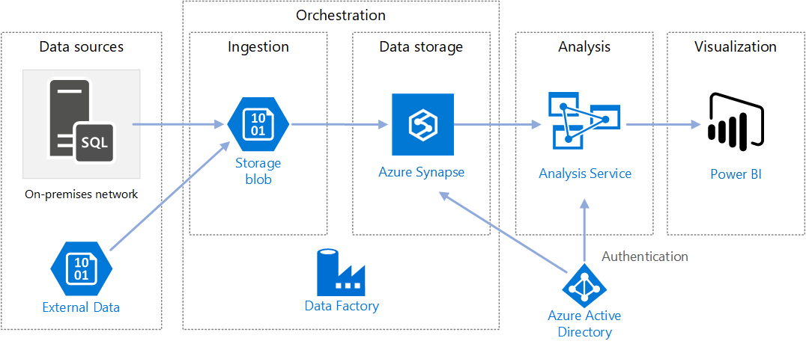
Data Pipelines

Slide 37
Storage Account Replication
1
3
3
2
LRS
ZRS

Slide 38
Storage Account Replication
3
3
GRS/RA-GRS

Slide 39
Storage Account Replication
1
3
1
3
2
2
GZRS – RA/GZRS

Slide 40
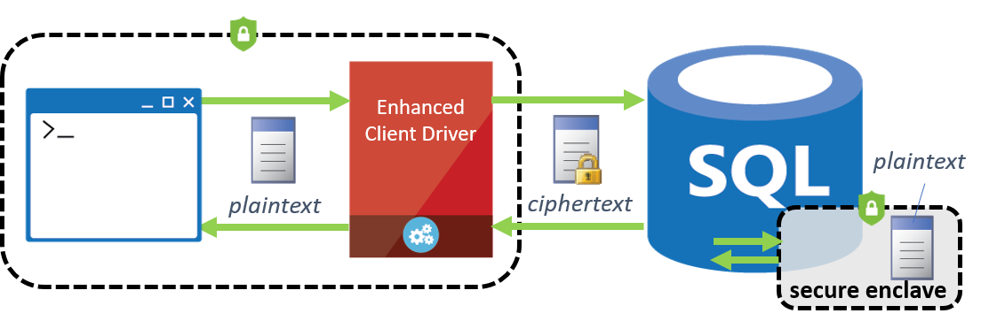
Always Encrypted

Slide 41
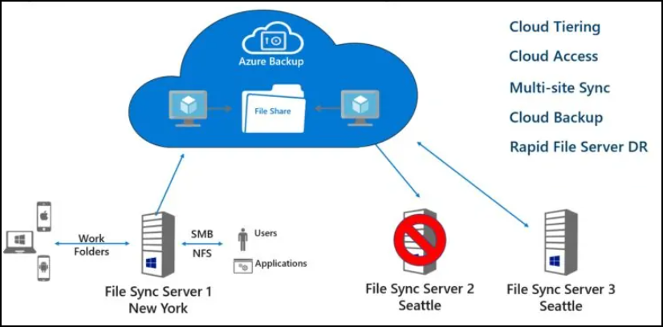
Azure File Sync

Slide 42
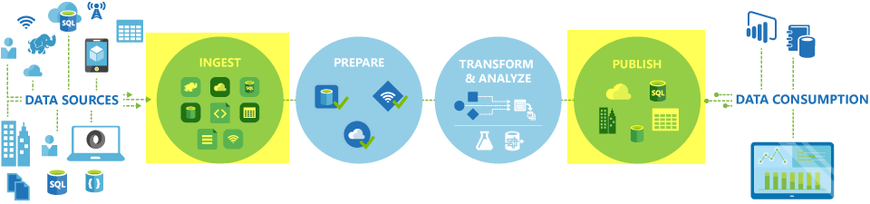
Azure Data Factory

Slide 43
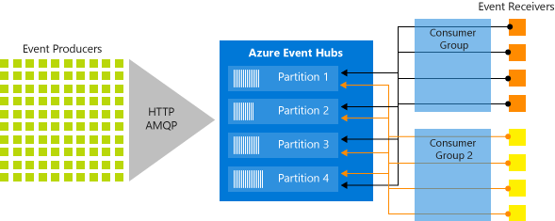
Event Architecture

Slide 44
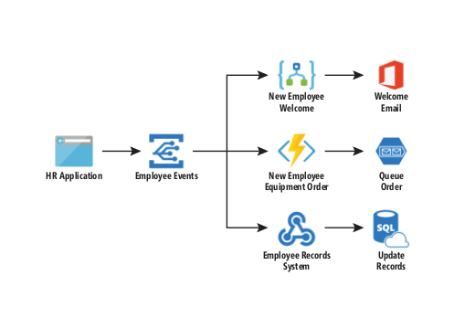
Event Architecture

Slide 45
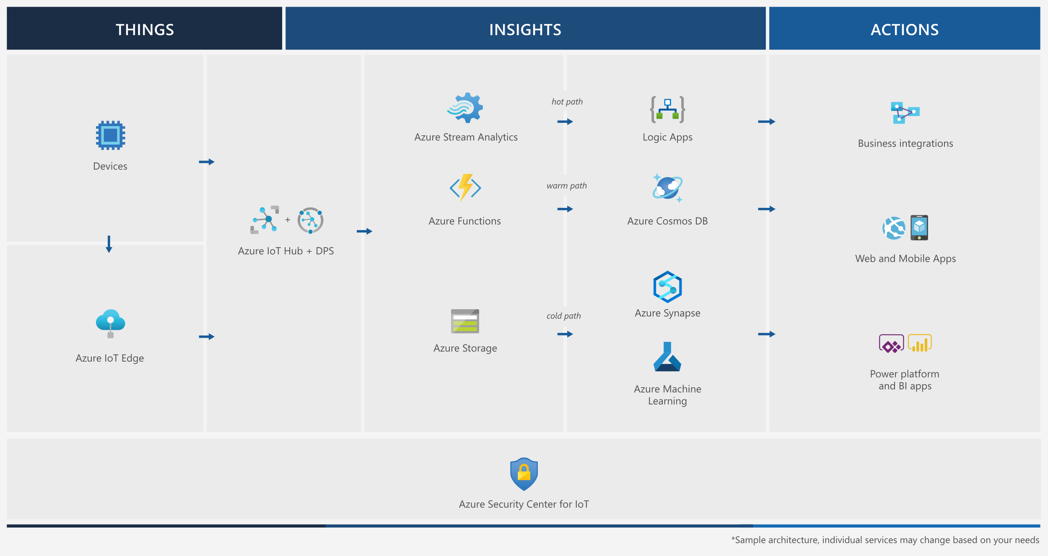
Event Architecture

Slide 46
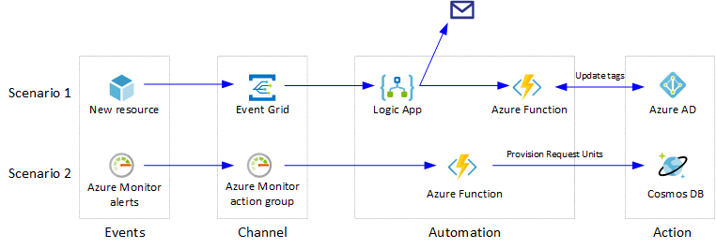
Event Architecture

