Slide 1



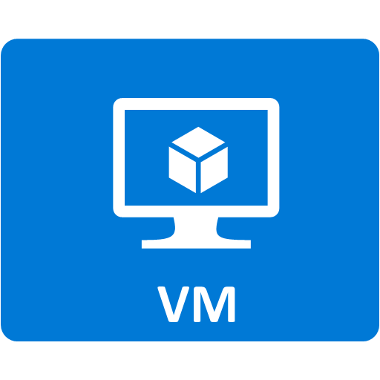


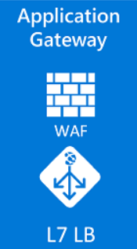




Azure Landing Zone (Azure Firewall/WAF)
On-premises network
Gateway subnet
VNet
Peering
(Bidirectional)
Web tier
Azure Firewall: NAT, Network and Application traffic filtering rules allows Inbound/Outbound access
Business tier
Data tier
UDR
L3-L7 Connectivity Policies
VNet
(Spoke 1)
Management
subnet
Jumpbox
App Services
Managed Database
Hub
VNet
VNet
Peering
(Bidirectional)
VNet
(Spoke 2)
1

Slide 2
Azure Landing Zone (NVA)
https://docs.microsoft.com/en-us/azure/architecture/reference-architectures/dmz/secure-vnet-dmz
On-premises network
Gateway subnet
Private DMZ in
Private DMZ out
Web tier
VNet
Peering
(Bidirectional)
Business tier
Data tier
UDR
Availability
set
VNet
(Spoke 1)
Management
subnet
Jumpbox
Public DMZ in
Public DMZ out
Availability
set
VNet
Peering
(Bidirectional)
App Services
Managed Database
Hub
VNet
VNet
(Spoke 2)

Slide 3





Azure Network Architecture: Deployment to Primary Azure Region
Hub Management Group
*
Additional Resource Groups will be used for Azure resources as required for better resource management and security control
Hub Subscription
On-premises Network HQ
Hub Resource Group(s)*
Non-Prod Management Group
Gateway Subnet
Non-Prod Subscription
S2S VPN Tunnel
Dev Resource Group(s)*
Firewall Subnet
VNet
Peering
(Bidirectional)
10.xx.xx.xx/yy
On-premises Network Site 2
10.xx.xx.xx/zz
10.xx.xx.xx/zz
Dev VNet
(Spoke 1)
10.xx.xx.xx/zz
10.xx.xx.xx/zz
10.xx.xx.xx/zz
S2S VPN Tunnel
Management Subnet
Test Resource Group(s)*
10.xx.xx.xx/zz
VNet
Peering
(Bidirectional)
10.xx.xx.xx/yy
VPN Client
Test VNet
(Spoke 2)
P2S VPN Tunnel
SIEM Subnet
10.xx.xx.xx/zz
10.xx.xx.xx/zz
10.xx.xx.xx/zz
10.xx.xx.xx/zz
Prod Management Group
Prod Subscription
HTTP/HTTPS
Prod Resource Group(s)*
WAF
Subnet
VNet
Peering
(Bidirectional)
Internet
10.xx.xx.xx/yy
10.xx.xx.xx/yy
Hub
VNet
Prod VNet
(Spoke 3)
10.xx.xx.xx/zz
10.xx.xx.xx/zz
10.xx.xx.xx/zz
10.xx.xx.xx/zz

Slide 4
Azure Network Architecture: with animation
Hub Management Group
*
Additional Resource Groups will be used for Azure resources as required for better resource management and security control
Hub Subscription
Hub Resource Group(s)*
Non-Prod Management Group
On-premises Network HQ
Non-Prod Subscription
Gateway Subnet
Dev Resource Group(s)*
S2S VPN Tunnel
Firewall Subnet
VNet
Peering
(Bidirectional)
10.xx.xx.xx/zz
10.xx.xx.xx/yy
On-premises Network Site 2
10.xx.xx.xx/zz
Dev VNet
(Spoke 1)
10.xx.xx.xx/zz
10.xx.xx.xx/zz
10.xx.xx.xx/zz
Management Subnet
Test Resource Group(s)*
S2S VPN Tunnel
10.xx.xx.xx/zz
VNet
Peering
(Bidirectional)
10.xx.xx.xx/yy
VPN Client
Test VNet
(Spoke 2)
10.xx.xx.xx/zz
SIEM Subnet
10.xx.xx.xx/zz
10.xx.xx.xx/zz
P2S VPN Tunnel
10.xx.xx.xx/zz
Prod Management Group
Prod Subscription
Prod Resource Group(s)*
HTTP/HTTPS
WAF
Subnet
VNet
Peering
(Bidirectional)
10.xx.xx.xx/yy
Internet
Hub
VNet
10.xx.xx.xx/yy
Prod VNet
(Spoke 3)
10.xx.xx.xx/zz
10.xx.xx.xx/zz
10.xx.xx.xx/zz
10.xx.xx.xx/zz

Slide 5
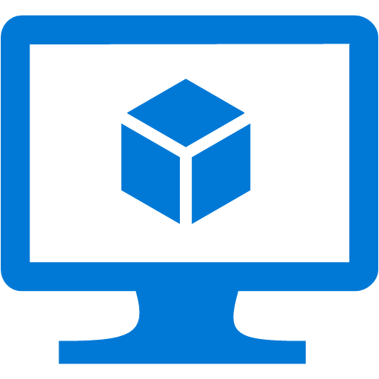




Hub and Spoke Network Topology
HTTP/
HTTPS
Spoke 1 Subnets
Spoke 3 Subnets
Spoke 2 VNet
Spoke 3 VNet
Hub Subnets
Gateway
Subnet
Spoke 2 Subnets
Spoke 4 Subnets
Spoke 2 VNet
Hub VNet
Spoke 4 VNet
P2S VPN Tunnel
S2S VPN
Tunnel
VPN Client
On-premises
Network HQ
On-premises
Network Site 2
5

Slide 6
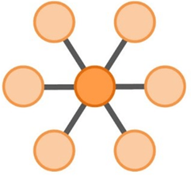
Hub and Spoke Topology
HTTP/
HTTPS
Spoke 1 Subnets
Spoke 3 Subnets
Spoke 2 VNet
Spoke 3 VNet
Hub Subnets
Gateway
Subnet
Spoke 2 Subnets
Spoke 4 Subnets
Spoke 2 VNet
Hub VNet
Spoke 4 VNet
P2S VPN Tunnel
S2S VPN
Tunnel
VPN Client
On-premises
Network HQ
On-premises
Network Site 2
 | Benefits | Drawbacks
Hub & Spoke | Easier to manage shared services Lower licensing costs Improved segregation Easy to scale | Single point of failure Overhead of managing UDRs
Simplified | No single point of failure | Duplication of shared services (Firewall, SIEM) Higher licensing costs Challenging to scale
6

Slide 7
Example Azure Network Plan: VNets & Subnets
ID | vNET | Subnet | Netmask | CIDR | # Of hosts | Subscription | Security zone | Gateway unit | Gateway address
1 | HUB | 10.151.98.0 | 26 | 10.151.98.0/26 | 62 | Hub | HUB_SZ_MSS | Microsoft Azure | 10.151.98.1
2 | HUB | 10.151.96.0 | 26 | 10.151.96.0/26 | 62 | Hub | HUB_SZ_PRIVATE_DMZ | Firewall 1(Internal) | 10.151.96.1
3 | HUB | 10.151.97.0 | 24 | 10.151.97.0/24 | 254 | Hub | HUB_SZ_PUBLIC_DMZ | Firewall 0 (External) | 10.151.97.1
4 | HUB | 10.151.98.64 | 26 | 10.151.98.64/26 | 62 | Hub | HUB_SZ_JUMP_BOX | Microsoft Azure | 10.151.98.65
5 | PROD | 10.151.0.0 | 19 | 10.151.0.0/19 | 8190 | Prod | PROD_SZ_WORKLOAD1 | Microsoft Azure | 10.151.0.1
6 | DEV | 10.151.32.0 | 19 | 10.151.32.0/19 | 8190 | Non-Prod | DEV_SZ_NON_PROD | Microsoft Azure | 10.151.32.1
7 | STAGING | 10.151.64.0 | 19 | 10.151.64.0/19 | 8190 | Non-Prod | STAGING_SZ_NON_PROD | Microsoft Azure | 10.151.64.1
7

