Slide 1
Architecting for high availability in Azure -
Industry-only
High availability SLA
Disaster recovery
VM SLA
VM SLA
VM SLA
Regions 54
99.9%
99.95%
99.99%
Region 1
Region 2
Single VM
Availability sets
Availability zones*
Site Recovery & Region pairs
Protection with Premium Storage
Protection against failures within datacenters
Protection from entire datacenter failures
Protection from disaster with data residency compliance
*AZs available across US, Europe and Asia
1

Slide 2
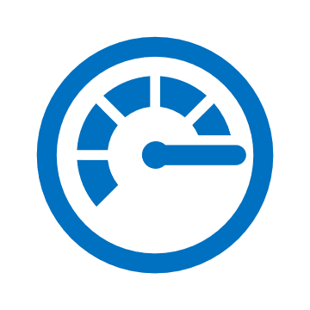

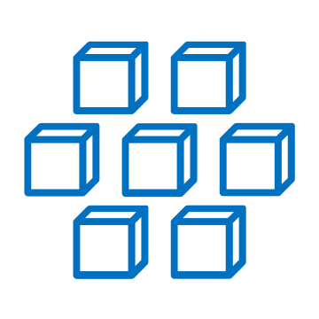
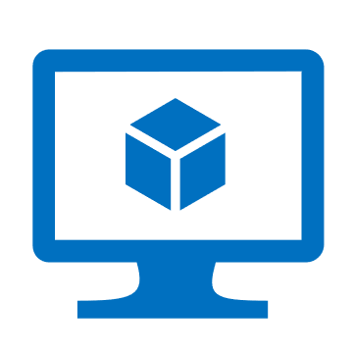





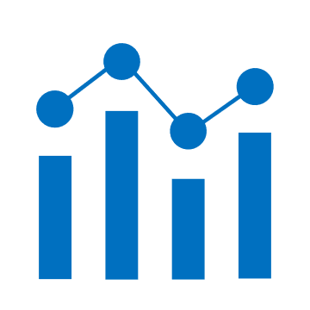
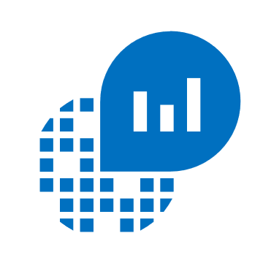





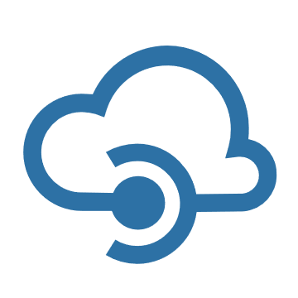
Azure Monitor
Azure Monitor
Insights
Application
Container
VM
Monitoring Solutions
Visualize
Application
Metrics
Dashboards
Views
Power BI
Workbooks
Infrastructure
Analyze
Network
Metrics Explorer
Log Analytics
Logs
Custom
Stores
Respond
Alerts
Autoscale
Integrate
Event Hubs
Logic Apps
Ingest & Export APIs
2

Slide 3
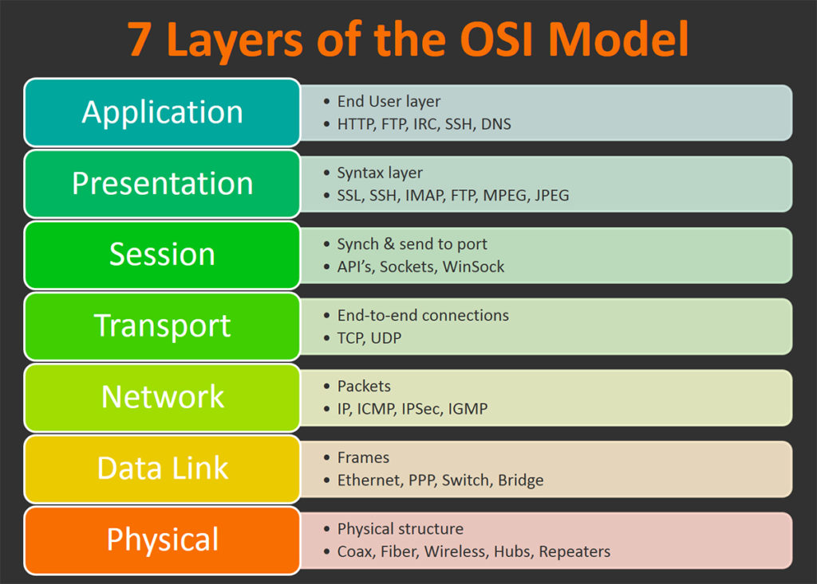
3

Slide 4
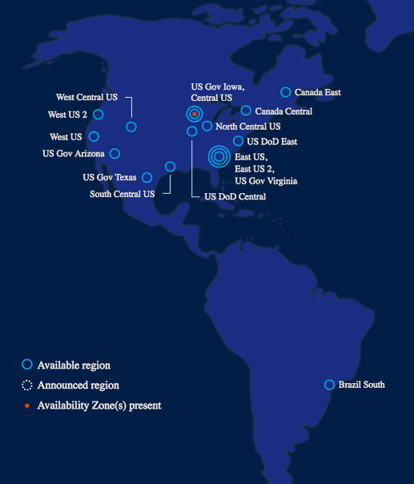
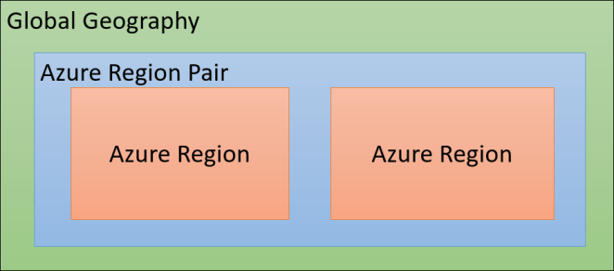
Azure Region Pairs for Oregon Lottery
Azure has more global regions than any other cloud provider—offering the scale needed to bring applications closer to users around the world, preserving data residency, and offering comprehensive compliance and resiliency options for customers.
A region is a set of datacenters deployed within a latency-defined perimeter and connected through a dedicated regional low-latency network.
Primary Azure Region:
West US 2
Secondary Azure Region (DR):
West Central US
Primary Azure Region: West US 2 (Quincy, Washington)
Secondary Azure Region (DR): West Central US (Cheyenne, Wyoming)
4

